Slide 1
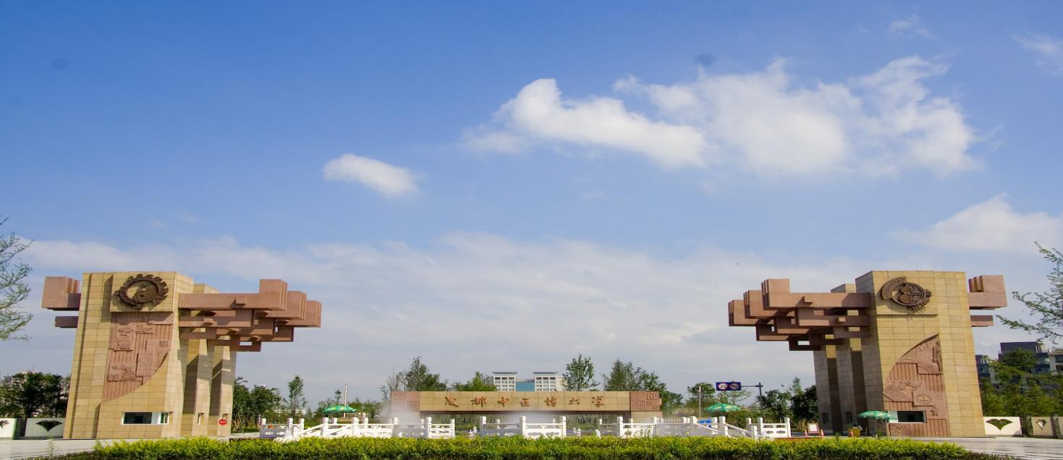
Date with CDUTCM
成都中医药大学
国际学生招生宣讲
Enrollment Promotion for International Students
https://cdutcm.edu.cn/gjjyxy/ WeChat info@cdutcm.edu.cn
Chengdu University of Traditional Chinese Medicine
Notes:
Hello everyone, welcome to this introduction to Chengdu University of Traditional Chinese Medicine, or CDUTCM, a prestigious institution located in the heart of West China.

Slide 2
成都概况 Chengdu Overview
中国西南·四川省省会
Southwest China
the capital of Sichuan Province
大熊猫的故乡
Hometown of giant panda
国家历史文化名城
National Historic&Cultural City
“中国最具幸福感城市”
The Happiest City in China
"2023年新一线城市”
第1名
NO.1 of 2023 New First-tier
Cities
Notes:
Let's begin with an overview of Chengdu, the capital of Sichuan Province. Known as the hometown of the giant panda, Chengdu is a city rich in history and culture. It has been recognized as the happiest city in China and ranked No.1 in the 2023 New First-tier Cities.

Slide 3
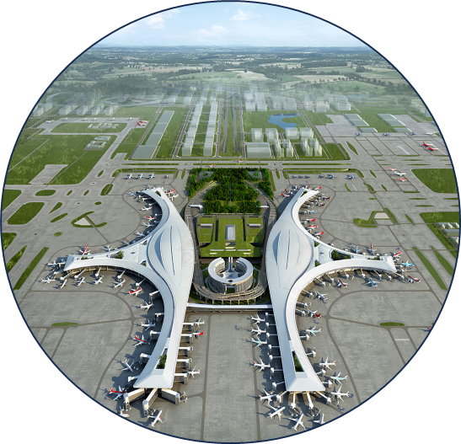
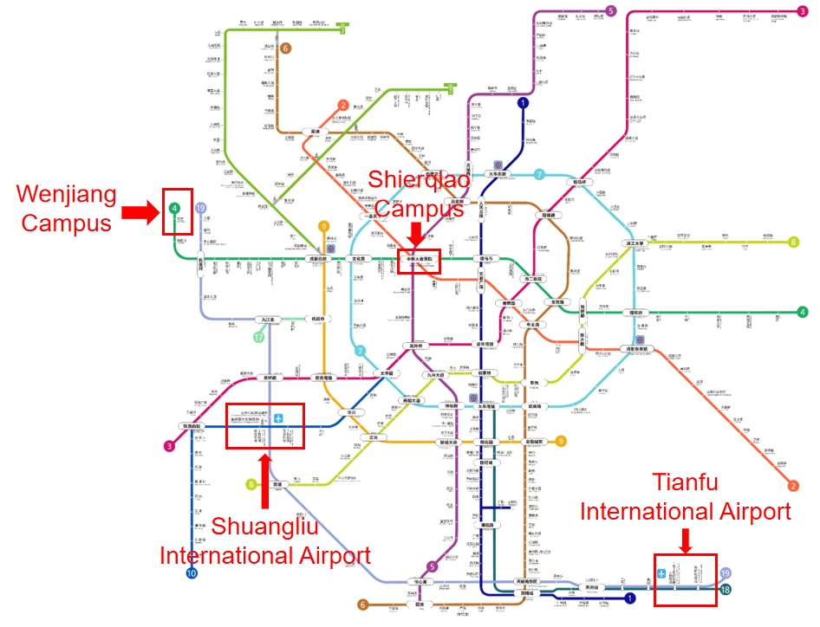
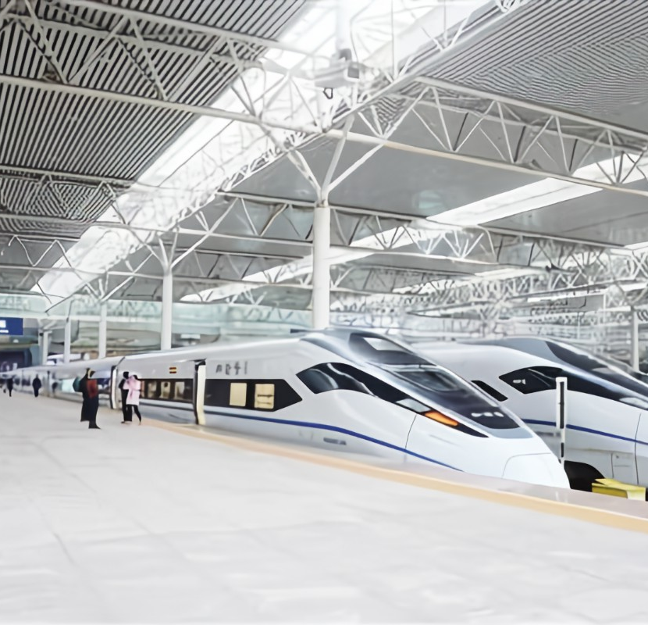
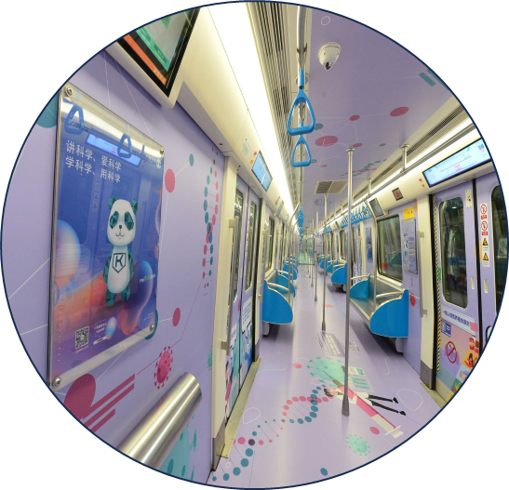
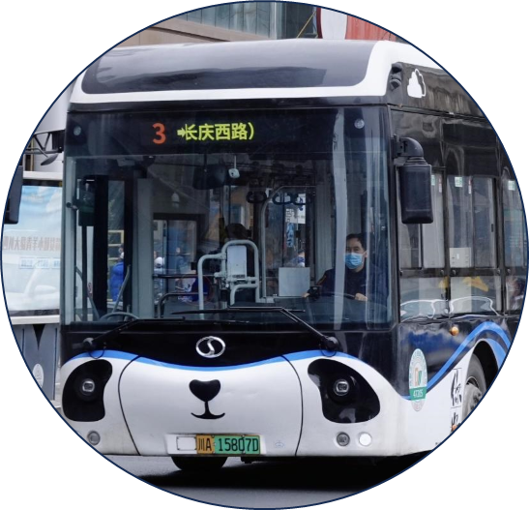
成都·交通Chengdu·Transportation
2个民用机场
2 civil airports
102条国际航线
102 international routes
4个市内火车站
已通高铁铁路
4 train stations
with high-speed rail
13条地铁线路
13 Metro lines
里程超600km
(全球城市排名第三）
over 600km of mileage(ranked 3rd in the world)
Notes:
It’s also a highly connected city with two civil airports, 102 international routes, four train stations with high-speed rail, and 13 metro lines covering over 600 kilometers.

Slide 4
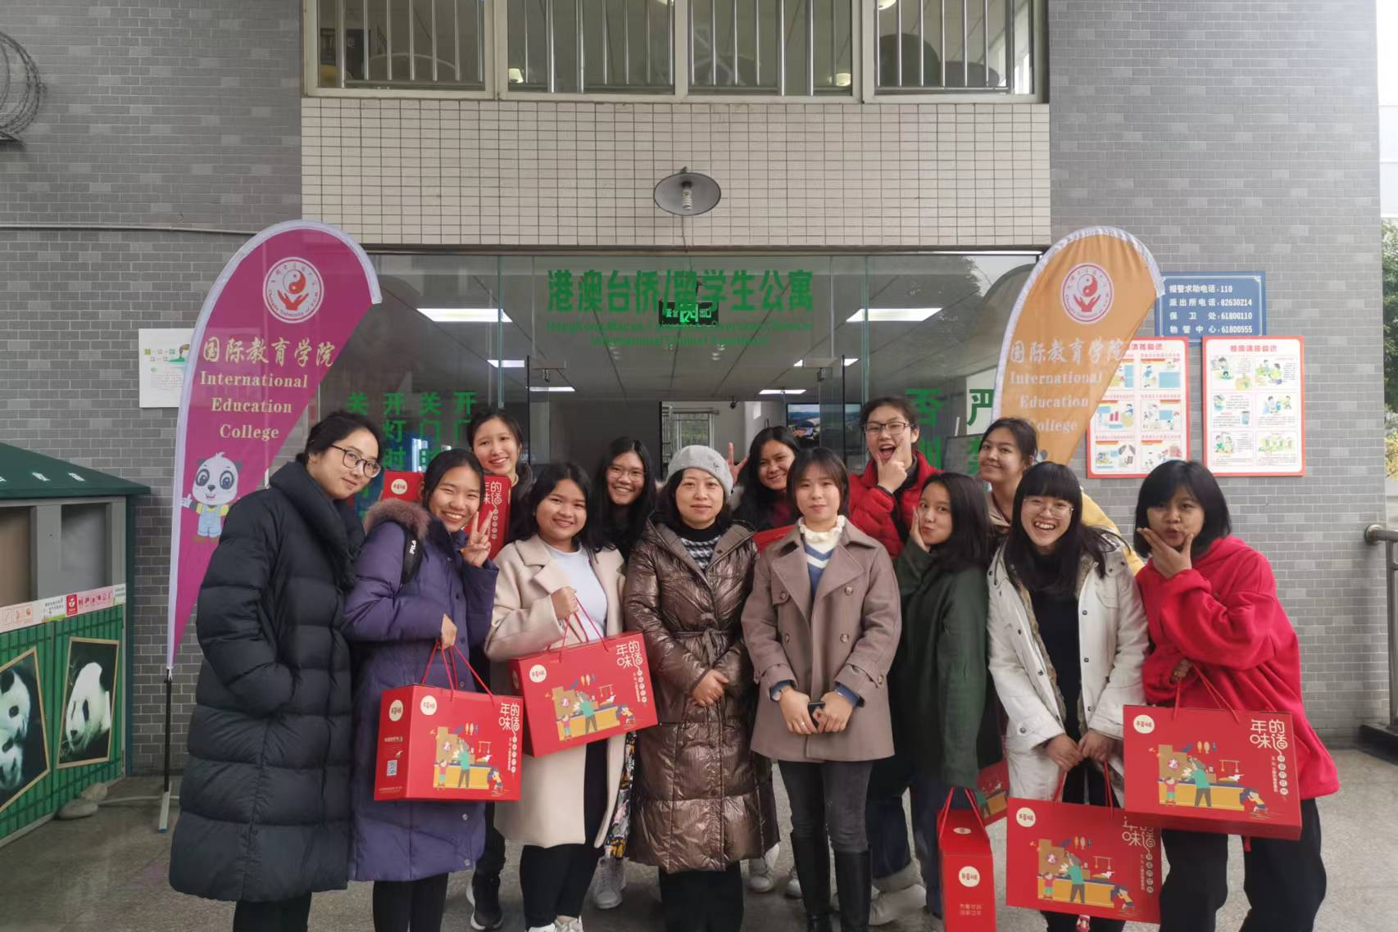
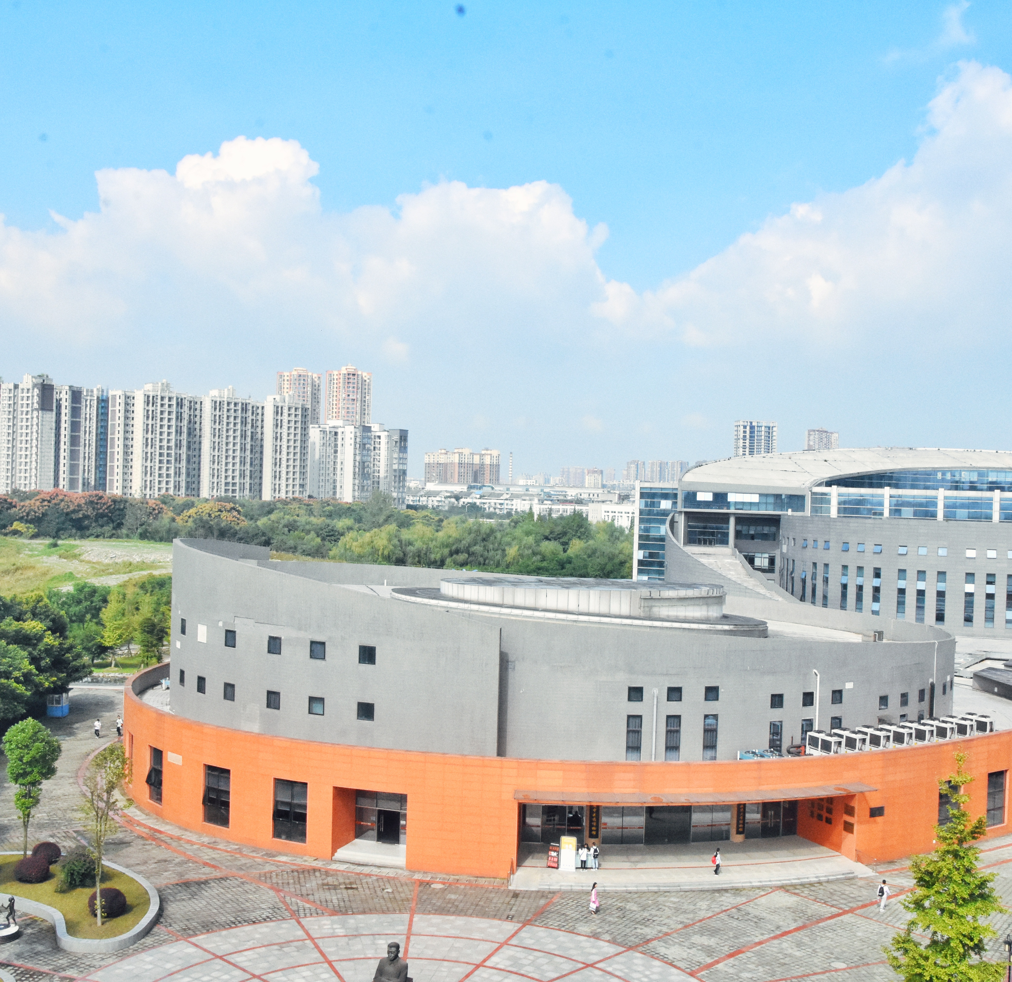
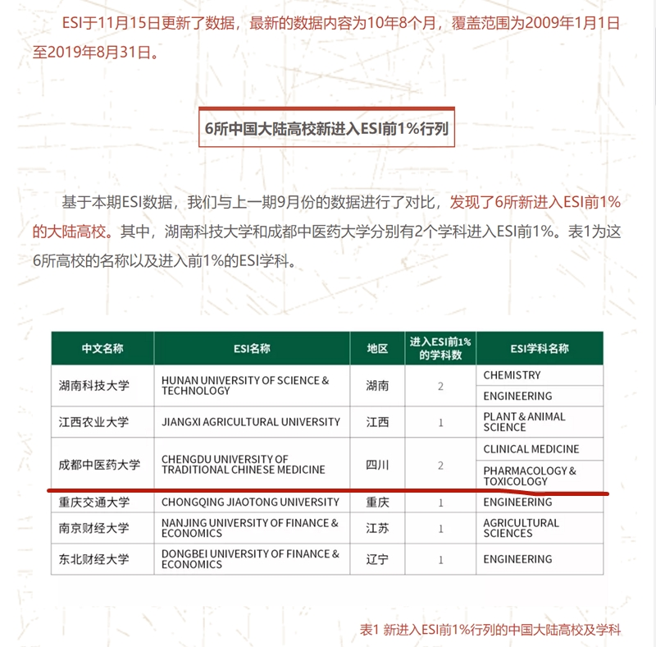
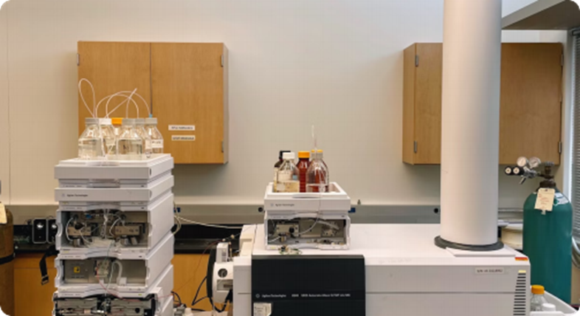
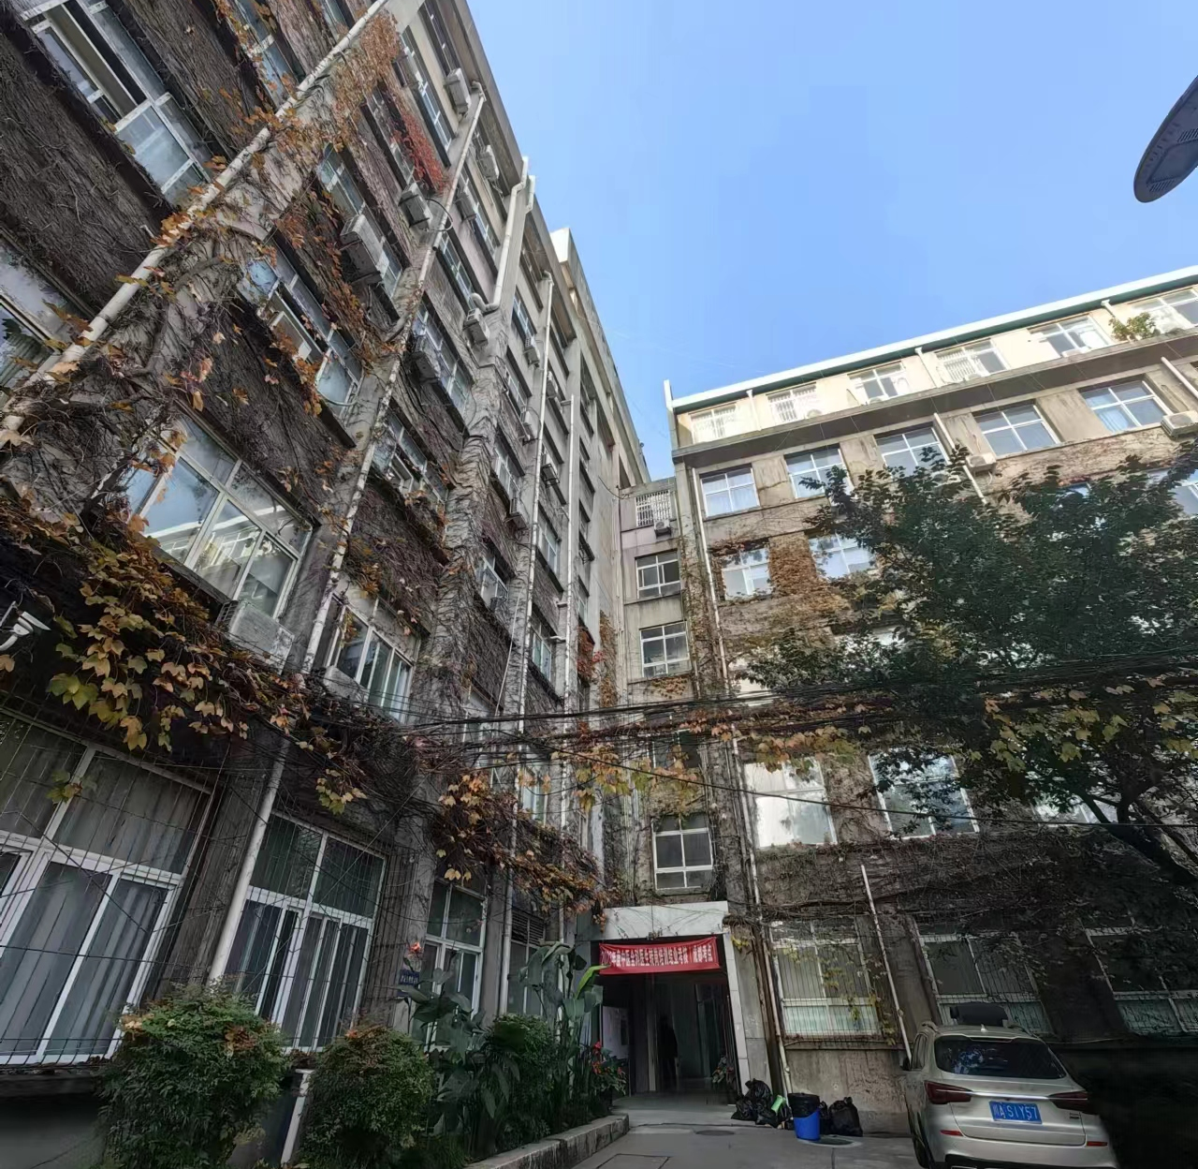
学在成中医 Study at CDUTCM
“双一流”学科建设高校
"National double first-class" construction universities in China
温江校区
Wenjiang campus
2019年11月
药物学与毒物学、临床医学学科
首次、双双进入ESI全球前1%
药物学与毒物学
（Pharmacology & Toxicology）、
临床医学（Clinical Medicine）、
化学（Chemistry）
From 2019
Pharmacology and toxicology,
Clinical medicine disciplines
both entered the top 1% of ESI
world rank
2023年9月新增
ESI化学全球前1%学科
September 2023
Chemistry discipline
Top 1% ESI worldwide
十二桥校区
Shierqiao campus
Notes:
CDUTCM is a 'National double first-class' university, offering programs across two main campuses. The university is globally recognized, with its Chemistry, Pharmacology & Toxicology, and Clinical Medicine disciplines ranked in the top 1% worldwide.

Slide 5
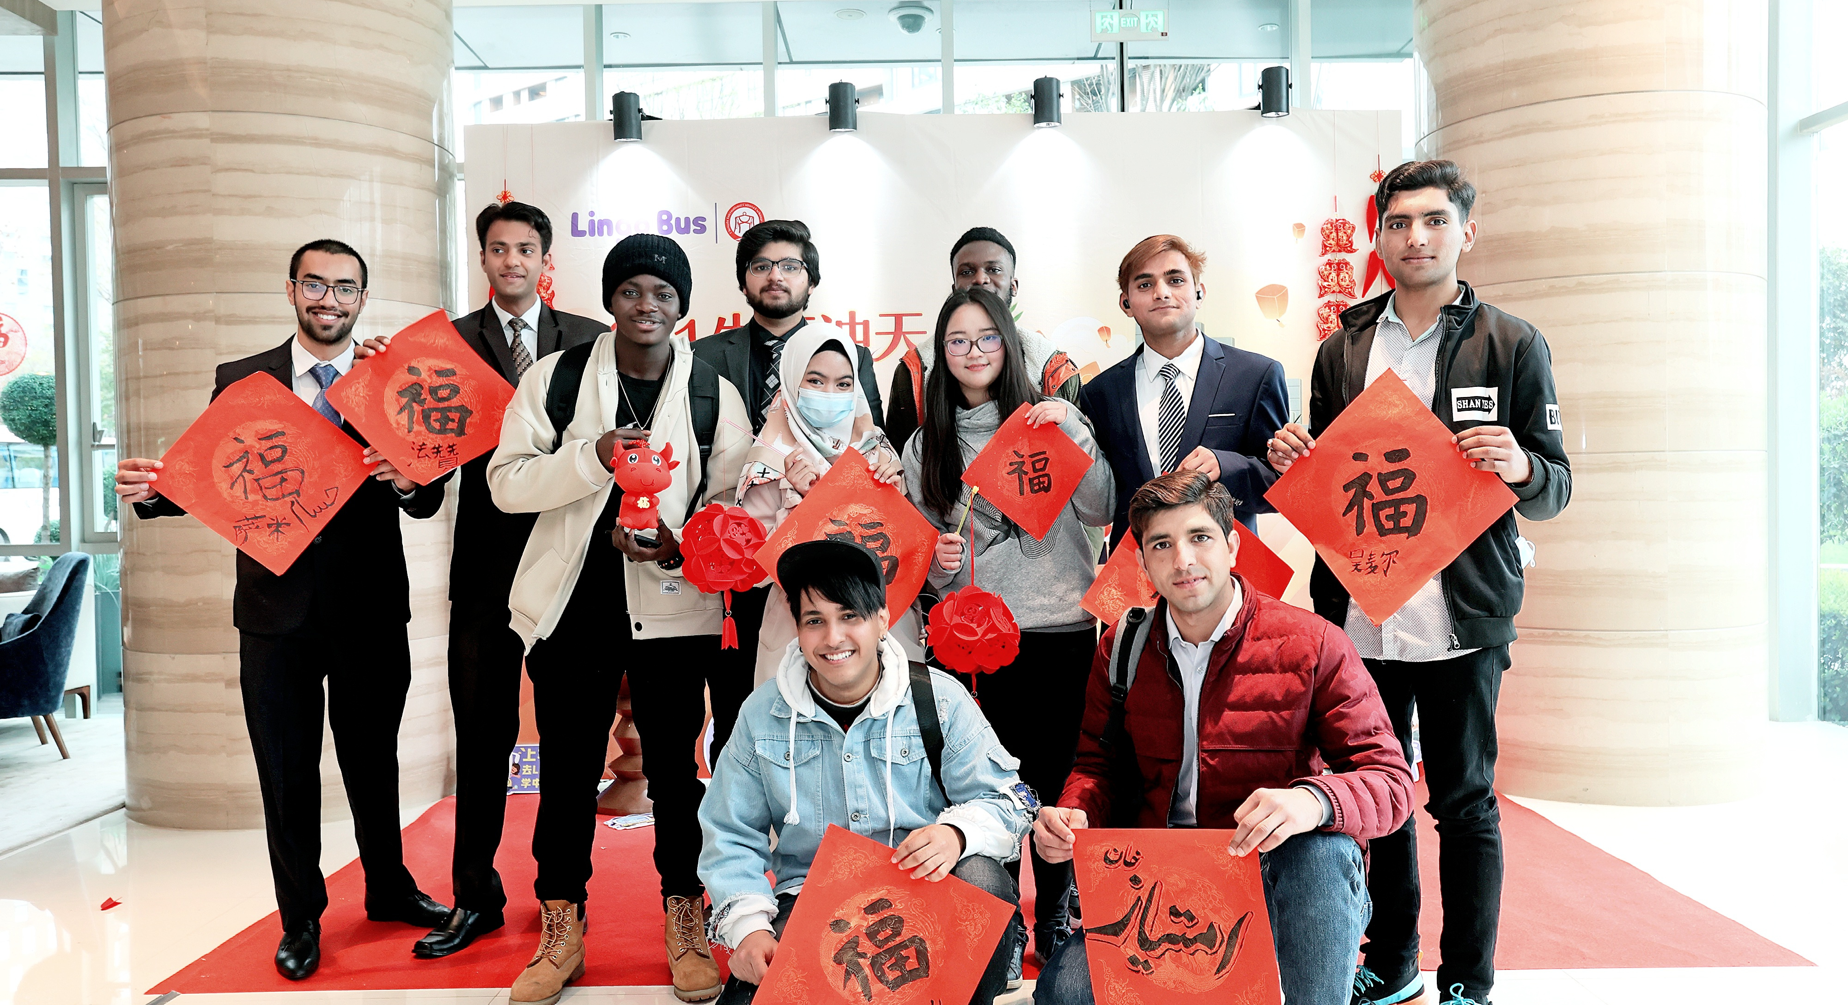
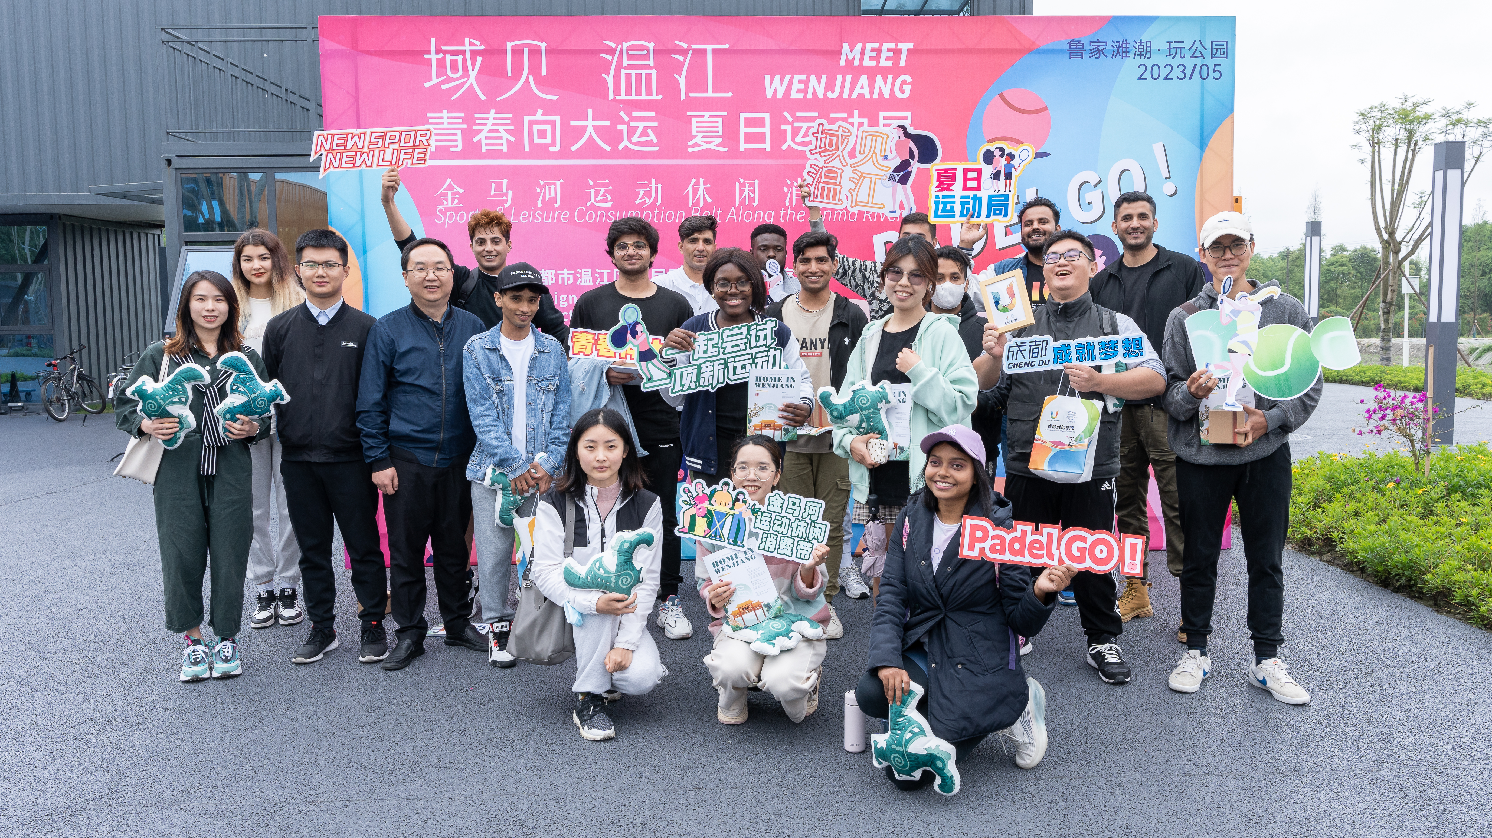
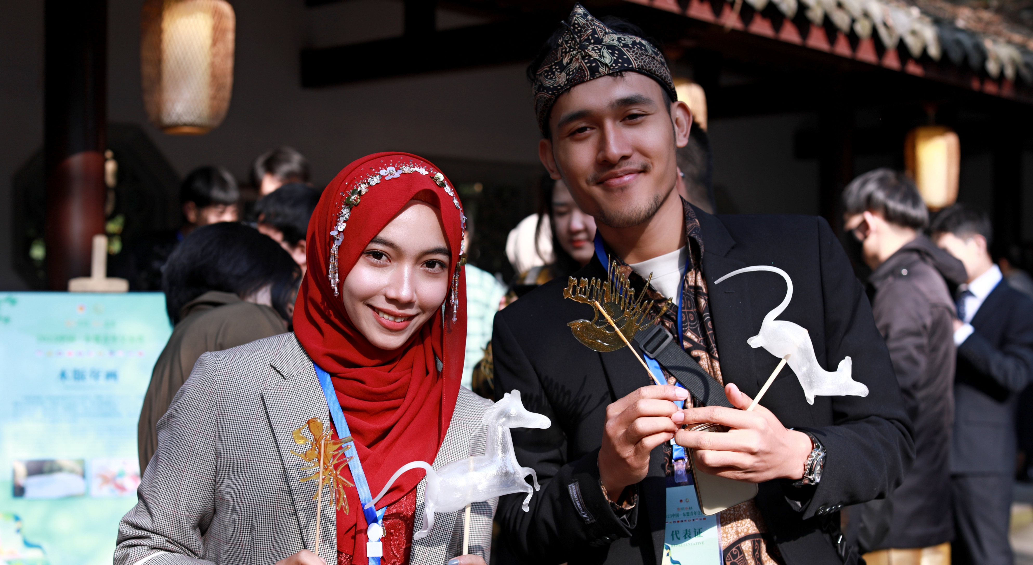
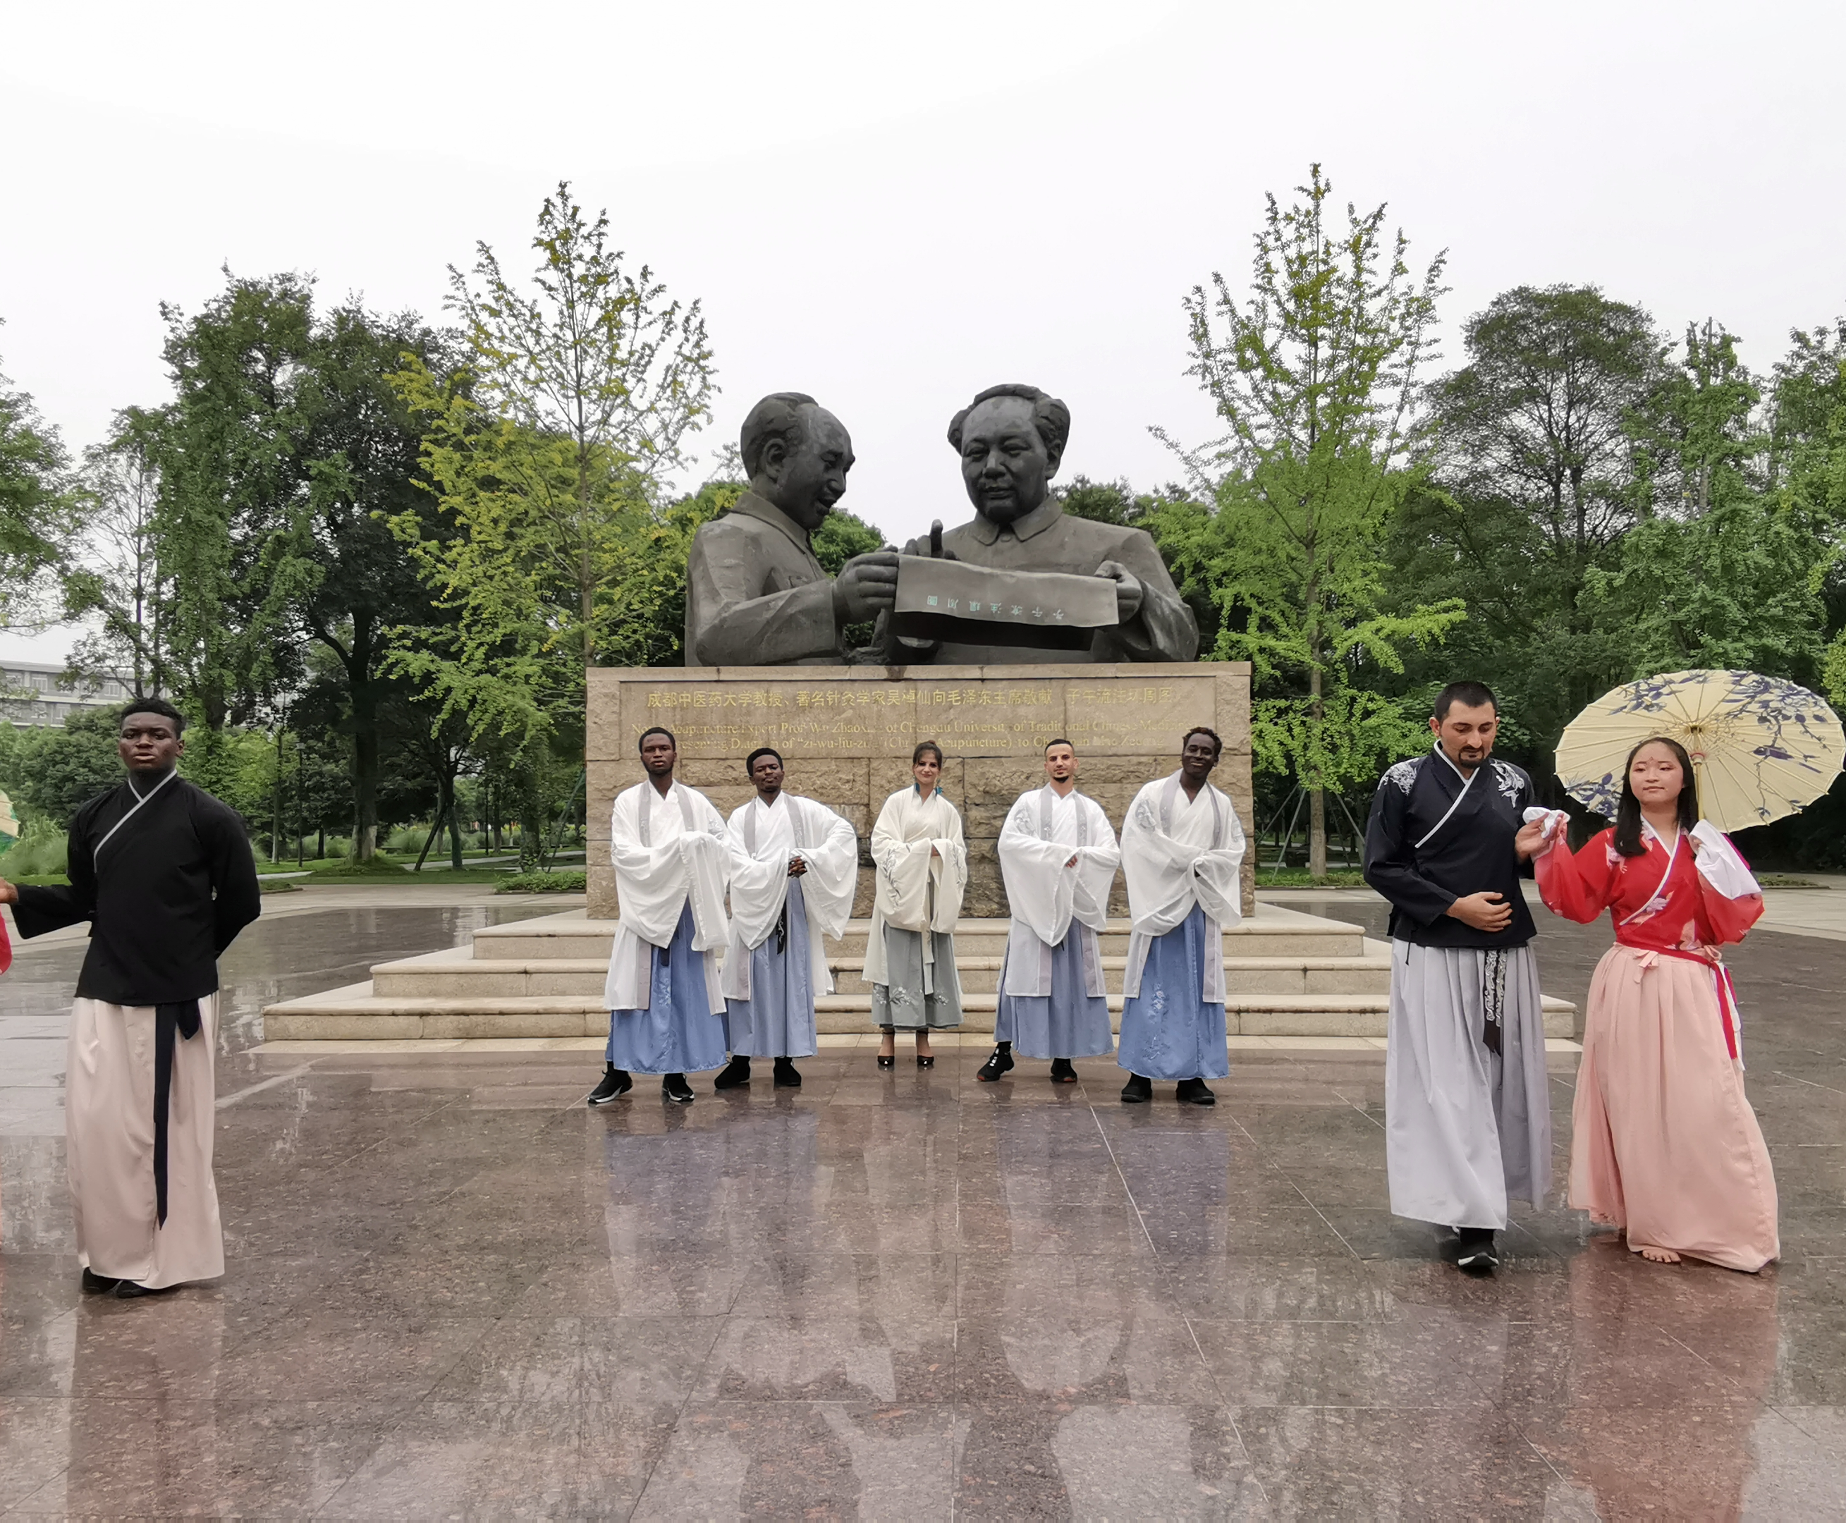
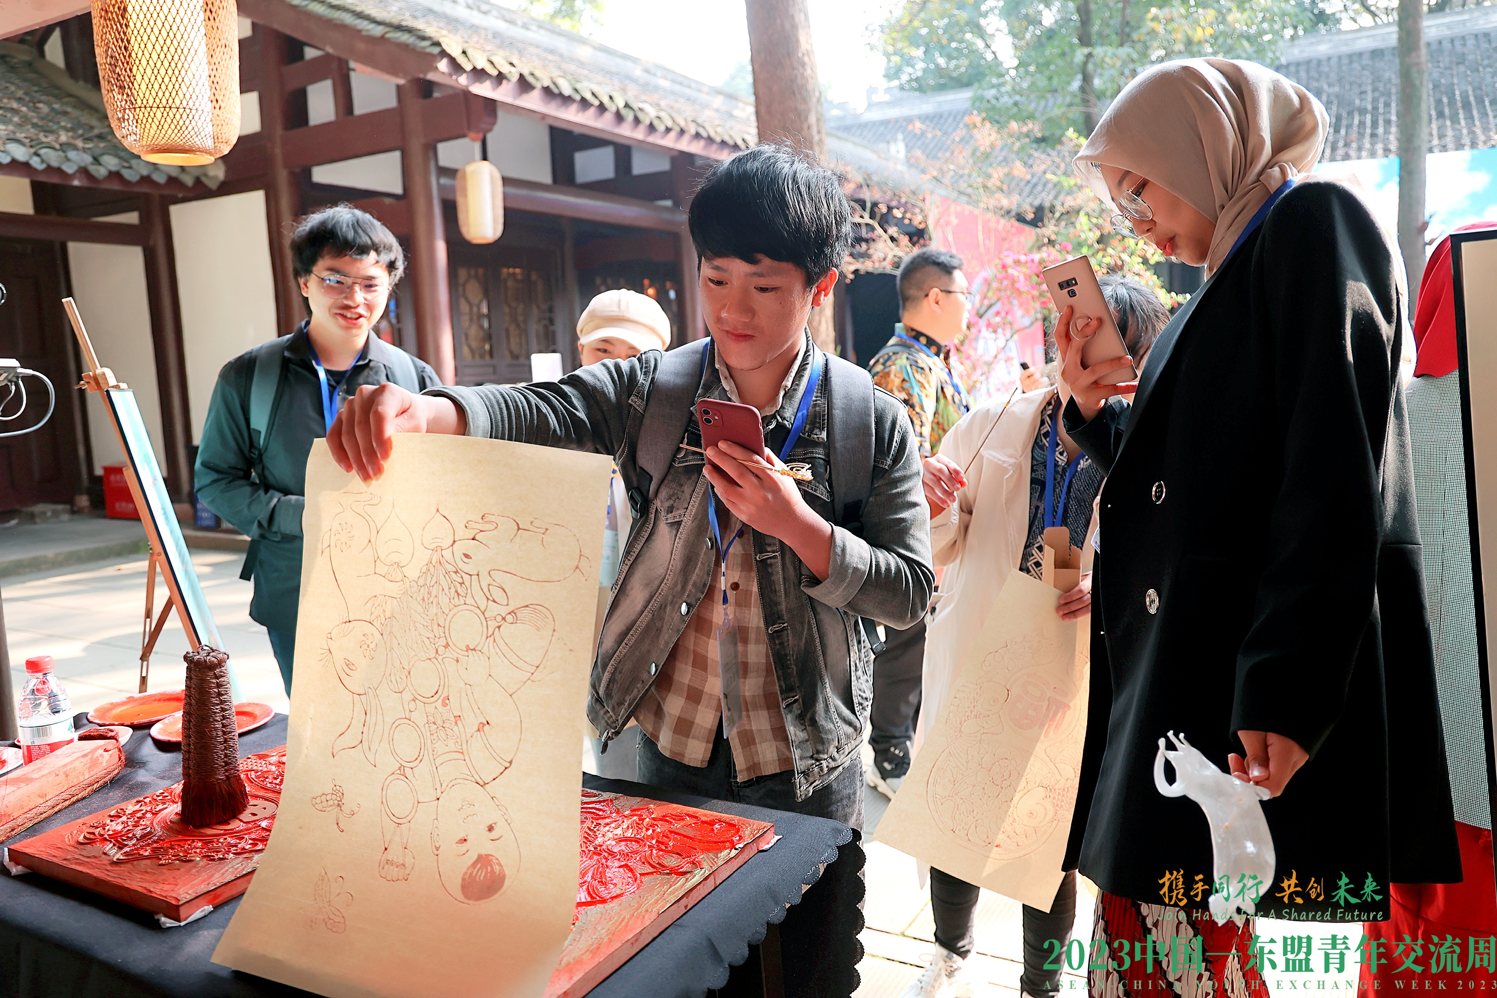
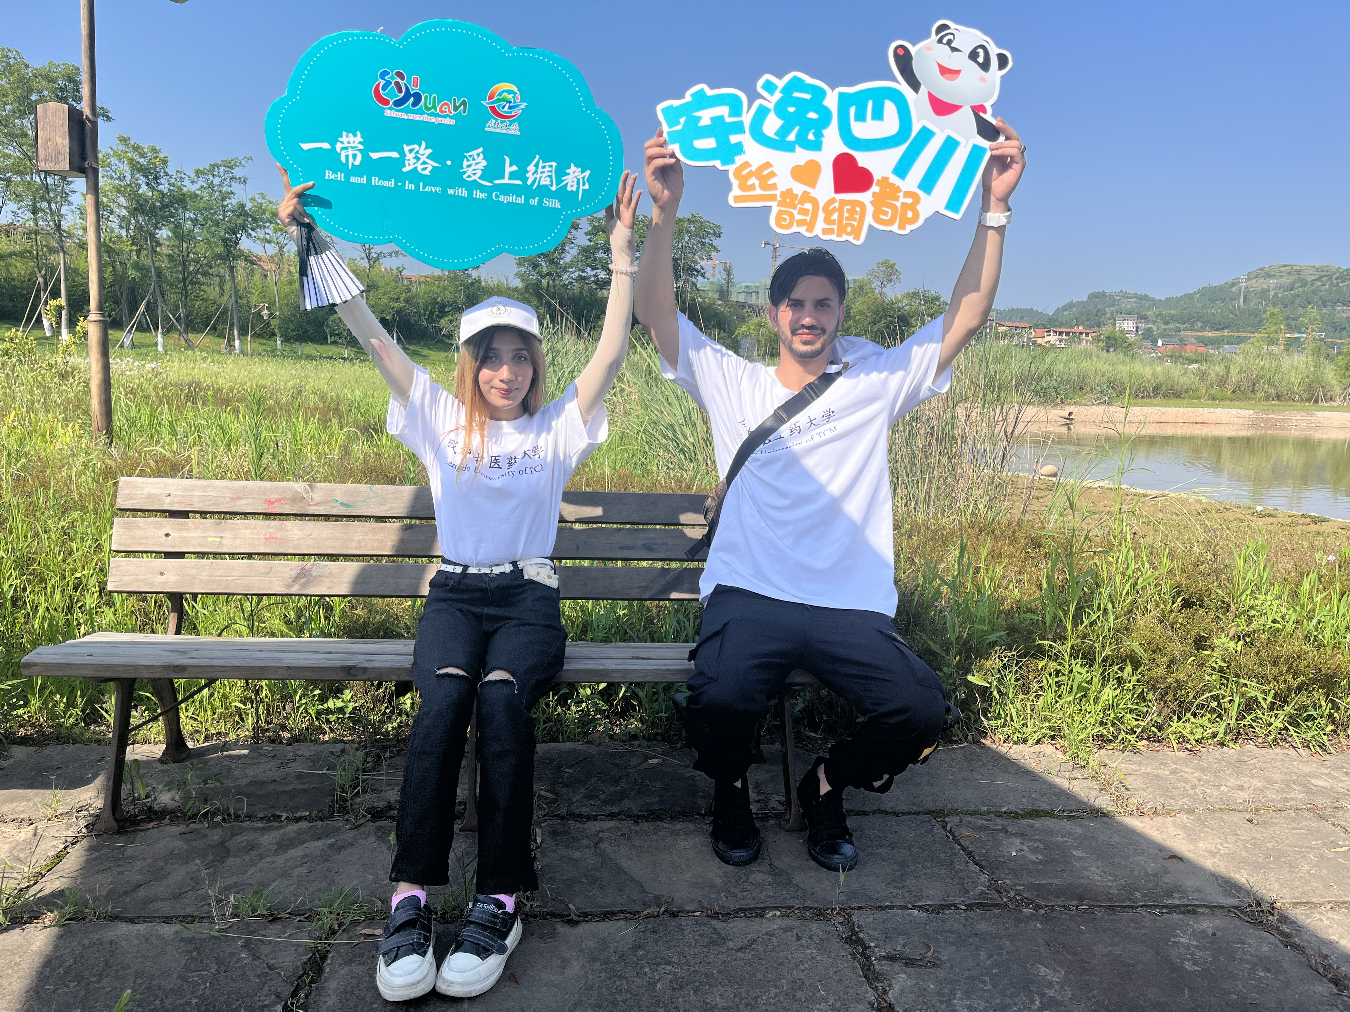
文化体验课程 Traditional Chinese Culture
Notes:
The campus facilities are extensive, providing international students with dormitories, sports facilities, libraries, and cultural experience courses.

Slide 6
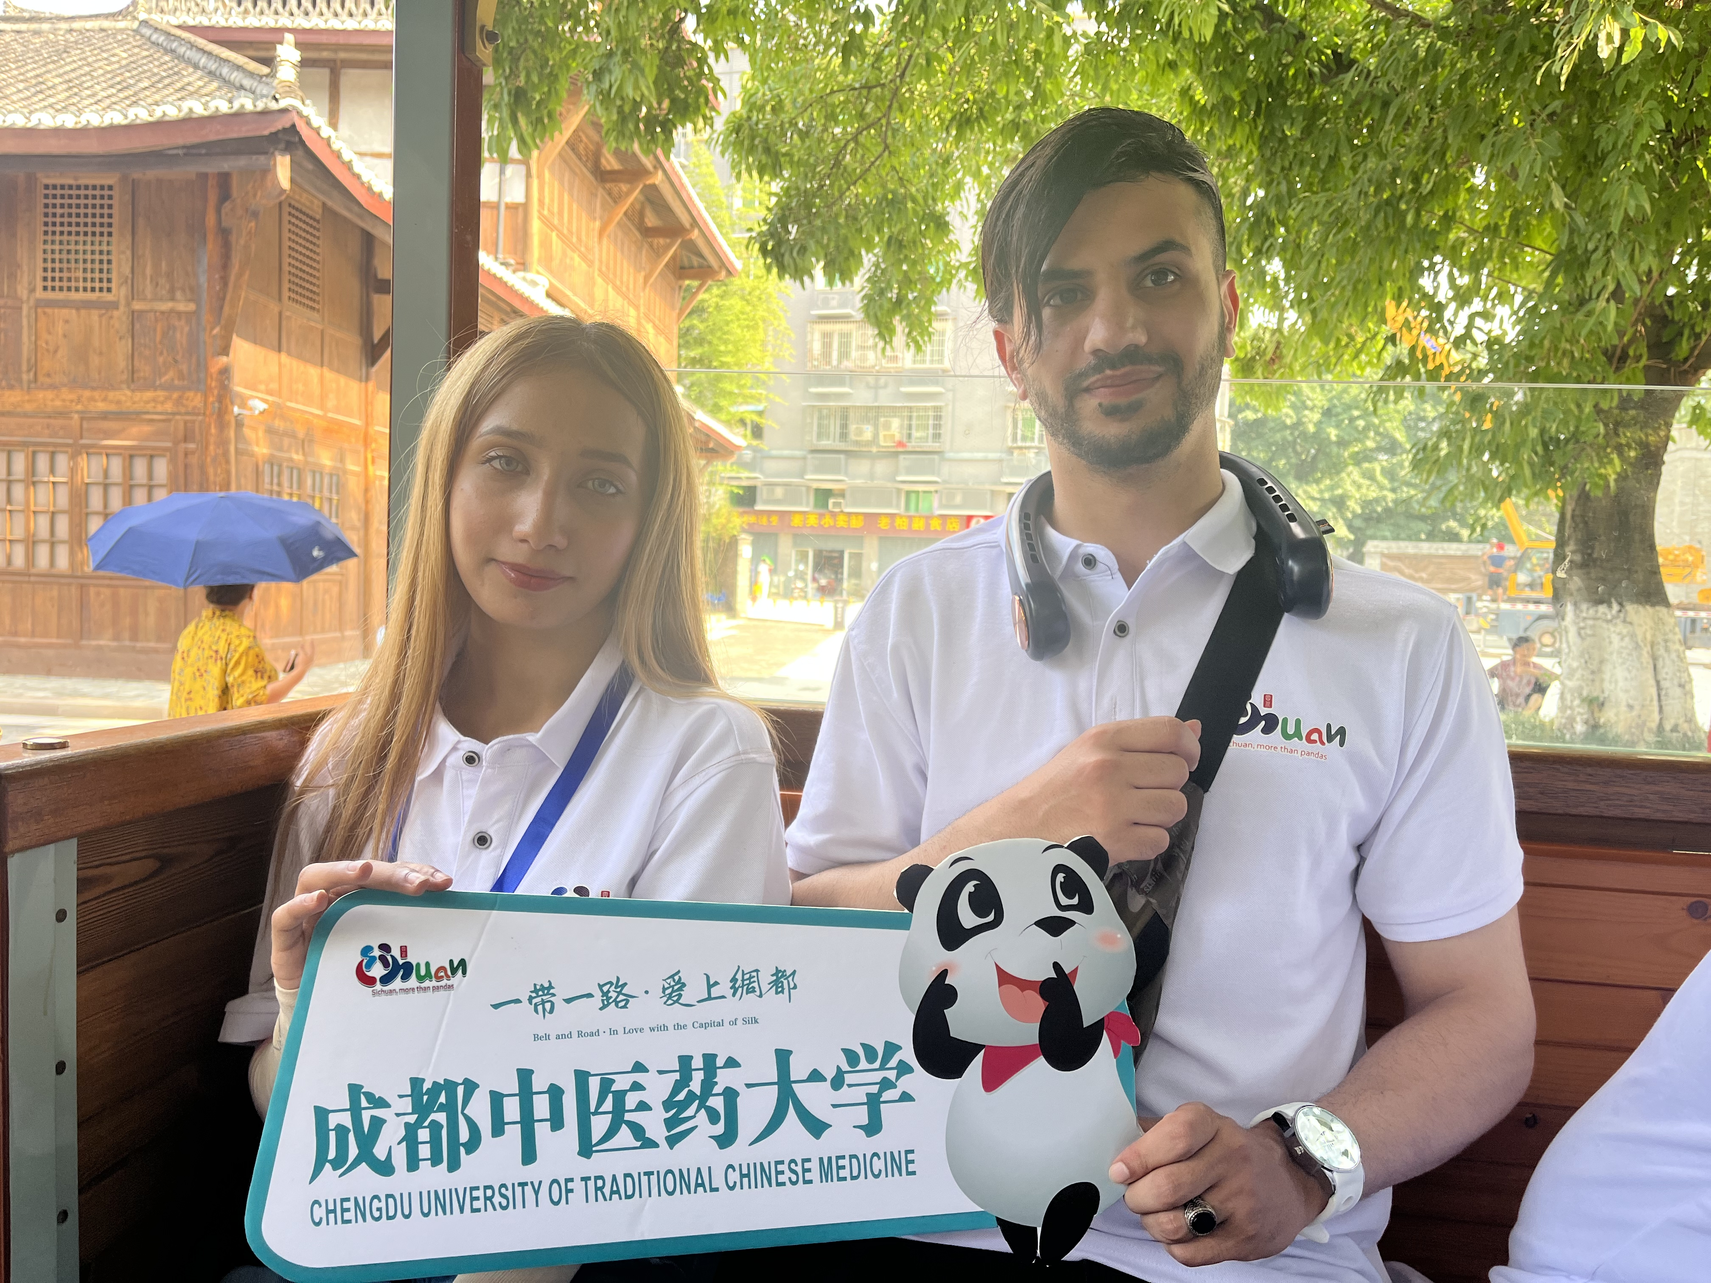
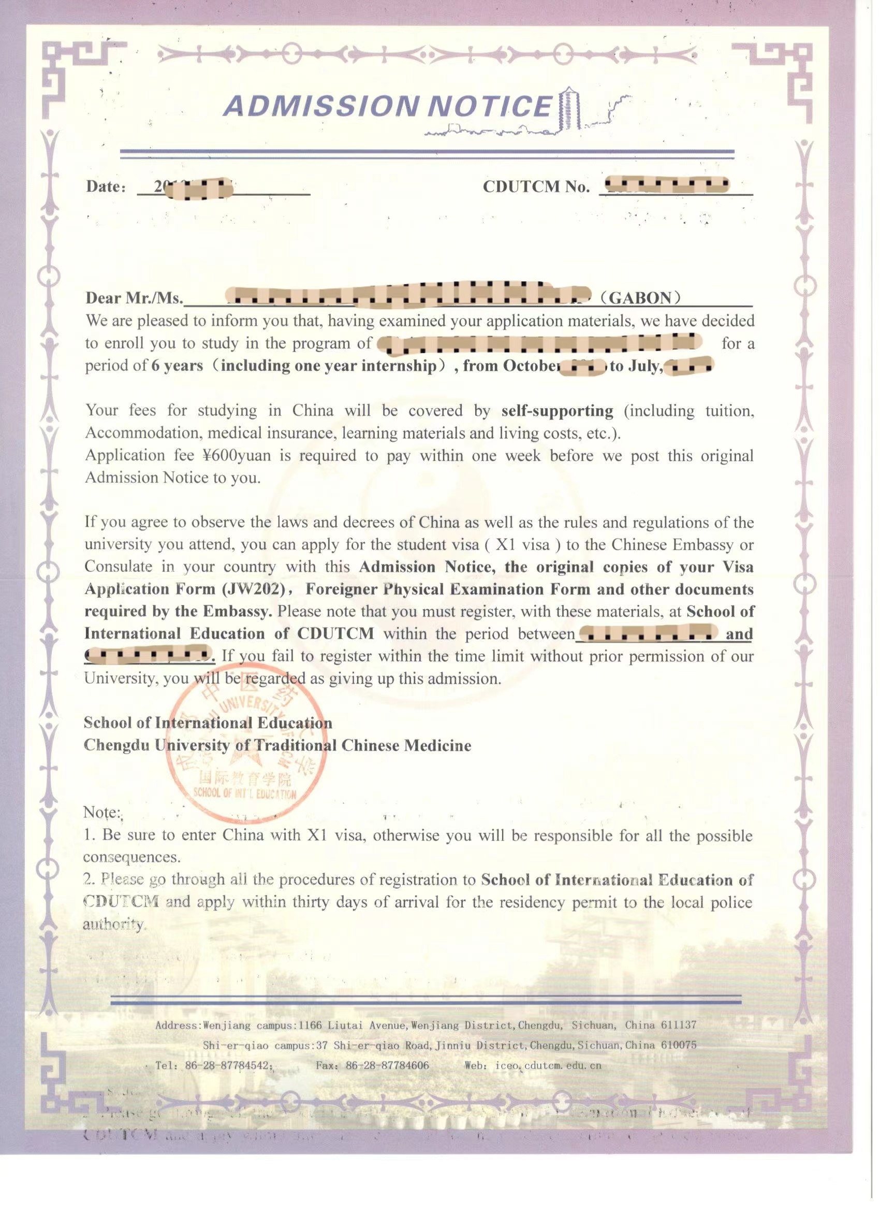
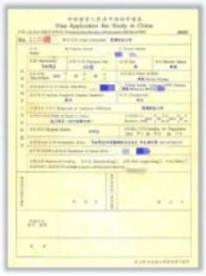
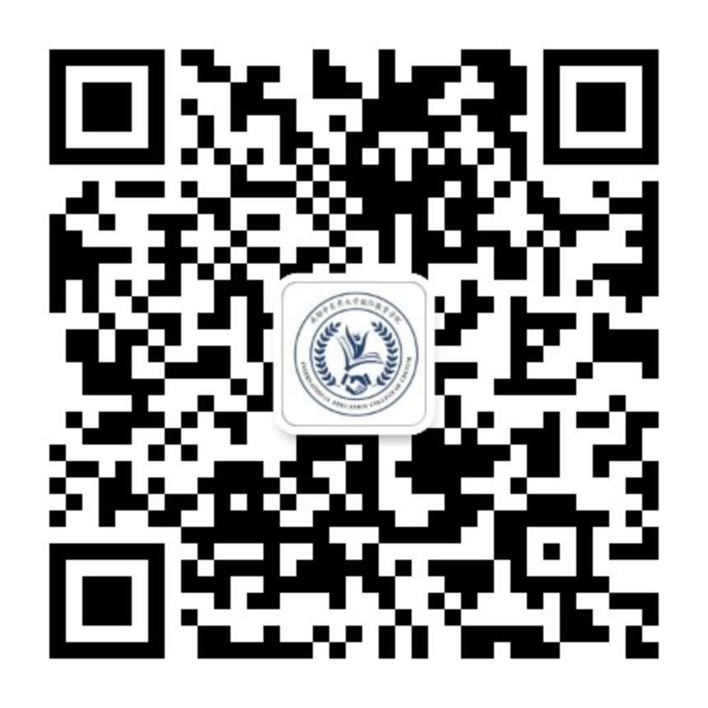
申请指南 Application Notes
申请时间/Application Period
01.01-05.30
申请方式/Application Approach
线上报名 Apply Online
申请材料/Supporting Documents
基本信息+毕业证+成绩单+语言证书+体检表+无犯罪记录证明
Personal Info+Diploma/Degree+Transcript+
Language Certificate+Healthy Physical Examination Report
申请流程/Admission Procedures
初审—考试/面试-复审-终审-录取
General Review（IEC Office）
→Online Exam/Interview→Academic Review（Commiittee of
Schools）→Final Review（Committee of CDUTCM）
Apply Online
Notes:
Applying to CDUTCM is straightforward. The application period runs from January to June each year. You can apply online and will need to submit personal information, diplomas, language certificates, transcripts, and a health examination report. The admission process includes a general review, online exams or interviews, academic review, and a final review by the university committee.

Slide 7
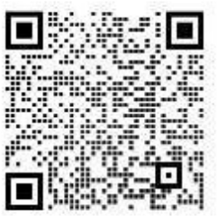
奖学金介绍 Scholarship
◇中国政府奖学金 Chinese Government Scholarship
国别及专项（Type A）
通过中国驻外国使领馆申请/Apply through Chinese embassy
申请时间：10月-次年2月前/Oct.-Feb.
(根据奖学金派出机构要求）
高校自主招生（Type B）
向成都中医药大学申请/Apply through CDUTCM
申请时间：1月-2月/Jan.-Feb.
机构代码/Agency No.:10633
Application Notice
It is also available for English-instructed degree programs !
Coverge: Tuition,
Accommodation, Insurance,
Living allowance
Standard of allowancce:
Bachelor: 2,500RMB/month
Master: 3,000RMB/month
PhD: 3,500RMB/month
Age and Language Requirements:
Bachelor:≤25，HSK3+
Master: ≤35，HSK4+
PhD:≤40，HSK4+
Please feel free to contact
us via email or WeChat.
https://www.campuschina.org/
info@cdutcm.edu.cn
N
Notes:
At CDUTCM, we provide a supportive and enriching environment for international students. We offer various scholarships including the Chinese Government Scholarship, Sichuan Government Scholarship, Chengdu Government Scholarship, The Belt and Road Scholarship, and many more. These scholarships cater to both undergraduates and graduates, including specific programs for students from our overseas branches.

Slide 8
奖学金介绍 Scholarship
四川省政府奖学金
Sichuan Government Scholarship
申请时间：04.30前（Before April，30）
部分(Partial): Subsidiary Tuition
Age and Language Requirements
Bachelor:30 HSK-4+
Master:35 HSK-4+
PhD: /
It is also available for English-instructed degree programs!
成都市政府奖学金
Chengdu Government Scholarship
“一带一路”奖学金 The Belt and Road Scholarship Belt and Road Initiative
Country （Including Indonesia）
国际友好城市奖学金 Sister City Scholarship Medan City in Indonesia
*申请人须为持有外国国籍的友城公民，出生于成都市友城或有在成都市友城工作、学习经历
*须由友好城市奖学金申请人所在友城政府部门出具《友城身份确认函》
申请时间/Application Time: 通常为4-6月 April-June
It is also available for English-instructed degree programs!
Age and Language Requirements：
Bachelor: / HSK 4 +
Master: / HSK 5 +
PhD: / HSK 5 +
Schlolarship Coverage：
Bachelor: partial tuition
Master: partial tuition
PhD: partial tuition

Slide 9
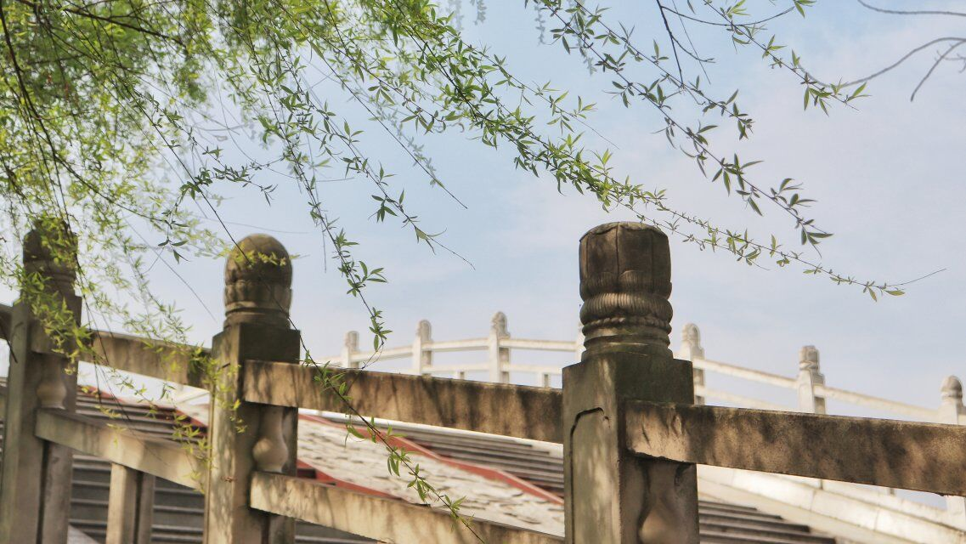
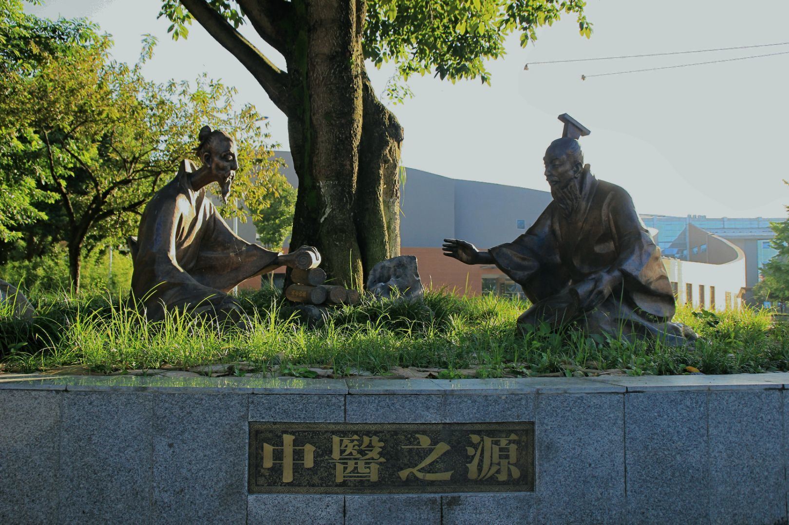
奖学金介绍 Scholarship
成中医奖学金 Study at CDUTCM Scholarship
优秀本科生奖学金（含汉语授课项目、全英文授课项目）
Outstanding Undergraduate Schoolarships（including Chinese-taught and
English taught programs）
优秀研究生奖学金
Scholarship for Outstanding Graduate Students
海外分校来华实习奖学金
Internship Scholarship for Branch School students in China
专升本项目奖学金
Scholarship for Top-up Degree Program

Slide 10
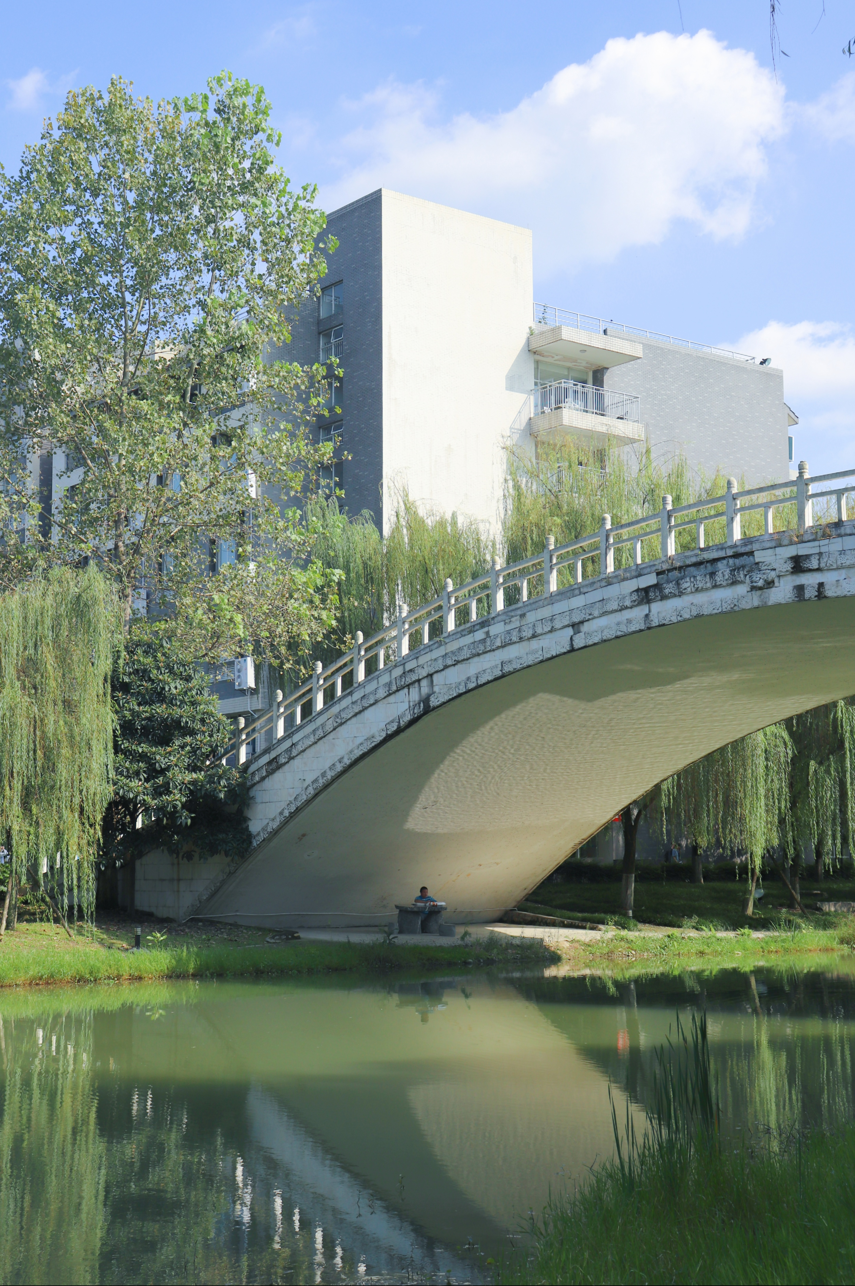
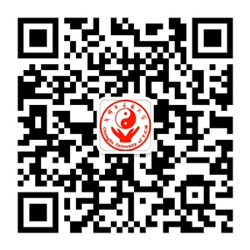
联系方式 Contact us
info@cdutcm.edu.cn
86-28-82682984；86-28-82682484
https://cdutcm.17gz.org/
University
Wechat Official Account
International School
Wechat Official Account
INFO Wechat Account
Notes:
For more information, you can follow our official WeChat accounts or visit our website. Our contact numbers and email address are also available for any inquiries. We are here to help you start your journey at CDUTCM and in Chengdu.Chengdu and CDUTCM offer a unique and fulfilling experience for those interested in traditional Chinese medicine and a culturally rich lifestyle. We look forward to welcoming you to our community and making you one of the extended family member of CDUTCM.

