Slide 1
China University of Mining and Technology

Slide 2
01
HISTORY
02
LOCATION
03
FACTS & FIGURES
CONTENTS
04
CAMPUS LIFE
05
APPLICATION
06
SHORT TERM CAMP

Slide 3
Part 01
History

Slide 4
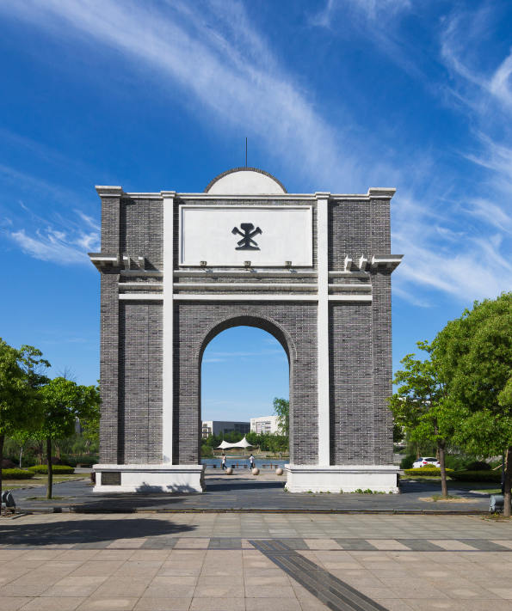
1909
Predecessor of CUMT established.
Oldest
One of the oldest private institutions in modern China
First
The first private college of engineering established in China by the Westerners in early 20th century

Slide 5
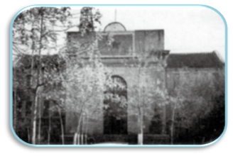
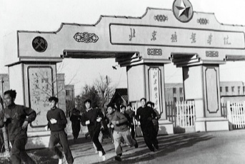
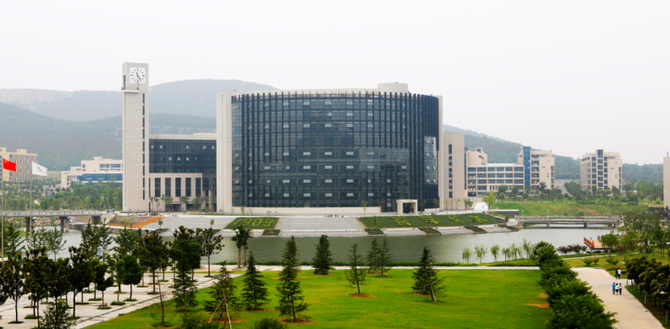
History and Evolution
14 times of relocating & 12 times of renaming
Jiaozuo, Henan Province
Jiaozuo School of Railroads and Mines
……
Jiaozuo Institute of Technology
1909_1949
Tianjin/Beijing
China Institute of Mining and Technology
Beijing Institute of Mining and Technology
……
1950_
1970
Xuzhou, Jiangsu Province
China Institute of Mining and Technology
China University of Mining and Technology
1978

Slide 6
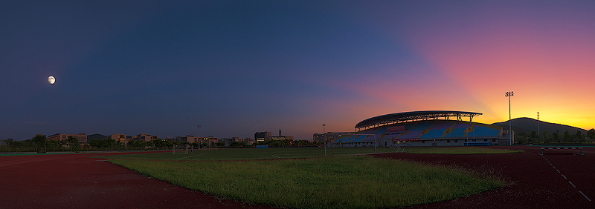
Part 02
Location

Slide 7
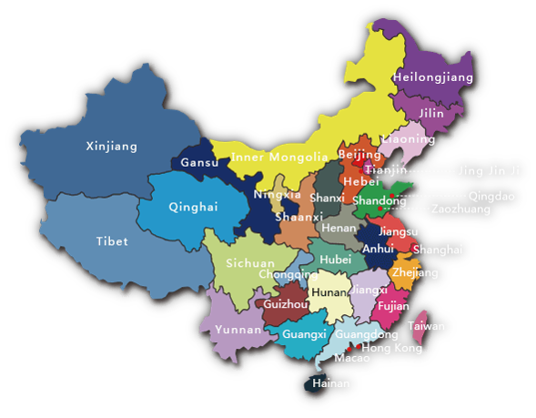
Located in the city of Xuzhou, east China’s Jiangsu Province, close to Ji’nan, Zhengzhou, Nanjing and Hefei. 3 hours from Beijing and 2 ½ hours from Shanghai by high speed train.

Slide 8
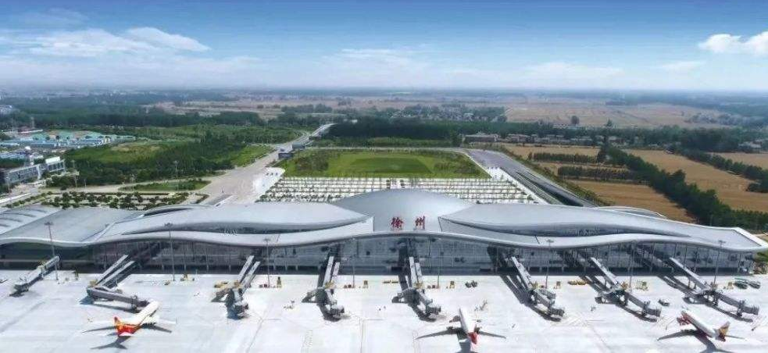
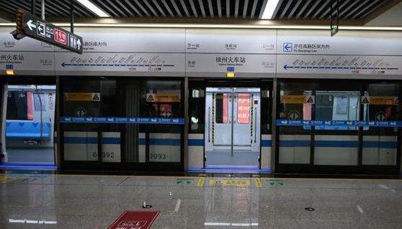
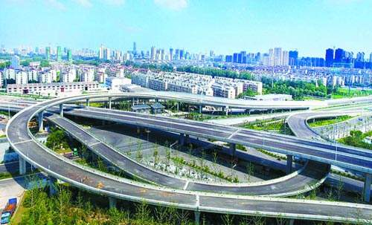
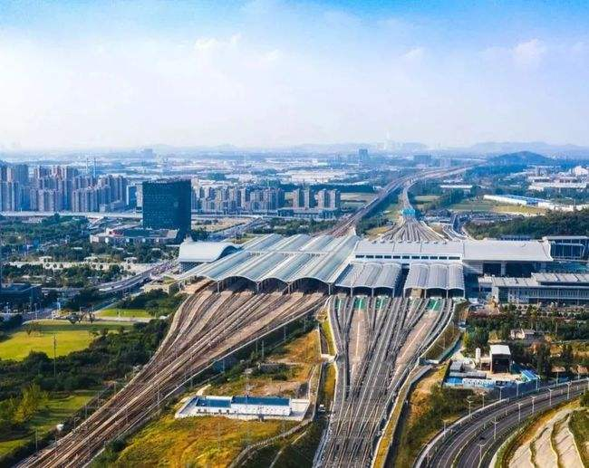
Transportation

Slide 9
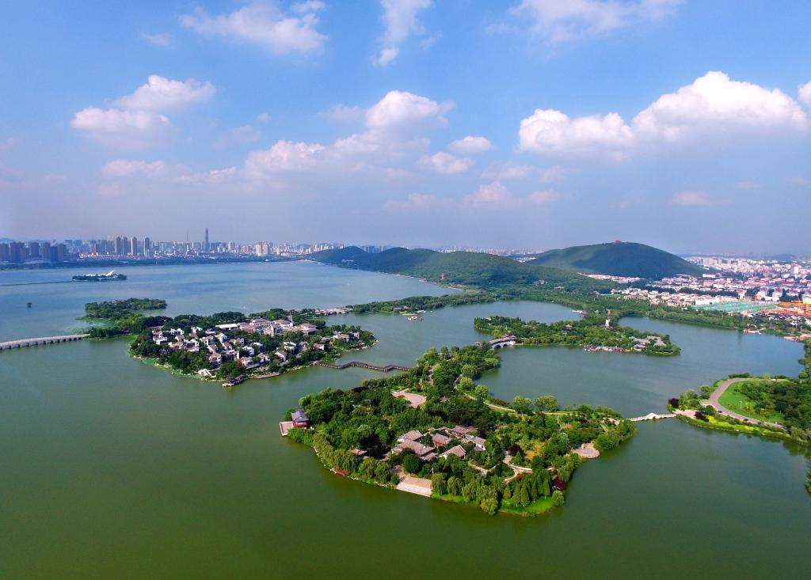
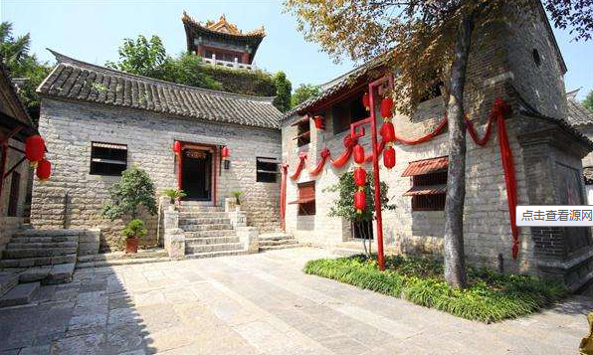
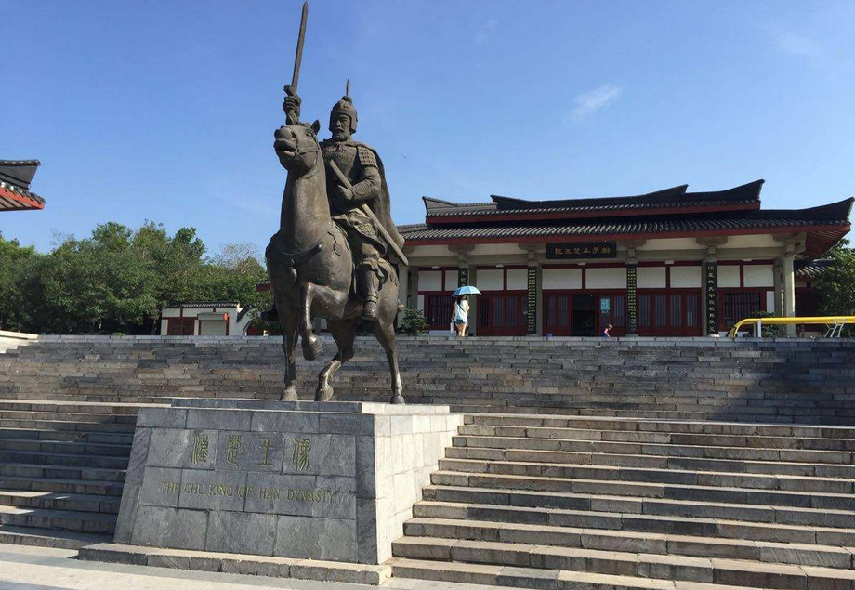
The Happiest Cities in China for 2021
On November 18, 2020 China’s Happy Cities Forum and the 14th China’s Happiest Cities Campaign were held in Hangzhou. Xuzhou was selected as one of the “The Happiest Cities in China for 2021”, the forth time to win the honor after 2017, 2019 and 2020.
Xuzhou City

Slide 10
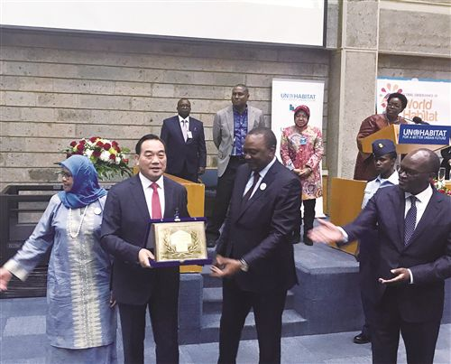
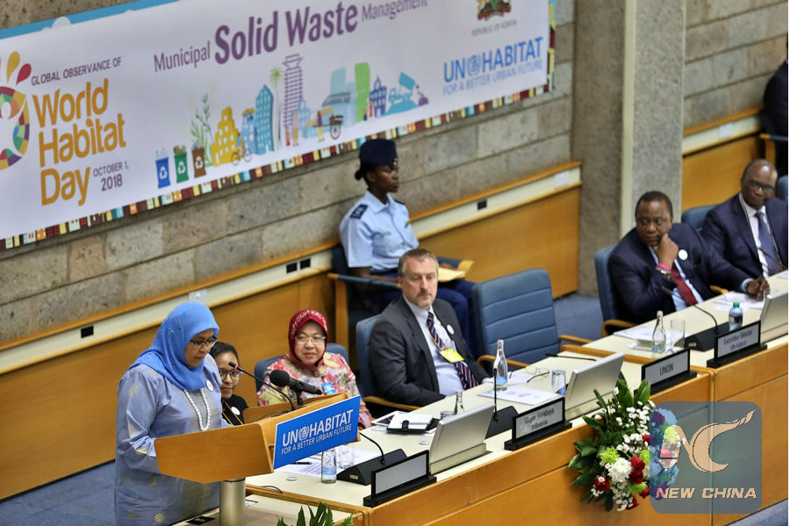
UN-Habitat Scroll of Honor
“Xuzhou, scooped the prestigious award for promoting holistic and broad-based approaches to ecological restoration through intelligent solid-waste management.”
"I hope Xuzhou's best practices can encourage other Chinese cities to move forward in implementing the Sustainable Development Goals" ---- Maimunah Mohd Sharif
Xuzhou City
Maimunah Mohd Sharif, executive director of UN-Habitat, makes an address during the World Habitat Day in Nairobi, Kenya, Oct. 1, 2018. Kenyan President Uhuru Kenyatta presented the UN-Habitat Scroll of Honor award to Xuzhou at a ceremony to mark the World Habitat Day held in the capital, Nairobi.

Slide 11
Part 03
Facts & Figures

Slide 12
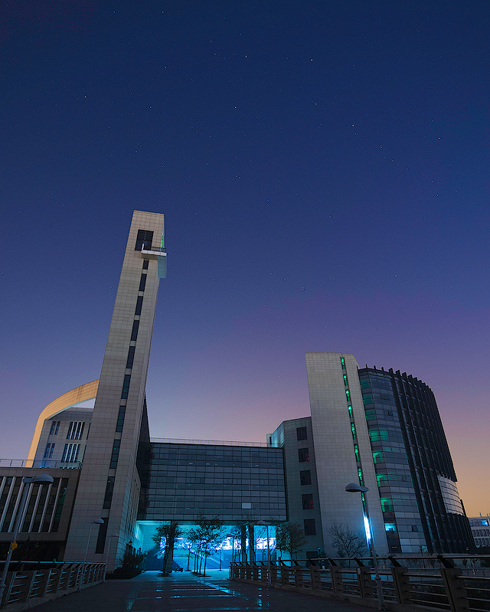
#57
Best Global Universities in China (US News & World Report 2023)
211 Project
985 Innovation Platform for Advantageous Disciplines
National First-Class Disciplines
Mining Engineering discipline ranks Top 17 in the QS University Rankings First-Class Disciplines

Slide 13
ESI Top 1%
Earth Science, Engineering Science, Materials Science, Chemistry, Mathematics, Environmental and Ecological Science, Computer Science and Technology, Geosciences
#1 in China for Mining Engr. and Safety Science and Engr.
#3 in China for Surveying and Mapping , Geological Resources and Geological Engr.
(China National Academic Discipline Assessment 2017 )

Slide 14
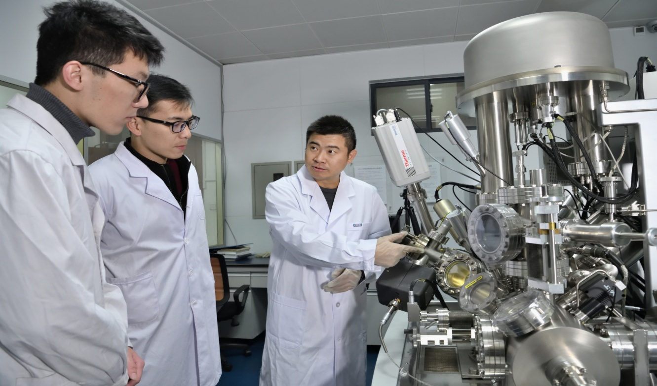
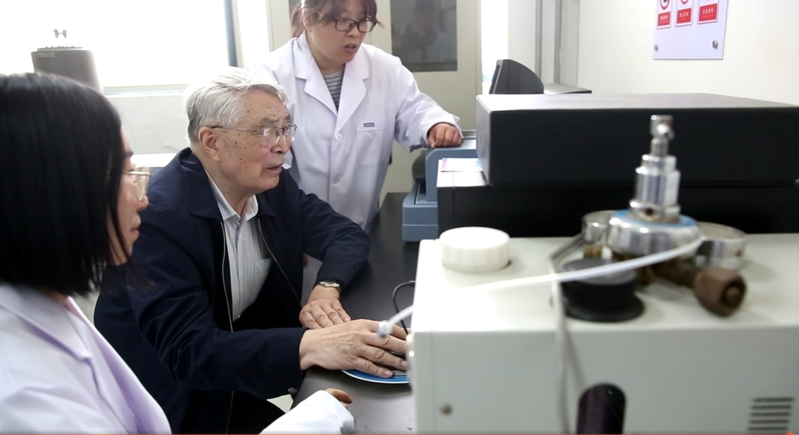
Team
2129
Teaching staff are currently working at CUMT
16
Academicians from Chinese Academy of Social Sciences and Chinese Academy of Engineering (including visiting professors)

Slide 15
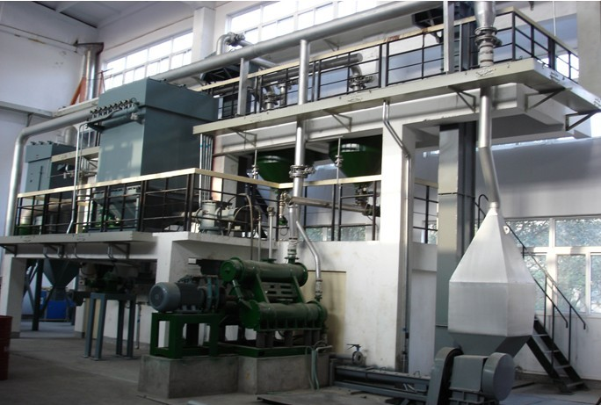
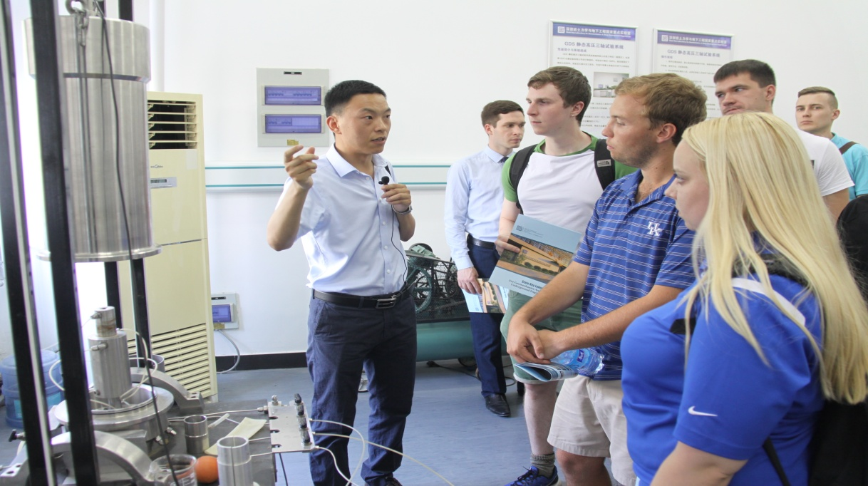
Facilities
2 National laboratories
2 National Engr. (tech.) research centers
1 National Engr. Laboratory
30+ Ministerial & Provincial-level labs, Engr. research centers or tech. centers

Slide 16
Part 04
Campus Life

Slide 17
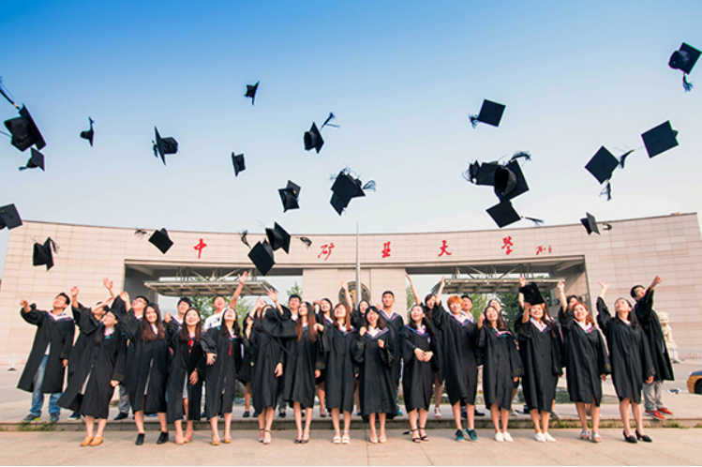
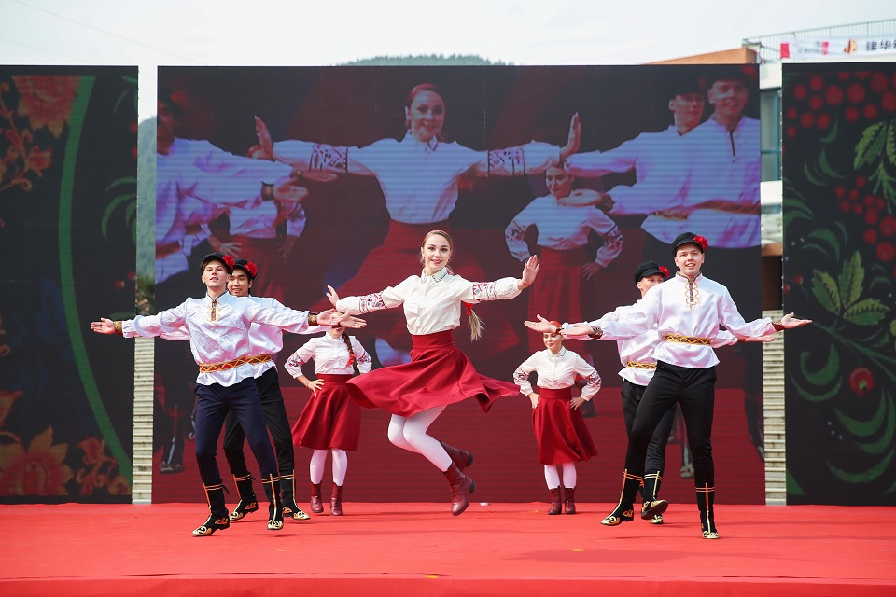
37,580
…students are currently registered at CUMT, including :
680
...international students from 82 countries
more than 4000 international graduates

Slide 18
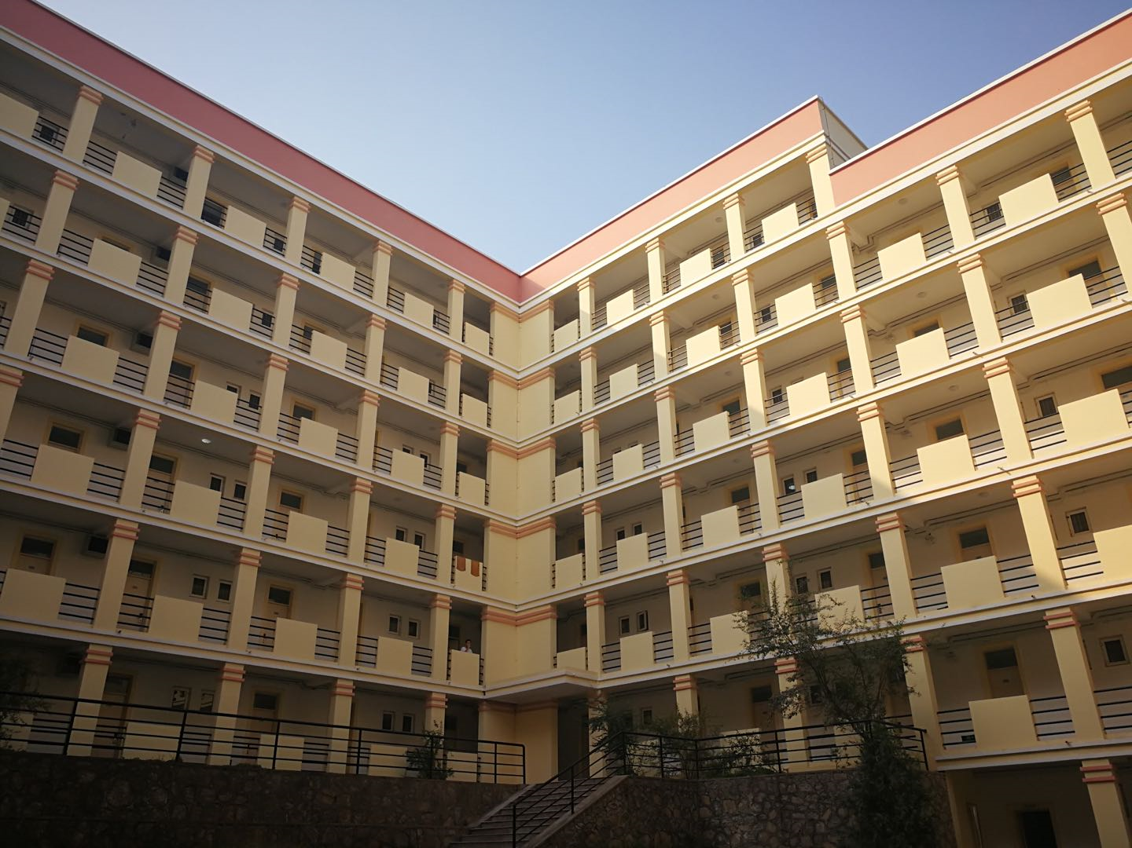
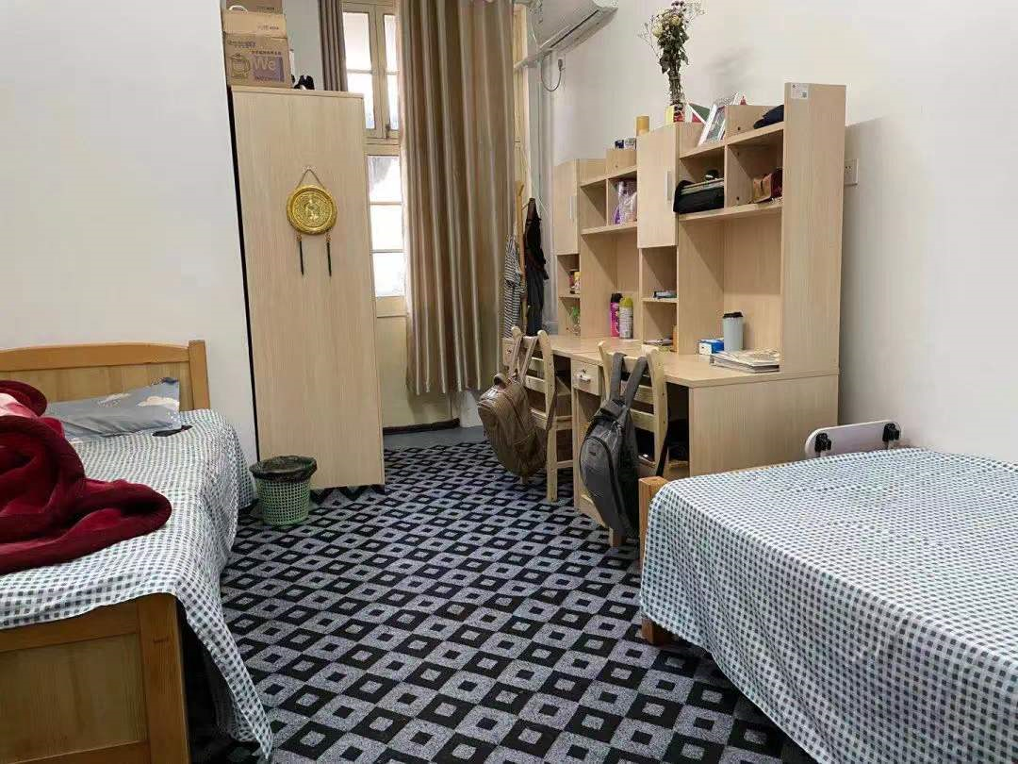
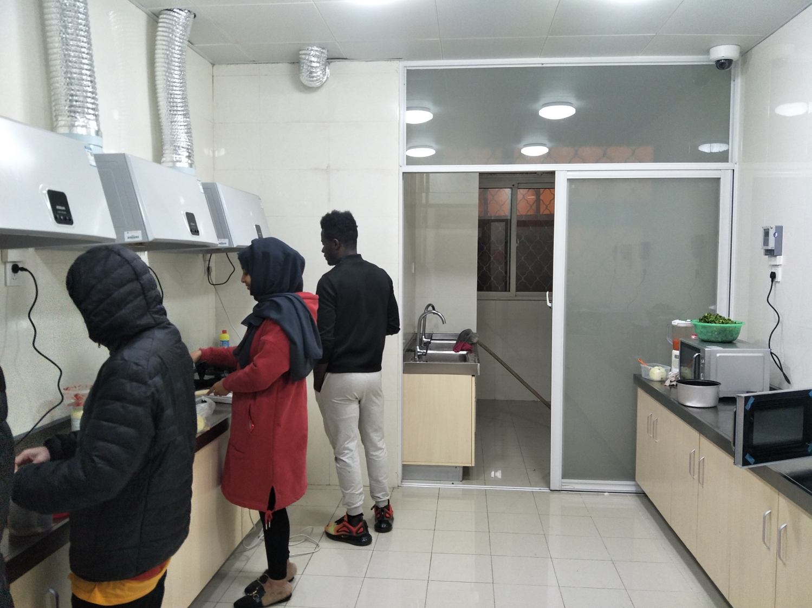
Dormitory

Slide 19
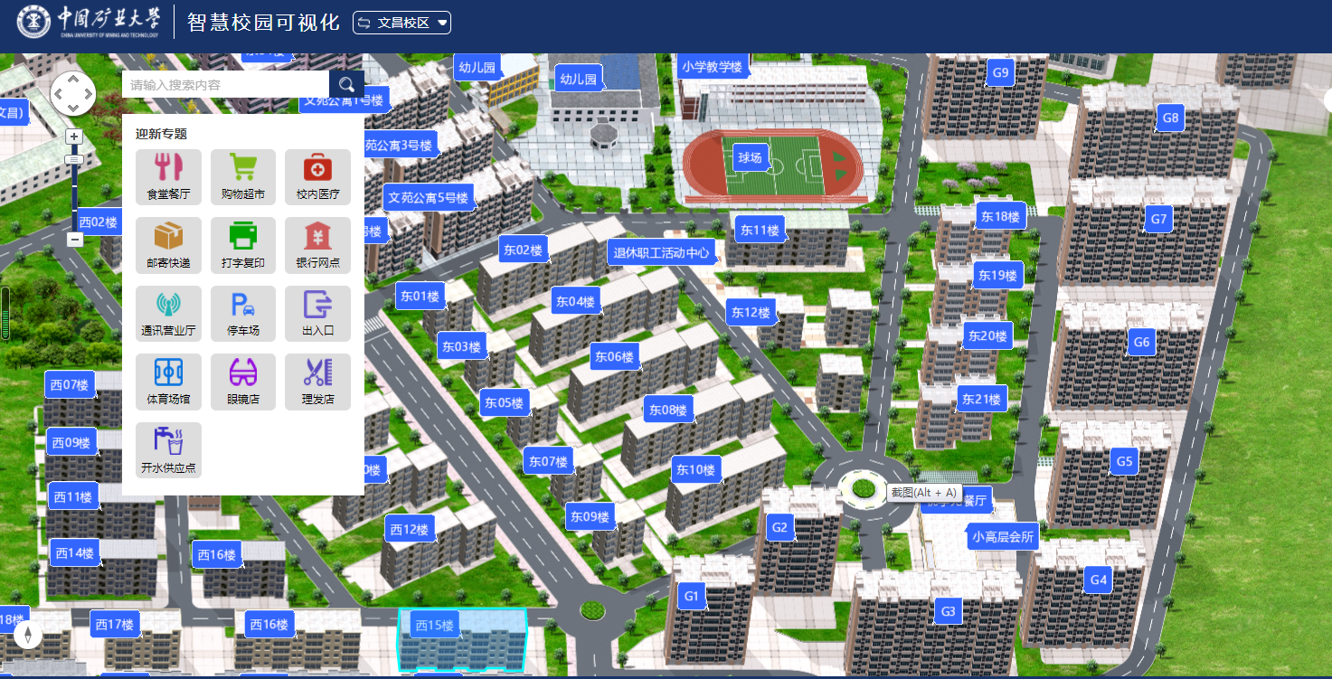
Digital Campus

Slide 20
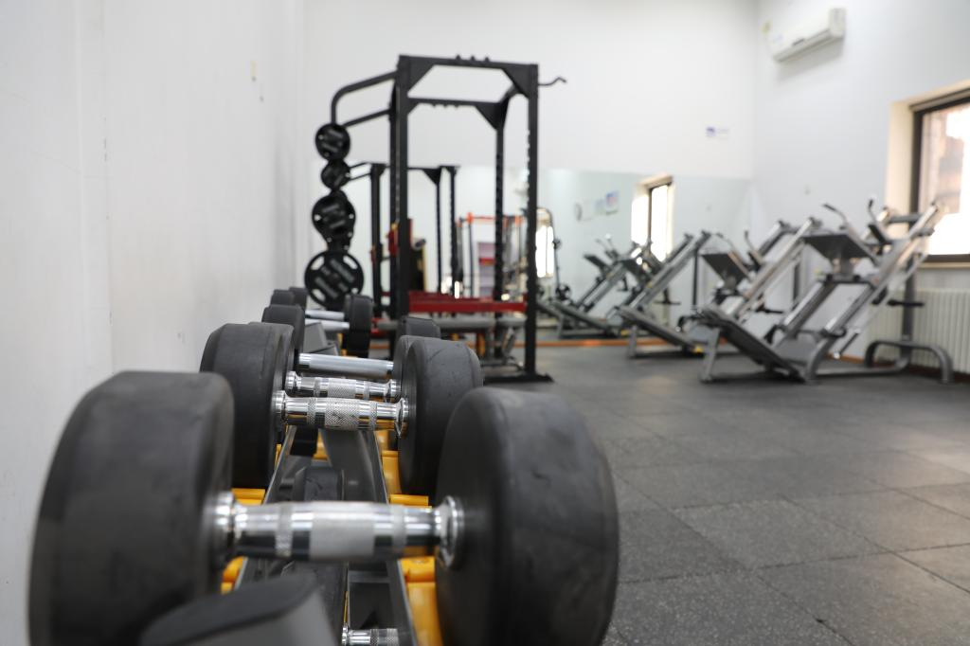
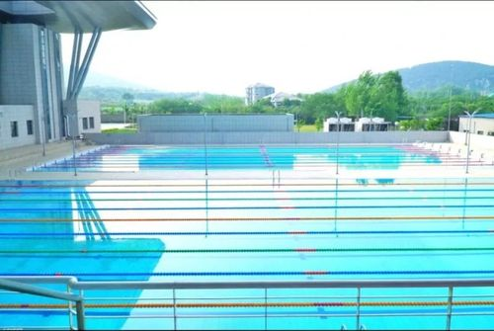
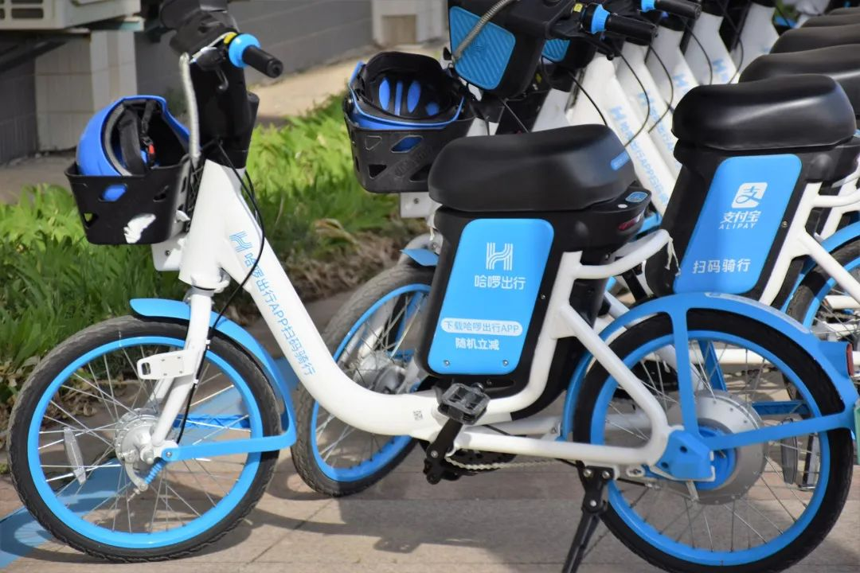
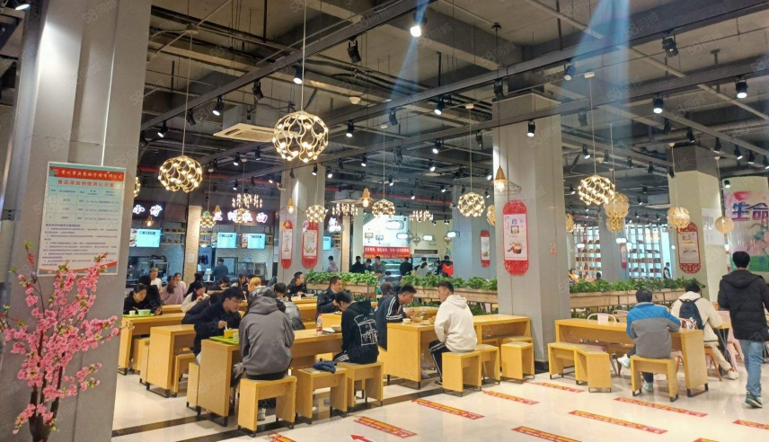
Campus Facilities

Slide 21
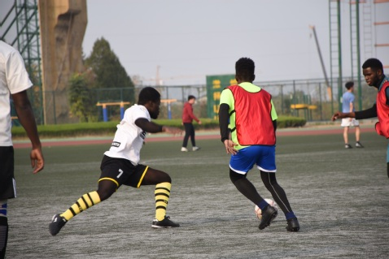
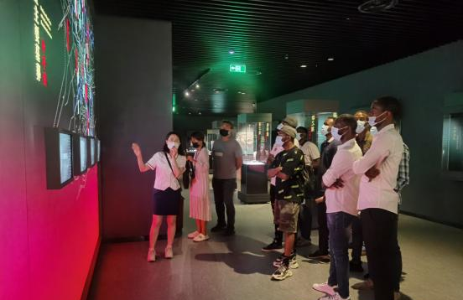
Activities

Slide 22
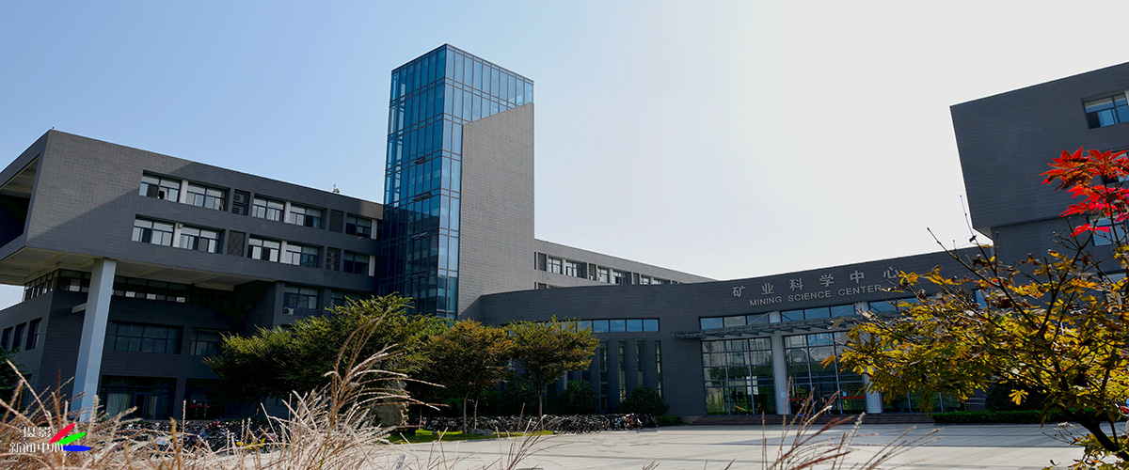
Part 05
APPLICATION

Slide 23
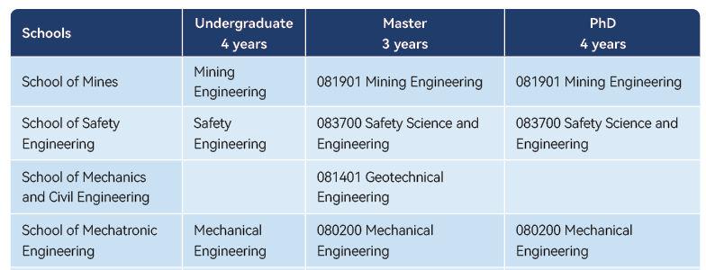
Programs Taught in English

Slide 24
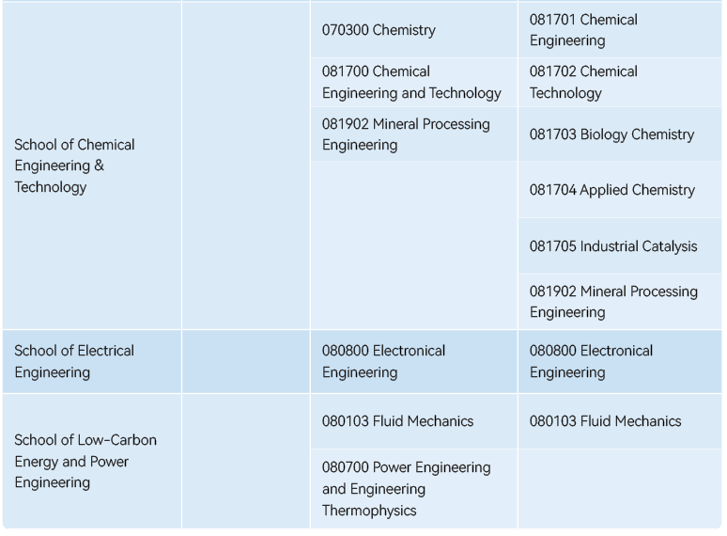

Slide 25
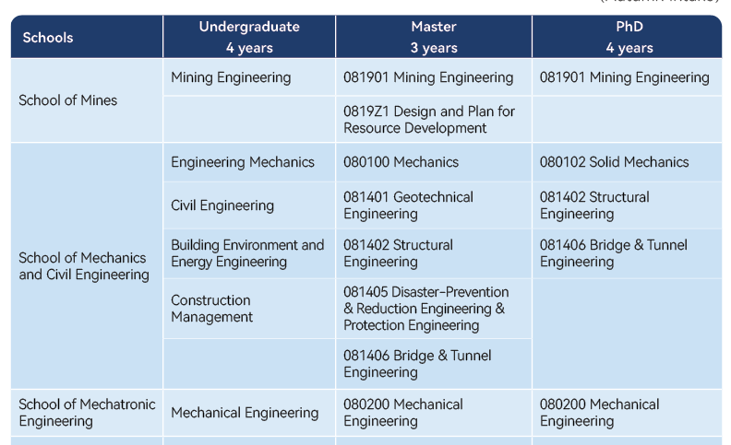
Programs Taught in Chinese

Slide 26
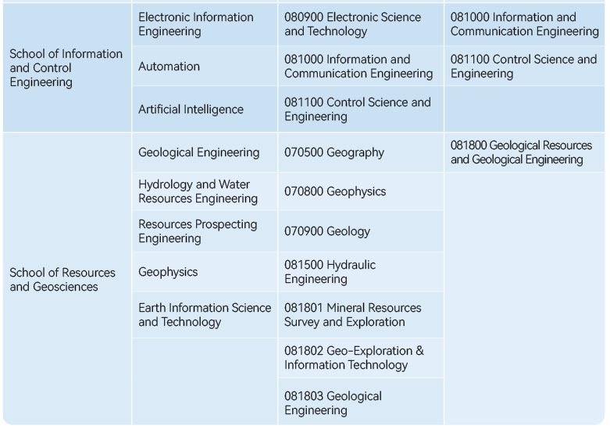

Slide 27
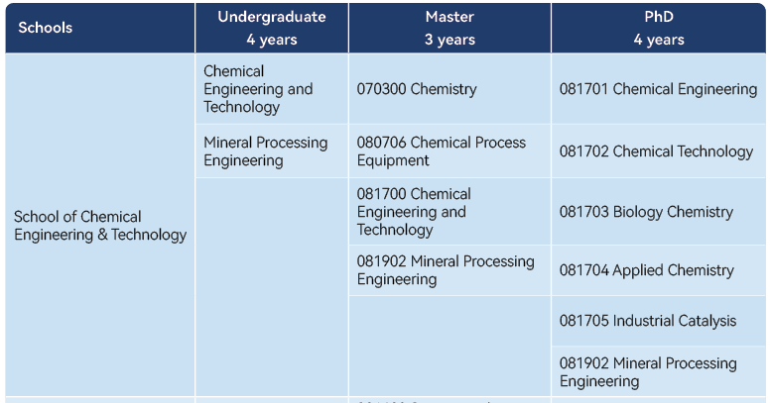

Slide 28
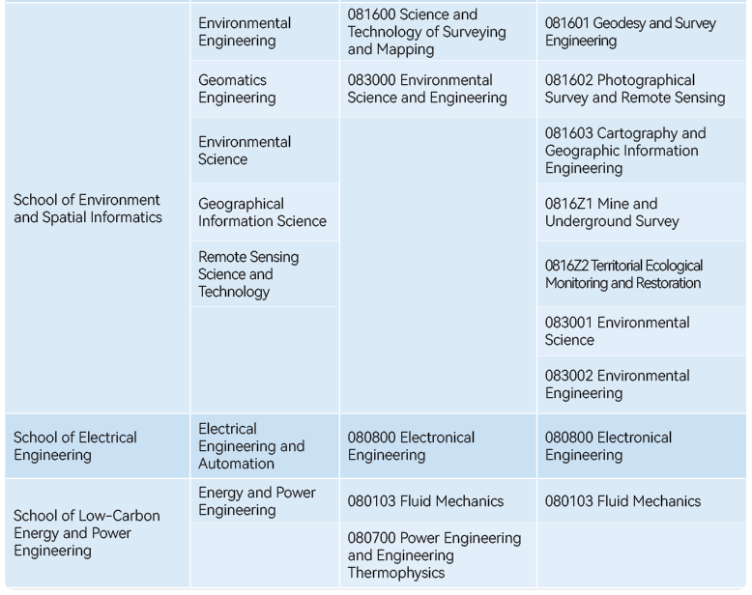

Slide 29
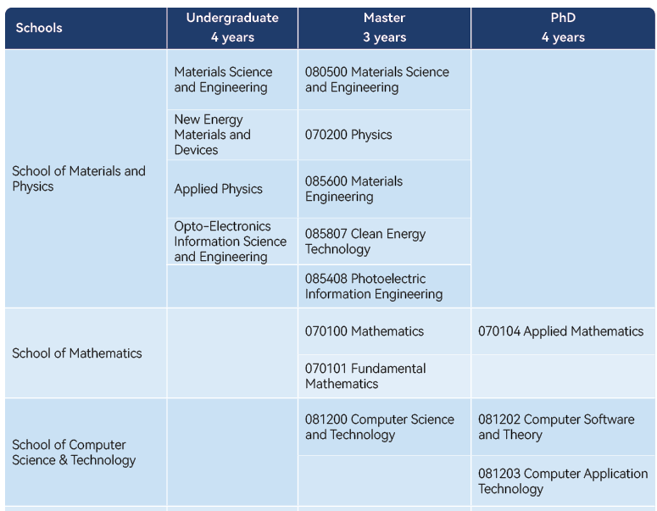

Slide 30
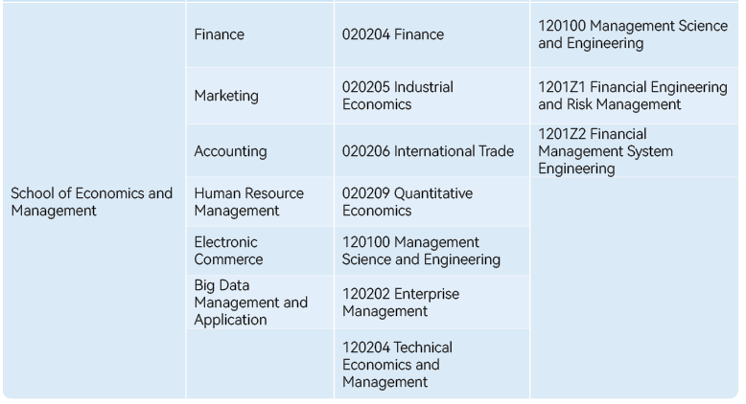

Slide 31
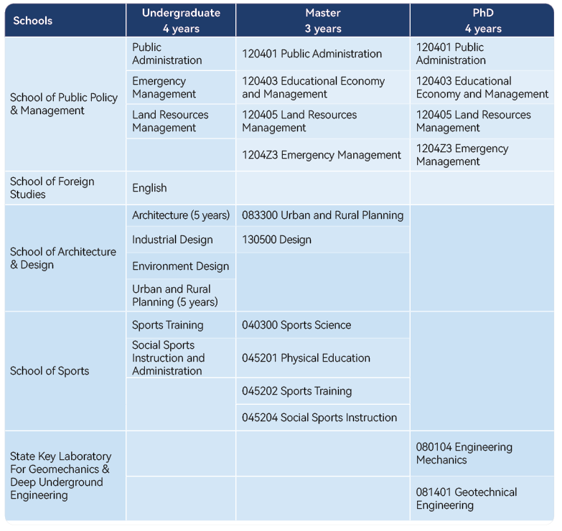

Slide 32
Language Requirement for All Applicants
Chinese:
≥ HSK-4
English:
IELTS ≥ 5.5, TOEFL ≥ 79, Duolingo English Test ≥95

Slide 33
Chinese Language Program

Slide 34
CUMT Scholarship
Website：
http://cumt.17gz.org/member/login.do
March Intake
September Intake
02
Pre-university Program Scholarship
CSC scholarship
01
03
Website： http://cumt.17gz.org/member/login.do
March Intake
September Intake
Website：http://www.campuschina.org/
September Intake
奖学金
Scholarship

Slide 35
CSC Scholarship Eligibility
Scholarship Postgraduate Program (Finished)
a bachelor's degree holder under the age of 35 when applying for master's programs
a master's degree holder under the age of 40 when applying for doctoral programs

Slide 36
Coverage
Full scholarship
Tuition Fees
Comprehensive Medical Insurance
Accommodation Fees
Life Allowance
Partial scholarship
Comprehensive Medical Insurance
Accommodation Fees
Life Allowance

Slide 37
Application Process
STEP 1: Online Application
(Visit http://www.campuschina.org and click “Application Online” to log in)
The Agency Number of CUMT: 10290 Type B
STEP 2: Exams & Interviews
STEP 3: Admission & Confirmation

Slide 38
Application Materials
1. CSC Application Form;
2. Copy of Passport Home Page;
3. Notarized Highest Diploma;
4. Academic Transcripts (from the undergraduate program onwards);
5. Language qualification certificates (English: IELTS ≥ 5.5, TOEFL ≥ 79, Duolingo English Test ≥95; Chinese: ≥ HSK-4 )
6. A study plan proposal (>1500 words； Chinese/English; signed by CUMT tutor for postgraduate applicant);
7. Two letters of recommendation(postgraduate applicant);
8. One Acceptance Letter from a CUMT tutor (postgraduate applicant);
9. A photocopy of the Foreigner Physical Examination Form completed in English (valid for only 6 months);
10. Non-criminal record report(issued within 6 months)

Slide 39
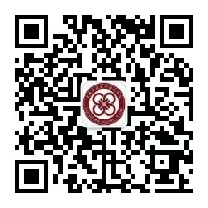
For More Details
CSC website
https://www.campuschina.org/content/details3_74776.html
or
CUMT Wechat Official Account

Slide 40
CUMT Scholarship
Application Time：
September Intake

Slide 41
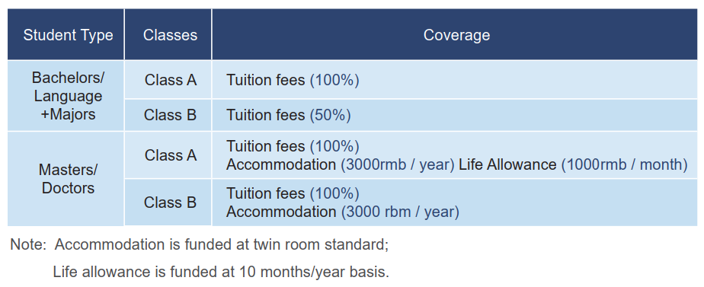
Pre-university Study Scholarship: Candidate who applied the major(Bachelor/Master/Doctor) together with 1 year pre-university language study, will enjoy 100% tuition fee covered during the language year.

Slide 42
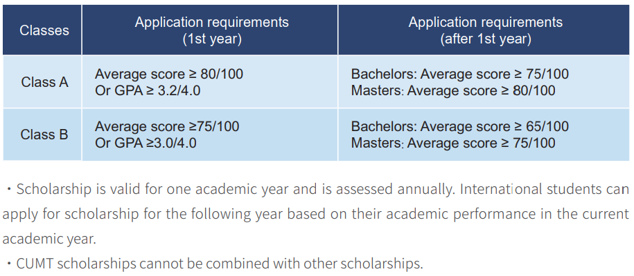
Interview Score
Entrance Test Score
Class of the Scholarship
GPA of the Highest Degree

Slide 43
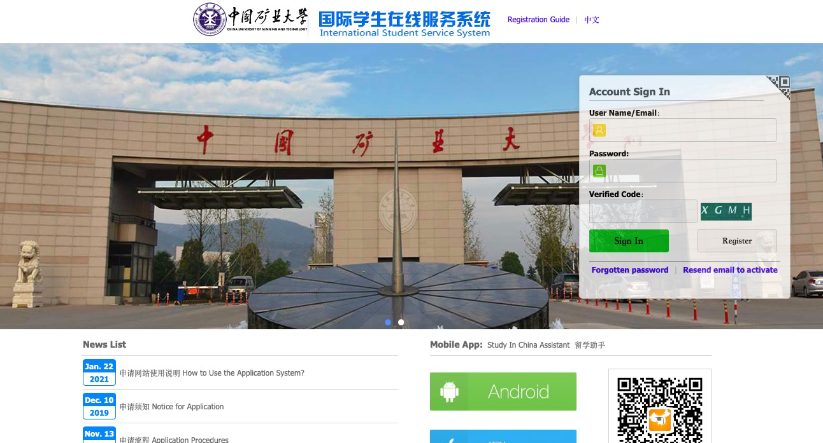
Application Process
STEP 1:
Register your account and activate it in application system. https://cumt.17gz.org/member/login.do
Applications ONLY be done online through the CUMT online system

Slide 44
STEP 2:
Fill out the application and upload all required application documents.
1.A passport photo;
2.A copy of your passport information page;
3.A copy of your highest graduation certificate;
4.A copy of the transcript of your highest degree;
5.A physical examination report within 6 months;
6.A non-criminal certificate issued by local police station within 6 months;
7.A bank statement within 6 months;
8.An acceptance letter(Master and PhD);
9.Two recommendation letters (Master and PhD);
10.Study plan or research proposal(>1500 words， (Master and PhD));
11.Language proficiency certificate (English: IELTS ≥ 5.5, TOEFL ≥ 79, Duolingo English Test ≥95; Chinese: ≥ HSK-4)

Slide 45
STEP 3:
Submit the application and note your application number.
STEP 4:
Pay for the application fees: 60 USD OR 400 CNY
STEP 5:
Take part in the online interview and the online entrance test.
STEP 6:
Get your admission result via application system and email.

Slide 46
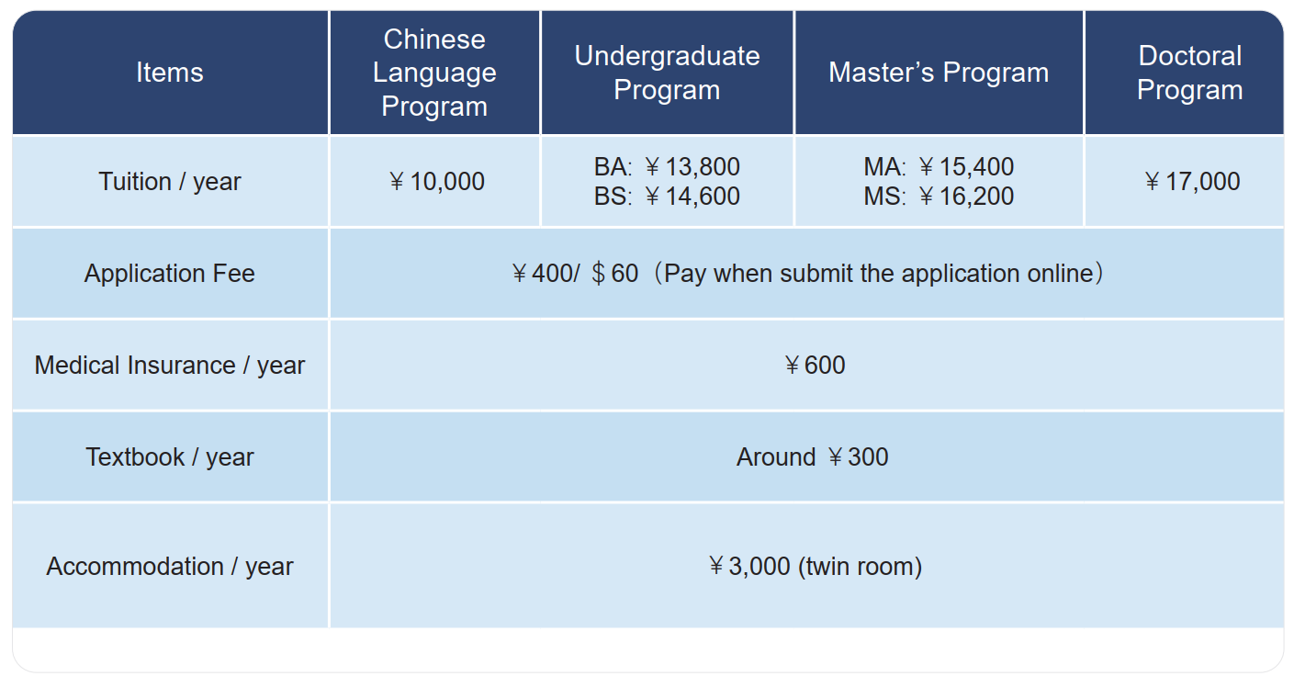
Cost

Slide 47
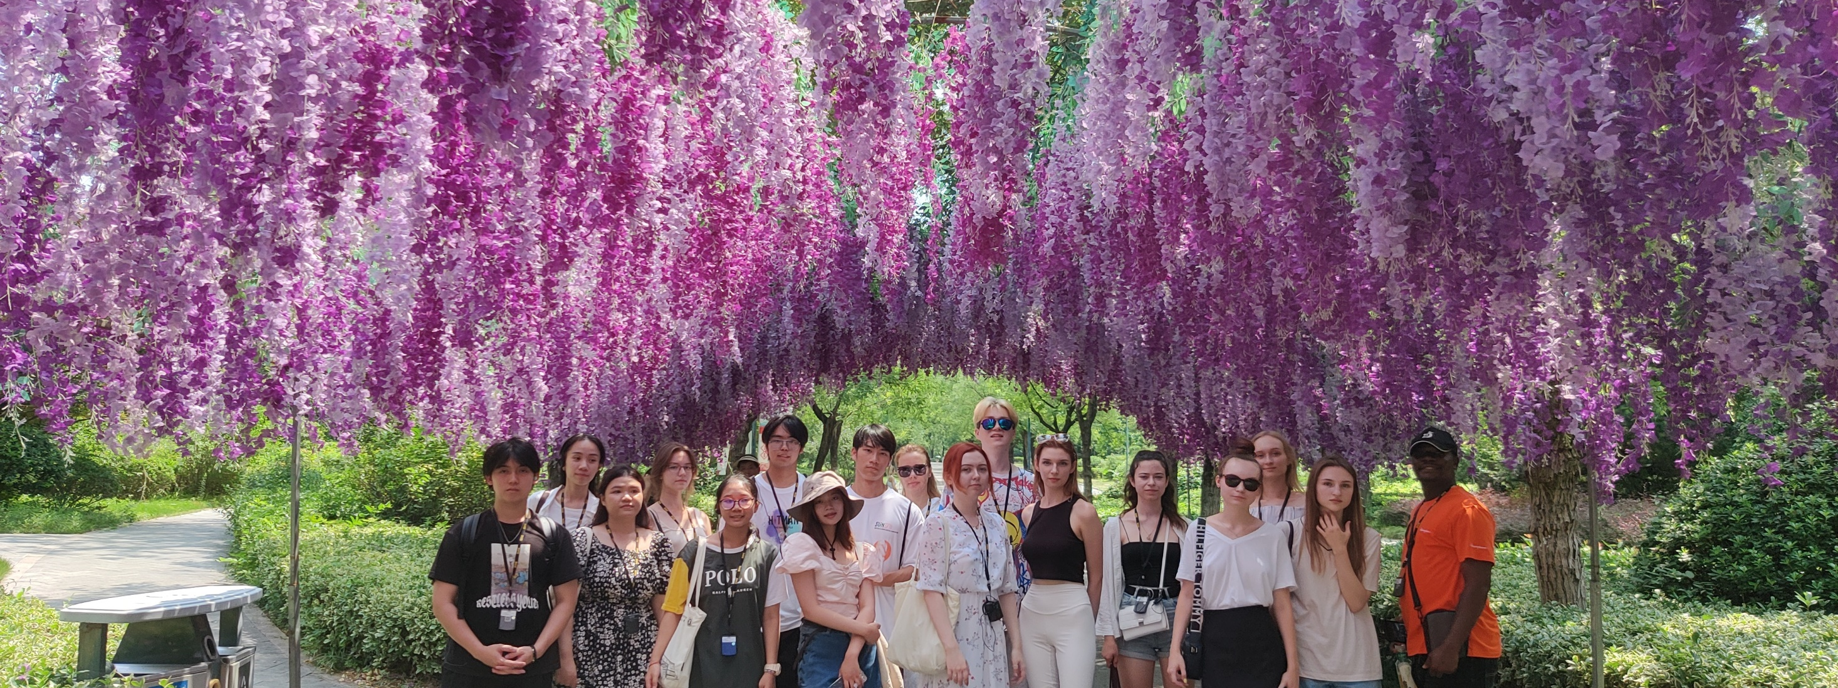
Part 06
SHORT TERM CAMP

Slide 48
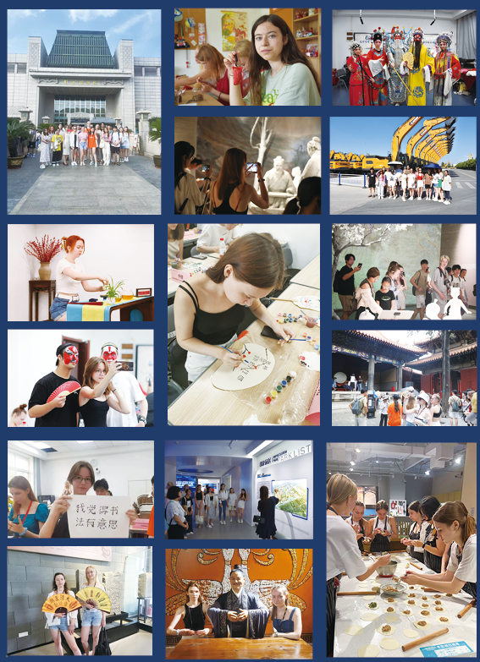

Slide 49
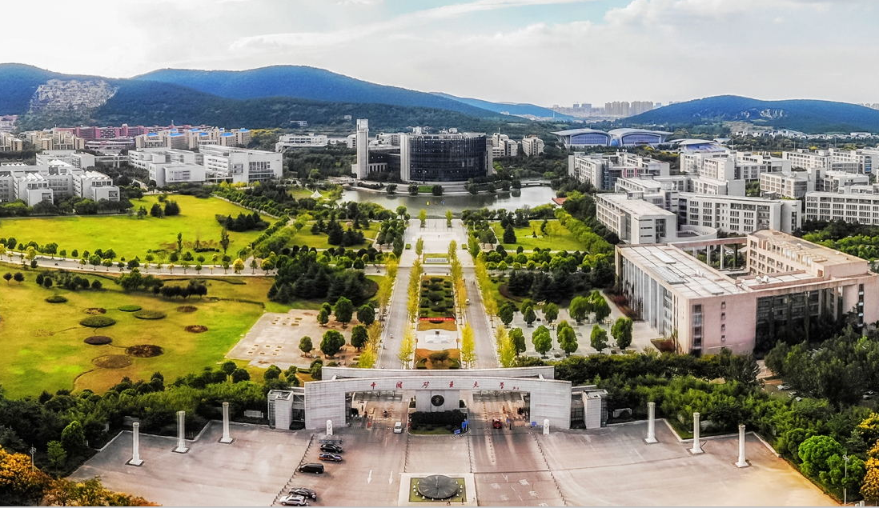
Welcome to CUMT！

Slide 50
Contacts
Ms. Wu Wenqing Ms. Chen Qiyu Ms. Pan Meichen
Email：admission@cumt.edu.cn
Tel: +86-516-83592816
Website: sac.cumt.edu.cn/en/

