Slide 1
15 May 2023
昆明医科大学
Kunming Medical University
OVERSEAS
STUDENTS

Slide 2
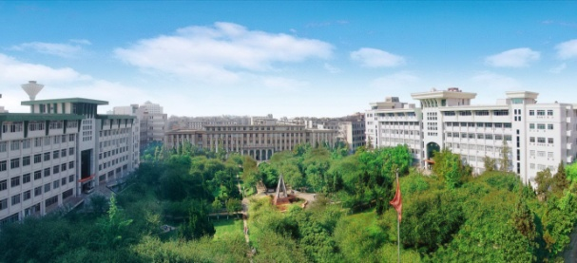
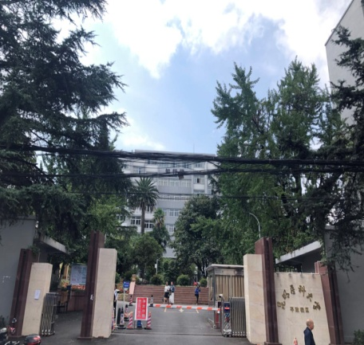
昆明医科大学 Kunming Medical University
three campuses covering nearly 244 acres of land having 3 campus
呈贡校区 Chenggong Campus
人民西路校区
West Renmin Road Campus
平政校区
Pingzheng Campus
KUNMING MEDICAL UNIVERSITY

Slide 3
昆明医科大学 Kunming Medical University
18 Academic Units
研究生院
Graduate School
外语部
Foreign Languages Department
基础医学院
School of Basic Medical Sciences
体育部
Sports Department
公共卫生学院
School of Public Health
国际教育学院
International Education School
法医学院
School of Forensic Medicine
继续教育学院
School of
Continuing Education
药学院
School of
Pharmaceutical Sciences
第一临床学院
The First School of
Clinical Medicine
护理学院
School of
Nursing
第二临床学院
The Second School of
Clinical Medicine
康复学院
School of Rehabilitation
School of Clinical Oncology
临床肿瘤学院
人文与管理学院
School of Humanities
and Social Science
口腔医学院
School of
Stomatology
马克思主义学院
School of Marxism
海源学院
Haiyuan College
KUNMING MEDICAL UNIVERSITY

Slide 4
昆明医科大学 Kunming Medical University
14 Research, Teaching, and Service Units
教学质量监控与评估中心
（高教研究所）
Teaching Quality Monitoring
& Evaluation Center
学报编辑部
University Editorial Department
生物医学工程研究院
Biomedical engineering Research Institute
档案馆
Archive Center
科技成果孵化中心
（技术转移中心）
Technology Achievement
Incubation Centre
(technology transference centre)
校医院
School Hospital
临床技能中心
Clinical Skill Centre
Management Committee of Pingzheng Campus
平政校区管委会
实验动物学部
（云南省实验动物管理办公室）
Laboratory Animal Department
Management Committee of Jingguan Campus
经管办学点管委会
图书馆
Library
资产经营有限责任公司
Asset Management Co., Ltd
现代教育技术中心
Modern Education Technology Centre
Logistics Service Development Centre
后勤服务发展中心
KUNMING MEDICAL UNIVERSITY

Slide 5
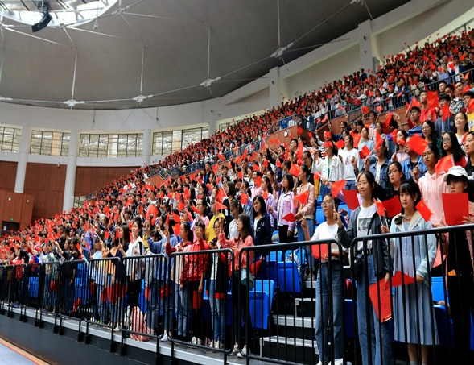
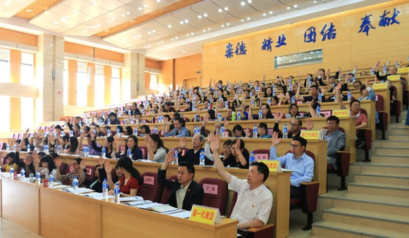
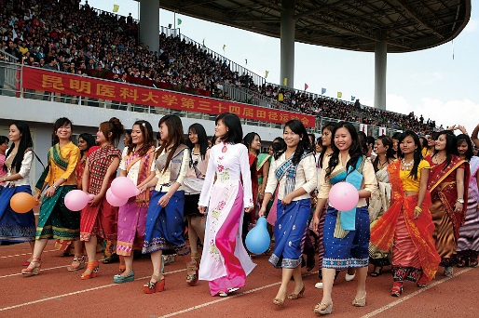
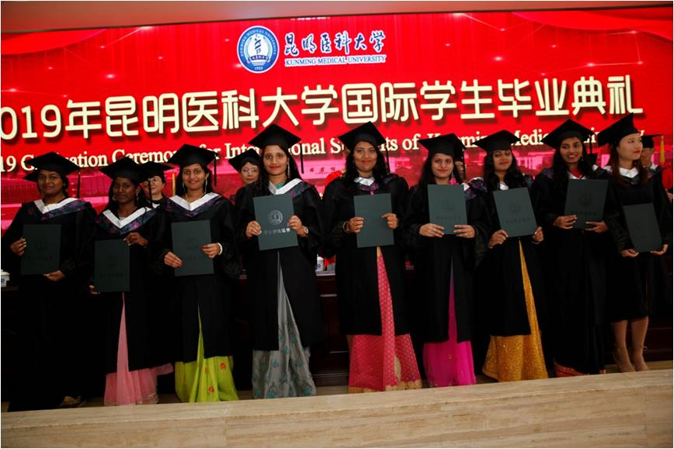
昆明医科大学 Kunming Medical University
536
doctors
4,396
postgraduates
15,268 undergraduates
and 470 international students.
There are 20,702
full-time students
KUNMING MEDICAL UNIVERSITY

Slide 6
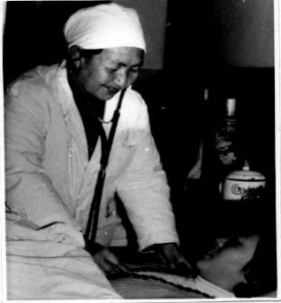
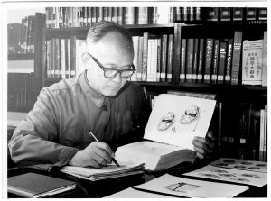
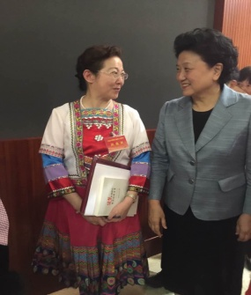
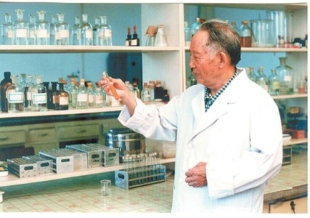
昆明医科大学 Kunming Medical University
There are 6,732 staff working in Kunming medical university, among which
1616 working in campus and 5116 working in affiliated hospitals.
无语良师
——李秉权教授
悬壶济世，大葬于心
——胡素秋教授
云南省首届“兴滇人才奖”专
业技术奖获得者——蓝瑚教授
全国教书育人十大楷模
——何黎教授
KUNMING MEDICAL UNIVERSITY

Slide 7
昆明医科大学 Kunming Medical University
TOP 1%
ESI
生物学与生物化学
临床医学
药理学与毒理学
神经科学与行为
Clinical
Medicine
Pharmacology & Toxicology
Neuroscience
& Behaviour
Biology &
Biochemistry
KUNMING MEDICAL UNIVERSITY

Slide 8
昆明医科大学 Kunming Medical University
•First batch to enroll MBBS
•Ranked in 1% of global ESI
•Passed the quality certification
of overseas students’ education
•Passed the professional certification
• Professionalism
• Knowledge
• Clinical Practice
MBBS
Acedemic Year | Teaching | Test | Clinical Practice | Vocation | Total
1 | 31 | 3 | —— | 12 | 46
2 | 36 | 4 | —— | 12 | 52
3 | 36 | 4 | —— | 12 | 52
4 | 36 | 4 | —— | 12 | 52
5 | 30 | 3 | 13 | 6 | 52
6 | —— | 1 | 39 | —— | 40
Total | 169 | 18 | 52 | 50 | 289
KUNMING MEDICAL UNIVERSITY

Slide 9
昆明医科大学 Kunming Medical University
Courses of MBBS
FORENSIC
MEDICINE
PATHOLOGY
SURGERY
Internal Medicine
Clinical Skills
ANATOMY
PEDIATRICS
OBSTETRICS & GYNECOLOGY
KUNMING MEDICAL UNIVERSITY

Slide 10
昆明医科大学 Kunming Medical University
Tuition Fees of Studying in KMU
Category | Tuition (Yuan/Year) | Registration Fees(Yuan/Year) | Note
Undergraduate Program(Chinese-medium) | 24,000 | 500 | ——
Undergraduate Program(English-medium) | 35,000 | 500 | ——
Master Program | 40,000 | 500 | ——
Doctoral Program | 45,000 | 500 | ——
Medical Scholars | 23,000 | 500 | ——
Chinese Language Study Scholars | 12,000 | 300 | ——
KUNMING MEDICAL UNIVERSITY

Slide 11
昆明医科大学 Kunming Medical University
Other Fees of Studying in KMU
Category |  | Fees (Yuan) | Note
Accommodation | Room for two (Pengyuelou Building) | 4,000/year/person | without air conditioner
 |  | 5,000/year/person | with air conditioner
 | Room for four (Pengyuelou Building) | 3,500/year/person | without air conditioner
 | Room for four (Common dormitory) | 1,200/year/room | without air conditioner
Medical Insurance |  | 800/year | compulsory to purchase every year
Health Examination |  | About 500 each time | ——
Residence permit |  | 400 each time | ——
KUNMING MEDICAL UNIVERSITY

Slide 12
昆明医科大学 Kunming Medical University
CSC Scholarship
(Full Scholarship)
► Full-time Master & Doctoral Degree Programs in English or Chinese medium
► Full-time Bachelor’s Degree Programs in Chinese medium
PROVINCIAL
UNIVERSITY
CSC
Yunnan Provincial Scholarship
(Full Scholarship)
University Scholarship
(Part Scholarship)
► Full-time Bachelor’s, Master’s and Doctoral Degree Students
► Full-time Bachelor’s Degree Programs in Chinese medium
KUNMING MEDICAL UNIVERSITY

Slide 13
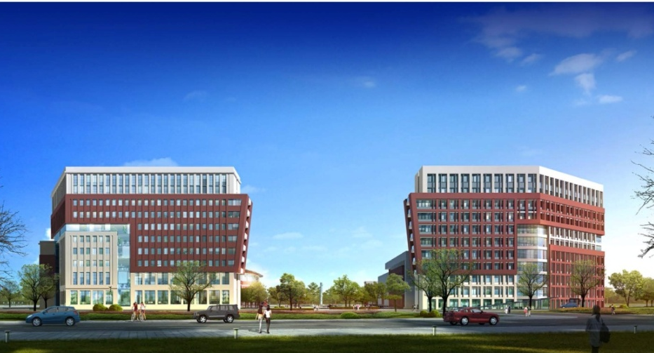
昆明医科大学 Kunming Medical University
Strengthen the construction
and renovation of the new and
old campuses, and expand the
teaching space in the later period
Improve the conditions for studying and optimize teaching resources
Accelerate the construction of green and smart campuses and improve
management services
KUNMING MEDICAL UNIVERSITY

Slide 14
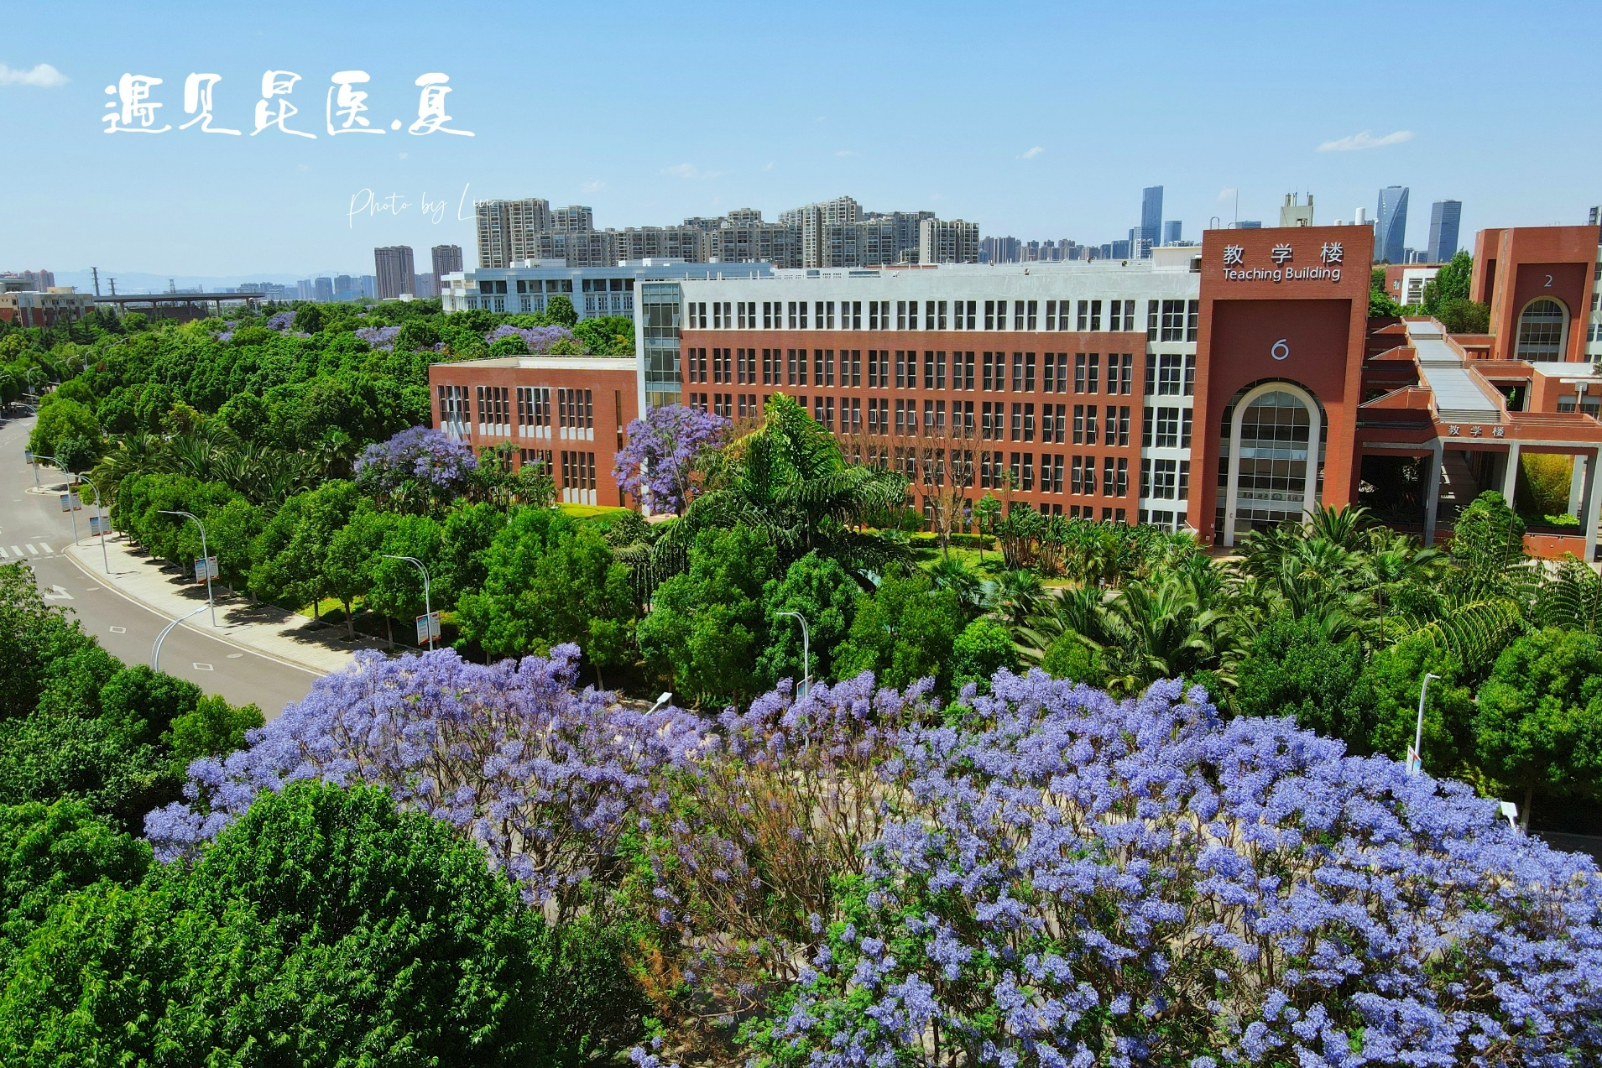
昆明医科大学 Kunming Medical University
KUNMING MEDICAL UNIVERSITY

Slide 15
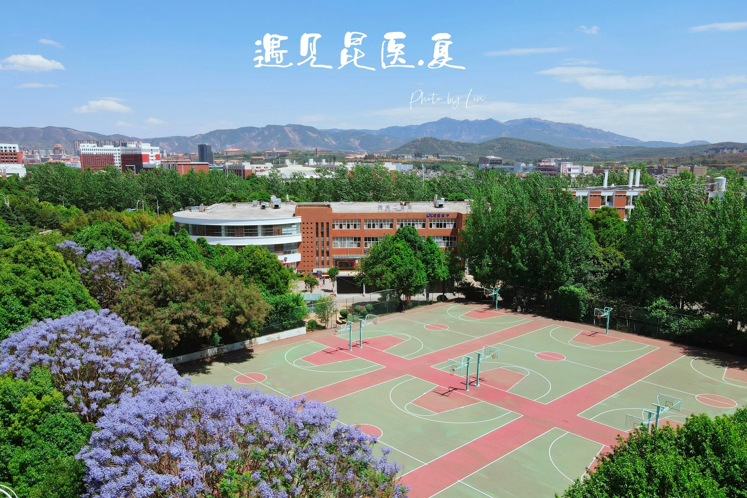
昆明医科大学 Kunming Medical University
KUNMING MEDICAL UNIVERSITY

Slide 16
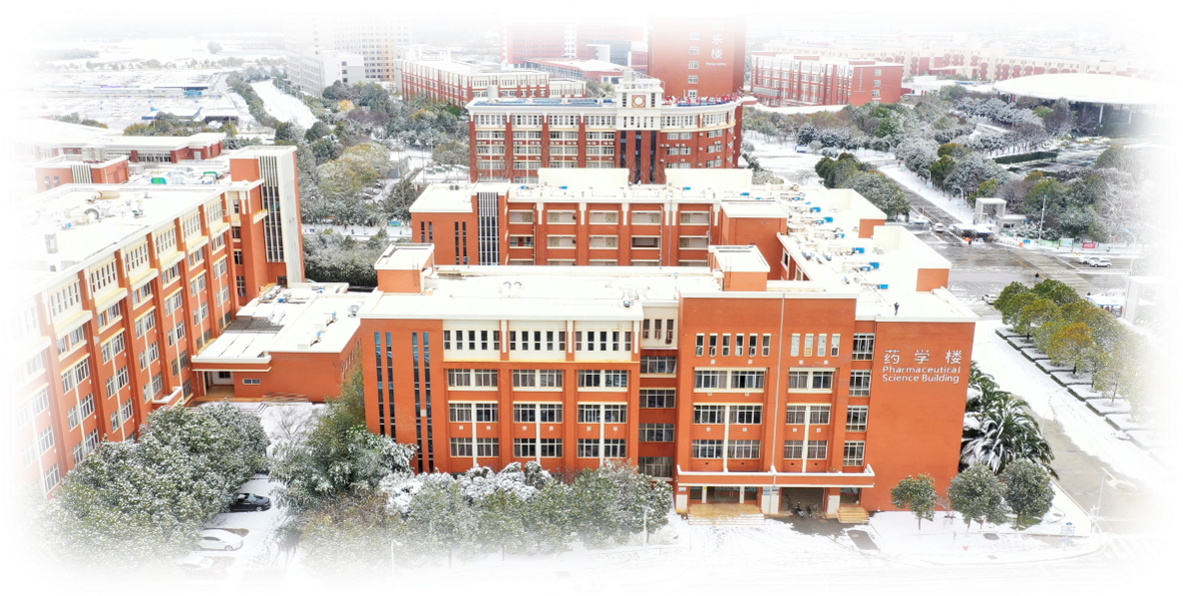
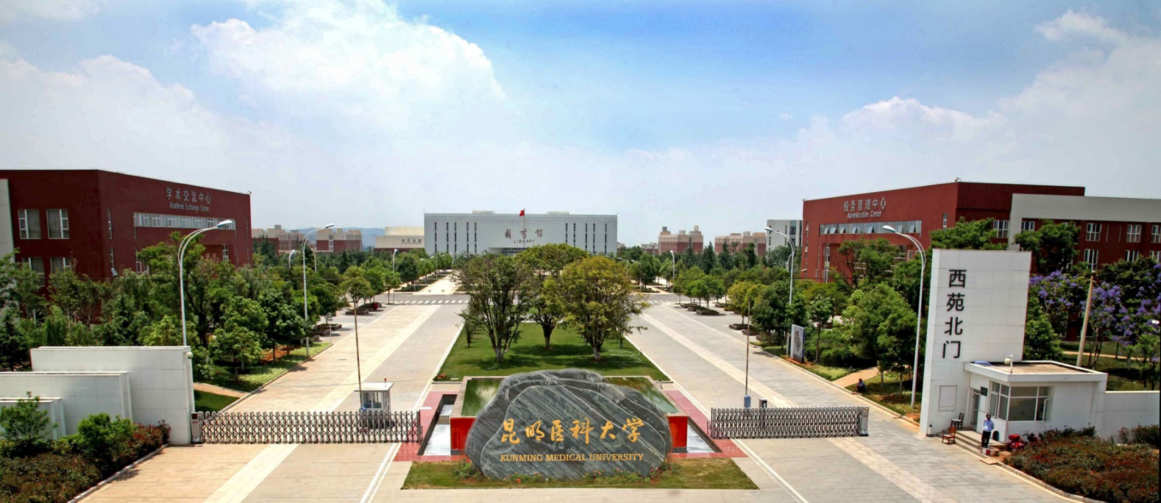
昆明医科大学 Kunming Medical University
KUNMING MEDICAL UNIVERSITY

Slide 17
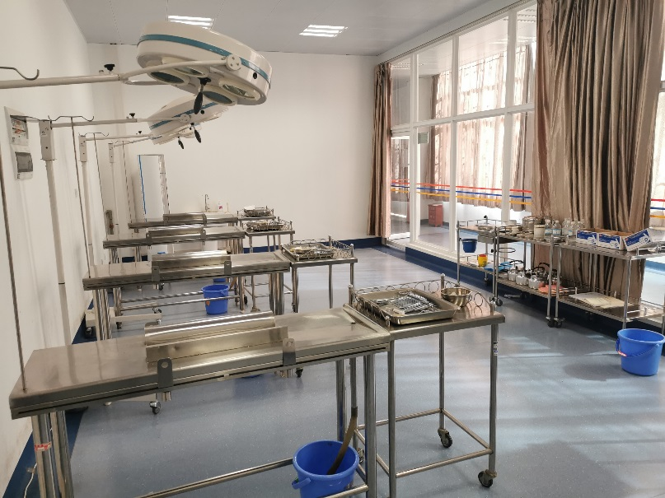
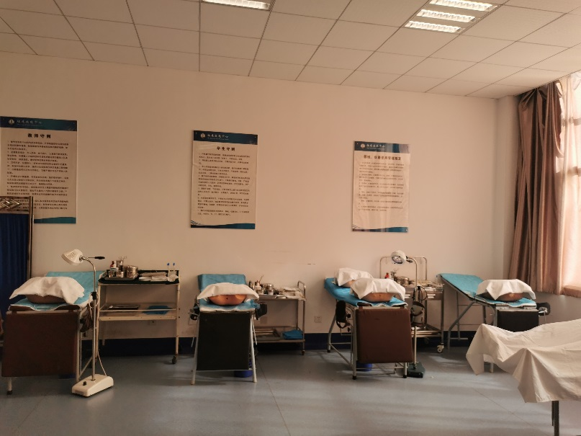
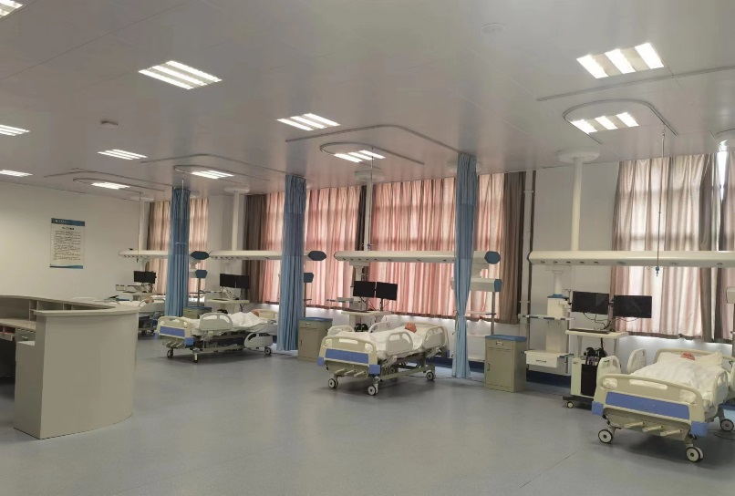
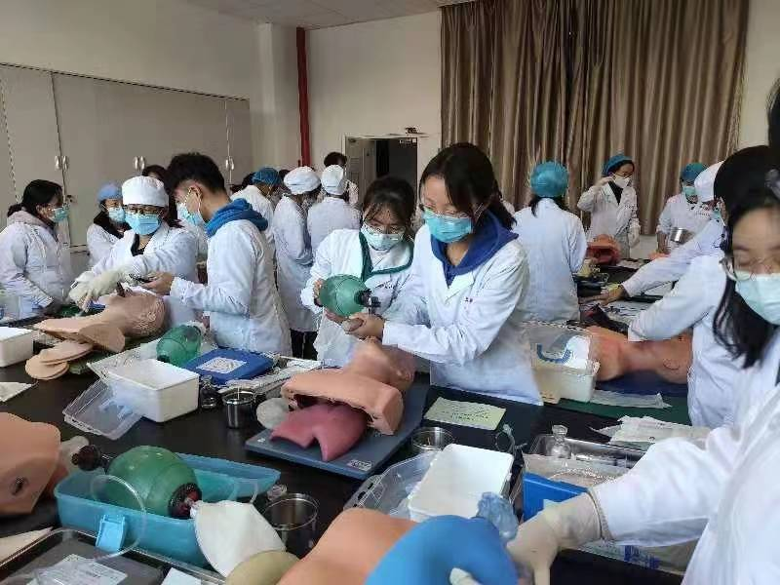
昆明医科大学 Kunming Medical University
KUNMING MEDICAL UNIVERSITY

Slide 18
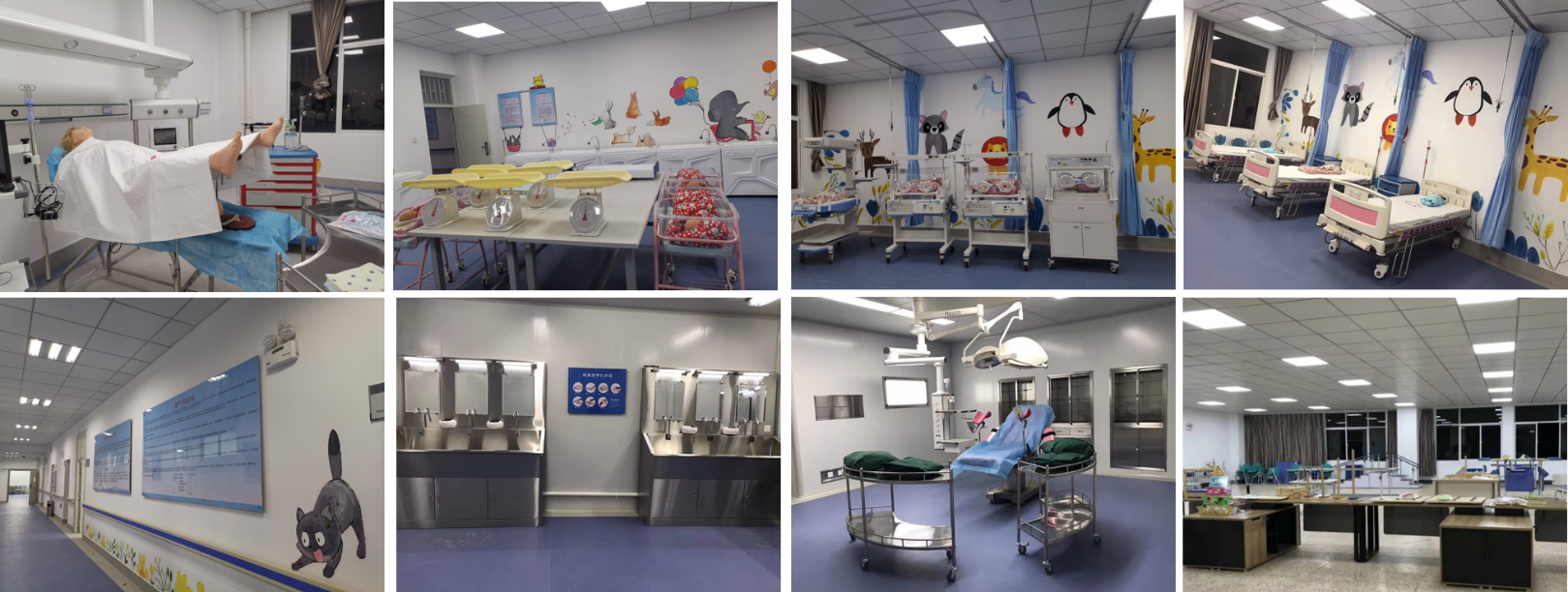
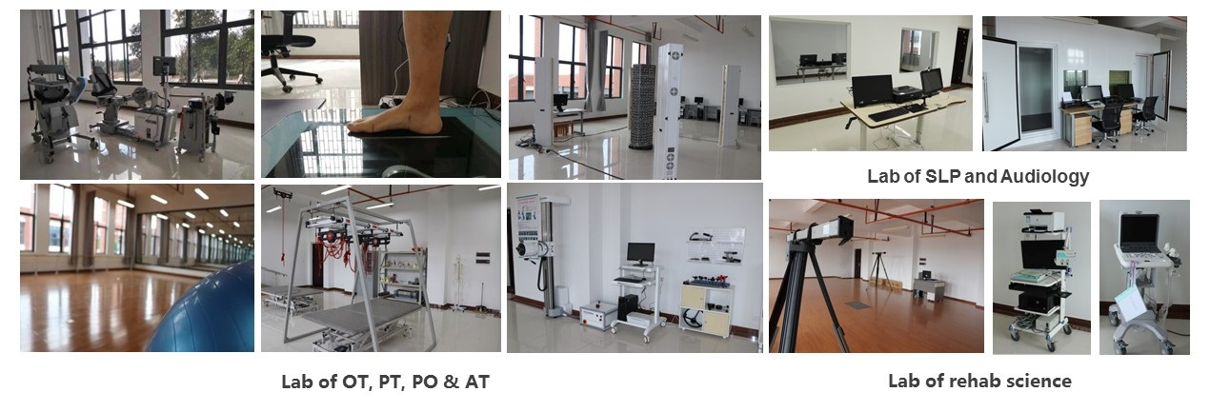
昆明医科大学 Kunming Medical University
KUNMING MEDICAL UNIVERSITY

Slide 19
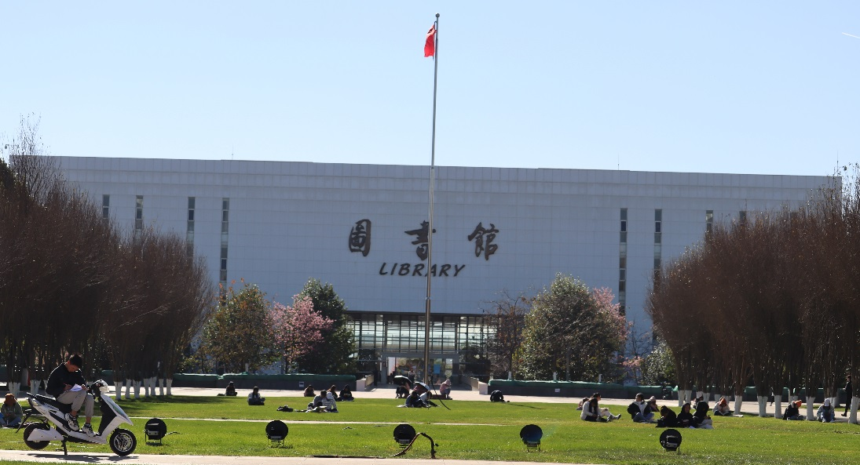
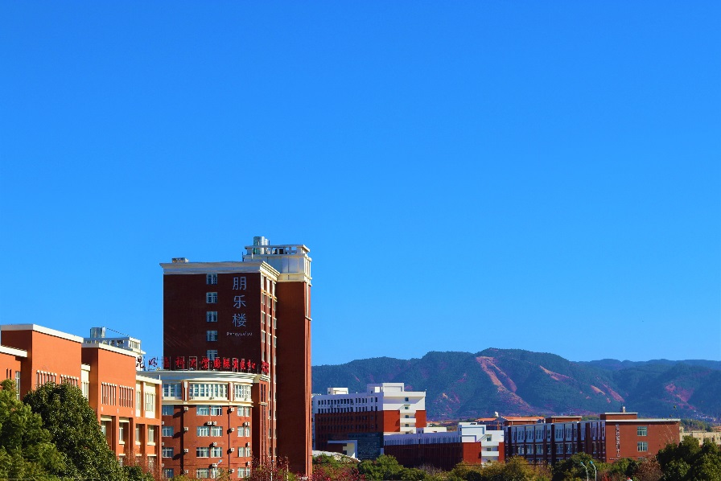
昆明医科大学 Kunming Medical University
Library is in the middle of the campus, it is the landmark of the university
Pengyuelou Building is the dormitory for international students, it is the highest building in the campus
KUNMING MEDICAL UNIVERSITY

Slide 20
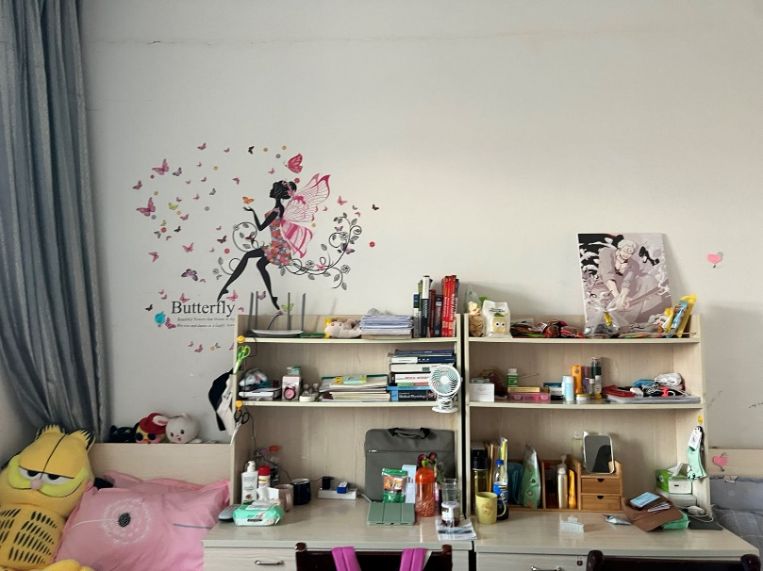
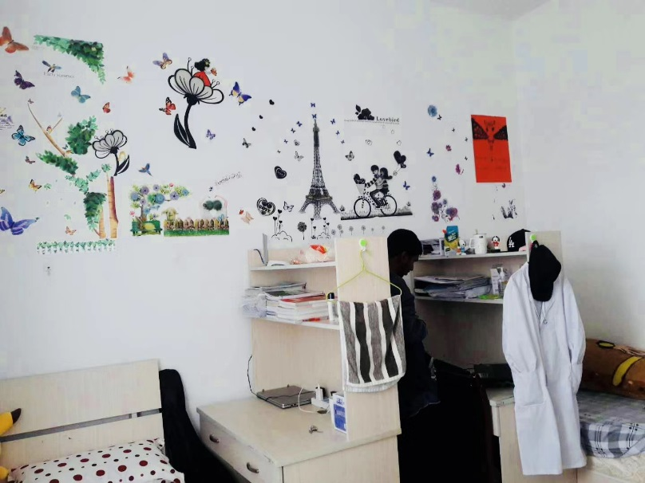
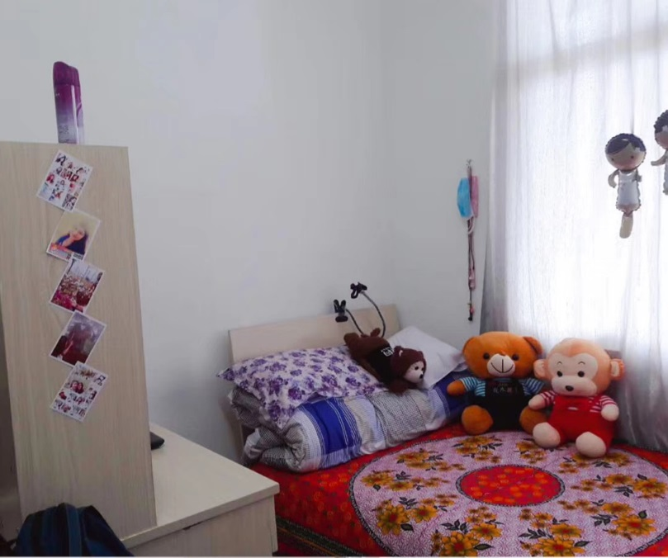
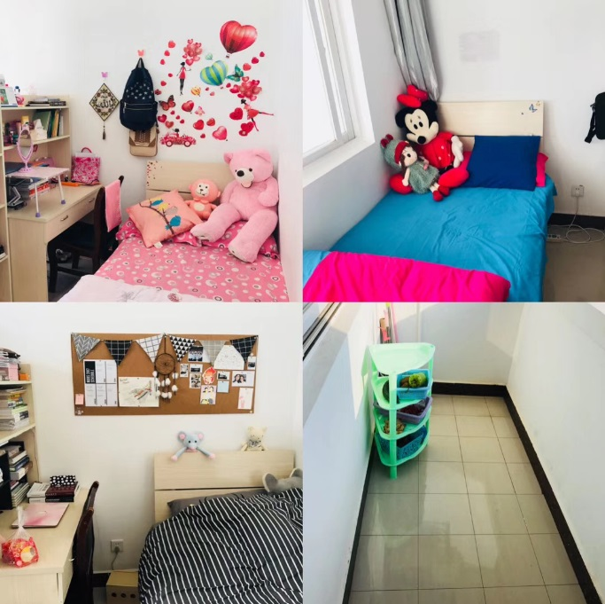
昆明医科大学 Kunming Medical University
KUNMING MEDICAL UNIVERSITY

Slide 21
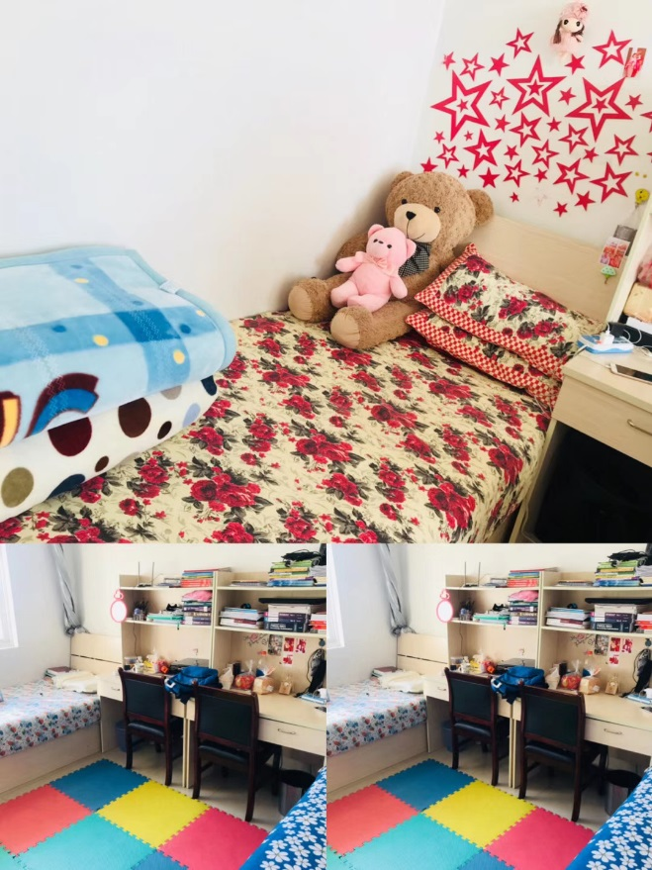
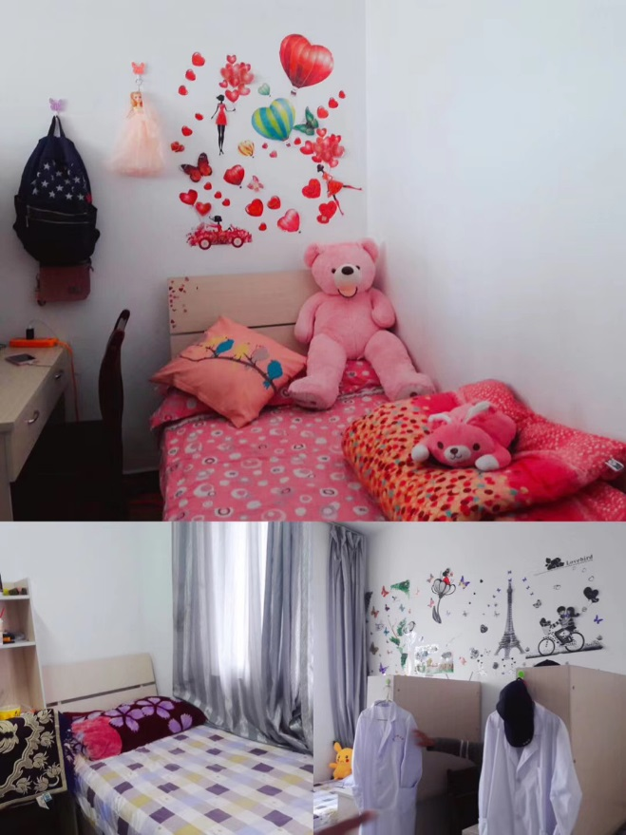
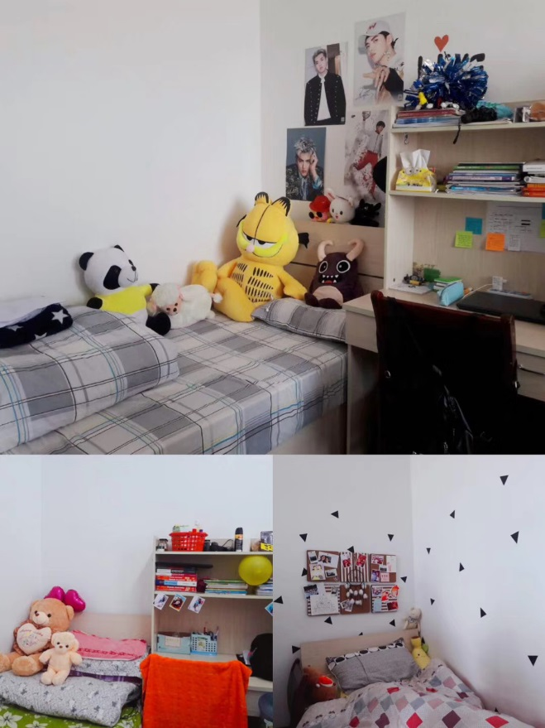
昆明医科大学 Kunming Medical University
KUNMING MEDICAL UNIVERSITY

Slide 22
昆明医科大学 Kunming Medical University
KUNMING MEDICAL UNIVERSITY

Slide 23
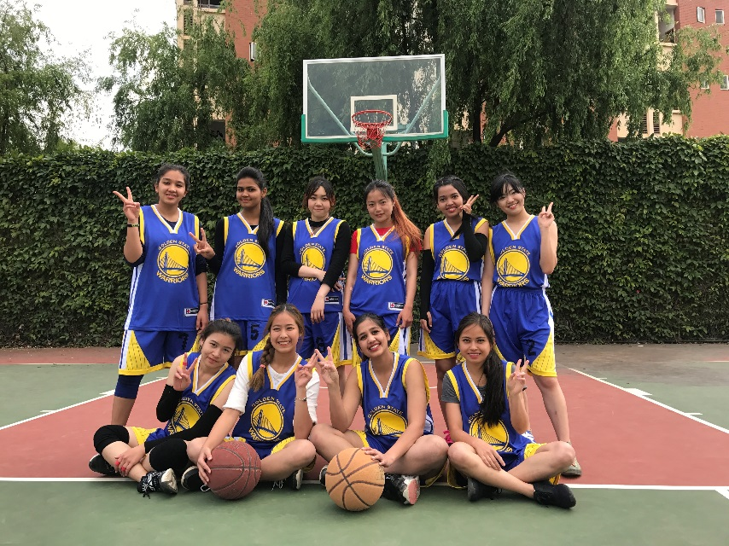
昆明医科大学 Kunming Medical University
KUNMING MEDICAL UNIVERSITY

Slide 24
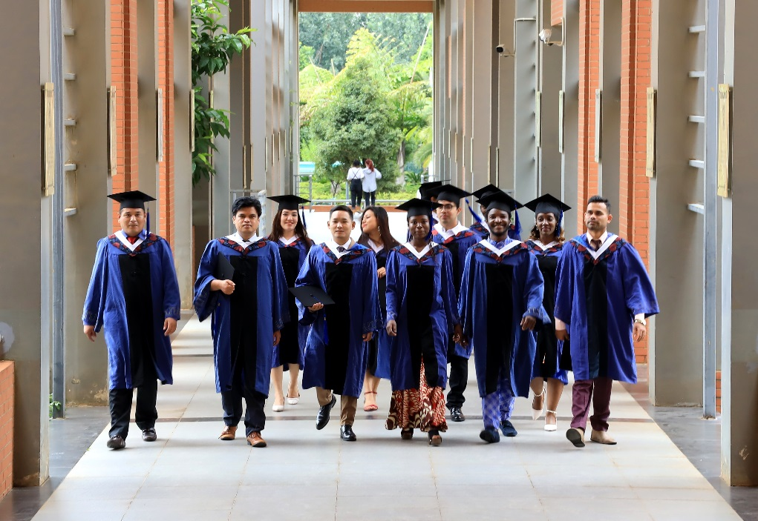
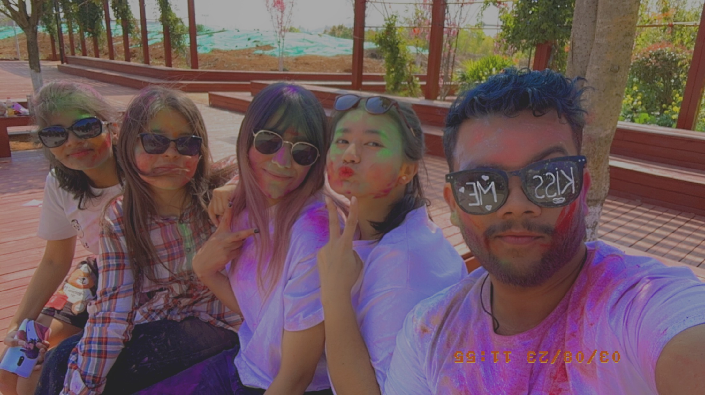
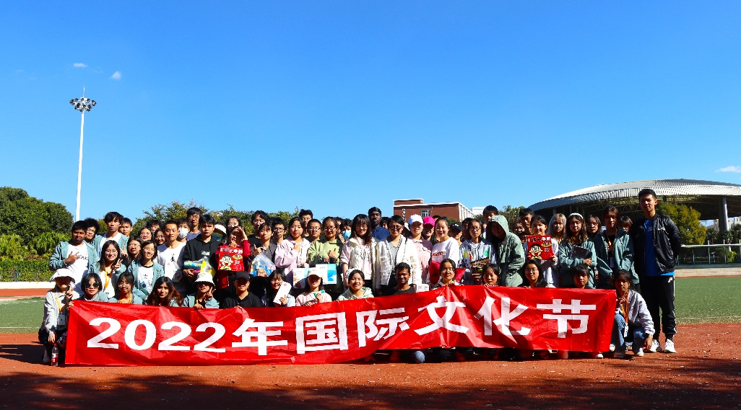
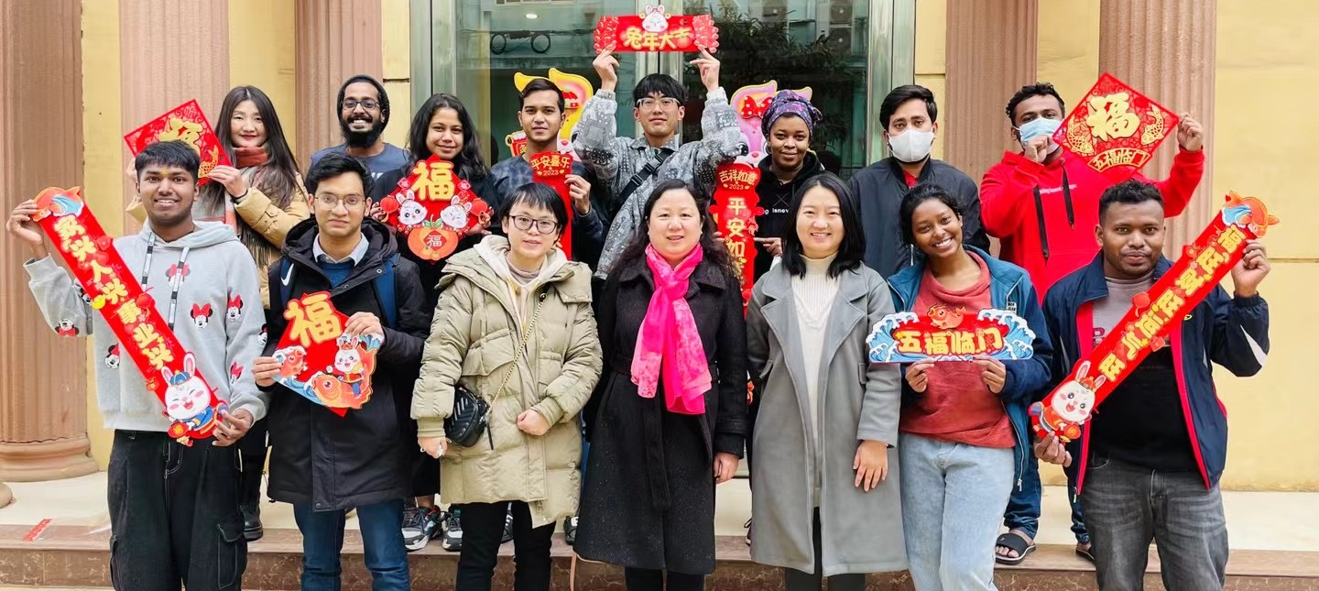
昆明医科大学 Kunming Medical University
KUNMING MEDICAL UNIVERSITY

Slide 25
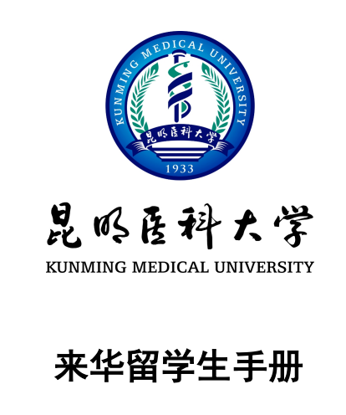
昆明医科大学 Kunming Medical University
Handbook for International Student
All students shall be abided by the university regulations as well as Chinese laws
KUNMING MEDICAL UNIVERSITY

Slide 26
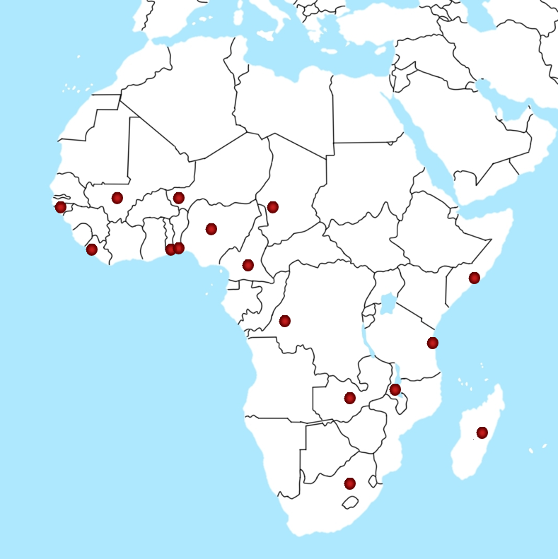
昆明医科大学 Kunming Medical University
27 students come from 16 countries of Africa
Benin, Chad, Liberia, Nigeria, Mali, Tanzania, Togo, Zambia, and so on
Covers bachelor’s, Master’s
and Doctor’s degree
KUNMING MEDICAL UNIVERSITY

Slide 27
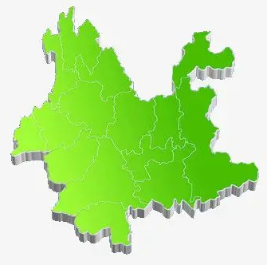
昆明医科大学 Kunming Medical University
4 directly affiliated hospitals
1
2
11 non-directly affiliated hospitals
17 teaching hospitals
3
42 practice hospitals
4
15 practice teaching community bases
5
76 practice teaching bases for certain programs
6
Well developed hospital networks
KUNMING MEDICAL UNIVERSITY

Slide 28
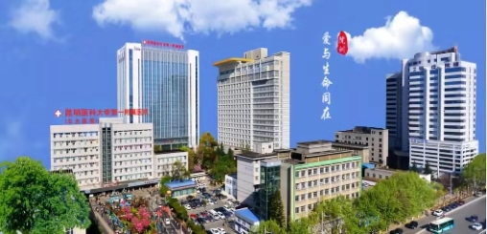
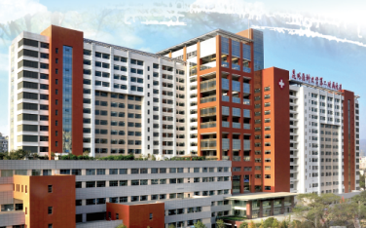
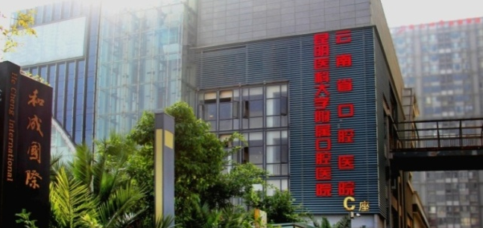
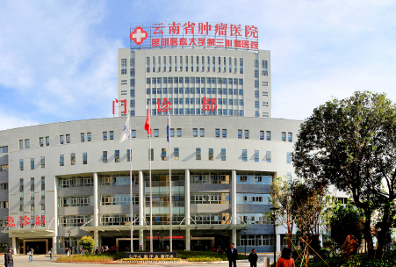
昆明医科大学 Kunming Medical University
First Affiliated Hospital, Ranking No.41 domestic
1st
DIRECT
AFFILIATED
HOSPITALS
Affiliated Stomatology Hospital and School of Stomatology
Second Affiliated
Hospital, Ranking No. 89 domestic
4th
2nd
3rd
Third Affiliated Hospital, Ranking No.15 among
oncologic domestic
KUNMING MEDICAL UNIVERSITY

Slide 29
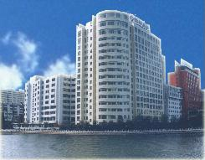
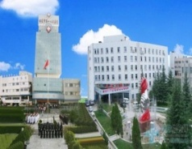
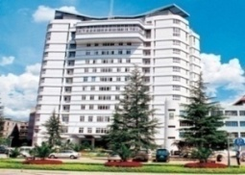
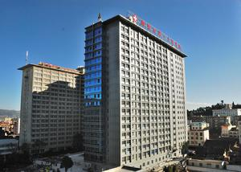
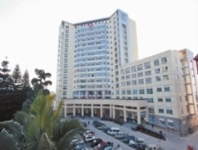
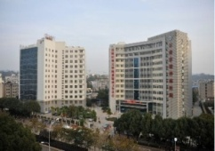
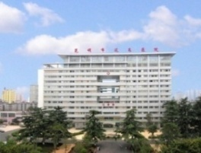
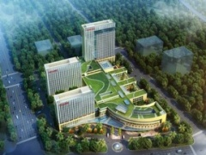
昆明医科大学 Kunming Medical University
All affiliated hospitals are Grade-A Tertiary Hospitals
Fifth Affiliated Hospital
Affiliated Zhaotong
Hospital
Sixth Affiliated Hospital
Affiliated Dehong
Hospital
Affiliated Qujing
Hospital
Affiliated Psychiatric
Hospital
Affiliated Yan An
Hospital
Affiliated Fuwai
Cardiovascular Hospital
Affiliated Calmette
Hospital
Affiliated Honghe
Hospital
Affiliated Children’s
Hospital
KUNMING MEDICAL UNIVERSITY

Slide 30
昆明医科大学 Kunming Medical University
1
More than 400 full-time international graduates
2
More than 100,000 full-time graduates
3
More than 100,000 part-time graduates
KUNMING MEDICAL UNIVERSITY

Slide 31
昆明医科大学 Kunming Medical University
TO THE FUTURE
育人是大学之本
Talent cultivation is foundation of higher education
质量是高等教育之“生命线”
Quality is core of higher education
高质量是高等教育发展的必由之路
High-quality is essential way for higher education development
KUNMING MEDICAL UNIVERSITY

Slide 32
昆明医科大学 Kunming Medical University
HOW TO APPLY
Chinese Government Scholarship http://www.campuschina.org
The Other Programs http://study.kmmc.cn or https://kmmc.17gz.org
KUNMING MEDICAL UNIVERSITY

Slide 33
昆明医科大学 Kunming Medical University
OFFICIAL WEBSITE
http://www.kmmc.cn
Address: 1168 West Chunrong Road, Chenggong District,
Kunming, 650500, Yunnan, P.R. China.
Email: application_for_admission@kmmu.edu.cn
Tel : +86-871-65932610
Fax: +86-871-65932610
Staff: Mr. LI, Ms. Zhang
KUNMING MEDICAL UNIVERSITY

