Slide 1
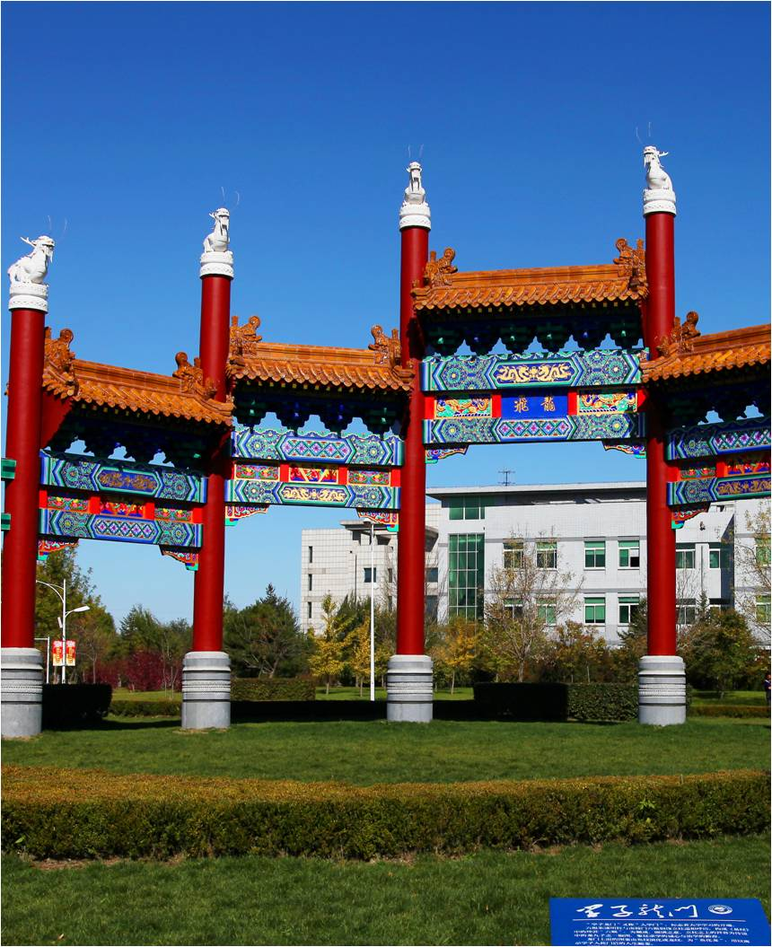
STUDY in SYUCT
学在化大
Lecturer 主讲人
Host 主办
Yang Bo
杨博
International Education School
国际教育学院

Slide 2
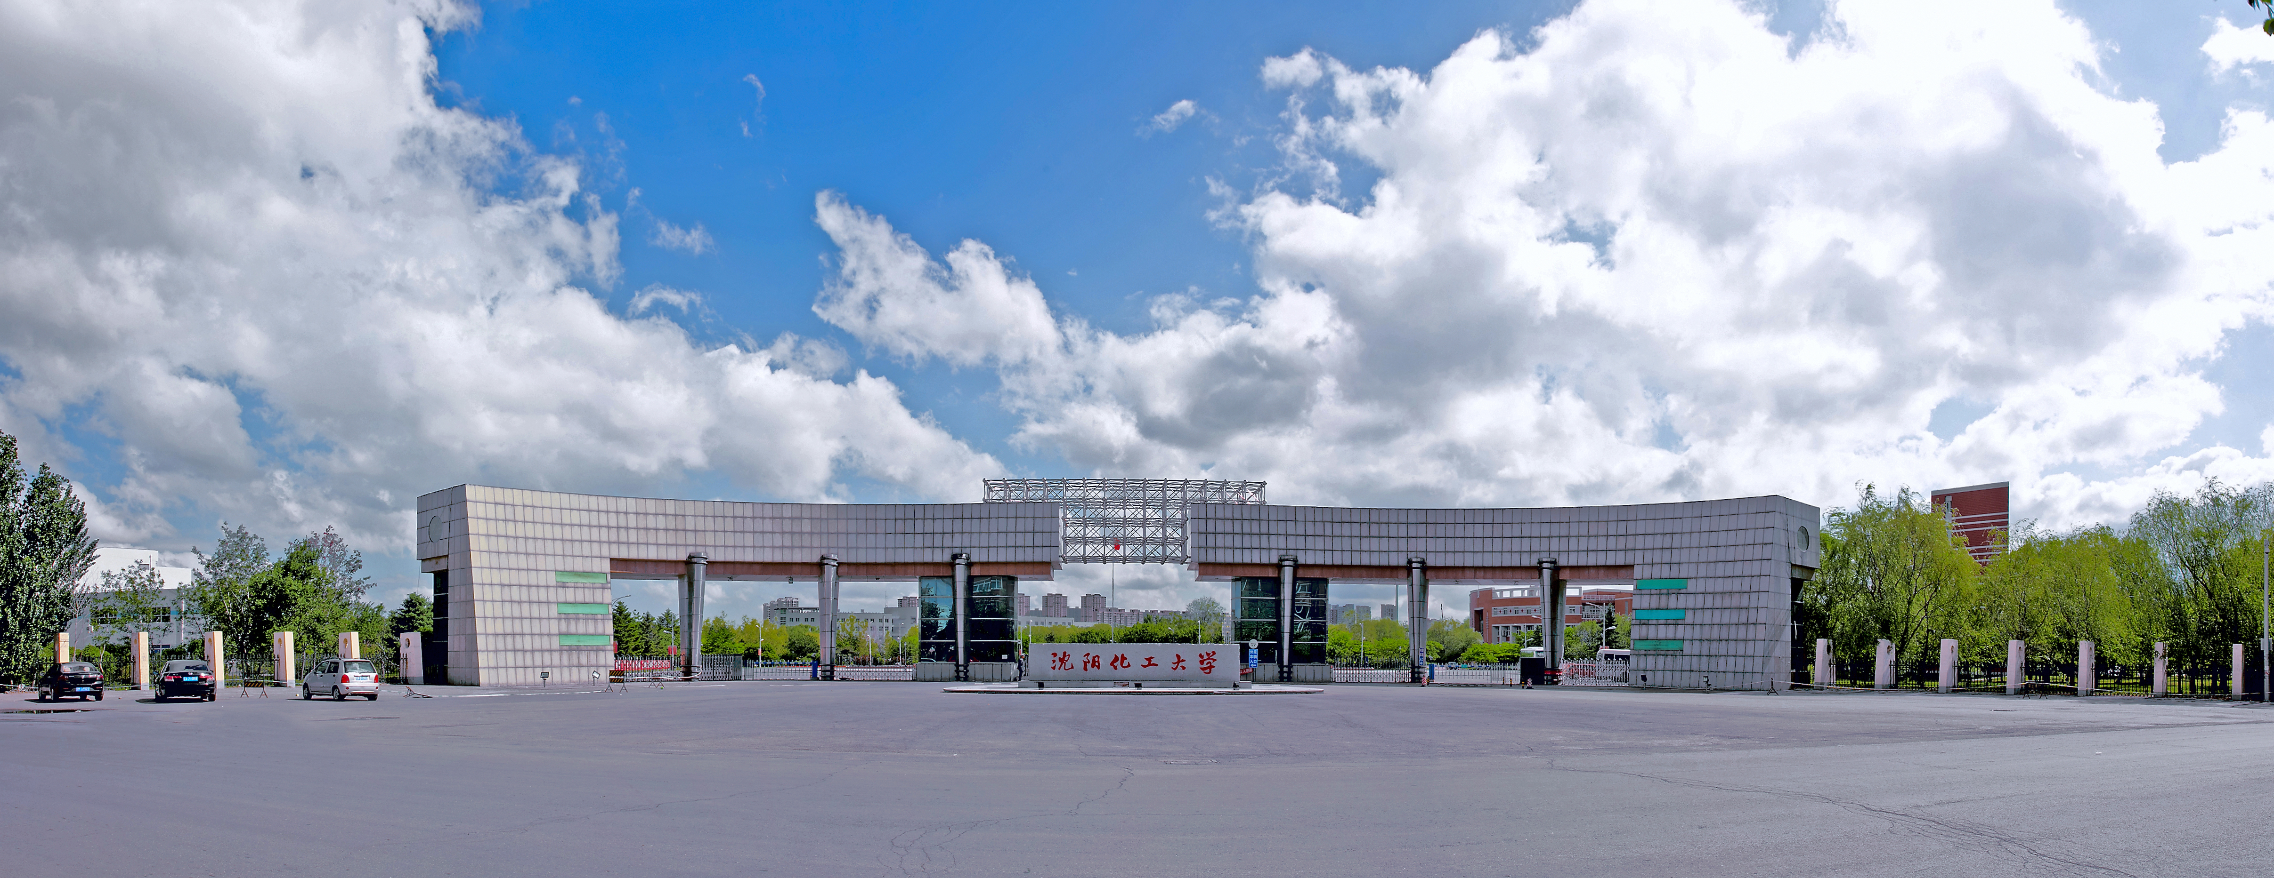
Shenyang University of Chemical Technology
University Website:
http://www.syuct.edu.cn/gjjy/
Online Application Website: http://admission.syuct.edu.cn

Slide 3
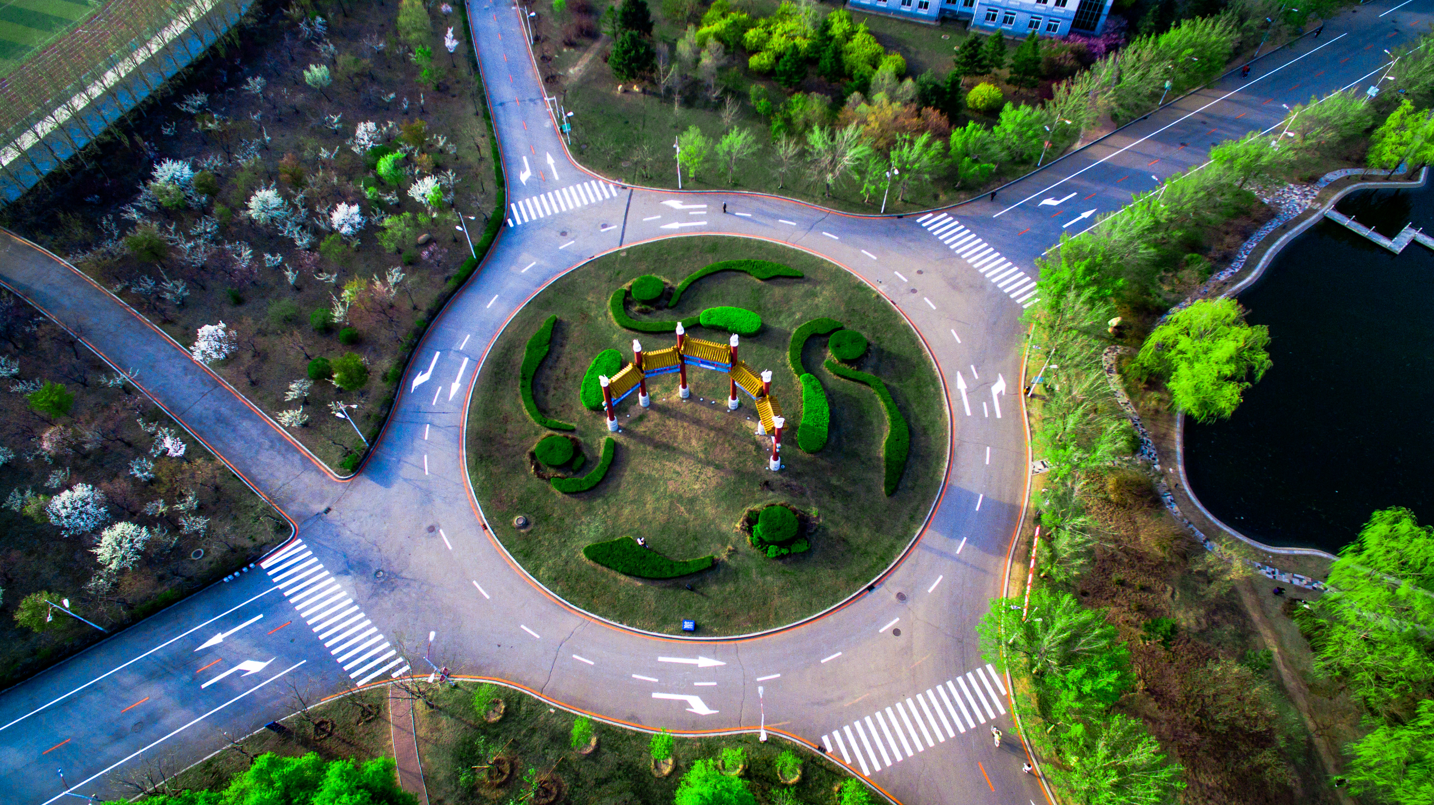
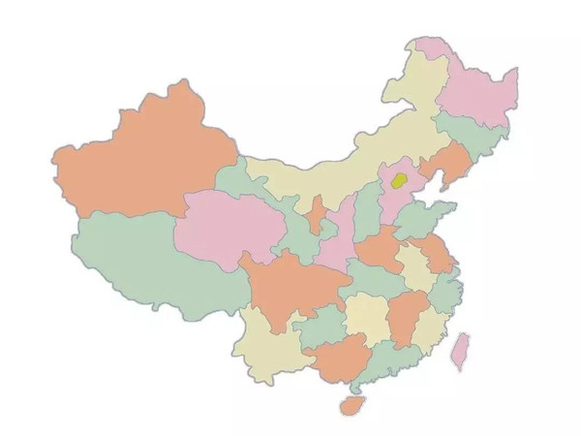
About SYUCT
SYUCT is located in the Shenyang Economic and Technology Development Zone. The campus covers an area of almost 250 acres, with a building area of more than 500,000 square meters. It is a blend of academics, gardens and art, and is known as one of the most beautiful campuses in Liaoning Province.

Slide 4
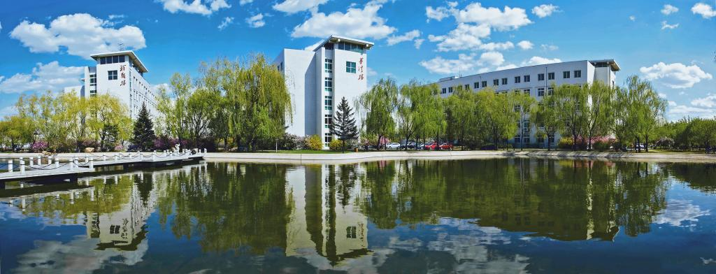
Campus Scene of SYUCT
Spring Season
Autumn Season
Summer Season

Slide 5
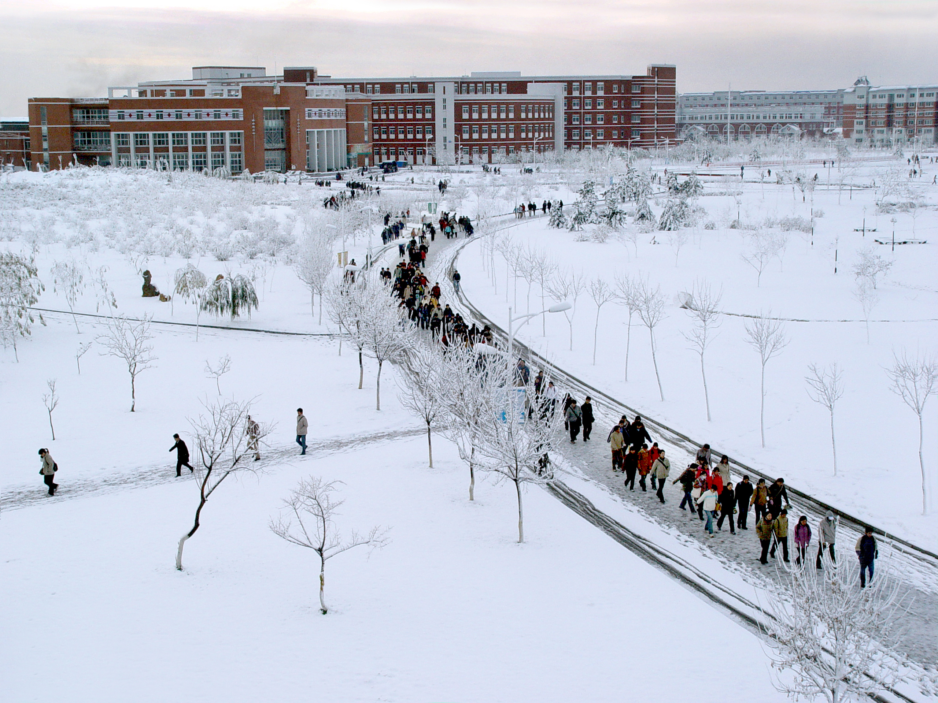
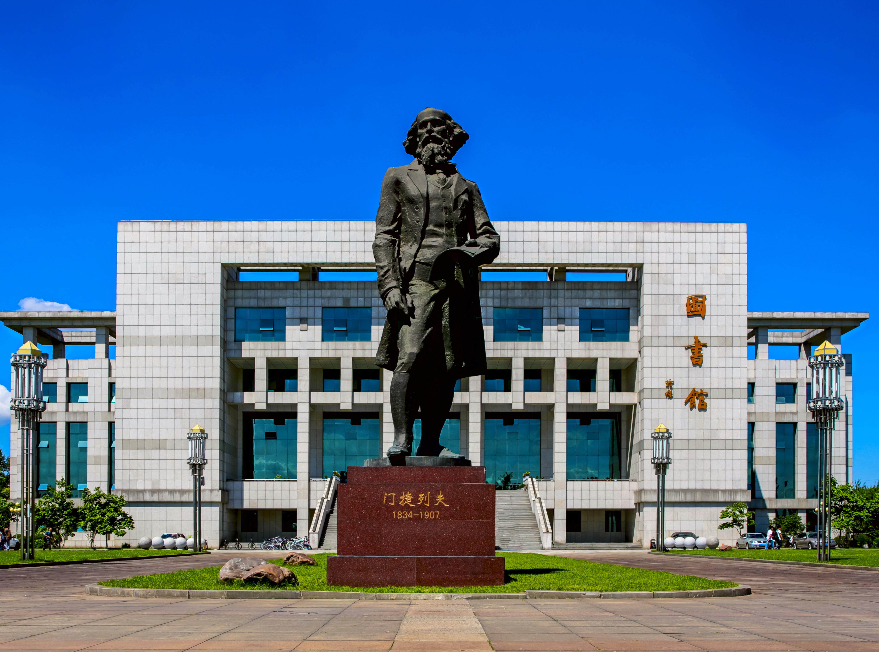
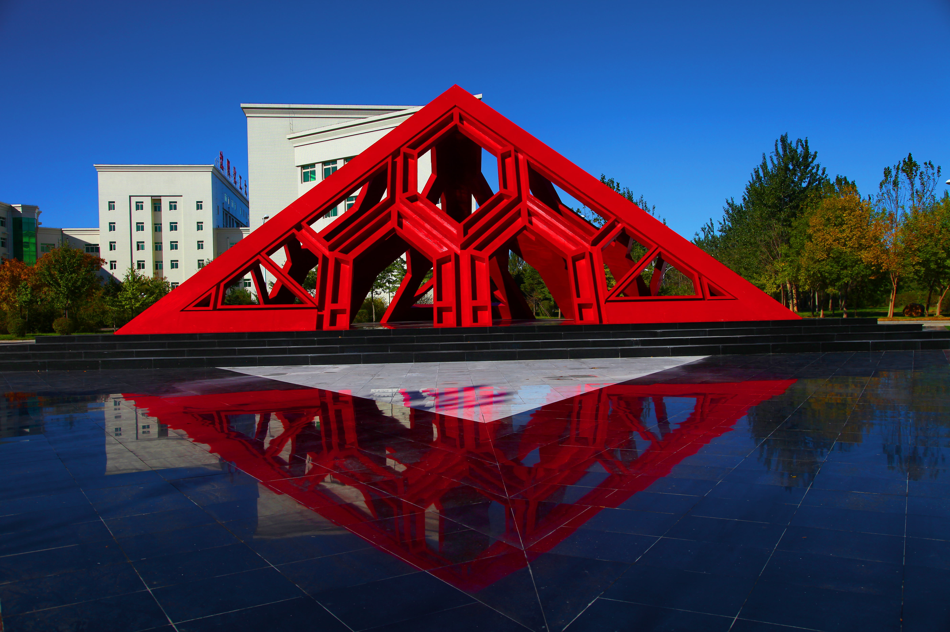
Campus Scene of SYUCT
Winter Season
Library Building
Pyramid Gate

Slide 6
Shenyang University of Chemical Technology (SYUCT) traces its origins to the year 1952. After more than sixty years’
construction and development, SYUCT has become an engineering-oriented institution of higher education.
Featuring Chemical Engineering, it has a combination of disciplines of engineering, science, management, economics, humanities, law, medicine etc.
SYUCT is the key construction university of “Double First-class University” (first-class university, first-class discipline) in Liaoning Province, and the national key construction university of “Basic Capacity Building Project in Central and Western Universities” (minor “211 Project”)

Slide 7
18,000
Full-time students
Undergraduates
Graduates
International Students
1,100
Faculty and staff members
5 Top National Scientists,
1 National Prominent Educator,
4 National Excellent Teachers,
15 National Outstanding Experts
25
Colleges and Departments
1 Top Scientist,
6 Outstanding Experts in Liaoning Province
17 Liaoning Province Prominent Educators

Slide 8
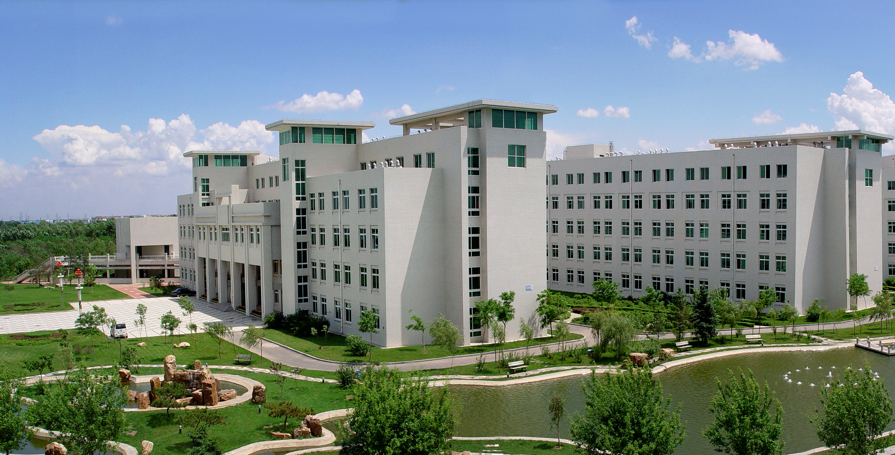
SYUCT currently offers
61 undergraduate programs,
14 master programs of first-level disciplines and are qualified for jointly-cultivation PhD. students in multiple disciplines. Chemical Engineering and Technology was selected as the “Double First-Class Disciplines” in Liaoning Province.
16 programs were selected as the national first-class programs.

Slide 9
International Education
400 international students from 30 countries
2019
International Education School Founded
2006
First Batch of Degree Students
1995
First Batch of International Students
1953

Slide 10
Undergraduate Programs
College | Specialty | Duration (Year) | Instruction Language | Tuition Fees (Yuan/Year) | Dormitory Fees (Yuan/Year/ Double Room)
College of Chemical Engineering | Chemical Engineering and Technology | 4 | Chinese/English | 14,000/16,000 | 4,000
College of Information Engineering | Electrical Engineering and Automation | 4 | Chinese/English | 14,000/16,000 | 4,000
College of Pharmaceutical and Biological Engineering | Pharmaceutical Engineering | 4 | Chinese/English | 14,000/16,000 | 4,000
College of Computer Science and Technology | Computer Science and Technology | 4 | Chinese/English | 14,000/16,000 | 4,000
College of Economics and Management | International Economics and Trade | 4 | Chinese/English | 14,000/16,000 | 4,000
NOTE: The above programs can only be offered after the enrollment has been reached.

Slide 11
Graduate Programs
College | Specialty | Duration (Year) | Instruction Language | Tuition Fees (Yuan/Year) | Dormitory Fees (Yuan/Year/ Double Room)
College of Chemical Engineering | Chemical Engineering | 3 | Chinese/English | 18,000/20,000 | 4,000
College of Information Engineering | Control Science and Engineering | 3 | Chinese/English | 18,000/20,000 | 4,000
College of Computer Science and Technology | Computer Science and Technology | 3 | Chinese/English | 18,000/20,000 | 4,000
College of Economics and Management | Applied Economics | 3 | Chinese/English | 18,000/20,000 | 4,000
 | Management Science and Engineering | 3 | Chinese/English | 18,000/20,000 | 4,000

Slide 12
Non-Degree Programs
College | Program | Program Length | Instruction Language | Tuition Fees | Dormitory Fees
School of International Education | Chinese Language | 1 semester | Chinese | 6,000 RMB | 2,000 RMB/Double Room
 | Chinese Language | 1 year | Chinese | 12,000 RMB | 4,000 RMB/Double Room

Slide 13
Non-Chinese citizen with the passport
Good physical and mental health
Basic Requirements
No criminal record
Financial ability to sponsor the expenses in China

Slide 14
Application Requirements
Age 18 years to 25 years old;
Passport valid for more than 12 months;
Highest academic qualifications and transcripts (non-English materials require a certified Chinese/English translation);
Proof of recent employment or proof of no criminal record (for applicants graduated for more than 12 months);
Physical Examination Form.
Language & Foundation Student
Undergraduate Student
Graduate Student

Slide 15
Application Requirements
Age 25 years old or younger;
Passport valid for more than 12 months;
Senior school diploma and transcripts (C/70% or above);
Language proficiency (Chinese HSK4, English TOEFL 60/ IELTS 5.0)；
Proof of recent employment or proof of no criminal record (for applicants graduated for more than 12 months);
Physical Examination Form.
Language & Foundation Student
Graduate Student
Undergraduate Student

Slide 16
Application Requirements
Age not more than 35 years old;
Passport valid for more than 12 months;
Bachelor degree and transcripts;
Proof of language proficiency;
Research Plan and 2 Recommendation Letters;
Proof of recent employment or proof of no criminal record (for applicants graduated for more than 12 months);
Physical Examination Form
Language & Foundation Student
Undergraduate Student
Graduate Student

Slide 17
Application Time
Semester Period：September to January next year
Admission Open Date：Oct.15
Admission Close Date：Jul.15 (Next Year)
September
Intake

Slide 18
SYUCT University Scholarship Types
Students Types
Period
Scholarship Details
SYUCT Partial Scholarship
Undergraduate
Tuition
RMB 12,000/ year
4 years
Accommodation
Fee waiver
Chinese + Program Scholarship
Undergraduate
Room & Board
RMB 8,400 /year
4 years
Medical Insurance
RMB 800/year

Slide 19
Basic Information
Scholarship Requirements: Senior School Transcript should be C or above
Instruction Language: English
Application Period: October 15 - July 15(Next year)
SYUCT Partial Scholarship
Chinese + Program Scholarship

Slide 20
Basic Information
Scholarship Requirements: HSK3 Score 210 or Above
Instruction Language: Chinese
Application Period: March 1, 2023 - May 15, 2023
SYUCT Partial Scholarship
Chinese + Program Scholarship

Slide 21
Chinese + Program Scholarship
Scholarship Introduction
In cooperation with the Center for Language Education and Cooperation (CLEC), Shenyang University of Chemical Technology set up the International Chinese Teachers' Scholarship for undergraduate students, recruiting
15 students in Chinese + Chemical Engineering and Technology, 15 students in Chinese + International Economics and Trade
The Bachelor of Engineering degree will be awarded upon completion of the undergraduate study program with satisfactory results.

Slide 22
Chinese + Program Scholarship
Application Requirements
Applicants should be non-Chinese citizen, in good physical and mental health and of good academic and behavioral standing. And the applicants should be aged between 18 and 25 years old on 1 September 2023.
Applicants should have a high school diploma and a minimum score of 210 on the HSK (Level 3).

Slide 23
Chinese + Program Scholarship
①
②
③
④
Login to cis.chinese.cn to register
Upload application materials
Follow the application progress and emails
Visit the International Student Service of SYUCT, register and submit application materials online
How to Apply?

Slide 24
Contact
University Website: http://www.syuct.edu.cn/gjjy/
Online Application Website: http://admission.syuct.edu.cn
Address: No. 11 Street, Economic and Technological Development Zone, Shenyang City, School of International Education, Shenyang University of Chemical Technology
Contact: Mr Yang Bo
Office Line: 0086-24-89381026
E-mail：syucties@syuct.edu.cn

Slide 25
THANK YOU FOR LISTENING!
Lecturer 主讲人
Host 主办
Yang Bo
杨博
International Education School
国际教育学院

Slide 26
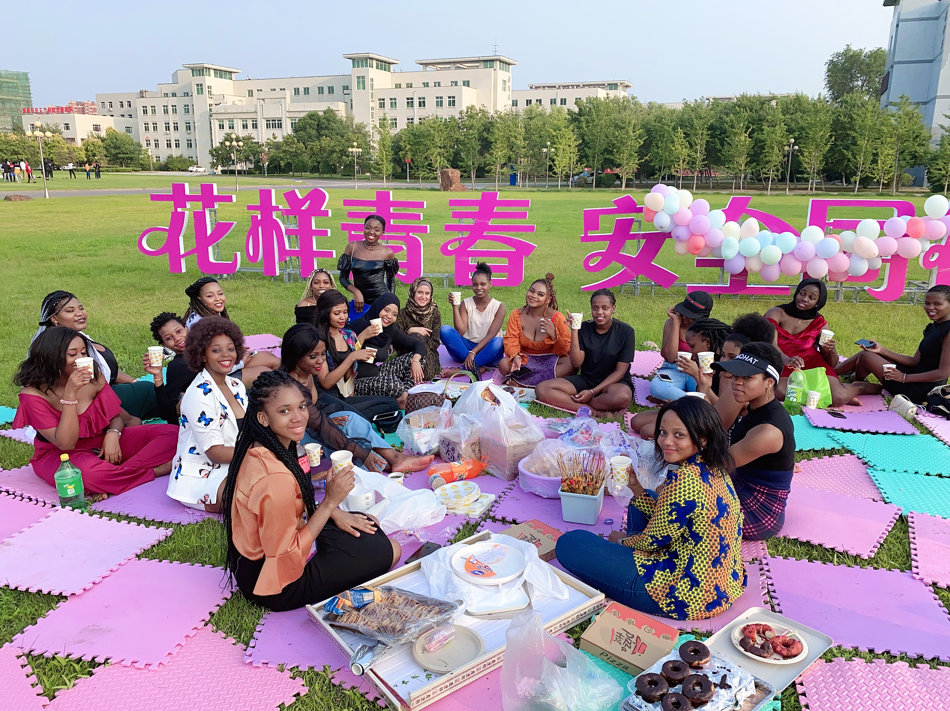
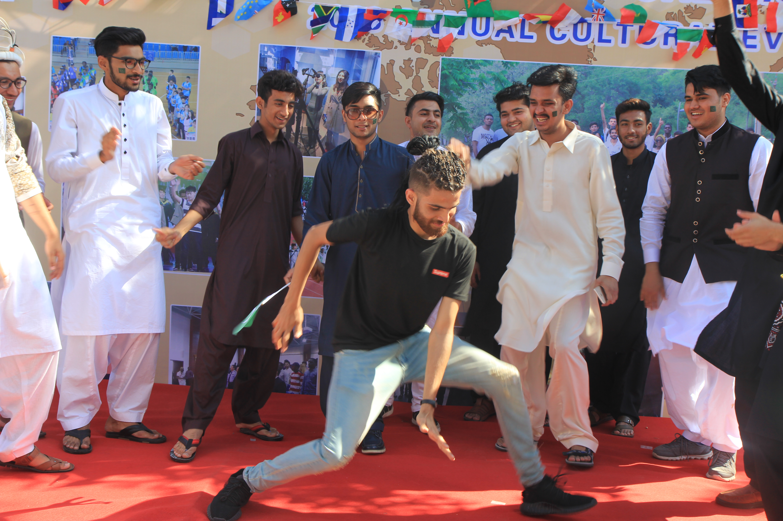
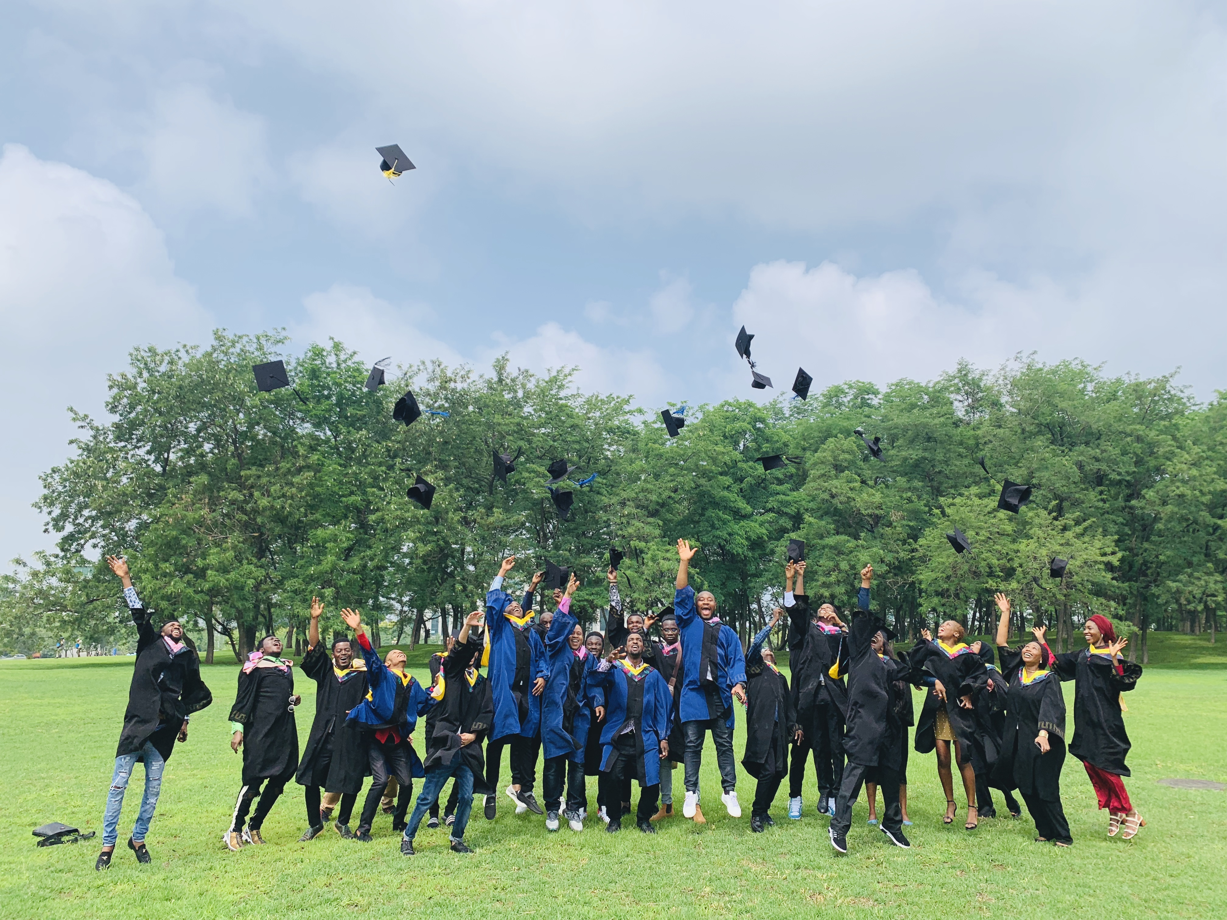
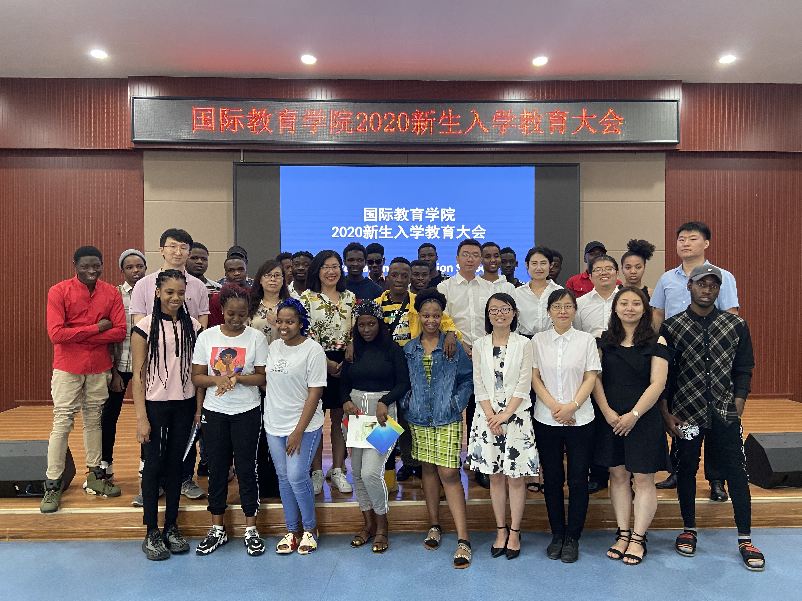
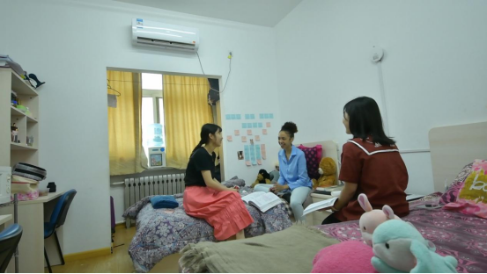
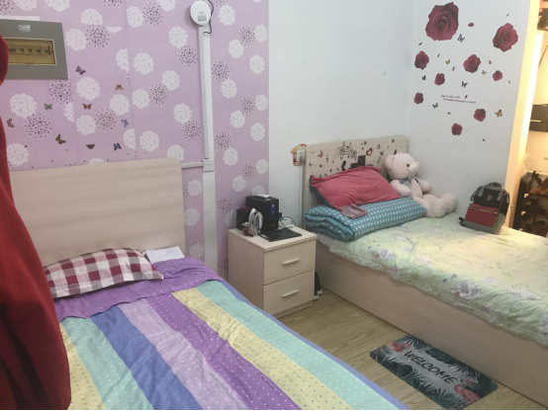
Student Life in SYUCT

Slide 27
Thank you for listening!

Slide 28
THANK YOU FOR COMING!
MC 主持人
Host 主办
Yang Bo
International Education School
国际教育学院

