Slide 1
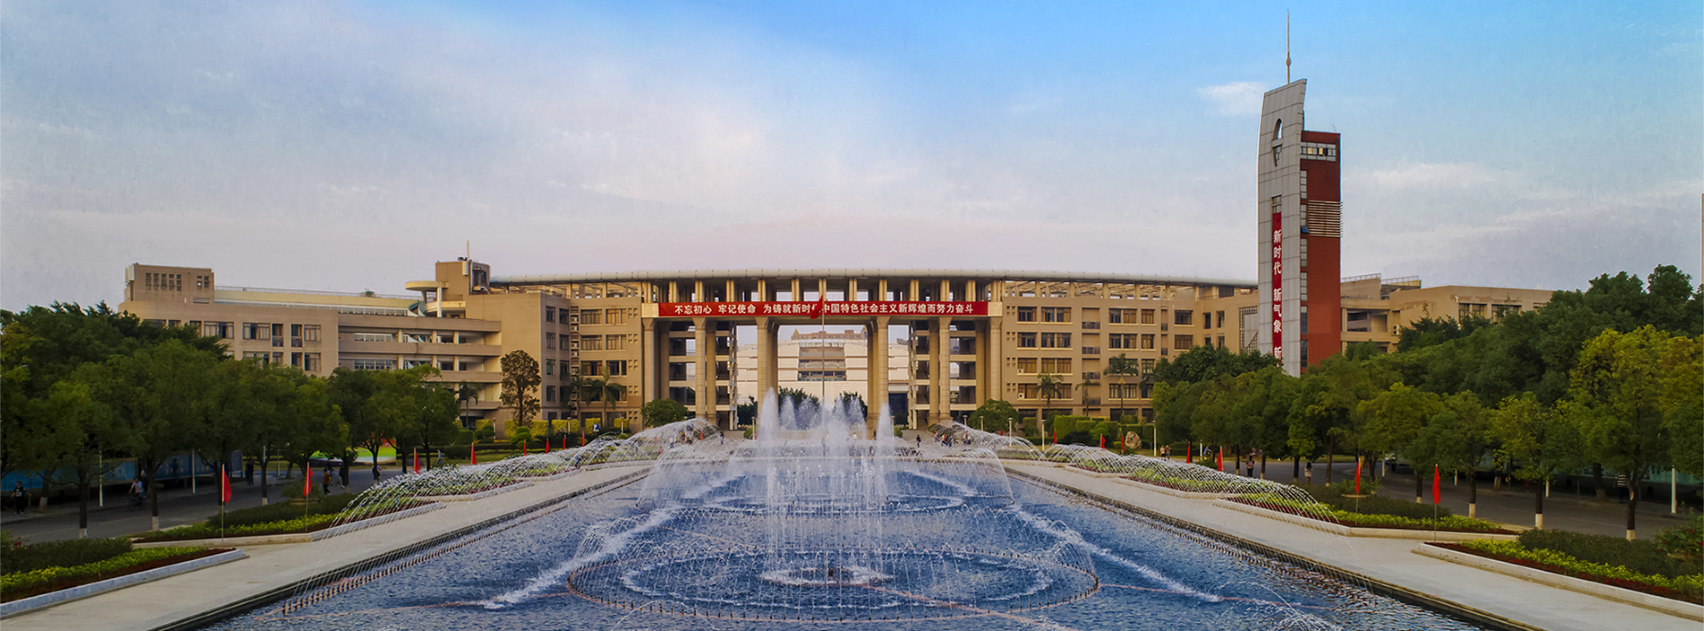
Fujian Medical University
福建医科大学
FJMU

Slide 2
CONTENTS
Part I. Introduction of FJMU
Part II. International Education
▲ Introduction of OEC
▲ Admissions & Scholarships
▲ Life in FJMU
FJMU

Slide 3
Part I. Introduction of FJMU
学校概况
√
FJMU

Slide 4
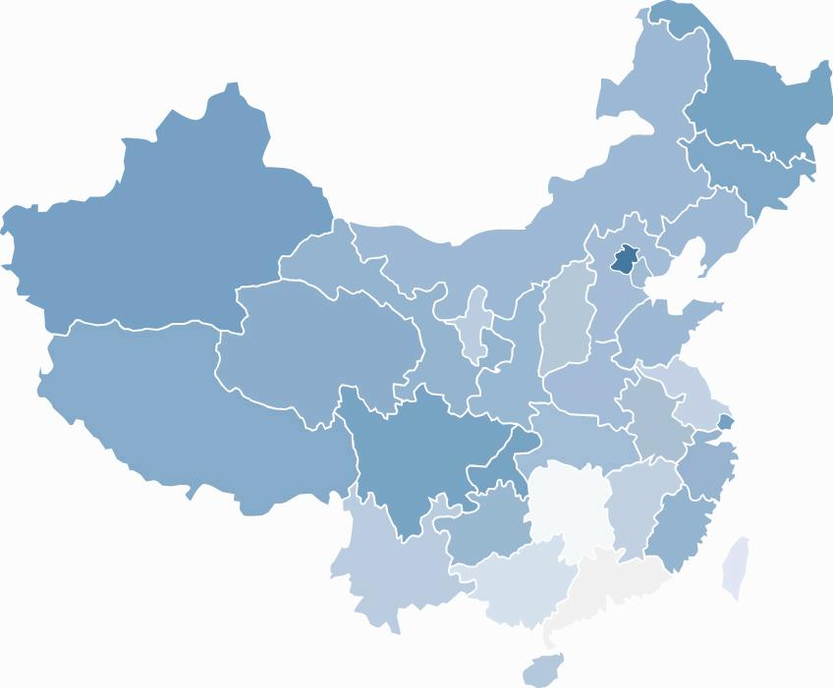
Location
Fujian Medical University (FJMU) is located in Fuzhou（福州市）, Fujian Province.
Fujian Province（福建省） lies on the southeastern coast of China, and faces Taiwan Island.位于中国东南沿海，与台湾省隔海相望
Fuzhou is the capital city of Fujian, with a history of more than 2,000 years, flaunting its modern cityscape. 福州简称“榕”，福建省省会，拥有两千年的悠久历史
Fuzhou
FJMU
Notes:
福州市，简称“榕”，别称榕城，是福建省省会，是海峡西岸经济区中心城市之一、滨江滨海生态园林城市 。地处中国华东地区、福建东部、闽江下游及沿海地区，与台湾省隔海相望，是中国东南沿海重要都市、首批对外开放的沿海开放城市、海洋经济发展示范区， [7] 海上丝绸之路门户以及中国（福建）自由贸易试验区组成部分；是近代中国最早开放的五个通商口岸之一。

Slide 5
History
Fujian Medical University Founded in 1937 成立于1937年
A comprehensive medical university with functions of Teaching, Research, Medical Treatment and Social Services集教学、科研、医疗、预防和社会服务于一体综合类医科大学
FJMU
Notes:
FJMU was founded in 1937, Through 85 years’ construction and development, it has became an integral education system offering bachelor's, master's and doctor's degree programs, integrating teaching, scientific research, medical treatment, social services.
福建医科大学创建于1937年，是我国建校较早的公立本科医学院校之一。80多年来，学校秉承“勤奋、严谨、求实、创新”的校训，砥砺“改善国民卫生的先锋，东南医药界的柱石”的初心，形成了“以人为本、求是至臻”的办学理念和“自强不息、追求卓越”的学校精神，孕育了“崇真向善、精诚致远”的校风、“厚德敬业”的教风和“博学笃行”的学风，推动学校各项事业不断向前发展。2020年，学校荣获第二届全国文明校园称号。

Slide 6
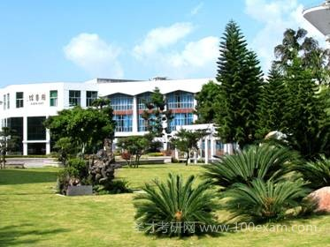
Campus
Qishan Campus 旗山校区
Wushan Campus 乌山校区
Two campuses cover an area of 893,211 m² in total.
The building area accounts for 440,317 m².
Qishan Campus is the main campus of FJMU.
FJMU
Notes:
We have 2 campuses located at Qishan and Wushan Campus respectively, OEC locates at Qishan Campus, it is the main campus of FJMU.
学校是一所以医为主，多学科协调发展，具有完整人才培养体系的福建省“双一流”建设高校，是福建省卫生人才培养中心、医学科学研究中心和医疗卫生服务中心。现有上街、台江2个校区，规划占地约1550亩。

Slide 7
Key Schools
Overseas Education College海外教育学院
School of Basic Medical Sciences 基础医学院
School of Public Health 公共卫生学院
School of Pharmacy 药学院
School of Stomatology 口腔医学院
School of Medical Technology and Engineering 医学技术与工程学院
School of Health 健康学院
School of Nursing 护理学院
School of Arts and Sciences 文理艺术学院
School of Clinical Medicine 临床医学院
School of Health Management卫生管理学院
School of Medical Imaging Science医学影像学院
FJMU
Notes:
FJMU has set up 23 schools and provides 30 majors. OEC is one of the key schools of FJMU

Slide 8
Students & Graduates
18,000+ Full-time Students在校生
High Employment Rate
320+ Overseas Students国际学生
12,300+ Undergraduates本科生
5,500+ Master & Doctoral Students
硕博研究生
Excellent in National Clinical Skills Competition for Undergraduates
High Pass Rate on Medical Licensing Examination
Cultivated Abundant Outstanding Talents for Society
FJMU
Notes:
For now, it has an enrollment of over 18,000 full-time students, of whom nearly 320 are international students, more than 5,500 are master’s program learners and doctoral programs learners currently.

Slide 9
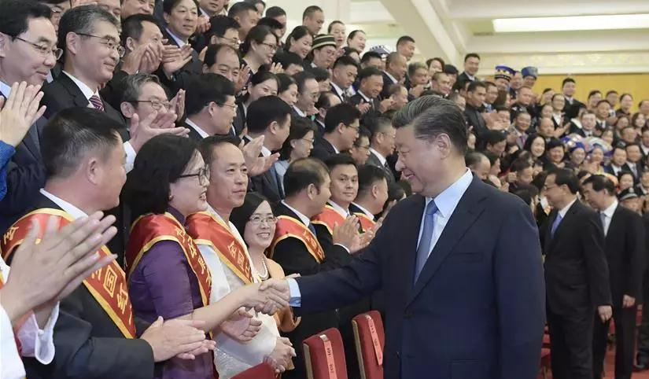
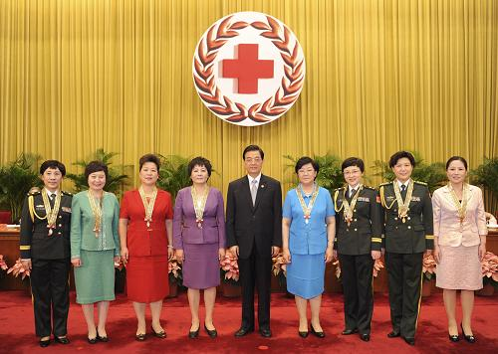
Faculty & Staff
370+ doctoral supervisors
13,000 + faculty
（affiliated hospitals included)
教职医护员工
1,700+ master supervisors
1,600+full-time teachers
专任教师
Doctoral degrees博士学位: 56%
Senior titles高级职称:
69%
FJMU
Notes:
FJMU has a faculty of over 13,000. Among 1,600 full-time teachers, those with Doctoral degrees account for 56%, senior professional title account for 69% and there are over 370 doctoral supervisors and 1776 master supervisors
1. 我校现有专任教师（含临床教师）1632人，其中具有博士学位教师占56.32%，具有高级职称教师占69.14%；
2. 现有教职医护员工13000多人（含附属医院），在校全日制学生17000多人

Slide 10
Programs
6 Doctoral Programs in Level I disciplines
博士学位一级学科
9 Master Programs in Level I disciplines
硕士学位一级学科
30 Bachelor Programs
本科专业
FJMU
Notes:
There are 6 doctor programs in Level I academic disciplines, 9 master programs in Level I academic disciplines, 9 master programs in professional disciplines, and 30 Bachelor programs.
现有临床医学、基础医学、口腔医学、公共卫生与预防医学、药学、护理学等博士学位授权一级学科6个，临床医学、口腔医学等博士专业学位授权点2个；硕士学位授权一级学科8个，硕士专业学位授权点6个。

Slide 11
Clinical Teaching
4 Directly-affiliated Hospitals 直属医院
2
3
11 Non-directly Affiliated Hospitals 非直属医院
1
4
27 Teaching Hospitals 临床教学医院
90 Practicing/Teaching Bases专业实践教学基地
FJMU
Notes:
FJMU boasts 4 directly affiliated hospitals, 11 non-directly affiliated hospitals, 27 clinical teaching-oriented hospitals and 90 professional practice teaching bases, forming a relatively complete system for clinical teaching and practice teaching.
学校拥有附属协和医院、附属第一医院、附属第二医院、附属第三医院、附属口腔医院、附属平潭协和医院等6所直属附属医院，编制床位数8500多张。拥有协和临床医学院、第一临床医学院、第二临床医学院、第三临床医学院、省立临床医学院、福总临床医学院、妇儿临床医学院等7所临床医学院。在福建省设有非直属附属医院13所，临床教学医院23所，专业实践教学基地96个。

Slide 12
Achievements
49 provincial and
ministerial-level scientific
research platforms省部级科研平台
8,400+ Articles on SCI Journals
发表SCI收录论文
over 5,000 research and study projects 各类科研项目
186 scientific awards and prizes, i.e.
国家级、省级科技奖
FJMU
Notes:
自2016年以来，承担 各类科研项目5000多项，发表SCI收录论文8400多篇。获中华医学科技奖、福建省科技进步奖、福建医学科技奖等143项

Slide 13
Part II. International Education
来华留学教育
▲ Introduction of OEC
▲ Admissions & Scholarships
▲ Life in FJMU
√
FJMU

Slide 14
Introduction
FJMU Became one of the universities that are entitled to enroll CSC Scholarship students
中国政府奖学金生接受院校
Overseas Education College established
海外教育学院
2008
2011
2009
2013
2019
the approval from
the Ministry of Education
to enroll MBBS students
英语授课本科临床医学专业
FJMU Passed Overseas
Education Evaluation
implemented by
the Ministry of Education
通过教育部教学工作专项评估
MBBS recognition by the Ministry of Education
FJMU
Notes:
Fujian Medical University has started the enrollment of international students since 1995. Overseas Education College of FJMU was established in July 2008. In 2009, FJMU was approved by Ministry of Education to enroll MBBS students. In 2011, after passing the assessment of Ministry of Education, FJMU became one of the universities that are entitled to enroll CSC Scholarship students. In 2013, FJMU passed the assessment of MBBS teaching program by Ministry of Education.
我校自1995年开始招收来华留学学历生，随后海外教育规模不断发展壮大。2009年获教育部批准开始招收英语授课本科临床医学专业（MBBS）来华留学生。2011年获教育部批准成为中国政府奖学金来华留学生接受院校。2013年通过教育部组织的来华留学生临床医学专业（英语授课）本科教学工作专项检查评估。

Slide 15
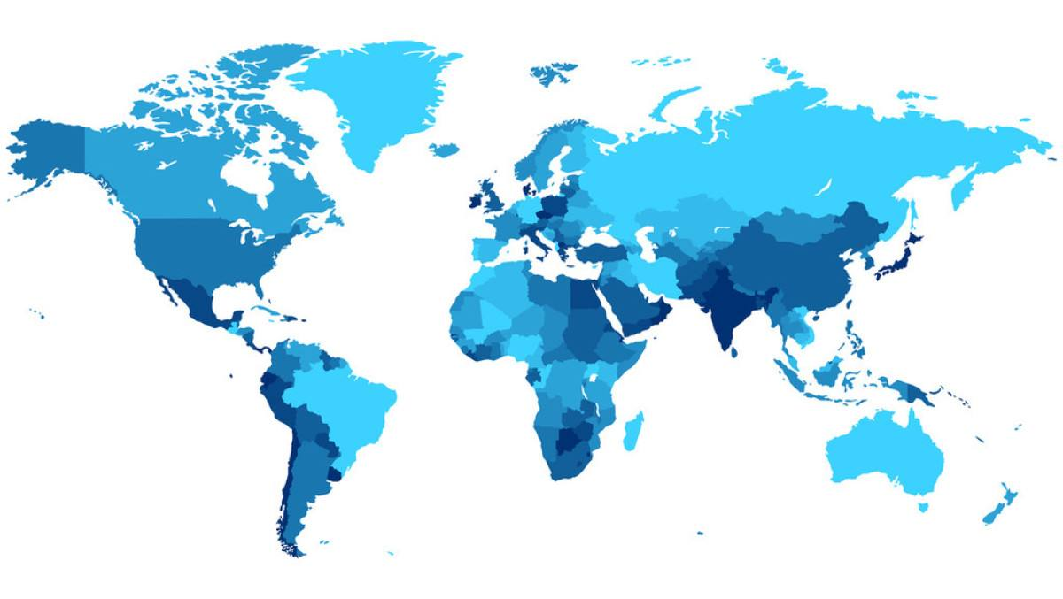
Students Distribution
FJMU has more than 320 overseas students from 44 countries.
Western Asia
Eastern Asia
North America
South Asia
Southeast Asia
Oceania
Africa
FJMU
Notes:
Currently, there are about 320 international students from over 44 countries in FJMU. Most of them are enrolled in undergraduate programs or postgraduate programs in clinical medicine that are taught in English or other medical programs taught in Chinese (for CSC Scholarship students).
目前，我校共有来自44个国家和地区的320多名来华留学生。培养层次涵盖本科和研究生（硕士及博士研究生），授课语言有英语和汉语。

Slide 16
Disciplines & Majors
Disciplines & Majors for Bachelor
本科专业
English Medium/英语
Clinical Medicine (MBBS) 六年制临床医学（英语授课）
Chinese Medium/中文
Clinical Medicine临床医学 *
Anesthesiology 麻醉学
Medical Imaging 医学影像学
Basic Medicine 基础医学 *
Radiology放射医学
Preventive Medicine 预防医学
Public Affairs Management 公共事业管理
Health Inspection and Quarantine 卫生检验和检疫
Medical Laboratory Technology 医学检验技术
Medical Imaging Technology医学影像技术
Optometry 眼视光学
Intelligent Medicine Engineering 智能医学工程
Bioinformatics 生物信息学
Stomatology 口腔医学 *
Pharmaceutical Science 药学
Pharmaceutical Preparation 药物制剂
Clinical Pharmacy 临床药学
Biological Pharmacy 生物制药
Nursing 护理学 *
Midwifery 助产学
Social Work 社会工作
Applied Psychology 应用心理学
Rehabilitation Therapeutics 康复治疗学
Sports Rehabilitation 运动康复
FJMU
Notes:
So here’s the disciplines and majors for bachelor. Undergraduate programs in clinical medicine (MBBS） that is taught in English or other medical programs taught in Chinese.

Slide 17
Disciplines & Majors
Disciplines & Majors for Postgraduates研究生专业
English & Chinese Medium中文或英文授课
Biology 生物学
Basic Medicine基础医学
Clinical Medicine临床医学
Stomatology口腔医学
Public Heath and Preventive Medicine公共卫生与预防医学
Pharmaceutical Science 药学
Nursing 护理
Medical Technology医学技术
Science of Public Management 公共管理学
Psychology 应用心理学
FJMU

Slide 18
Pre-medicine Education预科教育
Introduction 目的
Through preparatory education, we will help foreign students in China to prepare for their
professional studies.帮助留学生适应中国的教育模式和教学要求，做好专业学习的前期准备
Study Period 学习期限
March to July 3至7月
Courses 课程
The Chinese language courses and the Chinese culture courses. The Chinese language courses are
mainly aimed at learners with Chinese at the starting point. The Chinese culture courses will
provide a platform for learners to perceive Chinese culture and understand Chinese society.
Application Qualification 申请资格
be a non-Chinese citizen and in good health both mentally and physically
Age: below 29
High school Diploma, equivalent or higher
年龄不超过29周岁，身心健康，持外国有效普通护照的非中国籍公民
FJMU
Notes:
In order to help foreign students to prepare for their livings and professional studies in China, we set up a pre-medicine program for applicant.

Slide 19
Part II. International Education
▲ Introduction of OEC
▲ Admissions & Scholarships
▲ Life in FJMU
√
FJMU

Slide 20
How to Apply
Application and registration schedule 申请和注册
Application: all the year
Registration: September-October (subject to Admission Letter)
*Online Application portal for Self-Funded applicants 自费生申请平台
Link: http://hwjyxy.FJMU.edu.cn/member/login.do
Applicant should register and submit the required documents through “Fujian Medical University
Online Application System for International Students”
*Online Application portal for Chinese Government Scholarship 中国政府奖学金申请
Link: http://www.campuschina.org
Fujian Medical University is eligible to admit CSC Scholarship International students. The applicant
may submit applications to the dispatching authorities in their home countries or directly to Fujian Medical University. (FJMU Agency Code:10392)
FJMU
Notes:
Our enrollment is open to international applicants all the year, and the registration and courses start annually in September to October. Anyone can register and submit any applications anywhere at anytime to the following online application portals. Make sure you remember our FJMU agency code 10392 when applying for CGS.

Slide 21
Fee Structure
Fees (in RMB/CNY)
Catalogue 类别 | Application 申请费 | Tuition 学费 | Textbooks 书本费 | Accommodation 住宿费 | Insurance 保险费 | Health Certificate 体检费 | Resident Permit（≤1 year） 居留许可
Bachelor (MBBS) | 800.00 | 35,000.00 | 1,000.00 | 4,000.00/person (double room) | 600.00 | 500.00 | 400.00 -1000.00
Bachelor (Chinese Medium) |  | 28000.00
MASTER |  | 38,000.00
MD/PhD |  | 40,000.00
Pre-medicine | 600.00 | 9000.00 | none | 2000.00/person (double room)
FJMU

Slide 22
Scholarship Programs
Chinese Government Scholarship
（中国政府奖学金）
Eligibility: excellent international applicant for undergraduate and postgraduate program
of FJMU (FJMU Code:10392)
Coverage: Full Scholarship
· Exempt from tuition fee
· Free accommodation
· Comprehensive medical insurance
· Monthly living allowance(RMB): 2,500 for Bachelor, 3,000 for Master, 3,500 for MD/PhD
Fujian Provincial Government Scholarship（福建省政府奖学金）
Eligibility: full-time self-funded international students of FJMU with excellent comprehensive scores for admission
Coverage:
Bachelor: RMB 35,000 per academic year
Master: RMB 45,000 per academic year
MD/PhD: RMB 55,000 per academic year
FJMU Freshmen Scholarship
（新生奖学金）
Eligibility: international freshman with the comprehensive scores: within the top 30% of freshman candidates;
Exempt from tuition fee of the 1st academic year
Da Bo Scholarship（大博奖学金）
Eligibility: Top-ranked freshmen in comprehensive scores for admission
RMB 3,000 per academic year
FJMU
Notes:
国奖：In order to promote the mutual understanding, cooperation and exchanges in various fields between China and other countries, the Chinese government has set up a series of scholarship programs to sponsor international students in Chinese universities.
China Scholarship Council (hereinafter referred to as CSC), entrusted by the Ministry of Education of the People’s Republic of China (hereinafter referred to as MOE), is responsible for the enrollment and the administration of Chinese Government Scholarship programs.
省奖：In order to attract and encourage more outstanding international students to study for undergrad & postgrad degrees in FJMU, we provide a series of scholarship programs for outstanding international students.
FJMU, entrusted by the Dept. of Education of Fujian Province, is responsible for the enrollment, nomination and the administration of Fujian Provincial Government Scholarship Program for Foreign Students.

Slide 23
Scholarship Programs
FJMU Outstanding International Student Scholarship
（优秀来华留学生奖学金）
1/3,1/2 to full tuition fees per academic year at three levels respectively
FJMU Academic Progress Scholarship
（学业进步奖学金）
RMB1000 per academic year
FJMU Excellent Intern Scholarship（优秀实习生奖学金）
RMB2000 per academic year
FJMU Chinese Learning Scholarship
(汉语奖学金）
RMB600-1400 per academic year at respective levels of HSK
FJMU
Notes:
Categories of scholarships for international students in the University:
1. Freshman Scholarship;
2. Outstanding International Student Scholarship;
3. Academic Progress Scholarship;
4. Excellent Intern Scholarship;
5. Chinese Learning Scholarship

Slide 24
Part II. International Education
▲ Introduction of OEC
▲ Admissions & Scholarships
▲ Life in FJMU
√
FJMU

Slide 25
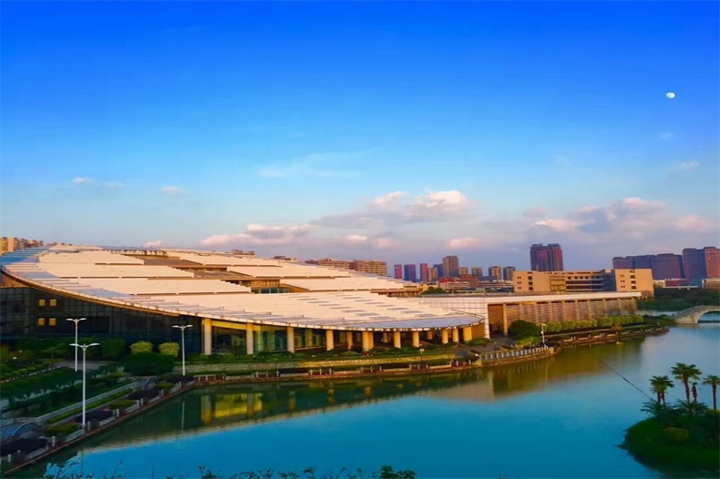
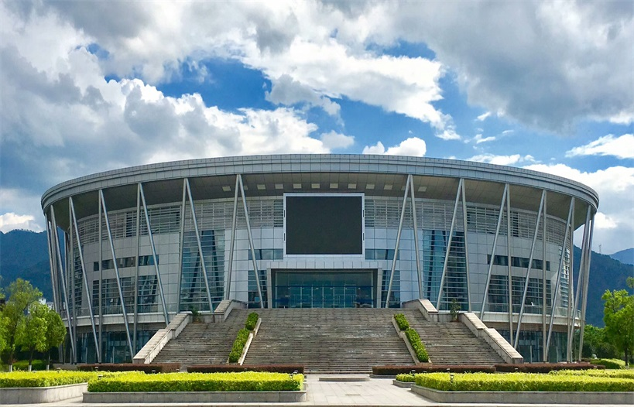
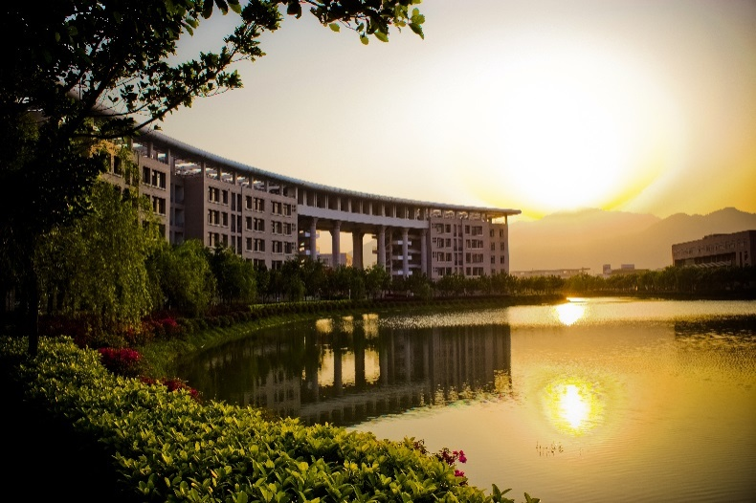
Facilities
FJMU

Slide 26
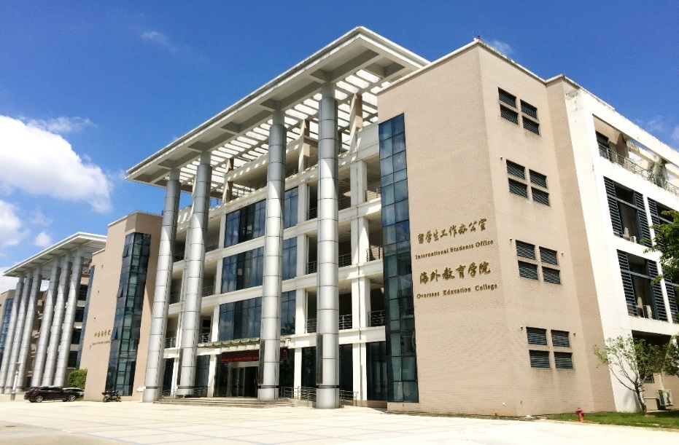
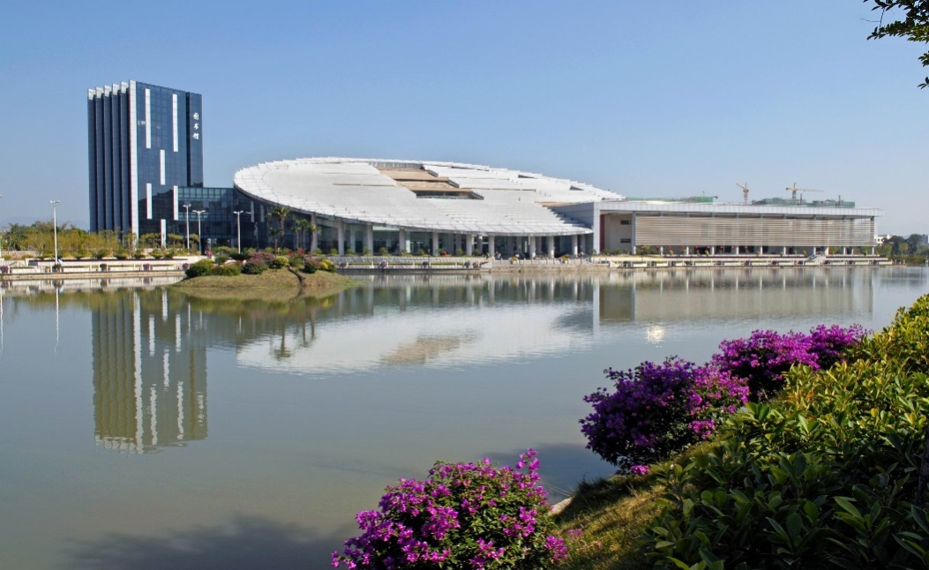
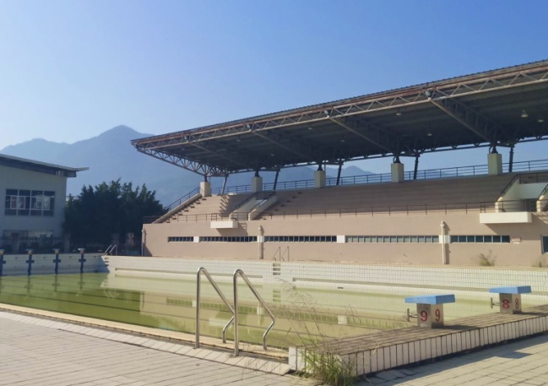
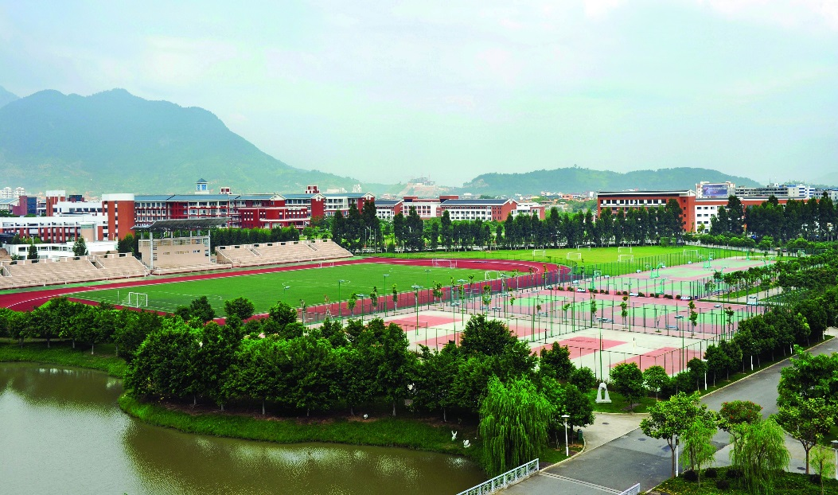
FJMU Facilities
FJMU

Slide 27
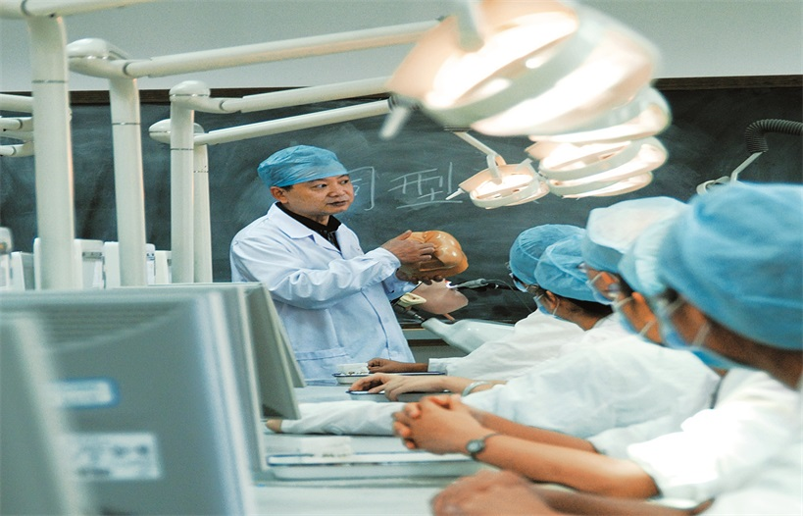
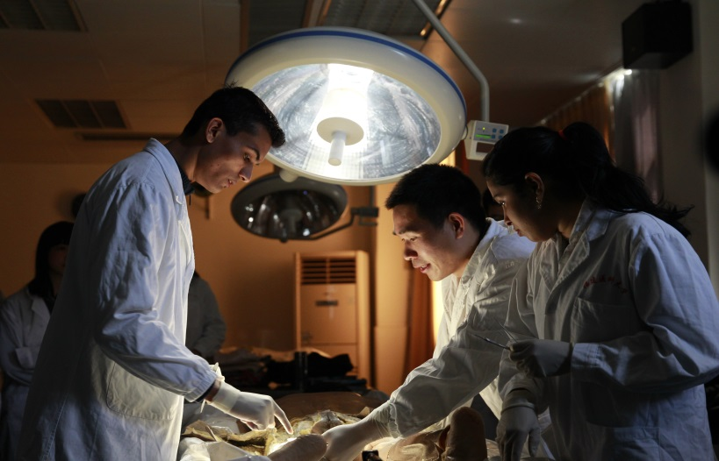
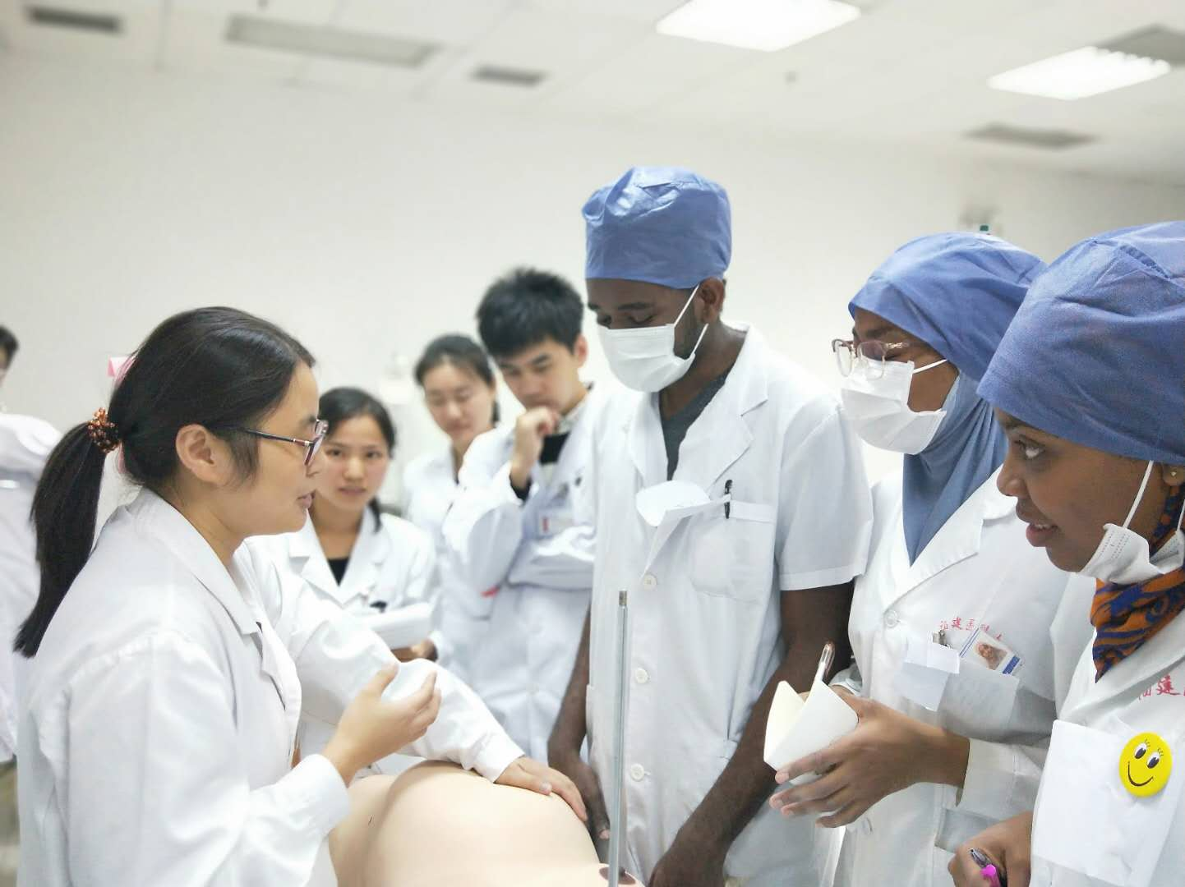
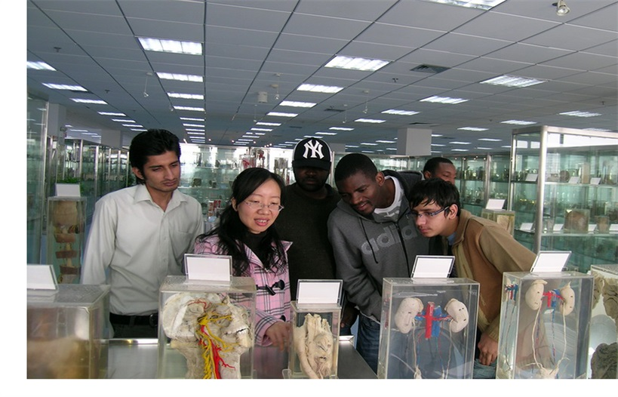
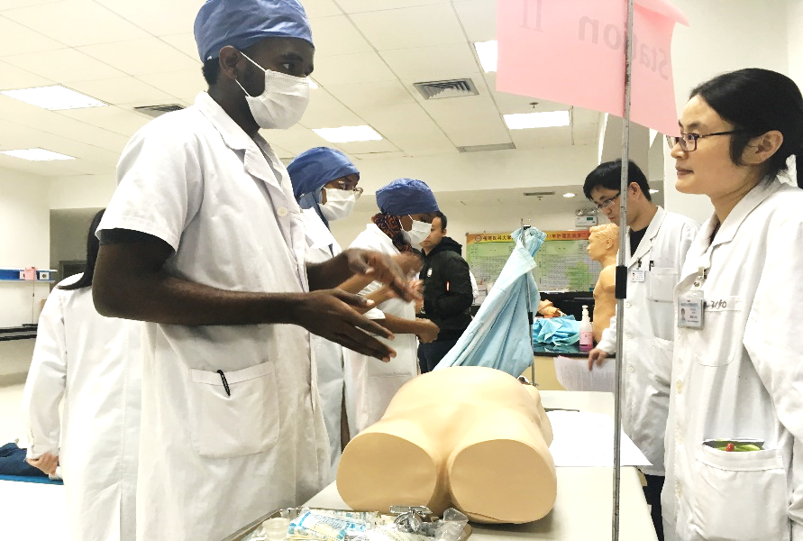
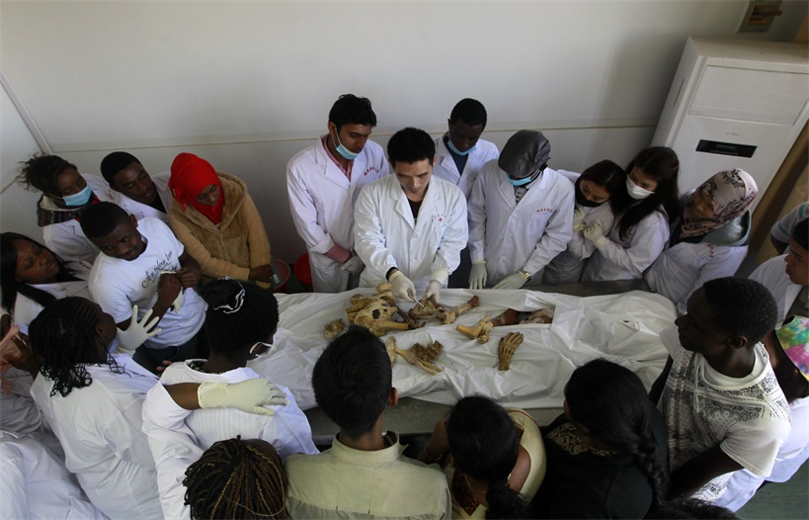
Study in FJMU
FJMU

Slide 28
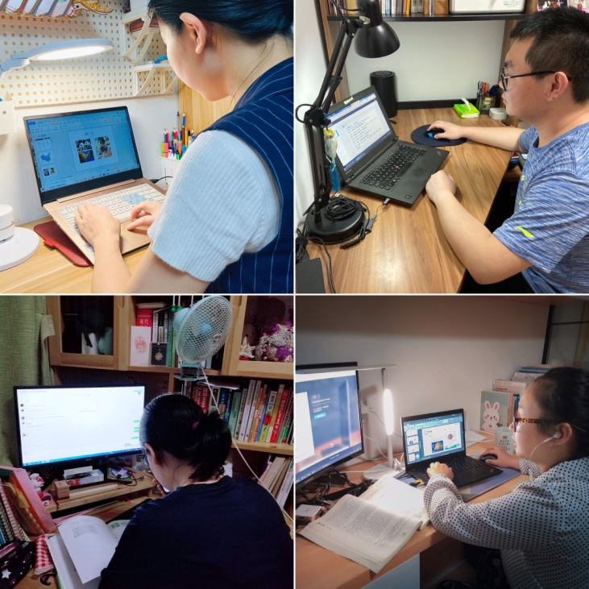
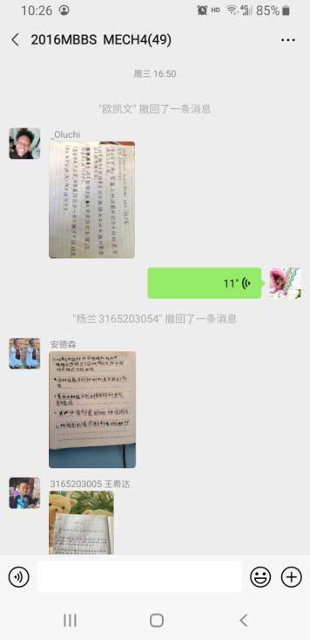
Study in FJMU
The teaching is conducted both online & offline
FJMU

Slide 29
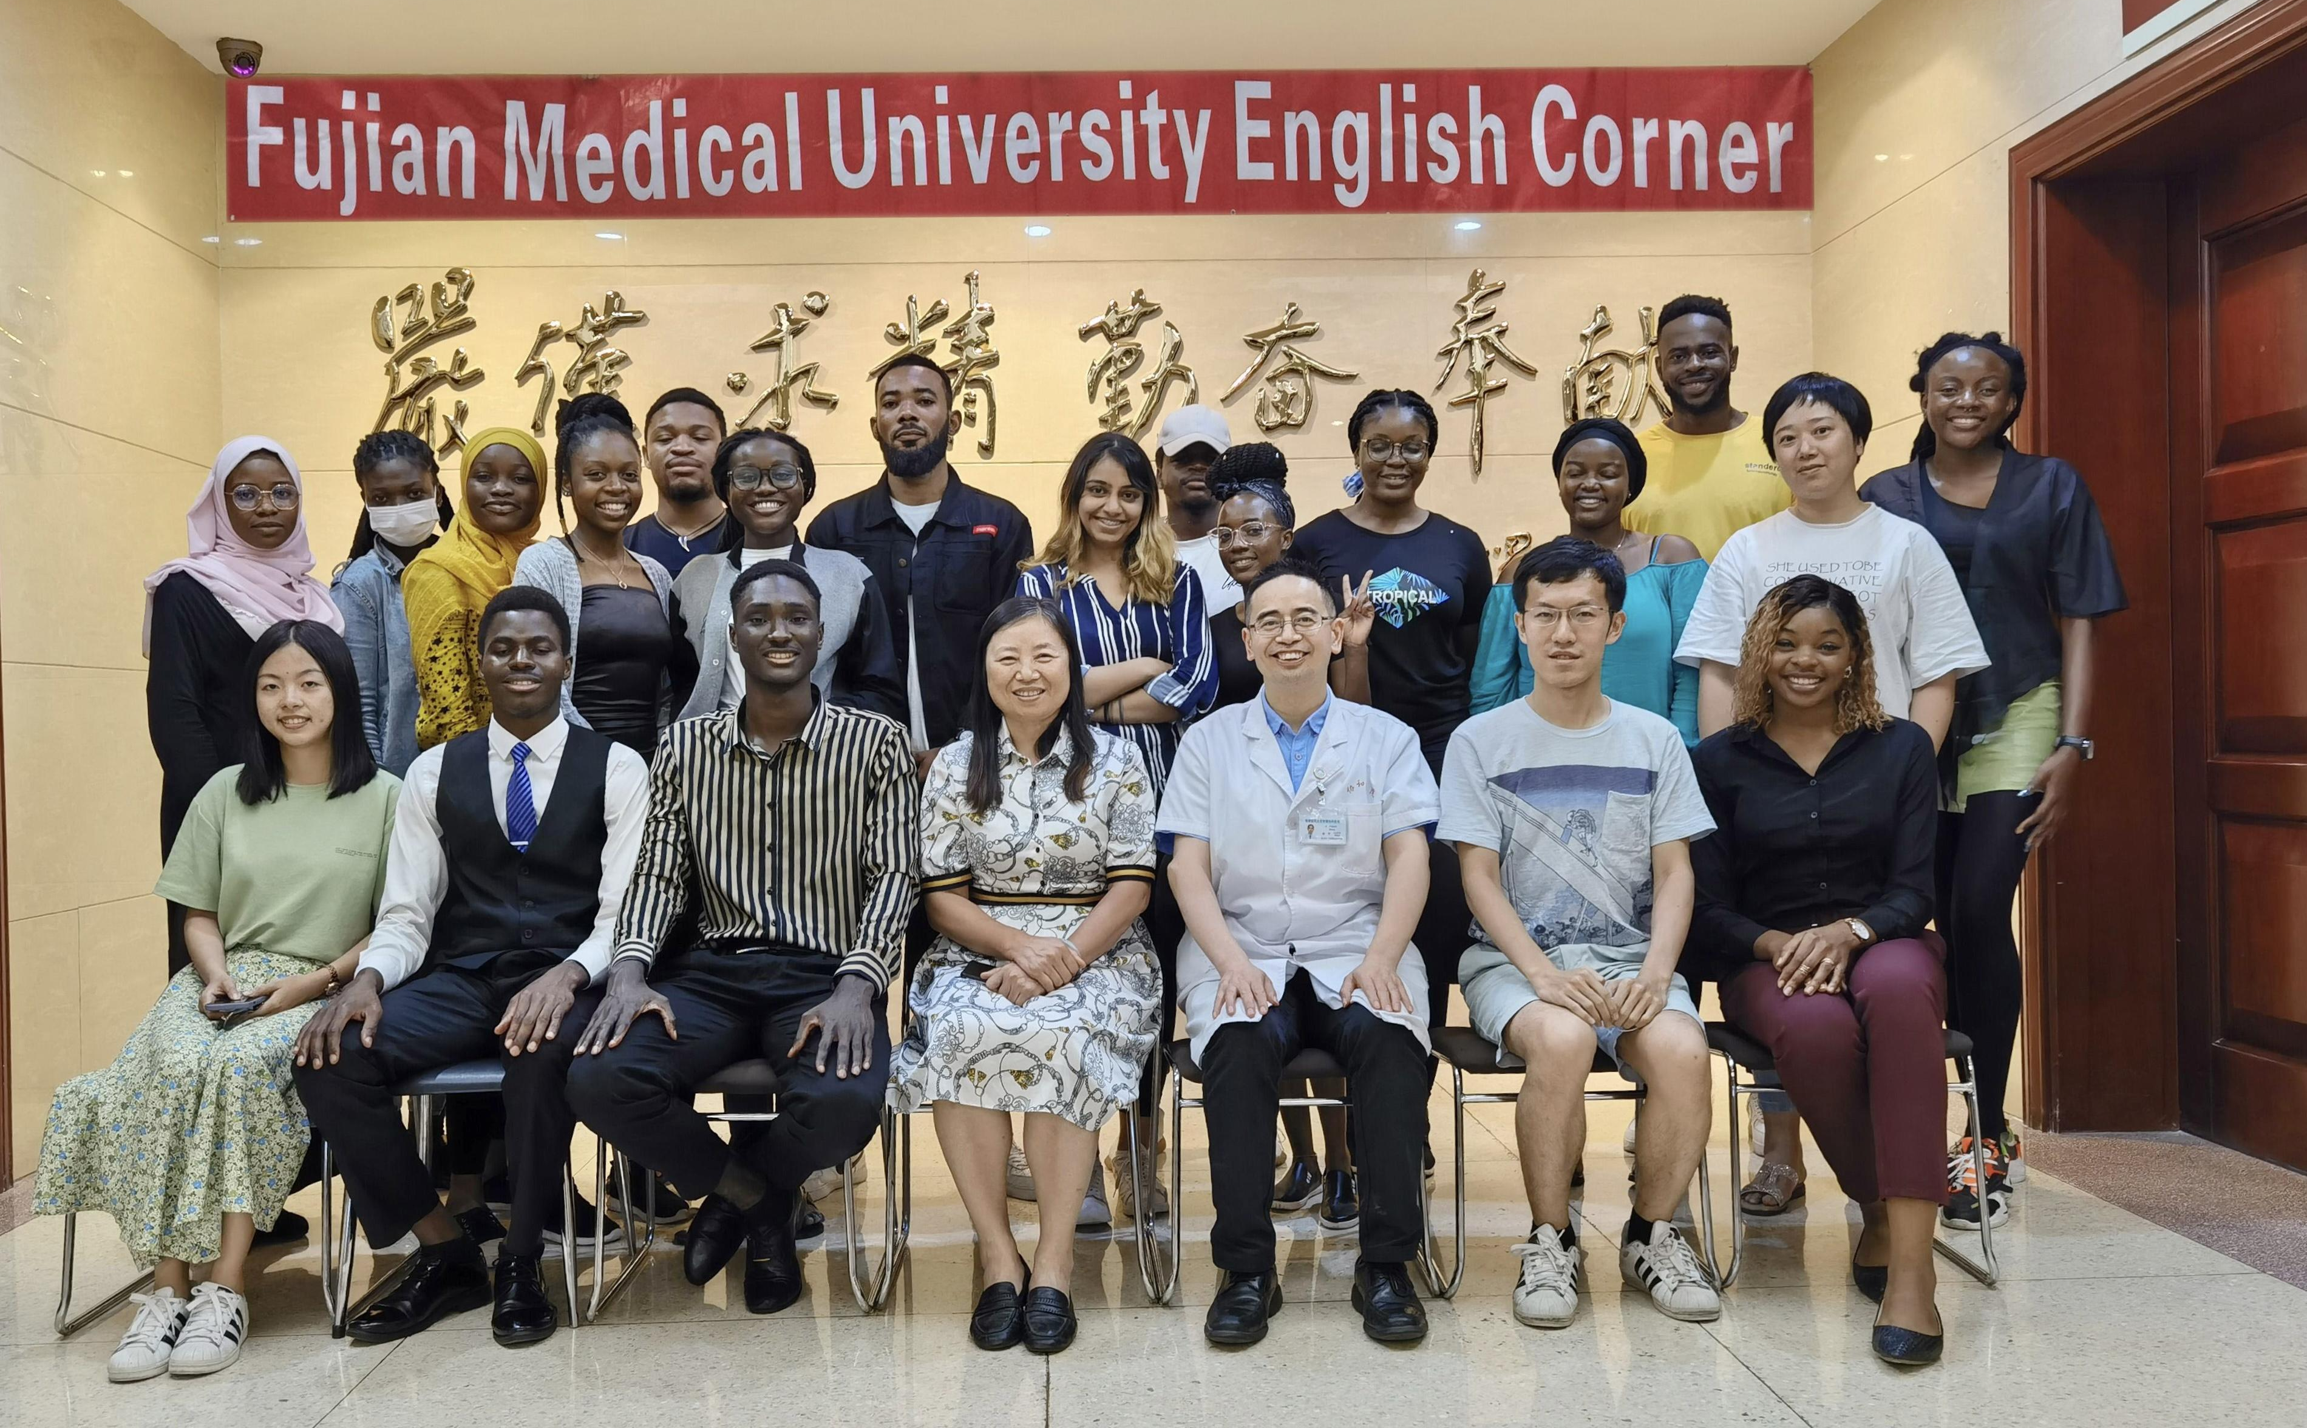
Academic Activities
FJMU

Slide 30
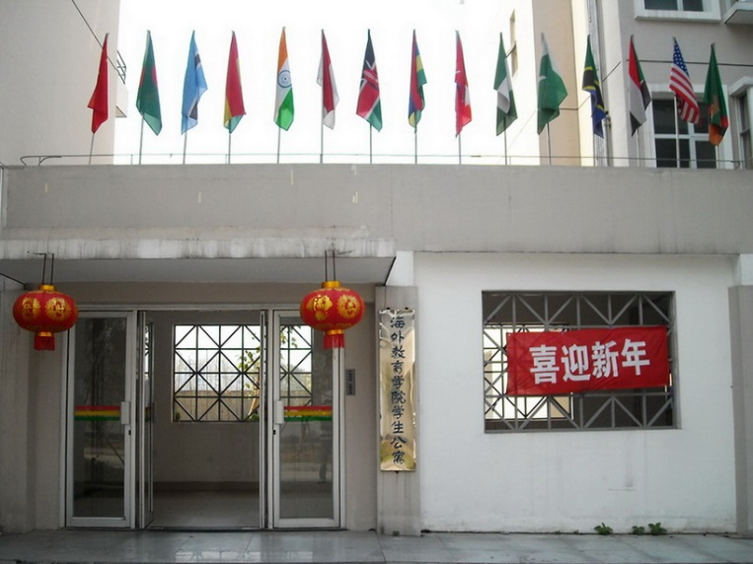
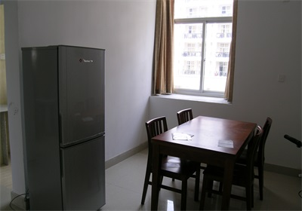
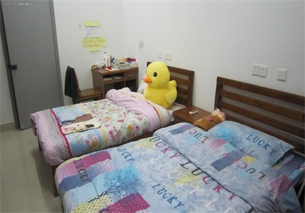
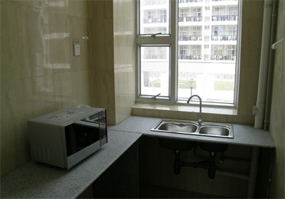
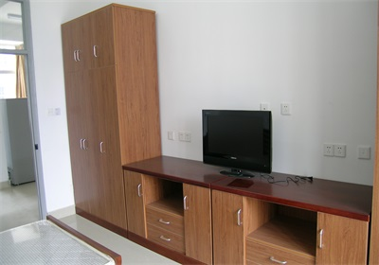
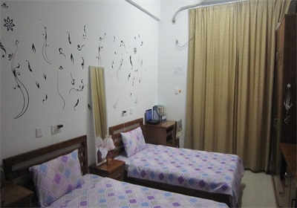
Accommodations
International Student Apartment locates at our campus, offering the double room facilitated with shower room, toilet, AC and water heater, etc.
FJMU

Slide 31
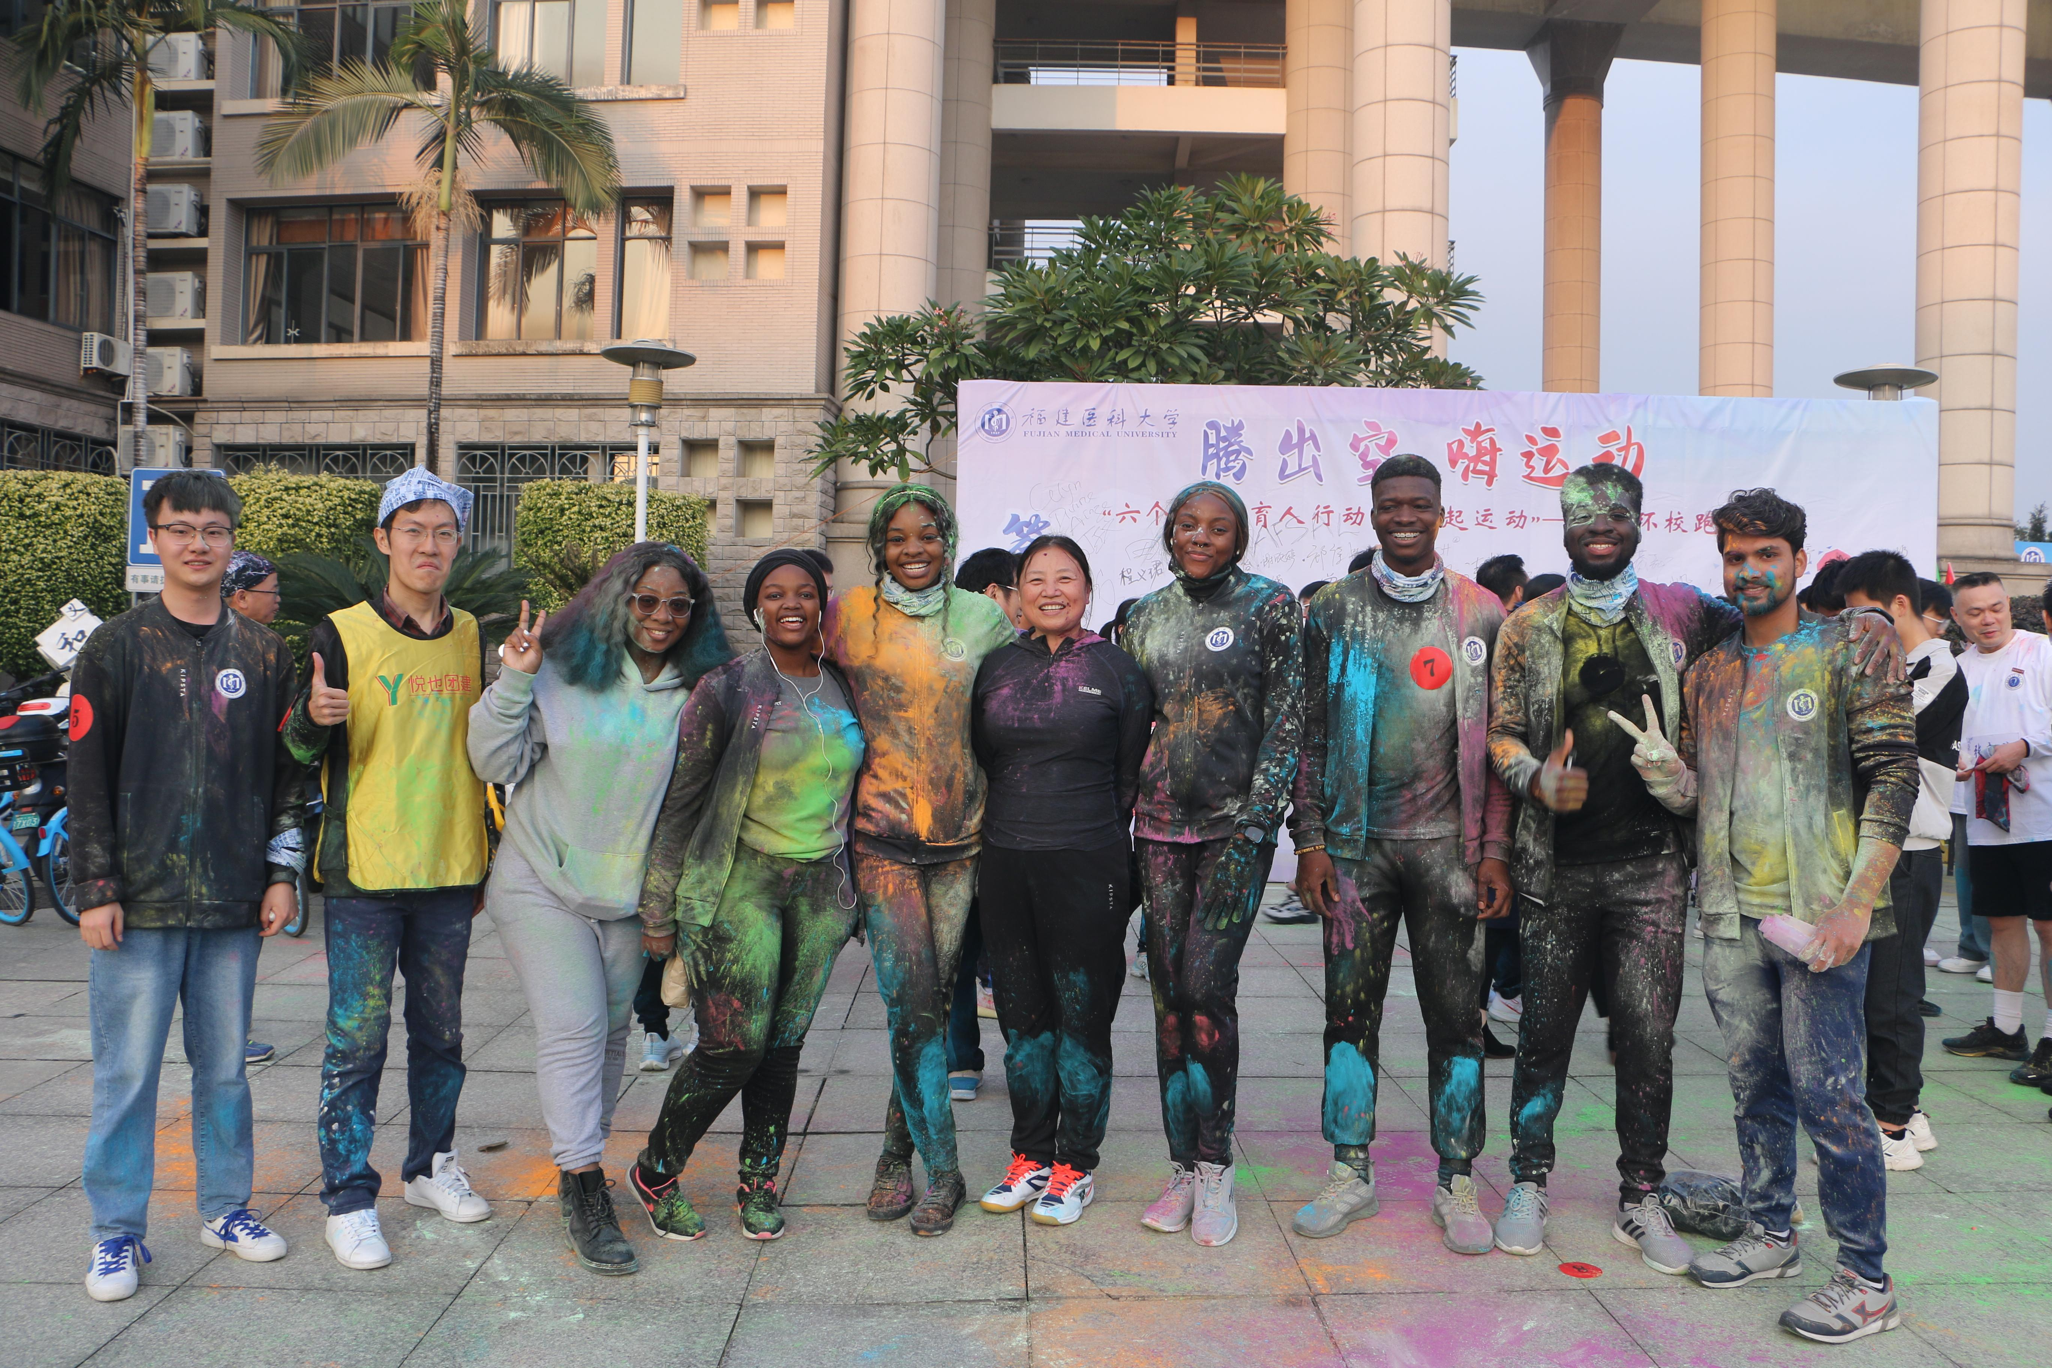
Sports Activities
FJMU

Slide 32
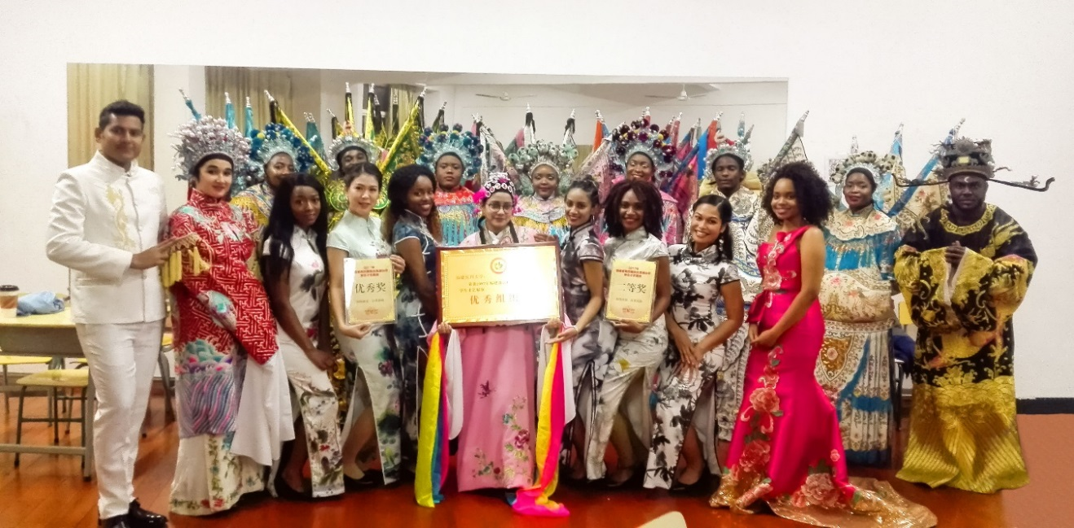
Extracurricular Activities
FJMU

Slide 33
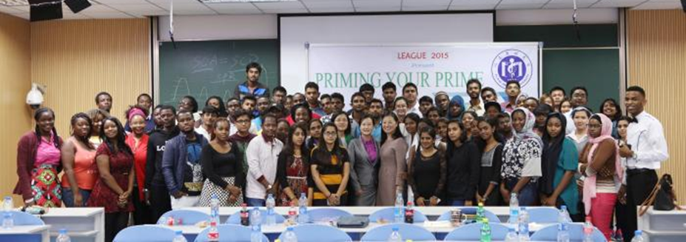
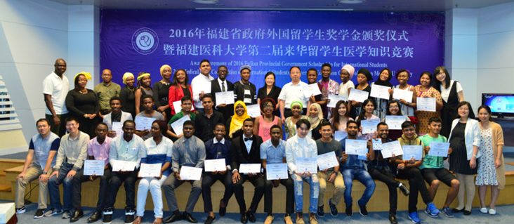
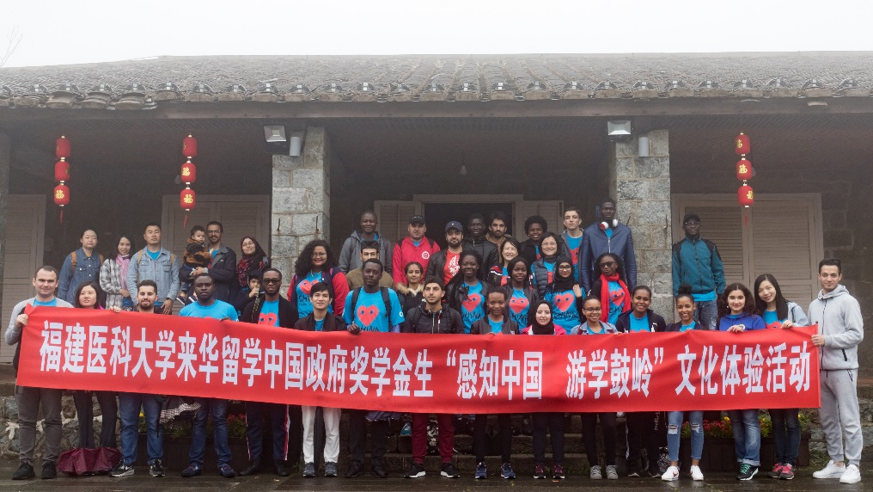
Extracurricular Activities
FJMU

Slide 34
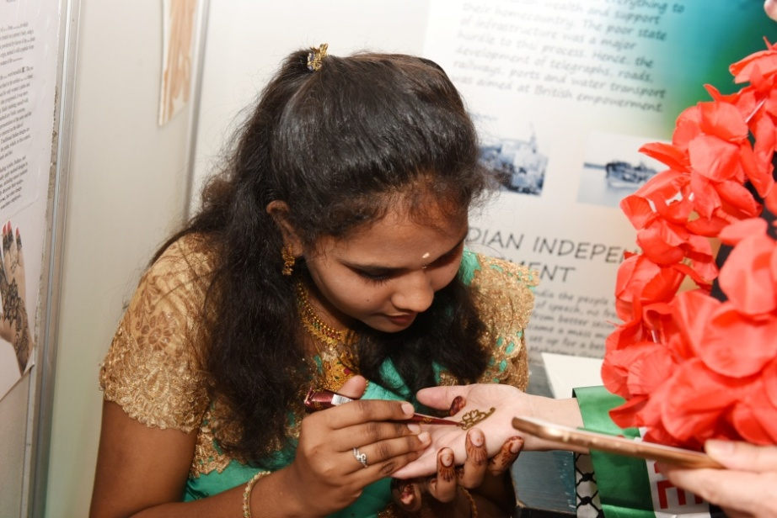
Extracurricular Activities
International Culture Festival
FJMU

Slide 35
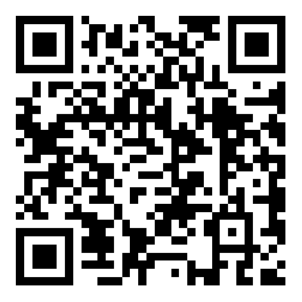
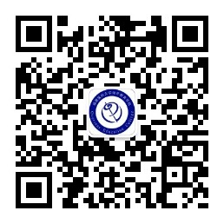
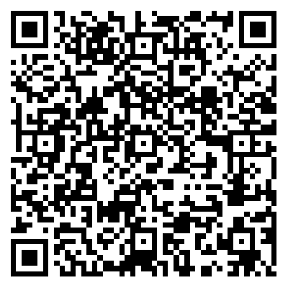
Contact
Overseas Education College
Contact: Ms. Suellen CHEN / Mr. Aaron LIU/ Mr. Jingyu Meng
Tel: 0086-591-22862611 / 0086-591-22868362
Fax: 0086-591-22862610
E-mail: admission@fjmu.edu.cn
Website: http://oec.fjmu.edu.cn/
CSC FJMU Agency Code: 10392
OEC official website
OEC WeChat official account
CSC (Study in China) FJMU
FJMU

Slide 36
Thank you!
FJMU

