Slide 1
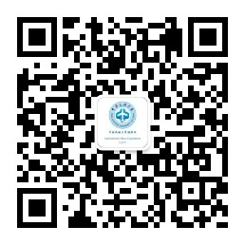
2023 International Students Admission of CAUC
In Kazakhstan
International Affairs Department
March 15, 2023

Slide 2
Contents
Introduction to CAUC
01
International Students Application
02
03
Q & A

Slide 3
Introduction to CAUC
CAAC
15
colleges
≈200
Int’l students
CAUC
1951
2.1k+
teachers & staff
Tianjin
28k+
students
ICAO, IATA, Airbus, Boeing, COMAC…

Slide 4
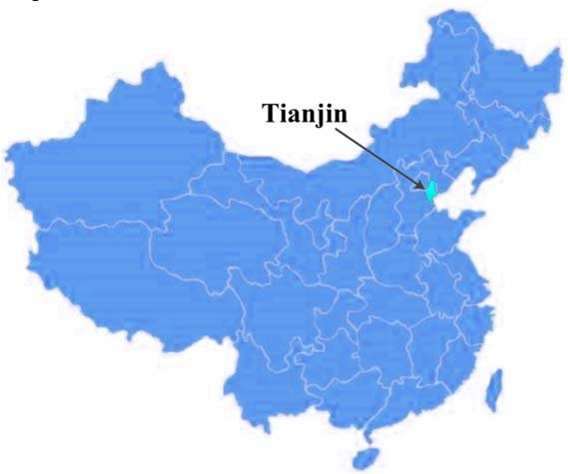
Introduction to CAUC
TIANJIN MUNCIPALITY
Population : 13.73 million
Coastal Metropolis
One of the four municipalities in China
Close to Beijing, capital of China

Slide 5
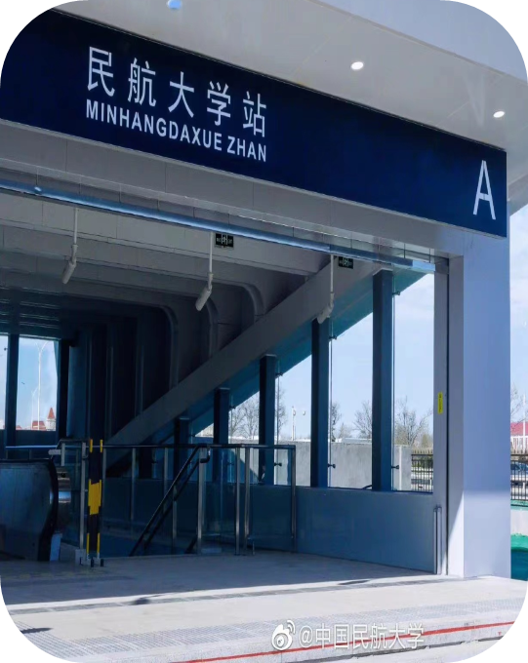
Introduction to CAUC
LOCATION
Airport：10 km , 15 mins by taxi
Train station: 13 km, 17 mins by taxi
Metro line 4
Nearest shopping mall: 6 stations away

Slide 6
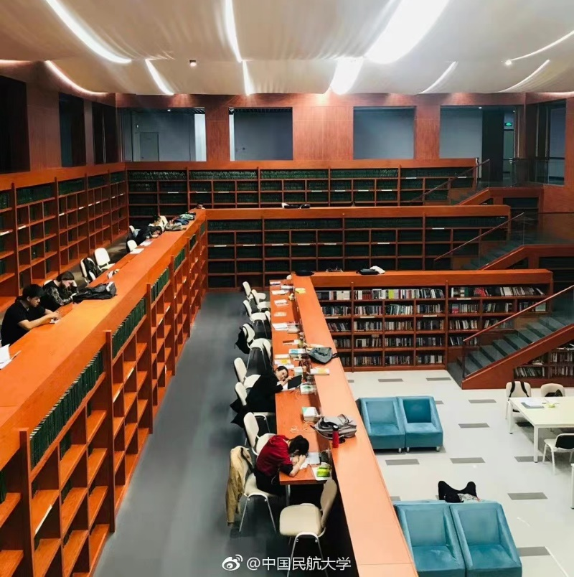
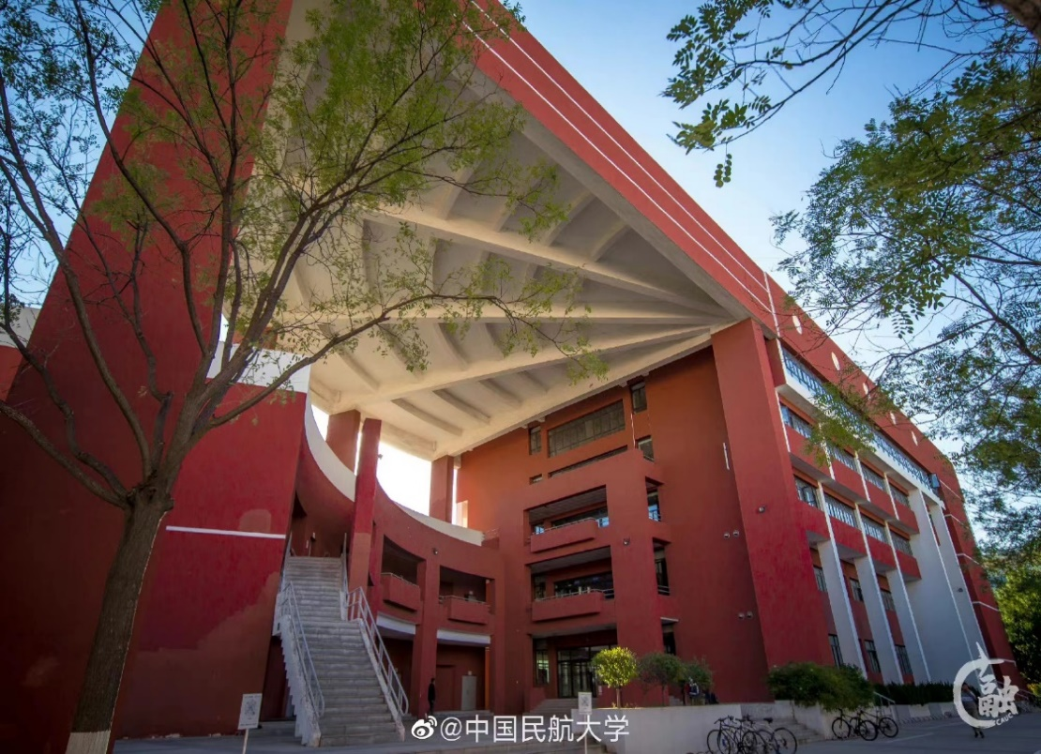
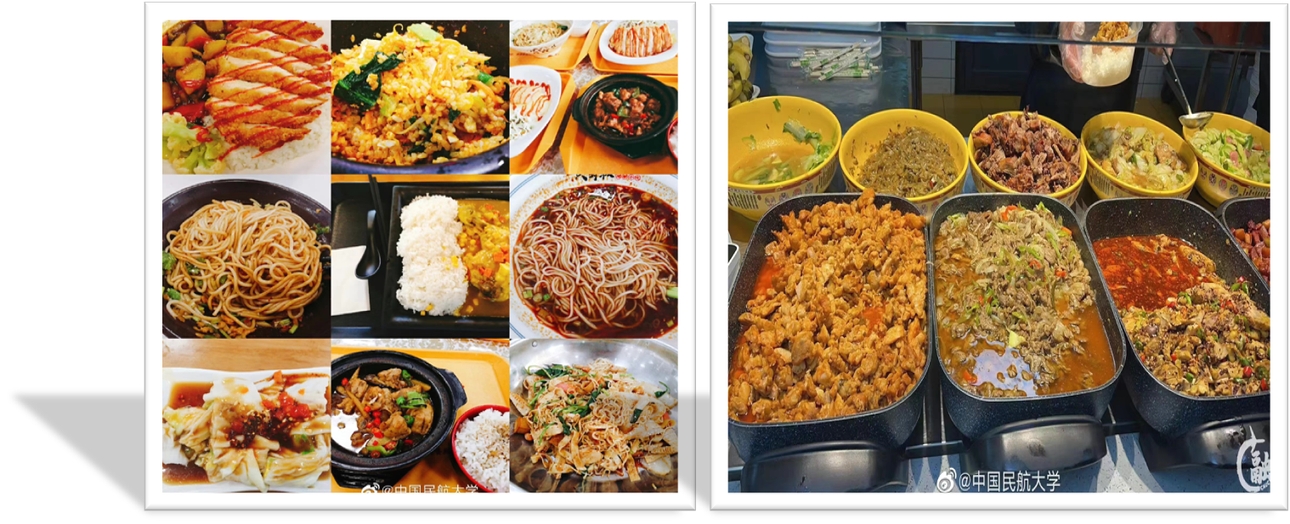
Introduction to CAUC
FACILITY

Slide 7
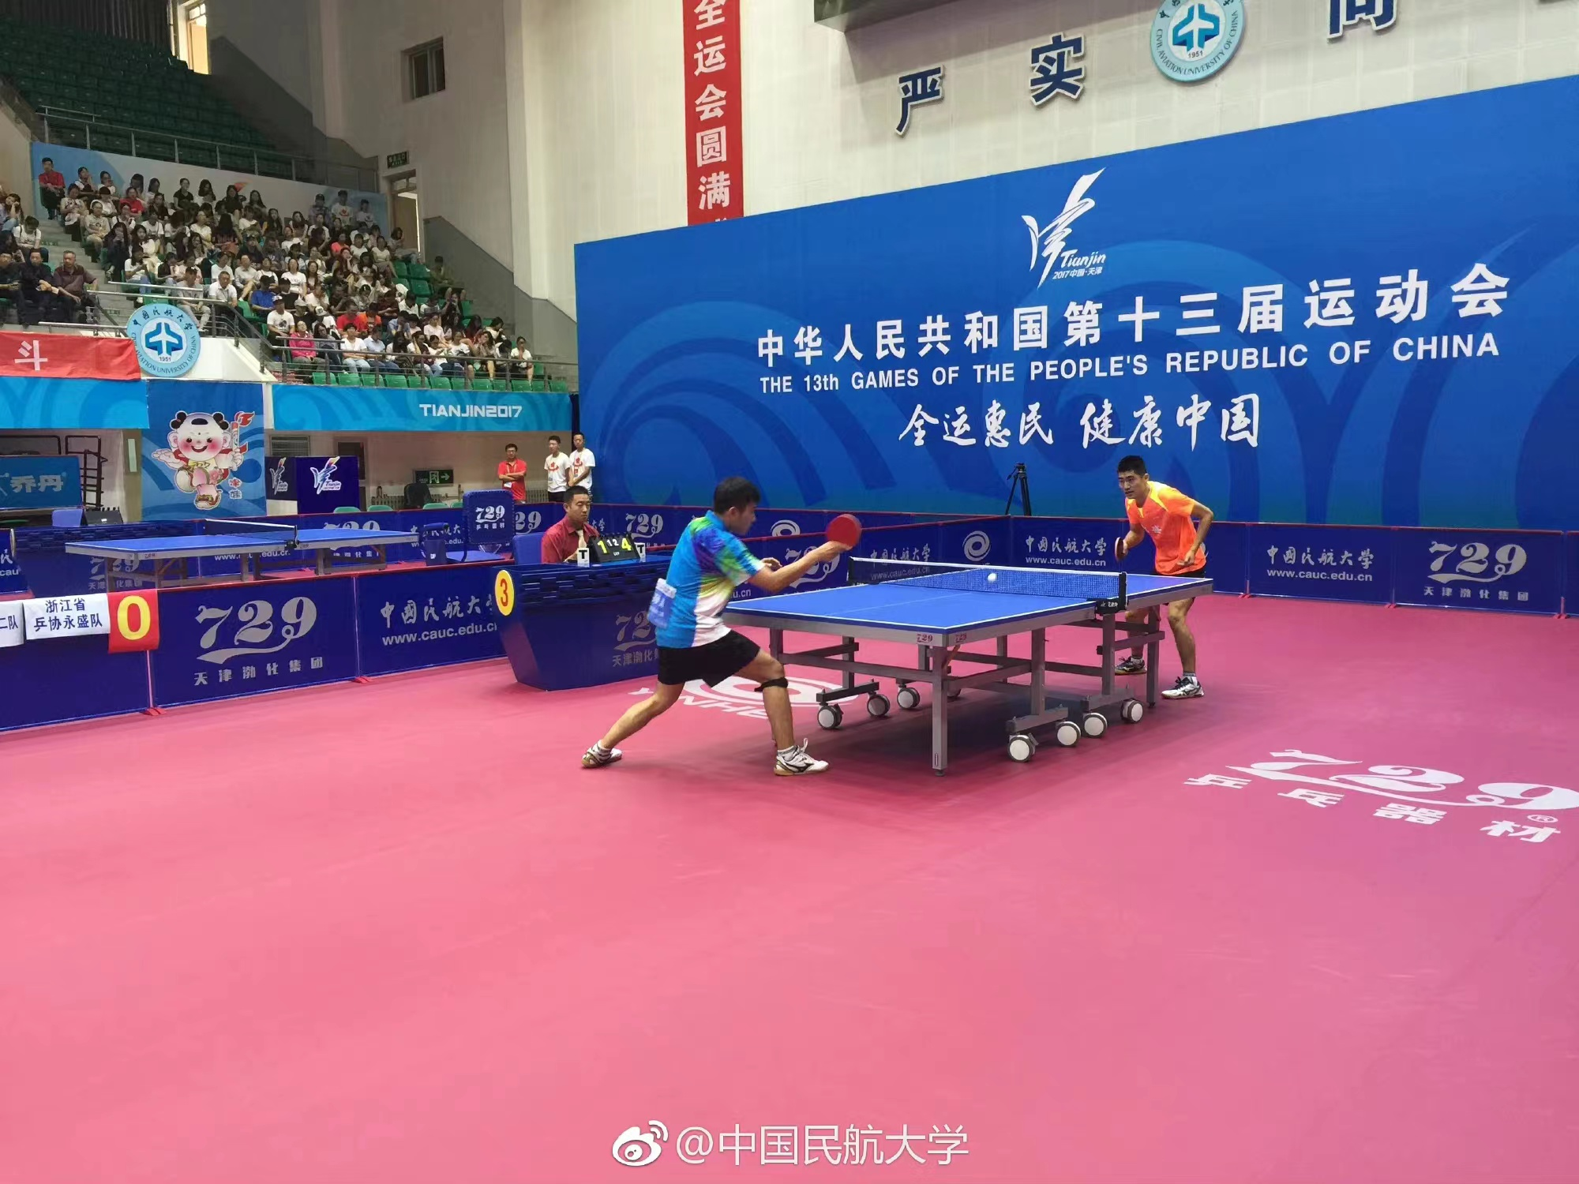
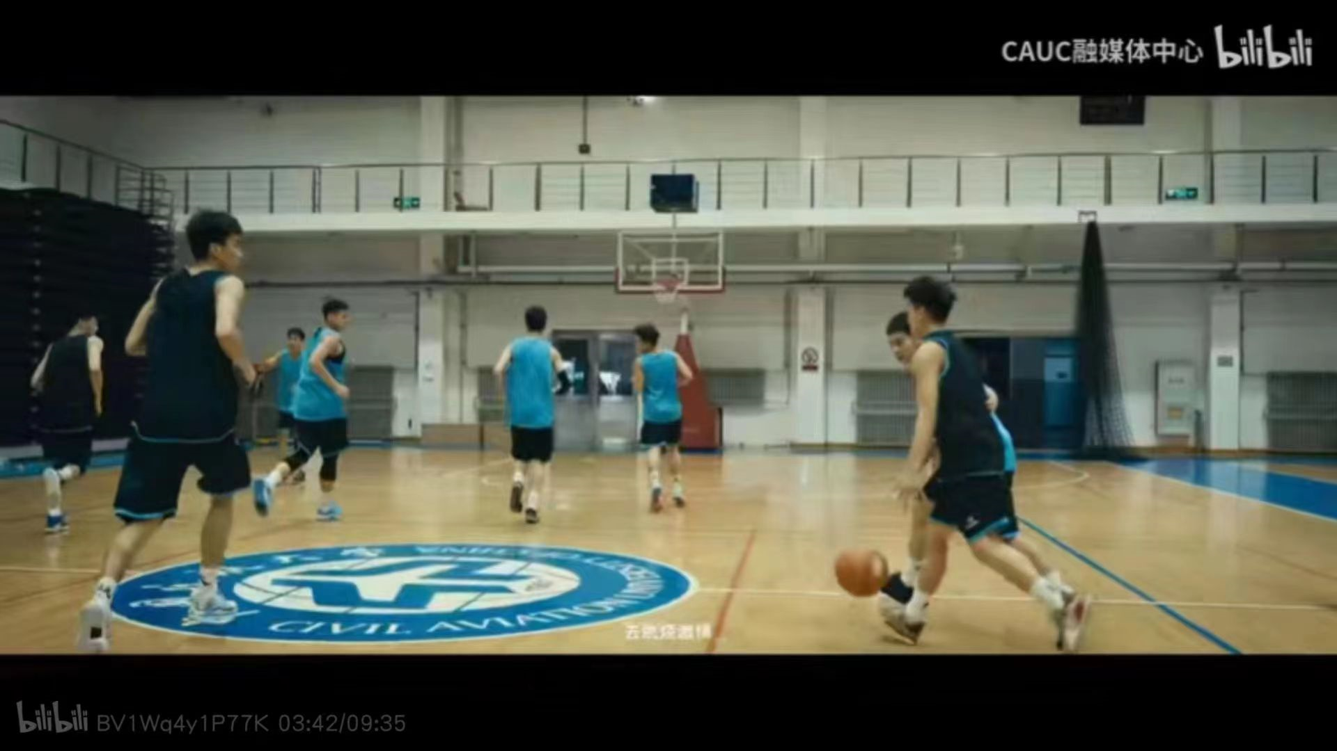
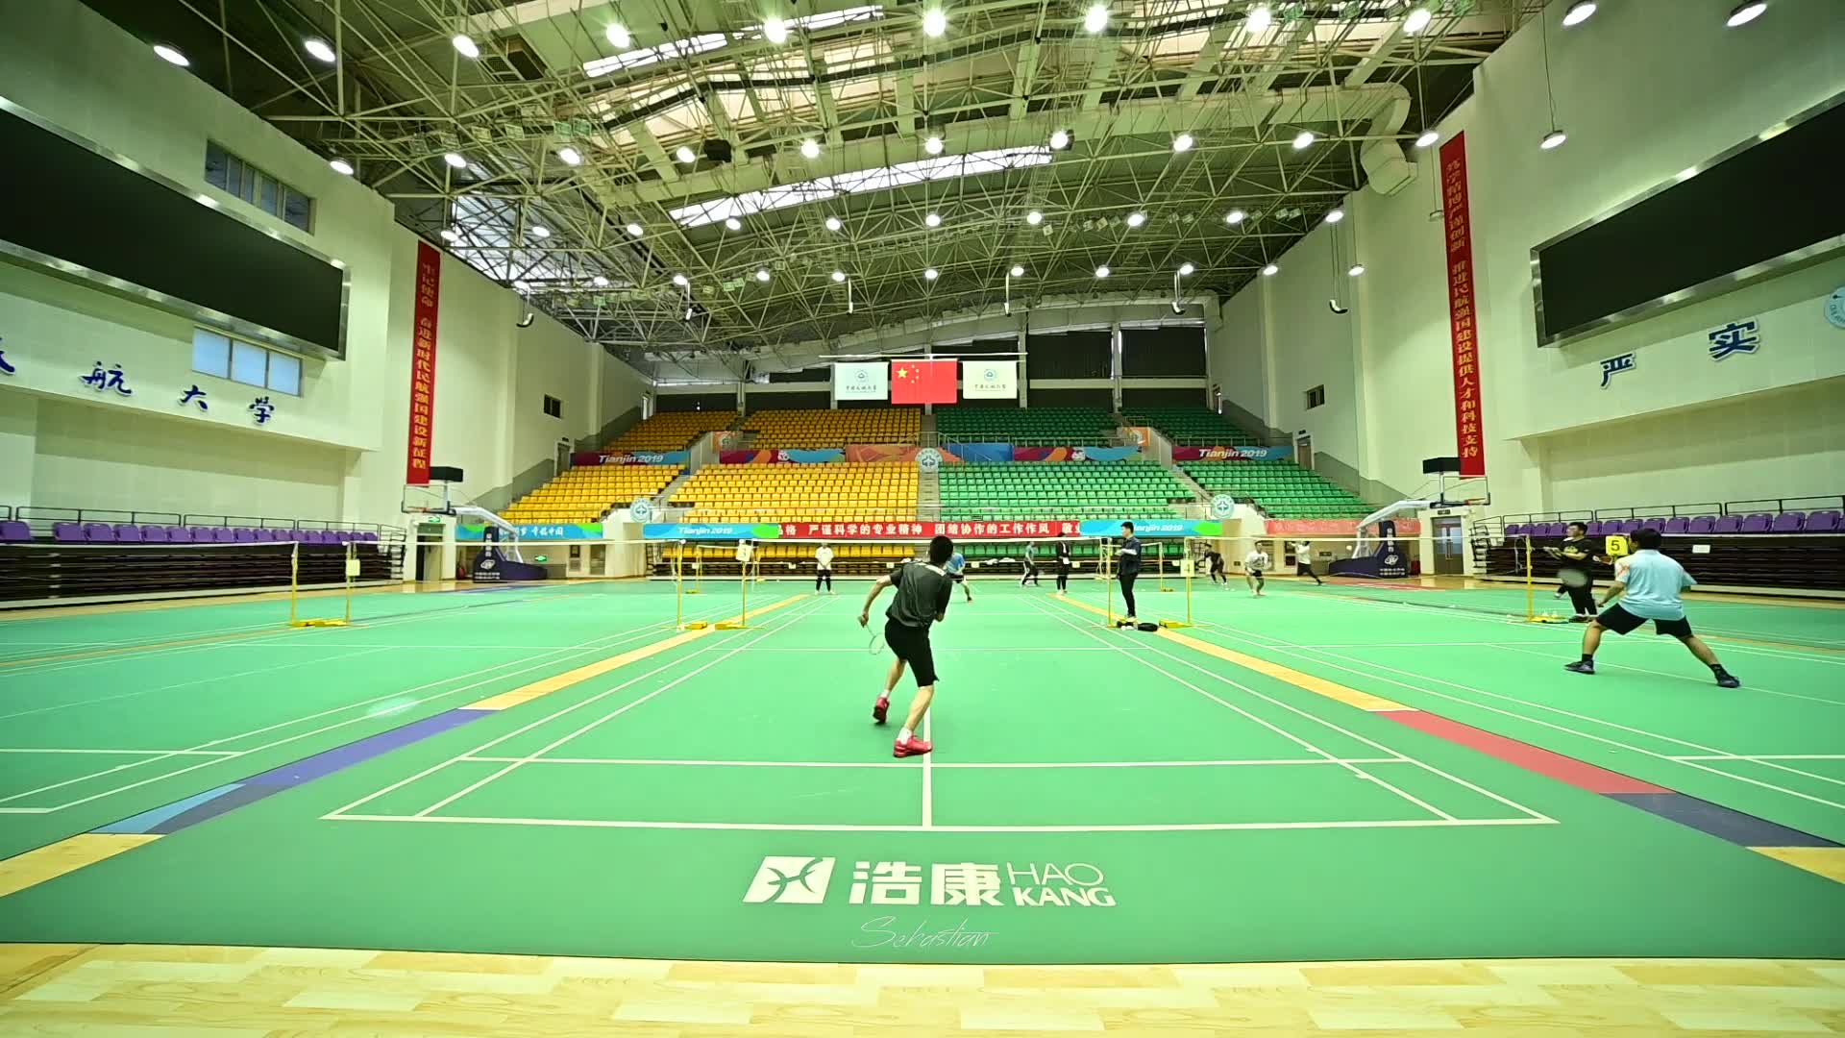
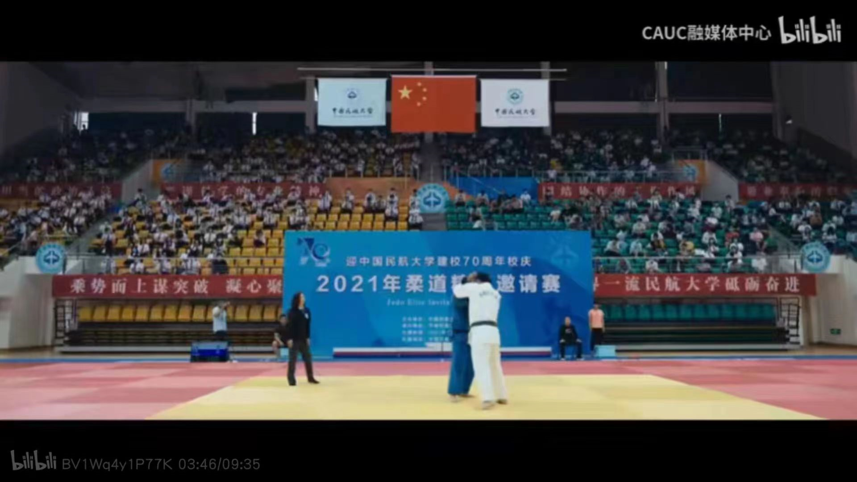
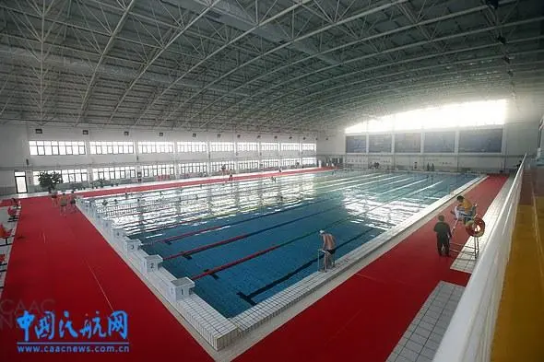
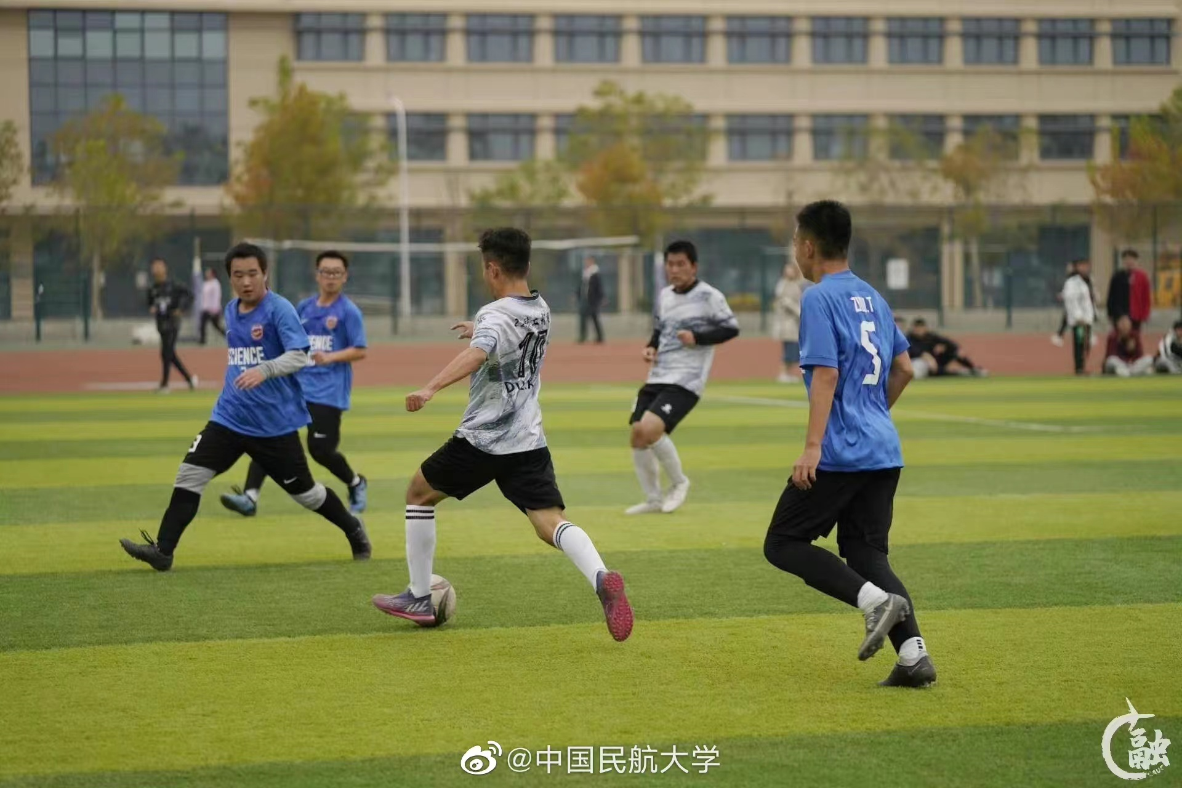
Introduction to CAUC
FACILITY

Slide 8
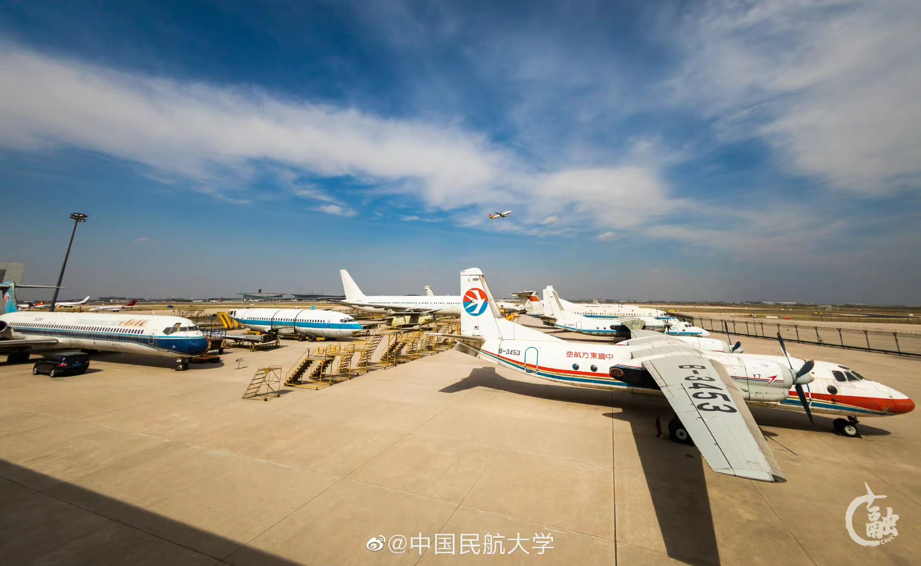
Introduction to CAUC
FACILITY

Slide 9
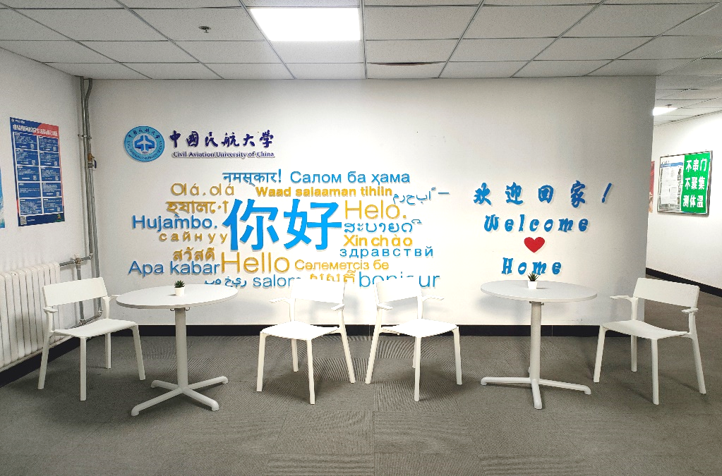
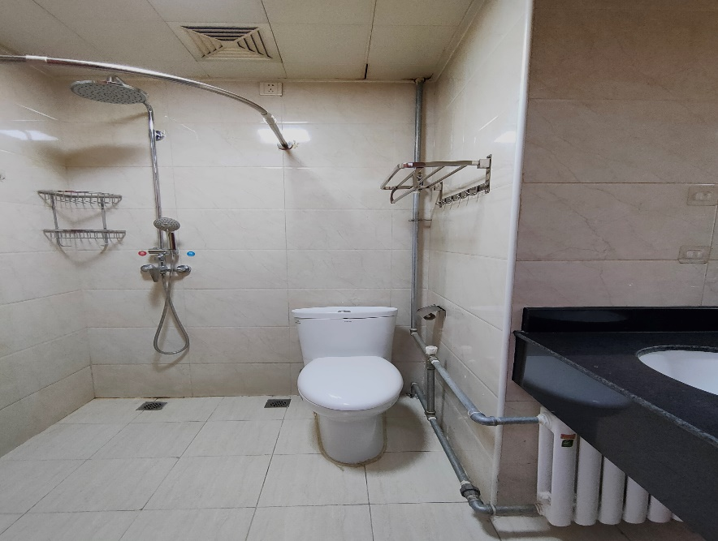
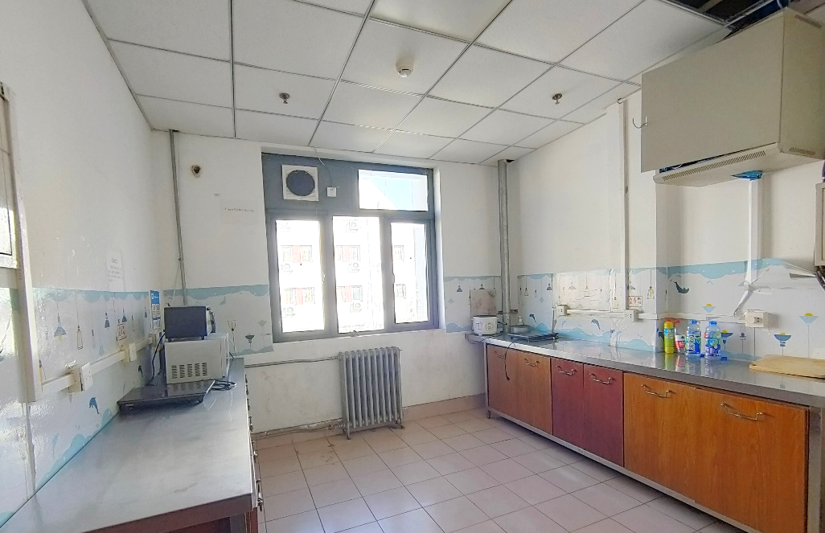
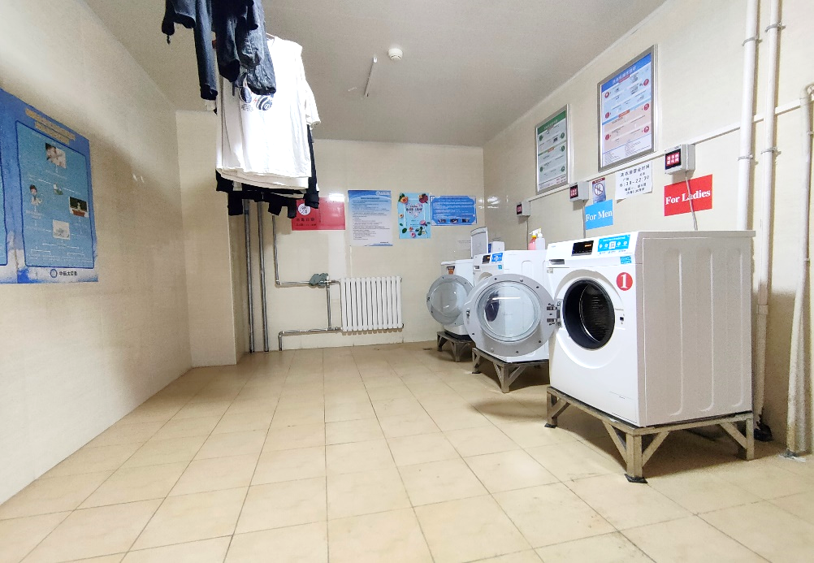
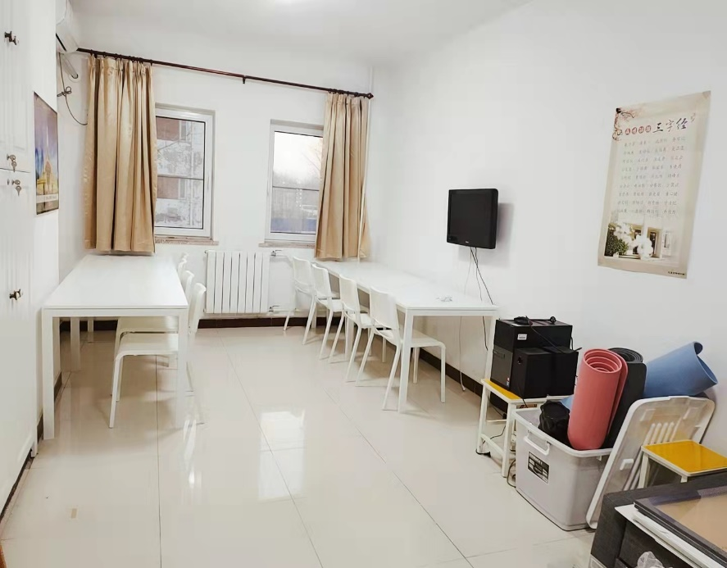
Introduction to CAUC
DORM

Slide 10
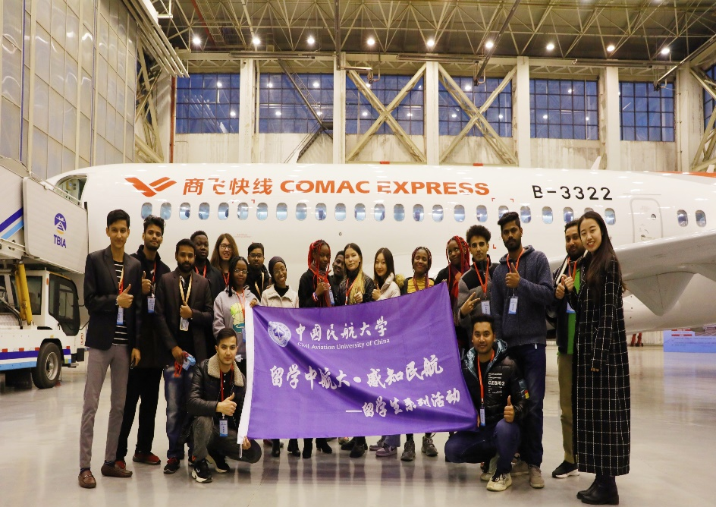
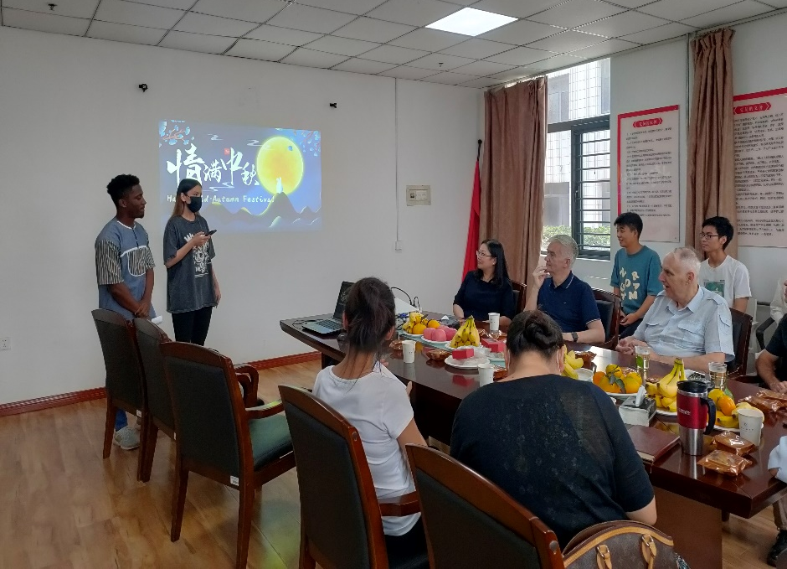
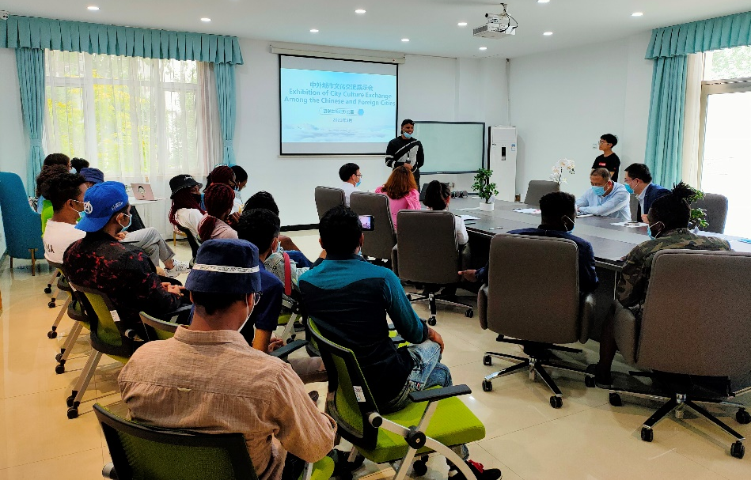
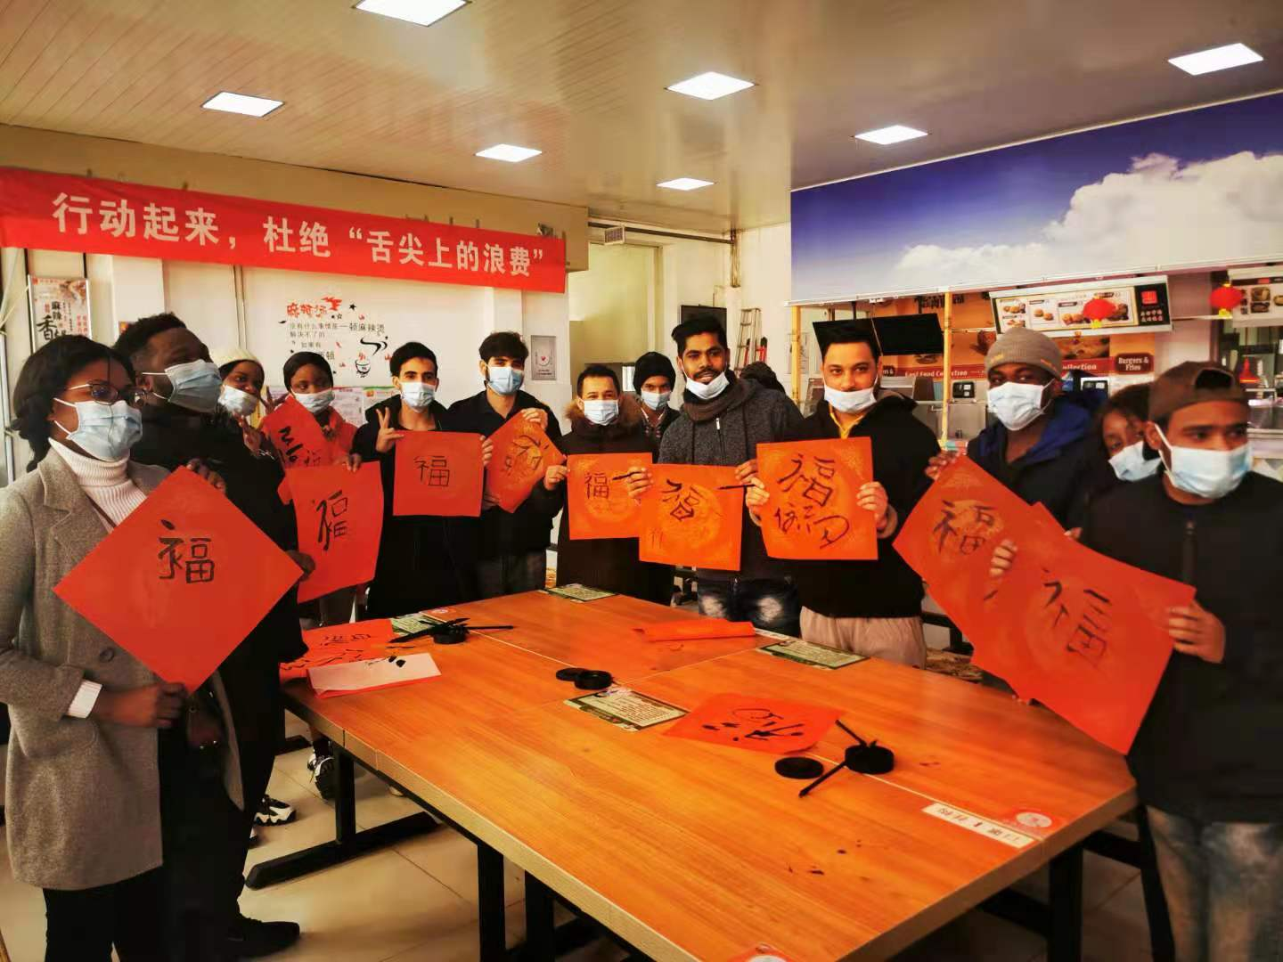
Introduction to CAUC
Cultural Activities

Slide 11
International Students Application
Bachelor Degree Programs (English)
College | Program
College of Electronic Information and Automation | Communication Engineering
College of Economics and Management | Business Administration

Slide 12
International Students Application
Bachelor Degree Programs (Chinese)
College | Program
College of Air Traffic Management | Traffic and Transportation (Air Traffic Control)
 | Traffic Management (Flight Operations Management)
College of Aeronautical Engineering | Flight Vehicle Propulsion Engineering (Aero-Engine)
 | Flight Vehicle Manufacturing Engineering (Aircraft Structure and System)
 | Materials Science and Engineering
College of Electronic Information and Automation | Electronic Information Engineering（Avionics）
 | Electrical Engineering and Automation (Aviation Electric)
 | Communication Engineering
 | Automation
College of Economics and Management | Business Administration

Slide 13
International Students Application
Master Degree Programs (English)
College | Program
College of Transportation Science and Engineering | Air Transport Management

Slide 14
International Students Application
Master Degree Programs (Chinese)
 | College | Program
Academic Master Degree Programs | College of Safety Science and Engineering | Safety Science and Engineering
 |  | Aircraft Airworthiness Certification and Engineering
 | College of Transportation Science and Engineering | Traffic and Transportation Engineering
 | College of Air Traffic Management | Traffic and Transportation Engineering
 | College of Aeronautical Engineering | Mechanical Engineering
 |  | Aeronautical and Astronautical Science and Technology
 | College of Electronic Information and Automation | Information and Communication Engineering
 |  | Control Science and Engineering
 | College of Computer Science and Technology | Computer Science and Technology
 |  | Air Transport Big Data Engineering
 | College of Economics and Management | Business Administration

Slide 15
International Students Application
Master Degree Programs (Chinese)
 | College | Program
Professional Master Degree Programs | College of Safety Science and Engineering | Network and Information Security
 |  | Air Traffic and Transportation
 | College of Transportation Science and Engineering | Air Traffic and Transportation
 | College of Air Traffic Management | Air Traffic and Transportation
 | College of Aeronautical Engineering | Mechanical Engineering
 |  | Aeronautical Engineering
 | College of Electronic Information and Automation | Electronic Information
 | College of Computer Science and Technology | Computer Technology

Slide 16
International Students Application
FEES
Double Room: 6,000 RMB/Person/Year
It should be paid upon registration.
400 RMB/person
It should be paid in RMB yuan upon application.
Application Fee
Tuition
Accommodation Fee
Transaction Information
Opening Bank: Tianjin Binhai International Airport Sub-branch, Industrial and Commercial Bank of China Account Name: Civil Aviation University of China Account Number: 0302015109100467065 SWIFT Code: ICBKCNBJTJN
Bachelor: 15,000 RMB/Person/Year
Master: 22,000 RMB/Person/Year
It should be paid upon registration.

Slide 17
International Students Application
SCHOLARSHIP
1st Year
Tianjin Municipal Government Scholarship CAUC Freshmen Scholarship
2nd, 3rd, 4th Years
CAUC Outstanding Enrolled Students Scholarship

Slide 18
International Students Application
Tianjin Municipal Government Scholarship
Type
Eligibility
(1) Applicants of bachelor degree programs should hold high school graduation certificate and be under the age of 30.
(2) Applicants of master degree programs should hold a bachelor degree and be under the age of 35.
(3) Language proficiency: Applicants of Chinese-taught programs should provide HSK certificate or other certificates that can prove their Chinese proficiency; Applicants of English-taught programs should provide English language certificate or English study certificate.
(4) Applicants should fill in Tianjin Municipal Government Scholarship Application Form, and handwrite their name down on the form.
(5) Master degree program applicants should submit two reference letters written by professors or associate professors.
First-Class Scholarship (Full Scholarship)
Coverage: Tuition, Accommodation and Living Stipend
Second-Class Scholarship (Partial Scholarship)
Coverage: Tuition and Accommodation
Duration: Ten Months of the First Academic Year

Slide 19
International Students Application
CAUC Freshmen Scholarship
Type
Eligibility
(1) Chinese-taught programs: Applicants of first-class scholarship should get a mark of 270 or higher in HSK 4; Applicants of second-class scholarship should get a mark of 180 or higher in HSK 4.
(2) English-taught programs: Applicants of first-class scholarship should get a mark of 7.0 or higher in IELTS, or should have an equivalent English proficiency level; Applicants of second-class scholarship should get a mark of 6.0 or higher in IELTS, or should have an equivalent English proficiency level;
(3) Applicants should not be awarded with other scholarships in the first year.
First-Class Scholarship (Full Scholarship)
Coverage: Tuition, Accommodation and Living Stipend
Second-Class Scholarship (Partial Scholarship)
Coverage: Tuition and Accommodation
Duration: Ten Months of the First Academic Year
在此添加关键字
在此添加关键字

Slide 20
International Students Application
CAUC Outstanding Enrolled Students Scholarship
 | First-Class Scholarship | Second-Class Scholarship | Third-Class Scholarship
Applicant Eligibility | (1) No suspension or extension of study in the previous academic year; (2) Meet the minimum credits requirements in the two semesters of the previous academic year; (3) Obey Chinese laws and university rules and regulations; (4) Not be awarded with other scholarships in the current academic year.
Coverage | Tuition, Accommodation and 10 Months of Living Stipend | Tuition and Accommodation | Tuition
Scholarship Duration | One academic year. The scholarship award is evaluated on a yearly basis to determine if the applicants will receive the financial aid in the coming academic year.

Slide 21
International Students Application
Application Documents
 | Chinese-Taught Bachelor Degree |  | English-Taught Bachelor Degree | Chinese-Taught Master Degree | English-Taught Master Degree
First Page of Valid Passport | √ |  | √ | √ | √
Valid Residence Permit | Applicants who are living in China should submit a scanned copy of valid residence permit.
Notarized High School Graduation Certificate and Transcript & Their English/Chinese Translation | √ Or a pre-graduation certificate |  |  | × | ×
Notarized Bachelor Degree Certificate and Transcript & Their English/Chinese Translation | × | × |  | √ Or a pre-graduation certificate
Foreigner Physical Examination Form | √ after January 1st, 2023.
Personal Information Form | √ | √ |  | √ | √
Tianjin Municipal Government Scholarship Application Form | √ | √ |  | √ | √
HSK Certificate | √ | Not a Must |  | √ | Not a Must
English Proficiency Proof (except for English native speakers) | × | √ |  | × | √
Study Plan | √ In Chinese | √ In English |  | √ In Chinese | √ In English
Police Clearance Record (in English or Chinese) | √ | √ |  | √ | √
Two Reference Letters from Prof. or Associate Prof. | × | × |  | √ | √
Self-Introduction Video | In Chinese | In English |  | In Chinese | In English

Slide 22
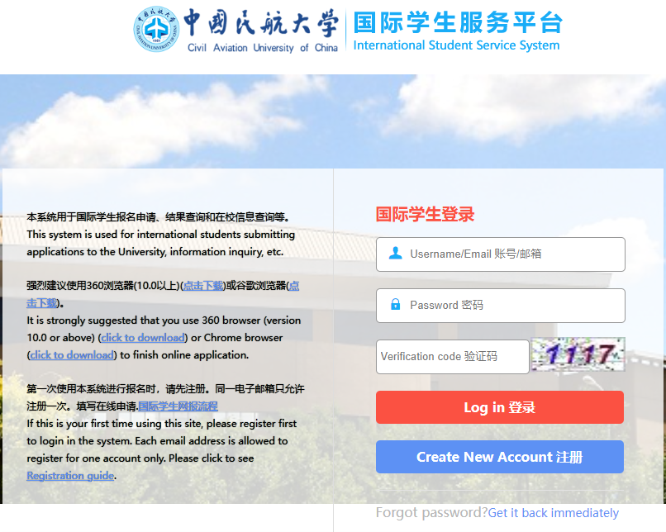
International Students Application
1
3
Submit your application on: cauc.at0086.cn/student (Fill out your information, upload the scanned copy of supporting documents, pay the application fee, upload the payment proof, submit the application)
Download the WeChat app and join the WeChat group chat by following the instruction on the Admission Notice
Apply for the visa
CAUCer
2
4
Waiting for the review.
The accepted applicants will receive a scanned copy of Admission Letter via the application website or email in early July.
Register on campus in September
Bring all the original documents that you submitted online

Slide 23
International Students Application
Deadline
May ${31}^{st}$, 2023 New semester starts in September, 2023 cauc.at0086.cn/student

Slide 24
Q & A

Slide 25
Thank you!
86-22-24092915，86-22-24092036 international@cauc.edu.cn https://www.cauc.edu.cn/en/
For Application: https://cauc.at0086.cn/student
No.2898, Jinbei Road, Dongli District, Tianjin, P.R.China
International Affairs Department
March 15, 2023

