Slide 1




Nanjing University of Information Science & Technology
南京信息工程大学
A National Key University
国家重点高校
National “Double First-class” Construction University and Discipline
国家双一流建设高校

Slide 2
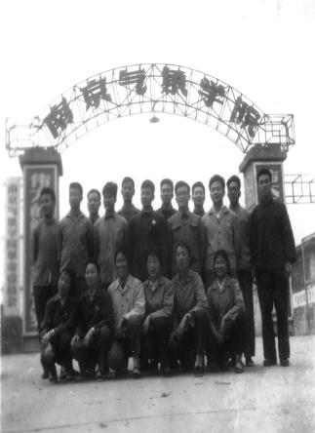
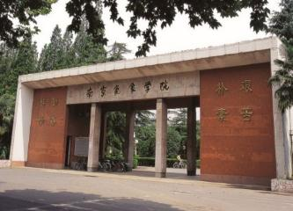
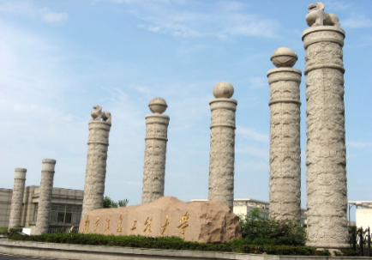
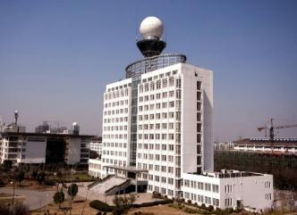
History(发展历程)
1978
2000
2007
2012
2014
2017
1960
Foundation
成立
Enlisted as a national key university
国家重点建设高校
Joined the fleet of provincial administration of Jiangsu
江苏省人民政府共建
Co-administration of CMA and Jiangsu中国气象局与江苏省人民政府共建
Three-party administration三方共建：中国教育部、中国气象局、江苏省人民政府
Four-party administration四方共建：中国教育部、中国气象局，中国海洋局、江苏省人民政府
Double First-rate Universities
双一流建设高校
+CMA
Chinese Government
+Ministry of
Education
+State Oceanic
Administration

Slide 3
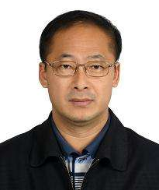
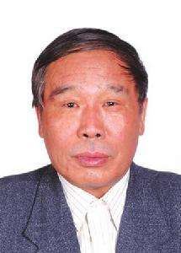

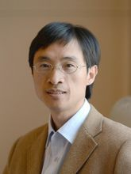
NUIST Today (今日信大) | Teachers (师资队伍)
Faculty全职教师
2000
Prof. and
Associate Prof.教授和副教授
51%
Doctorate Holders博士学位拥有者
85%
Huijun WANG
Chinese Academy of Sciences
Guangyu SHI
Chinese Academy of Sciences
Overseas PhD. Degree Holders海归博士
50%
CAS Members中科院院士
2
Members of Overseas Academies海外院士
18
Zbigniew W. Kundzewicz,
Polish Academy of Sciences
International Eurasian Academy of Sciences
Shuanggen JIN
Russian Academy of Natural Sciences

Slide 4


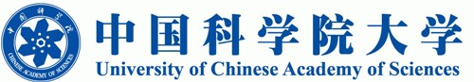



NUIST Today (今日信大) | Talent Cultivation (人才培养)
Campus
NUIST has its campus in Nanjing, the provincial capital of Jiangsu Province. The campus is located in Nanjing Jiangsu New Area, near China (Jiangsu) Pilot Free Trade Zone Nanjing Area. 南京信息工程大学坐落于江苏省省会南京市江北新区，毗邻中国江苏南京自贸区。
Size
30,000+ undergraduates, 4,000+ graduates, 1,200+ international students；22 Schools and Colleges; future scientists, entrepreneurs, globalized talents, market-oriented professionals.
本科生3万余名，研究生4千余名，留学生1200余名，学校共有22个专业学院，旨在培养科学家，企业家，全球化人才，市场专业人员。

Slide 5
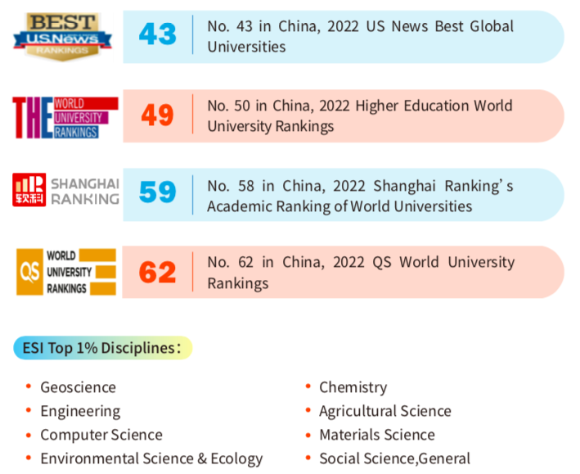
NUIST Today (今日信大) | Strength (综合实力)
95所双一流高校之一
8所江苏高水平大学之一
国内高校综合排名43-62名
ESI前1%的学科有：地球科学、工程学、计算机科学、环境与生态学、化学、农业科学、材料科学、社会科学总论
大气科学排名全国第一，世界第九

Slide 6
International Students (来华留学)
The university started to enroll international students from 1993.
我校于1993年起开始招收国际学生。
In 2022, the number of international students reached 1200+ from 130+ countries.
2022年，我校在校留学生共计有来自130多个国家和地区的1200余名。
现如今在校的马来西亚华文独中的学生分别来自：居銮中华中学，吉隆坡坤城中学，槟城恒毅国民型华文中学，育才独中
Notes:
NUIST started to enroll international students from 1993. The Number of international students reached 1200+ from 100+ countries, of which 700 are degree students, and 31% of them doing master or doctorate degrees.

Slide 7
Chapter 3
spring
summer
autumn
winter
NUIST
留学南信
Study at NUIST
春
夏
秋
冬
NUIST Campus in Four Seasons
Notes:
Next, I would like to give a brief introduction to NUIST training and degree programs.

Slide 8
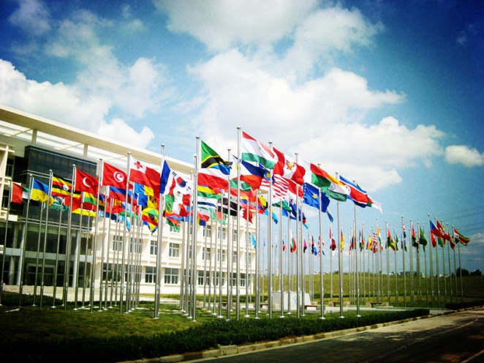
Study at NUIST（留学南信大）
| Degree Programs （学历项目）
A total of 77 undergraduate programs, 36 master’s degree programs and 29 doctoral degree programs are offered in NUIST. 学校共计开设77个本科专业，36个硕士专业和29个博士专业。
Programs in English-medium include:英文授课专业
Undergraduate Programs (4 years)本科（4年）
Computer Science and Technology 计算机科学与技术
Electronic Information Engineering 电子信息工程
International Economics and Trade 国际经济与贸易
Artificial Intelligence 人工智能
Master Programs (2 years) 硕士（2年）
Business Management 工商管理
Finance 金融
Artificial Intelligence 人工智能
Computer Science and Technology 计算机科学与技术
Environmental Science and Engineering 环境科学与工程
Meteorology 气象学
Applied Meteorology 应用气象学
Information and Communication Engineering 信息与通信工程

Slide 9
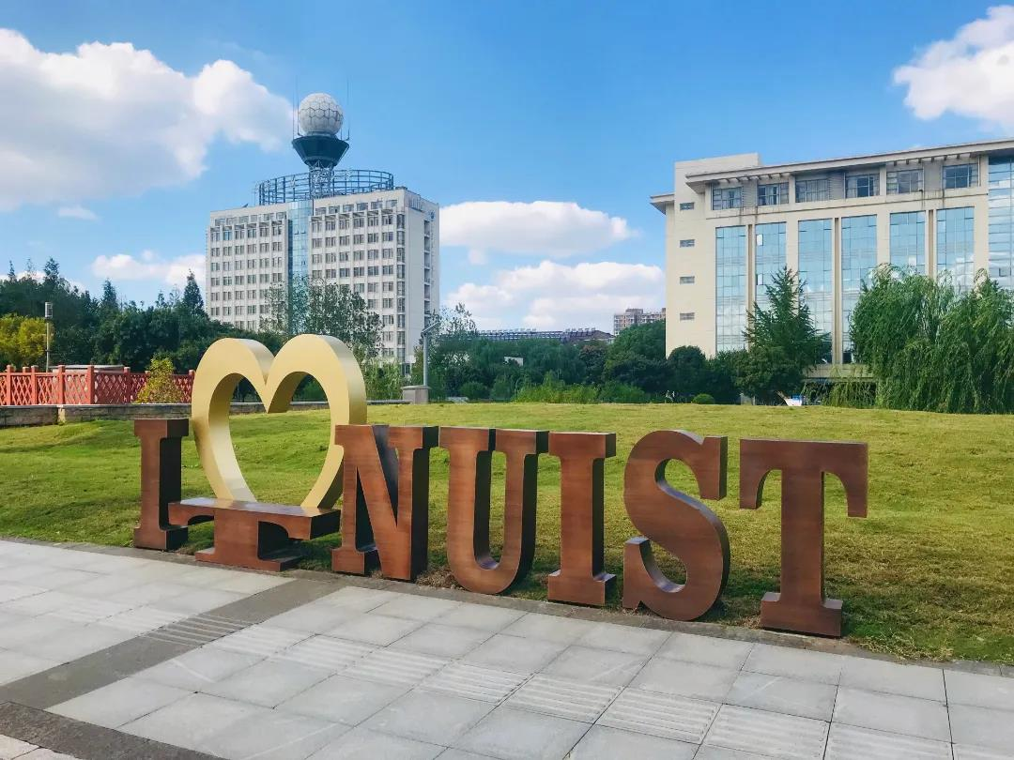
Study at NUIST（留学南信大）
| Degree Programs （学历项目）
All doctoral programs (3 years and above) can be taught in English. 博士专业均可英文授课，学制3年及以上
Meteorology related programs 气象学相关专业
Computer Science and Technology 计算机科学与技术
Artificial Intelligence 人工智能
Environmental Science and Engineering 环境科学与工程
Environmental Perception and Intelligent Control 环境感知与智能控制
Optoelectronic Information Engineering 光电信息工程
Management Science and Engineering 管理科学与工程
Emergency Management 应急管理
Mathematics 数学
History of Science and Technology 科学技术史

Slide 10
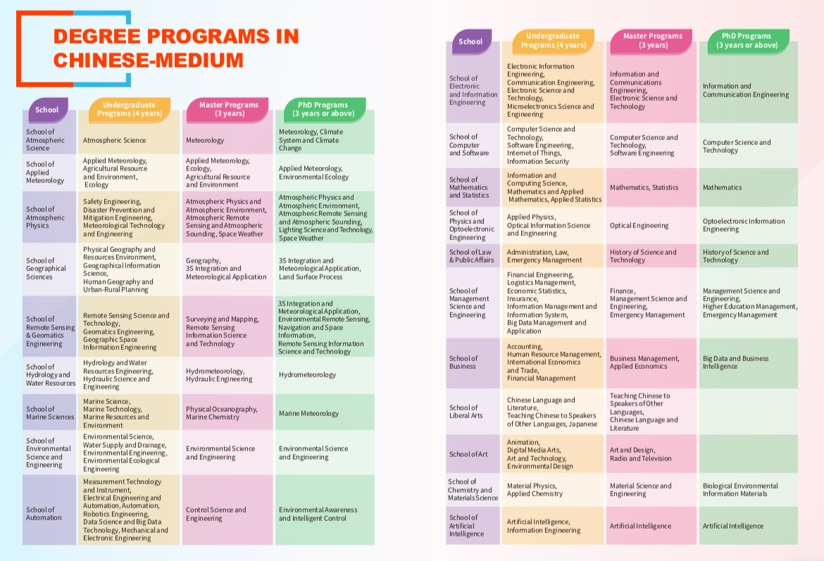
Study at NUIST（留学南信大）
| Degree Programs in Chinese Medium （中文授课学历项目）

Slide 11
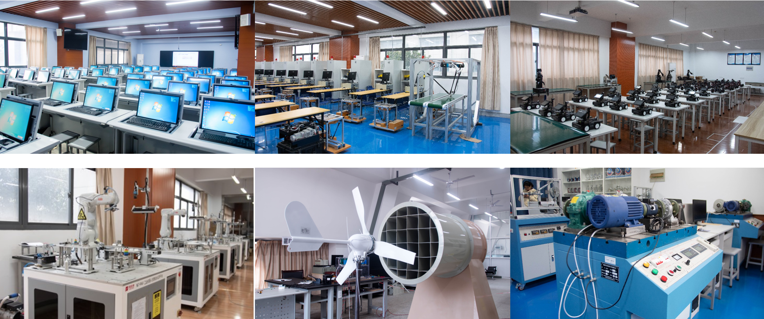
Degree Programs （学历项目）
| Teaching Facilities and Labs (教学平台及实验室)

Slide 12
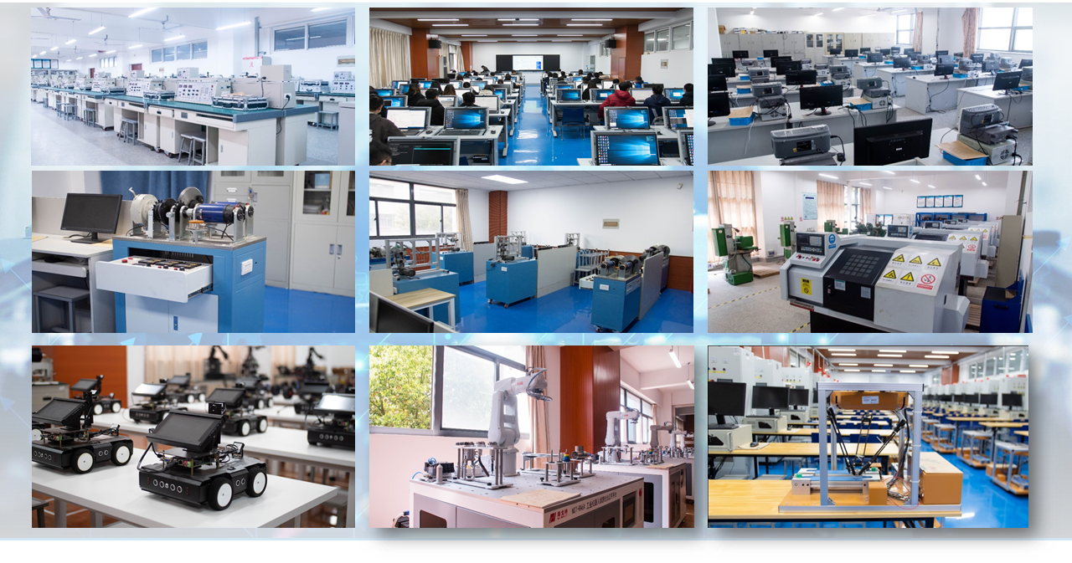
Degree Programs （学历项目）
| Teaching Facilities and Labs (教学平台及实验室)

Slide 13
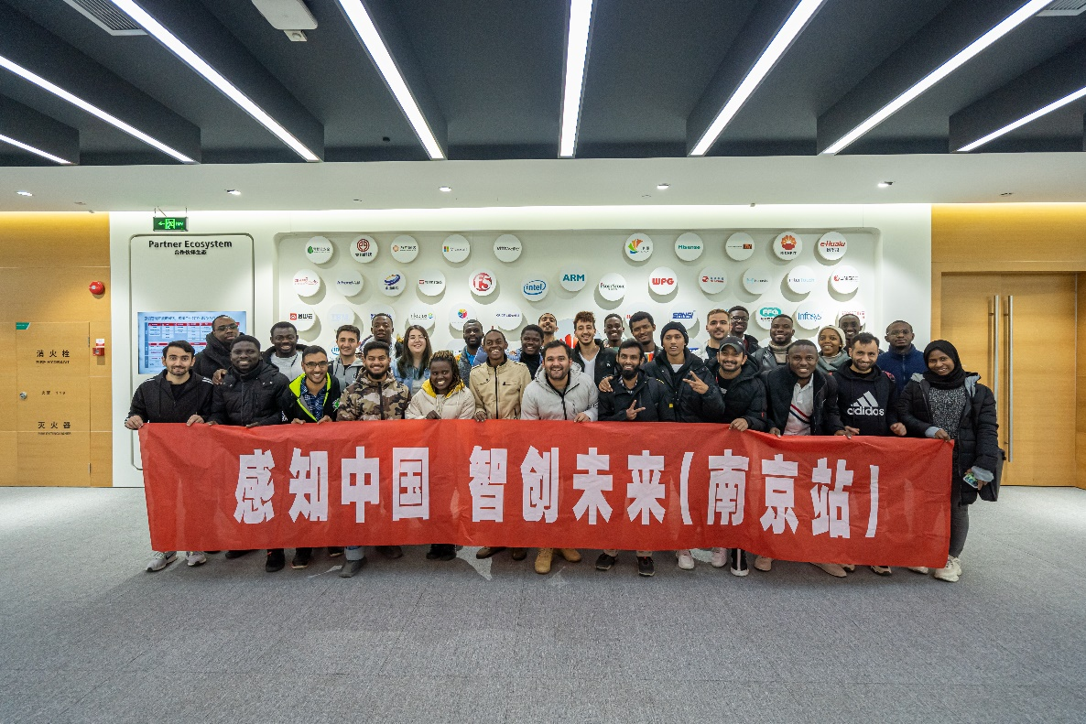
Degree Programs （学历项目）
| Internships & Practices（专业实习）
Huawei AI Training Camp

Slide 14
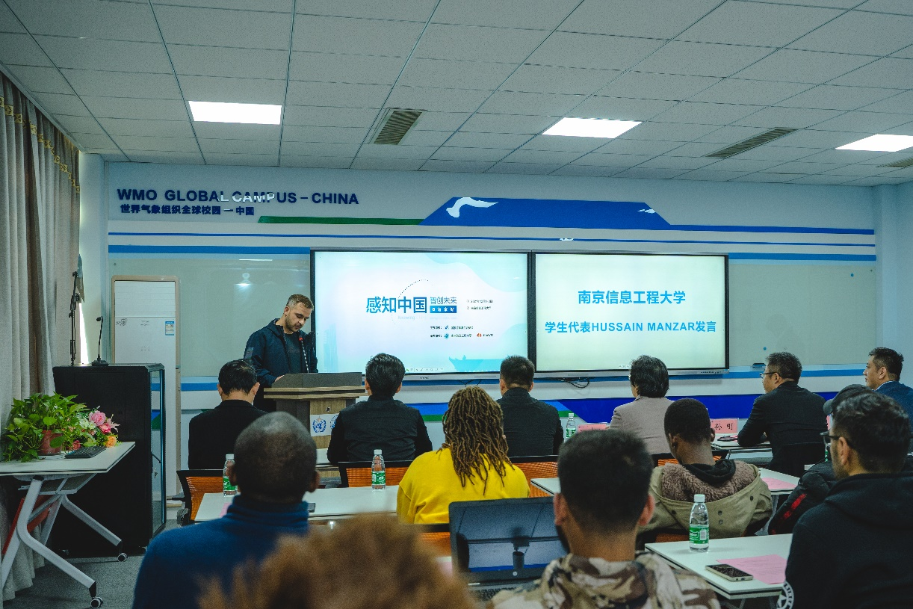
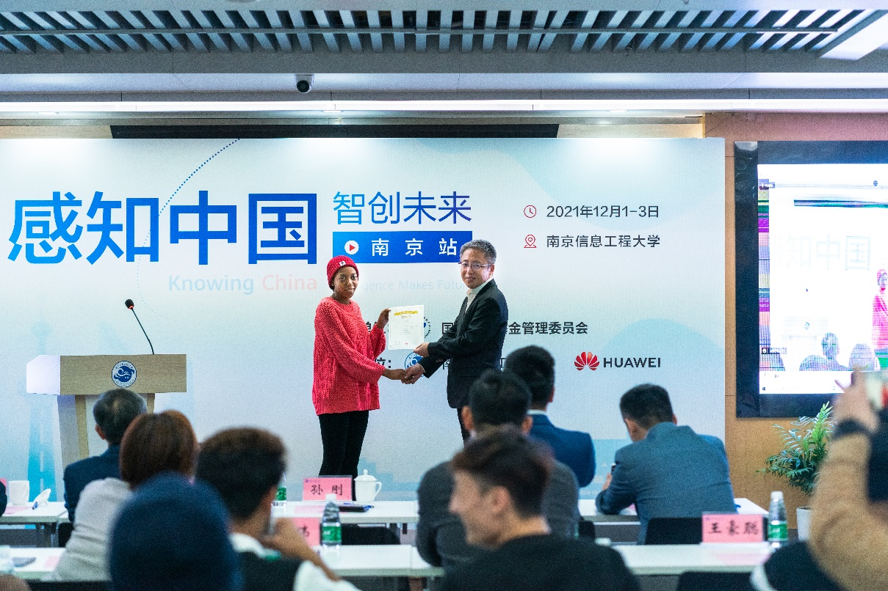
Degree Programs （学历项目）
| Internships & Practices（专业实习）
Huawei AI Training Camp

Slide 15
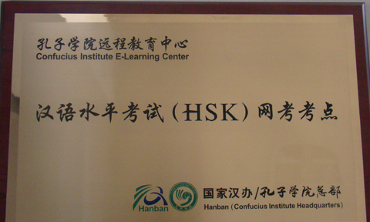
Study at NUIST（留学南信大）
| Chinese Language and Culture Programs
（汉语与中国文化项目）
Chinese Language Program 汉语言进修生项目
Study Duration: 1 semester to 2 academic years
Level 0: for beginners HSK Level 1-2
Level 1: Elementary Chinese HSK Level 3-4
Level 2: Mediate Chinese HSK Level 4-5
Level 3: Advanced Chinese HSK Level 5-6
学习周期从1学期到两学年不等，课程从零基础到高级汉语，对应HSK1级到6级。
Chinese Culture Program 中国文化项目
NUIST hosts Chinese Culture Program, the duration of which is around 2 to 4 weeks, and the courses include Chinese Language, Paper-cutting, Calligraphy, Martial Arts, etc. Students would visit Nanjing, the ancient capital of six dynasties for sightseeing, learn traditional Chinese arts and culture, and experience campus life in China.
中国文化项目学习周期未2-4周，涵盖汉语，剪纸，书法，等相关课程，学生会观光游览六朝古都南京，学习中国传统文化，体验中国的学校生活。
HSK Online Test Center of Confucius Institute was established in NUIST in 2012
2012年开始，学校内有HSK机考考点

Slide 16

Study at NUIST（留学南信大）
| Scholarships for New Students（新生奖学金）
Chinese Government Scholarship 中国政府奖学金
Master's Program of Meteorology sponsored by the Chinese Ministry of Commerce 商务部气象学硕士奖学金
International Chinese Language Teachers Scholarship国际汉语教师奖学金
Nanjing Municipal Government Scholarship南京市政府奖学金
NUIST-WMO Fellowship Program南京信息工程大学与世界气象组织奖学金
NUIST University Scholarship南京信息工程大学优秀新生奖学金
https://gjy.nuist.edu.cn/
Notes:
A variety of scholarships are available for outstanding international students to pursue their further education at NUIST, such as Chinese Government Scholarship, Scholarship of Chinese Ministry of Commerce, Confucius Institute Scholarship, Jasmine Jiangsu Government Scholarship, Nanjing Municipal Government Scholarship, NUIST-WMO Fellowship Program and university scholarship.

Slide 17
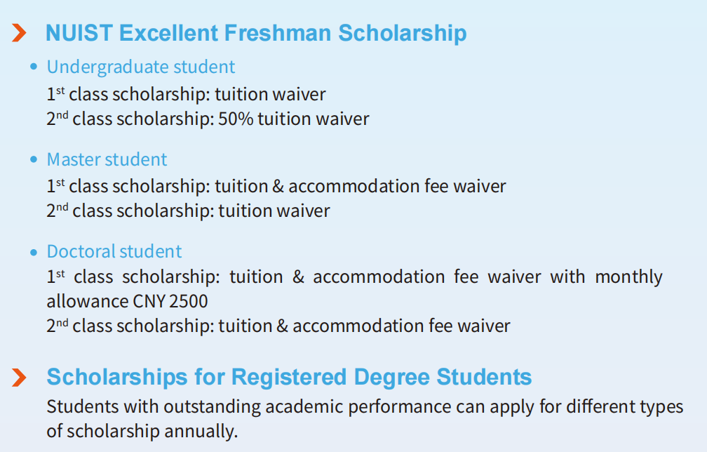
Study at NUIST（留学南信大）
| NUIST Excellent Freshman Scholarship（优秀新生奖学金）
https://gjy.nuist.edu.cn/
Notes:
A variety of scholarships are available for outstanding international students to pursue their further education at NUIST, such as Chinese Government Scholarship, Scholarship of Chinese Ministry of Commerce, Confucius Institute Scholarship, Jasmine Jiangsu Government Scholarship, Nanjing Municipal Government Scholarship, NUIST-WMO Fellowship Program and university scholarship.

Slide 18

Study at NUIST（留学南信大）
| Scholarships for Students on Campus（老生奖学金）
Chinese Government Excellent Student Scholarship 中国政府优秀留学生奖学金
30,000 CNY for master and doctoral students; 18,000 CNY for undergraduates硕士博士30000元人民币，本科18000元人民币
Jiangsu Government Excellent Student Scholarship 政府优秀留学生奖学金
30,000 CNY for master and doctoral students; 18,000 CNY for undergraduates硕士博士30000元人民币，本科18000元人民币
Longshan Scholarship B-class
Longshan Scholarship C-class
Longshan Scholarship D-class
龙山奖学金B/C/D（学校奖学金）

Slide 19
Study at NUIST（留学南信大）
| Application（申请）
Admission
Fees费用
Application Procedures申请流程
Teaching Pattens 教学方式

Slide 20
Study at NUIST（留学南信大）
| Fees（费用）
Application Fee申请费 | CNY 500 per person 500元人民币每人
Tuition学费 | Undergraduate Programs 本科 | CNY 15,000 per year
 | Master’s Programs 硕士 | CNY 20,000 per year
 | Doctoral Degree Programs 博士 | CNY 25,000 per year
 | Chinese Language Program 汉语言 | CNY 15,000 per year
 |  | CNY 7,500 per semester
Accommodation住宿费 | Single Room单人间 | CNY 4,000 per year
 | Quad Room四人间 | CNY 1,500 per year (Nanjing Campus) CNY 1,000 per year (Jin Niuhu Campus)
 | All the rooms are furnished with individual bathroom, water heater, air-conditioner, internet access and optional paid central heating. 所有的房间都配有独立卫生间，热水器，空调，网络接口和可选付费集中供暖。 There are public kitchen and laundry facilities in the dormitory buildings. 公共厨房和洗衣房也在宿舍楼内。
Comprehensive Medical Insurance综合医疗保险 | CNY 600 per year 每年600元
Physical Examination体检 | CNY 538 per person 每人538元
Residence Permit居留许可 | CNY 400 per year 每年400元

Slide 21
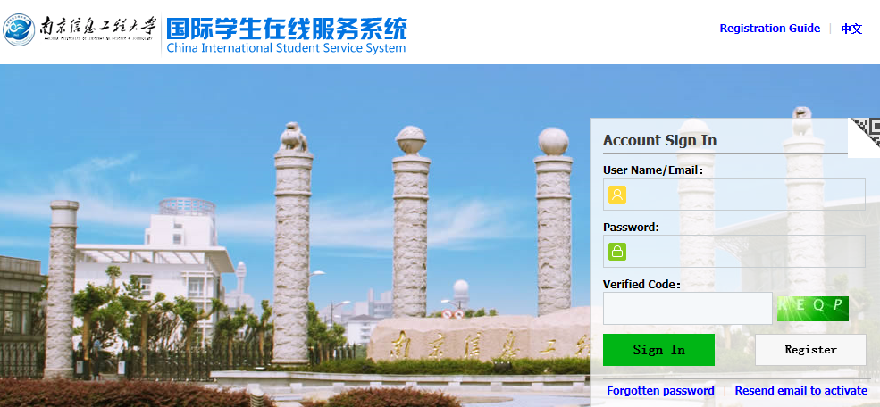
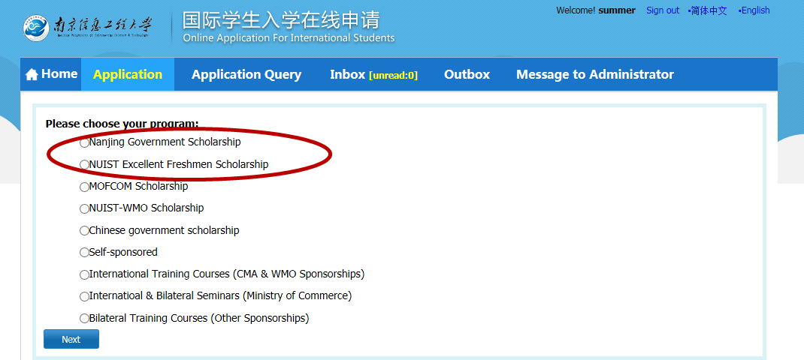
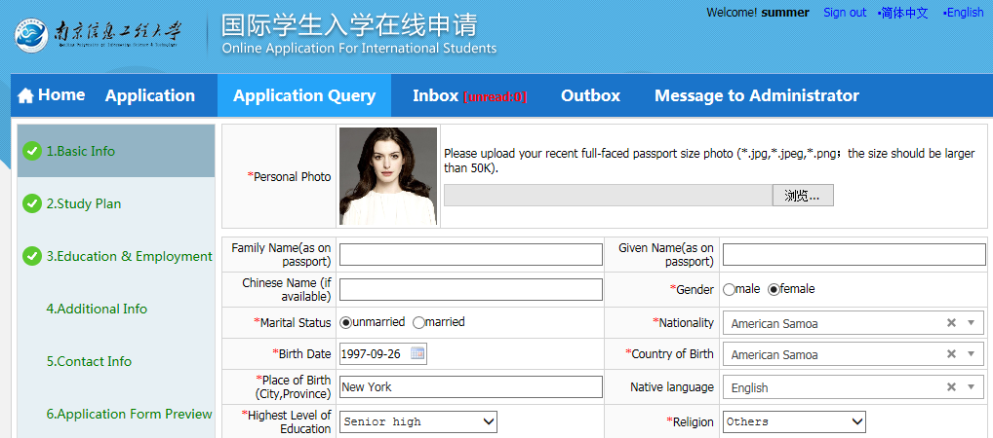
Study at NUIST（留学南信大）
| Application Procedures（申请流程）
NUIST Online Application System 在线申请系统 (http://nuist.17gz.org/member/login.do)
select the scholarship选择奖学金
/self-sponsored programs
complete the Application Form online, and upload e-copies of relevant original documents完成在线申请表并上传申请材料
application deadline: 申请截止日期
January 15 (March-intake); 春季3月15日
July 15(September-intake)秋季9月15日
applicants can query the application progress and results in the system申请者可在系统中查询申请流程和录取结果。

Slide 22

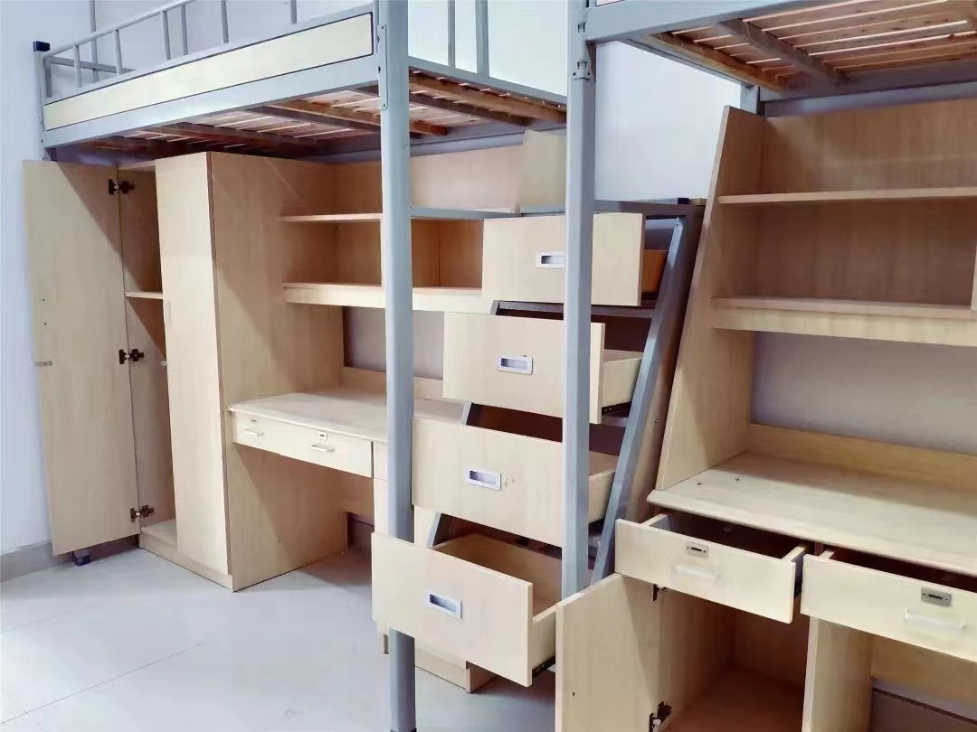
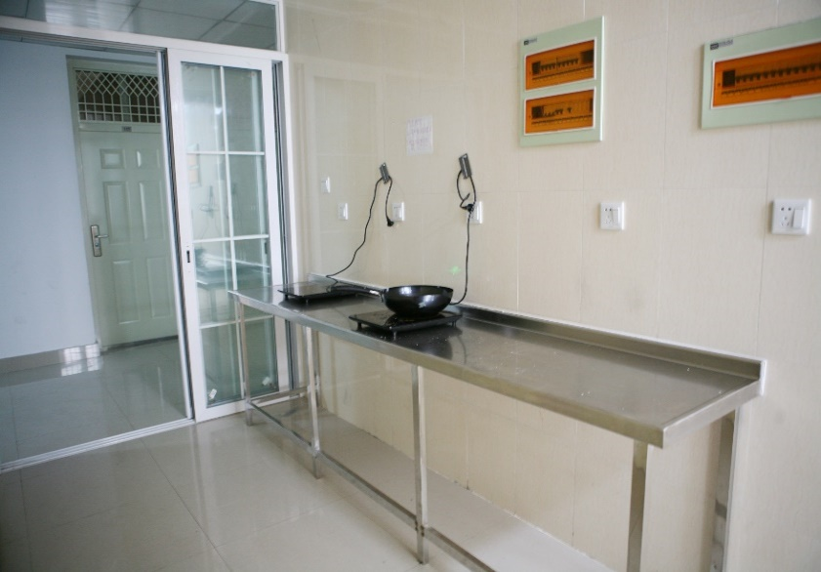
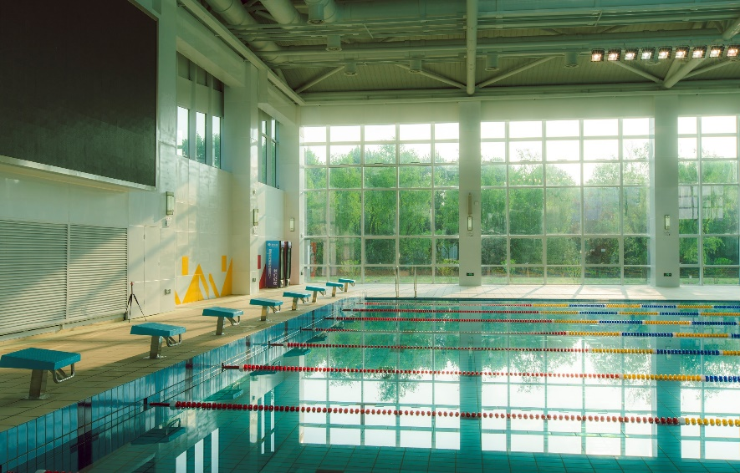
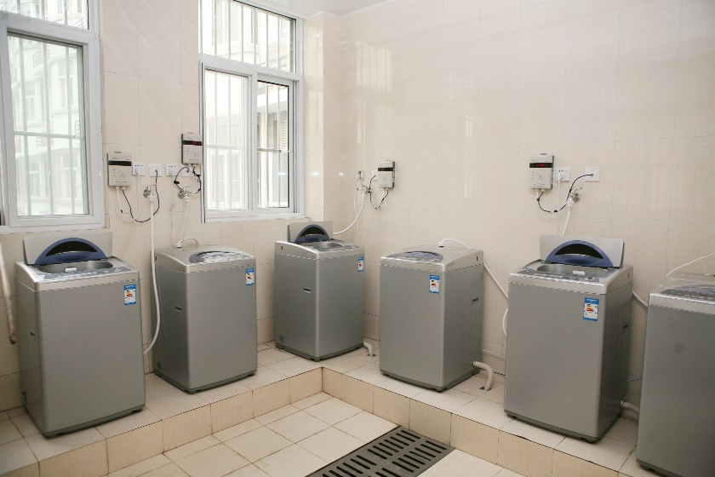
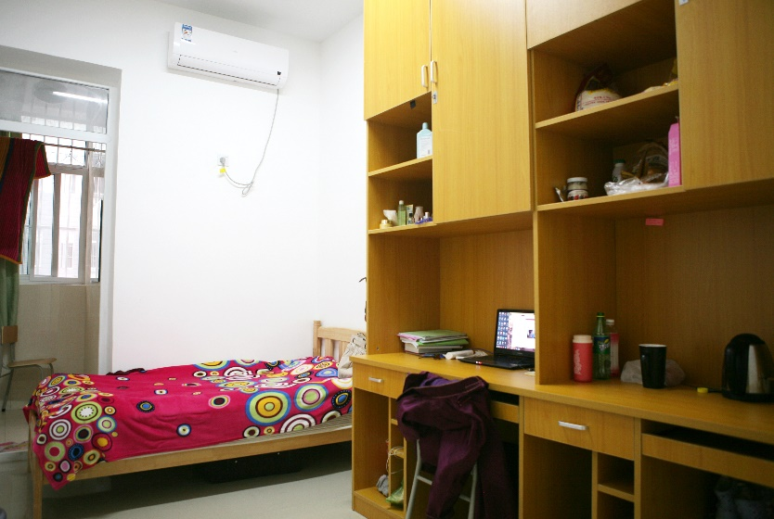
Study at NUIST（留学南信大）
| Campus Life（校园生活）

Slide 23
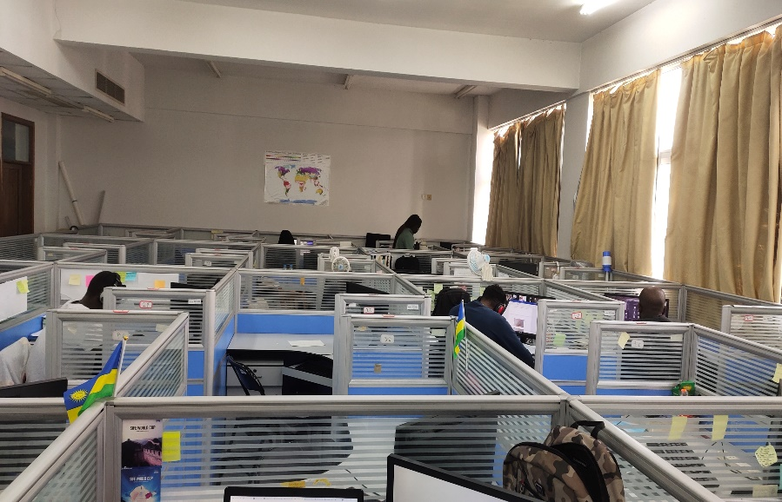
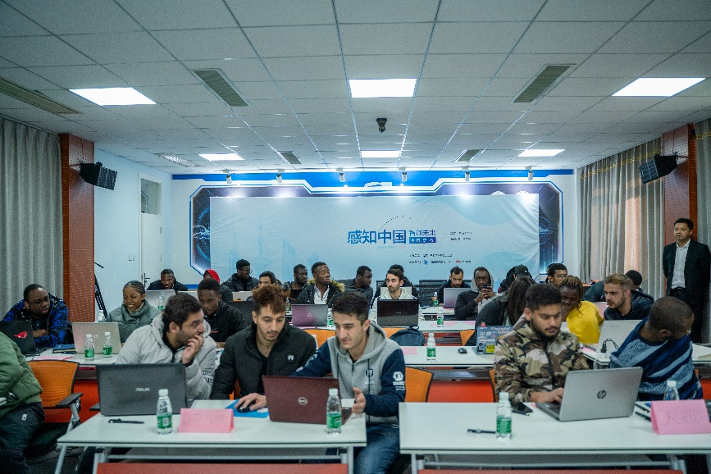
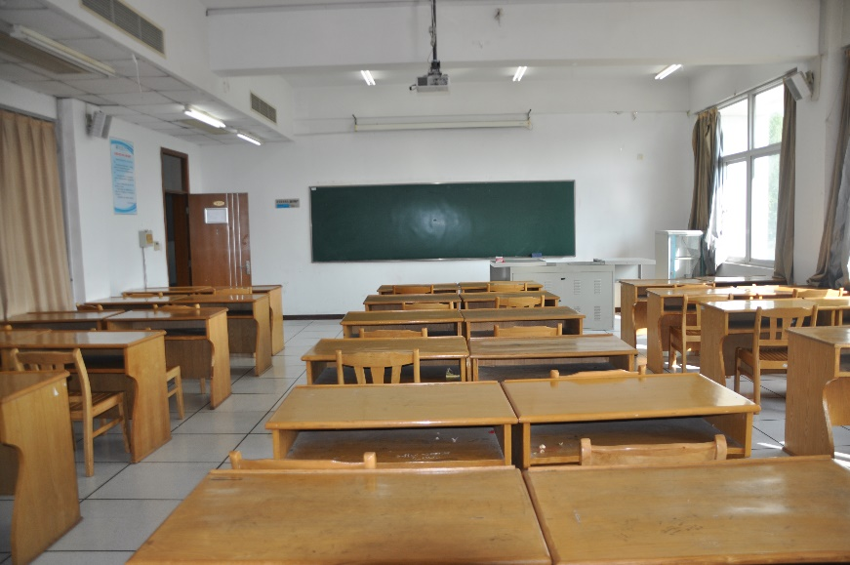
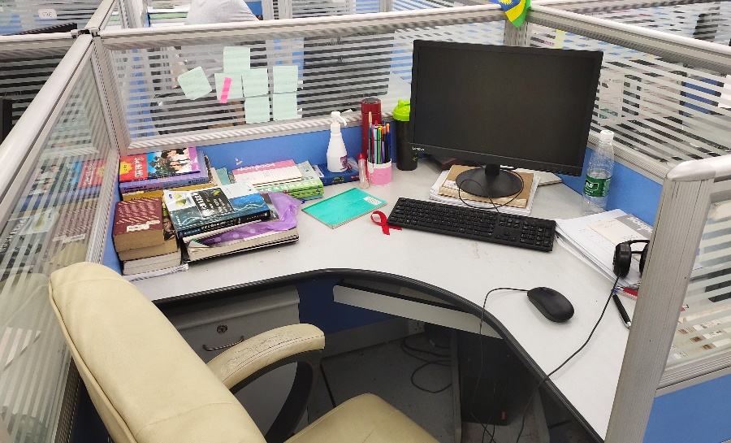
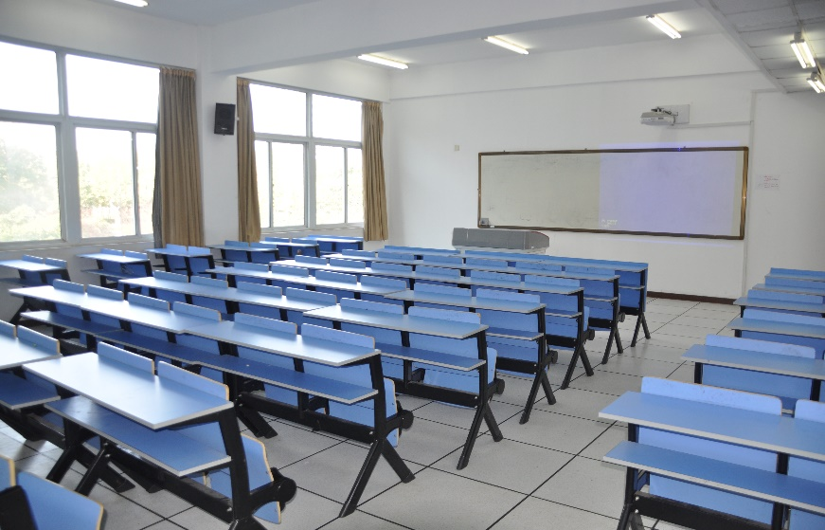
Study at NUIST（留学南信大）
| Campus Life（校园生活）

Slide 24


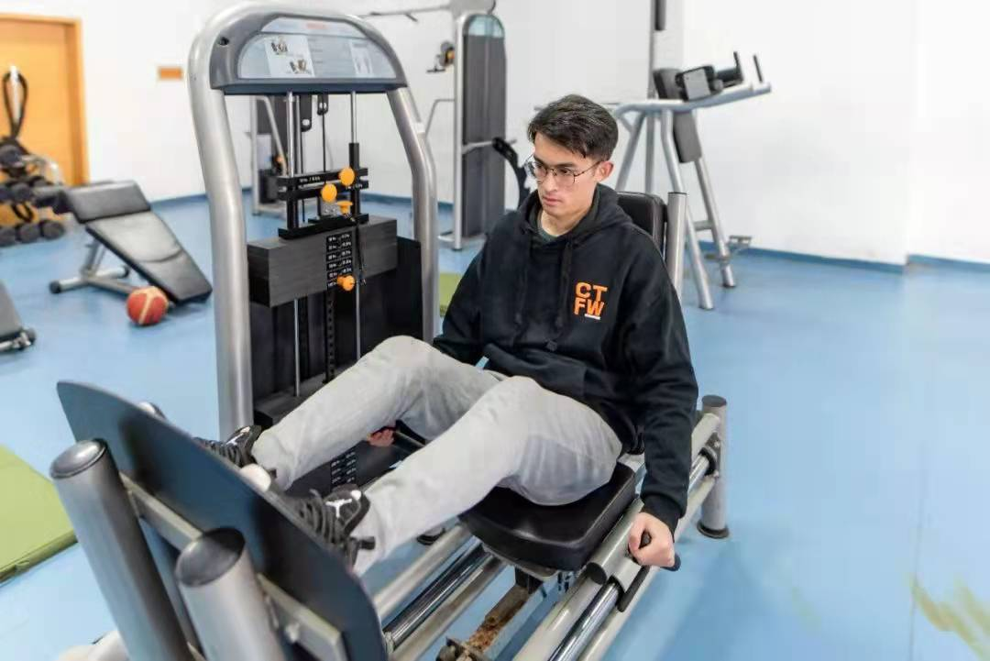
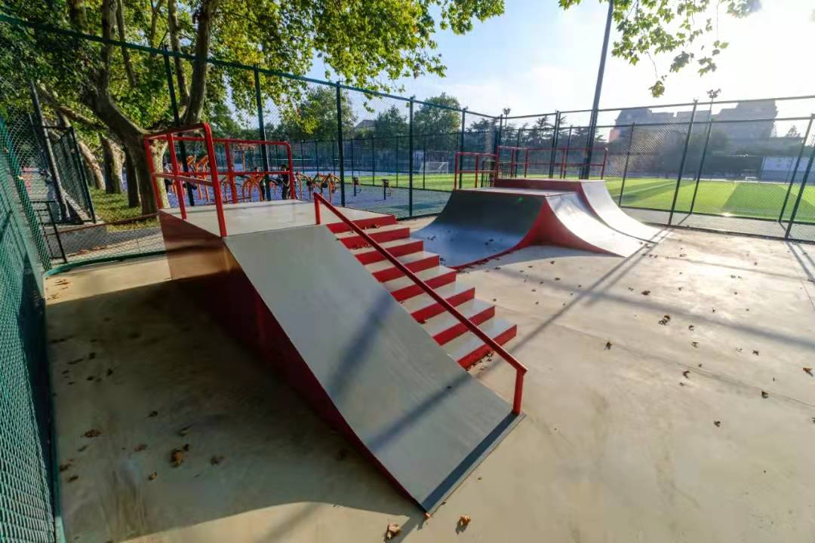
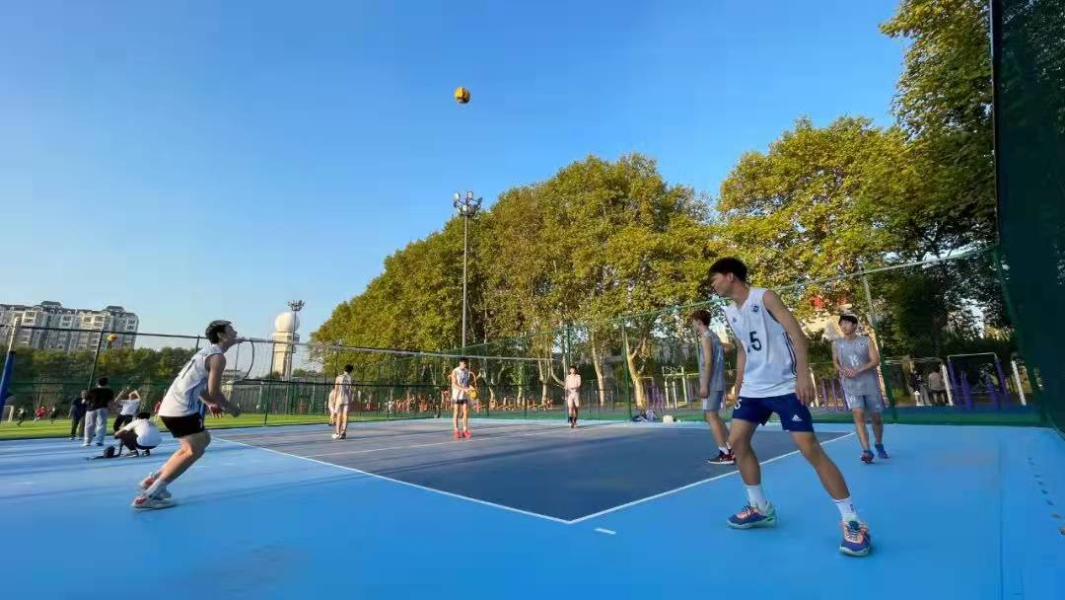

Study at NUIST（留学南信大）
| Campus Life（校园生活）

Slide 25
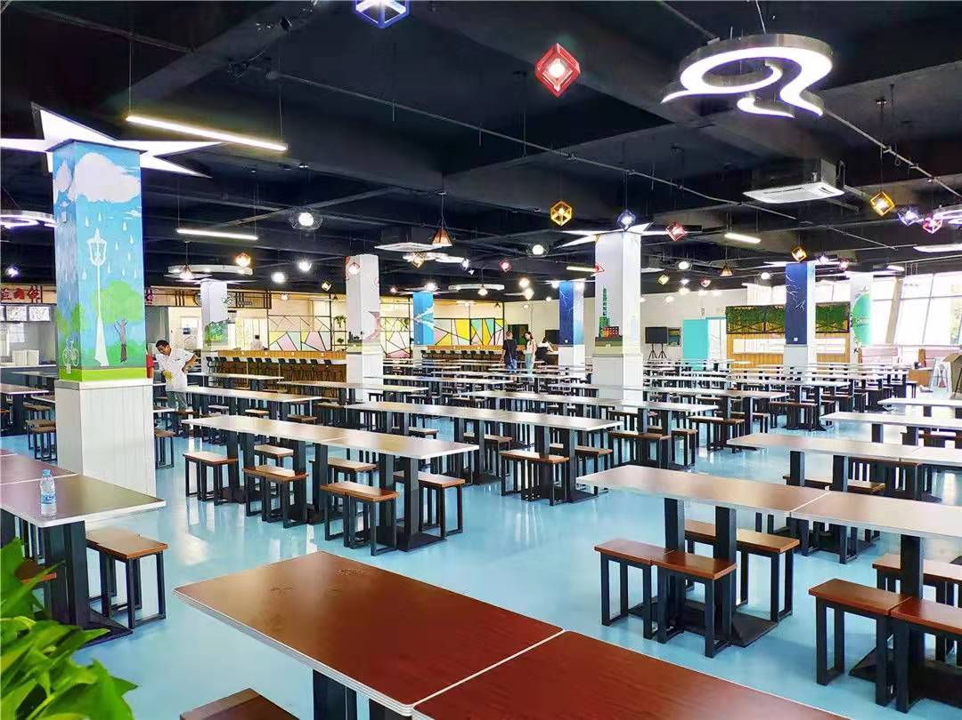


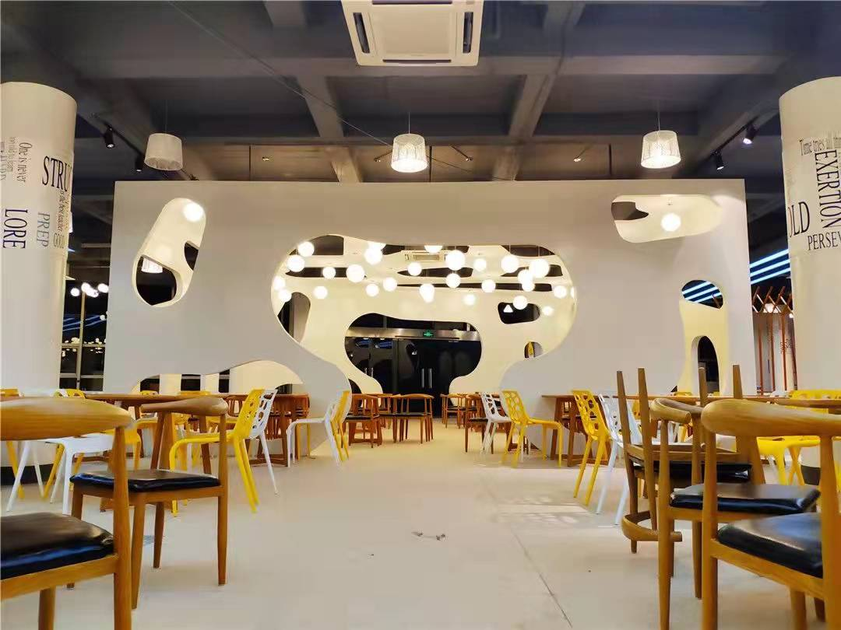
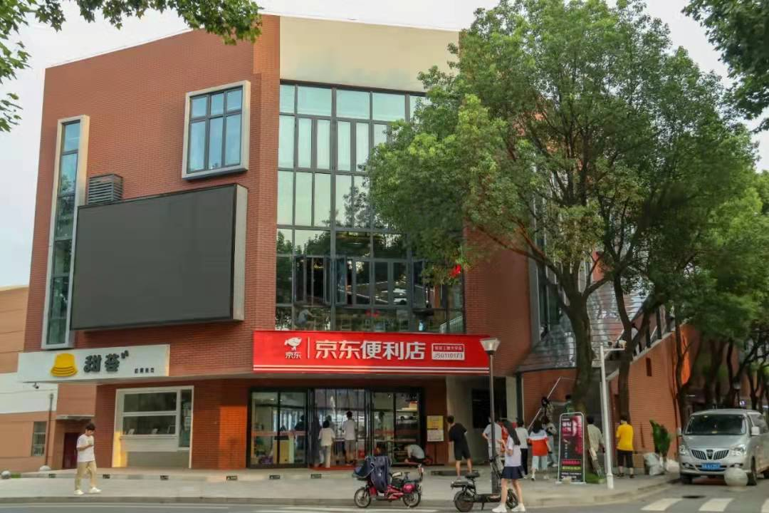
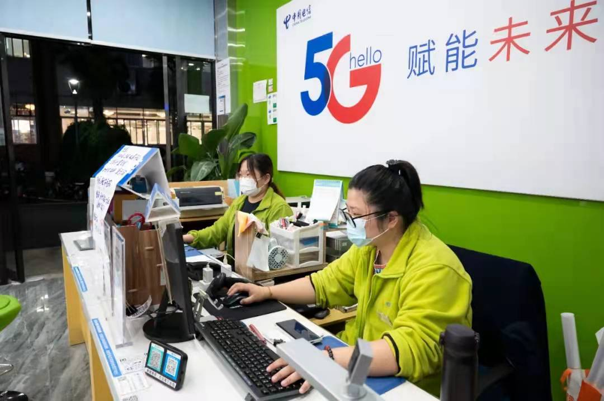
Study at NUIST（留学南信大）
| Campus Life（校园生活）

Slide 26


Study at NUIST（留学南信大）
| Students Activities（学生活动）
National Chinese Bridge Contest
Jiangsu Provincial Chinese Speech Contest

Slide 27
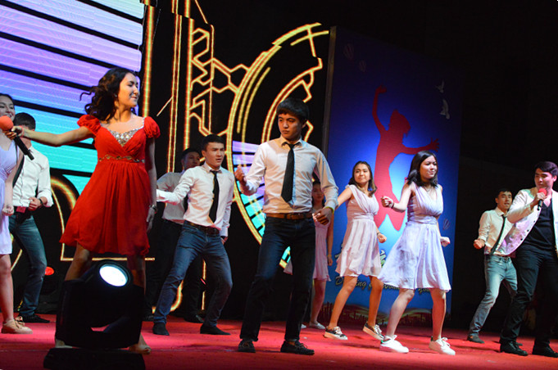
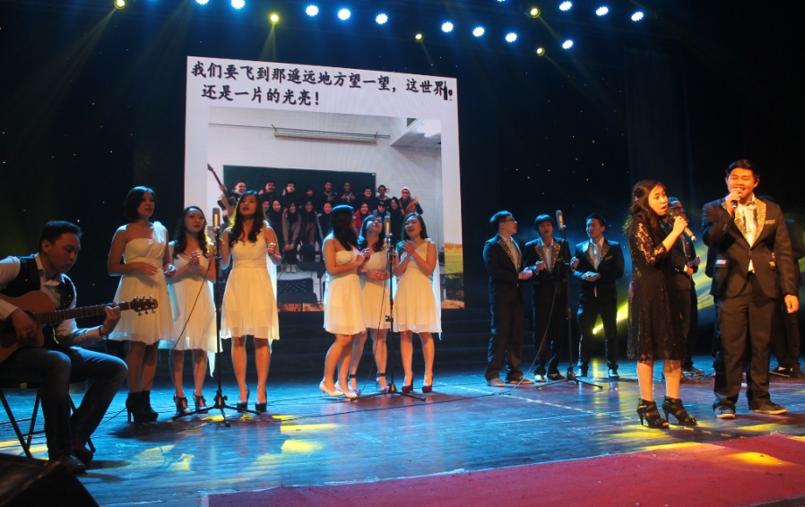

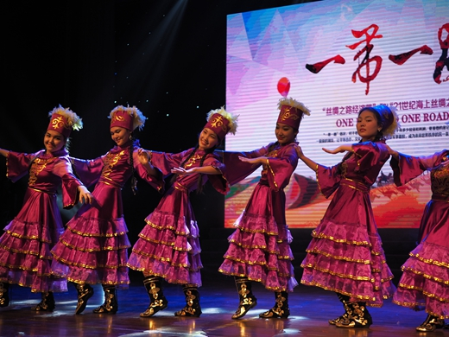
Study at NUIST（留学南信大）
| Students Activities（学生活动）
Arts Performance

Slide 28


Study at NUIST（留学南信大）
| Students Activities（学生活动）
Sports Activities

Slide 29
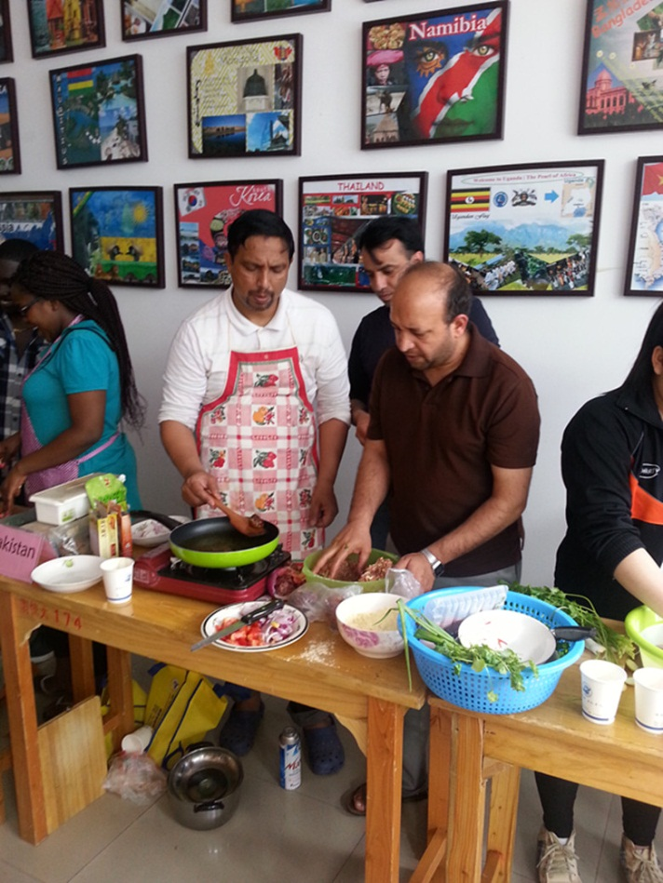
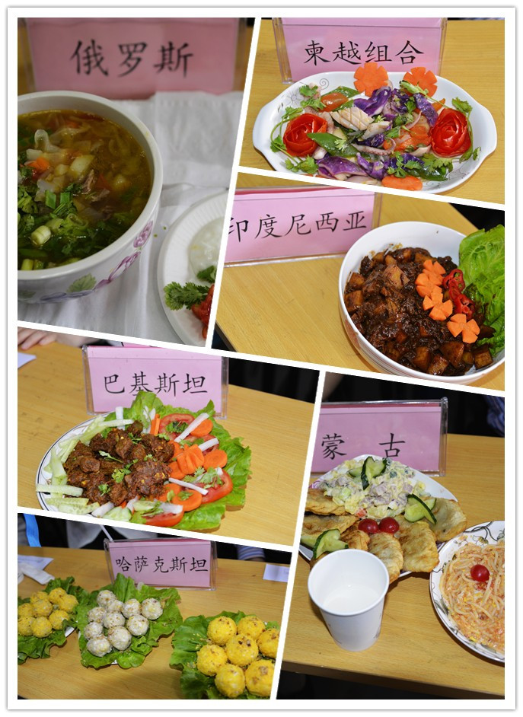
Study at NUIST（留学南信大）
| Students Activities（学生活动）
Cooking Competition

Slide 30
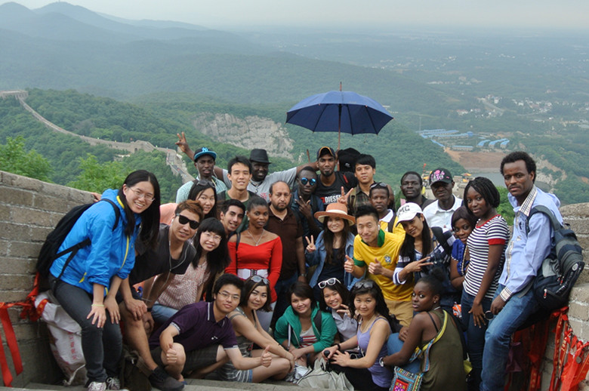
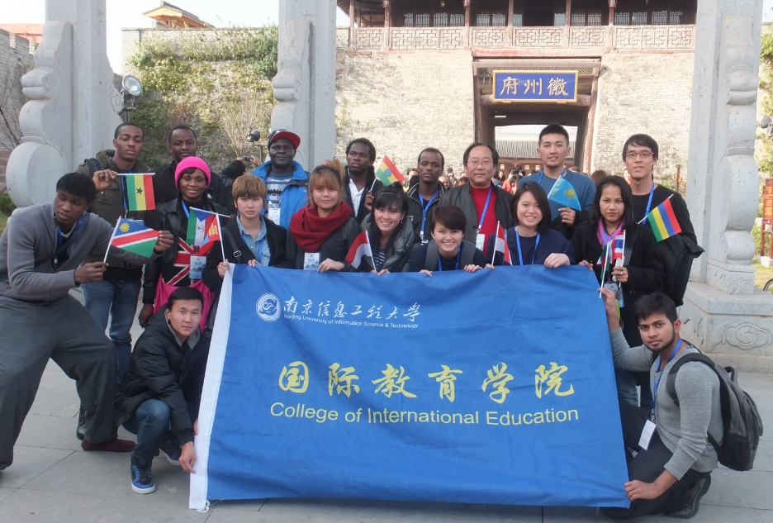
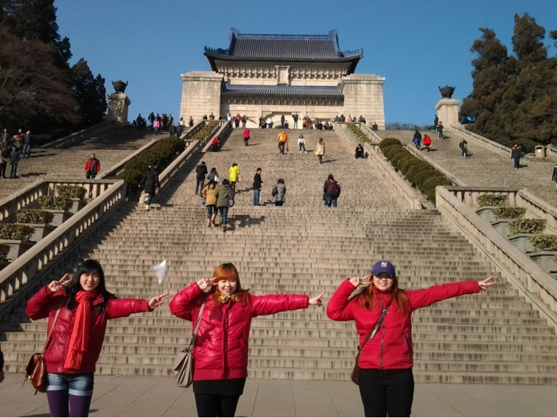
Study at NUIST（留学南信大）
| Students Activities（学生活动）
City Tours

Slide 31
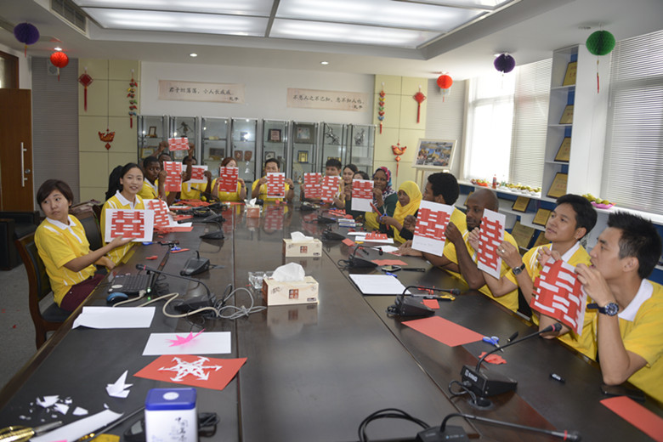
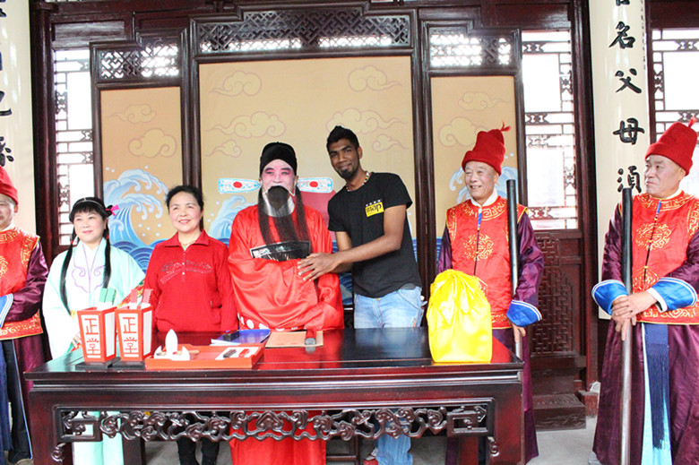
Study at NUIST（留学南信大）
| Students Activities（学生活动）
Experiencing Chinese Culture

Slide 32

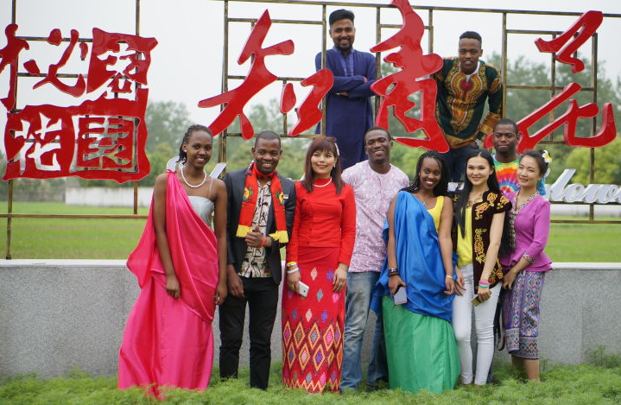
Study at NUIST（留学南信大）
| Students Activities（学生活动）
Annual Culture Exhibition of NUIST

Slide 33



Study at NUIST（留学南信大）
| CONTACT（联系我们）
CONTACT INFORMATION
College of International Students,
Nanjing University of Information Science & Technology, CHINA
Address: 219 Ningliu Road, Nanjing, Jiangsu Province, P.R.C., 210044
Tel: 86-25-58699848/58731383
Fax: 86-25-58699856
Email: oie@nuist.edu.cn
Website: https://gjy.nuist.edu.cn/
Apply Online: http://nuist.17gz.org/member/login.do
Mr. Jeremy
Admission Officer of Undergraduate Programs
Ms Candy
Admission Officer of Master & Doctoral Programs
Notes:
下一页加联系方式

Slide 34



谢谢！

