Slide 1
2023
CHONGQING
TECHNOLOGY AND BUSINESS
UNIVERSITY
CTBU

Slide 2
CONTENTS
Part One.
Part Two.
Facts and Figures
International Cooperation
Part Three.
Part Four.
Programs & Application
Life at CTBU

Slide 3
FACTS AND FIGURES
Municipality
Central city
The only municipality in western China
One of the five central cities of China
Economic center
Transport hub
CHONGQING
Economic center in the Upper Reaches of the Yangtze River
Transport hub in Southwest of China

Slide 4
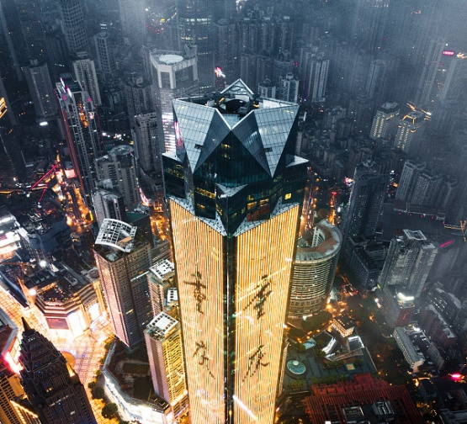
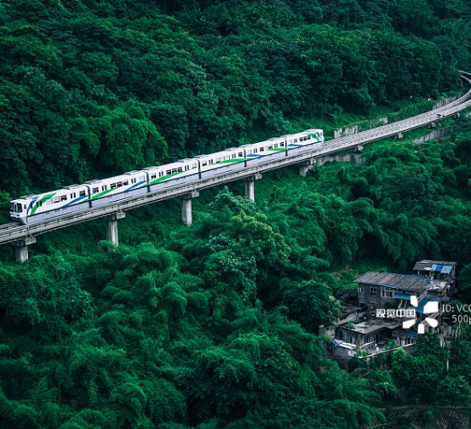
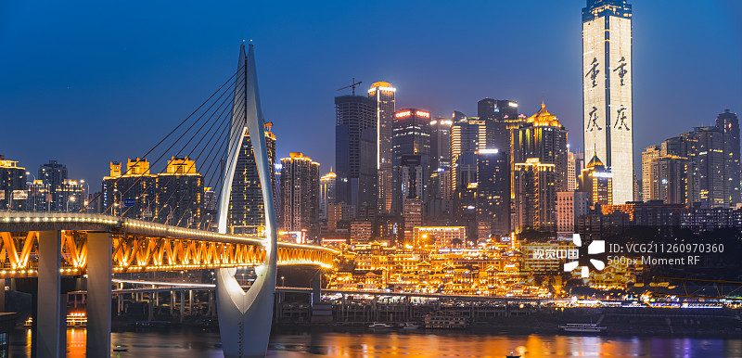
CHONGQING
Chongqing night view
Jialing River and Qiansimen Bridge
Jiefangbei-Downtown Area
Chaotianmen
rail traffic
Hongya cave

Slide 5
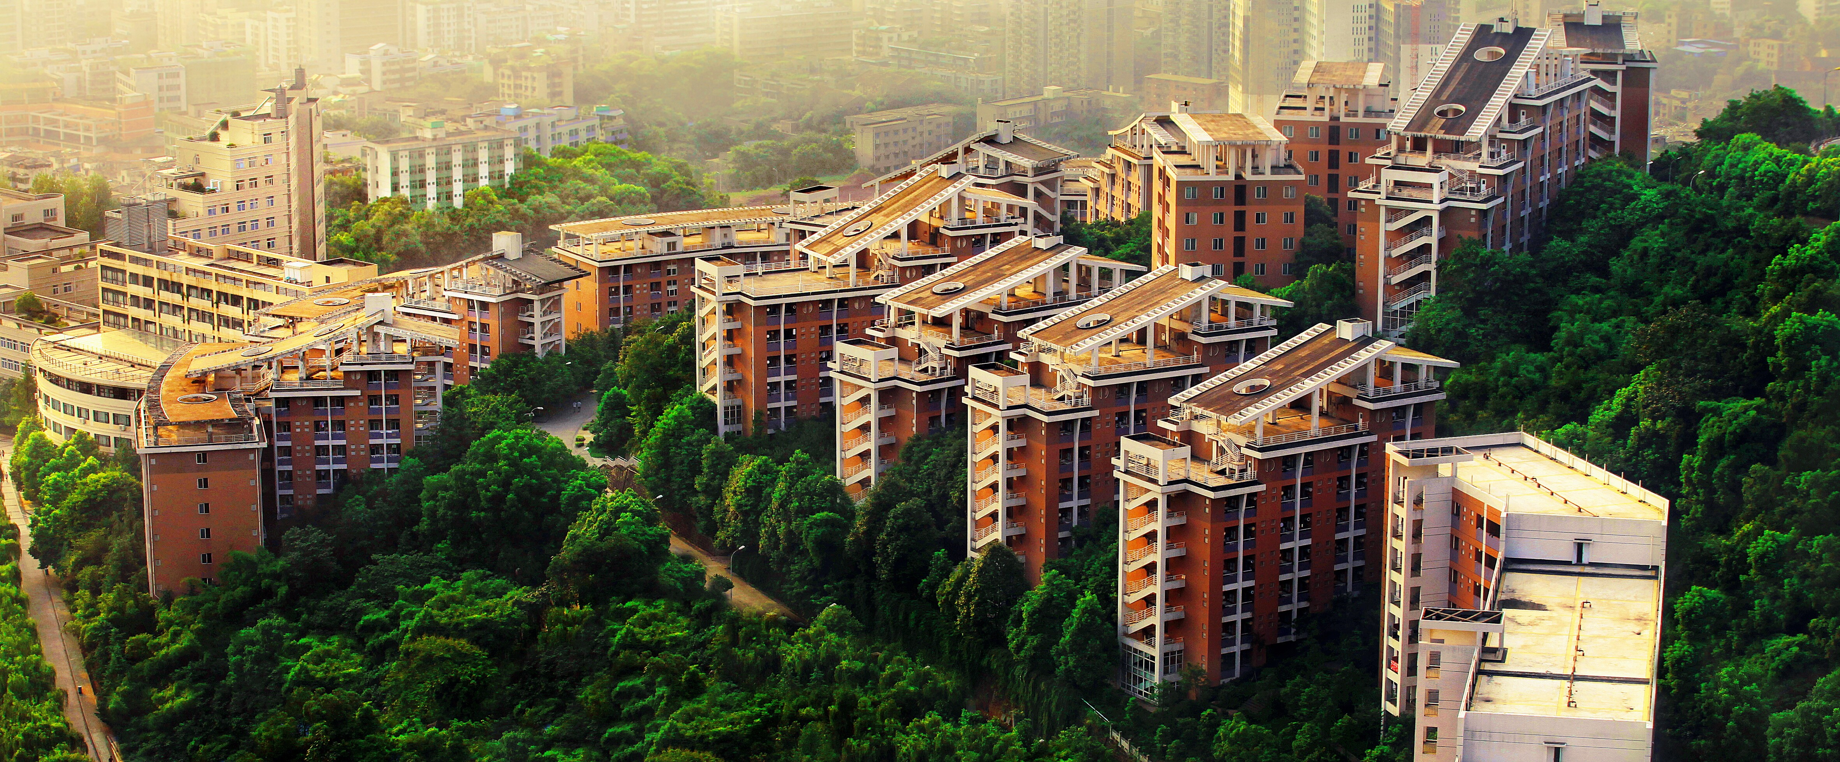
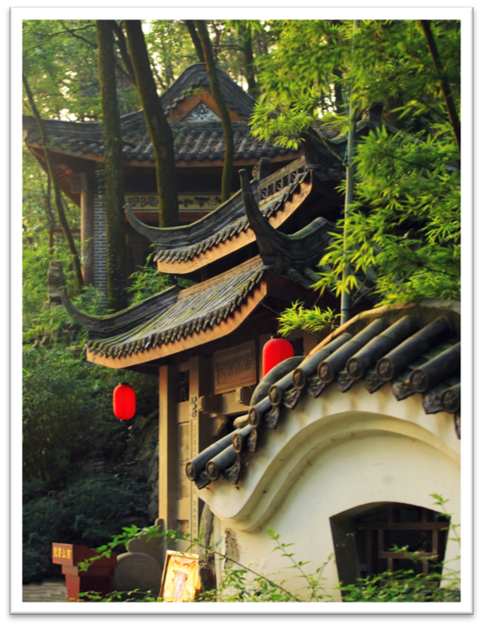
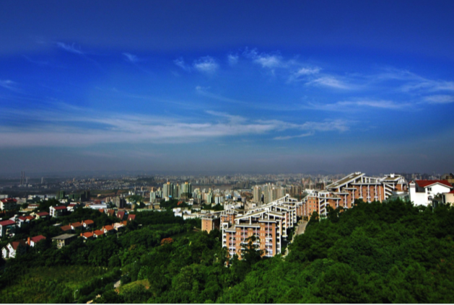
FACTS AND FIGURES
7
450
2500
30,000
Located in Nan'an district and only 7 km to the center.
Covers a total area of 450 acres.
Strong faculty, with 2500 professors, teachers and supporting staff.
More than 30,000 students

Slide 6
FACTS AND FIGURES
3
2
80&30
One of 3 in Chongqing getting special financial support from the Central government.
Has 2 of the first institutions in China to run Sino-foreign joint degree programs.
More than 80 undergraduate programs and 30 postgraduate Programs

Slide 7
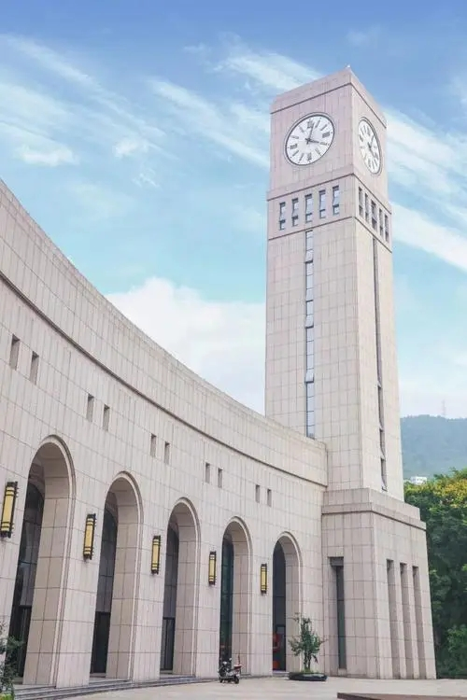
RESEARCH CENTERS
01
02
Research Centre of the Economy of the Upper Reaches of the Yangtze River
Chongqing Engineering Technology Research Centre for Information Management in Development
03
04
Engineering Research Centre for Waste Oil Recovery Technology and Equipment, Ministry of Education
Research Centre of Pharmaceutical Chemistry & Chemical Biology

Slide 8
MAJOR FORMS OF INTERNATIONAL COOPERATION
Joint degree programs: 1+3, 3+1, 2+2 .....
Student Exchange
Study & Culture programs
Staff Exchange
Co-teaching
Co-research

Slide 9
PROGRAMS OFFER TO INTERNATIONAL STUDENTS
Degree Programs | Bachelor's degree
 | Master's degree
Non-degree programs | Chinese Language Programs
 | CTBU Study and Culture Tour
 | Customized short-term programs

Slide 10
POPULAR BACHELOR’S DEGREE PROGRAMS
Schools | Programs
Business and Management | Business Administration （English Conducted)
 | International Tourism & Hospitality (English Conducted)
 | Management Information System
 | Business Administration
 | Logistics Management
 | Electronic Commerce
 | International Business
 | human Resource Management
 | Marketing
 | Tourism & Hospitality Management
Journalism and language | International Business Chinese
 | Chinese Language and Literature
 | Journalism
 | Business English
Design | Industrial Design
 | Product Design
 | Environment Design

Slide 11
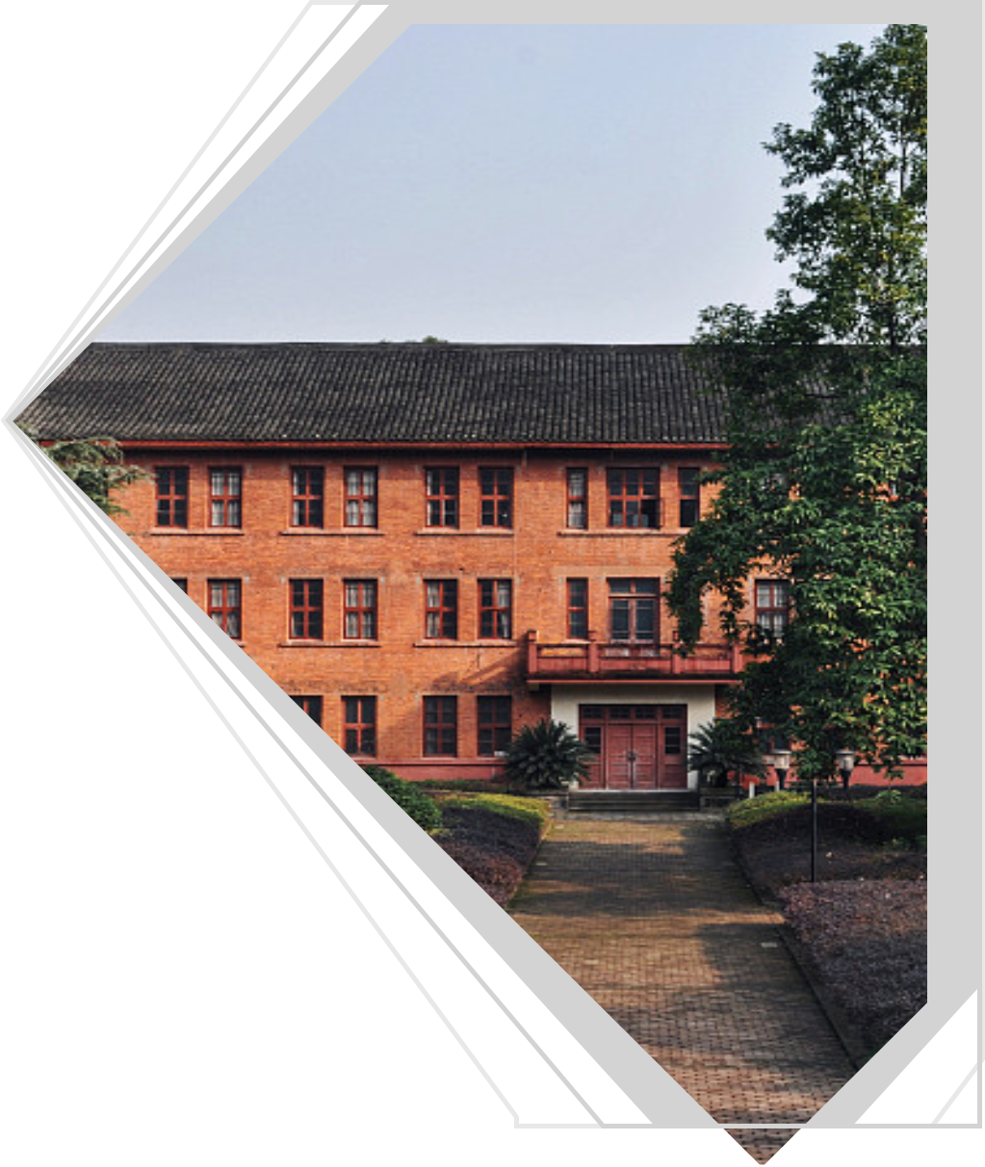
POPULAR MASTER’S DEGREE PROGRAMS
Popular Master’s Degree Programs
Master of Business Administration (MBA) (English Conducted) Regional Economics
International Trade
Financial Management
Human Resources Management
Tourism Administration
Business Administration
Communication

Slide 12
SCHOLARSHIP
Mayor’s Scholarship | RMB25000/year for Bachelor
 | RMB30000/year for Master
President's Scholarships | Grade One: Full of the Tuition
 | Grade One: Half of the Tuition
 | Grade One: 1/3 of the Tuition

Slide 13
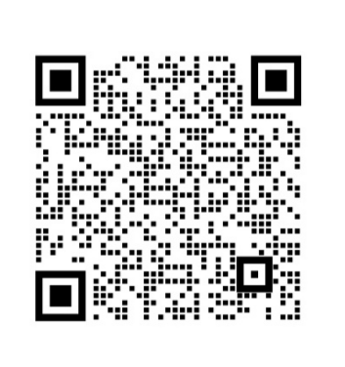
APPLICATION
Complete the online application procedure and upload the required documents on website: http://ctbu.at0086.cn/student
Any question,pls scan the code to contact Ms. Cathy Song

Slide 14
APPLICATION DOCUMENTS
Copy of the valid passport
Highest diploma
Official academic transcripts
Study plan
CV
Language proficiency certificate
Physical examination report
Other required documents

Slide 15
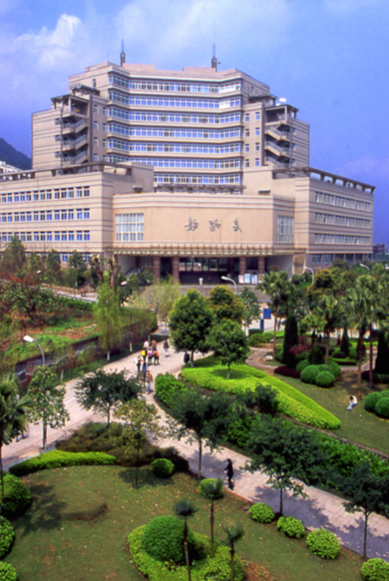
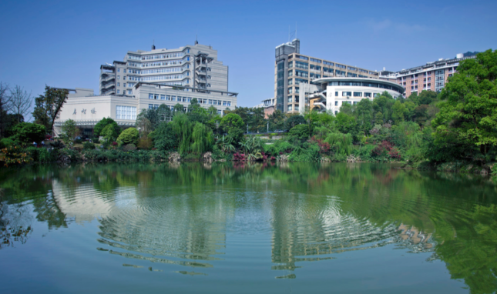
LIFE AT CTBU
CTBU provides a good environment and pleasant atmosphere where students can both study and live .

Slide 16
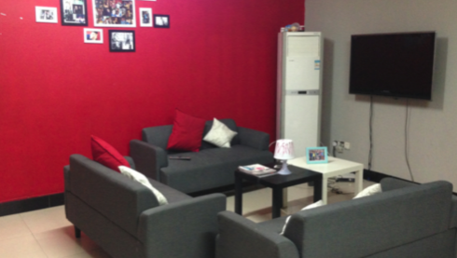
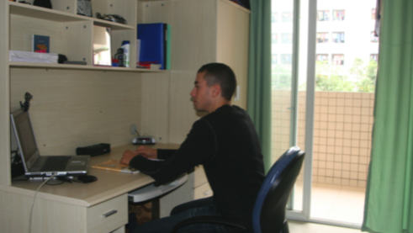
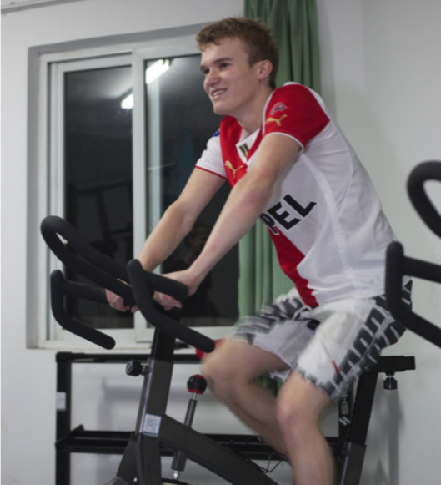
HARDWARE FACILITY
CTBU provides International Apartment for international students with necessary facilities and comfortable environment.

Slide 17
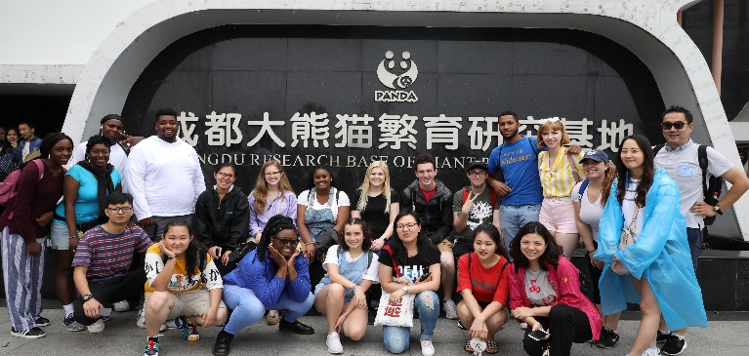
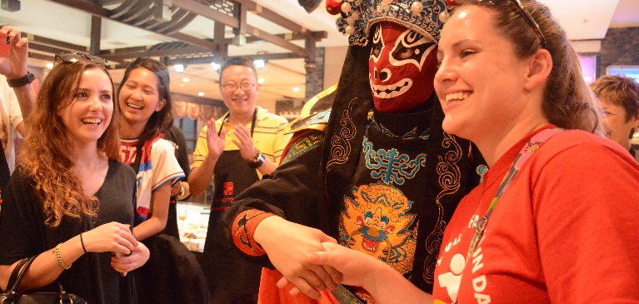
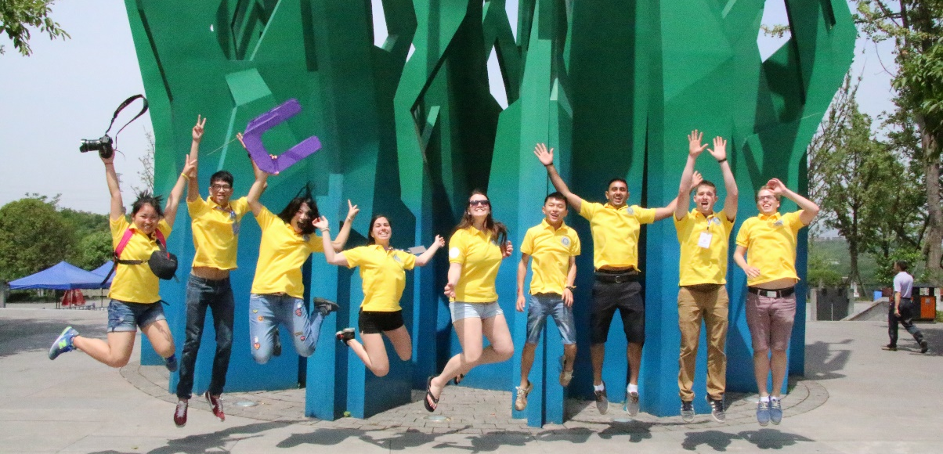
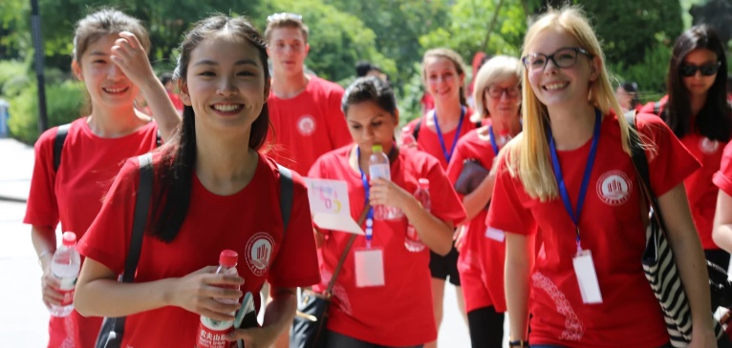
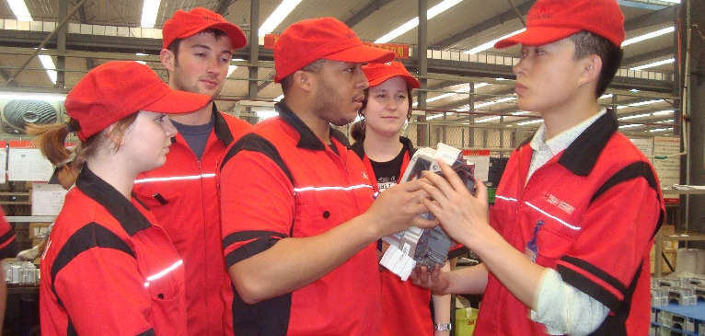
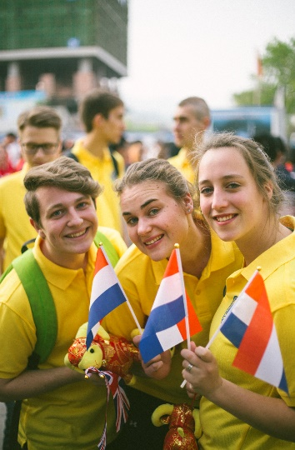
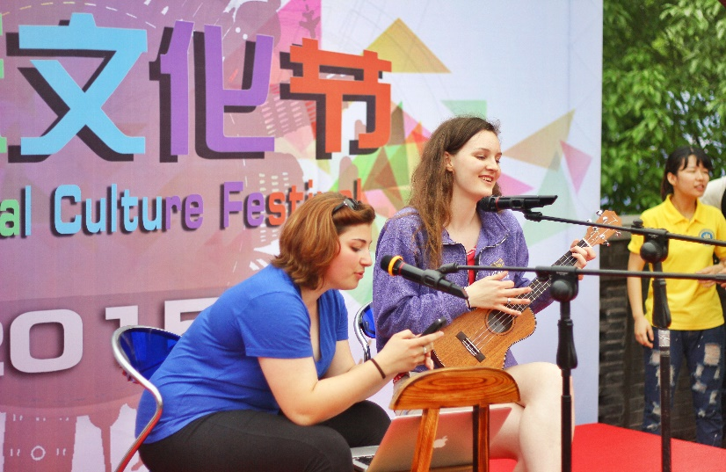
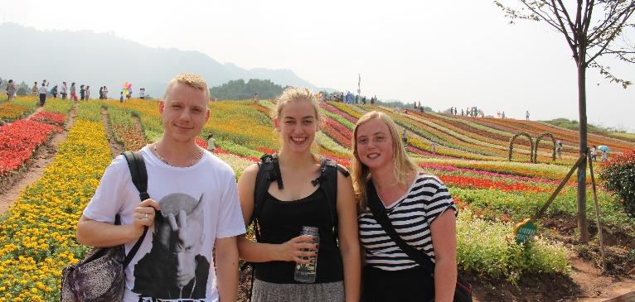
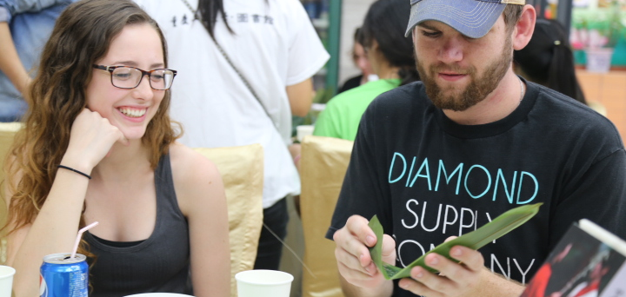
PROGRAMS OFFER TO INTERNATIONAL STUDENTS

Slide 18
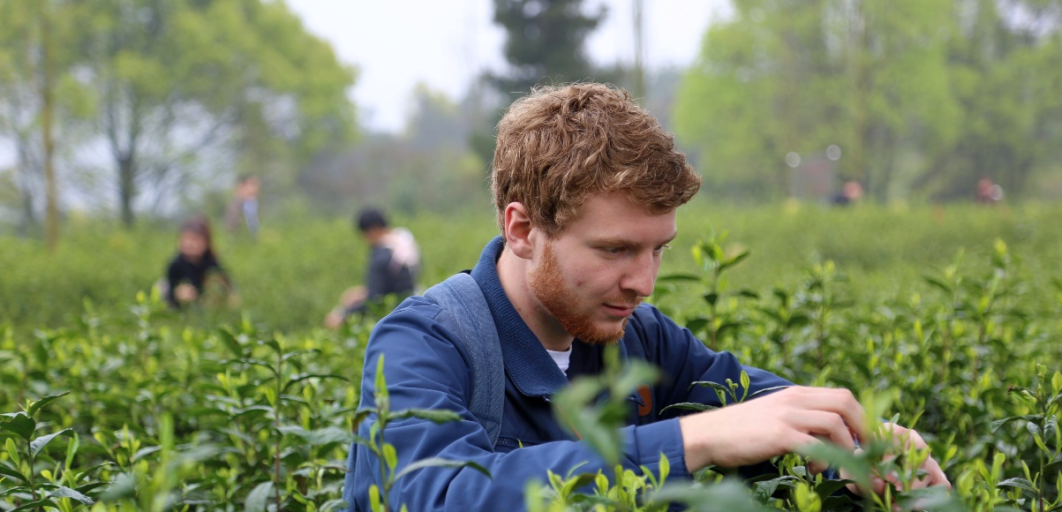
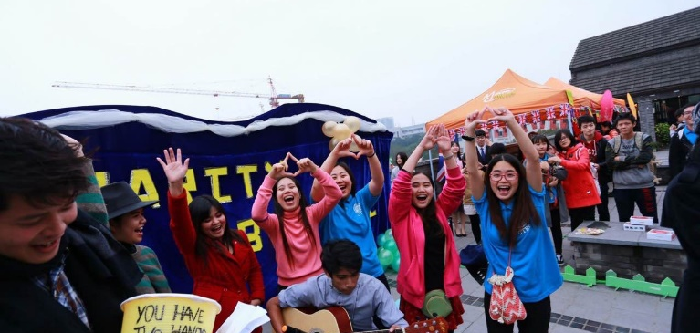
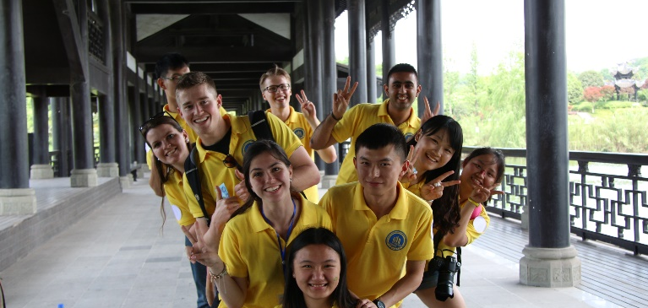
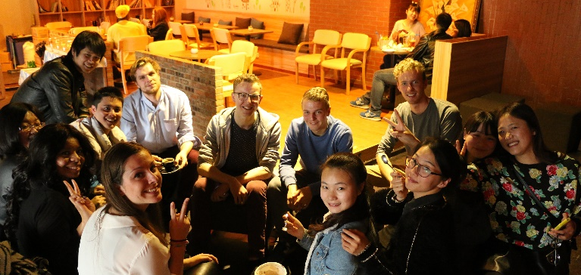
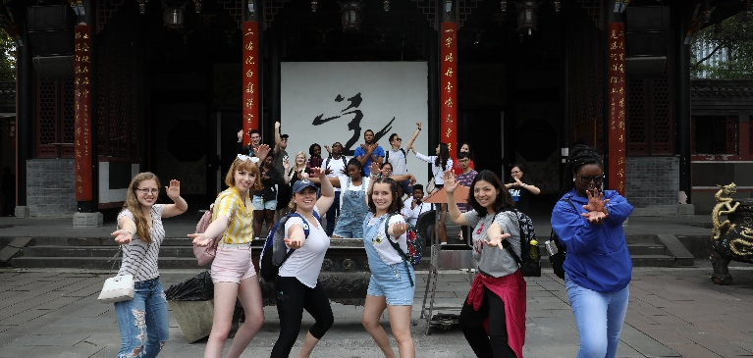
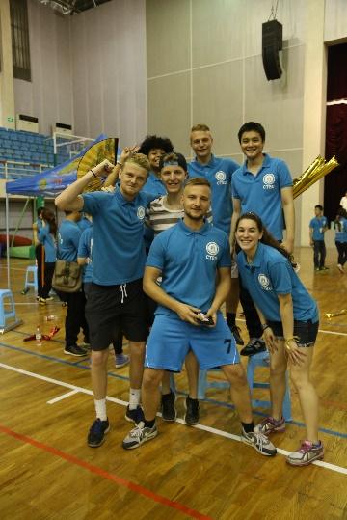
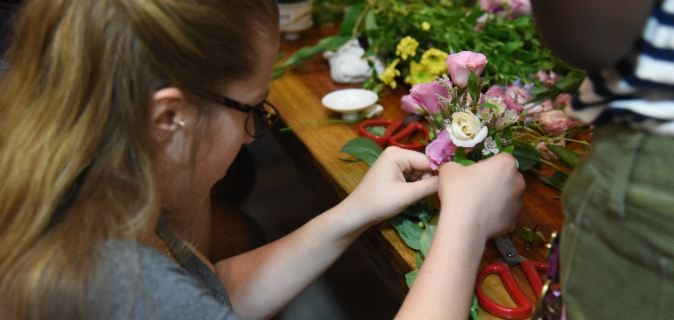
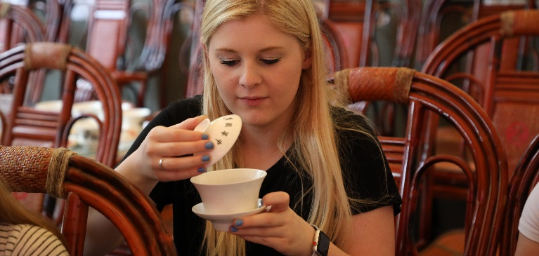
PROGRAMS OFFER TO INTERNATIONAL STUDENTS

Slide 19
THANK YOU
CTBU

