Slide 1
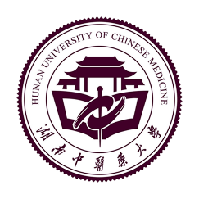
Hunan University of Chinese Medicine

Slide 2
Foreign Affairs and Exchange
I.
II.
Campus life
Application conditions
III.
Profile
Contents
IV.
Talent training
Faculty
V.
Major setup
VI.
VII.

Slide 3
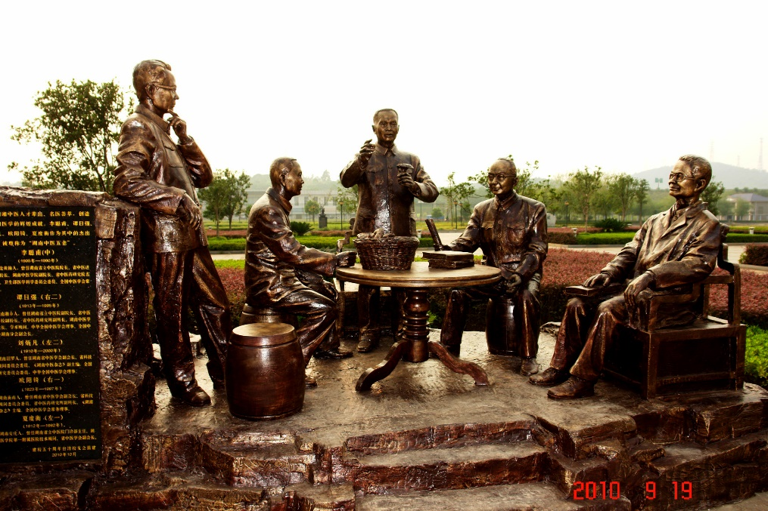
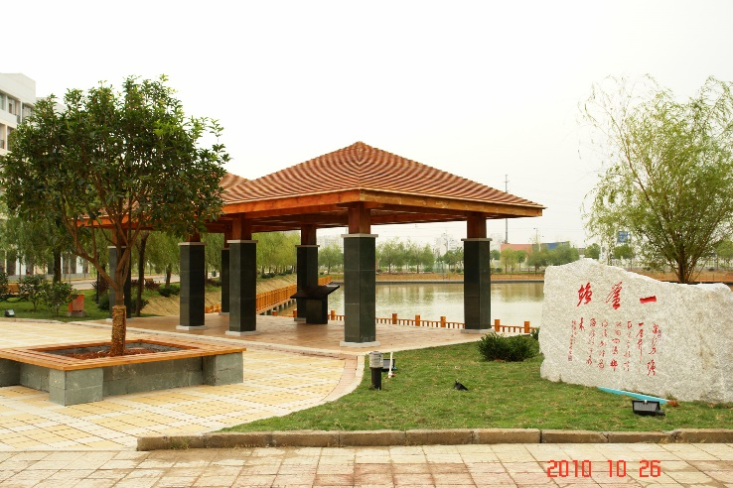
Profile
In 1934
Founded Hunan Technological School of Traditional National Medicine
In 1957
Founded Hunan Academy of Traditional Chinese Medicine
In 1960
Established the ordinary college - Hunan College of Traditional Chinese Medicine
In 1990
The original Hunan University of Science and Technology was completed merged into Hunan College of Traditional Chinese Medicine
In 2002
Merged with Hunan Academy of Chinese Medicine
In 2006
Renamed as Hunan University of Chinese Medicine
In 2012
Entered into the list of the first batch of undergraduate admission universities

Slide 4
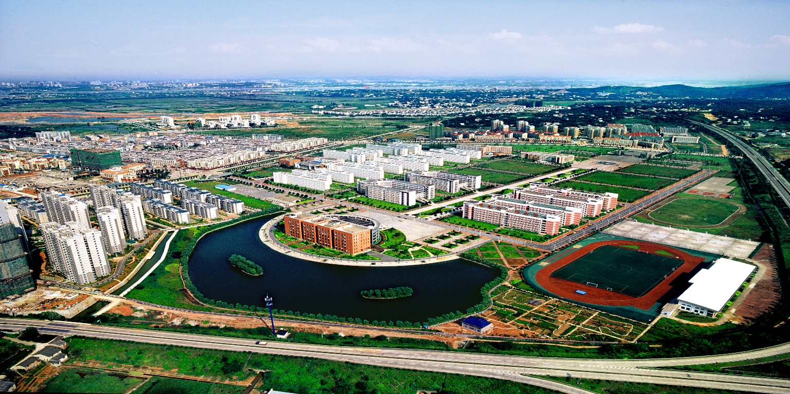
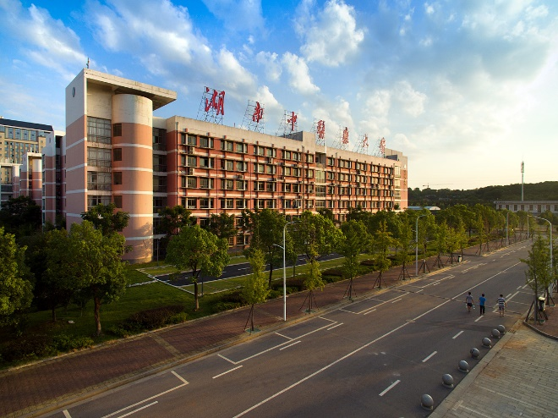
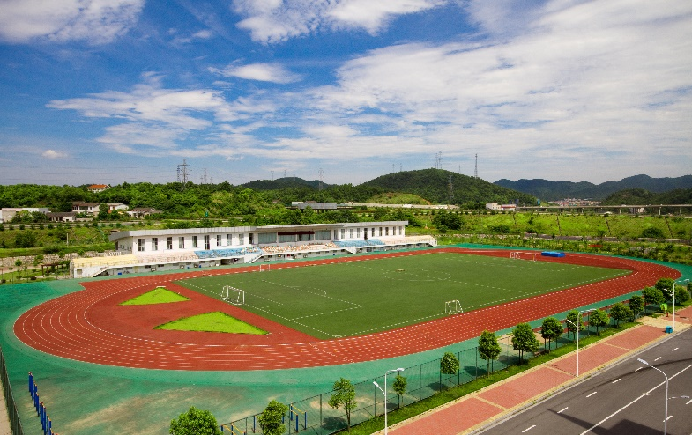
Profile
Situated in Changsha - a famous historical and cultural city in China and founded in 1934, Hunan University of Chinese Medicine is a higher institution of traditional Chinese medicine centered on teaching and integrating teaching, scientific research, medical treatment and comprehensive industry development. It covers a total floor area of 1,400 mu and has four campuses.

Slide 5
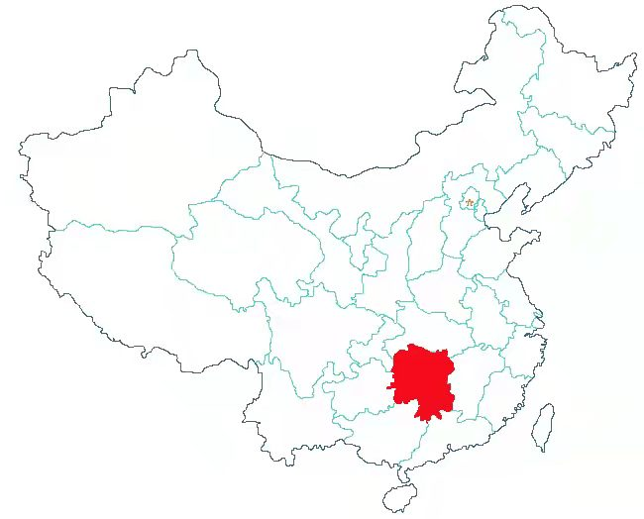
Profile
Changsha, also named Xingcheng, is the political, economic and cultural center of Hunan. It is not only a famous cultural city with over 3,000 years of history, but also an international metropolis full of modern energy. Owning unique geographical advantages and convenient transportation and logistics, Changsha serves as the central hub between the coastal area and the inland area of China, with developed mass media and television entertainment industry. The famous “Chinese Bridge” Chinese Proficiency Competitions for Foreign College Students and China Golden Eagle TV Art Festival are held in Changsha every year.
Situated in Changsha, a famous historical and cultural city with advantageous geographic position and elegant environment, it is not only a pleasant place to live in, but also an ideal world for students to study.
●

Slide 6
Talent training
Since its establishment, the university has cultivated over 70,000 elites engaged in developing TCM career, with graduates all over the world.

Slide 7
Talent training
Hunan University of Chinese Medicine, as the first batch of units admitting students from Hong Kong, Macao and Taiwan and foreign countries among higher institutions of Chinese medicine in China, is the international cooperation base for Chinese medicine of the National Administration of Traditional Chinese Medicine and has cultivated thousands of graduates from over 20 countries and regions.

Slide 8
Faculty
1,490 full-time teachers
667 associate senior professors
105 doctoral supervisors and 492 master supervisors
74 experts who enjoy special allowances of the State Council and the provincial government
170 national physician masters, Yangtze River Scholars, national and provincial famous doctors and physicians

Slide 9
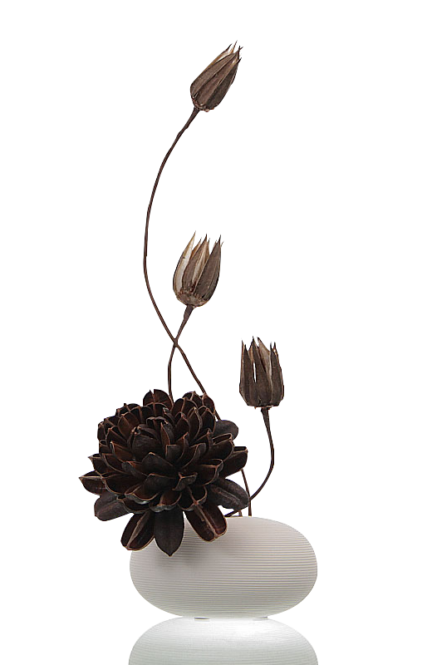
Faculty
Secondary colleges (departments): 18
College of Traditional Chinese Medicine
College of Acupuncture-Moxibustion-Tuina and Rehabilitation
College of Integrated Traditional Chinese and Western Medicine
College of Pharmacy
Medical College
College of Nursing
Graduate College
College of Clinical Medicine
College of Stomatology
The First Clinical College of Chinese Medicine
The Second Clinical College of Chinese Medicine
College of International Education
College of Information Science & Engineering
College of Humanities and Management
College of Continuing Education, Higher Vocational and Technical College
Xiangxing College (independent)
College of Sports & Arts
College of Marxism

Slide 10
Faculty
Scientific research institute: 14
Institute of TCM Diagnosis
Institute of Integrated Traditional Chinese and Western Medicine
Institute of Medical History Philology
Institute of TCM Traumatosis
Institute of Chinese Medicated Diet
Clinical Research Institute of Traditional Chinese Medicine
Institute of Basic TCM Theories
Institute of Acupuncture & Moxibustion and Meridian
Institute of Chinese Medicine Development
Institute of TCM Internal Diseases
Institute of Ophthalmology and Otolaryngoloy Diseases by TCM
Institute of higher education
Institute of Traditional Chinese Medicine
Institute of Philology Information

Slide 11
Faculty
Affiliated hospitals: 20
The First Hospital of Hunan University of Chinese Medicine
The Second Hospital of Hunan University of Chinese Medicine
Integrated Traditional Chinese and Western Medicine Hospital Affiliated with Hunan University of Chinese Medicine
The Third Hospital of Hunan University of Chinese Medicine
Integrated Traditional Chinese and Western Medicine Second Hospital Affiliated with Hunan University of Chinese Medicine
Changsha Hospital Affiliated with Hunan University of Chinese Medicine
Changsha Hospital of Traditional Chinese Medicine Affiliated with Hunan University of Chinese Medicine
Yiyang Central Hospital Affiliated with Hunan University of Chinese Medicine
Shaoyang Hospital Affiliated with Hunan University of Chinese Medicine
People's Hospital Affiliated with Hunan University of Chinese Medicine
Stomatological Hospital Affiliated with Hunan University of Chinese Medicine
Hengyang Hospital Affiliated with Hunan University of Chinese Medicine
Changde Hospital Affiliated with Hunan University of Chinese Medicine
Luoyang Orthopedic-Traumatological Hospital of Henan Province Affiliated with Hunan University of Chinese Medicine
Ningxiang Hospital Affiliated Hunan University of Chinese Medicine
Yueyang Hospital Affiliated with Hunan University of Chinese Medicine
Liling Hospital of Traditional Chinese Medicine Affiliated with Hunan University of Chinese Medicine
Yiyang Traditional Chinese Medicine Hospital Affiliated with Hunan University of Chinese Medicine
Dianjiang Hospital Affiliated with Hunan University of Chinese Medicine
Zhengda Shaoyang Orthopaedics Hospital Affiliated with Hunan University of Chinese Medicine

Slide 12
Faculty
Three-level key discipline system
University level
20 key discipline systems at university level
Provincial and ministerial level
2 key disciplines with advantages and characteristics in Hunan
8 key disciplines in Hunan
1 key discipline at national level
23 key disciplines of National Administration of Traditional Chinese Medicine
Country

Slide 13
Faculty
Journal of Hunan University of Chinese Medicine
Oriental Medicated Diet
Medical Humanities and Management
Digital Chinese Medicine
Academic journal: 4 types

Slide 14
Major setup
Undergraduate majors: 28, covering five subjects: medicine, science, engineering, management and literature
Traditional Chinese Medicine and Pharmacy
Traditional Chinese Medicine
Clinical Discipline of Integrated Traditional Chinese and Western Medicine
Acupuncture- Moxibustion & Tuina
Traditional Chinese Pharmacy Chinese Medicinal Resources and Development
“Domestic first-class construction subjects”
6
“Domestic first-class cultivation subjects”
Western Medicine and Pharmacy
Clinical Medicine Stomatology Medical Imaging Medical Laboratory Science
Rehabilitation Medicine Pharmacy Pharmaceutical Engineering Bioengineering Pharmaceutical Preparation
9
Others
Marketing Public Affairs Administration Food Engineering and Science Applied Psychology Computer Science & Technology English
6

Slide 15
Major setup
Traditional Chinese Medicine
Integration of Traditional Chinese and Western Medicine
Master’s Degree and Doctoral Degree Authorization Centers
Postdoctoral research mobile stations
27 doctoral programs
85 master programs

Slide 16
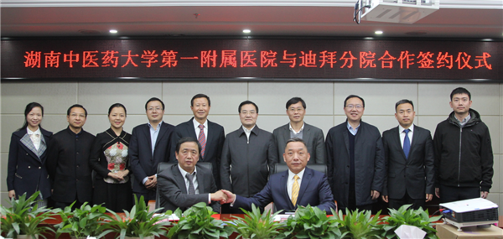
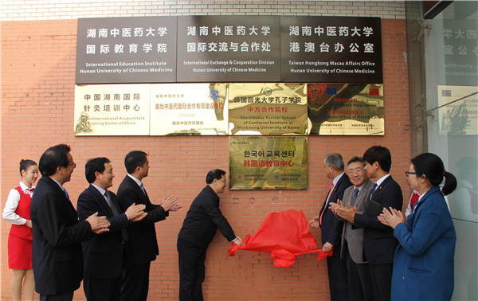
Foreign affairs and exchange
Since 1981, our school has officially enrolled overseas students. It is the first batch of Chinese medicine universities that recruits students from Hong Kong, Macao and Taiwan regions and foreign countries in China, the “National Chinese Medicine Foreign Exchange and Cooperation Base”, “Hunan International Acupuncture & Moxibustion Training Center in China”, and the “First Contact Unit in the Health Field in EU Framework Plan”.

Slide 17
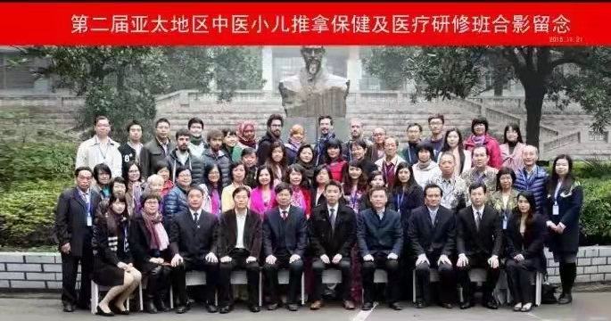
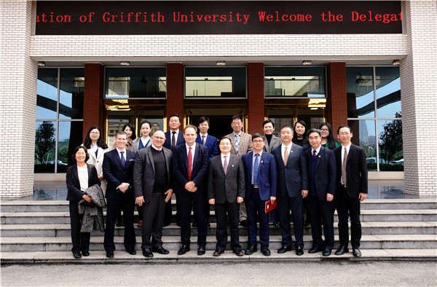
Foreign affairs and exchange
the school adheres to the concept of open-up enrollment, actively supports the “belt and road initiative”, continuously expands the international cooperation fields and channels for exchange projects, and has established long-term exchange and cooperation relations with more than 20 countries and regions such as the United States, Canada, Singapore, Japan, South Korea, Malaysia and Pakistan.

Slide 18
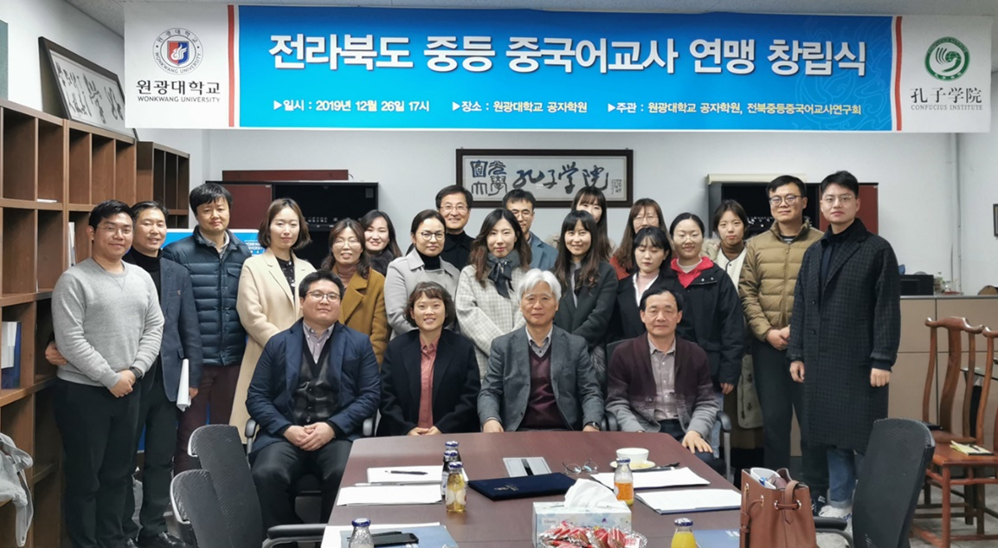
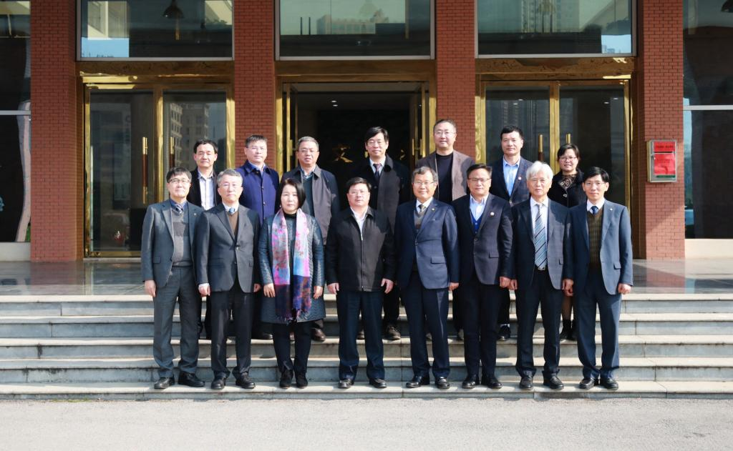
Foreign affairs and exchange
The school founded the “Confucius Institute at Wonkwang University” and “Korea Education Center of Confucius Institute at Wonkwang University” in cooperation with Wonkwang University.

Slide 19
Foreign affairs and exchange
Students from French College of Traditional Chinese Medicine carried out internship at the First Hospital of Hunan University of Chinese Medicine

Slide 20
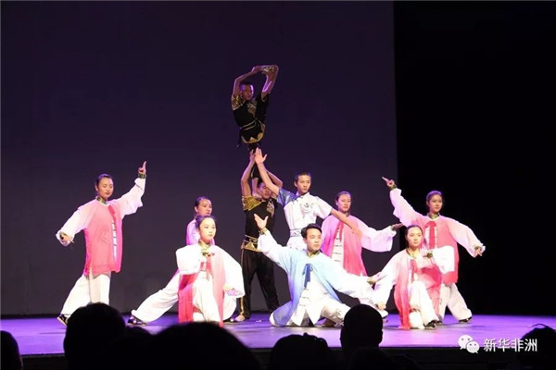
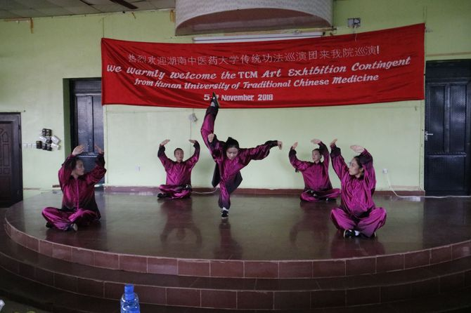
Foreign affairs and exchange
Entrusted by National Hanban, the Traditional Health Care Team of Hunan University of Chinese Medicine carried out study tour at Finland, Estonia, Norway, Namibia, Nigeria, Liberia, Philippines and Malaysia

Slide 21
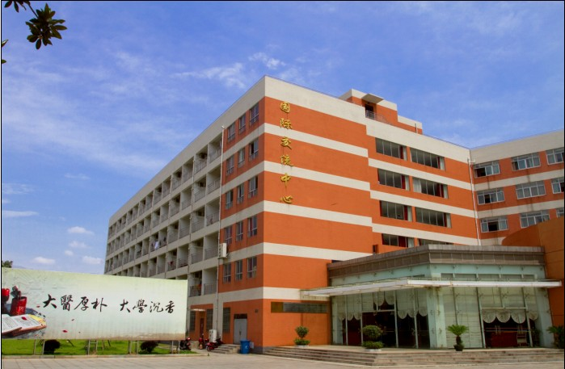
Campus life
Since 1981, our school has enrolled overseas students. There are 358 overseas students from 25 countries and regions. Dormitory for overseas students is equipped with air conditioners and water heaters, independent toilets, balconies and basic living furniture. There are classrooms, activity rooms, restaurants, meeting rooms and coffee bars for foreign students in the school.

Slide 22
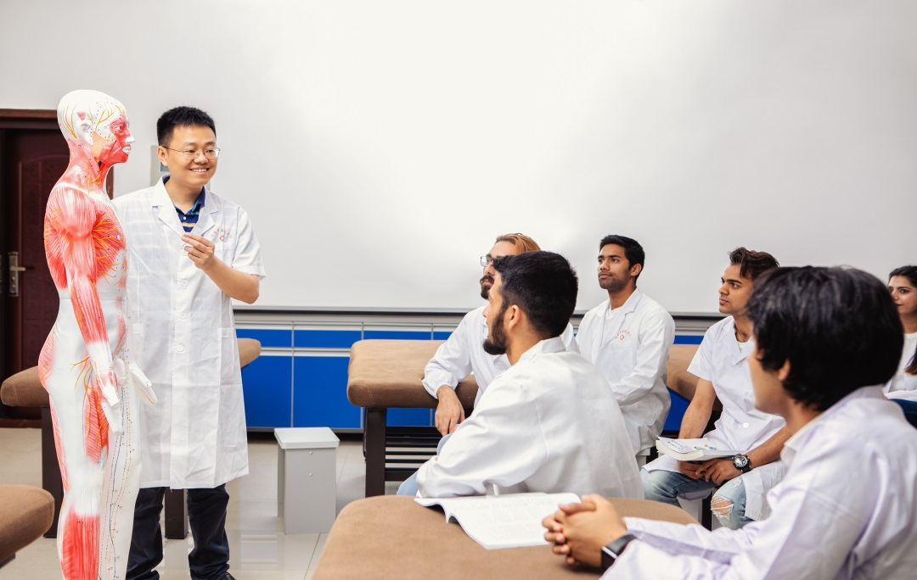
Clinical practical class

Slide 23
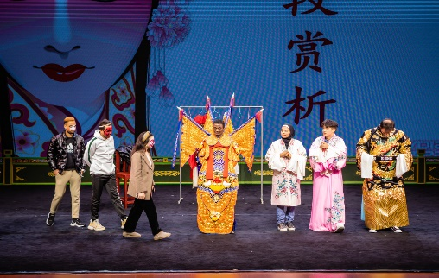
Beijing opera performance
Handwork activity

Slide 24
Scholarship setup
Confucius Institute scholarship
Funded by Hanban/Confucius Institute Headquarters, Confucius Institute Scholarship covers tuition, accommodation, insurance and living expense of students. Applicants can apply to the Confucius Institute in their own countries for one academic year or one semester of research and studies in Chinese or Chinese medicine and Taiji culture.
Hunan Provincial Scholarships of the “Belt and Road Initiative”
Hunan Provincial Scholarships of the “Belt and Road Initiative” for National Language Students is a scholarship granted to students who participate in advanced study of Chinese language, traditional Chinese medicine and Taiji culture from countries along the Silk Road on Land & Sea by the Hunan Provincial Government, including free tuition and accommodation fees.
Full scholarship for outstanding Chinese medicine students
The full scholarship for outstanding Chinese medicine students is a scholarship granted to outstanding undergraduates, postgraduates and doctoral students majoring in traditional Chinese medicine by the school, including free tuition.

Slide 25
Charging standards
For overseas undergraduate candidates, RMB 20,000
For overseas postgraduate candidates, RMB 23,000
For overseas doctoral candidates, RMB 32,000
For overseas advanced candidates, RMB 6,500/month
RMB 14,500/3 months
RMB 20,000/6 months
RMB 32,000/year
Accommodation fee: RMB 2,600/year

Slide 26
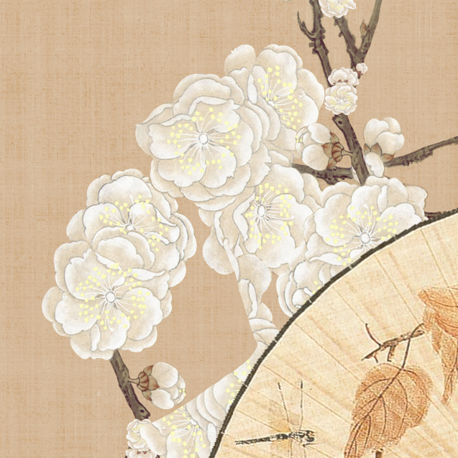
Application conditions
Undergraduate
Ordinary advanced students
Submission of materials:
1. Application Form for Hunan University of Chinese Medicine
2. Photocopies of passports
3. Copies of high school graduation certificates and transcripts
4. Copy of Chinese proficiency certificate (HSK4 or above)
5. Copy of certificate of clearance
6. Copy of medical examination form
7. Financial guarantee or certificate of bank deposit (deposits in the student or his/her parents’ bank card for two years of tuition fees)
8. Other documents required by the school
Submission of materials:
1. Application Form for Hunan University of Chinese Medicine
2. Photocopies of passports
3. Copy of the student’s highest academic certificate and transcripts
4. Copy of certificate of clearance
5. Copy of medical examination form
6. Financial guarantee or certificate of bank deposit (deposits in the student or his/her parents’ bank card for two years of tuition fees)
7. Other documents required by the school

Slide 27
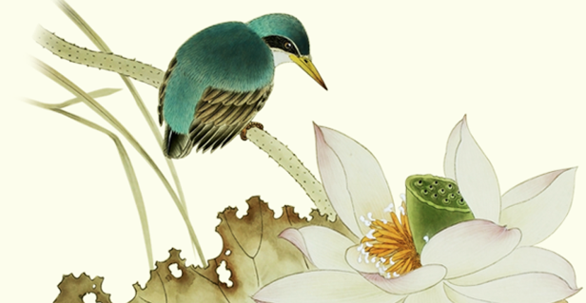
Application conditions
Doctoral candidate
Postgraduate candidate
Submission of materials:
1. Application Form for Hunan University of Chinese Medicine
2. Photocopies of passports
3. Copies of the candidate’s master diploma, degree certificate and transcripts
4. Copy of Chinese proficiency certificate (HSK4 or above)
5. Resume
6. Two letters of recommendation from experts and scholars with associate professor title or above.
7. Research plan
8. Copy of certificate of clearance
9. Physical examination form
10. Financial guarantee or certificate of bank deposit (deposits in the candidate or his/her parents’ bank card for two years of tuition fees)
11. Other documents required by the school
Submission of materials:
1. Application Form for Hunan University of Chinese Medicine
2. Photocopies of passports
3. Copies of the candidate‘s college diploma, degree certificate and transcripts
4. Copy of Chinese proficiency certificate (HSK4 or above)
5. Resume
6. Two letters of recommendation from experts and scholars with associate professor title or above.
7. Research plan
8. Copy of certificate of clearance
9. Copy of medical examination form
10. Financial guarantee or certificate of bank deposit (deposits in the candidate or his/her parents’ bank card for two years of tuition fees)
11. Other documents required by the school

Slide 28
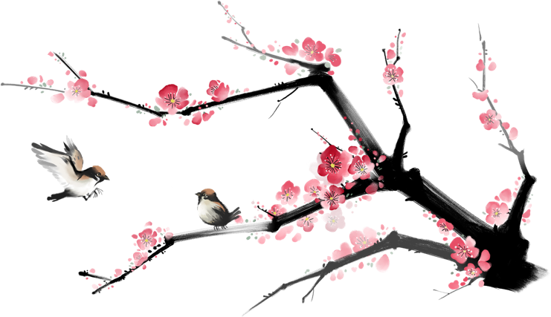
Contact Information
Tel.: 0086-731-88458265
Fax: 0086-731-88458261
Postcode: 410208
E-mail: hnucmoverseas@126.com
liuxin2005cs@126.com
Website: http://www.hnucm.edu.cn

Slide 29
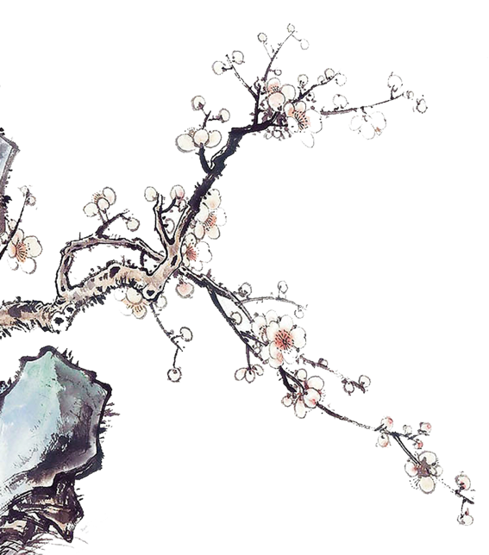
Thank You

