Slide 1
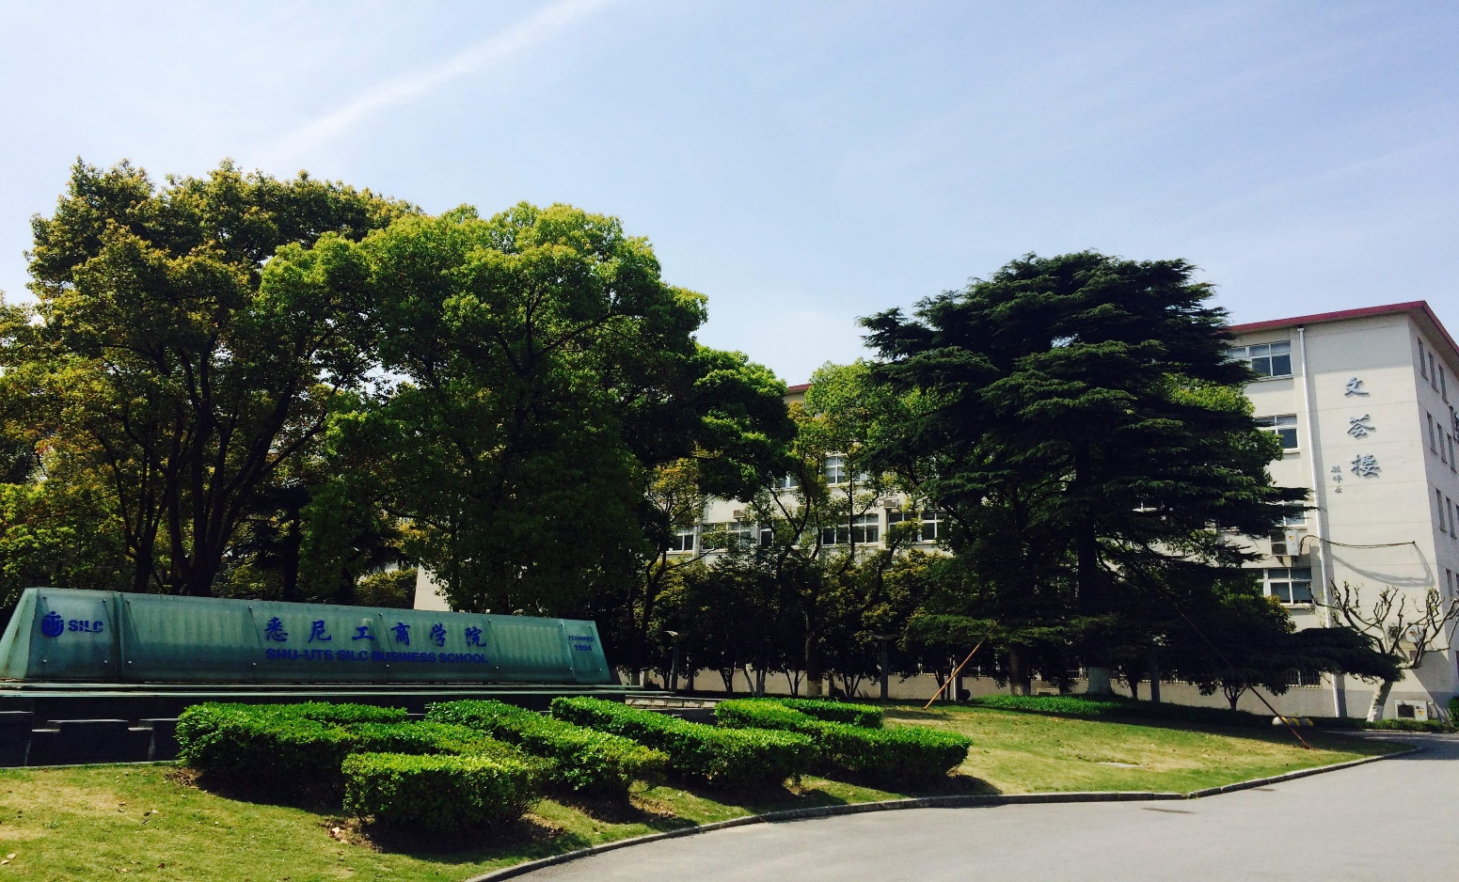
SILC BUSINESS SCHOOL
SHANGHAI UNIVERSITY

Slide 2

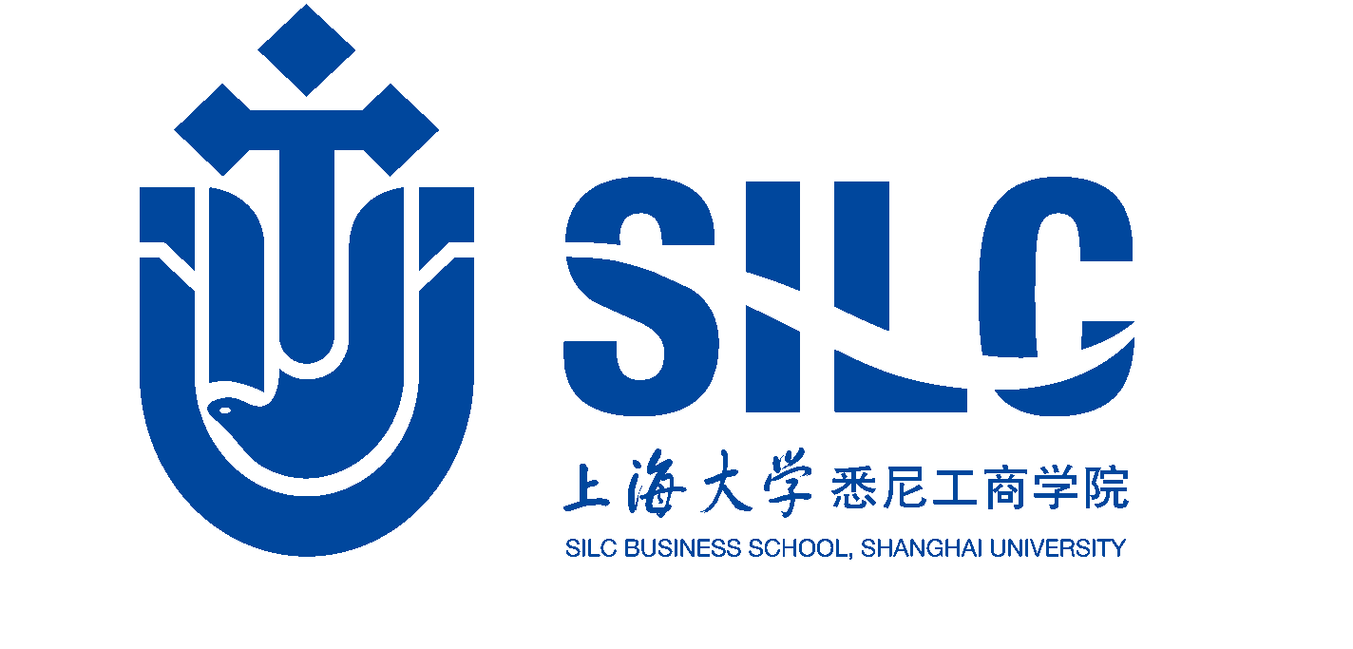
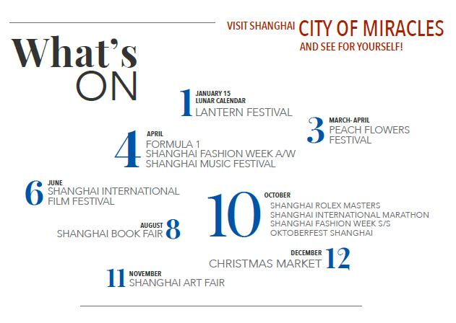
DISCOVER
SHANGHAI
WITH A POPULATION OF OVER 24 MILLION, SHANGHAI IS FREQUENTLY CITED AS THE WORLD’S LARGEST “PROPER” CITY
CHINA’S FINANCE AND BUSINESS CENTER, AND A THRIVING CULTURAL CENTER AS WELL
ONE OF THE MOST EXCITING CITIES IN THE WORLD!

Slide 3

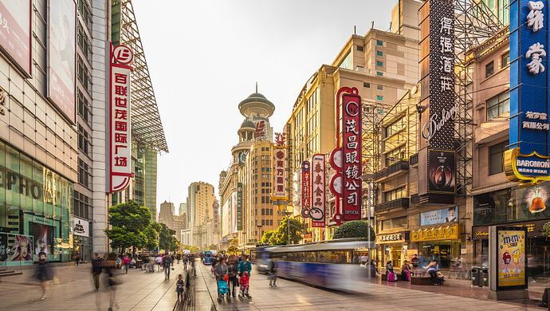
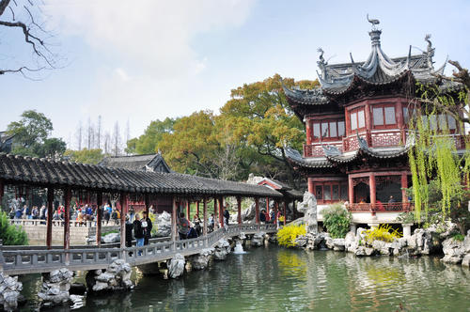
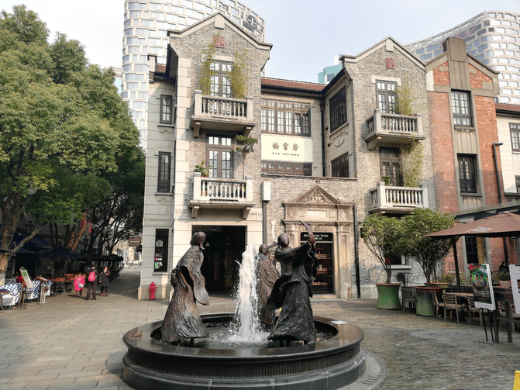
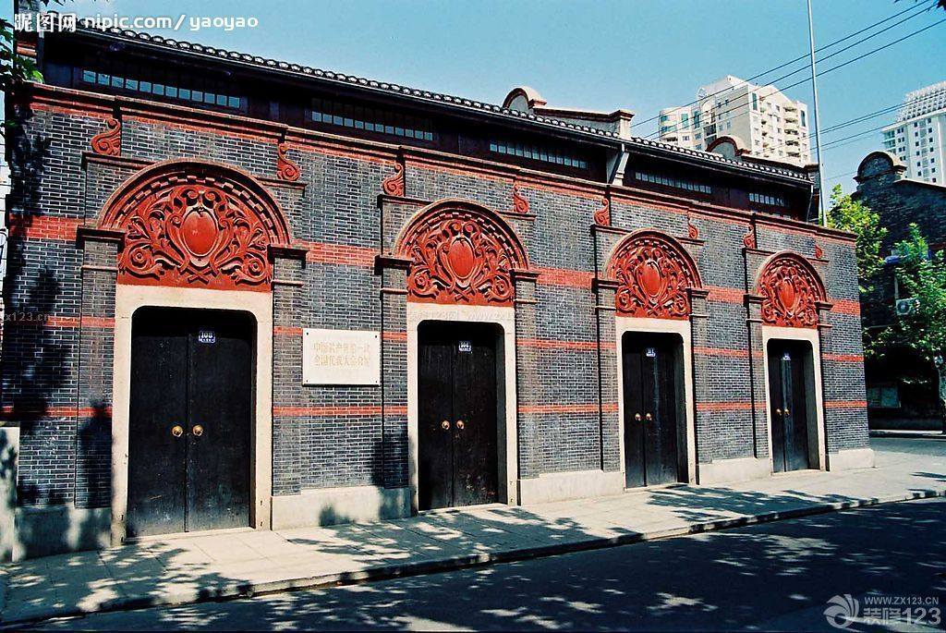

Slide 4
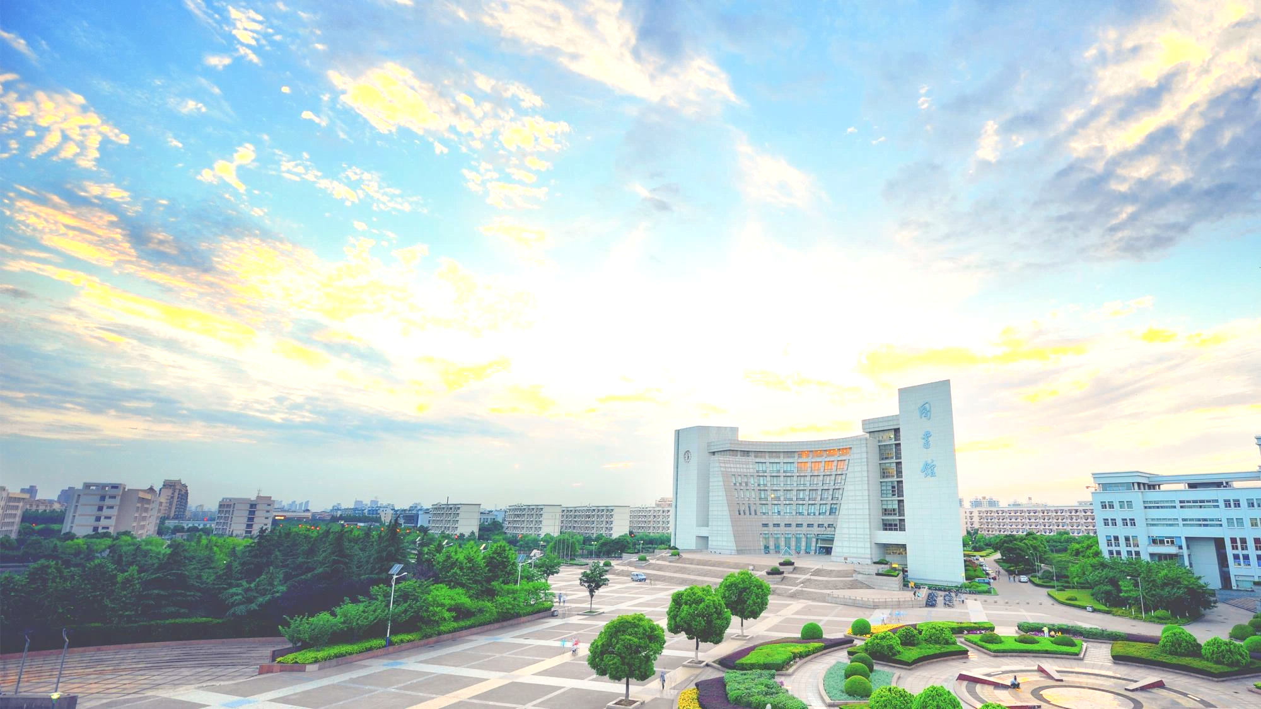

ABOUT SHU
Shanghai University
Established in 1922
387th ranked in the QS World Rankings 2021，top 100 Asian universities
16th ranked in QS mainland China Ranking 2021
4,156 full-time faculty members
2268 international students
Comprehensive university offering 86 undergraduate programs, 221 graduate programs, and 117 doctoral programs in various disciplines

Slide 5

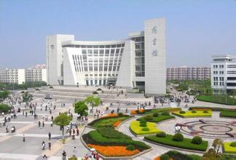

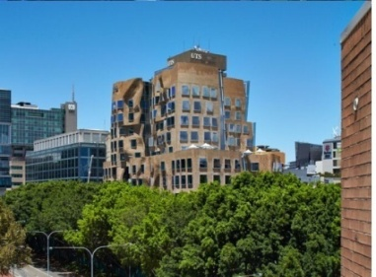
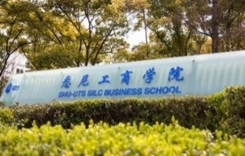
ABOUT SILC
Shanghai University (SHU)
Traditional Chinese University
University of Technology Sydney (UTS)
133rd Ranked in the world (2022 QS)
Traditional Western University
SILC Business School, Shanghai University (since 1994)
Combination of Eastern and Western educational cultures

Slide 6
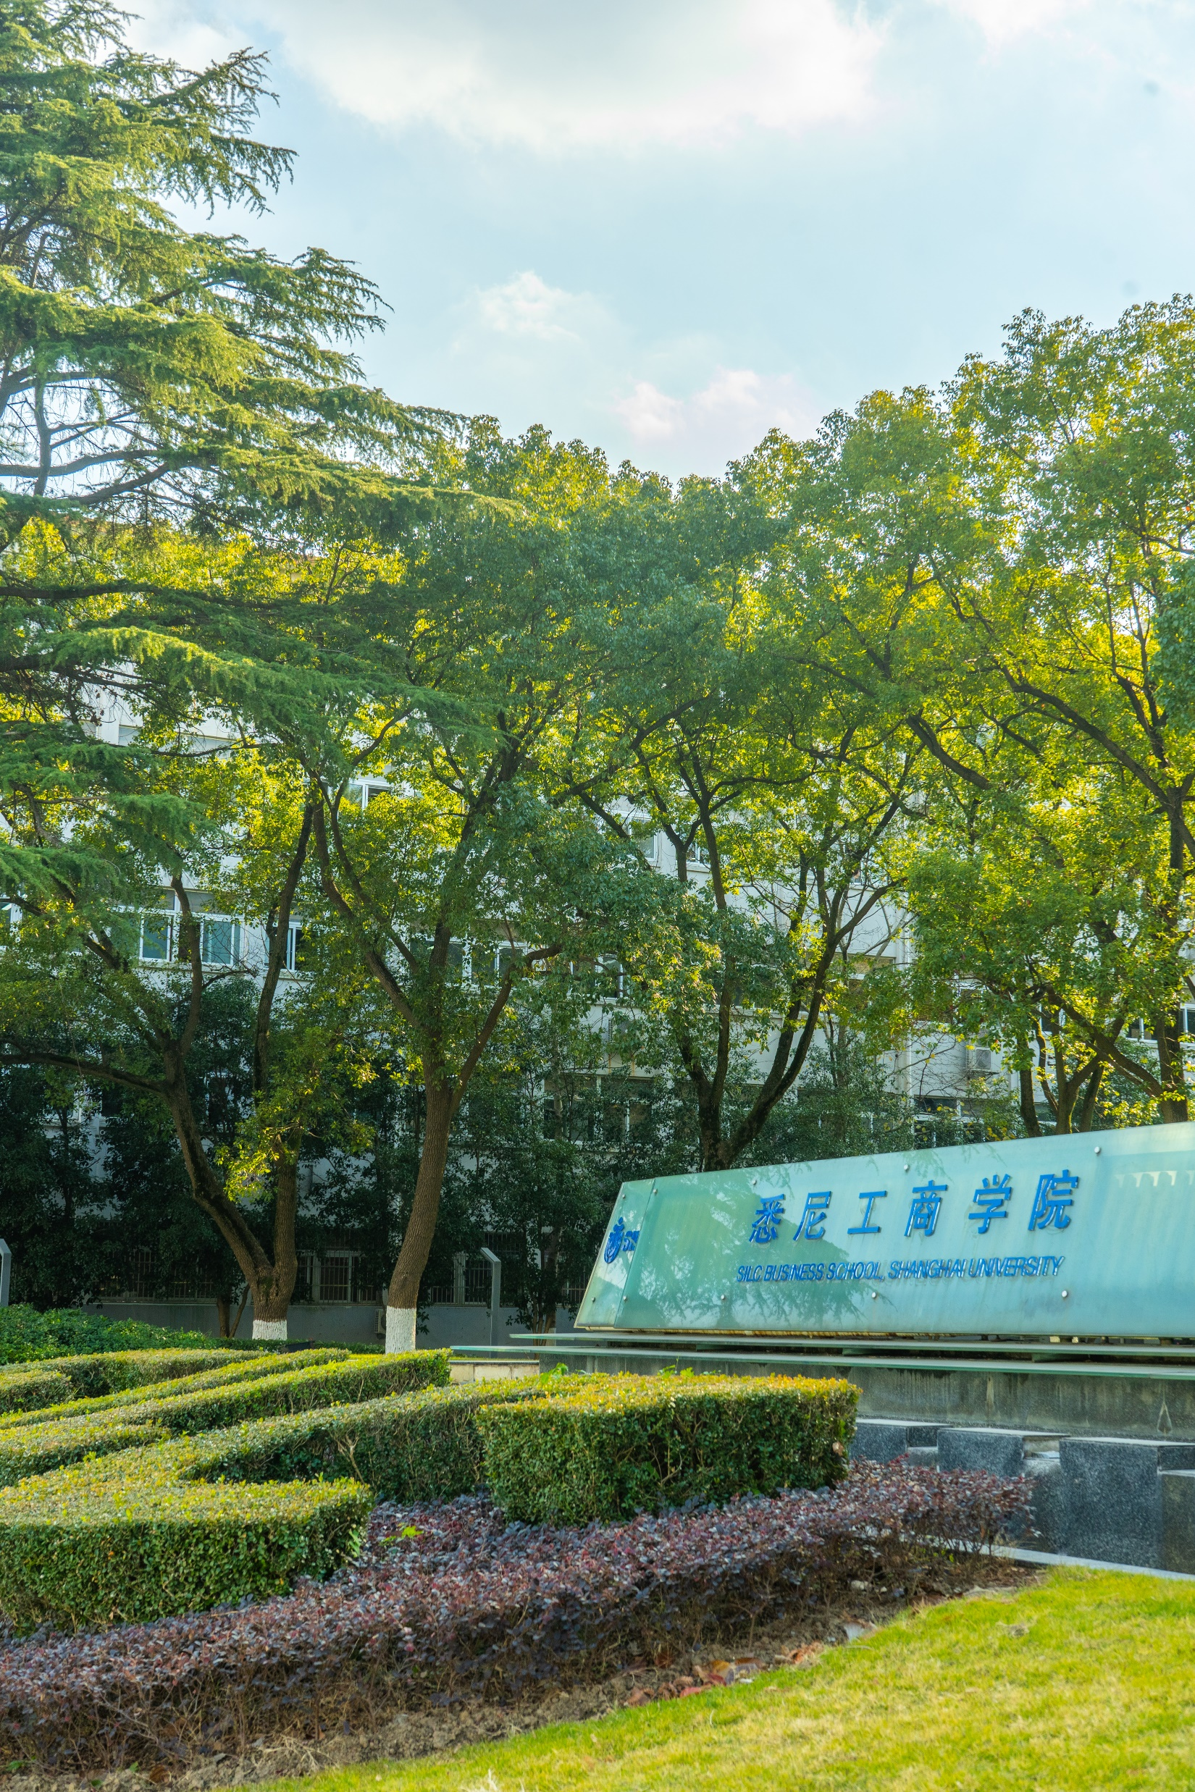



Scholarship
Innovation
Leadership
Cooperation
Founded in 1994
2020 Received AACSB accreditation
SHU-UTS Double Degree
120 Partners
28 countries and regions
3935 Enrolled Students
110 Faculty Members
72 Staff Member
20 Foreign Experts
VISION: To become a globally-recognized leading business school in China

Slide 7
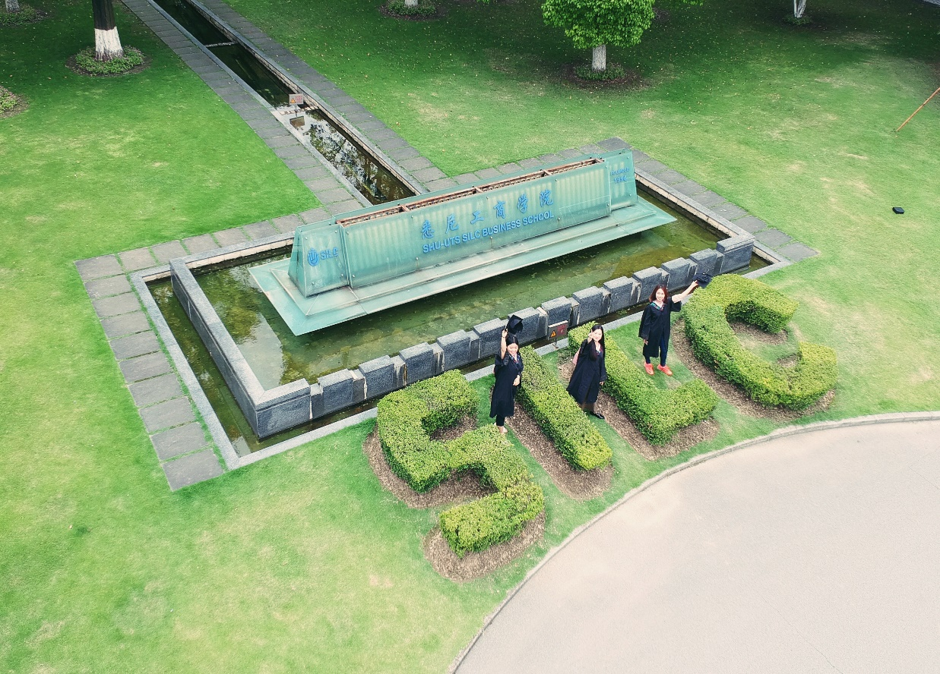
400+ International Students per year
In 2020，SILC published
33 SSCI/SCI/ESCI/CSSCI articles
18 teaching cases
5 books
300 Students aboard per year
16000+ Alumni
Approaching 100% Employment Rate
International Internship
MISSION :To integrate academic and experiential learning to develop business talents with an international horizon and undertake business research to contribute to the regional and national economic advancement.

Slide 8

Our Scope
Undergraduate Programs (English)
International Economics and Trade （Cross-Border E-commerce） |  |  | Finance (Corporate Finance) | Business Administration | Business Administration (Digital Marketing） | Business Administration(Digital Marketing） |  | Business Administration （Innovation and Entrepreneurship）
Master’s Programs
Chinese | Finance | Accounting |  | Regional Economics |  |  | Corporate Management |  | Management Science and Engineering
English | Finance (Corporate Finance) |  |  |  |  | Accounting （International Accounting Standards and Information Disclosure）
 | Finance （Technology and Internet Finance) |  |  |  |  | Accounting （Intelligent Accounting and Digital Management）
 | Finance (Cross-Border E-commerce) |  |  |  |  | Accounting （Management Control and Innovation Management）

Slide 9
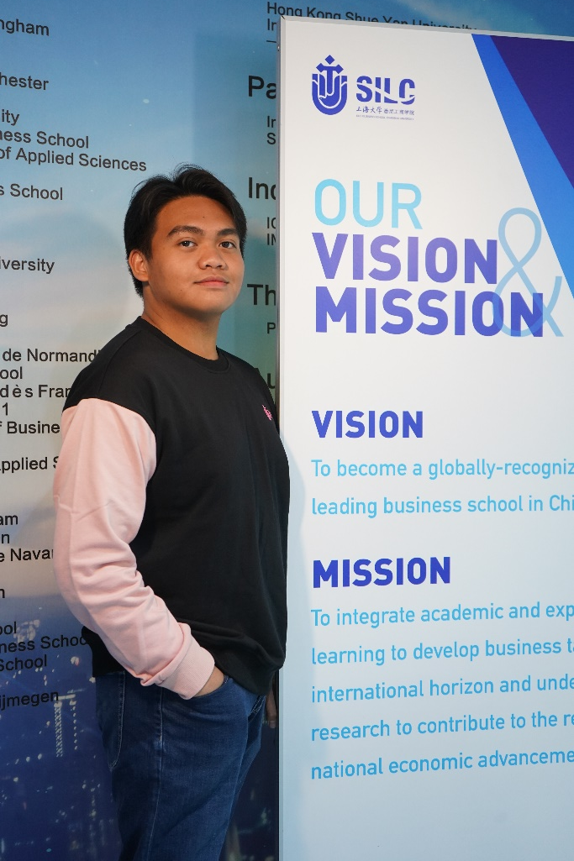
Undergraduate Programs
Majors:
Finance
International Economics and Trade
Business Administration Digital Marketing
Business Administration Innovation and Entrepreneurship
Teaching Language : English
Tuition ：RMB 30,000 / year (USD 4,700)
Program duration: 4 years
Double Degree Opportunity
One from SHU: Bachelor of Economics; Bachelor of Management
One from UTS: Bachelor of Business

Slide 10

Master’s Programs( English）
Finance(Corporate Finance)
Finance（Technology and Internet Finance)
Finance(Cross-Border E-commerce)
2 years
RMB 45,000 / year ( USD 7,000)
Accounting（International Accounting Standards
and Information Disclosure）
Accounting（Intelligent Accounting and Digital Management）
Accounting（Management Control and Innovation Management）
2 years
RMB 59,000 / year (USD 9,200)

Slide 11
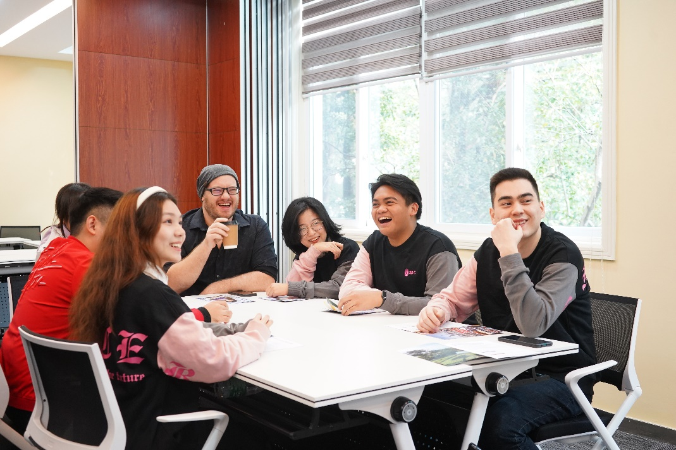
Master’s Programs（Chinese）
Finance
2 years
RMB 45,000 / year ( USD 7,000)
Professional Accounting
2 years
RMB 59,000 / year (USD 9,000)
Regional Economics
Corporate Management
Management Science and Engineering
2.5 years
RMB 29,000 /year (USD 4,500)

Slide 12

Admission Requirements
Academic Requirements
High school graduation with GPA 3.0/4 or above or its equivalent for Undergraduate Programs Bachelor’s degree with GPA 2.5/4 or above or its equivalent for Master’s Programs
Qualified mathematics record
Language Requirements
English-taught programs:
Native speakers of English
IELTS 6.5 / TOEFL 90(iBT) / Duolingo 105 or above
Previous degree was fully taught in English
Pass SILC English Proficiency Test
Chinese-taught programs:
Native speakers of Chinese
HSK 5 180 or above
Previous degree was fully taught in Chinese

Slide 13
Application Documents
Required
Supporting
ID photo
Research output
( publication, reports, works)
Passport photo page
Selfie video
Honors/ Awards
Study Plan or Research Proposal
Highest Degree Certificate
& Official Academic Transcripts
Others (according to specific disciplines)
Language Proficiency Certificate
Statement of Financial Support
Written in
Chinese or English
Guarantee Statement (under 18 years old)
No Criminal Record Commitment

Slide 14
Application Process
University Qualification Assessment (UQA)&SHU Security and Background Check (SBC)
Receive Pre-admission Notice
Pay tuition-deposit and confirm offer online
2
4
6
1
3
5
7
Apply online: https://apply.shu.edu.cn
Telephone Interview
Select funding method and pay the application fee
Receive Official Admission Notice
Application Deadline: June 30th,2022

Slide 15
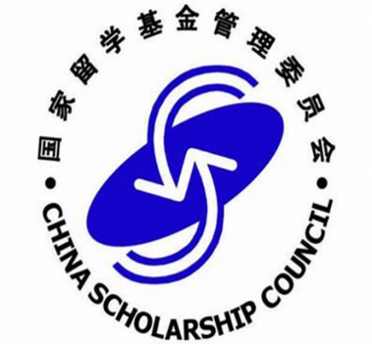


Scholarships
CSC
SGS
SHU
SILC
中国政府奖学金
上海市政府奖学金
上海大学奖学金
悉商国际新生奖学金
Chinese Government
Scholarship
Shanghai Government
Scholarship
Shanghai University
Scholarship
SILC New International Students
Scholarship
Cover: Tuition, accommodation, insurance, stipends
Cover: Tuition, accommodation, insurance, stipends
Cover: Tuition, accommodation, insurance
Cover: Tuition fees-
ranging from half an academic year to four academic years
Application deadline: May 15th,2022
Apply for scholarships: https://apply.shu.edu.cn/application/scholarships

Slide 16

Living Cost
Accommodation
International Student’s Dormitory (single/double/four-bed) RMB 30-140 / day
Living off campus:
Single Rental: RMB 2000-3000 / month
Shared Rental : RMB 1500-2000 / month
Food & Daily Expenses
RMB 1500-2500/ month
Estimated monthly expenses in total
RMB 3000-5500/ month (USD 500-800/month)
*1 USD = approximately RMB 6.36
（2022 March）

Slide 17
INTERNSHIP & CAREER
As of 2020, SILC has established 54 internship and employment bases. The employment rate of SILC's
undergraduate students is approaching 100%, among which 21.64% of the students have successfully worked
in World Top 500 companies and 4 accounting firms. In 2020, 231 undergraduates from SILC were employed,
The employment units are divided into 5 segments:
Average annual salary after graduation in Shanghai | Undergraduate：110,000 RMB = 17,296 USD Postgraduate：170,000 RMB = 26,730 USD

Slide 18
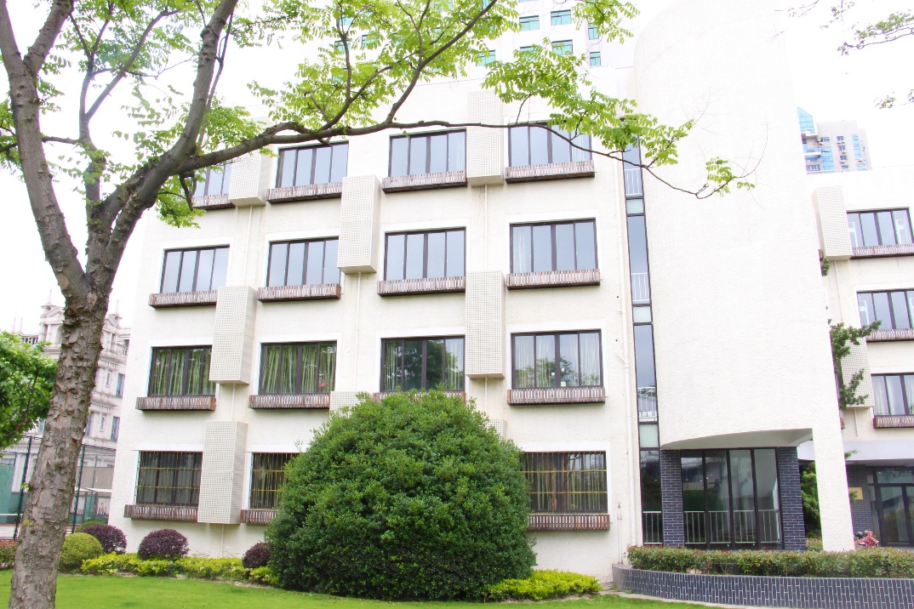
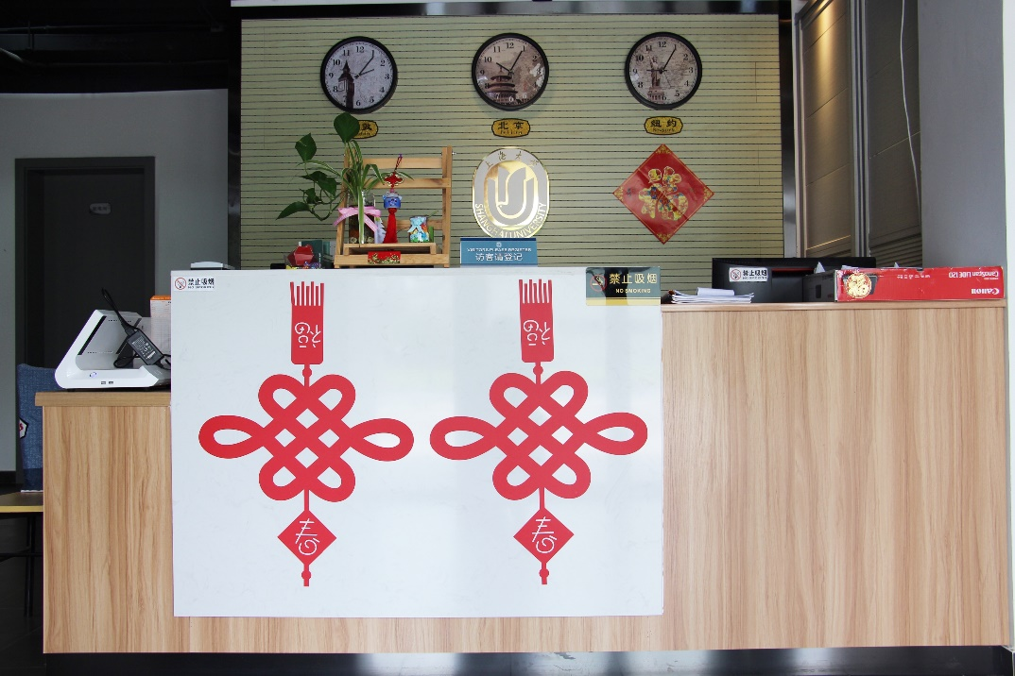
On-Campus Dormitory

Slide 19
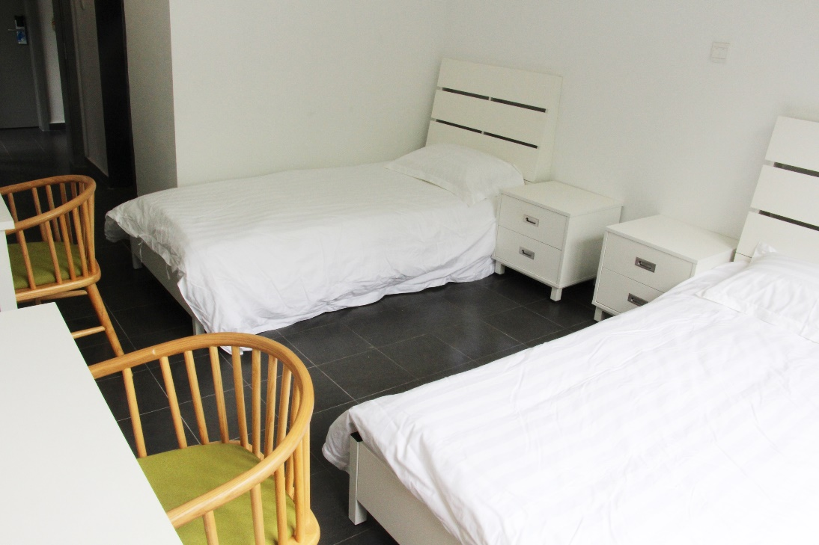
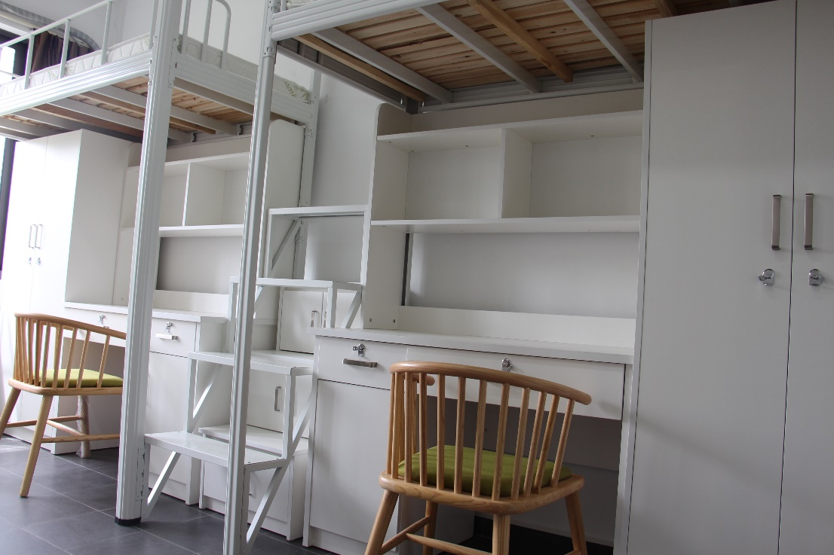
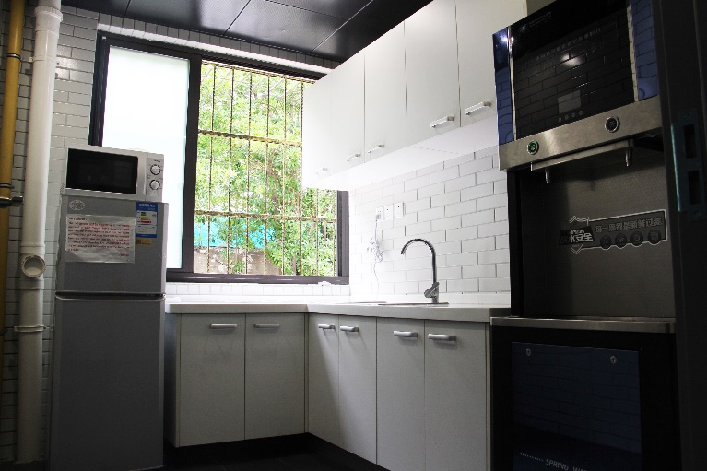
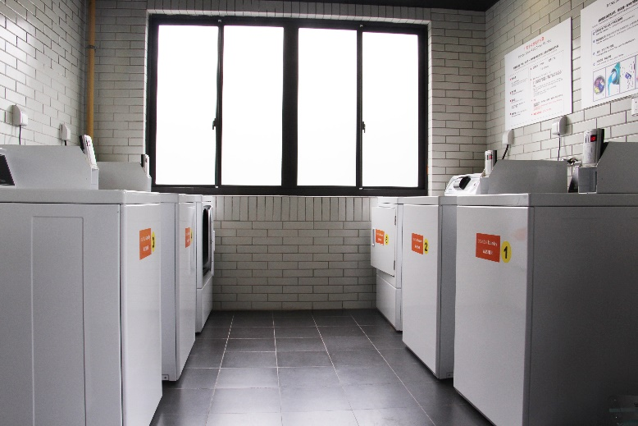
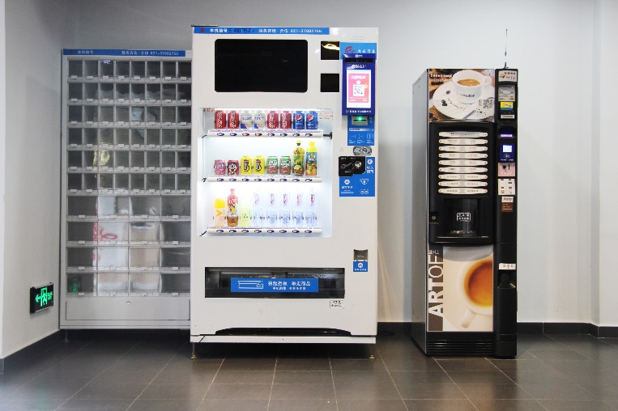


International Student Dormitory
SHU-UTS SILC BUSINESS SCHOOL

Slide 20
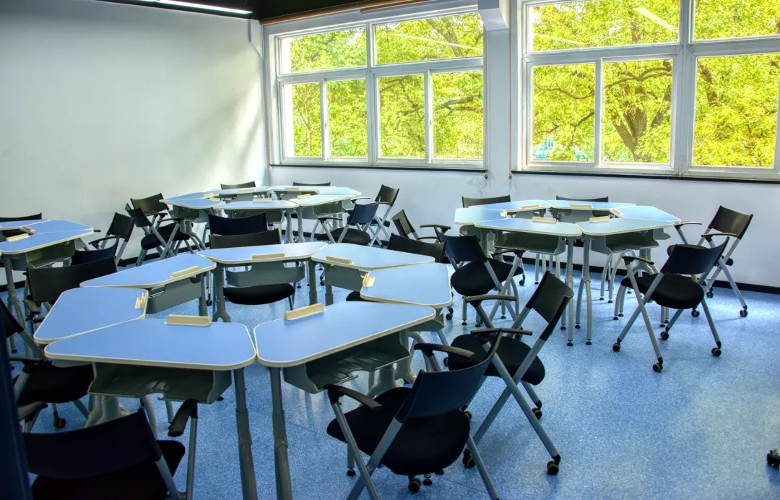
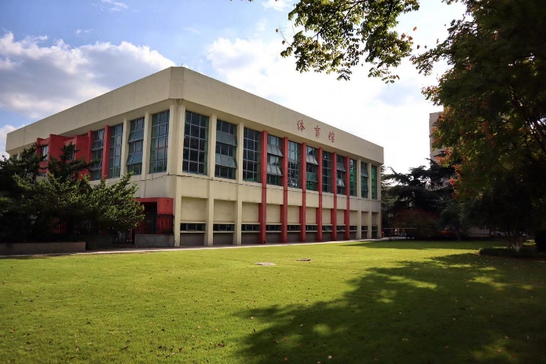
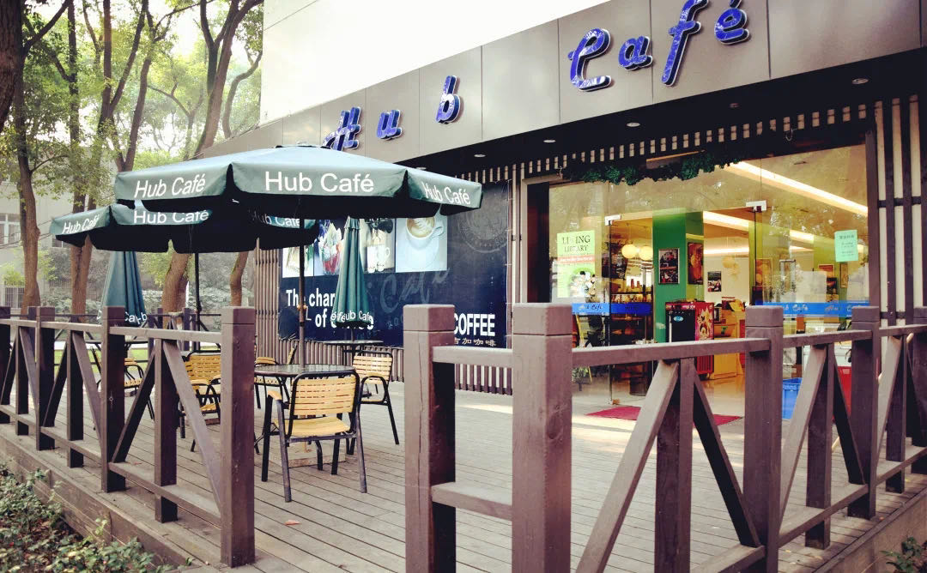
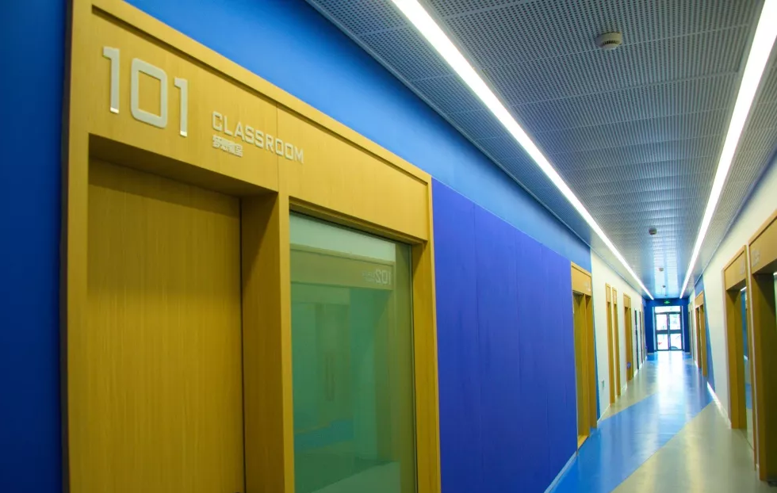
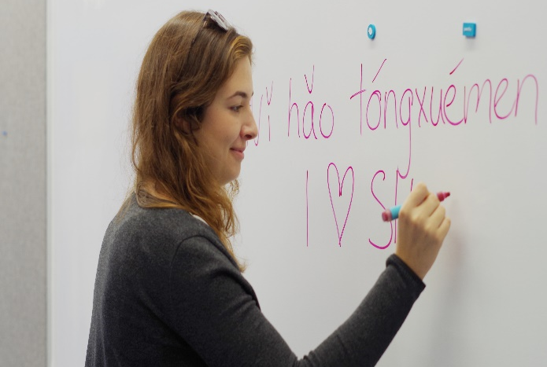
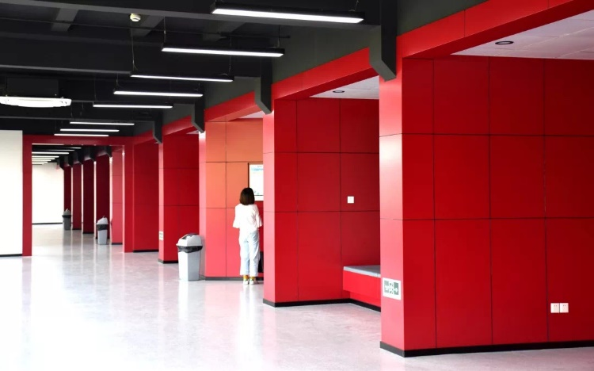
Facilities

Slide 21
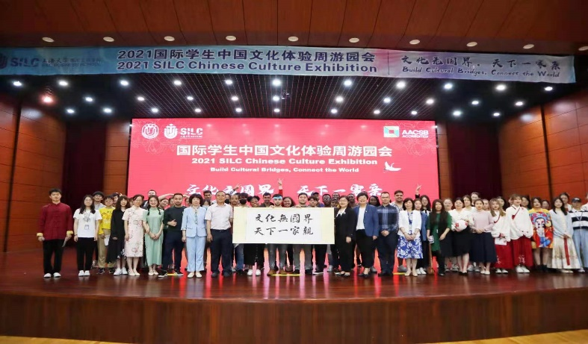
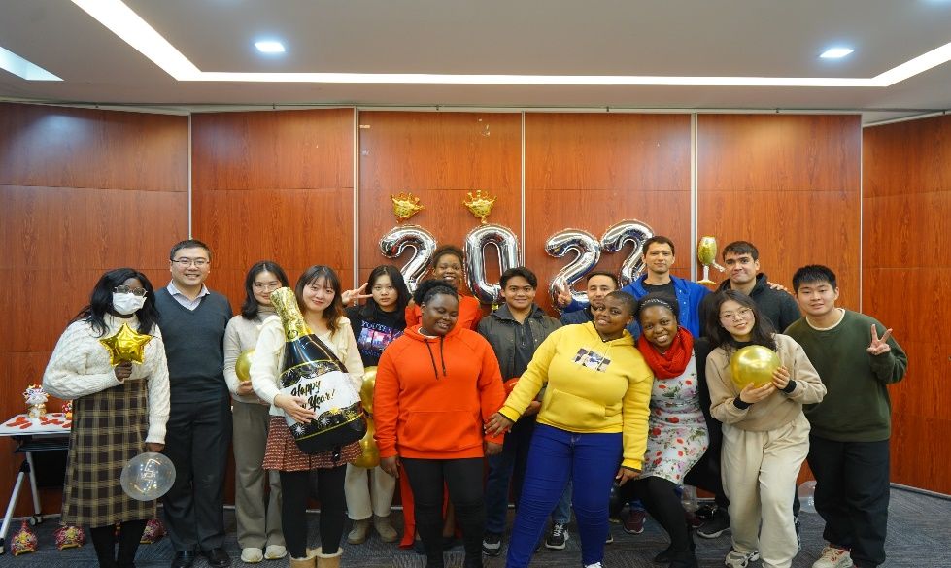


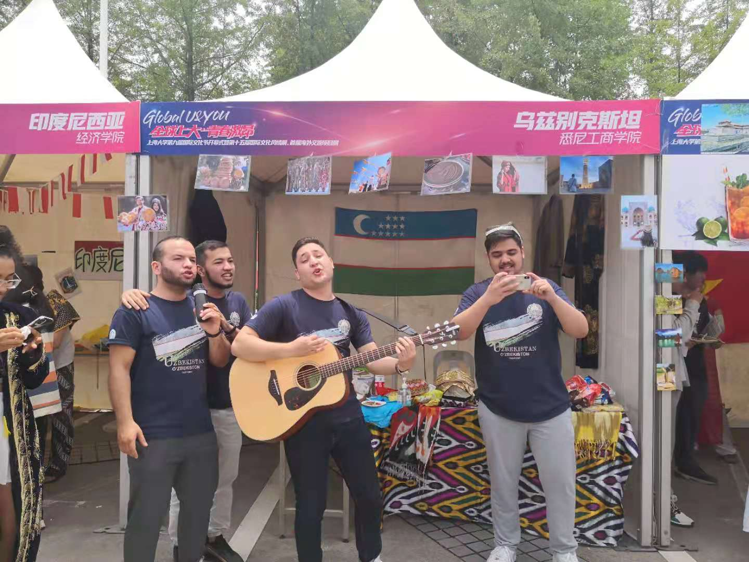
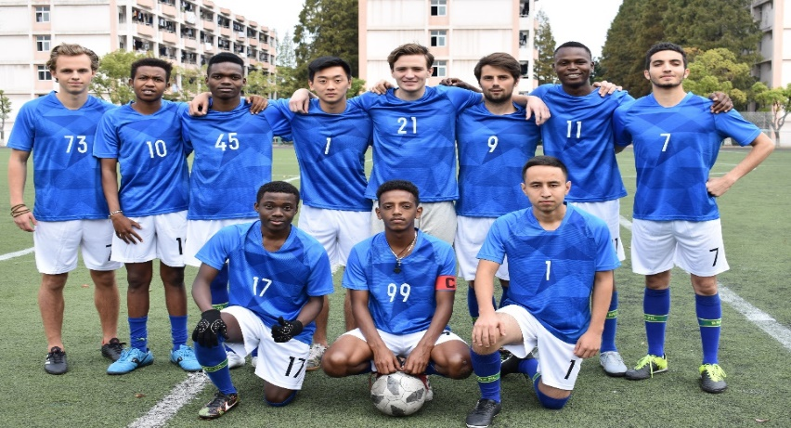
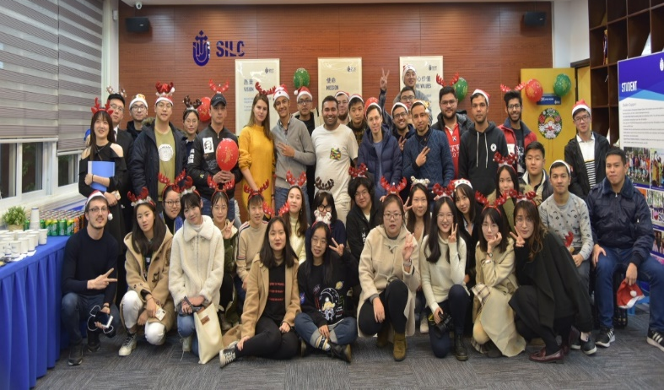
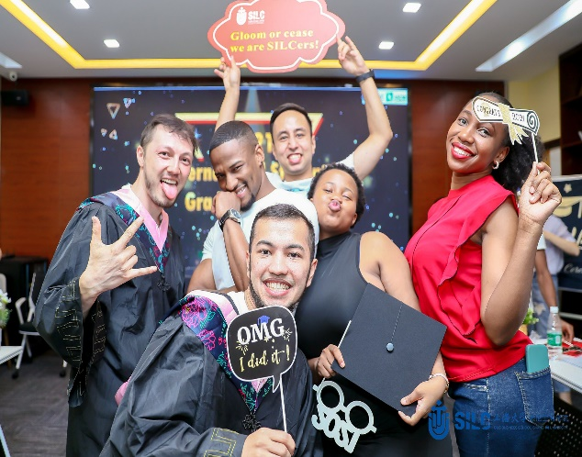
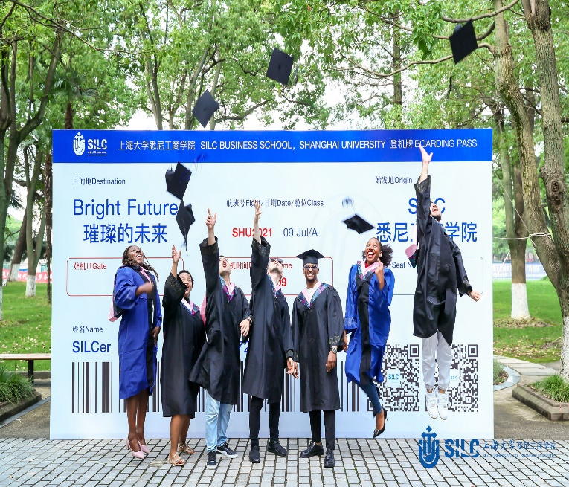
CAMPUS LIFE

Slide 22

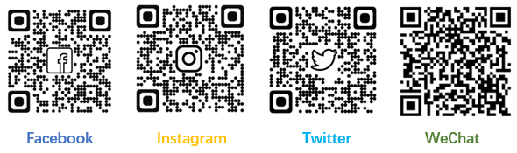
CONTACT US
Director of International Office
Dr. Harry Gu
Email: guhaodong@shu.edu.cn
International Recruitment & Marketing Team
Ms. Isa Meng Email: isa.mengrq@shu.edu.cn
Ms. Chloe Ding Email: chloeding@shu.edu.cn
admission.silc@oa.shu.edu.cn
Tel: 86-21-69980028-92011
Application website: https://apply.shu.edu.cn

