Slide 1
Zhejiang University of
Science and Technology
Hangzhou, China

Slide 2
1
About Zhejiang & Hangzhou
Content
2
About ZUST
3
Internationalization

Slide 3
1
About
Zhejiang & Hangzhou

Slide 4
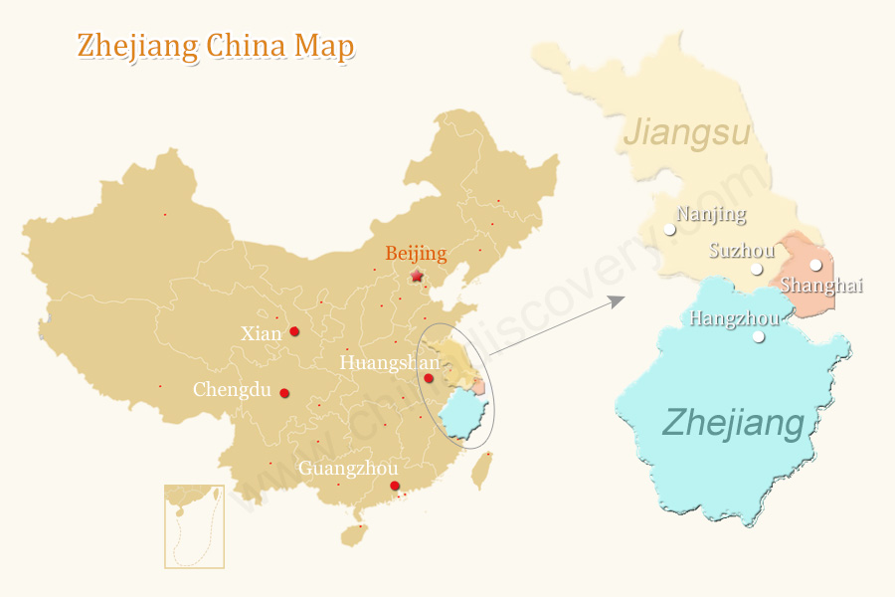
* 151 km from Shanghai
* 40 minutes by high-speed train
* Xiaoshan International Airport
Shanghai
Hangzhou
* Eastern Coastal Province
* GDP 4th in China
* Electromechanical Industries, textiles, chemical industries, food, and construction materials

Slide 5
Alibaba
World
Top
Corporations
Geely Auto Group
Hailiang Group
Wuchan Zhongda Group

Slide 6
2
About
ZUST

Slide 7
Intro
Founded in 1980
Multi-disciplinary
Specialized

Slide 8
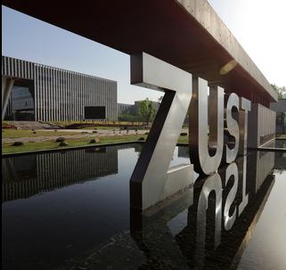
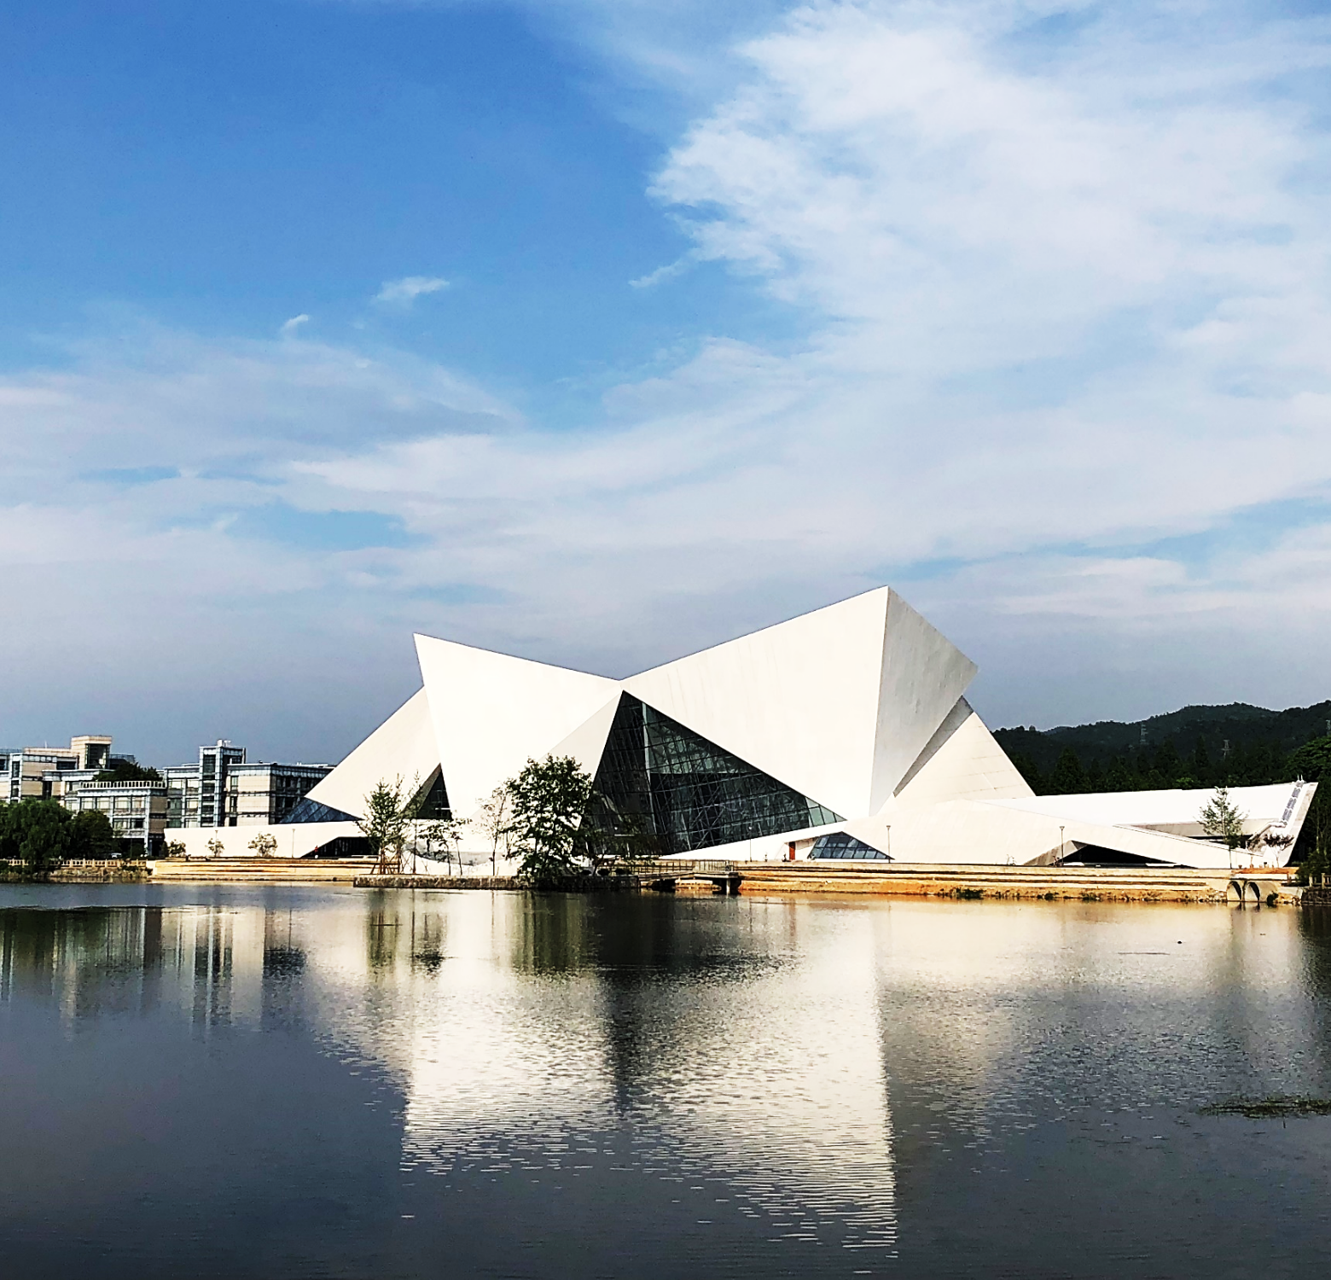
Scale
Features
Anji Campus
Xiaoheshan Campus

Slide 9
Scale
41 Years of History
17 Schools/Faculties
1400+ Faculty Members
1100+ Teachers
20000+ Full-time Students
2100+ International Students
8 English-taught Master Programs
11 English-taught Bachelor Programs

Slide 10
Scale
56 Chinese-taught Bachelor Programs
30 Engineering Programs
40+ Chinese-taught Master Programs/Directions
173 Mobility Programs
60+ International students/year on mobility programs

Slide 11
International Education
International Student Education
#International Degree Students
5th
#International Students
4th

Slide 12
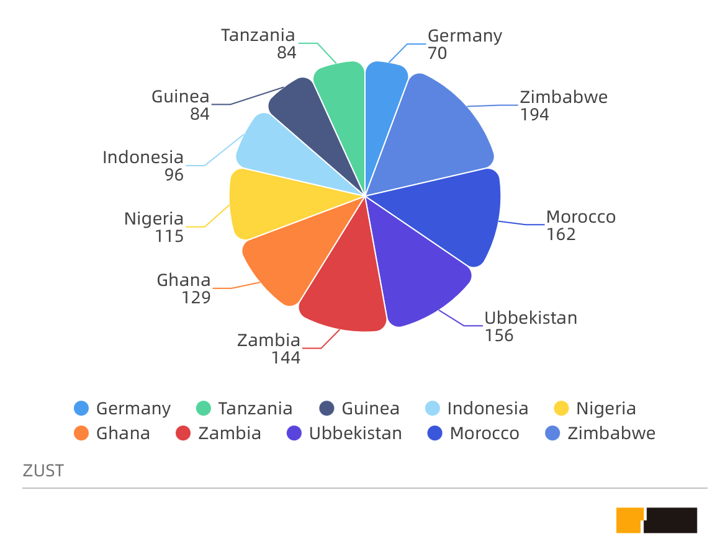
International Education
Top10 Countries

Slide 13
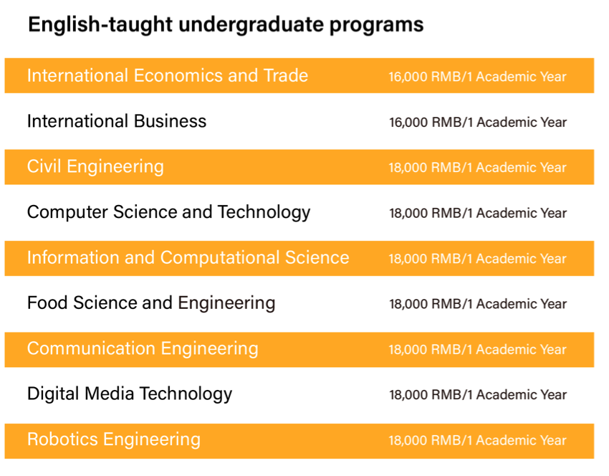
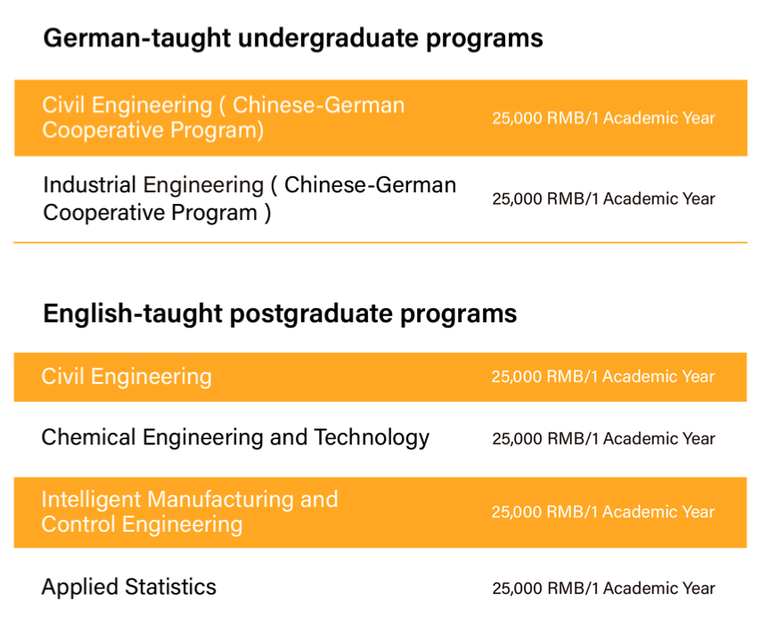
Programs

Slide 14
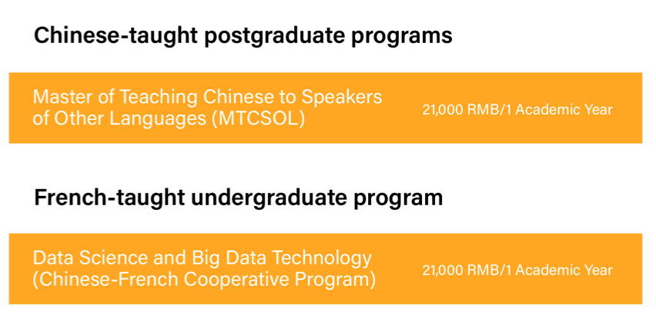
Programs

Slide 15
International Student Education
Programs
Distinctive ones:
Degree | Major
Bachelor’s Degree | Fashion Performance and Image Design (Chinese-taught Bachelor)
Training Program | Chinese Language Program (Long term& short term)
Bachelor’s Degree | Chinese Language and Literature (Business Chinese) with Bachelor Degree
Master's Degree | Master of Teaching Chinese to Speakers of Other Languages (MTCSOL)
Training Program | Summer Study Tour (SST)

Slide 16
Features
2 Practice Semesters
Project-based Learning
Top Rates
Employment rate Satisfaction rate
Payment of graduates
30% credits of engineering programs
Modular teaching online teaching close cooperation with industry

Slide 17
3
Internationalization

Slide 18
Double Degree Program
Joint Establishment of
Confucius Institute
Chinese-Foreign
Cooperatively-Run
Education Program
Cooperation
Models
Student & faculty exchange
Running schools or programs
in foreign regions & countries
Academic Exchange &
Research Collaboration

Slide 19
6
Sino-Germany Platforms
Chinese-German School （CDI）
1
Chinese-German Institute
of Applied Engineering (CDAI)
2
Confucius Institute-Erfurt
6
Zhejiang Sino-Germany Sci-tech
Promotion Center
5
Research Center of German Universities of Applied Sciences
4
The CDAH Forum
3

Slide 20
8
Double-degree Programs
01
03
05
HOCHSCHULE HANNOVER UNIVERSITY OF APPLIED SCIENCES AND ARTS
Chinese Language and Literature (Business Chinese)
HONAM UNIVERSITY
02
04
06
SABAH INSTITUTE OF ART
International Economics&Trade
Digital Media Technology
07
STMIK LIKMI
Bandung, Indonesia
08
Digital Media Technology

Slide 21
Scholarships

Slide 22
Accommodation Fees (Tingsong Dormitory)
Single Room (1 Student Only) | 1,200RMB | 1 Month | * Water and internet bills are included. * Electricity bill must be paid by students.
Double Room (2 Students) | 600RMB | 1 Month
Room Deposit | 1,000RMB | 1 Academic Year | * The amount will be returned, if all equipment is in good condition when students check out. * Room facilities: AC, water dispenser, bed, wardrobe, desk, chair, bookshelf, shower, public washing machine, public kitchen.
Bedding | 350 - 500RMB |  | Students can buy bedding provided by school or prepare bedding by themselves
Prepaid Electricity Fee | 1,000RMB |  | To either refund an overcharge or ask for a surcharge in case of a price change

Slide 23
Accommodation Fees (Donghe Dormitory)
Single Room(1 Student Only) | 800RMB | 1 Month | * Water and internet bills are included. * Electricity bill must be paid by students.
Double Room | 400RMB | 1 Month
Room Deposit | 1,000RMB | 1 Academic Year | * The amount will be returned, if all equipment is in good condition when students check out. * Room facilities: AC, water dispenser, bed, wardrobe, desk, chair, bookshelf, shower, public washing machine, public kitchen.
Bedding | 350 - 500RMB |  | Students can buy bedding provided by school or prepare bedding by themselves
Prepaid Electricity Fee | 1000RMB |  | To either refund an overcharge or ask for a surcharge in case of a price change

Slide 24
Student
Aqsa Noreen
ZUST international student Aqsa Noreen, from Pakistani, majoring in Chemical Engineering and Technology, published the paper “One-pass Hydrogenation of CO2 to Multi-branched Isoparaffins over Bifunctional Zeolite Based Catalysts”in a top academic journal “ACS Catalysis”. In addition, she also teamed up with her supervisors and other teammates and published two other papers:“Syngas to isoparaffins: Rationalizing selectivity over zeolites assisted by a predictive isomerization model”and “Fabricating Fe Nanoparticles Embedded in Zeolite Y Micro-Crystals as an Active Catalyst for Fischer-Tropsch Synthesis”.
Academic Quality

Slide 25
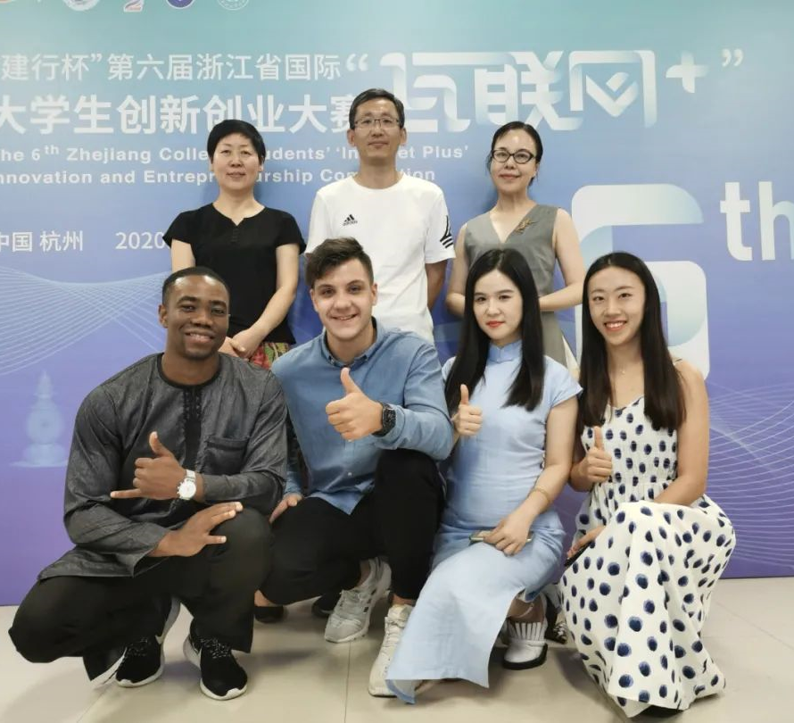
International
Competition
ZUST international student Riswan Hassan Ali(Tanzanian)'s team, Shannon Choo Sher Ning(Malaysian)'s team won the Golden Award of International Track in the Zhejiang provincial competition.
Academic Quality

Slide 26
Entrepreneurial
Innovation
ZUST graduate Gastone Mwewa Mpande Chiboko (Gai Shitong) from Zambia, is the first overseas student to receive the personal affair Residence Permit in Hangzhou since the implementation of new policy in this regard on December 29,2017.

Slide 27
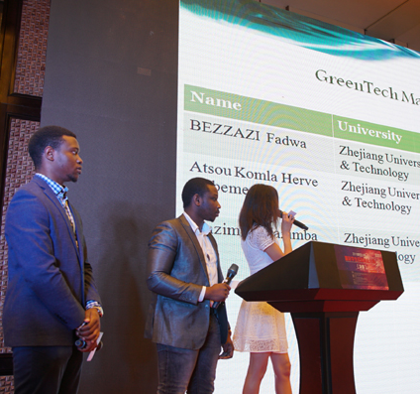
Entrepreneurial
Practice
ZUST team got the 3rd Prize of
International Student Innovation and
Entrepreneurship Competition in
Cross-border Trading Town.
Entrepreneurial Practice Base

Slide 28
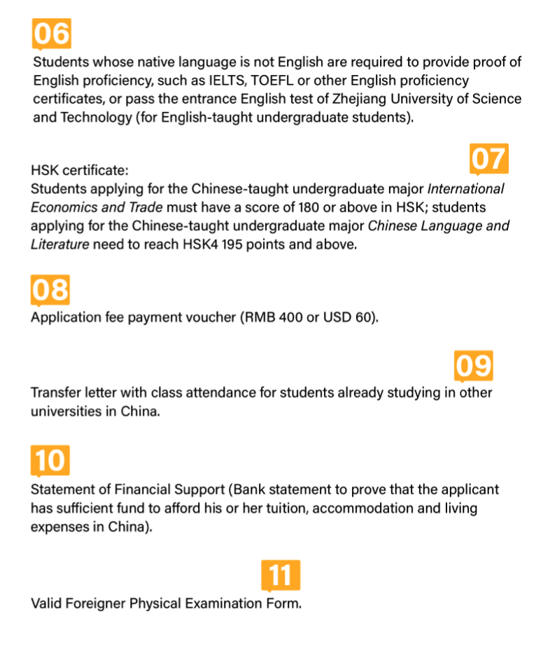
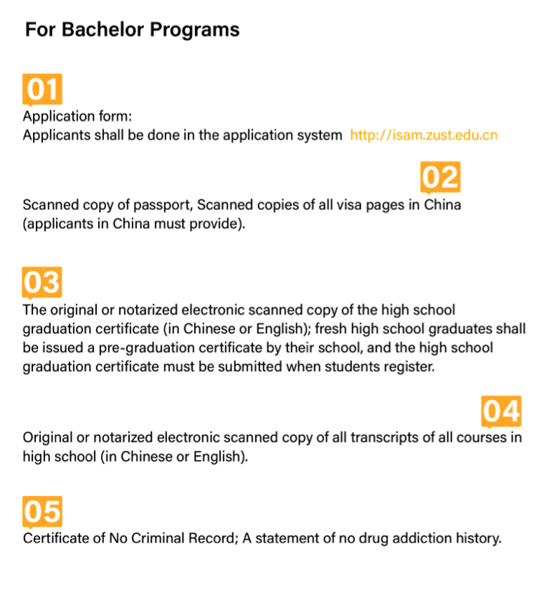
How to Apply?

Slide 29
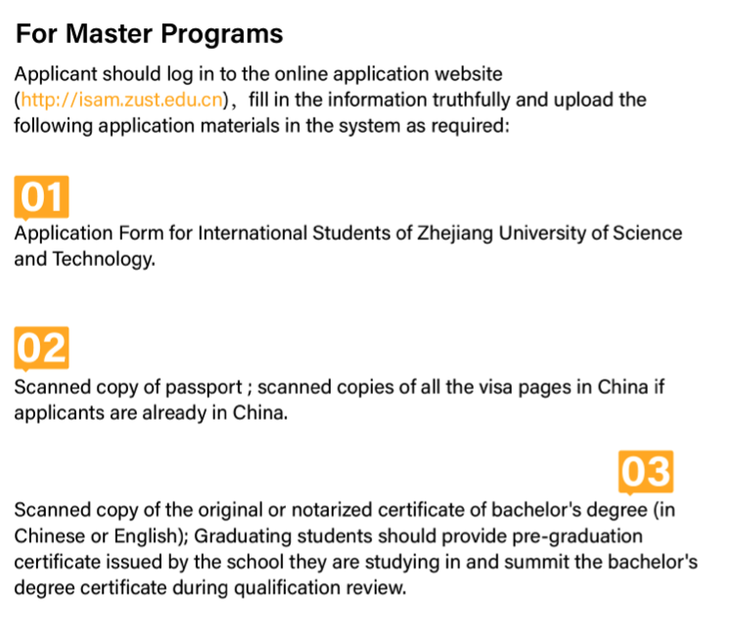
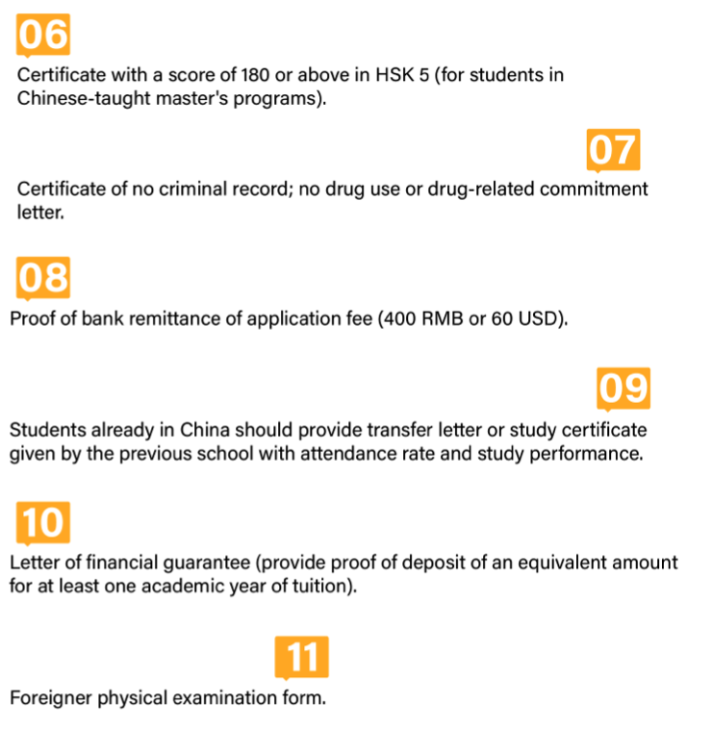
How to Apply?

Slide 30
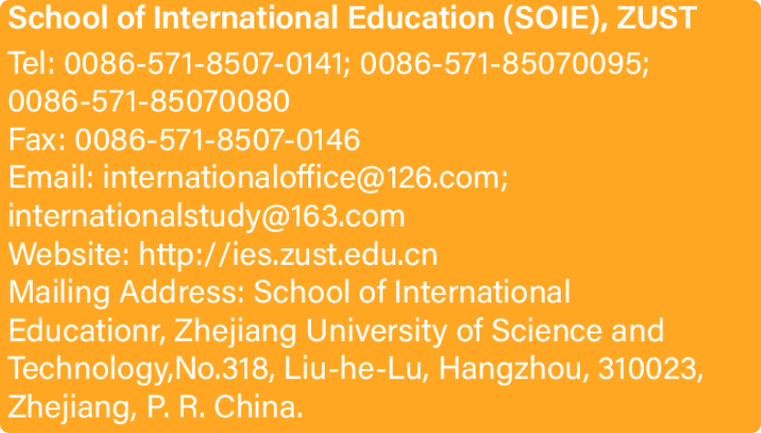
School of International Education (SOIE), ZUST
Tel: 0086-571-8507-0141: 0086-571-85070095;
0086-571-85070080
Fax: 0086-571-8507-0146
Email: internationaloffice@126.com;
internationalstudy@163.com
Website: http://ies.zust.edu.cn
Mailing Address: School of International
Education, Zhejiang University of Science and
Technology,No.318, Liu-he-Lu, Hangzhou, 310023,
Zhejiang, P. R. China.
CONTACT US

