Slide 1
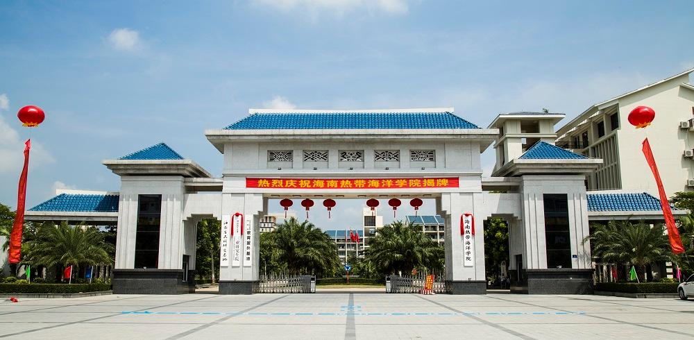
WELCOME TO HAINAN TROPICAL OCEAN UNIVERSITY
2022.4.26

Slide 2
BRIEF INTRODUCTION OF HAINAN TROPICAL OCEAN UNIVERSITY
- We are China-Asean education training center.
- We are a fully government-funded public university.
- We are founded in 1954, with a reasonably long history.
- We are located in the “Hawaii of China” Sanya, the southernmost coastal tourist city in China.
- We have faculties with more than 18,000 students.
●

Slide 3
- We offer 56 Bachelor degree programs and 3 Master degree programs.
- We provide apartments exclusively for international students, with one room for one person, and a common kitchen and a washing machine on each floor. Students can enjoy life and study with peace of mind.
- We organize various extracurricular activities for international students. Students can learn more about China and experience a different life.

Slide 4
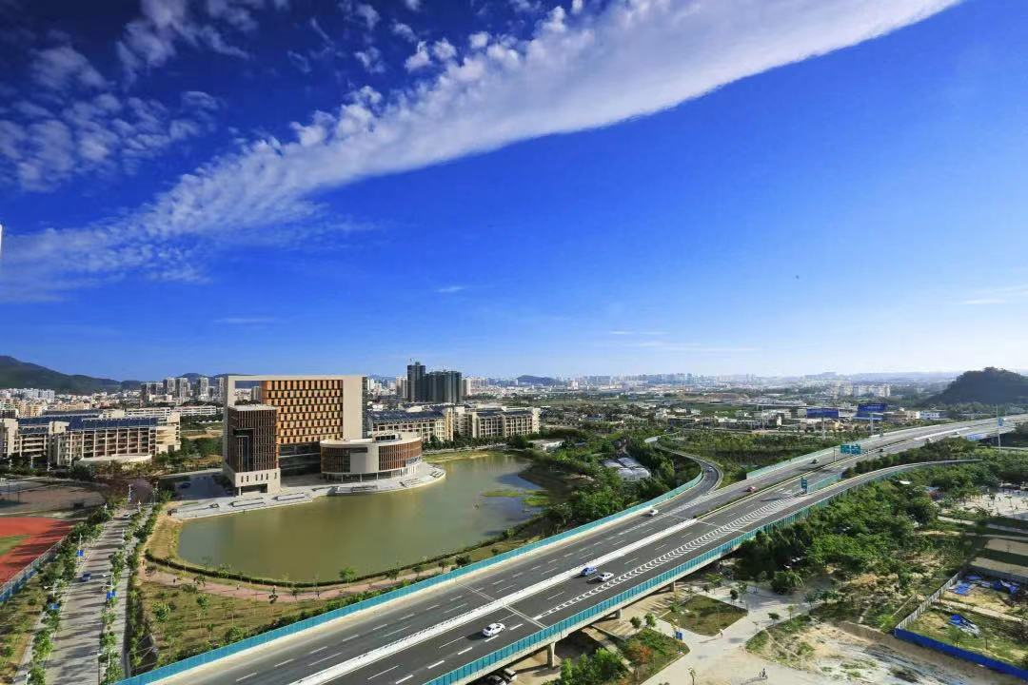

Slide 5
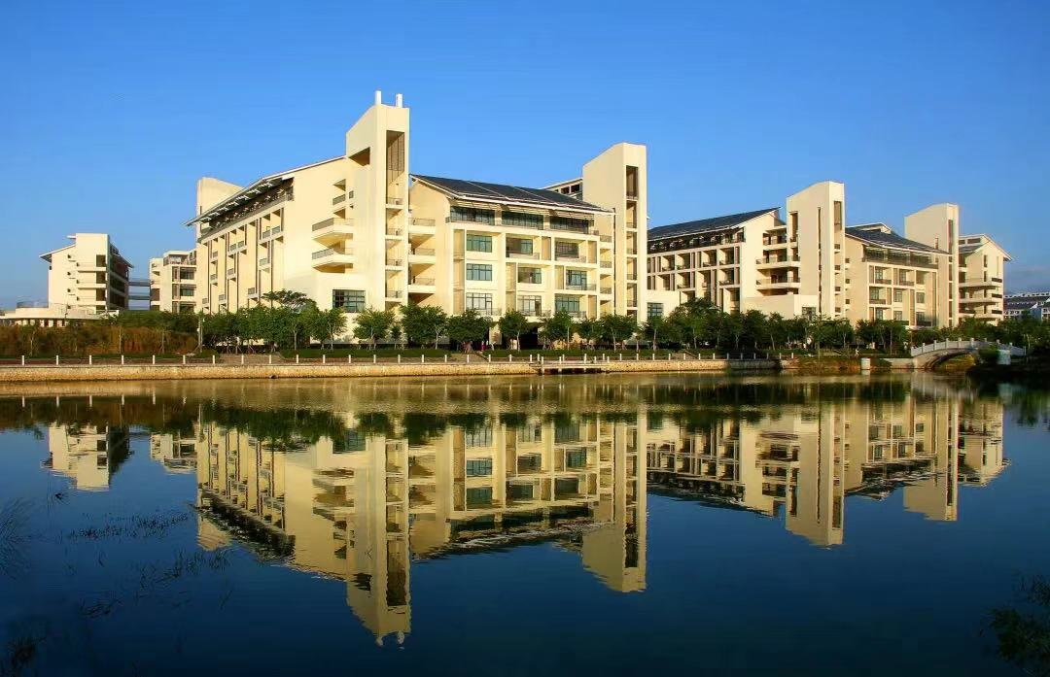

Slide 6
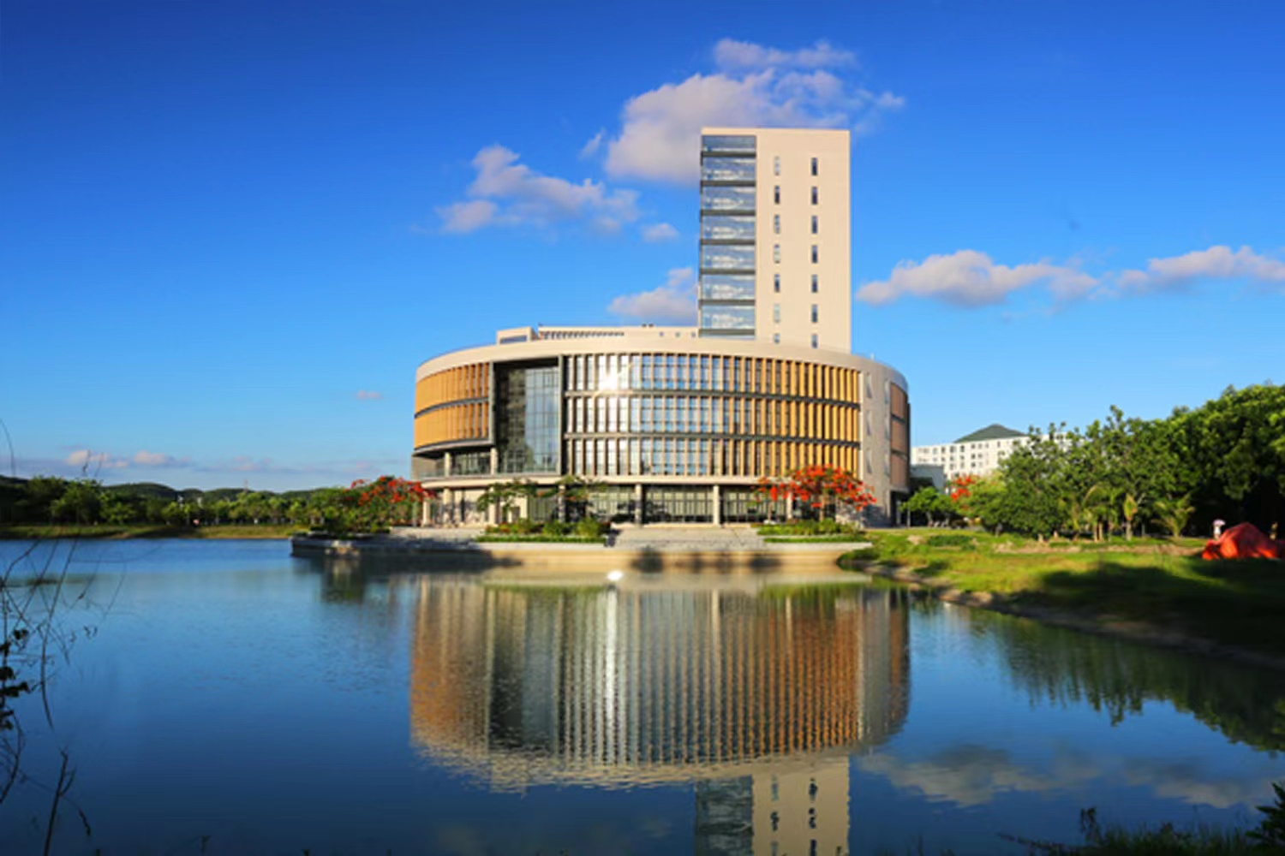

Slide 7
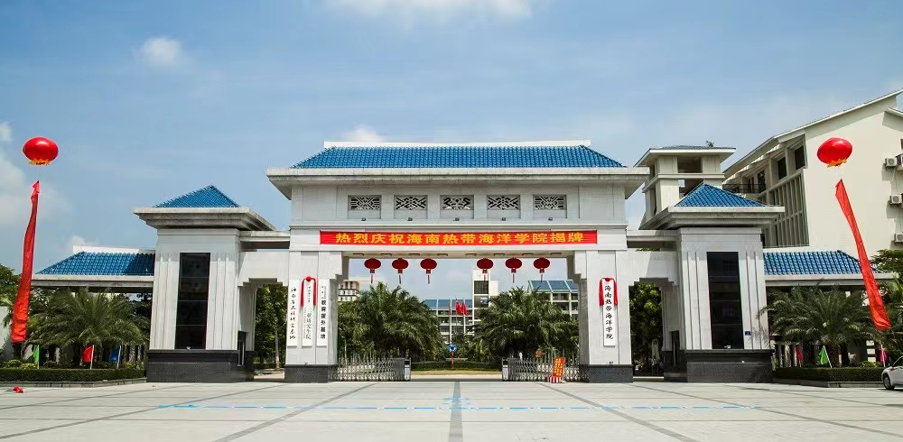

Slide 8
The advantage of location of Hainan

Slide 9
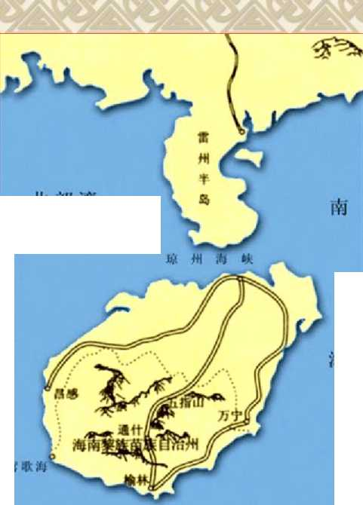
Hainan Island
The advantage of the location:
The location of Land and sea: Hainan Island is located in the southern border of China, surrounded by the sea, backed by the Mainland of China, and separated from Leizhou Peninsula of Guangdong by qiongzhou Strait, which is about 30 kilometers wide, with obvious geographical location advantages：
1.The forefront from southwest part to the the world.
2.Bases to develop and utilize the resources of the South China Sea
北部湾

Slide 10
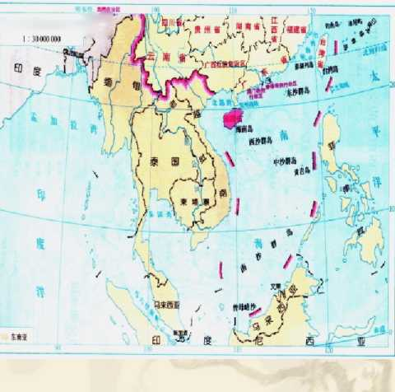
The advantage of
its economy
海南岛的地理位置:香
It is close to Hong Kong and Macao, with Taiwan in the distance, the economically developed Pearl River Delta within, and southeast Asia, the most active region in the Asia-pacific economic circle outside:
Both relying on the hinterland of the economy, and under the radiation and drive of the developed areas, it is convenient to draw from inside and outside, and develop the economy.

Slide 11
The advantage of its transportation
Close to the international deep-water waterways of East and Southeast Asia. Connecting Asia with Oceania, the Pacific Ocean and the Indian Ocean, the South China Sea is China's maritime route to Southeast Asia, the Indian Ocean, Africa and Europe:
It is beneficial to rely on the port to develop export-oriented economy and participate in the international economic cycle.

Slide 12
The advantage of FTZ policy
Relying on the advantages of hainan Free Trade Port in location, resources and policies, The economy of Hainan Island has developed rapidly.

Slide 13
五、热带资源优势The advantage of tropical rescources
1、位置：位于北回归线以南，属于热带。
2、地形:全岛近似椭园形、地势中高四周低、有山地、丘陵、 台地和平原
3、气候一热带季风气候，热带天气， 年日照时数大于2000小时，光照充足，夏热冬暖，降水丰富
4、植被：热带（国）雨林和热带例滓雨林以及众多的动植物一热带物种基因库
5、农作物和一年三熟，但需注意冬春的低温（d就n） 危害和夏秋季的台风破坏。
1.Location: Located south of the Tropic of Cancer, it is tropical.
2.Terrain: the island approximately elliptic, high terrain around low, mountains, hills, tableland and plains
3.Climate: tropical monsoon climate, tropical weather, sunshine hours more than 2000 hours a year, adequate sunlight, hot summer and warm winter, abundant rainfall
4.Vegetation: tropical rainforests and rainforests as well as numerous plants and animals a gene pool of tropical species
5.Crops and a year three ripe, but need to pay attention to winter and spring low temperature (D on N) harm and summer and autumn typhoon damage.

Slide 14
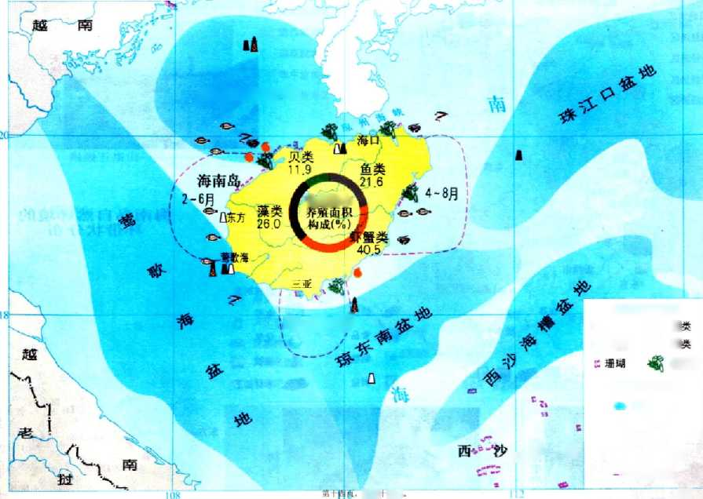
海南岛的海洋资源
北部湾盆地
全岛海水
明-翌单月J
海洋水产资源 Q鱼类 •贝 核虾蟹 7讓
红树林
海洋油1资源 油气盆地
1石油
 | n天然气
5群岛 | 1油气开采区
―_L. | --渔汛苑图 114
共三I六页

Slide 15
The Advantage of ocean rescources
1. Biological Resources - the largest gene bank of tropical species
2. Rich fishery resources
3. Rich in mineral and oil and gas resources
4. Abundant tourism resources
5. Space resources: it has more than 600 islands and reefs, of which 225 are larger than 500 square meters, which can be developed into a tropical Marine research base for Marine fisheries replenishment, trade and tourism.

Slide 16
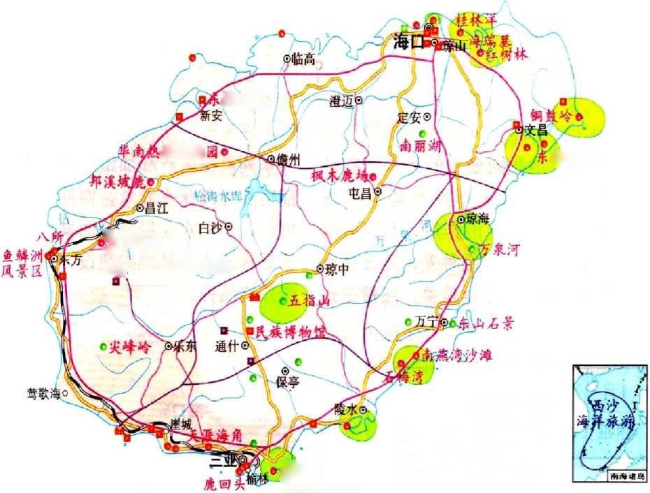
十大重点 开发旅游区
坡书院
帝抜物
郊椰林
矢的坡鹿
X，坝王心臂猿
M革命纪念地 。文化古迹 。民族风情 □民间工艺
。海滨风光 C山水景色 。珍稀物种
危湾
執卜九虬共三十六页.

Slide 17
三亚城市介绍
国际旅游城市 “东方夏威夷”

Slide 18
三亚简介
A Brief introduction
我国唯一的热带滨海旅游城市，境内汇集了阳光、海水、沙滩、气候、森林、动物、温泉、岩洞、田 园、风情等十大风景资源。
China's only tropical coastal tourism city, within the territory of sunshine, seawater, beaches, climate, forests, animals, hot springs, caves, gardens, customs and other ten scenic resources.

Slide 19
三亚简介
A Brief introduction
三亚市，是海南省地级市，别称鹿城，地处海南岛的最南端。三亚东邻陵水黎族自治县，西接乐东黎族自治县，北毗保亭黎族苗族自治县，南临南海，三亚市陆地总面积1921平方千米 ，海域总面积3226平方千米。
Sanya city, hainan province prefecture level city, also known as Lucheng, is located in the southernmost tip of hainan Island.Sanya is adjacent to Lingshui Li Autonomous County in the east, Ledong Li Autonomous County in the west, Baoting Li and Miao Autonomous County in the north, and the South China Sea in the south. Sanya has a total land area of 1921 square kilometers and a total sea area of 3226 square kilometers.

Slide 20
三亚简介
A Brief introduction
三亚是具有热带海滨风景特色的国际旅游城市，又被称为“东方夏威夷”。 2016年6月14日，中国科学院对外发布《中国宜居城市研究报告》，三亚宜居指数在全国40个城市中位居第三。
Sanya is an international tourist city with tropical coastal scenery, also known as the "Oriental Hawaii".On June 14, 2016, Chinese Academy of Sciences released the "Study Report on Livable Cities in China", and Sanya's livable index ranked third among 40 cities in China.

Slide 21
三亚简介
A Brief introduction
2016年9月，三亚入选“中国地级市民生发展100强”。
2017年2月，三亚入选第三批国家低碳城市试点之一。三亚也是同时入选中国特色魅力城市200强及世界特色魅力城市200强。
2018年12月，入选2018中国最佳旅游目的地城市第15名。
2018年12月13日，入选中国特色农产品优势区名单。 三亚是“无废城市”建设试点城市。
2019年10月23日，被确定为“第三批城市黑臭水体治理示范城市”。
In September 2016, Sanya was selected as one of China's
Top 100 prefecture-level cities for Livelihood Development.
In February 2017, Sanya was selected as one of the third batch of national low-carbon city pilot projects. Sanya was also included in the Top 200 Cities with Chinese characteristics and the Top 200 cities with Global characteristics.
In December 2018, it was selected as the 15th best Tourist destination city in China in 2018.
On December 13, 2018, it was selected into the list of Advantages of Agricultural products with Chinese characteristics. Sanya is a pilot city in the construction of "waste free city".
On October 23, 2019, it was identified as "the third batch of demonstration cities for urban black and odorous Water Treatment".

Slide 22
三亚标志性动植物
Sanya's iconic animals and plants

Slide 23
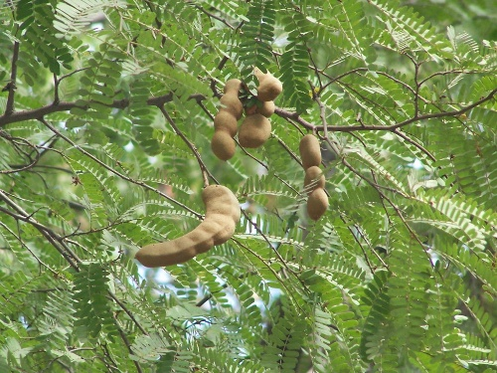
三亚市市树：酸豆树
Sanya city tree: capers

Slide 24
三亚市市鸟：白鹭
Sanya city bird: egret

Slide 25
三亚市市花：三角梅
City flower of Sanya: bougainvillea

Slide 26
椰 林
Coconut forest

Slide 27
三亚市旅游景点Scenic spots in Sanya
南山文化旅游区
Nanshan Cultural Tourism Area
大小洞天旅游区
Daxiao Dongtian Scenic Spot
蜈支洲岛
Wuzhizhou Island
亚龙湾
Yalong Bay
呀诺达 Ya nuo da
天涯海角 Tianyahaijiao

Slide 28
南山文化旅游区 Nanshan Cultural Tourism Area

Slide 29
大小洞天旅游区 Daxiao Dongtian Scenic Spot

Slide 30
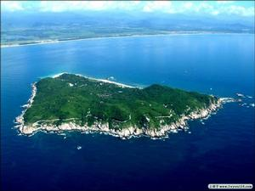
蜈支洲岛
Wuzhizhou Island

Slide 31
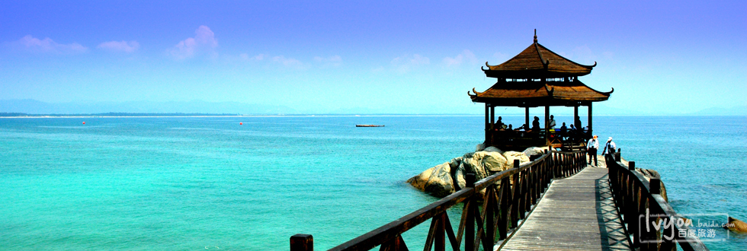
蜈支洲岛
碧海蓝天，细沙椰风，在这儿的每一次呼吸，都感觉灵魂被洗涤。

Slide 32
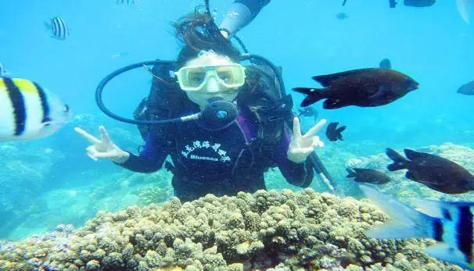
亚龙湾 Yalong Bay

Slide 33
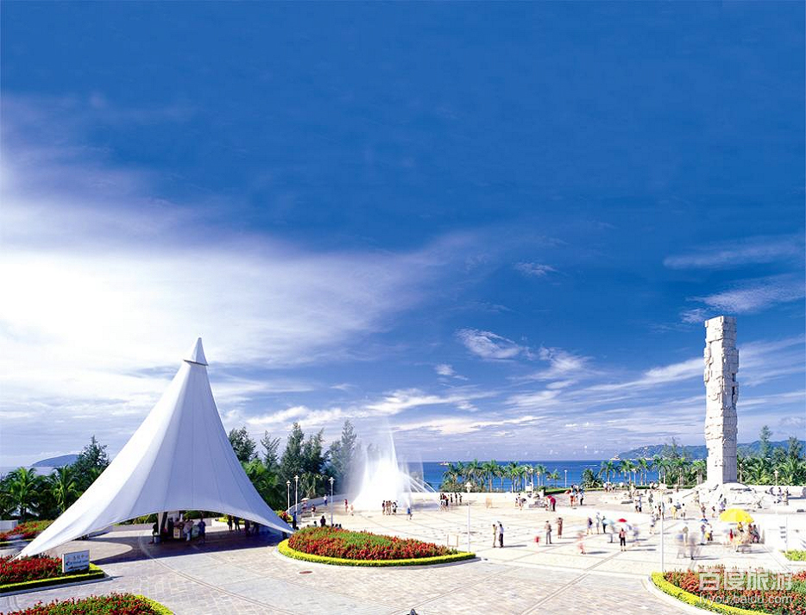
三亚湾 Sanya Bay

Slide 34
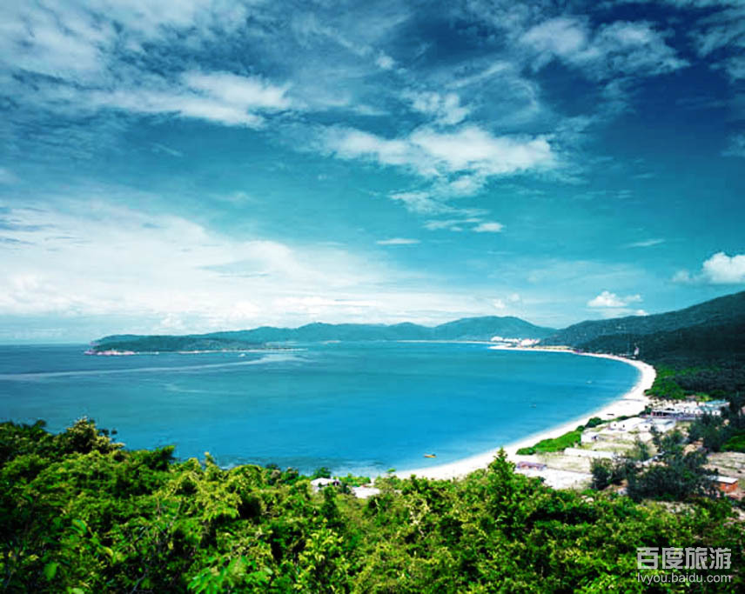
还是三亚湾still Sanya Bay

Slide 35
呀诺达

Slide 36
天涯海角At the Edge of the World

Slide 37
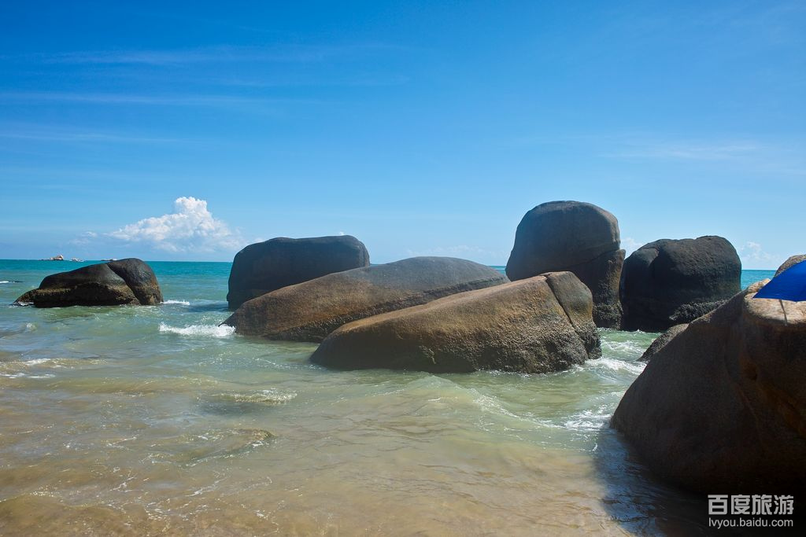
天涯 海角

Slide 38
美食小吃Local Specalities
鸡腿螺 Chicken legs screw
梅花参Thelenota ananas
槟榔花鸡Areca flower chicken
海南椰子饭Hainan coconut rice
羊栏酸鱼汤Yanglan sour fish soup
黎族竹筒饭Li nationality bamboo rice

Slide 39
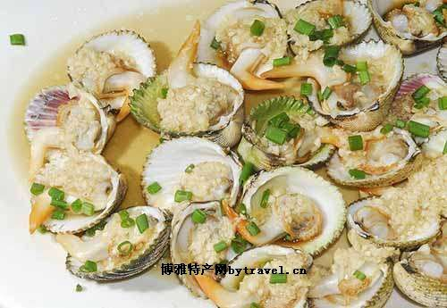
鸡腿螺Chicken legs screw
鸡腿螺其实是贝类，俗称“美人腿”，为海南特产贝类海鲜。
每年3月至6月，10月至12月最好吃，以高蛋白、低脂肪、肉质肥嫩、味道鲜美而享盛誉。

Slide 40
梅花参Thelenota ananas

Slide 41
槟榔花鸡 Areca flower chicken
槟榔花鸡 —— 槟榔河旅游区 鸡是槟榔树下养的鸡，花是槟榔树上开的花，两下相遇，创造出一个三亚特色的药膳，汤汁咸鲜可口，鸡肉质嫩香甜，饱了口福还养肠胃，值得一吃再吃。

Slide 42
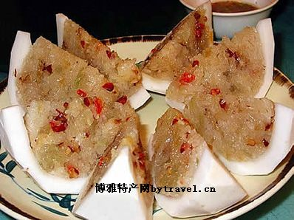
海南椰子饭Hainan coconut rice

Slide 43
黎族竹筒饭 Li nationality bamboo rice
其用山兰稻(一种旱稻)中的“香米”并配肉类为原料，放进新鲜的粉竹或山竹锯成的竹筒中，加适量的水，再用香蕉叶将竹筒口堵严，炭火中绿竹烤焦即可。
最好吃的是野味香饭。
目前，在三亚的天鹿风情寨可尝到黎族竹筒香饭。

Slide 44
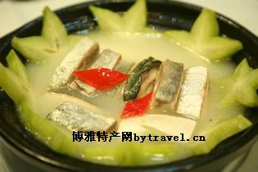
羊栏酸鱼汤Yanglan sour fish soup
由三亚疍家人首创，后经羊栏镇的当地人发扬光大。食材取自三亚近海各种鱼类，辅以三亚酸豆树叶和果、酸杨桃、西红柿、酸笋等。各种鱼肉鲜嫩可口，鱼汤酸度适中，食之令人胃口大开。

Slide 45
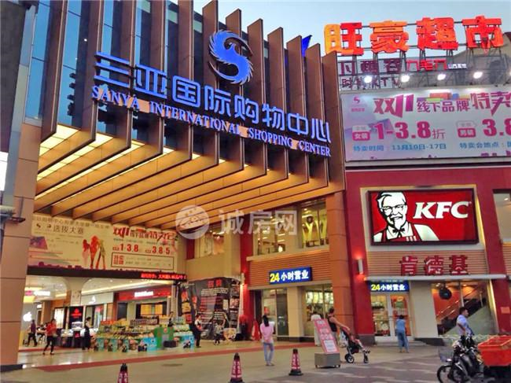
三亚国际购物中心 Sanya International Shopping Center

Slide 46
三亚大东海购物中心 Sanya Dadonghai shopping Center

Slide 47
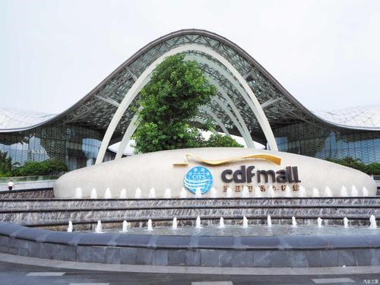
三亚免税城

Slide 48
三亚的未来The future of Sanya：
1.世界级的热带滨海风景旅游城市
2.开放创新的海南自贸港标杆城市
3.生态文明与宜居宜业的幸福城市
4.经略南海与科技创新的城市
1. A world-class tropical coastal scenic tourist city
2. Hainan free Trade Port as an open and innovative benchmark city
3. A happy city of ecological civilization and livable work
4. The city of scientific and technological innovation
因此，选择来我们学校留学=选择了美丽三亚=光明的未来
Therefore, Choice of study at HTOU=Choice of Sanya=Bright future

Slide 49
海南留学的自贸港政策优势
The Advangtage of FTZ policy for studying in Hainan from aboard

Slide 50
自贸港政策的形成
The formation of FTZ policy
加快推进Accelerate the process
习近平总书记先后12次就海南自由留易港建设作出“逐步探索”"加快推进”等系列 重要批示指示。
正式宣布 Formalannouncement
2018年4月13日，习近平 总书记宣布,支持海南逐步 探索、稳步推进中国特色自由留易港建设。
On April 13, 2018, General Secretary Xi Jinping announced that he supports Hainan's efforts to gradually explore and steadily promote the construction of free immigration in The Port with Chinese characteristics.
“逐步探索〃 | "加快推进”
General Secretary Xi Jinping has issued a series of important instructions on 12 occasions, including "gradually explore" and "speed up" the construction of Hainan Free Trade Ports.
正式公布 Official announcement
首次提出
First put forward the policy
2017年10月18日，习近平在十九大会议上明确提出：
赋予自由贸易试验区更大的改革自主权，探索建设自由贸易港。
It was clearly put forward at the 19th National Congress by Xi Jinping: Give the pilot Free Trade Zone greater reform autonomy and explore the construction of a free trade port.
2020年6月1日中共中央、 国务院正式公布《海南自由贸易港建设总体方案》
On June 1, 2020, the CPC Central Committee and The State Council officially announced the Overall Plan for the Construction of Hainan Free Trade Port.

Slide 51
自贸港概念分析
Part I ANALYSIS OF THE CONCEPTS
自由贸易 Free Trade
自由贸易区Free Trade Zone
自由贸易港Free Trade Port
境内关外Domestic and foreign customs
负面清单Negative list
封关运作Customs closure operation

Slide 52
Part I ANALYSIS OF THE CONCEPTS
在当今世界能纳入自由贸易概念体系名称有自由港，航空港， 国际航空港、码头.码头区,转口区和自由区,对外贸易区,自由 贸易区、自由区、自由带、出口自由区、仓库和转口区、免税贸易区，边境区，边境自由区，出口加工区，出口产品加工工业村、电 子工业岀口加工区、投资促进区、科学工业园区、自由关税区、保税区.保税仓库、免税工厂,保税陈列厂,保税棚、贸易仓库、货物集散地,冷藏自由区等等几十种之多。
In today's world can be incorporated into the concept of free trade system names are free ports, airports, international airports, terminals. Docklands, transit area and the free zone, foreign trade zone, free trade zone, free zone, free zone, export free zone, warehouse and transit area, free-trade zone, border, border free zone, export processing zones, export processing industry village, electric industrial forwarders processing, investment promotion, science-based industrial park, tariff-free zone, bonded zone. Bonded warehouse, duty-free factory, bonded display factory, bonded shed, trade warehouse, goods distribution center, refrigerated free area and so on dozens of many.

Slide 53
Part I ANALYSIS OF THE CONCEPTS
FTA
自由贸易区
专指两个及两个以上拥有主权的 （关税领土）为促逬彼此的贸易往来互设置各种优惠政策的特定区域。
Pertaining to two or more sovereign (customs territories) areas that establish preferential policies for entering trade with each other.

Slide 54
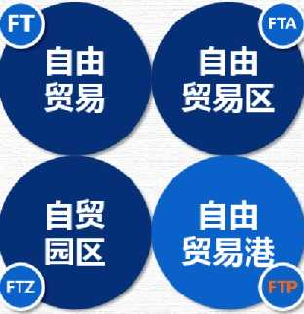
Part I ANALYSIS OF THE CONCEPTS
Free Trade
自由贸易指取消对出口贸易的限制和阻碍，取消对本国进出口商品的各种特权和优惠.使商品、服务、资金 人员自由进出、自由竞争是“贸易保护主义”的对称。
Free trade refers to the removal of restrictions and barriers on export trade and the removal of all kinds of privileges and preferences for domestic imports and exports. Free entry and competition of goods, services, capital and personnel is the symmetry of "trade protectionism".
Free Trade Area
专指两个及两个以上拥有主权的国家 （关税领土）为促进彼此的贸易往来， 相互设置各种优惠玫策的特定区域。
A specific area in which two or more sovereign countries (customs territories) set up various preferential policies to promote trade between them.
Free Trade Zone
在国境内的划出一圾区域,进行围网隔离，对境外入区货物的关权买实施免税或保税.是单个主权国家（地区）的行为.
Delimit a rubbish area within the territory of the country, carry out purse Seine isolation, and implement duty-free or bonded purchase of customs rights of goods entering the area from abroad. Is the behavior of a single sovereign state (region).
Free Trade Port
自由港是设在一国（地区）境内关外、货物资金进出自由，绝大多数商品免征关枳的特定区域，是目前全球开放水平最高的特殊经济功能区“
A free port is a special area within and outside a country (region), where goods and capital can enter and exit freely and most commodities are exempted from customs. It is the special economic function zone with the highest level of openness in the world.

Slide 55
Parti
“自由港是设在一国（地区）境内关外、货物 资金人员进出自由,绝大多数商品免征关税的特定 区域，是目前全球开放水平最高的特殊经济功能区"
"A free port is a special zone within and outside a country (region), where goods, capital and people can enter and leave freely and most commodities are exempted from tariffs. It is the special economic functional zone with the highest level of openness in the world."
FTP
自由贸易港
汪洋 《推动形成全面开放新格局》，人民日报
Wang Yang, Promoting the Formation of a New Pattern of All-round Opening up, People's Daily

Slide 56
Part I ANALYSIS OF THE CONCEPTS
境内关外
Domestic and foreign customs
监管方式
supervising pattern
一线放开 境外要素可以不受海关监管自由岀入境；
二线管住 要素从自由贸易区出入非自由贸易区要接受海关监管
区内自由 区内要素可以不受海关监管自由在区内
Let the first-line open: Overseas elements can enter the country freely without customs supervision;
Second-line control: elements from the free trade area to enter non-free trade zone to accept customs supervision. Free elements flow in FTA:within the free area elements can not be subject to customs supervision free in the area
im

Slide 57
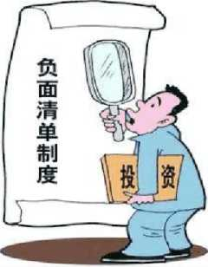
Part I ANALYSIS OF THE CONCEPTS
负面清单
Negative list
负面清单管理模式指的是一个国家在引进外资的过程中， 对某些与国民待遇不符的管理措施，以清单形式公开列明， 在一些实行对外资最惠国待的国家，有关这方面的要求也 以清单形式公开列明。The negative list management mode refers to that in the process of introducing foreign investment, some management measures inconsistent with national treatment are publicly listed in the form of a list. In some countries that implement most-favored-nation treatment for foreign investment, relevant requirements are also publicly listed in the form of a list。

Slide 58
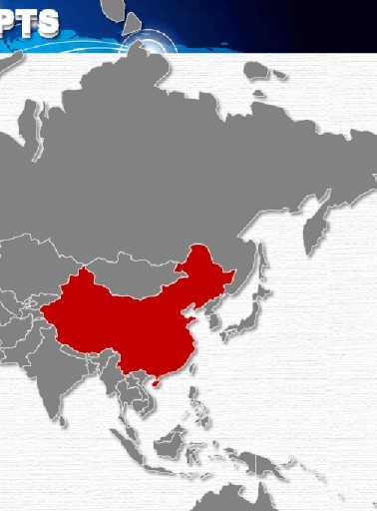
Part I ANALYSIS OF THE CONCEPTS
封关运作
Customs closure operation
全岛封关运作海南自贸港的实施范围为海南全岛，但在概念理解上，要明确区分封关运作与封岛运作的不同性质。
The implementation scope of Hainan FREE Trade Port is the whole island of Hainan, but in terms of conceptual understanding, it is necessary to clearly distinguish the different nature of sealing-off operation and island-sealing operation.
、

Slide 59
Part II ANALYS1S OF THE MASTER PLAN
总体要求General requirements
■指导思想Guidelines：
＞对标国际高水平经贸规则Same as international high-level economic and trade rules
＞聚焦贸易投资自由化便利化Focus on trade and investment liberalization and facilitation
＞建立与高水平自由贸易港相适应的政策制度体系
establish policies and systems that are compatible with high-level free trade ports
＞建设具有国际彰响力的海关特殊监管区
Building a special customs supervision zone with international prominence
＞打造引领我国新时代对外开放的鲜明旗帜和重要开放门户
build a clear banner and an important gateway for China's opening-up in the new era

Slide 60
Part II ANLYSIS OF THE MASTER PLAN
Basic principles of Hainan free trade port construction
借鉴国际经验
draw experience from international practice
体现中国特色
Embodied With Chinese Characteristics
符合海南定位
In line with hainan positioning
突出改革创新
Highlighting reform and innovation
坚持底线思维
Stick to the bottom line of thinking

Slide 61
Part II ANALYSIS OF THE MASTER PLAN
Goal of development
complletely built well
2025 年
更加成熟
more mature
初步建成
Preliminary built

Slide 62
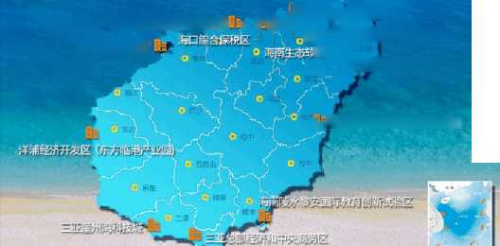
Part II ANALYASIS OFTHE MASTER PLAN
■实施范围:海南岛全岛
The scope of implementation：the whole island
=9个迪拜 9 Dubai
=32个香港 32 HongKong
=49个新加坡 49 Singapore
=354个鹿特丹 354Rotterdam
海口号兴城与联网信息产业県
洋浦经济开发区（临高金牌港临港产业园））目-L： i ；既海”江东新区
海口国家高新技术产业幵发区
洋浦经济开发区
福?
—[E勤文昌国际航天城
• -1組誅城SI5®?旅游為亍区

Slide 63
Part II ANALYSIS OFTHE MASTER PLAN
—— 制度设计System design——
“6”+“1” + “3”+“1”:
以贸易投资自由化便利化为重点，以各类生产要素跨境自由有序安全便捷的流动和现代产业体系为支撑，以特殊的税收制度安排、高效的社会治理体系和完备的法治体系为保障 在明确分工和机制措施.守住不发生系统性风险的前提下，构建海南自由贸易港政策制度体系。
With the focus on trade and investment liberalization and facilitation, supported by the free, orderly, safe and convenient cross-border flow of various factors of production and the modern industrial system, and guaranteed by special tax arrangements, efficient social governance system and complete legal system, the division of labor, mechanisms and measures are clearly defined. On the premise of avoiding systemic risks, the policy system of Hainan free trade port should be established.
皿
ri

Slide 64
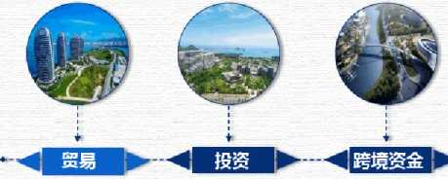
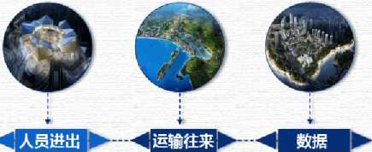
Part II ANALYSIS OFTHE MASTER PLAN
6“”
＞对外籍高层次人才提供出入境便利
＞建立健全人才服 务管理制度
＞实施更加便利的 出入境管理政策
＞ ,,—线“放开
＞ “二线“管住
＞ 岛内自由
■ 推逬服务贸易 自由便利
"实施市场准入承诺即入制
创新完善投资自由制席
＞建立健全公平竞 争制度
＞完善产权保护制 度
构建多功能自由贸易帐户体系
便利跨境贸易投资资金金流动
扩大金融业对内对外开放
加快金融改革创新
＞建立更加自由开 放的航运制度
，提升运输便利化 和服务保障水平
有序扩大通信资源和业务开放

Slide 65
Part II ANALYSIS OFTHE MASTER PLAN
、
6“”
trade
investment
cross-border capital
entry and exit
transportation
data
Facilitate entry and exit for high-level foreign talents
Establish and improve the personnel service management system
Implement a more convenient immigration control policy
＞ Let the first-line open
＞Second-line control
＞ Free elements flow in FTA
Implement a market access system based on commitments
Innovate and improve the system of free investment
Establish and improve a fair competition system
Improve the property rights protection system
Establish a multifunctional free trade account system
Acilitating the flow of funds for cross-border trade and investment
Further open up the financial sector to the outside world
Accelerate financial reform and innovation
Establish a freer shipping system
Enhance transport facilitation and service guarantee level
Expand communication resources and open services in an orderly manner

Slide 66
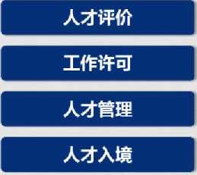
Part II ANALYSIS OF THE MASTER PLAN
人员进出自由便利
Free and convenient access
salary standard
facilitation
Joint trial and joint investigation
Entry convenience
personnel/talent evaluation
work permit
talent management
entry of foreign talent
薪酬标准
便利化
联审联检
入境便利

Slide 67
*实施执业人员境外专业资格单向认可*
One-way recognition of overseas professional qualifications will be implemented
:
/ 一 一 J /
单向认可
目前，国际上在国家或地区之间对于专业资格认可实行协议双向认可。
海南自由贸易港实行主动开放、单向认可政策,即取得境外职业资格或公认的国际专业组织资质的专业人士，通过技能认定后，可直接为自由贸易港企业和居民提供专业服务。
At present, the international recognition of professional qualifications between countries or regions to implement the agreement of two-way recognition.Hainan Free Trade Port implements the policy of active opening and one-way recognition, that is, professionals who have obtained overseas professional qualifications or recognized international professional organization qualifications can directly provide professional services to enterprises and residents of the free Trade port after passing the skill recognition.

Slide 68
允许境外人员担任法定机构,事业单位,国有企业的法定代表人
Foreign personnel are allowed to serve as legal representatives of legal institutions,
public institutions and state-owned enterprises
■相关单位可根据需要，按人事管理权限进行报批任命。
Relevant units can apply for approval and appointment according to the personnel management authority as required.
■有利于加大海南自由贸易港园区管理机构、科研机构、国有航运公司、国有金融机构等 对外籍人才的吸引力度，引入全球更多的先进技术、管理经验，为自由贸易港建设提供强有力的人才支撑。
It is conducive to attracting more foreign talents to the management institutions, scientific research institutions, state-owned shipping companies and state-owned financial institutions of hainan Free Trade Port Park, introducing more advanced technologies and management experience from all over the world, and providing strong talent support for the construction of the free trade port.
囲
115

Slide 69
□对外籍人员赴海南自由贸易港的工作许可实行负面清单管理,放宽外籍专业技术技能人员停居留政策，遵循"非禁即入”原则，最大化减少外籍人员来琼工作限制。
Implement negative list management for foreign nationals' work permits in Hainan Free Trade Port, relax the stop-residence policy for foreign professionals, and follow the principle of "entry or entry" to minimize the restrictions on foreign nationals coming to Hainan to work.

Slide 70
人员进出自由便利的其他政策
Other policies to facilitate the free entry and exit of persons
以薪酬水平为主要 指标评估人力资源
建立健全人才★移民★服务管理制度
We will establish and improve the management system for personnel migration and services of talents.
实施更加便利的免签入境政策
More convenient visa-free entry policies will be implemented.
Evaluate the human resource category with salary level as the main indicator.

Slide 71
■海南正在规划建设陵水黎安国际教育创新试验区、三亚崖州湾科教城、 海口桂林洋大学城三大国际教育集聚区；
Hainan is planning to build three international education clusters: Lingshui Li 'an International Education Innovation Pilot Zone, Sanya Yazhou Bay Science and Education City and Haikou Guilin Yang University City.
■上海交通大学医学院和爰丁堡大学合作办学项目、中国农业大学与康奈 尔大学等国外4所顶尖农业高校合作A5联盟等项目正在推进，哈罗公学已经开始办学。
The school of Medicine of Shanghai Jiao Tong University and The University of Tendinburg are cooperating with each other, and the A5 alliance between China Agricultural University and Cornell University is under way. Harrow School has already started its operation.

Slide 72
允许境外理工农医大学及职业院校在海南独立办学
Foreign science, industry, agriculture and medical universities and vocational colleges are allowed
to run schools independently in Hainan
理工农医类大学及职业院校
允许独立办学.设立国际学校
Science, industry, agriculture and medical universities and vocational colleges are allowed to run their schools independently
and establish international schols
德国比勒费尔律应用技术大学（独立办学）落地洋浦经济开发区
Germany Bielefellaw Applied Technology University (independent) settled in Yangpu Economic Development Zone

Slide 73
建设智慧海南
, ■
建设海南国际设计岛
CL
Building a smart Hainan
Construct Hainan International Design Island
化贸易基地
建设国家区块链技术和产业创新发展基地
Build national foreign cultural base
Building a national blockchain technology and industrial innovation and development base
支持海南建该区域医疗中心
建设邮轮旅游试验区
support Hainan in building a medical center in the region
Pilot cruise tourism zones will be established
游艇产业改革发展创新试验区
Establis pilot zone for yacht industry reform, development and innovation

Slide 74
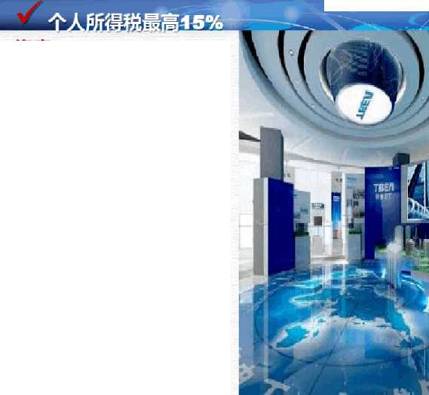
海南Hainan
•在海南自由贸易港工作的高端人才和紧缺人才，其个人所得税实际税负超过15%的部分,予以免征。实施清单管理， 将覆盖绝大部分来海南就业的人才。
High-end talents and talents in short supply working in Hainan Free Trade Port will be exempted from personal income tax if their actual tax burden exceeds 15%. The implementation of list management will cover the vast majority of talents who come to Hainan for employment.
•全岛封关运作后，纳税年度内 在海南自贸港累计居住满183天的个人，按照3%、10%、15%三档超额累进税率征收个人所得税。
After the island-wide closure, individuals who have lived in Hainan Free Trade Port for 183 days in total during the tax year will be charged individual income tax at three progressive tax rates of 3%, 10% and 15%.
I;
内地
最高45%The mainland up to 45%
粤港澳大湾区
最高15% ,超岀部分地方政府补贴,只适用境外人才，至2023年底。
Guangdong-hong Kong-Macao Greater Bay Area
Maximum 15%, super report part of local government subsidies, only apply to overseas talents, to the end of 2023.
上海临港新片区
承诺最高15% ,超岀部分地方政府补贴，只适用境外人才。
Shanghai Waterfront New Area
The commitment is up to 15%, exceeding some local government subsidies, only applicable to overseas talents.
新加坡最高22% Singapore up to 22%
中国香港 Hongkong
最高 15%-17% up to 15%-17%

Slide 75
Part II ANALYSIS OF THE MASTER PLAN
税制改革 Reform of tax system
2025年
鼓励类产业企业,减按15%征收企业所得税。
新増境外直接投资取得的所得，免征企业所得税。
对企业符合条件的资本性支出，允许在支出发生当期一次性税前扣除或加速折旧和摊销。
对高端人才和紧缺人才，其个人所得税实际税负超过15%的部分，予以免征。
在全岛封关运作的同时，依法将现行増值税，消费税、车辆购置税、城市维护建设税及教育费附加等税奏进行简并，启动在货物和服务零售环节征收销售税相关工作。
Encourage industrial enterprises, reduced by 15% corporate income tax.
Income from newly increased overseas direct investment will be exempted from corporate income tax.
For eligible capital expenditures of enterprises, one-time pre-tax deductions or accelerated depreciation and amortization are allowed in the current period of expenditures.
For high-end talents and talents in short supply, the part whose actual personal income tax burden exceeds 15% will be exempted.
In addition to the island-wide closure operation, the current value-added tax, consumption tax, vehicle purchase tax, urban maintenance and construction tax, education surcharge and other taxes will be simplified according to law, and the collection of sales tax in the retail link of goods and services will be started.

Slide 76
Part III ANALYSIS OF THE MASTER PLAN
税制改革 Reform of tax system
2035年
对注册在海南自由贸易港并实质性运营的企业（员面清单行业除外），减按15%征收企业所得税。
累计居住满183天的个人，按照3%, 10%, 15%三档超额累进税率征收个人所得税。
For enterprises registered in Hainan Free Trade Port and substantially operating (except for the industries listed on the staff list), the corporate income tax will be reduced by 15%.
Individuals who have resided for 183 days in total will be charged individual income tax at three progressive rates of 3%, 10% and 15%.
自主减征，免征.缓征除具有生态补偿性质外的政府性基金，自主设立涉企行政事业性收费项目。
Voluntary tax reduction and exemption. We will suspend the collection of government-managed funds other
than those for ecological compensation, and independently set up administrative charges for enterprises.
企业所得税、个人所得税作为中央与地方共享收入，销售税及其他国内税种收入作为地方收入。
Income tax and individual income tax are shared between the central and local governments, and sales tax and
other domestic tax revenues are shared between the local governments.入。

Slide 77
Part III ANALYSIS OF BENEFITS FROM STUYING
IN SANYA, HAINAN FROM ABOARD
海南是
我国开放型经济新高地
具有较强国际影响力的高水平自由贸易港
引领我国新时代对外开放的鲜明旗帜和重要开放门户
Hainan is
China's open economy up to a new lead;
a high-level free trade port with strong international influence;
A clear banner leading China's opening up in the new era and an important gateway for opening up.

Slide 78
Part III ANALYSIS OF BENEFITS FROM STUYING
IN SANYA, HAINAN FROM ABOARD
留学我校，你会享受到海南自贸港政策带来的如下好处：
1、享受我校因自贸港政策带来的国际化优质高等教学资源；
2、海南自贸港建设的见证者和建设者；
3、享受海南自贸港人员自由进出的便利政策；
4、硕士毕业生可在海南找工作，办理工作许可证。
5、硕士毕业生若在海南投资创业，享受自贸港的宽松投资政策。
You will enjoy the following benefits of Hainan Free Trade Port policy:
1. Enjoy international high-quality higher teaching resources brought by the free trade port policy to our university;
2. Witness and builder of hainan Free Trade Port construction;
3. Enjoy the convenient policy of free entry and exit of hainan Free Trade Port;
4, Master graduates can find jobs in Hainan, apply for a work permit.
5. If master graduates invest and start businesses in Hainan, they can enjoy the loose investment policy of free trade port.

Slide 79
Part III ANALYSIS OF BENEFITS FROM STUYING
IN SANYA, HAINAN FROM ABOARD
出入境便利政策系列三（高校留学生篇）
政策一：在国内重点高等院校获得本科以上学历的外国优秀留学生，毕业后在中国从事创新创业活动的，可凭高校毕业证书和创新创业证明材料，申办有效期2至5年的私人事务类居留许可（加注“创业”）期间被海南省内单位聘雇的可换发工作类居留许可。
政策二
在中国高等院校获得硕士研究生及以上学历的外国留学生，经所属高校推荐可办理2年有效的私人事务类居留许可在海南创新创业。
The exit and entry facilitation policies
Section Three Foreign Students
1. Outstanding foreign students who have received bachelor's degrees or above from well-established Chinese institutions of higher learning and engaged in innovative and entrepreneurial activities in China after graduation can,with their university diplomas and supporting documents proving their engagement in innovative and entrepreneurial activities, apply to the immigration department of China's public security authorities for a residence permit for private affairs (noted "Entrepreneurship) valid for two to five years. Employment-based residence permit can be obtained
after being hired by entities in Hainan province.
2. Foreign students who have received master‘s degrees or above from well-established Chinese institutions of higher learning and engaged in innovative and entrepreneurial activities in China after graduation can, upon the recommendation of the graduated universities,apply for a residence permit valid for up to two vears for innovative and entrepreneurial activities.

Slide 80
Part III ANALYSIS OF BENEFITS FROM STUYING
IN SANYA, HAINAN FROM ABOARD
出入境便利政策系列三（高校留学生篇）
政策三：在国际知名高校毕业的外国学生，毕业后2年内来中国创新创业的，可凭学历（学位）证明申办有效期2年以内的私人事务类居留许可（加注“创业”）；期间被海南省内单位聘雇的可换发工作类居留许可。
政策四：在境外高等院校学 习的外国学生到国内知名企业和事业位海南星级酒店、医院、国际学校等单位定期实凭相关单位邀请函件、外国高校在读证明申办口岸签证入境或在境内换发私人事务类进行实习。根据政府间协议来华实习的境外高校外国学生，可按规定申办工华类居留许可。
The exit and entry facilitation policies
Section Three Foreign Students
Ill. Foreign students who have graduated from internationally renowned universities and come to China for innovative and entrepreneurial activities within two years after graduation can with documents including their academic certificates (diplomas), apply to the immigration department of China's public security authorities for a residence permit for private affairs (noted "Entrepreneurship”) valid for up to two years. Employment-based repermit can be obtained after being hired by entities in Hainan province.
IV. Foreign students of overseases who come to China for internship in well-known companies or public institutions such as Star hotel, hospitals and international school in Hainan can apply to the visa department of China’s public security authorities at the port entry for an entry Visa or da residedee permit for private affairs.Foreign students of overseas universities who come to China for internship under intergovernmental agreements can apply for an emoloyment-based residence permit according to existed regulations.

Slide 81
Part III ANALYSIS OF BENEFITS FROM STUYING
IN SANYA, HAINAN FROM ABOARD
出入境便利政策系列二（引才引智篇）
政策一：国内重点高等院校、科研院所和知名企业邀请的外国专家学者，以及设区的市级议上人民政府人才主管部门、科技创新可办理口岸签证入境。入境后凭邀请单位的证明函件等材料，司由办有效期5年以内的多次签证或私人事务类居留许可，被企业、单位聘雇的可按规定申办有效期5年以内的工作类居留许可
政策二：海南重点领域，行业引进的高级技术和管理人才、急需紧缺专门人才和科技创新团队成员等外籍高层次人才，办妥许可证明的，可在入境口岸用请工作签证入境；为办妥工作许可证明的，可凭相关主管部门出具的邀请函件申请人才签证入境。入境后可按规定申请签发有效期5年以丙的长期签证或居留许可。
政策三
海南引进的境外高层次人才(包括外国人，港澳台人员），提供担保和雇佣合同，可聘雇外籍家政服务人员并为其办理私人事务类居留许可。
The exit and entry facilitation policies
Section Two Foreign Talents
1. Foreign experts and scholars invited by well-established institutions of universities, scientific research institutes or well-known companies in China, high-skilled foreign management and technology professionals identified by the human resource or the technology innovation departments of the people's governments at or above the municipal (with districts underneath) level can apply to the visa department of China's public security authorities at the port of entry for an entry visa. After entering China, they can apply to the immigration department of China's public security authorities for a multiple-entry visa or a residence permit valid for up to five years with documents including certificate letters issued by the organizations that sent the invitation.
2. Foreign technical professionals and managerial talents working for key sectors or industries in Hainan, urgently-needed specialists and members of innovative and entrepreneurial teams who have received their work permits can apply to the visa department of China's public security authorities at the port of entry for an entry visa.The above mentioned foreign talents who do not hold work permit can apply talent visa (R-visa) upon the recommendation from competent national authorities and apply for a residence permit valid for up to five years.
3. Foreign nationals (and Hong Kong,Macao and Taiwan residents) with advanced
professional skills working in Hainan can employ Foreign domestic service staffs and apply a residence permit for private affairs for them with guarantee letter and employment contract.

Slide 82
Part III ANALYSIS OF BENEFITS FROM STUYING
IN SANYA, HAINAN FROM ABOARD
The exit and entry facilitation policies
Section Two Foreign Talents
4. Foreign professionals and members of innovative and entrepreneurial teams working for key sectors or industries in China can, with documents including their work permits and letters issued by the employers, apply for a work type residence permit valid for up to five years. Foreign members of the innovative and entrepreneurial team can also apply for residence permit for private affairs (noted
"Entrepreneurship") valid for up to five yearswith guarantee letters issued by the head of the team.
5. Foreign nationals who have made outstanding achievements or having exceptional ability needed by China's national development can recommend to the immigration department of China's public security authorities to apply a long-term visa or residence permit valid for up to five years for foreign members of their team and their research assistants.
6. Foreign nationals employed by companies or public institutions in China who have received their work permits but have no time to get their work visa outside China can, with their work permit, apply to the immgration department of China’s public security authorities for an employment-based residence permit.Those who have received two consecutive employment-based residence permits,each vavid for more than one year,and have no recond of violating laws and regulations in China, can at the third application,apply to the immigration department of China’s public security authorities for an employment-based residence permit valid for five years.
入境便利政策系列二（引才引智篇）
政策四：
国内重点发展领域、行业引进的外籍人才和创新创业团队成员，可凭工作许可和单位函件申办有效期5年以内的工作类居留许可。创新创业团队外籍成员，也可凭团队负责人担保函件办理有效期5年以内的私人事务类居留许可（加注“创业”）
政策五：有重大突出贡献以及国家特别需要的外国人可推荐其带领的工作团队外籍成员和科研辅助人员，申办有效期5年以内的长期签证或居留许可。己办妥工作许可为的第三次申请工作类居留许可，可以按规定申办有效期5年的工作类居留许可。
政策六：中国境内企事业单位解聘的外国人，已办妥工作许可，来不及出境办理工作签证的，可凭工作许可直接申办工作类居留许可；对已连续两次办理1年以上工作类居留许可且无违法违规行为的，第三次申请工作类居留签证许可，可以按规定申办有效期5年的工作类居留许可。

Slide 83
Part III ANALYSIS OF BENEFITS FROM STUYING
IN SANYA, HAINAN FROM ABOARD
入境便利政策系列二（引才引智篇）
政策七：围绕海南旅游、热带特色高效农业、医疗健康高新技术教育文化体育等重点产业发展需要，对在海南就业的高端星级酒店厨师、博鳌乐城医疗旅游先行区医疗医护人员等外籍技术技能人员可发放与工作合同期限一致的工作类居留许可.
政策八：在海南任职的外籍嵩层次人才经工作单位和兼职单位同意并向出入境管理部门备案，可在海南兼职工作或创新创业。
政策九：
支持海南落实博鳌乐城国际医疗旅游先行区政策，对外籍患者及陪护家属凭海南医疔机构出具的医疗服务证明，可申请与医疗服务期限
一致的私人事务类签证或居留许可（加注“医疗”）
The exit and entry facilitation policies
Section Two Foreign Talents
7. Considering development needs of Hainan's key industries such as tourism,
high-efficiency tropical agriculture,health-care,high-tech, education,culture and
sports, employment-based residence permit valid for the contracted period might be issued for foreign professionals such as chefs of premium star hotel and medical staffs of Bo ao Lecheng International Medical Tourism Pilot Zone.
8. Foreign nationals with advanced professional skills can engage in innovative and entrepreneurial activities on a part-time basis upon the consent of both their full-time and part-time employers and after reporting to the entry-exit administration authorities of China's public security authorities for record-keeping.
9. To Support the implementation policy of Boao Lecheng International Medical Tourism Pilot Zone, foreign patients and accompanying family members can with the supporting documents for medical service issued hy medical institutions in Hainan,apply for visa or residence permit of private affair valid during the medical treatment period.

Slide 84
Part III ANALYSIS OF BENEFITS FROM STUYING
IN SANYA, HAINAN FROM ABOARD
各国在琼留学生:爱上海南生活 感受自贸港蓬勃发展
http://www.hi.chinanews.com.cn/hnnew/2021-07-01/588506.html

Slide 85
Brief Introduction of International Education School
The School of International Education is a secondary school which is responsible for the recruitment, management and preparatory Chinese language education of international students. The school consists of three departments ,which is Party and Government Department, Student Management Department,Department of enrollment and teaching and training.
We provide all-round support and service to international students during the time they spending at university. "All for the students" is the aim of us , standardized management, professional service, international conduct is the goal for development of the school, Everything is working towards the goal.
旅游学院

Slide 86
Brief Introduction of International Education School
旅游学院
Students come from 24 countries including Asia ,Africa,America and Europe. The School of International Education organizes a variety of extracurricular activities for international students regularly, so that students can understand China better, experience China better, then become a bond of friendship between China and foreign countries.
Warmly welcomes to students from all over the world to study in our university . Experience the wonderful time study in China!

Slide 87
Programs we offered
1.Bachelor Degree
2.Master's Degree
3.Chinese Language and Culture Course (non-degree)

Slide 88
Our Students are come from 24 countries
Africa | Comoros,Cape Verde,Nigeria, Zimbabwe, South Africa, Ghana, Cameroon
Asia | Uzbekistan, Kazakhstan, Kyrgyzstan, Cambodia, Bangladesh, Thailand, Afghanistan, Philippines
Europe | Russia, Ukraine, The United Kingdom, Germany, Austria, Poland
America | Canada, Barbados, Ecuador

Slide 89
Chinese Language And Culture Program
Language Class (Preparatory)
According to the Chinese proficiency of international students, the School of International Education offers beginner, intermediate and advanced classes .
Beginner class: for students who have no basic knowledge about Chinese, it offers comprehensive Chinese , listening, reading , writing courses and culture courses.
Intermediate class: for students with HSK level 2-3, it offers comprehensive Chinese , listening, conversation, writing, culture and other courses.
Advanced class: for students with HSK level 3-4, it offers Chinese comprehensive, listening, writing, reading ,culture and other courses.

Slide 90
Chinese Language And Culture Program
Every class has 14-18 study hours per week.
According to the characteristics and requirements of the major, the School of International Education provides the same courses for international students as those for Chinese students: Advanced Chinese, Overview of China, etc., and basically implements assimilation teaching management.

Slide 91
Bachelor And Master Program
Undergraduate and Master students are organized into the school of their maojor, which is jointly managed and trained by the School of International Education and the school of their maojor.
In 2022, their are 17 colleges, 56 undergraduate programs and 3 master programs will be open to international students.
Program | Duration of Study
Chinese Language and Culture Course (non-degree) | Flexible(short/long term)
Bachelor Degree | 4 years
Master's Degree | 2-3 years

Slide 92
Bachelor Degree Program
Marine and tourism majors are our advantage professions.
The professions below are also very popular by international stusents.
The top 3 popular professions | School of the profession
Tourism Management | School of Tourism
Teaching Chinese As A Second Language | School of Humanities and Social Sciences
Computer Science And Technology | School of Computer Science and Technology

Slide 93
Master Degree Program
SCHOOL | MA/MSC PROGRAMS OFFERED
School of Ecological Environment | Master of Resources and Environment (MRE)
School of Tourism Management | Master of Tourism Administration (MTA)
School of Humanities and Social Sciences | Master of Social Work (MSW)

Slide 94
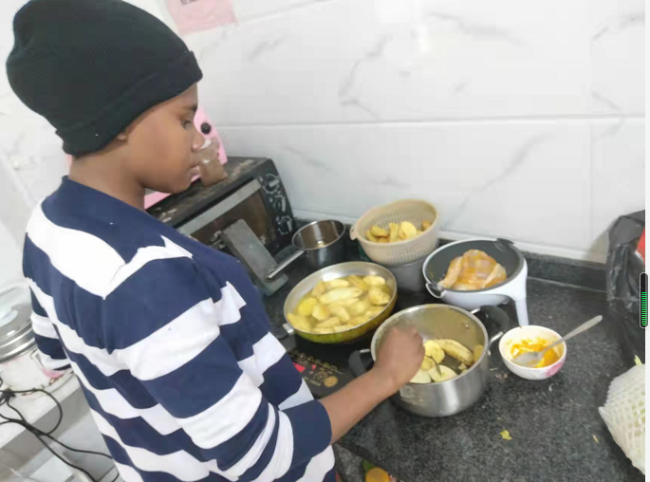
We offer single rooms for international students ,one room for one person,Our International student apartment is equipped with washing machine and shared kitchen (including ordinary kitchen and halal kitchen), so students can enjoy the convenience of life and relax their study.

Slide 95
Our international students have rich extracurricular life, with those activities,students can experience China and the wonderful life of studying abroad better , and enrich their life.

Slide 96
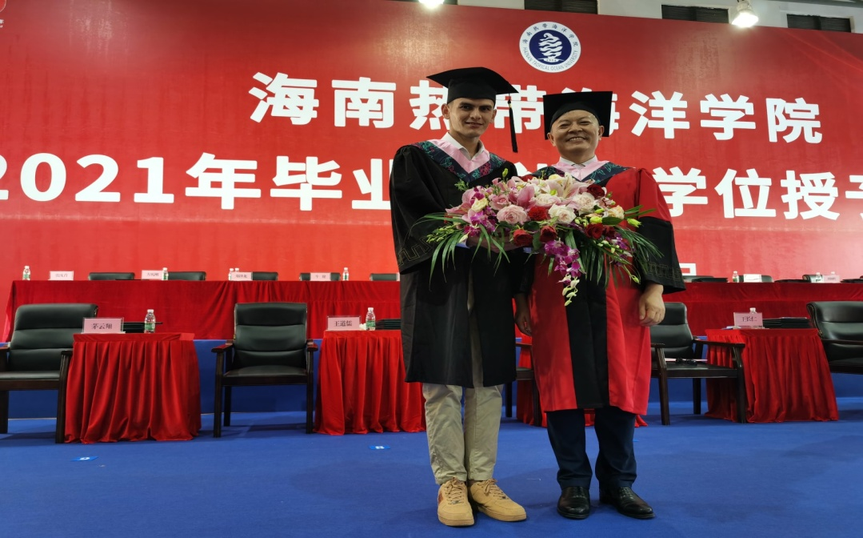
Outstanding Alumni
TOSHPULATOV SULTONMUROD , outstanding graduate of TCSOL major of School of Humanities and Social Sciences:
Awarded the 8th SYTYC College English Series of Hainan Tropical Ocean University in July.
Awarded Hainan Tropical Ocean University Third prize of English drama skill competition;
Won the title of "Outstanding Volunteer of the Fifth China Enterprise Globalization Forum" in 2018,2019,2020.
Participated in the 2021 Intercollegiate Football Cup of Hainan Tropical Ocean University on behalf of the School of International Education, and won the first place together with other partners of the school.In June 2021;
he was admitted to Shanghai Jiao Tong University majoring in Political Science (Master's degree).

Slide 97
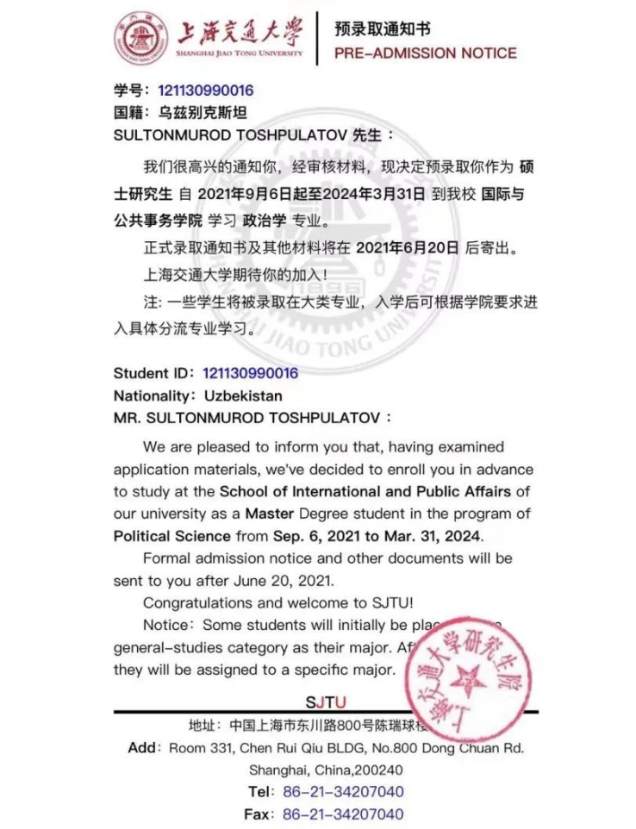
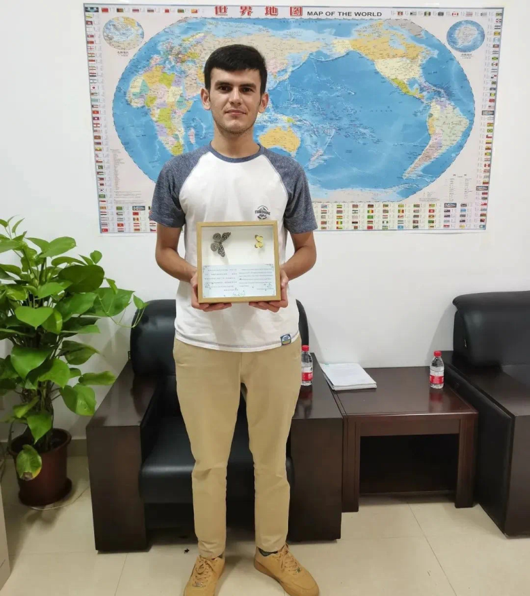
Outstanding Alumni

Slide 98
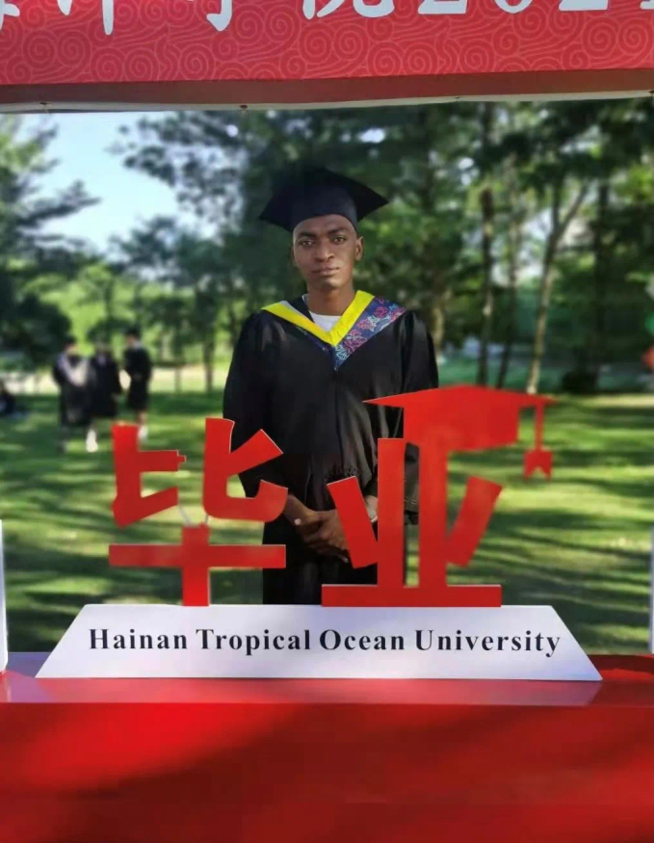
Outstanding Alumni
KADAFI SAID YOUSSOUF
Excellent Graduate of Network Engineering major of School of Computer Science and Technology
1.First prize of the first "Coconut Wind Cup" International Student Essay Contest in Hainan province in 2018;
2. The third prize of the 7th International Chinese and Talent Competition of Hainan Province in 2017;
3.2019-2021 Hainan Provincial Government Scholarship;
4. Awarded Agile Scholarship of Hainan Tropical Ocean University in 2021 in June .
5.2021, he was admitted to the industrial Design (Master's degree) major of Zhejiang University.

Slide 99
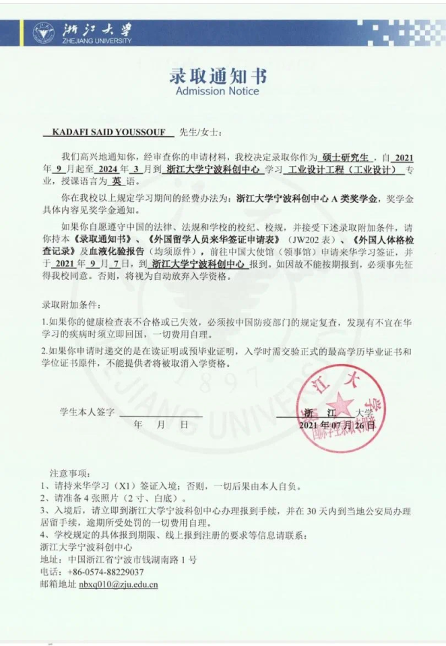
Outstanding Alumni

Slide 100
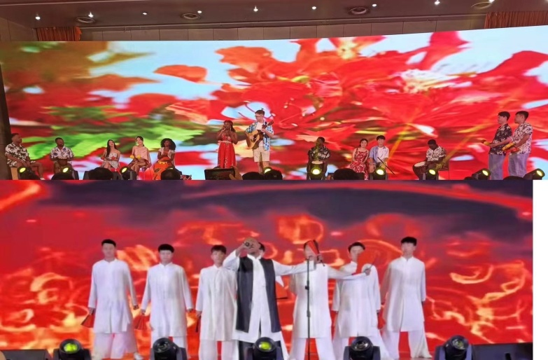
Outstanding Alumni
NADHIR-EDINE
The outstanding student of social Work (Master's degree) major of School of Nationalities of our university.
won the first prize and the best talent award in the "Qiongzhou Cup" Chinese and Talent Competition for international Students in 2021.It is the biggest compettion of International students in Hainan Province.

Slide 101
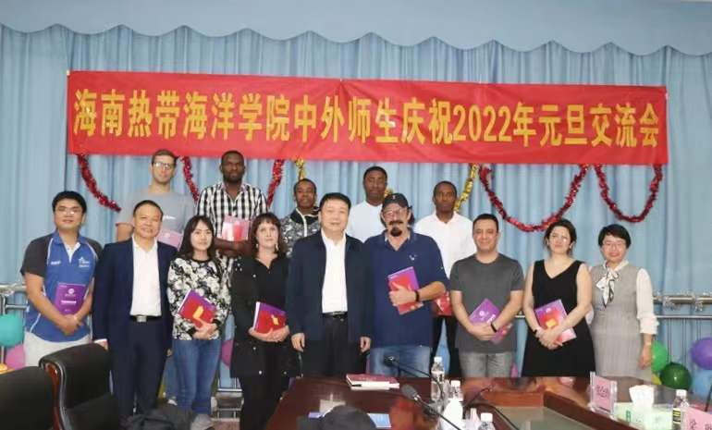
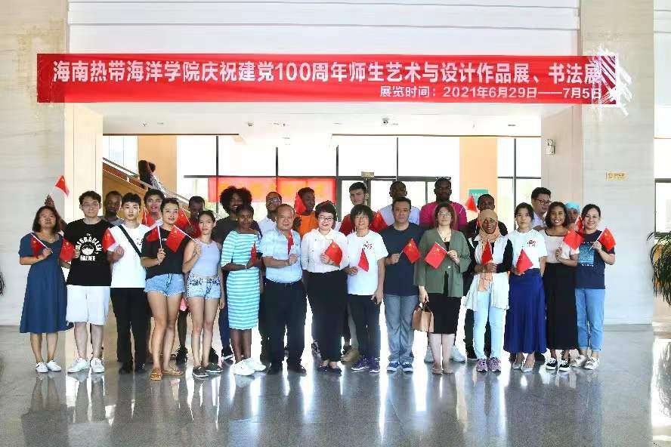
Colorful activities
旅游学院

Slide 102
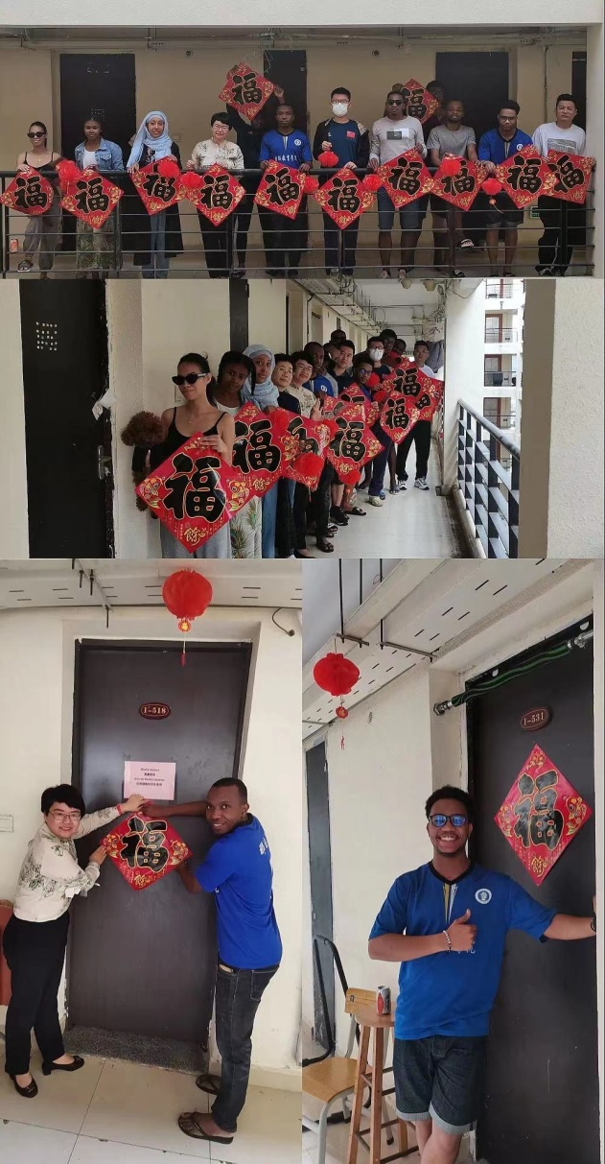
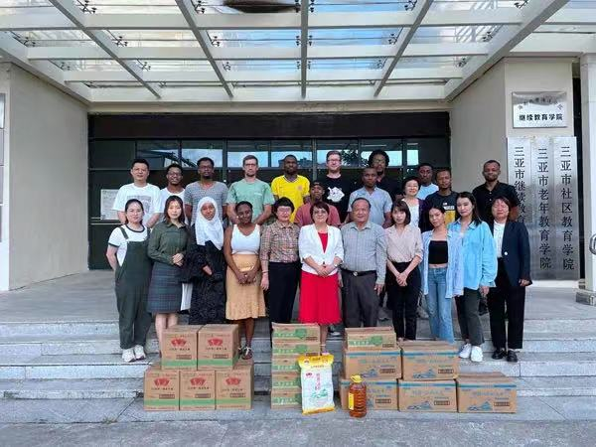
Colorful activities
旅游学院

Slide 103
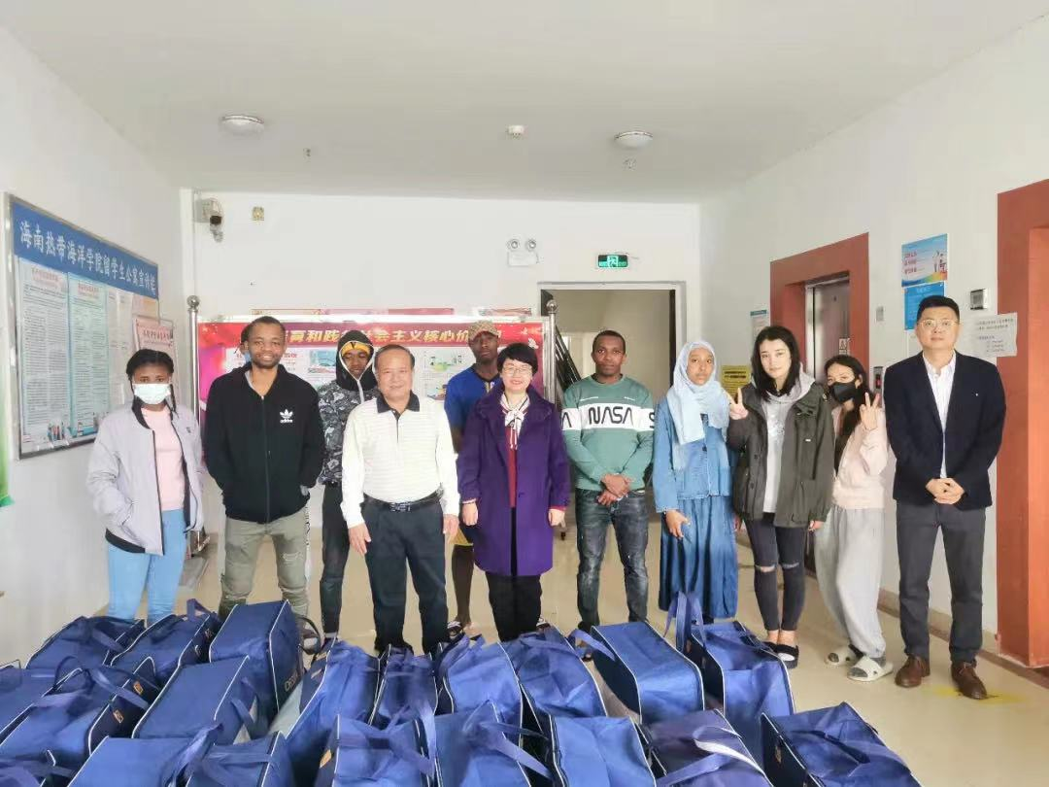
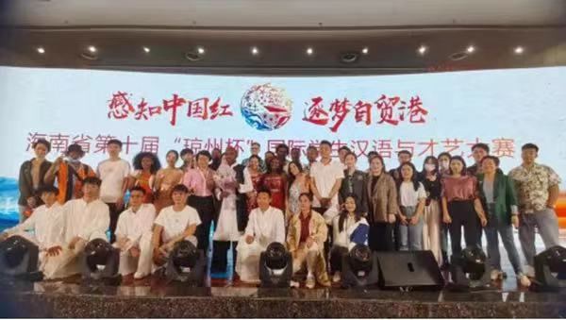
Colorful activities
旅游学院

Slide 104
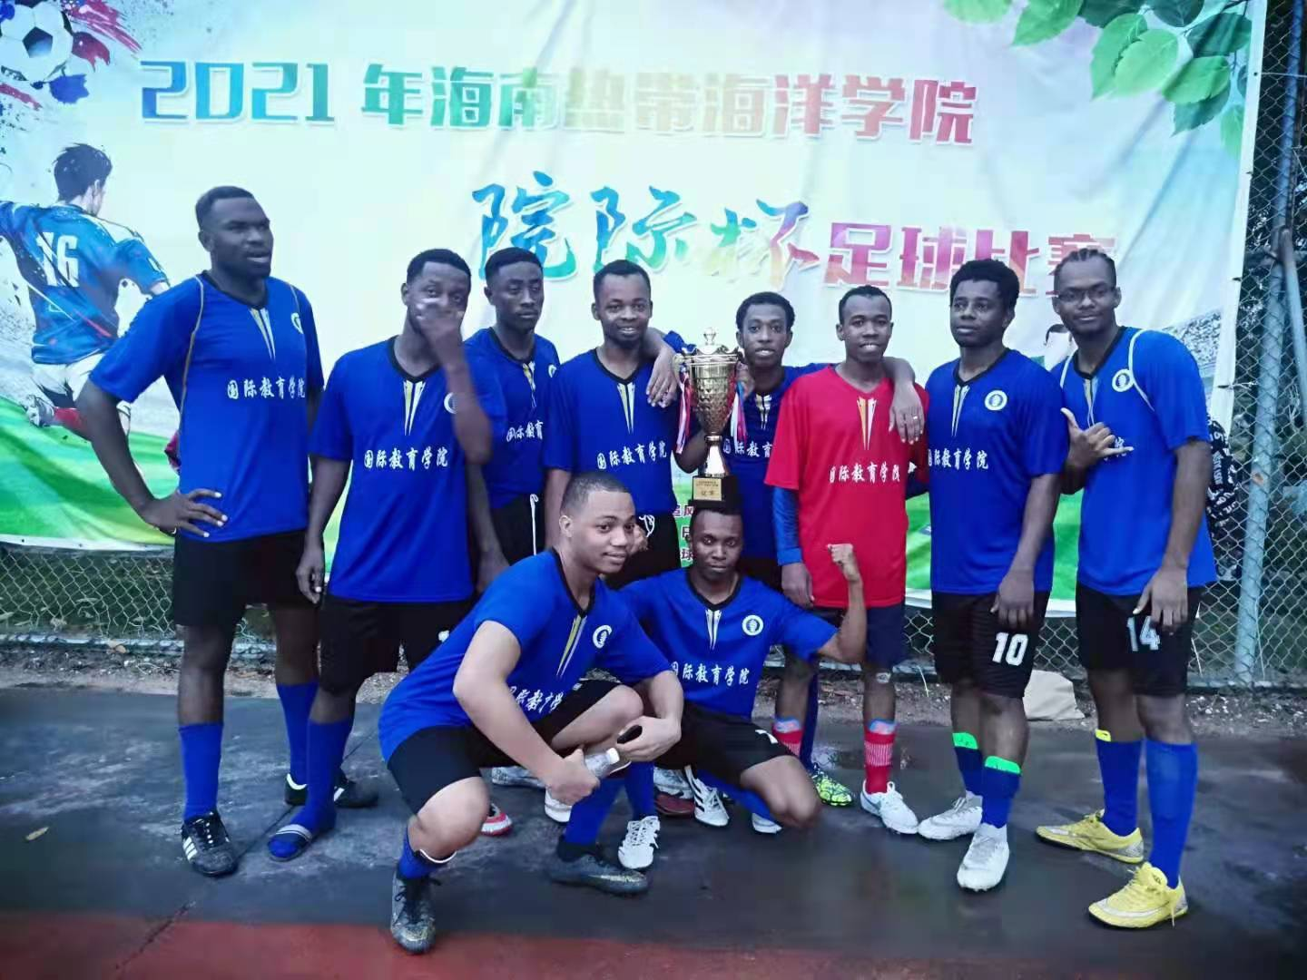
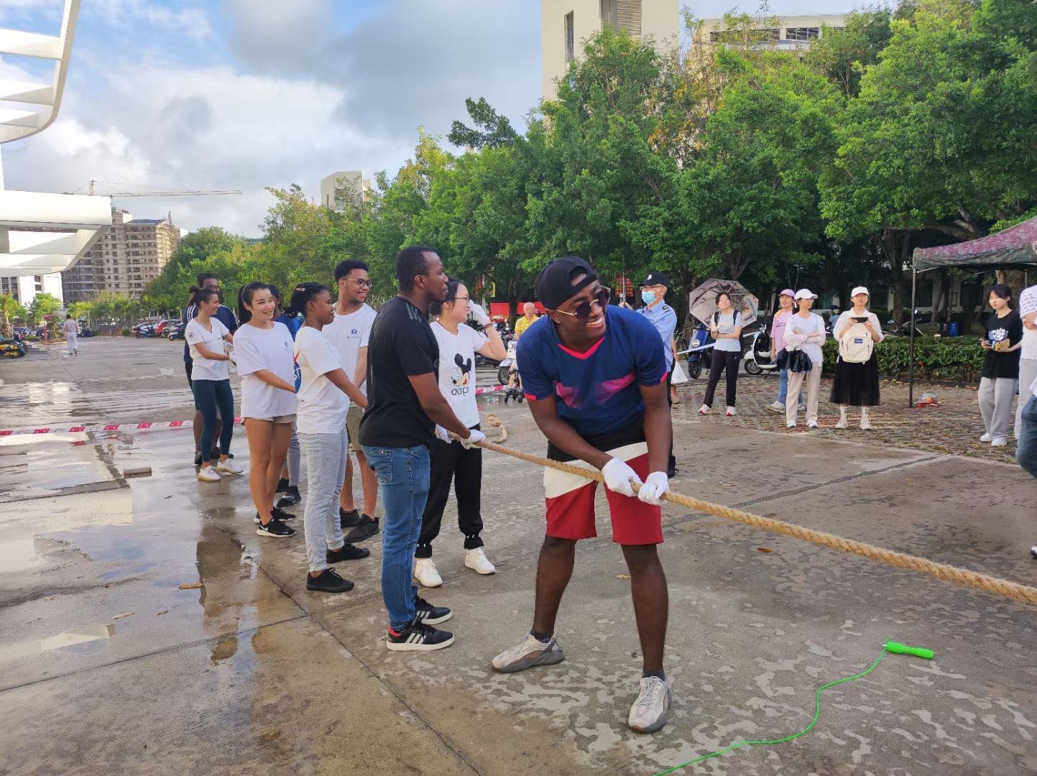
Colorful activities

Slide 105
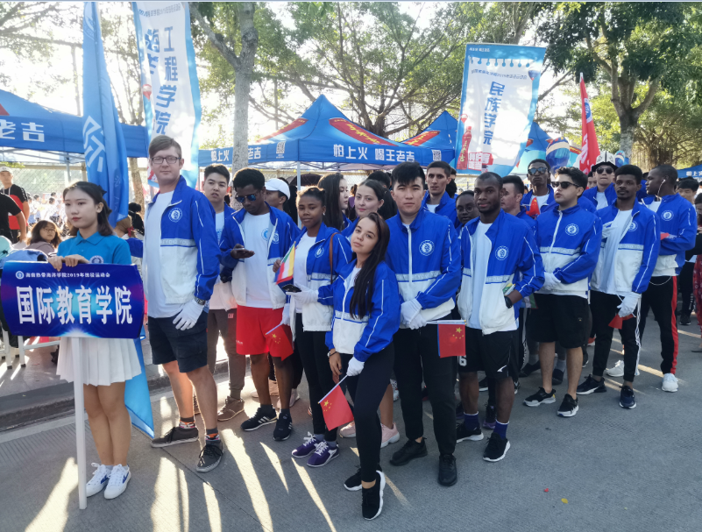
Colorful activities
旅游学院

Slide 106
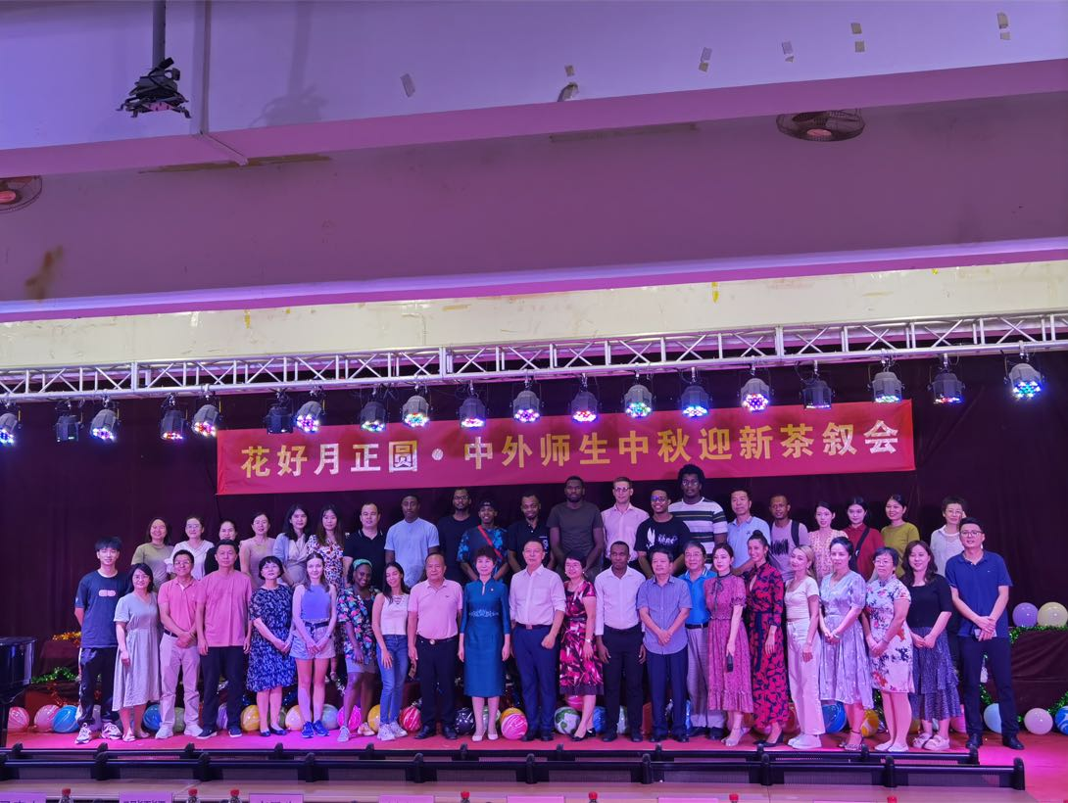
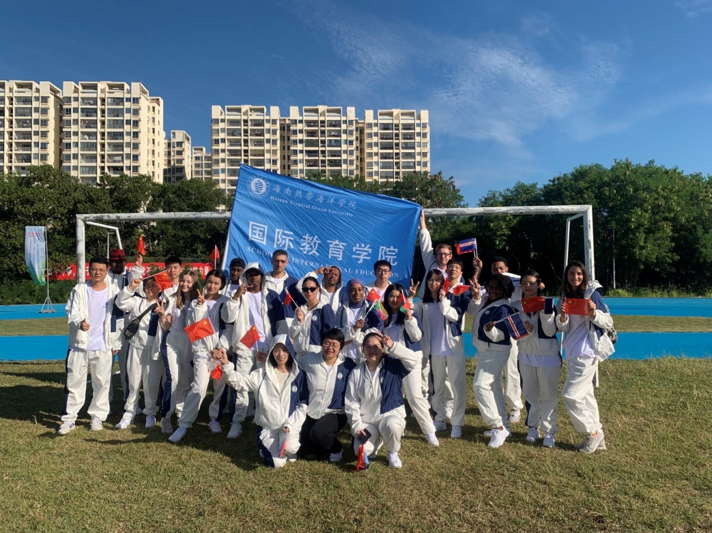
Colorful activities
旅游学院

Slide 107
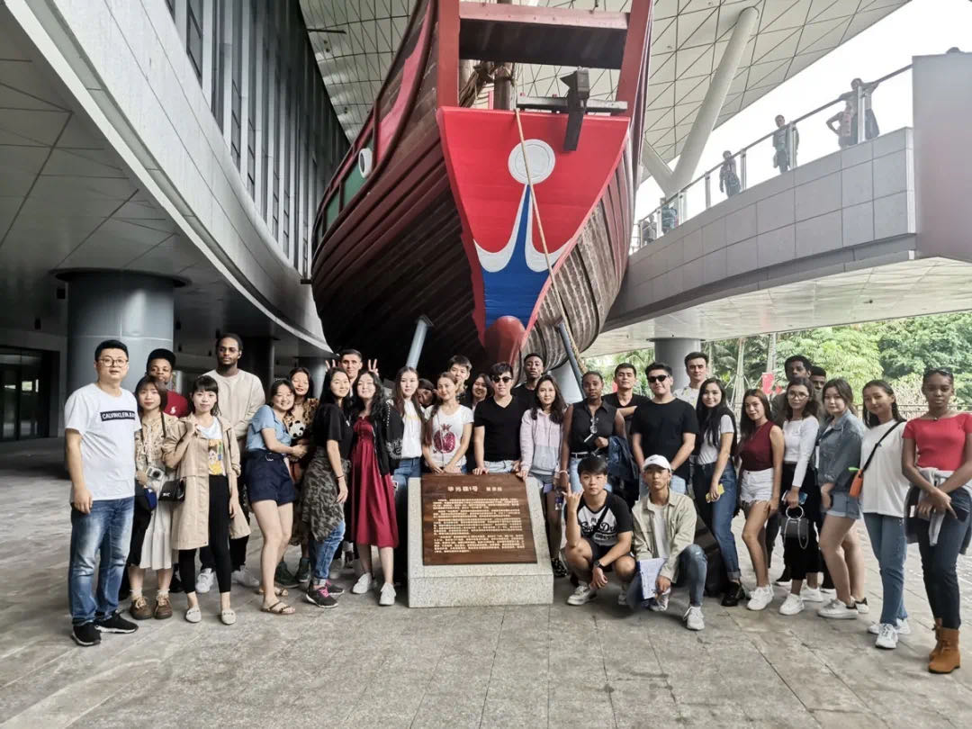
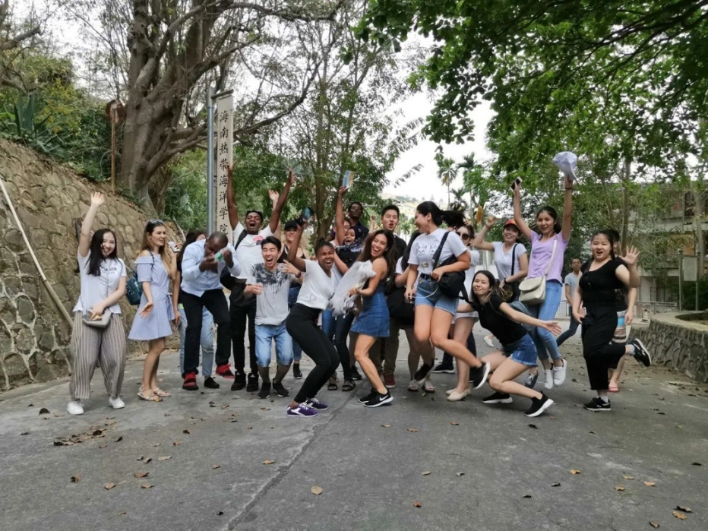
Colorful activities
Activities of Experience China-Qionghai station
旅游学院

Slide 108
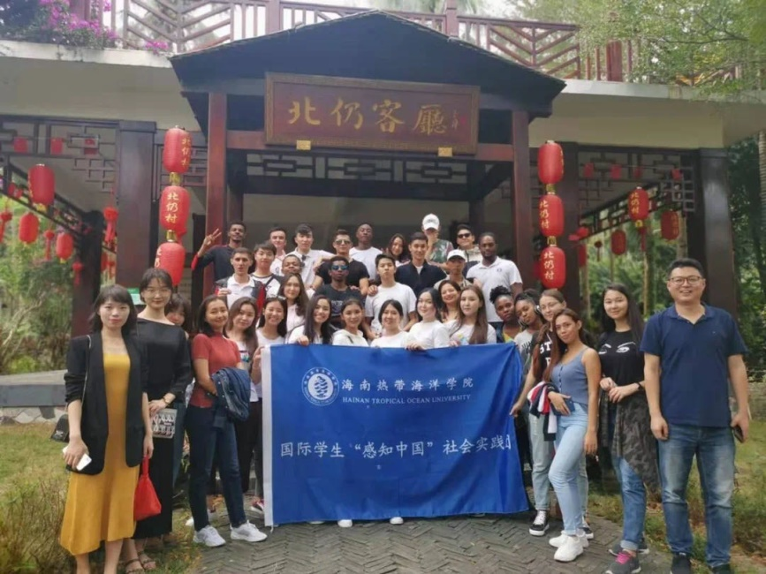
Colorful activities
Activities of Experience China-Qionghai station
旅游学院

Slide 109
Colorful activities
Activities of Experience China-Wuzhishan station
旅游学院

Slide 110
Colorful activities
旅游学院

Slide 111
Colorful activities
旅游学院

Slide 112
Where We Are
旅游学院

Slide 113
See ya in sanya
旅游学院

Slide 114
See ya in sanya
旅游学院

Slide 115
WeChat Access
Mobile Webpage
旅游学院

Slide 116
诚挚感谢您的耐心倾听!
欢迎您来海南热带海洋学院留学
Thank you for your attention!
Welcome to study in HTOU

Slide 117
我们在三亚等你！

