Slide 1
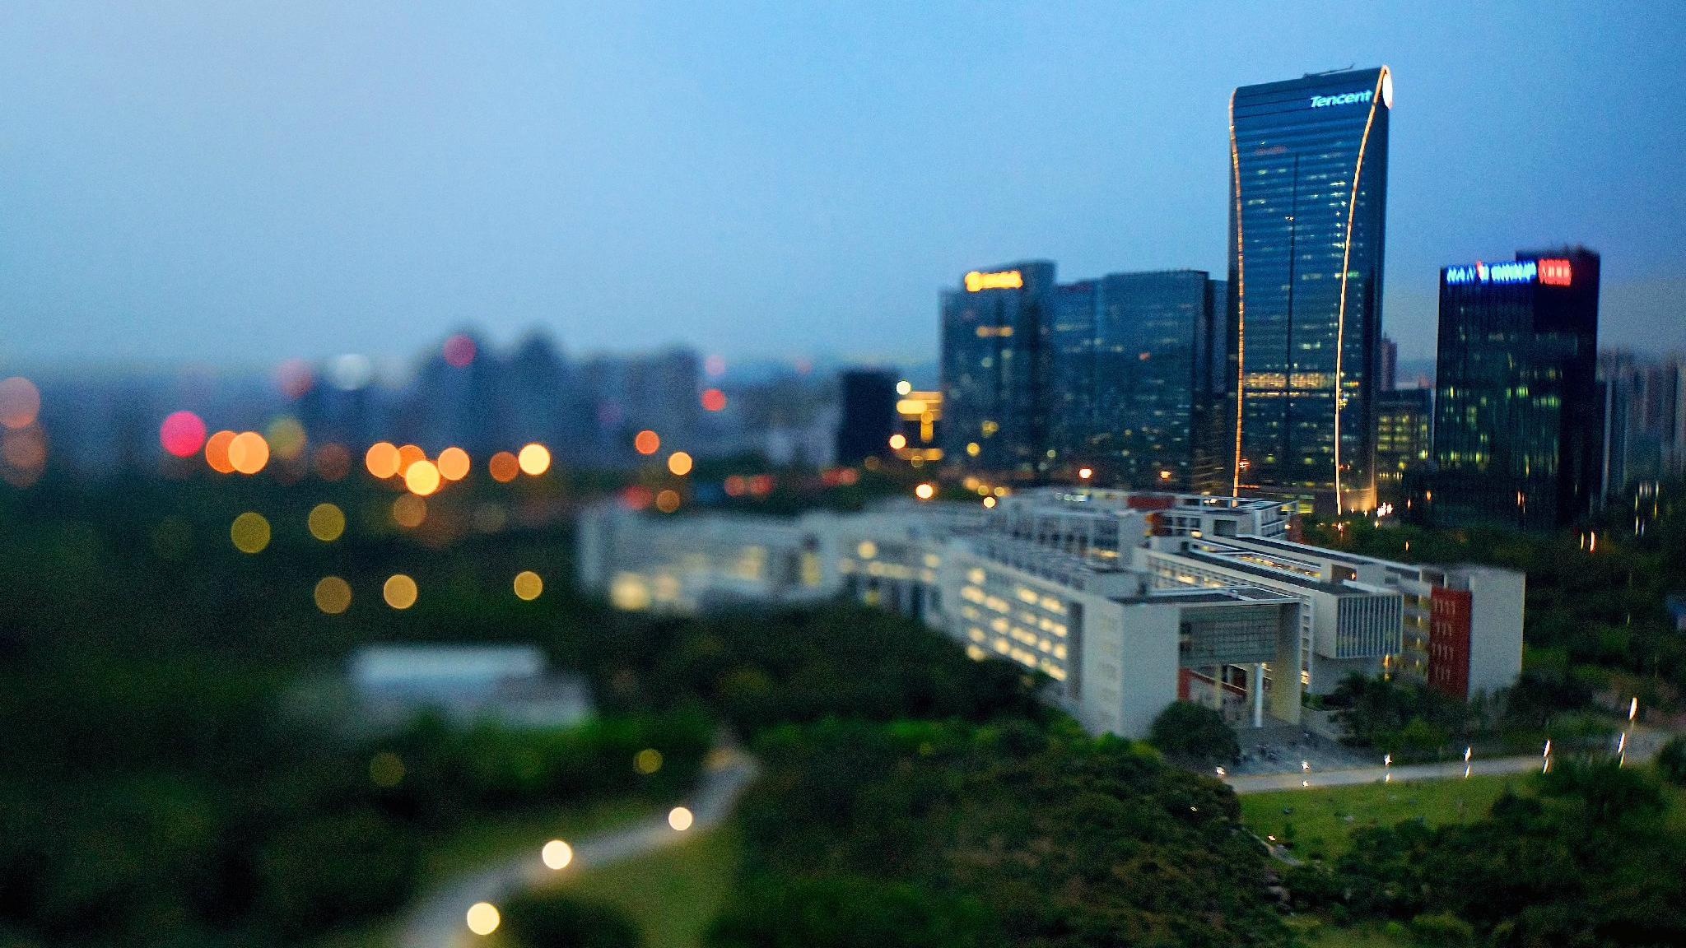
SHENZHEN UNIVERSITY

Slide 2
SHENZHEN UNIVERSITY
如何申请？
HOW TO APPLY?
校园环境最优美 TOP 10
就业率最高 TOP 20
毕业生最满意 TOP 20
师资力量最强的地方大学
办学资源最充裕的地方大学
内地发展最快的地方大学

Slide 3
申请流程Application Procedures
登录http://lxs.szu.edu.cn/ 进入在线报名
Log on http://lxs.szu.edu.cn/ enter on-line admission
进入系统在线填写个人信息并上传所需申请材料
Fill out the applicant’s personal information and upload the scanned copy of supporting documents
如您通过审核，将会受到一封电子版录取通知书
If you are accepted, you will receive an electronic Admission Letter
外国留学人员来华签证申请表(JW202)以及正式录取通知书
The JW202 form and Official Admission Letter
您需持JW202表及录取通知书到当地大使馆申请学生签证(X1)
Apply for the STUDY(X1) visa in the Chinese Embassy
欢迎前来深圳大学报到注册
Report your arrival at SZU

Slide 4
专业列表Program List
2022年来华留学本科生招生专业表 2022 SZU Undergraduate Programs for International Students
序号 | 学院（部）College | 专业Program | 备注
1 | 国际交流学院 College of International Exchange | 汉语言文学 Chinese language and Literature | 大三分专业方向（商务方向、语言与文化方向） Students will choose their specialty in their third year (Commercial Affairs、Language and Culture)
2 | 传播学院 School of Media and Communication | 网络与新媒体 The Internet and New Media
3 | 材料学院 College of Materials Science and Engineering | 材料科学与工程 Materials Science and Engineering
4 |  | 高分子材料与工程 Polymer Materials and Engineering
5 | 电子与信息工程学院 College of Electronics and Information Engineering | 电子科学与技术 Electronic Science andTechnology
6 |  | 电子信息工程 Electronic Information Engineering
7 |  | 通信工程 Communications Engineering
8 |  | 微电子科学与工程 Microelectronic Science and Engineering
9 | 法学院 Law School | 法学 Law

Slide 5
专业列表Program List
10 | 管理学院 College of Management | 电子商务 Electronic Commerce
11 |  | 工商管理 Business Administration
12 |  | 工商管理（国际班） International Business Administration | 英文授课 Taught in English
13 |  | 人力资源管理 Human Resource Management
14 |  | 市场营销 Marketing Management
15 |  | 信息管理与信息系统 Information Management and Information Systems
16 | 政府管理学院 School of Government | 行政管理 Public Administration
17 | 机电与控制工程学院 College of Mechatronics and Control Engineering | 机器人工程 Robotic Engineering
18 |  | 机械设计制造及其自动化 Mechanical Design Manufacturing and Automation
19 |  | 自动化 Automation
20 | 计算机与软件学院 College of Computer Science and Software Engineering | 计算机科学与技术 Computer Science and Technology
21 | 经济学院 College of Economics | 国际经济与贸易 International Economics and Trade
22 |  | 国际经济与贸易 International Economics and Trade | 英文授课 Taught in English

Slide 6
专业列表Program List
23 | 师范学院（教育学部） Normal College | 教育技术学 Educational Technology
24 |  | 体育教育 Physical Education
25 |  | 心理学 Psychology
26 |  | 学前教育 Early Childhood Education
27 | 数学与统计学院 The College of Mathematics and Statistics | 数学与应用数学 Mathematics and Applied Mathematics
28 |  | 数学与应用数学（师范） Mathematical Education
29 |  | 统计学 Statistics
30 |  | 信息与计算科学 Information and Computing Science
31 | 土木与交通工程学院 College of Civil and Transportation Engineering | 工程管理 Construction management
32 |  | 交通工程 Transportation Engineering
33 | 外国语学院 School of Foreign Languages | 德语 German
34 |  | 法语 French
35 |  | 日语 Japanese
36 |  | 西班牙语 Spanish
37 |  | 英语 English

Slide 7
专业列表Program List
38 | 艺术学部 Division of Arts | 美术学 Fine Arts | 需要专业测试。大三分专业方向（国画、油画、版画、雕塑）。 Specialized test is required.Students will choose their specialty in their third year (Traditional Chinese Painting, Oil Painting, Printmaking, Sculpture ).
39
 |  | 设计学类 Design | 需要专业测试。大二分专业：艺术设计学（创意策划与设计管理）；视觉传达设计；环境设计；产品设计；服装与服饰设计；数字媒体艺术。Specialized test is required.Students will choose their specialty in their sophomore year: Art Design (Creative Planning and Design Management),Visual Communication Design, Environmental Design,Product Design, Clothing and Apparel Design, Environmental Design, Animation
40 |  | 表演（影视戏剧） Acting (Film, Television and Theatre) | 需要专业测试 Specialized test is required
41 |  | 播音与主持艺术 Broadcasting and Hosting Art
42 |  | 舞蹈编导 Choreography
43 |  | 音乐表演(流行器乐演奏) Music Performance (Popular Instrumental Performance)
44 |  | 音乐表演(流行演唱) Music Performance (Popular Music Performance)
45 |  | 音乐表演(器乐演奏) Music Performance (Instrumental Performance)
46 |  | 音乐表演(声乐演唱) Music Performance (Vocal Performance)
47 |  | 音乐表演(音乐编创) Music Performance (Music Creation)
48 |  | 音乐学（师范） Musicology (Teacher Education)

Slide 8
本科项目 Bachelor Programs
一. 英语授课专业
Taught in English Programs
二. 汉语言文学
Chinese Language and Literature
三. 中文授课专业
Taught in Chinese Programs

Slide 9
本科项目 Bachelor Programs
国际经济与贸易International Economics and Trade
工商管理 Business Administrations
英语授课
Taught in English
英语能力证书（雅思5.5分或者托福80分以上，母语为英语者除外）
English Proficiency Certificate （IELTS 5.5 or TOEFL 80 above, Excluding
English native speaker.）
提供网上授课
Online Study
Those who apply for bachelor program of Chinese language with New HSK Band 4 (total score over 210) and one-year Chinese study experience, can start from Grade 2 (Only limited to the Chinese language training program in colleges and universities or having the undergraduate study experience taught in Chinese); and those with New HSK Band 5 (total score over 210) and two-year Chinese study experience can start from Grade 3 (Only limited to the Chinese language training program in colleges and universities or having the undergraduate study experience taught in Chinese).

Slide 10
本科项目 Bachelor Programs
汉语言文学（含商务方向和语言与文化方向）
Chinese Language and Literature
(including Business and Literary Chinese)
适合汉语初学者
Suitable for Chinese Beginners
可插级
Transfer Available
Applicants with HSK 4 (total score over 180) can attend the exam for starting from Grade 2
Applicants with HSK 5 (total score over 180) can attend the exam for starting from Grade 3
提供网上授课
Online Study

Slide 11
本科项目 Bachelor Programs
其他中文授课专业 Other Taught in Chinese Programs
HSK 5级180分以上
HSK 5 (total score over 180)
与中国学生同堂上课
Study with Chinese Students

Slide 12
招生要求Admission Requirements
申请材料 Required application materials | 本科生 Bachelor
护照复印件Passport copy (Require passport to be valid for at least two years)
电子版照片 Photo（within Six Months）
高中毕业证High School Diploma (Graduates shall provide Pre-graduation certificate)
高中成绩单 Transcripts
两封推荐信 Two Reference Letters
语言能力证明 Language Proficiency Certificate
备注Note:
申请中文授课专业的需提供汉语水平考试证书
For Chinese-medium programs, applicants must provide the HSK certificate (HSK5, 180 scores or above).
申请英文授课项目需提交英语水平证明
For English-medium programs, applicants must provide the English proficiency certificate.(Excluding English native speaker)

Slide 13
学费 Tuition Fee
文科类 | 理工科类 | 艺术、体育类
26000RMB/year | 30000RMB/year | 40000RMB/year

Slide 14
奖学金政策Scholarship Policy
奖学金种类 Scholarship Categories | 金额 Amount | 覆盖率 Probability
深圳大学新生奖学金University-level Scholarship | 10000RMB | 100%
广东省来粤奖学金 Province-level Scholarship | 10000RMB | Around 50%

Slide 15
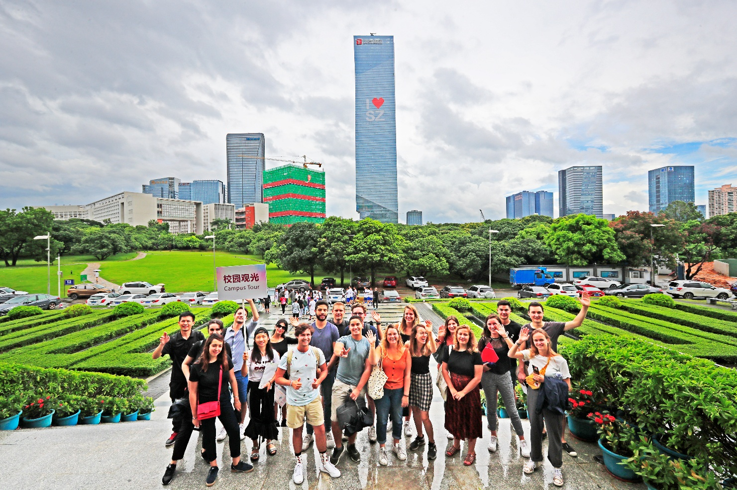
申请时间 Application Time
2月21日 4月30日，2022
February 21 April 30, 2022

Slide 16
联系我们Contact Us
深圳大学国际交流学院
地址：深圳市南山区南海大道3688号深圳大学综合楼3楼
电话：86-755-26558894/26535159
邮编：518060
邮箱：szulxs@szu.edu.cn
网址：http://lxs.szu.edu.cn, http://www.szu.edu.cn
College of International Exchange Shenzhen University
Add: 3/F Zonghe Building, College of International Exchange, Shenzhen University, Nanhai Ave 3688, Shenzhen, P.R.China 518060
Tel：86-755-26558894/26535159
Email: szulxs@szu.edu.cn
Website：http://lxs.szu.edu.cn, http://www.szu.edu.cn

Slide 17
SZU
Welcome
Ex cellent
You！

