Slide 1
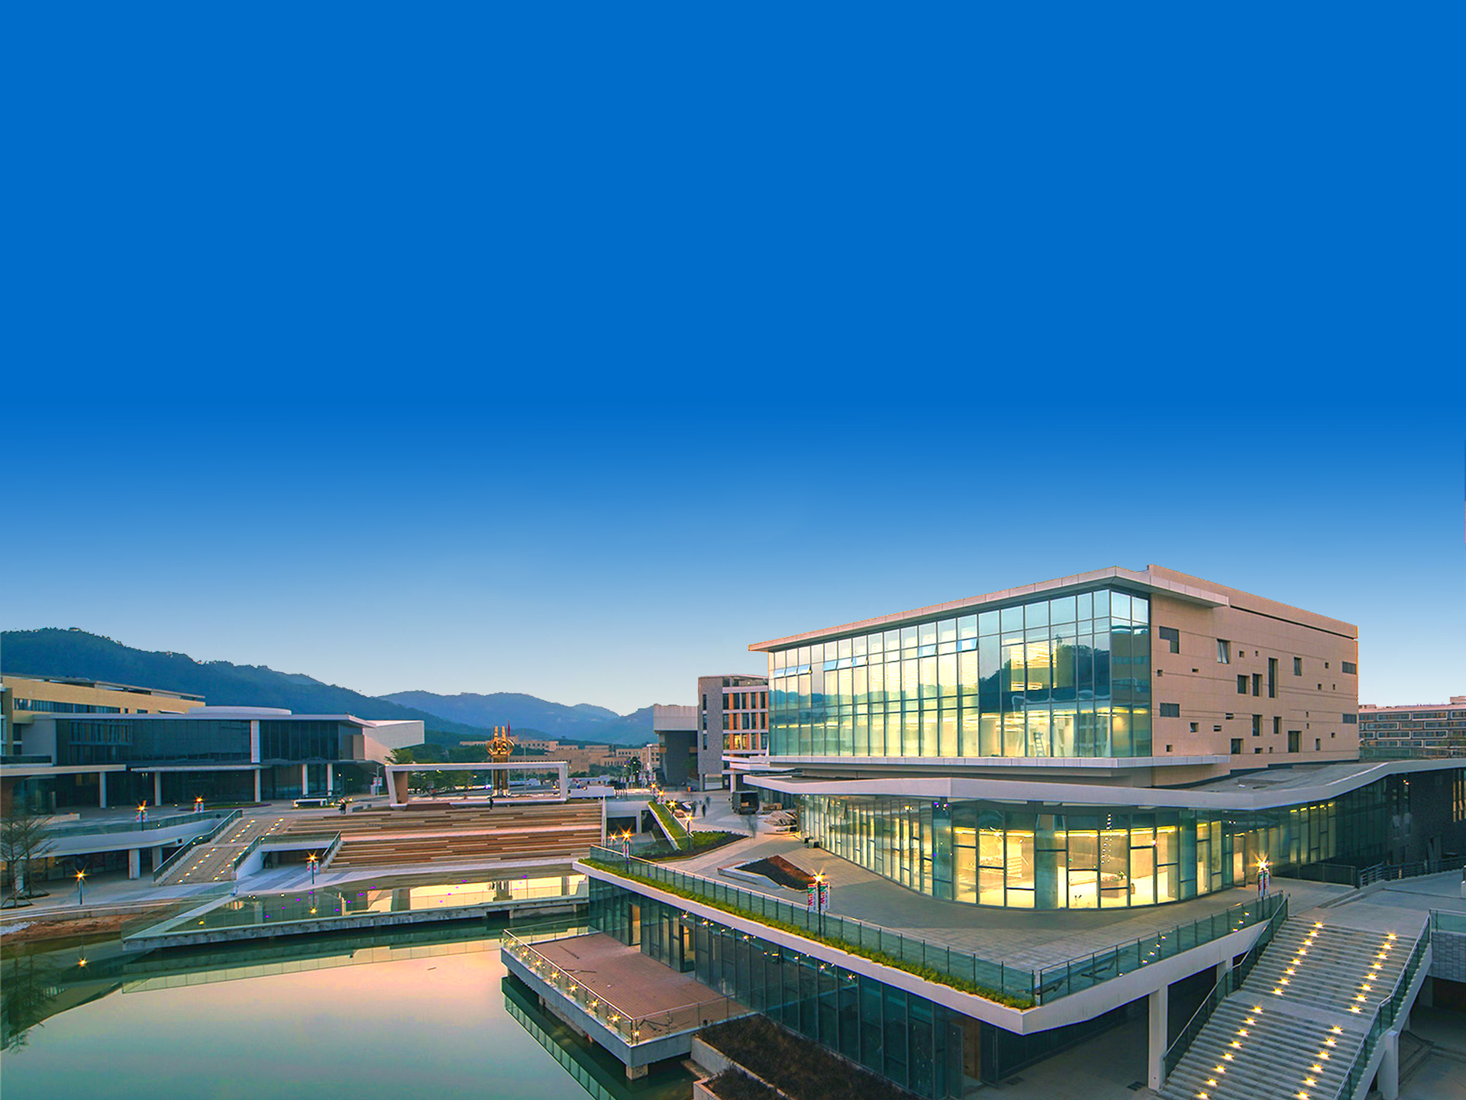
Introduction

Slide 2
Beijing Normal University-Hong Kong Baptist University United International College ( UIC )
The First Higher Education Institution Jointly founded by a Mainland University and a Hong Kong University
Beijing Normal University
Hong Kong Baptist University
Grew out of the Education Department of Imperial University of Peking established in 1902
A comprehensive and research-intensive university with its main characteristics of basic disciplines in sciences and humanities, teacher education and educational science
Founded by the Baptist Convention of Hong Kong, committed to the provision of academic excellence and whole person education in 1956
Fully-funded public tertiary institution

Slide 3
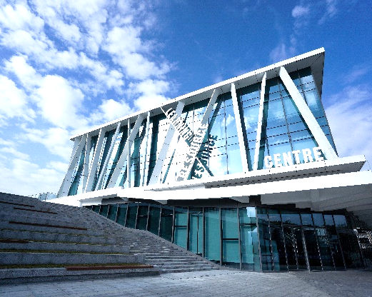
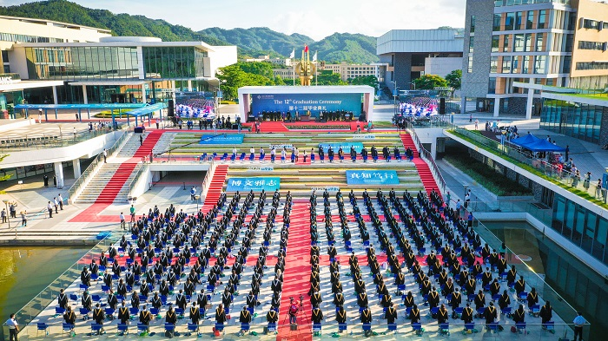
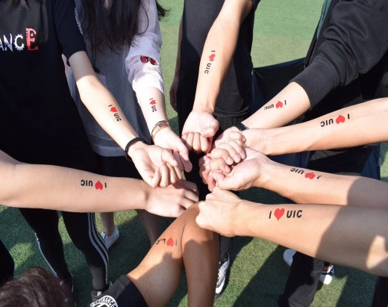
Our Position
Mission
Character
Strategic Positioning
To develop a liberal arts college dedicated to producing well-rounded global talents
To uphold academic meritocracy, language proficiency, national anchoring and international orientation
To establish a liberal arts college rooted in excellence in undergraduate education and graduate programmes that highlight our strengths

Slide 4
Location
UIC is located in the beautiful coastal city of Zhuhai in the Guangdong-Hong Kong-Macao Greater Bay Area. Zhuhai was one of the first places where modern Chinese met Western culture.
UIC shoulders the historical mission of advancing the internationalization of Chinese higher education and taking the lead in implementing liberal arts education in China.
UIC (Phase II blueprint)
UIC (Phase I campus)

Slide 5
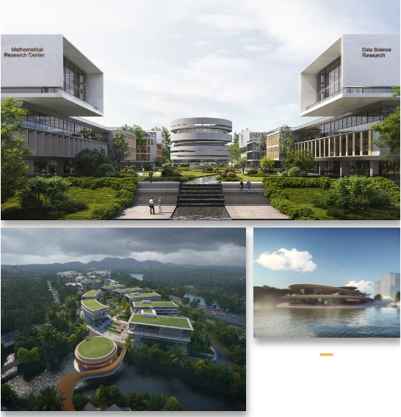
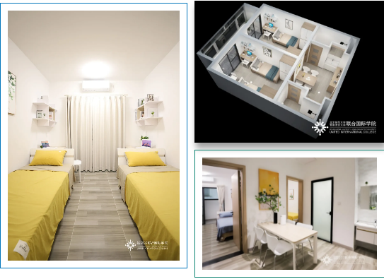
Future from New Campus
The second-phase campus will mainly be the home of science programmes and Graduate School. The building area of approximately 400,000 square meters will host the bases of science, engineering, interdisciplinary subjects, cutting-edge technologies and industrial transformation. The project is expected to be fully put into use in September 2025.
The second-phase campus consists of three clusters: scientific research buildings, teaching blocks and residence halls
Dormitory construction will start first

Slide 6
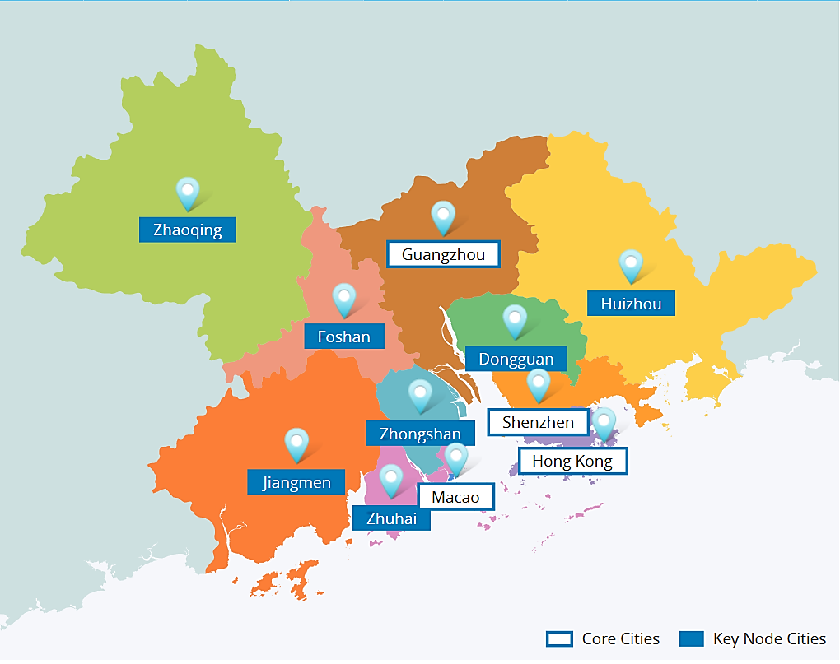
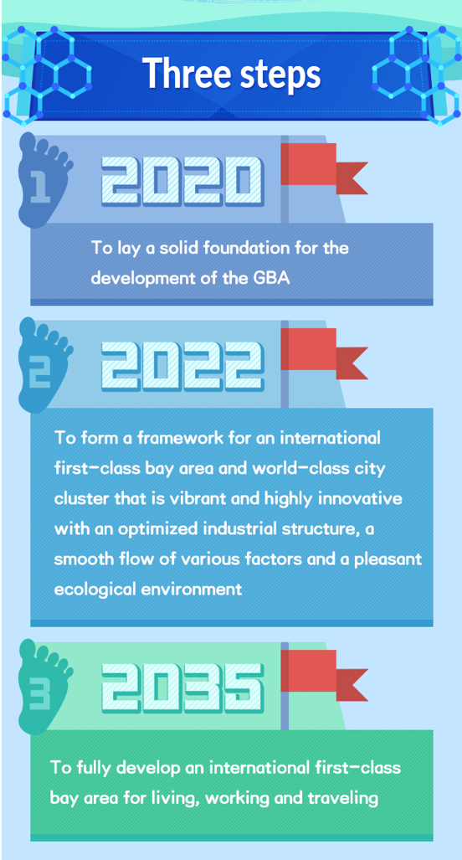
Development Opportunities of the Greater Bay Area
the Guangdong-Hong Kong-Macao Greater Bay Area

Slide 7
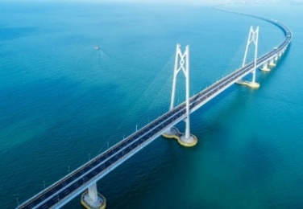
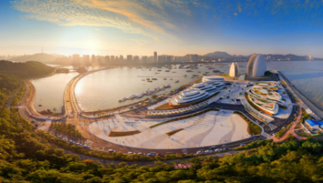
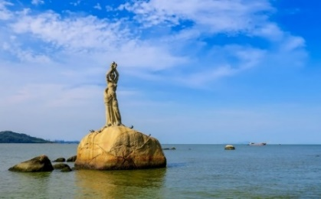
Development Opportunities of the Greater Bay Area
Innovation
Education
Communication
Culture
Talents
Technology

Slide 8
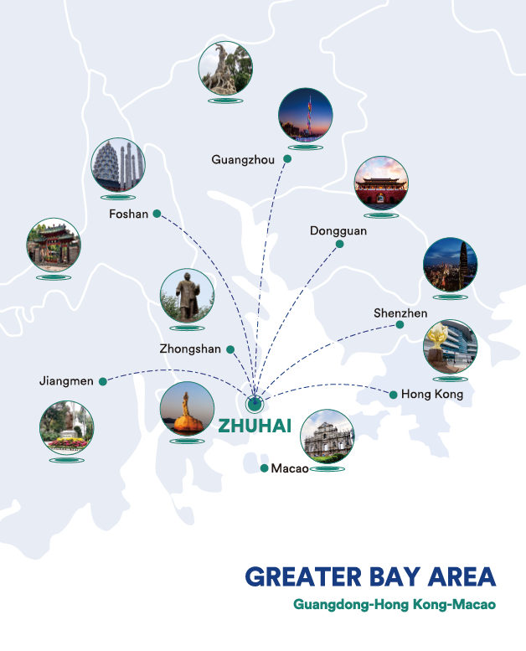
Future Career
UIC located in the Greater Bay Area (GBA), and the graduates are expected to gain more possibilities to work in Hong Kong once the initiatives (Immigration Arrangement for Non-local Graduates programme) to expand Hong Kong's talent pool are implemented.

Slide 9
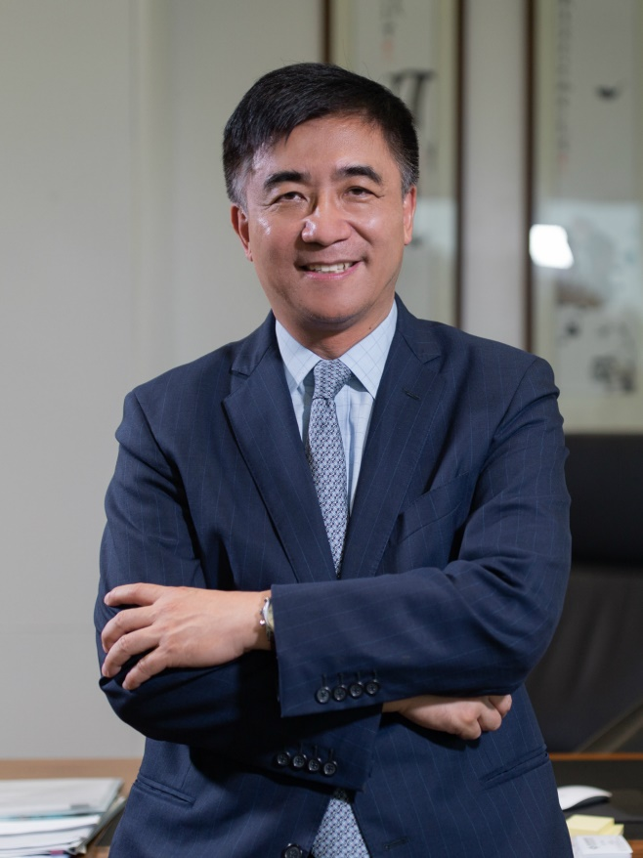
Our President
Professor Tang Tao
Mathematician, Member of the Chinese Academy of Sciences, Chair Professor
Professor Tang Tao obtained his Bachelor’s degree in Mathematics from Peking University in 1984, followed by a PhD in Applied Mathematics from the University of Leeds in 1989. Professor Tang’s honours are as international as they are multiple. They include election as a Fellow of the American Mathematical Society and a Fellow of the Society for Industrial and Applied Mathematics (SIAM).
Long a faculty member at Simon Fraser University, Canada, between 1990 and 1998, he subsequently served at Hong Kong Baptist University from 1998 to 2015, in a variety of key roles, from Head of the Department of Mathematics, Dean of Science, Director of Graduate School, to Associate Vice-President. Before joining UIC, Professor Tang was the Vice-president and Provost at the Southern University of Science and Technology as well as its Chair Professor of Mathematics.
In May 2021 Stanford University scholars released a list of the World's Top 2% Scientists 2020 from nearly 7 million scientists worldwide from 176 sub-disciplines under 22 fields in arts, science and engineering, and Prof Tang Tao entered both lists of career-long impact and single year impact.

Slide 10
International Faculties and Students
Teachers:
Students:
Hong Kong，Macao, Taiwan:
36%
Mainland China
Mainland China:
32%
Hong Kong，Macao, Taiwan
Intl Students
Overseas:
32%
Worldwide staff recruitment.
Faculty members come from more than 30 countries and regions.

Slide 11
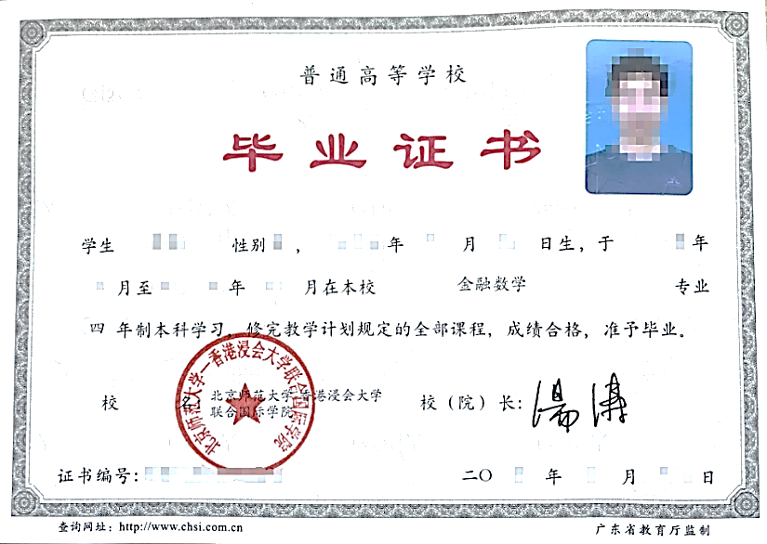
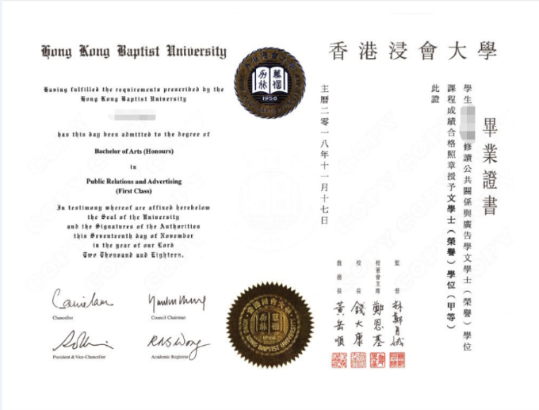
Graduation Certificate awarded by UIC & Degree conferred by HKBU
Graduation certificate of
Beijing Normal University - Hong Kong Baptist University
United International College
Bachelor’s Degree of
Hong Kong Baptist University

Slide 12
Divisions and other Course Offering Units
Division of Business
and Management
Division of
Science and Technology
General Education Office
Whole Person Education Office
English Language Centre
Chinese Language and Culture Centre
Division of Humanities and Social Sciences
Division of
Culture and Creativity
Research Centres and Laboratories

Slide 13
Division of Business and Management
Accounting
Bachelor of Business Administration (Honours) (Accounting)
会计学商学士（荣誉）学位
Applied Economics
Bachelor of Business Administration (Honours) (Applied Economics)
应用经济学商学士（荣誉）学位
Finance
Bachelor of Business Administration (Honours) (Finance)
财务学商学士（荣誉）学位
Management of Human Resources
Bachelor of Business Administration (Honours) (Management of Human Resources)
人力资源管理商学士（荣誉）学位
Marketing Management
Bachelor of Business Administration (Honours) (Marketing Management)
市场营销管理商学士（荣誉）学位
Entrepreneurship and Innovation
Bachelor of Business Administration (Honours) (Entrepreneurship and Innovation)
创业与创新管理商学士（荣誉）学位
e-Business Management and Information Systems
Bachelor of Business Administration (Honours) (e-Business Management and Information Systems)
电子商务与资讯系统管理商学士（荣誉）学位

Slide 14
Division of Science and Technology
Computer Science and Technology
Bachelor of Science (Honours) in Computer Science and Technology
计算机科学与技术理学士（荣誉）学位
Data Science
Bachelor of Science (Honours) in Data Science
数据科学理学士（荣誉）学位
Applied Psychology
Bachelor of Science (Honours) in Applied Psychology
应用心理学理学士（荣誉）学位
Food Science and Technology
Bachelor of Science (Honours) in Food Science and Technology
食品科学与工程理学士（荣誉）学位
Environmental Science
Bachelor of Science (Honours) in Environmental Science
环境科学理学士（荣誉）学位
Statistics
Bachelor of Science (Honours) in Statistics
统计学理学士（荣誉）学位
Financial Mathematics
Bachelor of Science (Honours) in Financial Mathematics
金融数学理学士（荣誉）学位
Applied Mathematics
（New）
Bachelor of Sciences (Honours) in Applied Mathematics
应用数学理学士（荣誉）学位
AI
Bachelor of Science (Honours) in Artificial Intelligence
人工智能理学士（荣誉）学位

Slide 15
Division of Humanities and Social Sciences
Public Relations and Advertising
Bachelor of Arts (Honours) in Public Relations and Advertising
公共关系与广告学文学士（荣誉）学位
Media and Communication Studies
Bachelor of Communication (Honours) in Media and Communication Studies
媒体与传播学传播学士（荣誉）学位
Globalisation and Development
Bachelor of Social Sciences (Honours) in Globalisation and Development
全球化与发展社会科学学士（荣誉）学位
Chinese Culture and Global Communication
Bachelor of Arts (Honours) in Chinese Culture and Global Communication
中华文化与国际传播学士（荣誉）学位
English Language and Literature Studies
Bachelor of Arts (Honours) in English Language and Literature Studies
英语语言文学文学士（荣誉）学位
Applied Translation
Bachelor of Arts (Honours) in Applied Translation Studies
应用翻译学文学士（荣誉）学位

Slide 16
Division of Culture and Creativity
Media Arts and Design
Bachelor of Communication (Honours) in Media Arts and Design
媒体艺术与设计传播学士（荣誉）学位
Cinema and Television
Bachelor of Arts (Honours) in Cinema and Television
影视学文学士（荣誉）学位
Culture, Creativity and Management
Bachelor of Business Administration (Honours) (Culture, Creativity and Management)
文化创意与管理商学士（荣誉）学位
Musical Arts
Bachelor of Arts (Honours) in Musical Arts
音乐艺术文学士（荣誉）学位
Animation and Interactive Media
Bachelor of Communication (Honours) in Animation and Interactive Media
动画与互动媒体学士（荣誉）学位
Tourism, Hospitality and Event Management
Bachelor of Business Administration (Honours) in Tourism, Hospitality and Event Management
旅游、酒店与会展管理学士（荣誉）学位

Slide 17
Curriculum Structure
Course Categories | Units
Major Courses | 63-75
General Education Distribution (GED) Requirements | 18
General Education Core (GEC) Requirements | 36
Free Electives | 18-30
Total | 147-154
English taught curriculum

Slide 18
Diversified Performance Evaluation Criteria

Slide 19
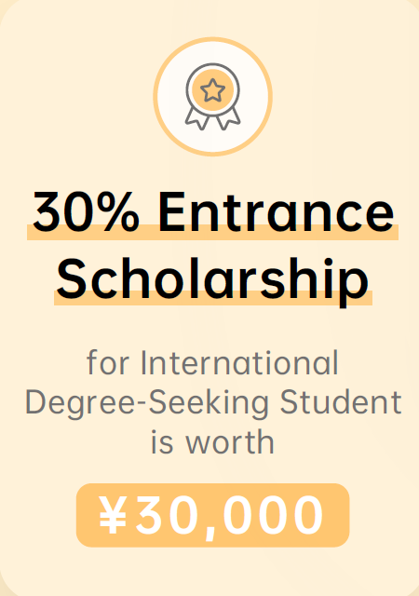
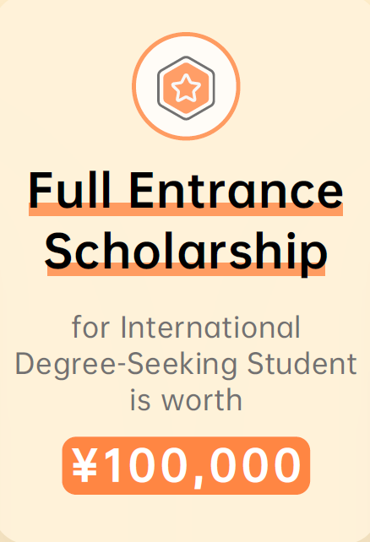
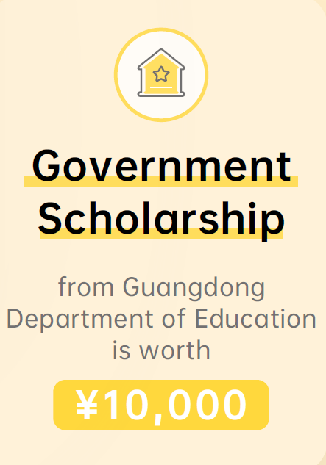
Scholarship
For elite international students,
we offer different types of entry scholarships.
* First come first served.

Slide 20
Whole Person Education
In line with UIC's vision of creating a new model of liberal education for China and the world, WPEO aims to implement Whole Person Education ideology by providing experiential learning courses, programs and activities that foster students’ development in teamwork, stamina and persistence, interpersonal skill, self-awareness, endurance, creativity, sense of responsibility and culture awareness.
Adversity Management
Emotional Intelligence
Experiential Development
Sports Culture
Environmental Awareness
Experiential Arts
Voluntary Service

Slide 21
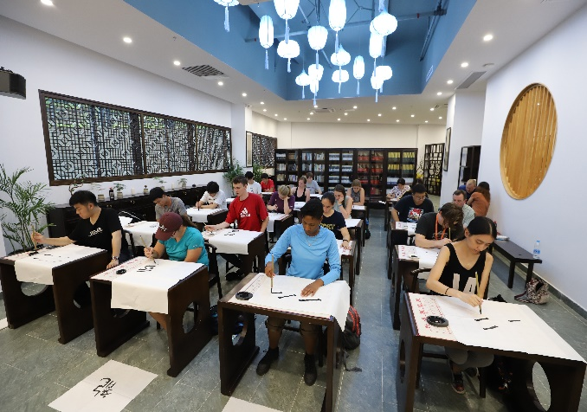
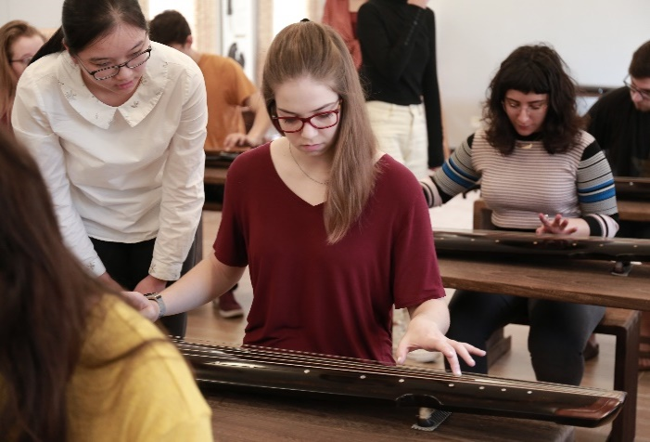
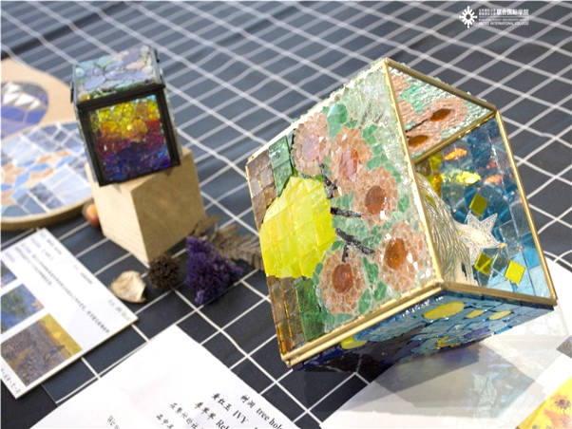
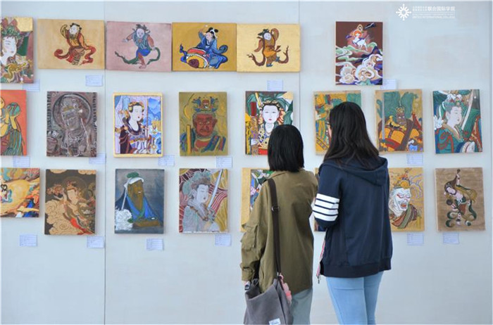
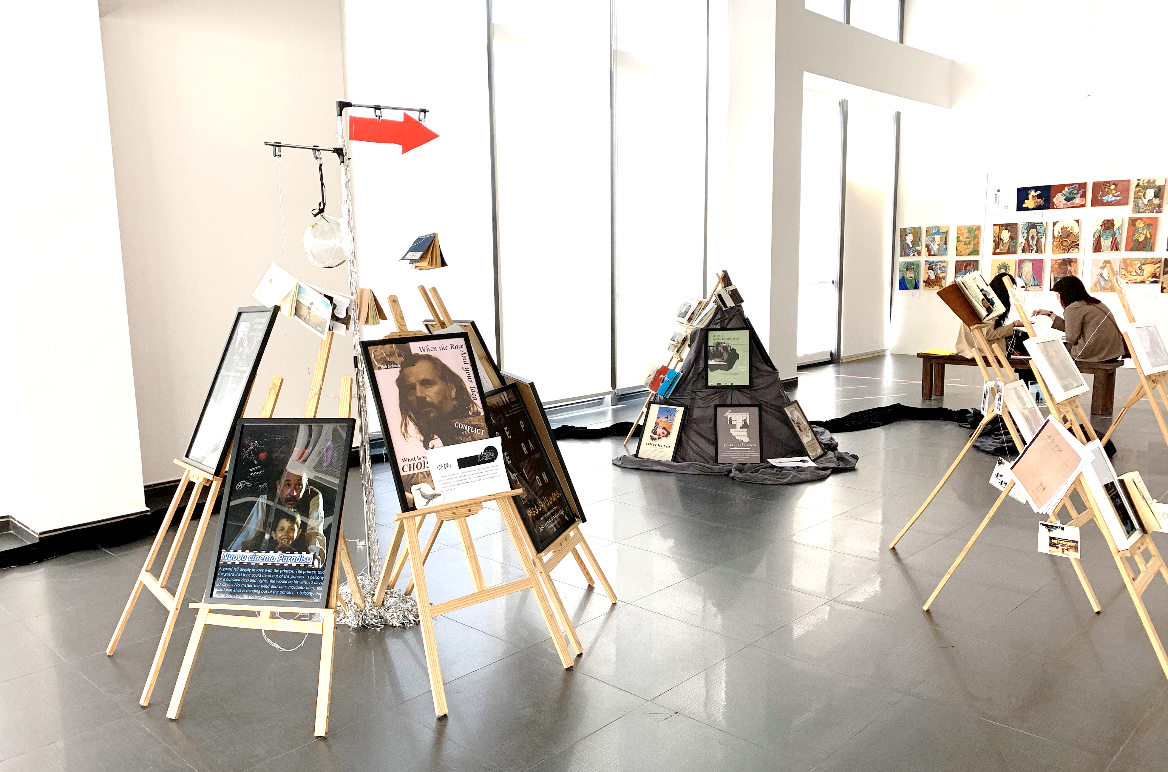
Artistic Experience

Slide 22
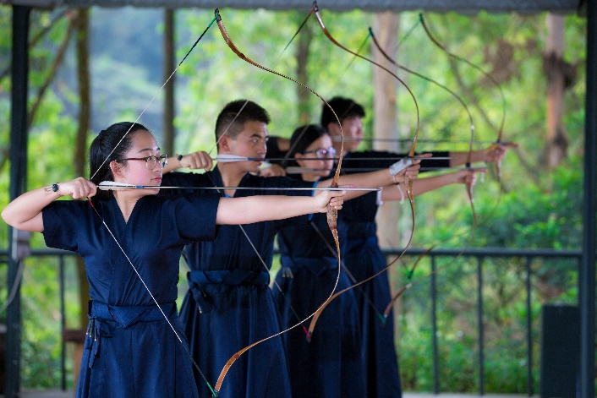
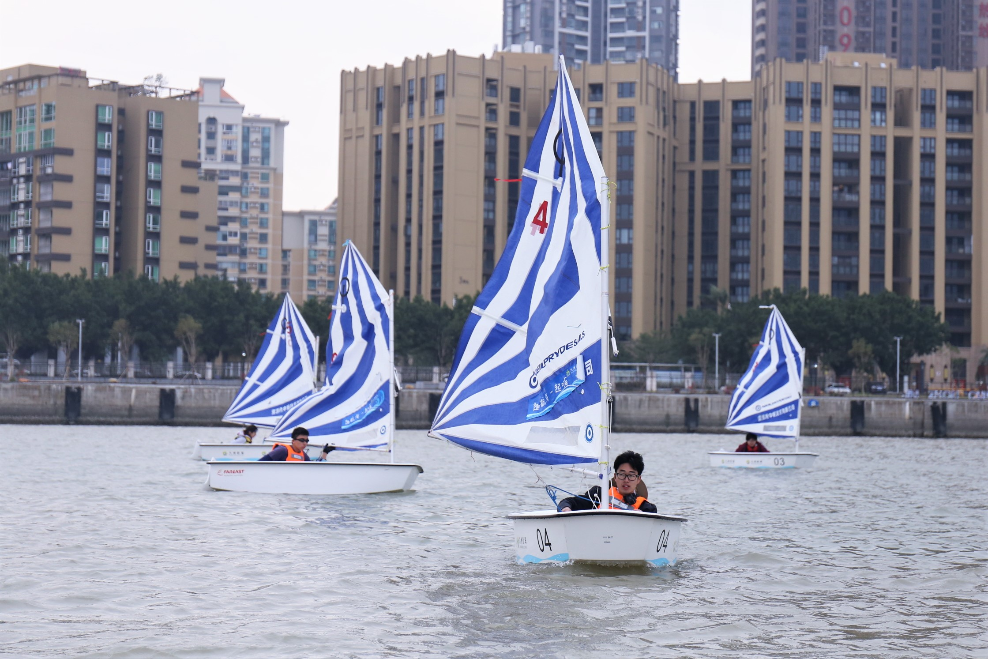
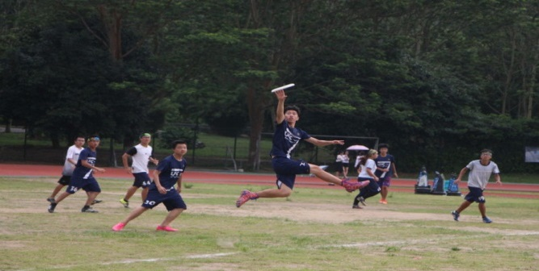
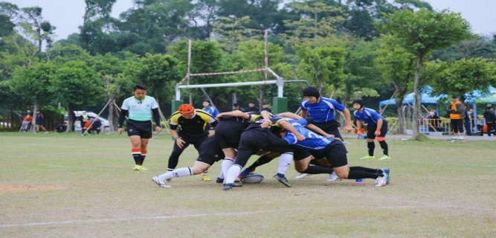
Sports Culture

Slide 23
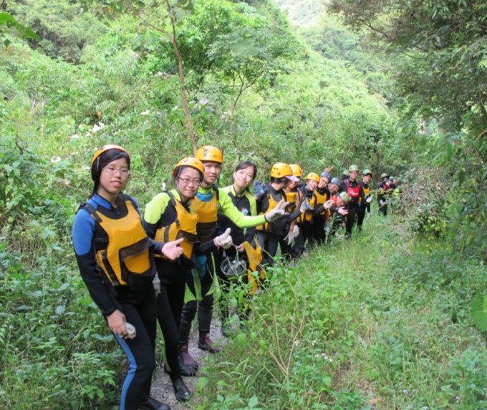
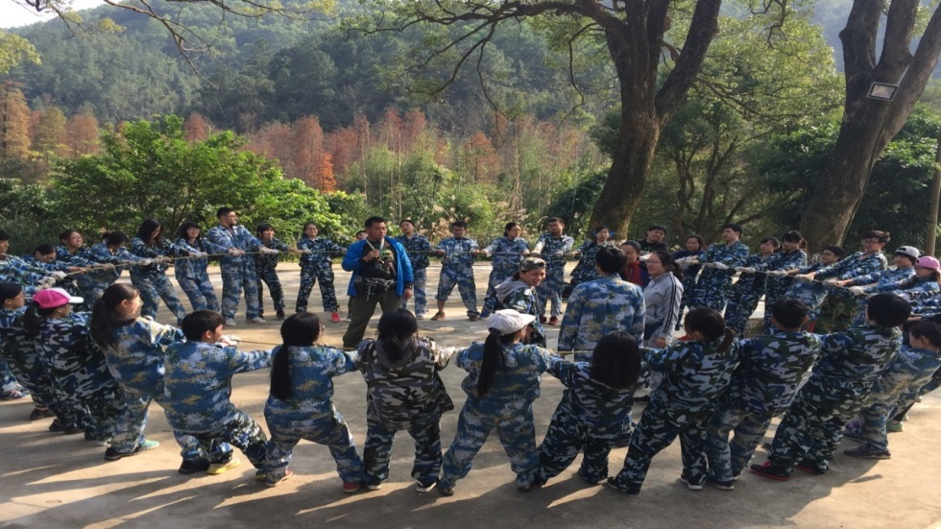
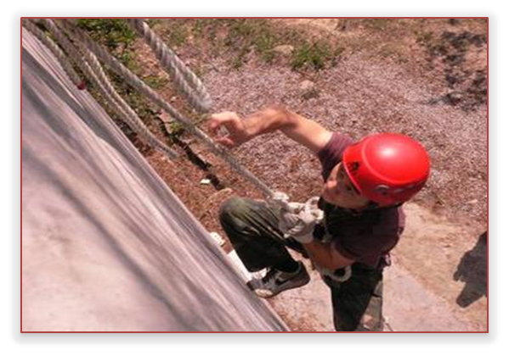
Adversity Management

Slide 24
Four-Point Education
SOCIETY
STUDENTS
UIC
PARENTS

Slide 25
Cooperation with Worldwide Institutions
By far, UIC developed various types of cooperation with 62 universities:

Slide 26
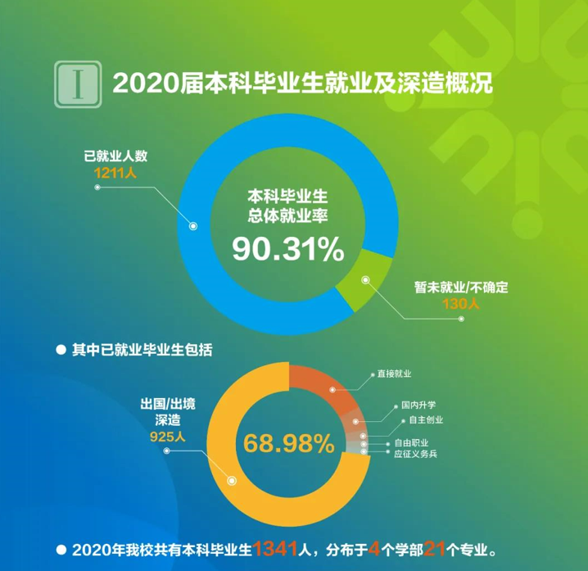
UIC Graduates’ Prospects
In 2020, 925 out of 1341 graduates left the mainland for further studies, representing 68.98% of the graduating class, with most going either to the UK, Australia, etc.

Slide 27
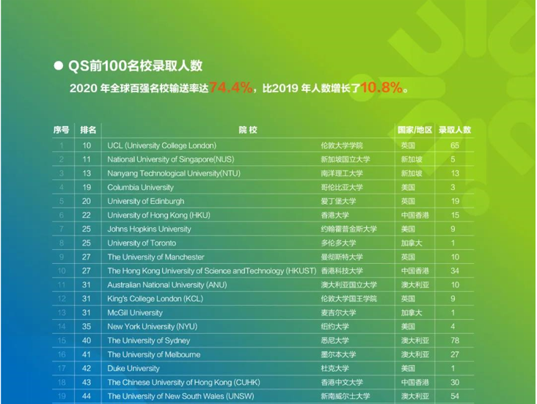
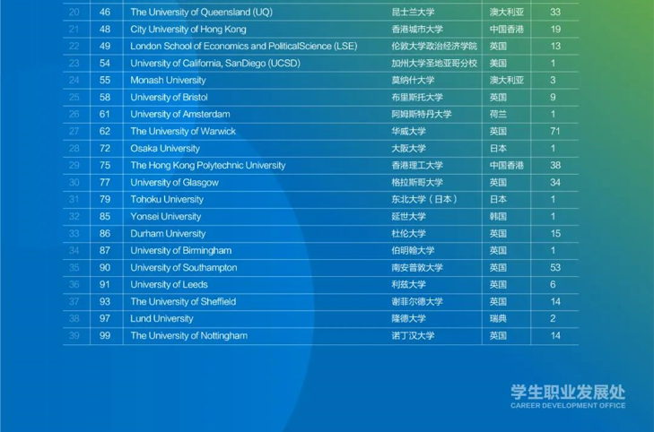
UIC Graduates’ Prospects
In 2020, 718 of our graduates were admitted to top-100 QS-ranked universities.

Slide 28
General College Admission Requirements
Applicants belong to the categories listed below can select only one of them which can best reflect the Highest Qualifications/Status:
1
International Baccalaureate Diploma
3
Cambridge Pre-U Diploma
Grade 4 in:
IB English A (Higher or Standard Level); or IB English B (Higher Level); or
IB English Literature and Performance (Standard Level)
OR
Grade 5 in: IB English B (Standard Level)
Grade P3 (Pass 3) or better in three Cambridge Pre-U Principal Subjects; or
Cambridge Pre-U Diploma
(Not including Chinese and English Language subjects)
4
BTEC
2
GCE Qualification
BTEC Higher National Certificate (HNC); or BTEC Higher National Diploma (HND); or BTEC Level 3 National Diploma (ND)/ BTEC Level 3 Extended Diploma
(Foundation, Diploma and Certificate qualifications awarded by colleges and universities in the UK will be considered on a case-by-case basis for admission without advanced standing)
GCE Advanced Level (AL)/ International Advanced Level (IAL):
Grade E or above in three AL/ IAL subjects; or Grade E or above in two AL/ IAL subjects plus two Advanced Supplementary Level (ASL) subjects
(Not including Chinese and English Language subjects. The same subject cannot be counted at both the AL and ASL.)
Country specific qualifications: https://ido.uic.edu.cn/info/1013/1010.htm

Slide 29
General College Admission Requirements
Applicants belong to the categories listed below can select only one of them which can best reflect the Highest Qualifications/Status:
5
SAT Qualifications
8
Associate Degree Student/Holder (AD)
Minimum score of 1,190 (out of 1,600) in new SAT or 1,650 (out of 2,400) in old SAT (minimum score of 550 in each of Critical Reading, Mathematics and Writing), and a sub- score on essay writing of no less than 8
Successful completion of one year's study in a full-time AD programme at a recognised US university/ community college, the duration of which should be no less than two years in full-time mode
6
Advanced Placement (AP)
9
Intersegmental General Education Transfer Curriculum (IGETC) in community colleges
Grade 3 in at least two AP subjects
Successful completion of IGETC with Grade C or above in each of the subjects
7
American College Test (ACT)
IMinimum composite score of 23

Slide 30
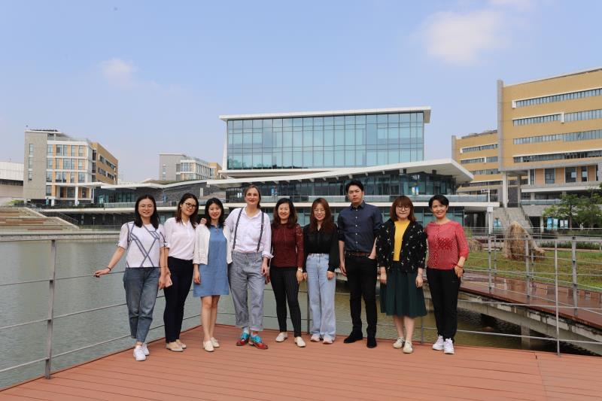
How to Apply
For International Degree-seeking Students:
http://web.uic.edu.hk/en/ido/apply/
Graduate Certification of High School
Transcripts
Recommendation Letter
Personal Statement
Passport Copy
Language Certification (TOEFL Score-79 Internet-based or IELTS Score-6)
Application Deadline: 30 June Every Year
Questions?
Meet the team and have a chat….
is@uic.edu.cn

Slide 31
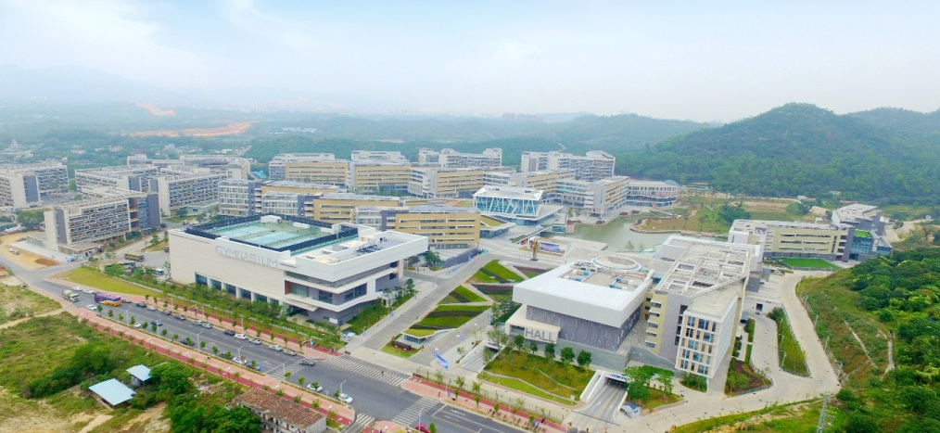
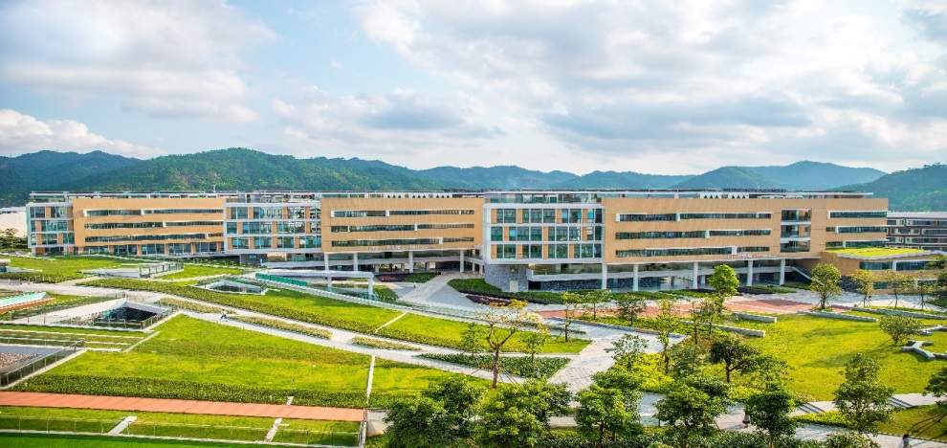
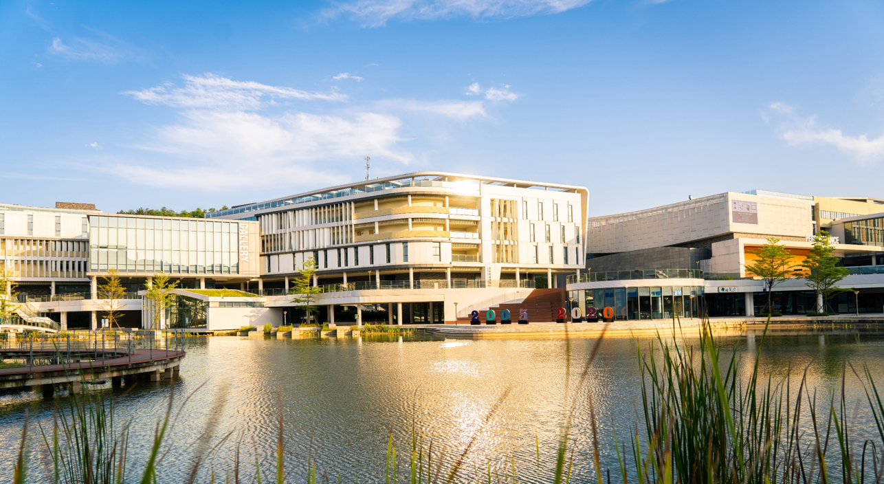
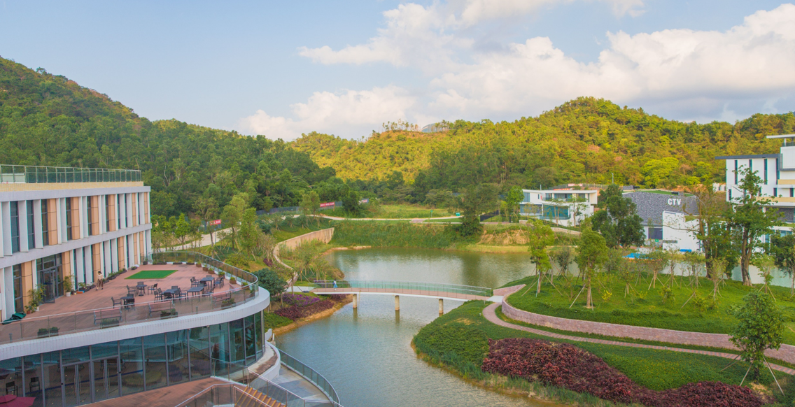
Campus Scenery

Slide 32
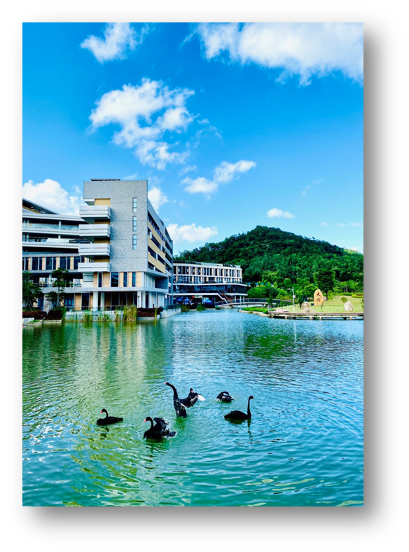
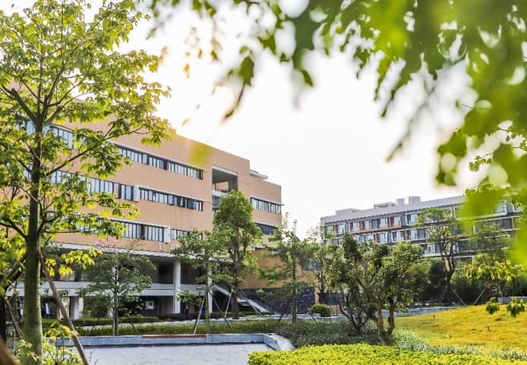
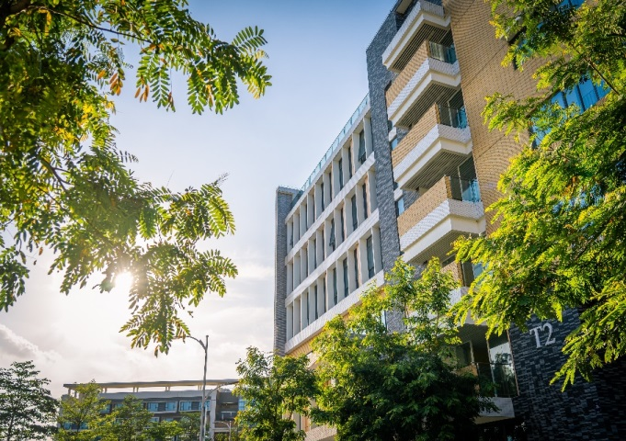
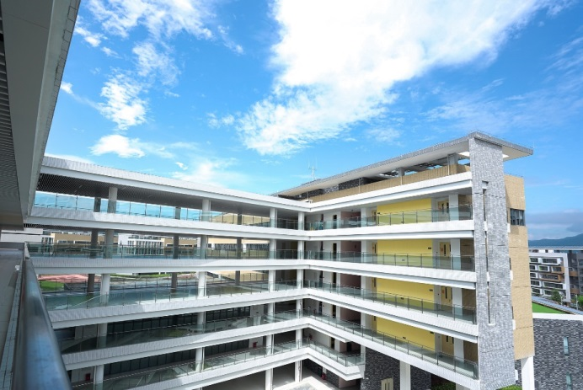
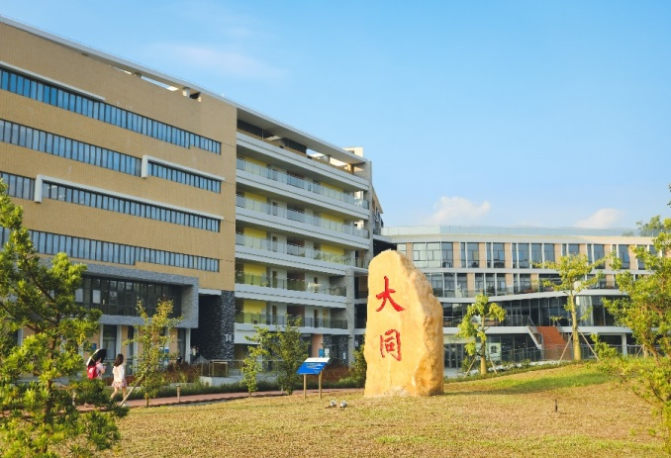
Campus Scenery

Slide 33
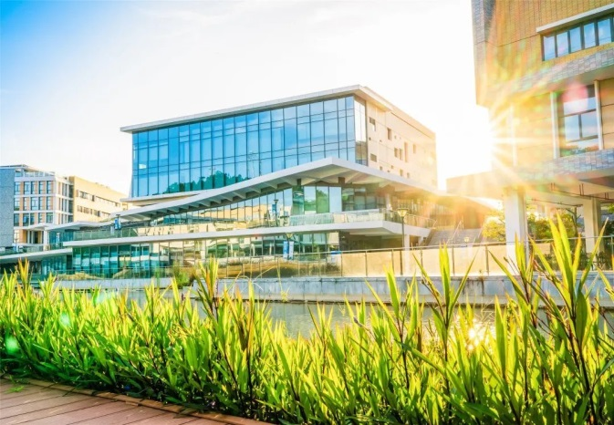
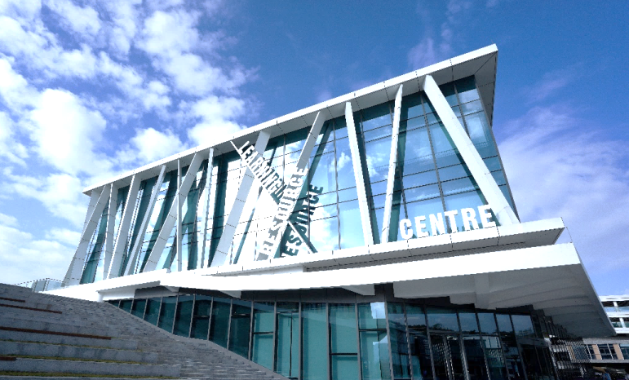
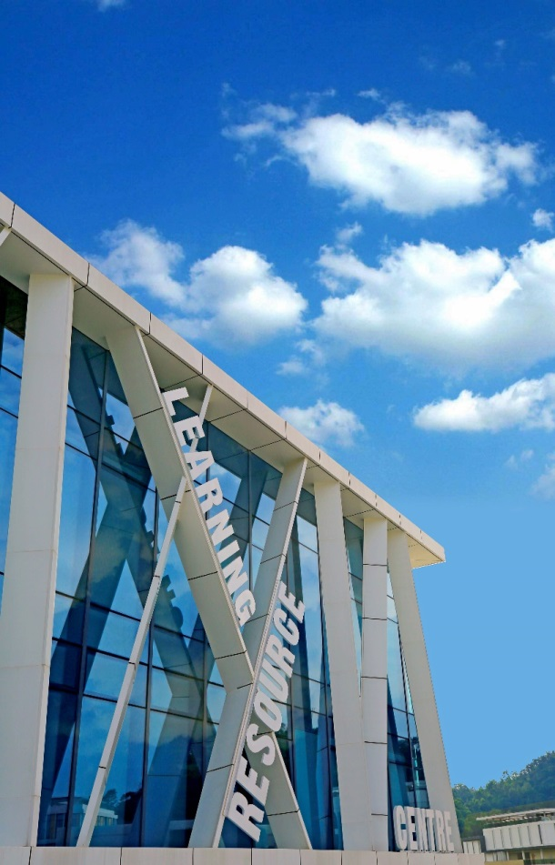
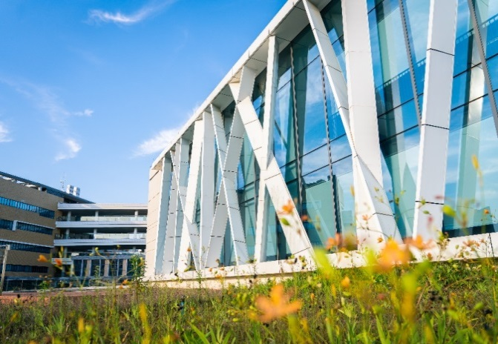
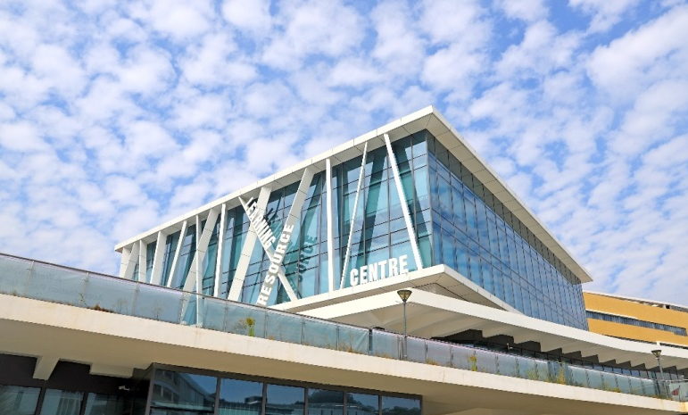
Learning Resource Center

Slide 34
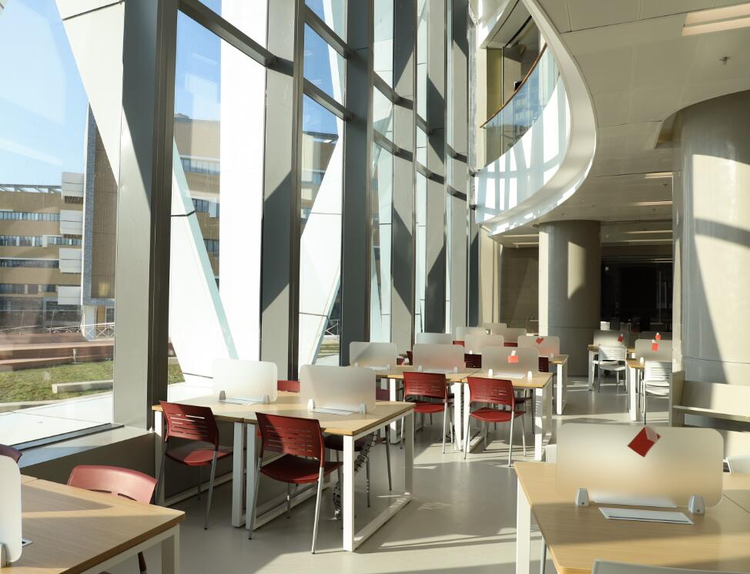
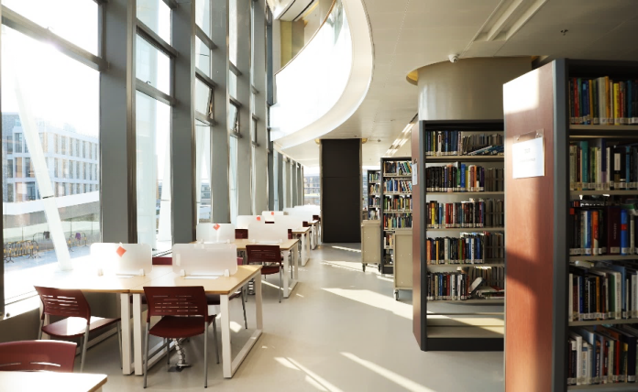
Learning Resource Center

Slide 35
Student Dormitory

Slide 36
HuiTong Sports Park

Slide 37
International Development Office (IDO)
is@uic.edu.cn
https://ido.uic.edu.cn/
Thank You!

