Slide 1
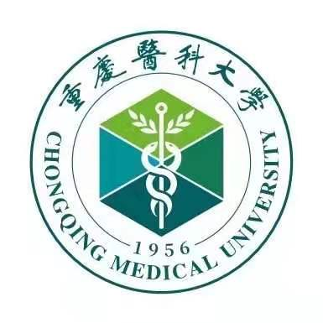
Chongqing Medical University
http://english.cqmu.edu.cn

Slide 2
Content
1.
Overview of Chongqing
2.
Overview of CQMU
3.
International Education
4.
Admission for 2022

Slide 3
1. Overview of Chongqing

Slide 4
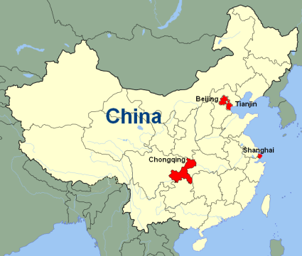
About Chongqing
History: Over 3,000 years
Areas: 82,402 km²
Population: 31 million
Municipality: Directly under Central Government of China
Location:
Southwest of China
Joint Point of “Belt and Road” and “Yangtze River
Economic Belt”
Features:
National Historical and Cultural City
A city of mountains & rivers
A Bridge City
Nick Name: Mountain City

Slide 5
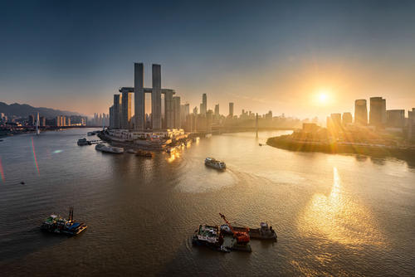
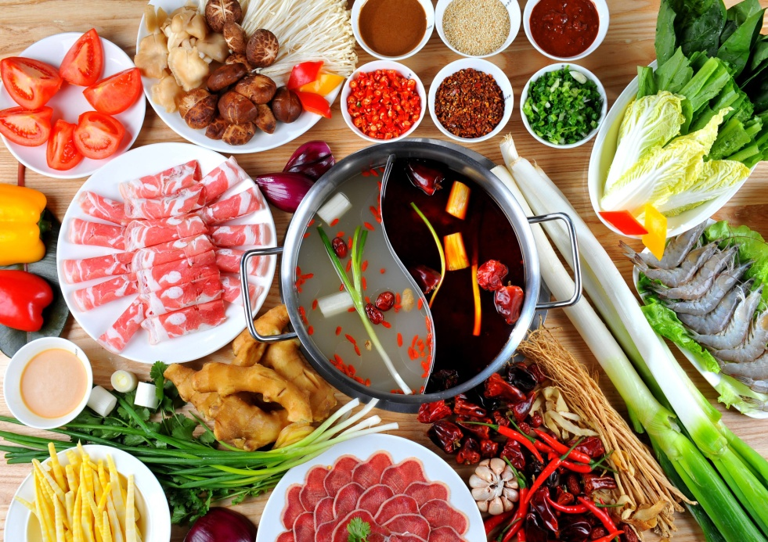
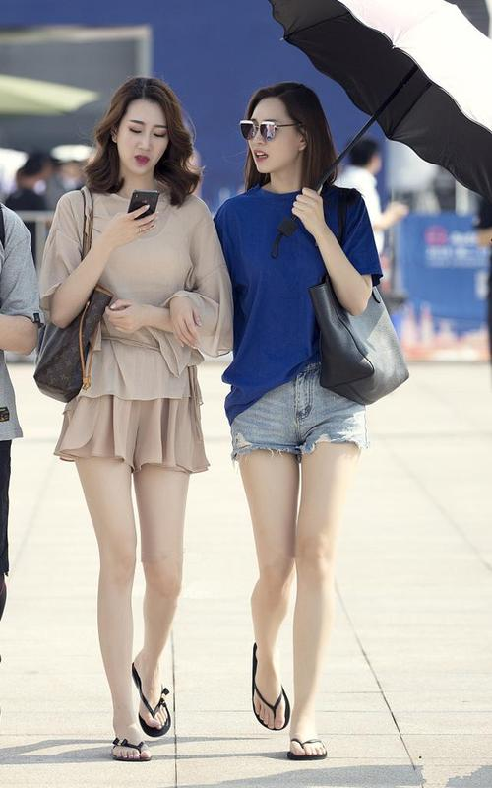
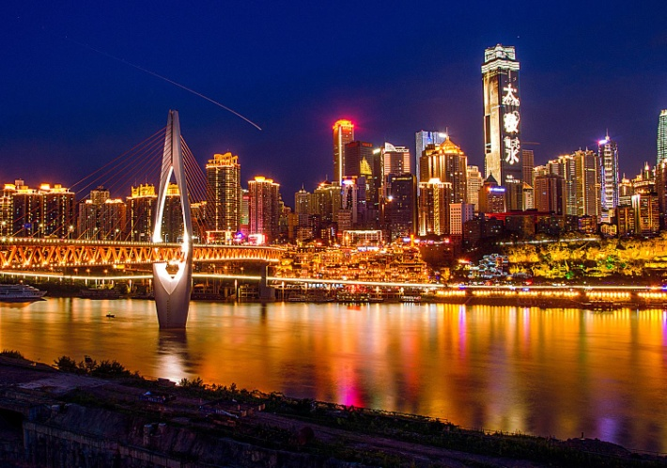
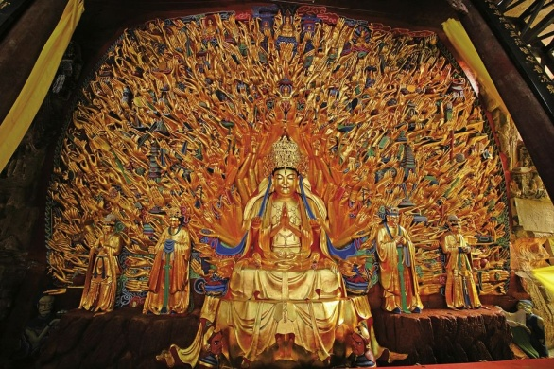
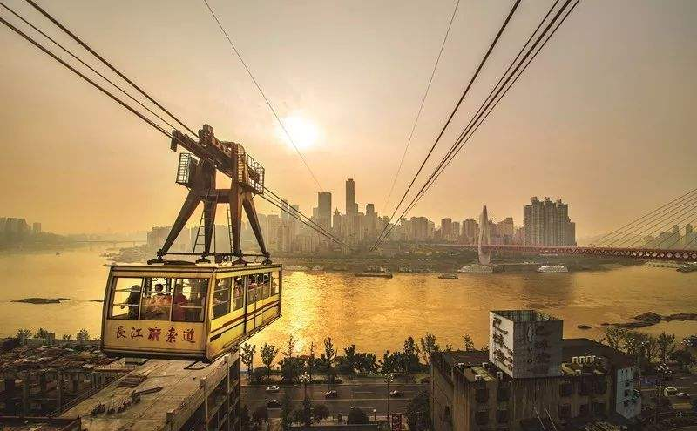
About Chongqing

Slide 6
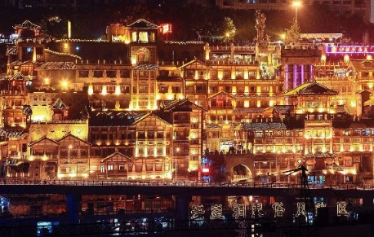
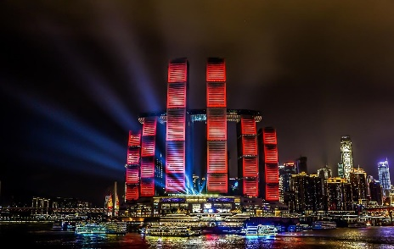
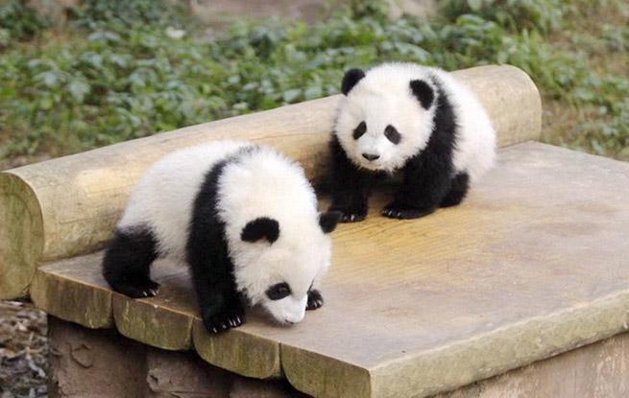
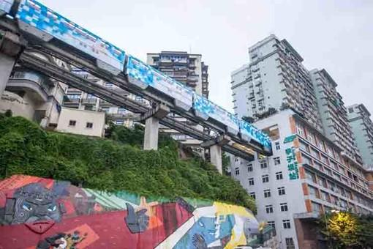
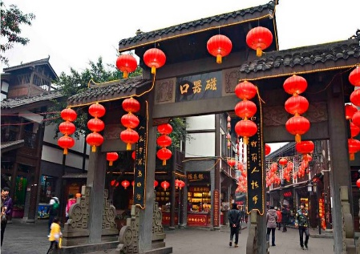
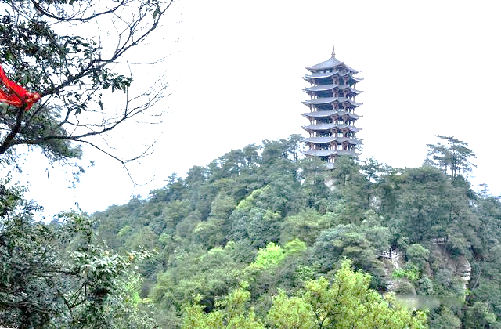
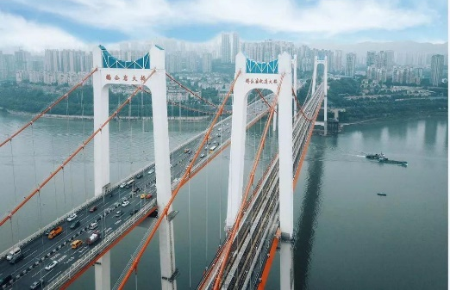
About Chongqing
Hongyadong
Jiefangbei
Laifushi Square
Chongqing Zoo
Metro Line 2
Ciqikou
Jinyun Mountain
Egongyan Bridge

Slide 7
2. Overview of CQMU

Slide 8
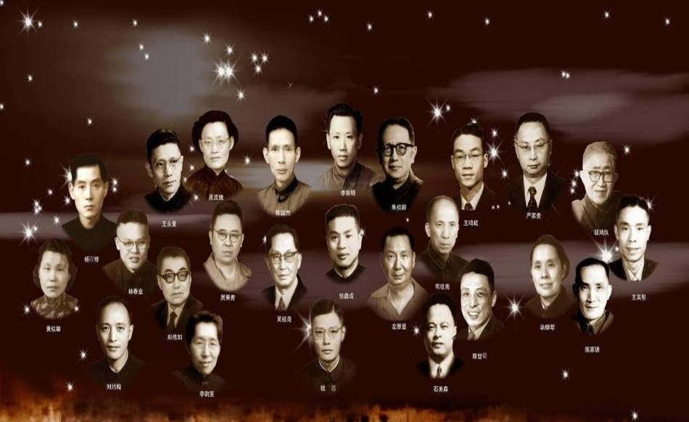
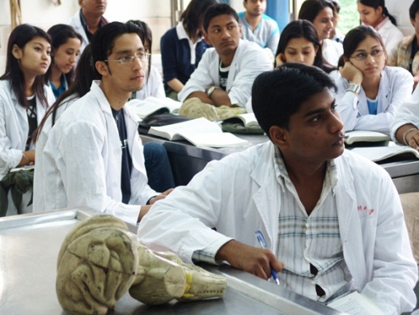
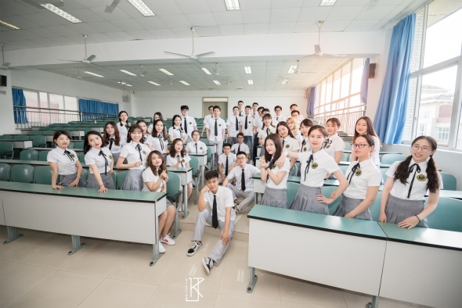
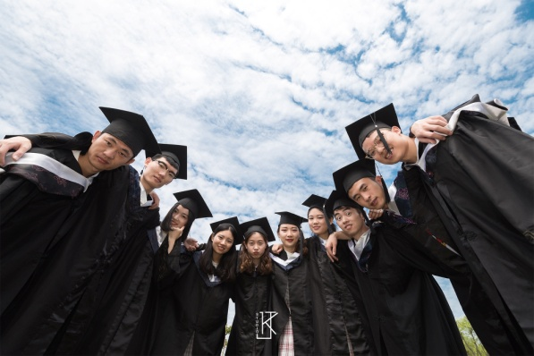
Chongqing Medical University
History: since 1956
Originated: from Shanghai Medical College
Education: Bachelor, Master, PhD/MD

Slide 9
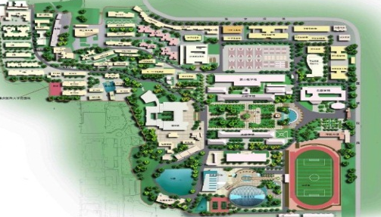
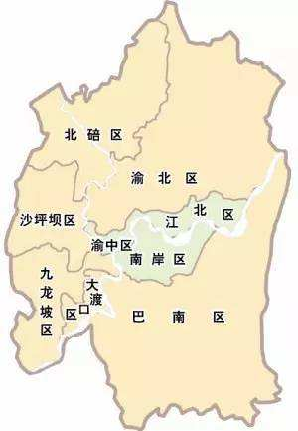
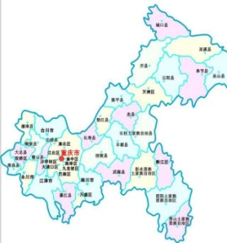
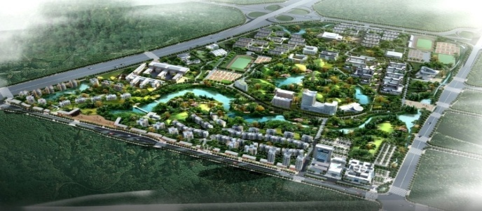
Campuses
Jinyun Campus
Undergraduate education
Location: China (West) Science City
Yuanjiagang Campus
Scientific Research & Graduate education
Location: Chongqing Downtown
Areas: 1.76 km²

Slide 10
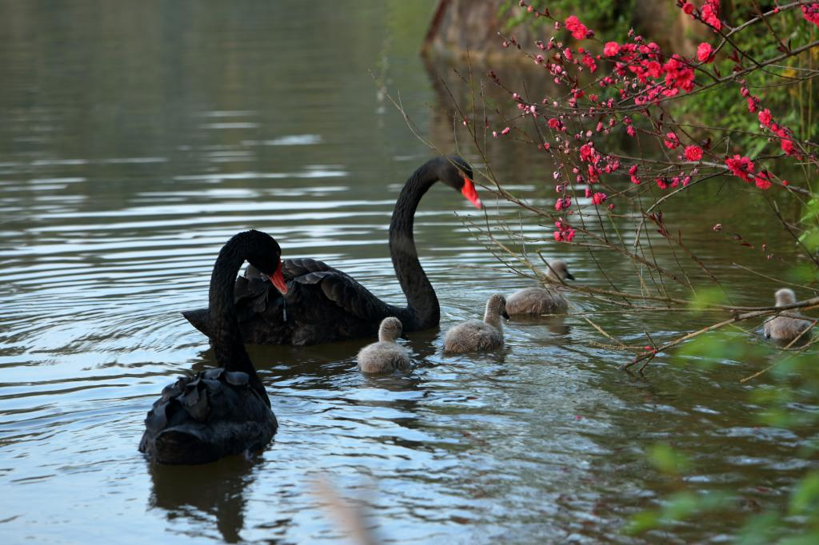
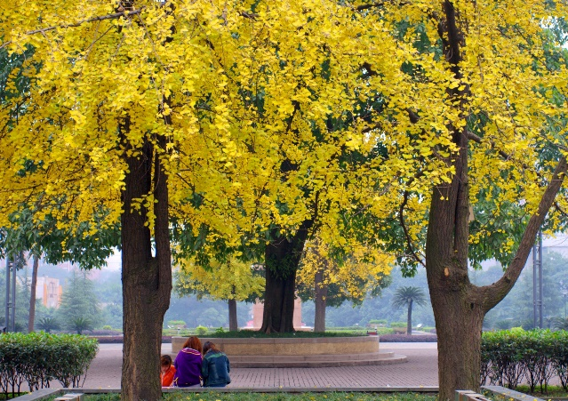
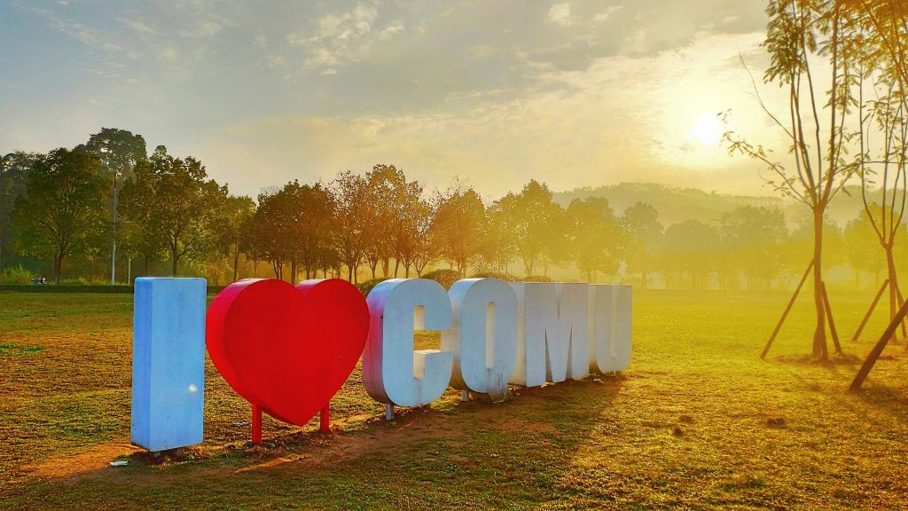
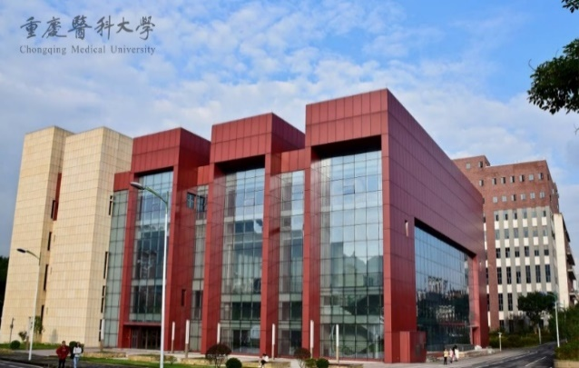
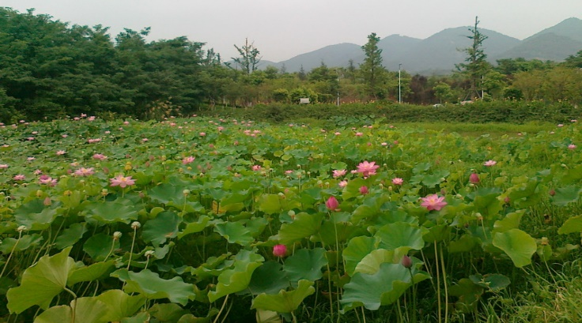
Campuses
Beautiful sceneries

Slide 11
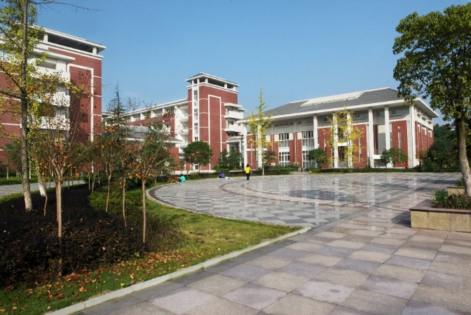
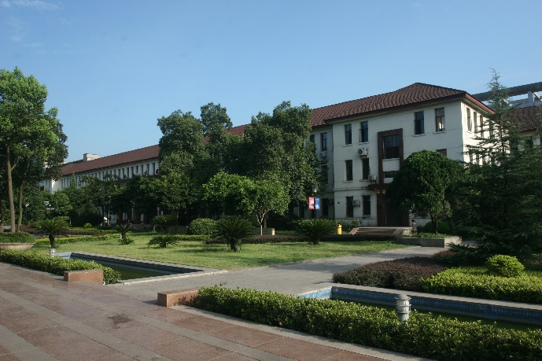
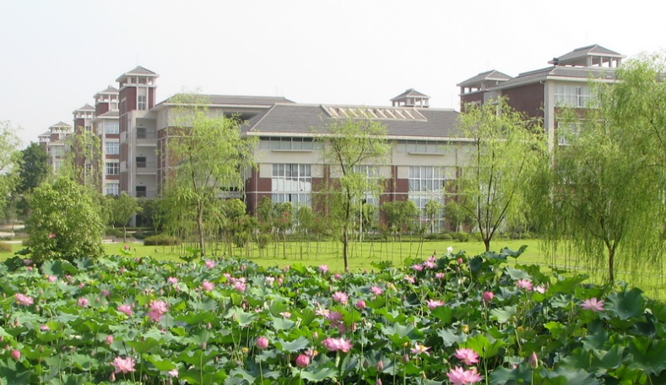
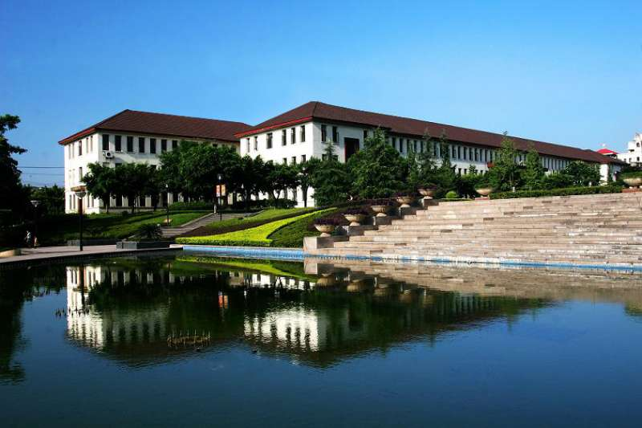
Campuses
Teaching buildings
Jinyun Campus
Yuanjiagang Campus

Slide 12
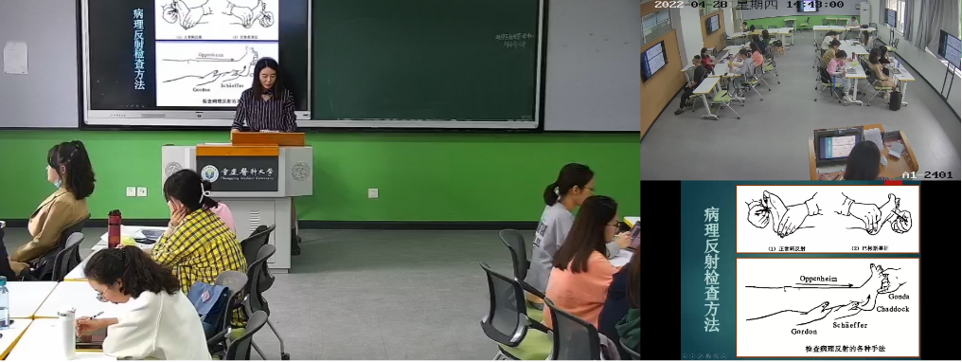
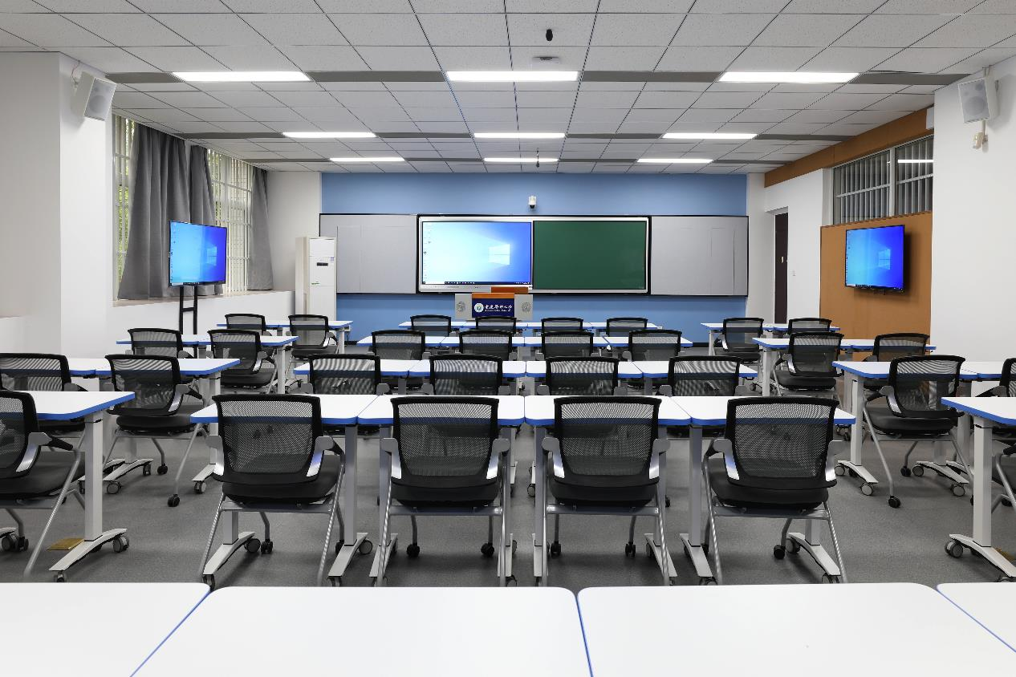
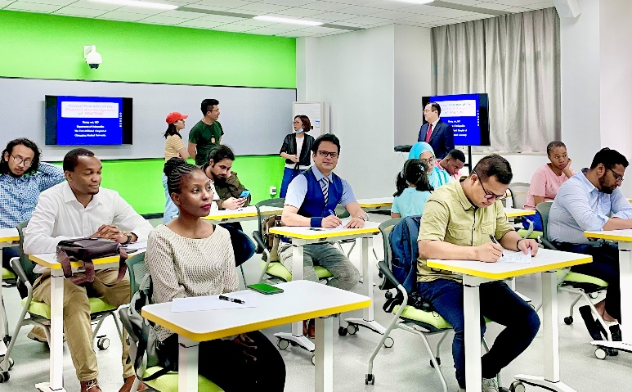
Campuses
Smart Classrooms

Slide 13
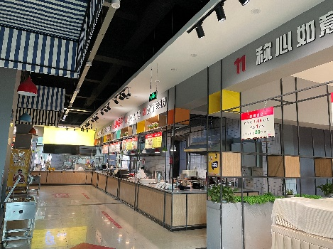
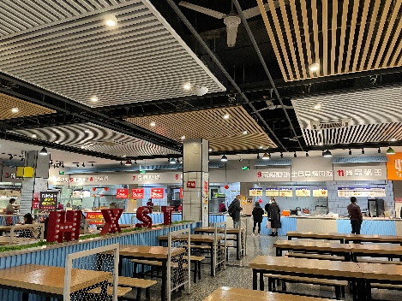
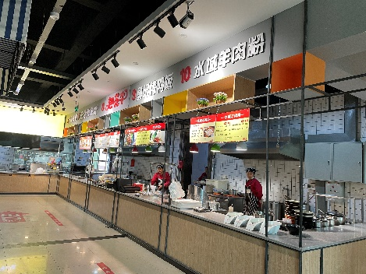
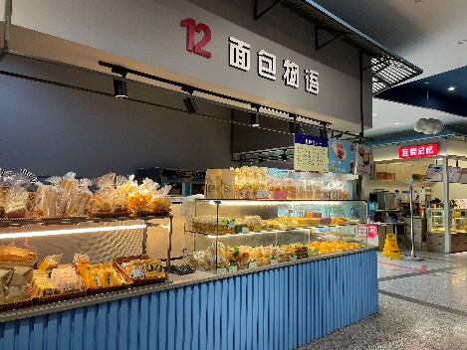
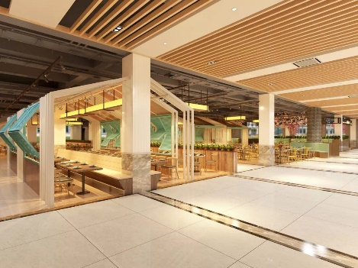
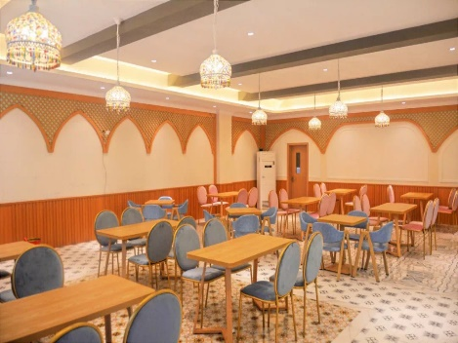
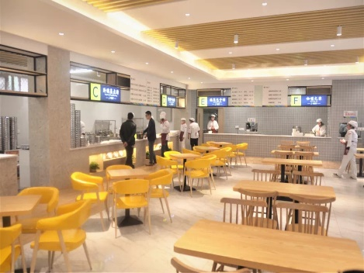
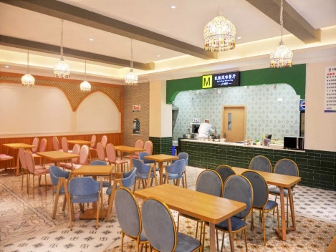
Campuses
Canteens

Slide 14
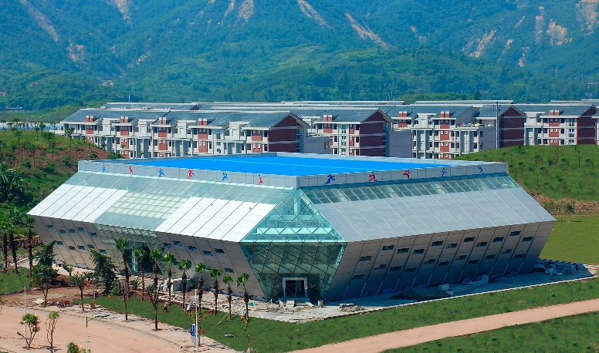
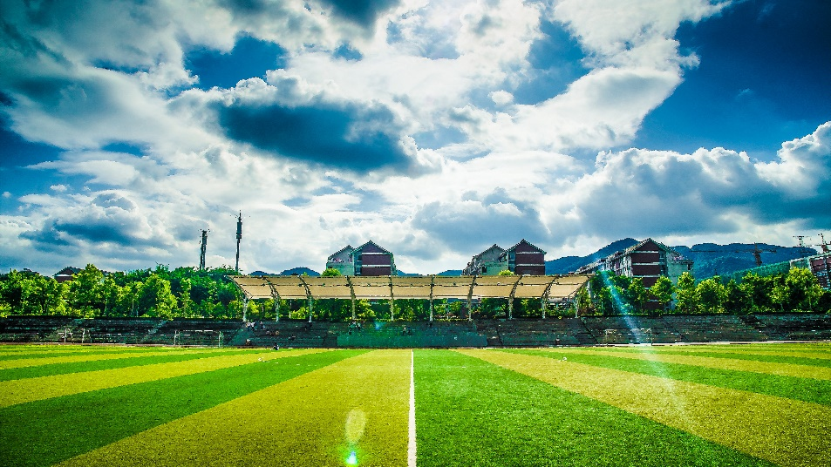
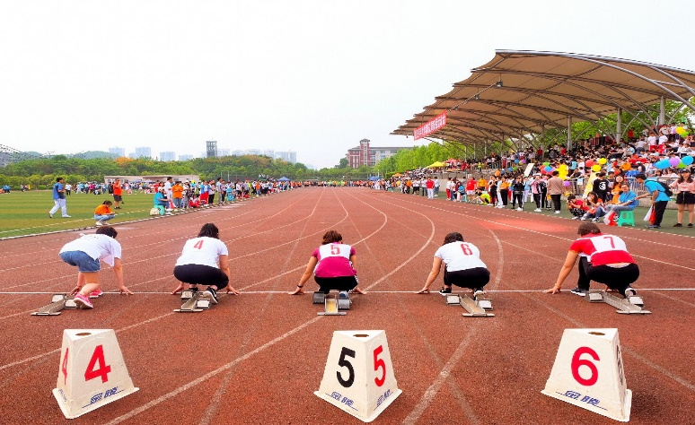
Campuses
Gym and Football Yard

Slide 15
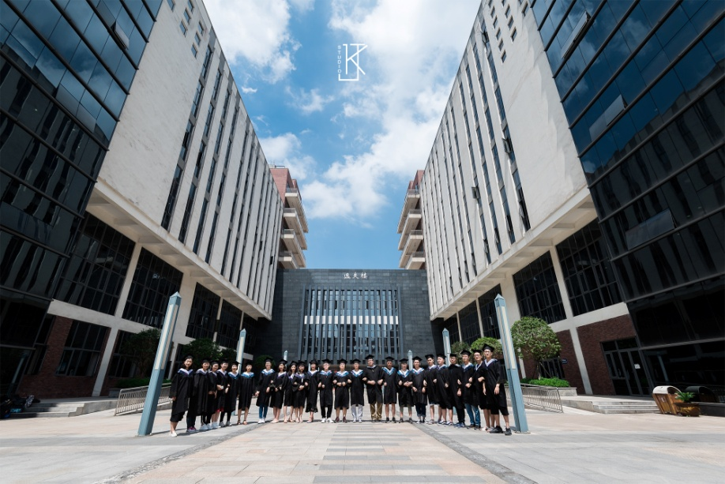
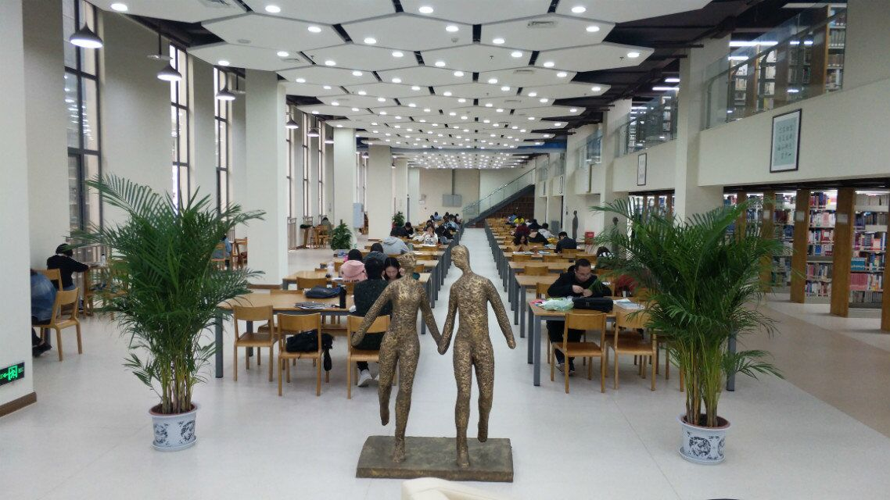
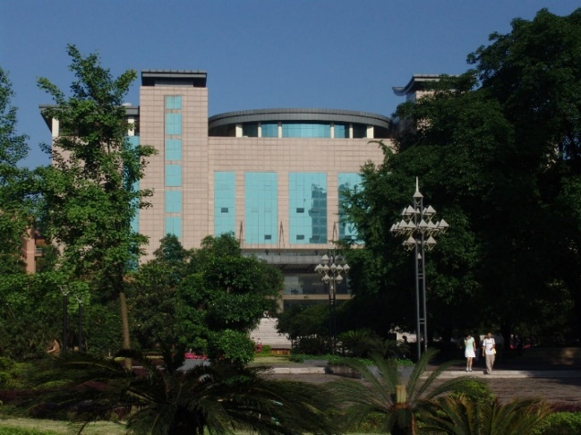
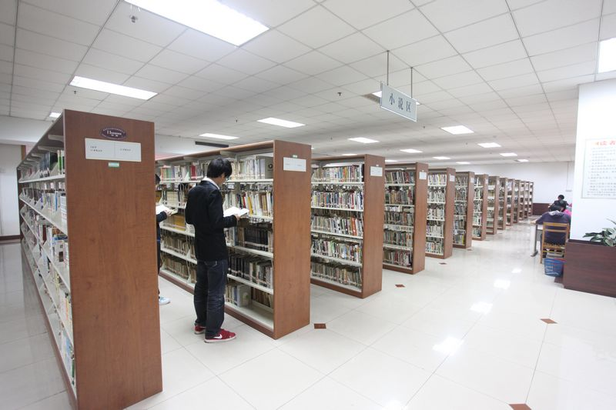
Campuses
Libraries
Areas: 28,000 m2
Seats: 3,560 reading seats
Collections: 1.83 million volumes
Data base： 72
E-books：33.8 million
Electronic Journals：49 million
Dissertation：17 million volumes
Audio and video：2063 H

Slide 16
Campuses
Human Life and Heath Museum & Traditional Chinese Medicine Museum

Slide 17
Colleges
Clinical Colleges: 5
Pediatric College
College of Stomatology
International Medical College
College of Basic Medicine
College of Laboratory Medicine
College of Public Health and Health Management
College of Pharmacy
College of Biomedical Engineering
College of Nursing
College of Traditional Chinese Medicine
College of Medical Informatics
College of Foreign Languages
College of Sports Medicine
College of International Education
Department of Medical Imaging
Department of Anesthesiology

Slide 18
Students
Sstudents in total: 26810
PhD/MD students: 927
Master students: 7124
Undergraduates: 18824
International students: 604

Slide 19
Faculty
Faculty members : 5,196
(including 3,500 for clinical teaching)
Professors & Associate professors: 1,429
PhD/MD supervisors: 315
Post-doctoral Workstations: 7

Slide 20
Disciplines
PhD discipline: 10
Master discipline: 23
State key discipline: 4
Clinical Laboratory Diagnostics
Pediatrics
Infectious Disease
Neurology
ESI Top 1% : 8
Clinical Medicine
Pharmacology & Toxicology
Neuroscience & Behavior
Biology & Biochemistry
Immunology
Molecular Biology & Genetics
Chemistry
Materials science

Slide 21
Affiliated Hospitals
Directly affiliated hospitals: 12 hospitals
Beds: 17,000
Out-patient visits: 15,000,000 per year
Inpatient visits: 600,000 per year

Slide 22
Academic Exchange
International Conferences
Student Exchange
Faculty Exchange

Slide 23
3. International Education

Slide 24
International Education
Source Countries: 60 countries in Asia, Africa, Europe, America & Oceana
Students: Undergraduate 528, Graduate 76
Programmes: Clinical Medicine, Basic Medicine, Traditional Chinese Medicine, etc.
Medical Student Oath
Clinical Skills Competition
Free Clinic
Team Building
Medal Winner
English Opera Night
Experimental Course
Graduation
Competition
International Culture Festival

Slide 25
CQMU Study & Culture Tour for International Students
Cultural Exchange

Slide 26
International Education
National Demonstration Base for International Education, approved by the Ministry of Education (MOE) in China
International Education was Accredited by MOE in 2019
Chinese Government Scholarship student Social practice and cultural experience base

Slide 27
International Education
Excellent Alumni
Shambhu Kumar Sah:
Master in Imaging and Nuclear Medicine (2013-2016)
Publication: SCI papers 14
Book 1
Now working as a doctor in Nepal

Slide 28
International Education
Excellent Alumni
SANG JUN HAN
Master in Stomatology (2014-2017)
Passed the qualification for practicing medicine in China
Now he opened his own dental clinic in Chongqing

Slide 29
International Education
Excellent Alumni
Laxman Gyawali:
Master in Internal Medicine (2013-2016)
Cardiologist at the Second Affiliated Hospital of CQMU
Sandeep Kumar Karn:
MBBS student (2011-2017)
Works at the Second Affiliated Hospital of CQMU
One of the Editors of Journal of Clinical and Translational Hematology

Slide 30
4. Admission for 2022

Slide 31
International Education
Bachelor’s Degree Programs
English-medium Program
MBBS (Bachelor of Medicine & Bachelor of Surgery)
Length of schooling: 6 years (5-year academic study + 1-year internship)
Seats per year: 90
Courses: 60+
Start from September
Application Deadline: October 30th

Slide 32
International Education
Bachelor’s Programs
Chinese-medium Program
Majors: 33
Length of schooling: 4-5 years
Start from September
Application Deadline: August 30th

Slide 33
International Education
Bachelor’s Programs
https://english.cqmu.edu.cn/Education/Admissions.htm
Program information
Major
Teaching Language
Study Period
Seats

Slide 34
International Education
Master’s & PhD Programs
English-medium or Chinese-medium Program
39 master specialties
22 doctoral specialties
Length of schooling: 3 years
Knowledgeable and responsible faculty
School begins in September each year
Application Deadline: May 30th

Slide 35
International Education
Master’s & PhD Programs
https://english.cqmu.edu.cn/Education/Admissions.htm
Supervisor List
Colleges
Supervisors
Teaching language
Supervisors’ Email
Enrollment category (Master / PhD)
Second-level Discipline
Third-level Discipline

Slide 36
International Education
Fees
Tuition | Bachelor’s program | RMB 30,000 per academic year
 | Master’s program | RMB 41,000 per academic year
 | Ph.D. program | RMB 50,000 per academic year
 | Visiting program | Depending on study time and specialty
Accommodation | RMB 4,800 per year for double-bed room
 | RMB 9,600 per year for one-bed room
Insurance | RMB 800 per year
Application fee | RMB 450, only for the first year

Slide 37
International Education
Scholarship
Chinese Government Scholarship
CQMU
Scholarship
Chongqing
Municipal
Government
Mayor
Scholarship
Full Scholarship
Undergraduate: partial
Postgraduate: full & partial
Undergraduate: partial
Postgraduate: full

Slide 38
International Education
Scholarship
Type | class | Full scholarship or not | Monthly allowance | Content
Chinese Government Scholarship | / | Yes | Yes | Tuition, Accommodation, Monthly Allowance, Insurance
Mayor Scholarship | / | Yes | Yes | Tuition, Accommodation, Monthly Allowance, Insurance
CQMU Scholarship (for PG) | First | Yes | Yes | Tuition, Accommodation, Monthly Allowance, Insurance
 | Second | No | No | Tuition, Accommodation, Insurance

Slide 39
International Education
Online application
Link: https://lxs.cqmu.edu.cn/

Slide 40
International Education
Contact Us
College of International Education
Tel: +86-23-68485041
Email：694634862@qq.com, 102712@cqmu.edu.cn
Address: No. 1 Yixueyuan Road, Yuzhong District, Chongqing, 400016, P. R. China.

Slide 41
We cordially welcome you at CQMU!
重 庆 医 科 大 学 欢 迎 您 !

