Slide 1
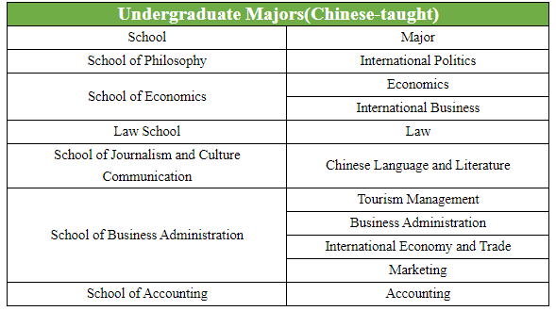
Undergraduate Majors
Sapienza University
of Rome
University of Hamburg
Stony Brook University
ESC RENNES
项目名称
项目名称
正文内容本段适应大段文字章节
正文内容本段适应大段文字章节

Slide 2
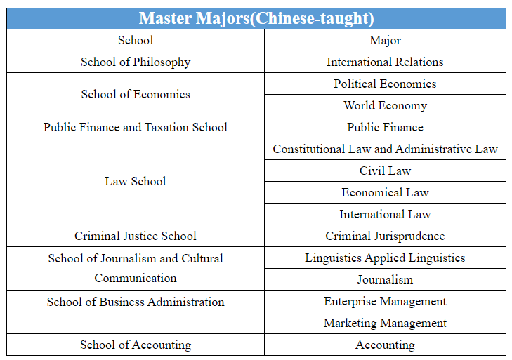
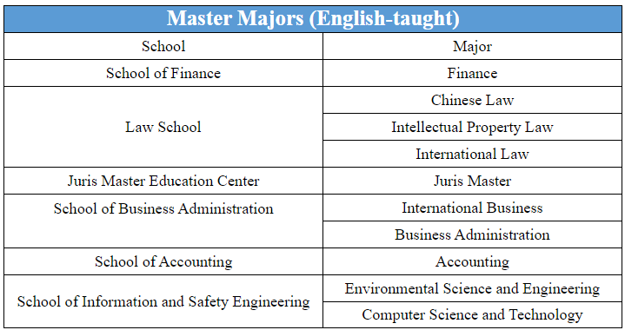
Master Majors
Sapienza University
of Rome
University of Hamburg
Stony Brook University
ESC RENNES
项目名称
项目名称
正文内容本段适应大段文字章节
正文内容本段适应大段文字章节

Slide 3
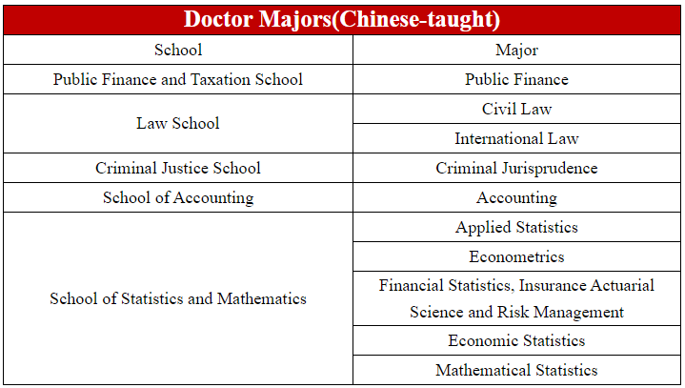
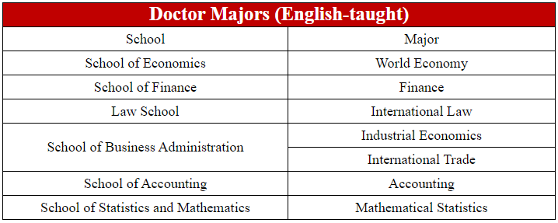
Docter Majors
Sapienza University
of Rome
University of Hamburg
Stony Brook University
ESC RENNES
项目名称
项目名称
正文内容本段适应大段文字章节
正文内容本段适应大段文字章节

Slide 4
application time
1. Scholarship application period:
March-April every year
For details, please check the school website: http://ies-en.zuel.edu.cn/
2. Self-pay application period
①Autumn semester: March 1 to June 15 each year
② Spring semester: October 1st to December 15th every year

Slide 5
Language requirements
1.Chinese-taught programs
Undergraduate students need to submit HSK4 certificate;
Master and Doctoral students need to submit HSK5 certificate.
2.English-taught programs
A TOEFL score of 80 or IELTS score of 6 or above is required,
or relevant proof that the pre-degree is taught in English.
Note: If the language scores do not meet the requirements, our university does not have preparatory classes.

Slide 6
Application process
1. Online registration
Log in to the online service system for international students of ZUEL(http://iesmis.zuel.edu.cn/member/login.do), complete the registration information and upload the application materials as required.
2. Qualification
After the application deadline, applicants can log in to the application system to check the admission status.

Slide 7
Type of Scholarship
1. Chinese Government Scholarship
① Chinese Government Scholarships (Bilateral Program, Great Wall Program, EU Program, AUN Program, PIF Program ,WMO Program)
② Chinese Government Scholarship-Chinese University Program
③ Chinese Government Scholarship-Silk Road Program
④ "Belt and Road" Chinese Government Intellectual Property Law English Master Scholarship Program
⑤ Chinese Government Scholarship-Sino-American Cultural Exchange Scholarship Program for Degree Students
⑥Chinese Government Scholarship-China-Africa Friendship Scholarship Program for Degree Students
⑦Chinese Government Scholarship-China-Africa Friendship Scholarship Program for Advanced Students

Slide 8
2. University Scholarship
① “Study in ZUEL” scholarship program:
Scholarship for freshmen and scholarship for current students.
② "Academic in ZUEL" Research and Innovation Scholarship Program
③ “Language in ZUEL” Chinese Study Scholarship Program
④ "Glory in ZUEL" Practical Activity Scholarship Program

Slide 9
Scholarship Criteria
1. Exemption from tuition fees
2. Exemption from on-campus accommodation fees
3. Provide living expenses:
undergraduate students 2500 yuan/month,
master students 3000 yuan/month,
doctoral students 3500 yuan/month.
4. Provide comprehensive medical insurance for international students in China (800 yuan/year)

Slide 10
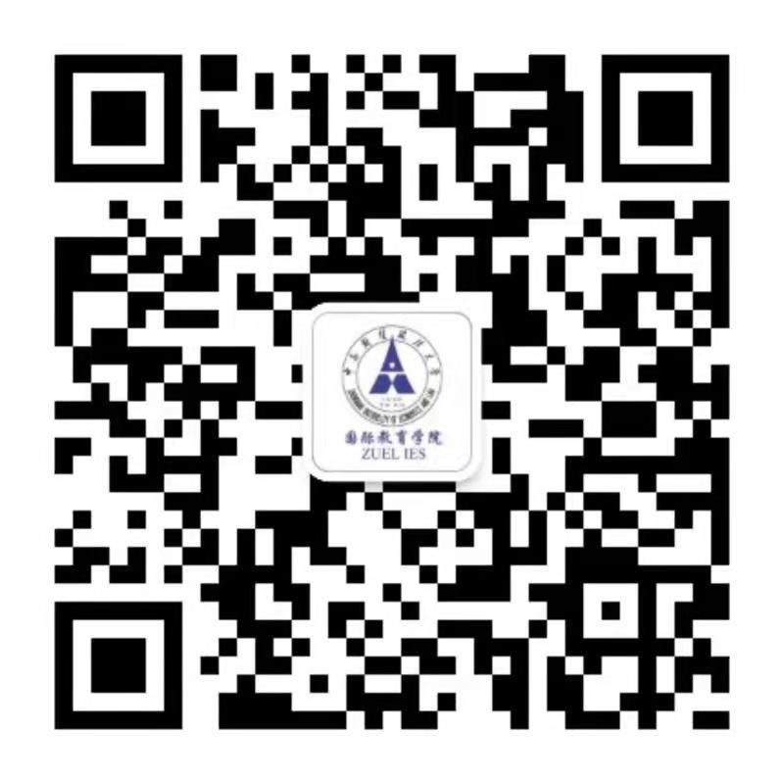
Welcome to ZUEL！
Contact person: Mr.Chen
Tel: 0086-27-88386601
E-mail:admissions@zuel.edu.cn
Website：http://ies.zuel.edu.cn/main.htm
Address:182# Nanhu Avenue, East Lake High-tech Development Zone, Wuhan 430073, P.R.China

