Slide 1
申请材料模板
Template of Application documents
ZJNU

Slide 2
报名照片/portrait photo
2-inch bareheaded photo in color with blank background no border
the head occupies 2/3 of photo size
size is 100-500KB, JPG format
don’t upload life photo

Slide 3
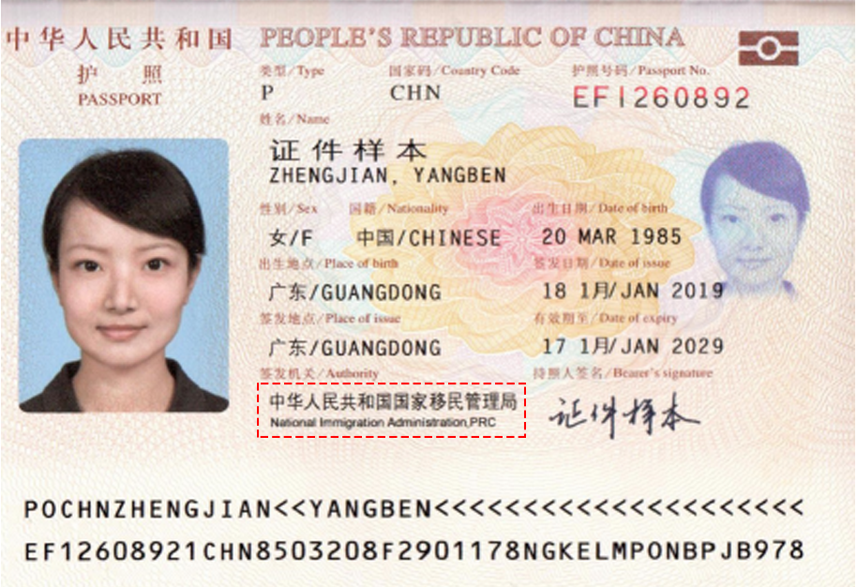
护照 / Valid passport
All information should be clear
Not expired
Fill information exactly same with passport
Wrong information will cause unexpected consequences, students need to take all responsibility.

Slide 4
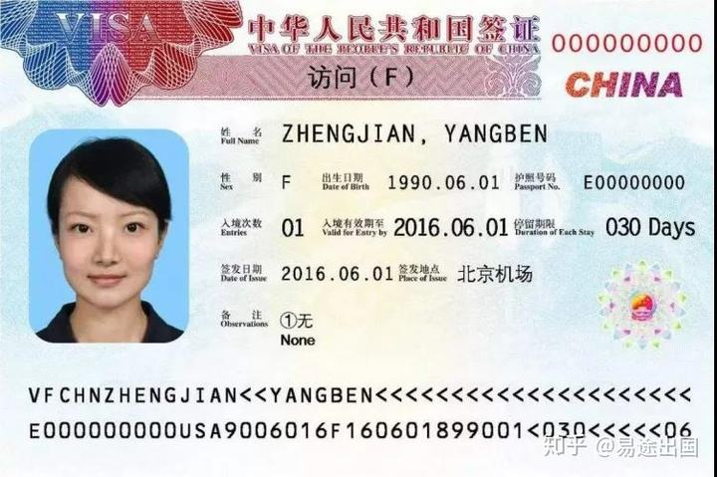
签证页 / Visa page
If you are in China now, you need to upload.
If you are not in China now, you can leave it blank.
Upload the latest valid Visa page.

Slide 5
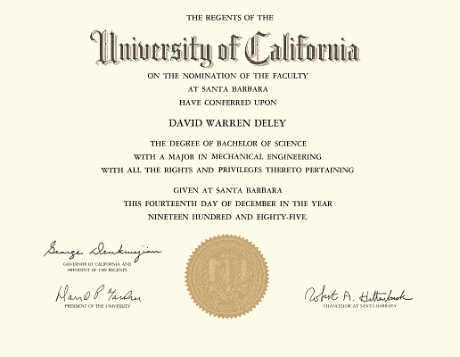
最高学历证书 / Highest Diploma
Apply for Bachelor program, you need to have high school graduation certificate. It’s better if you can upload education system in your country together.
Apply for Master program, you need to upload bachelor degree certificate.
Apply for Doctoral program, you need to upload master degree certificate.
Documents in languages other than Chinese or English Must be attached with notarized Chinese or English translations.

Slide 6
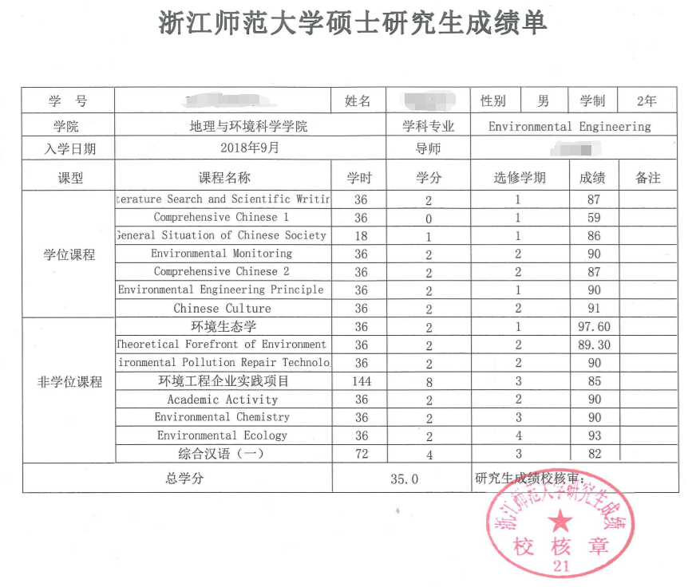
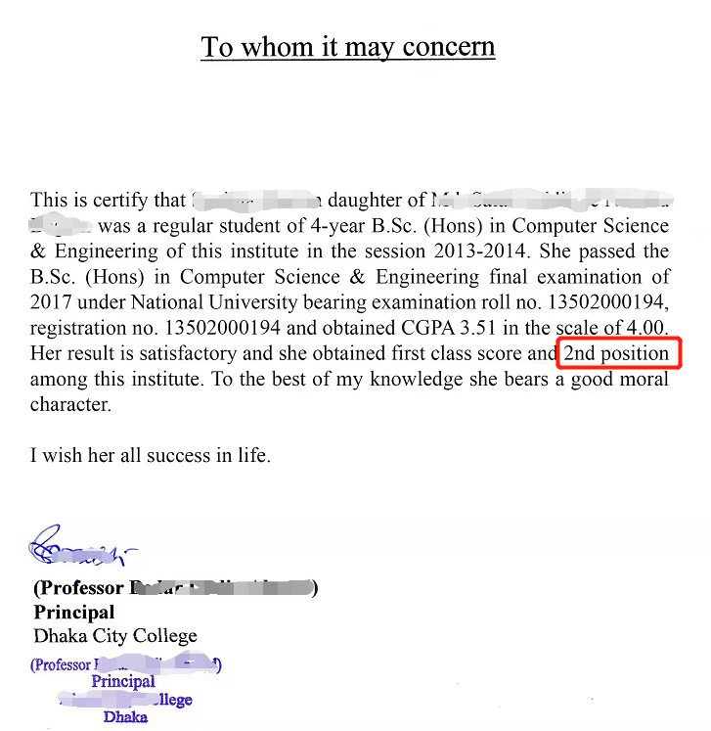
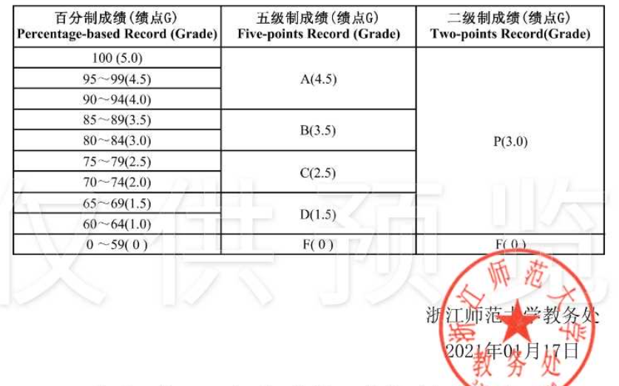
最高学历成绩单 / Transcripts
The Transcripts must have official stamp of the college or university.
Grading system is helpful for teachers to understand your performance.
A ranking statement from your college can tell us your position in your class or institute.

Slide 7
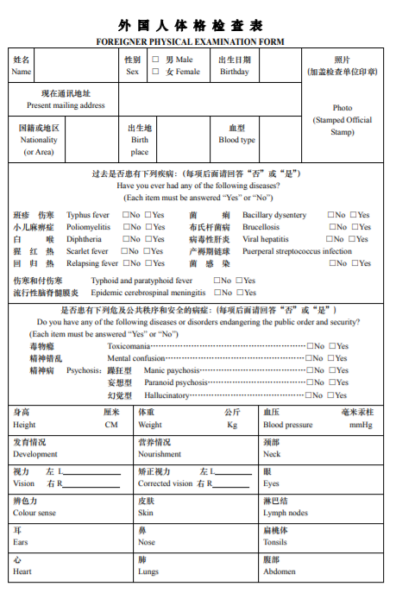
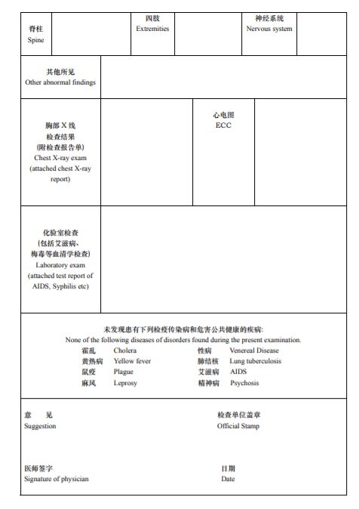
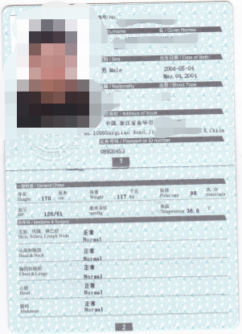
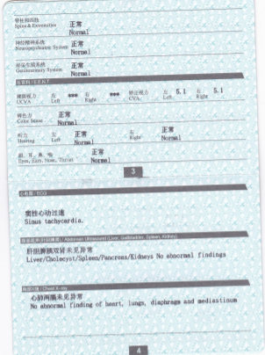
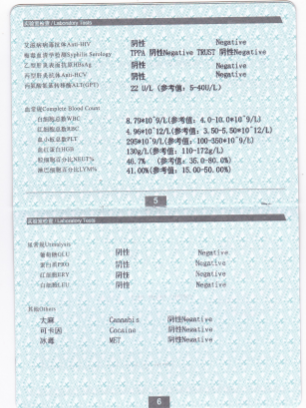
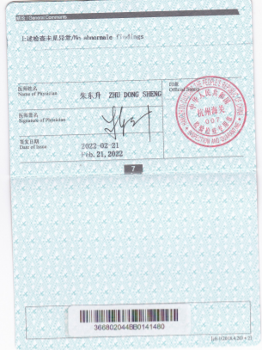
外国人体格检查表 / Foreigner Physical Examination Form
The physical examinations must cover all the items listed in the form.
The signature of the attending physician
The official stamp of the hospital
Sealed photograph of the applicant
The test should be taken in recent 6 months.
For students who are in China now, test report from customs is acceptable, test should be taken in recent 6 months

Slide 8
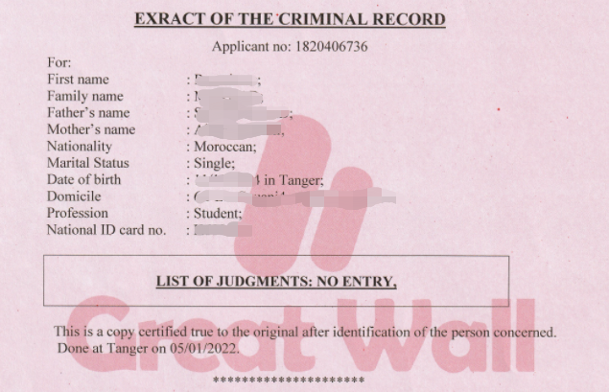
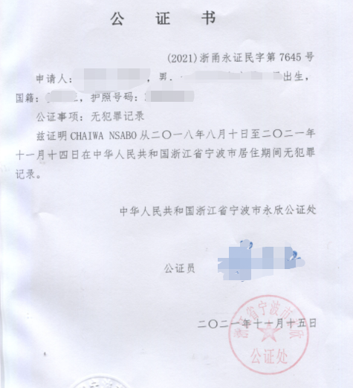
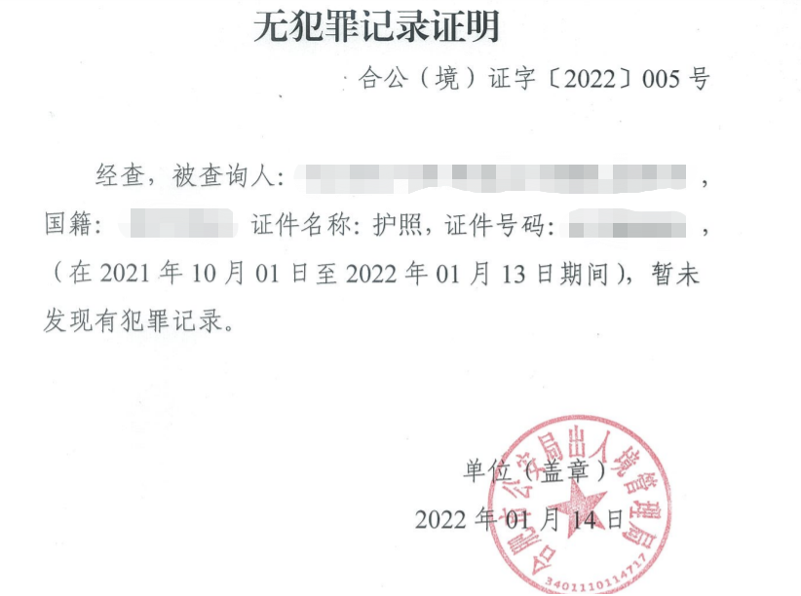
无犯罪记录 / Police Certificate
You can call it criminal record, criminal check, police clearance certificate, certificate of conduct or Good conduct statement,etc.
You can get it from police station, immigration office, embassy, notary public office or your current college.
Should have official stamp on it.
Should be given in recent 6 months.

Slide 9
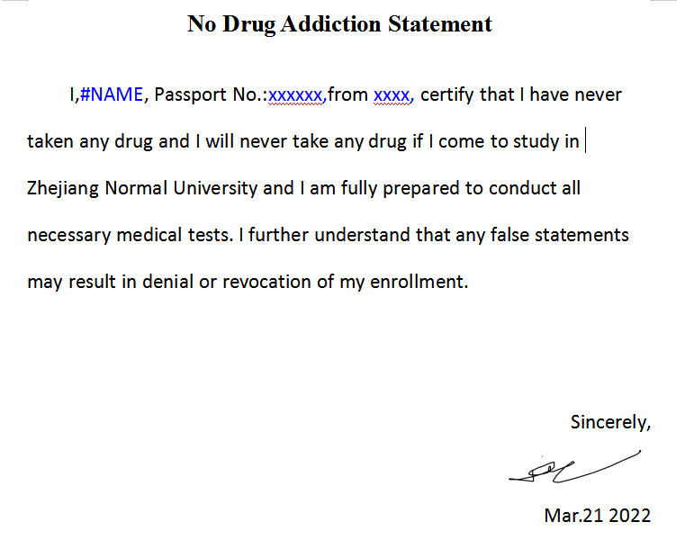
无吸毒史声明 / No Drug Addiction Statement
Smoking marijuana is illegal in China.
All foreign students who come to study in Zhejiang Normal University must be tested for drugs.
Handwriting signature is mandatory.

Slide 10
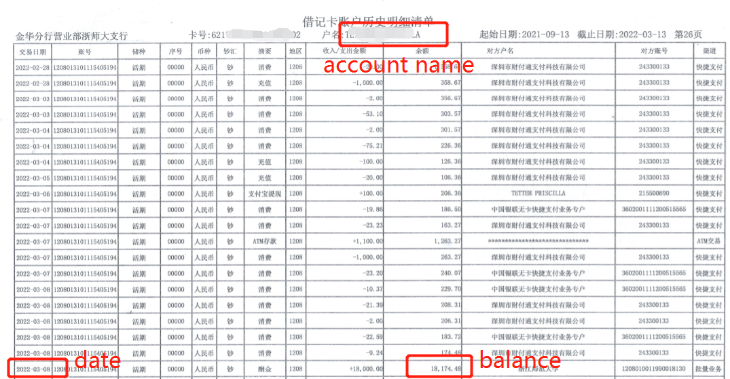
存款证明 / Bank Statement
Balance: To make sure you can support your study here, You need to deposit one semester tuition fee at least.
Account name: should be you or your parents. If not, you need to upload a letter of sponsorship together.
Date: should be printed in recent 3 months
Letter of sponsorship This letter verifies that I,(sponsor’s name and relationship to applicant, e.g. Mary’s Uncle) am willing and able to financially support (applicant’s name) for the academic fees and living expenses throughout the duration of his/her studies at ZJNU. Should you have any queries, please do not hesitate to contact: Sponsors: Relationship: Residential address: Mobile/office number: Sponsor’s signature Date

Slide 11
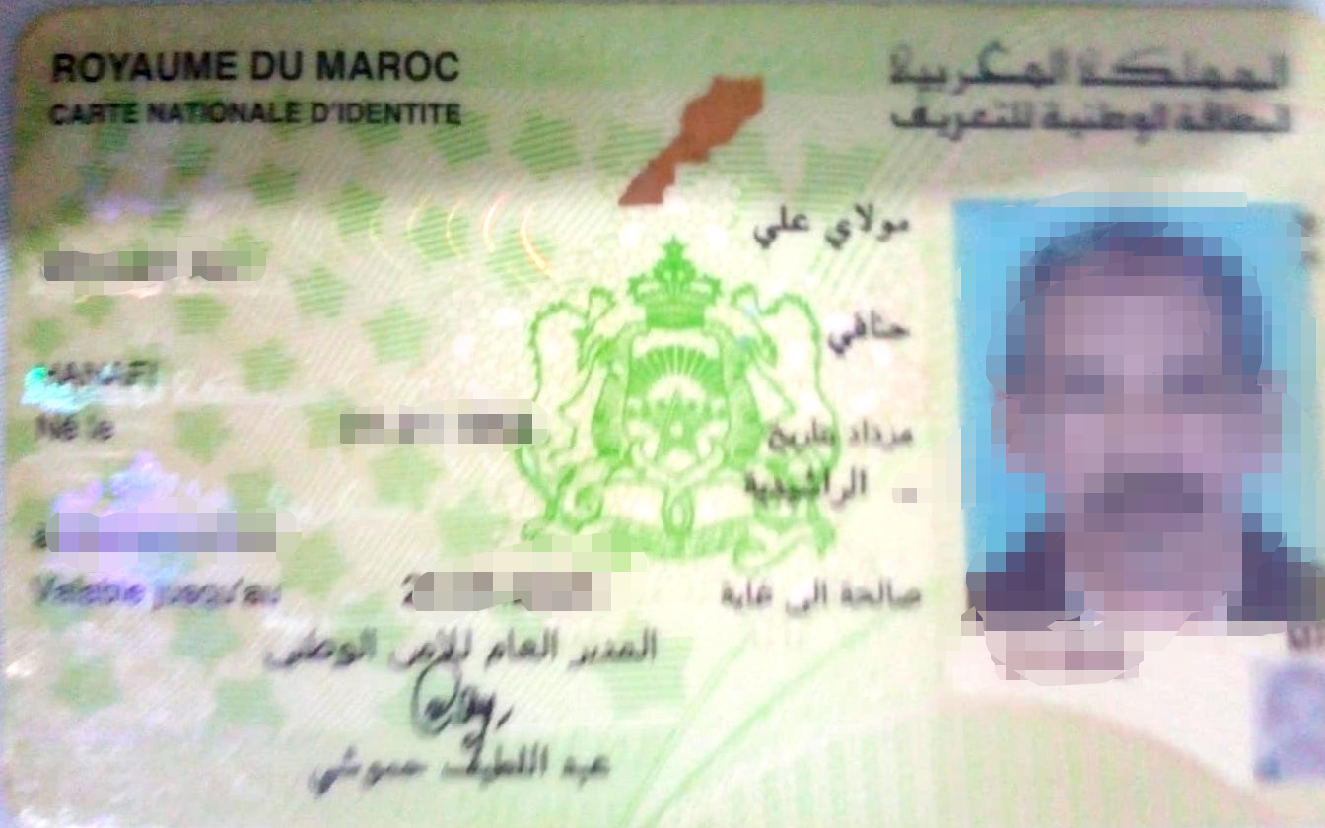
父母亲国籍证明 / Certificate of Parents' Nationality
Any documents that can prove their nationality, eg. ID card, social insurance, birth certificate....
If you can’t find any documents at hand, you can upload a Statement of Parents' Nationality.
Statement of Parents' Nationality I,(applicant’s name), was born in Location as a citizen of Nation. My father,(father’s name), is a citizen of Nation. My monther,(mother’s name),is a citizen of Nation. I confirm all the information above are true. I understand that if I provide false information, I might be refused to register in ZJNU, or expelled from university. Applicant’s signature Date

Slide 12
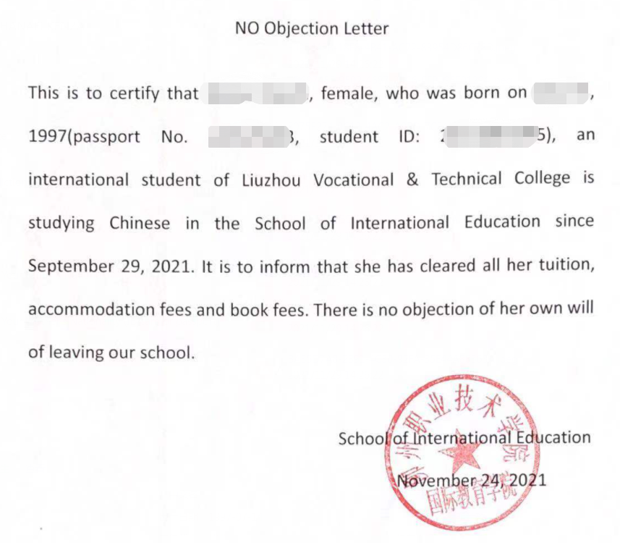
转校证明 / Transfer Letter
Only for students who studies in China already
This document is used to confirm that your college teacher know you are going to leave, and there is no dispute between you and your college.

Slide 13
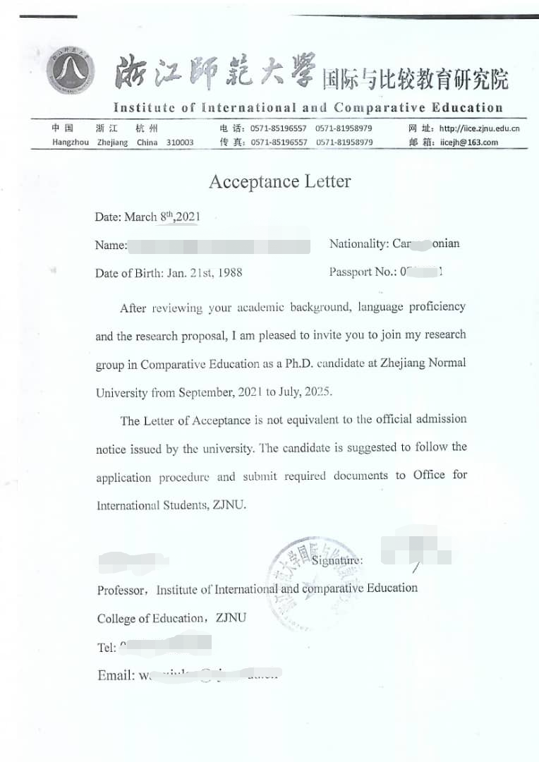
导师接收函 / Acceptance Letter
You can send mail to admission@zjnu.edu.cn to get contact information of professors. Or you can visit www.zjnu.edu.cn to find out college website, get contact information of professors.
It’s mandatory for doctoral programs. You don’t need to prepare this, if you are applying for Bachelor or Master programs.
Only for Doctoral Program Application

Slide 14
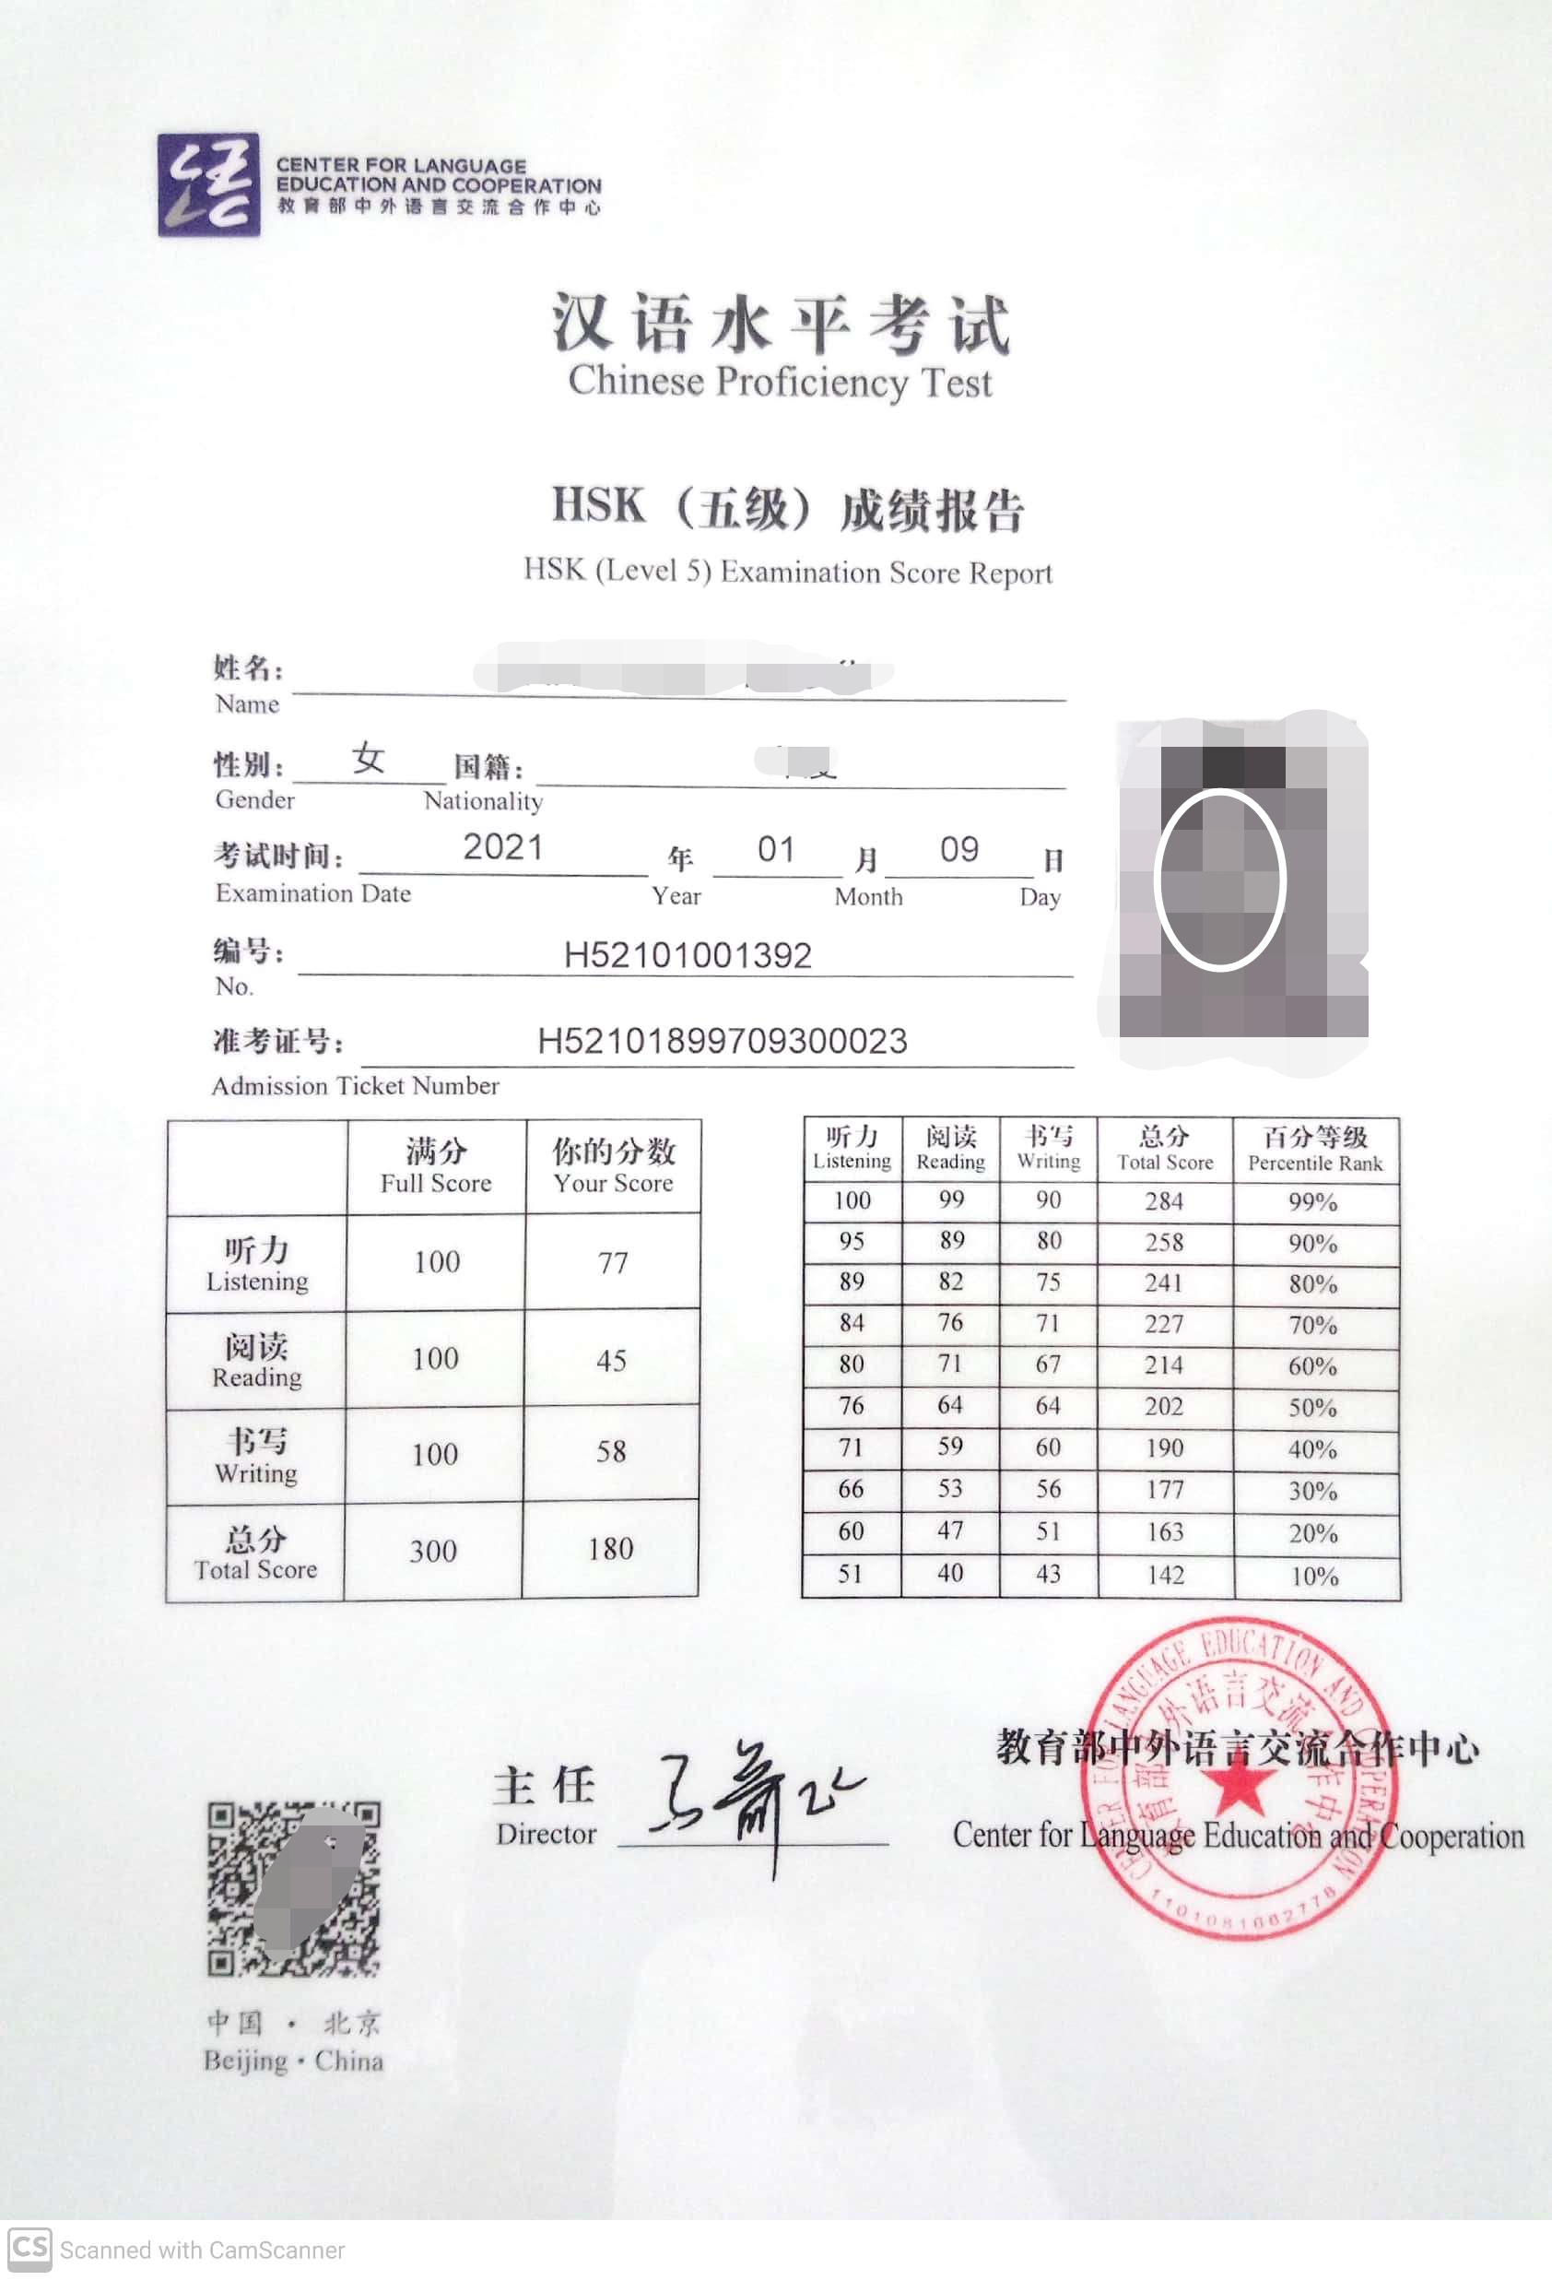
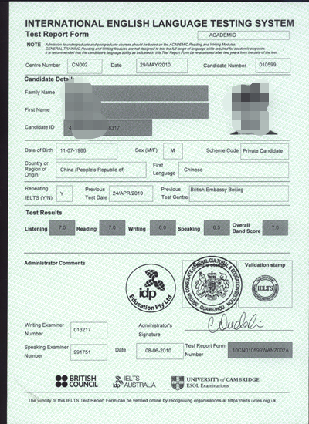
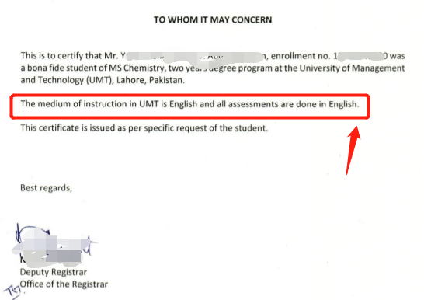
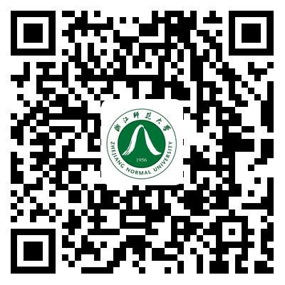
语言能力证明 / Language Proficiency Certificates
For Chinese-taught program, you need to upload HSK report.
For English-taught program, you need to upload IELTs ≥5.5 or Toefl ≥80 report if you are not from English speaking country.
If you don’t have IELTs ≥5.5 or Toefl ≥80, you need to upload other certificates, which can prove your English ability.
Interview might be taken with you, to double check your Chinese or English ability.
For detail language requirements, please scan QR Code and click the latest bulletin.

Slide 15
推荐信/Recommendation letters
For postgraduate programs, You need to upload two recommendation letters from assistant professors or professors.

Slide 16
Other / 其他
Upload something can help you get admission or better scholarship
Scholarships you won before
Important contest you won before
Article you published
……
Don’t upload unimportant documents

Slide 17
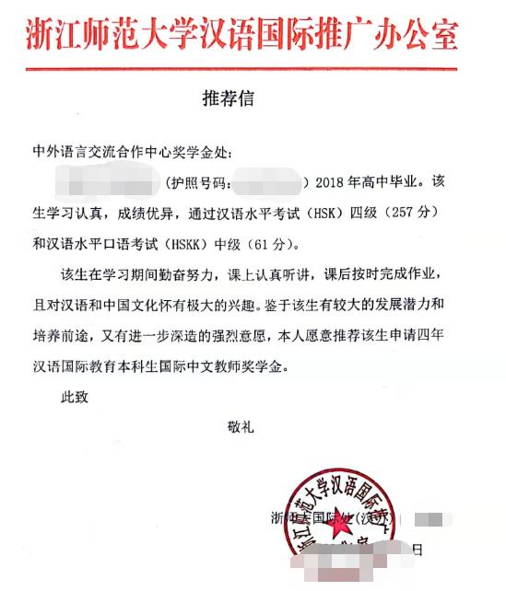
CIS推荐信/ CIS Recommendation letters
Send documents to admission@zjnu.edu.cn to apply for CIS Recommendation letter
Passport
Highest Diploma
Transcripts
HSK report
HSKK report
Only for International Chinese Language Teachers Scholarship Application

Slide 18
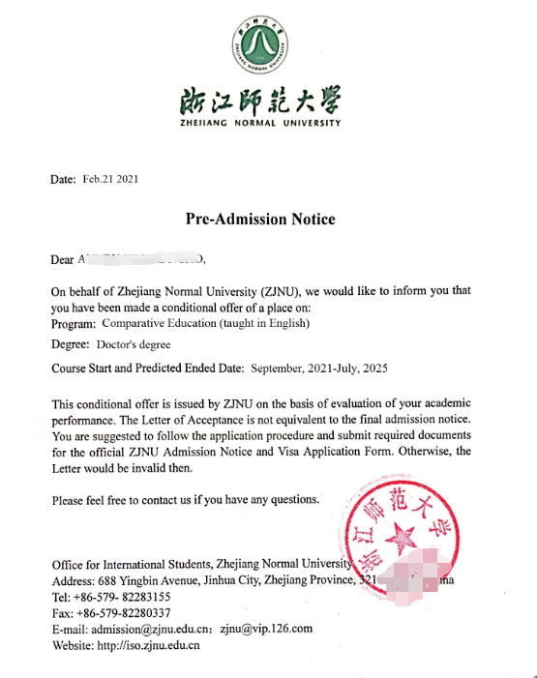
预录取通知书 / Pre-admission notice
Send documents to admission@zjnu.edu.cn to apply for Pre-admission notice
Passport
Highest Diploma
Transcripts
Foreigner Physical Examination Form
Police clearance certificate
Language proficiency certificate
Write down your full name, passport number and the major(taught in Chinese or English) and degree you are applying for
Only for Chinese Government Scholarship TYPE A Application through embassy

Slide 19
谢谢！
Thank you.
ZJNU

