Slide 1
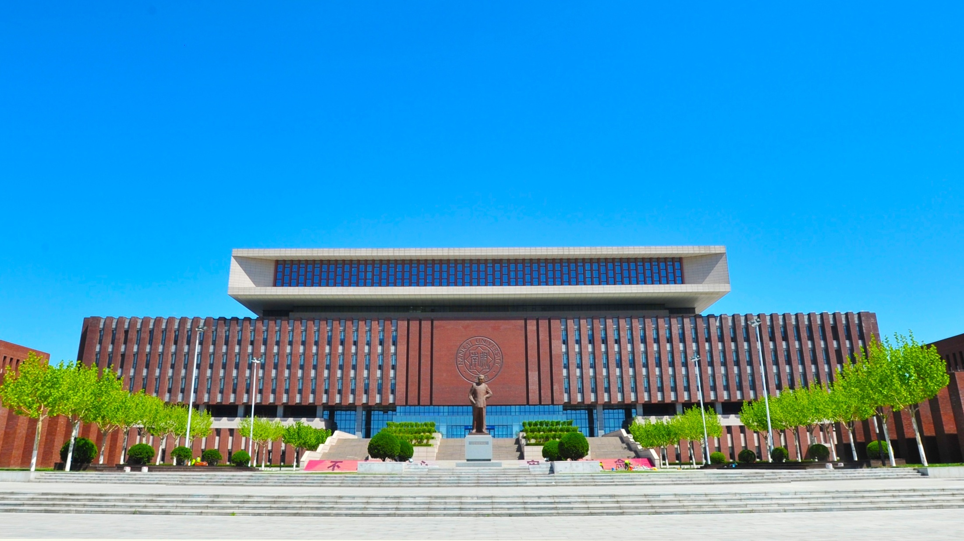
Welcome to NKU
School of International Education
2022

Slide 2
CONTENTS
PART ONE
Tianjin: Location of NKU
PART TWO
Choosing NKU
PART THREE
Programs & Scholarship

Slide 3

01
Tianjin: Location of NKU

Slide 4
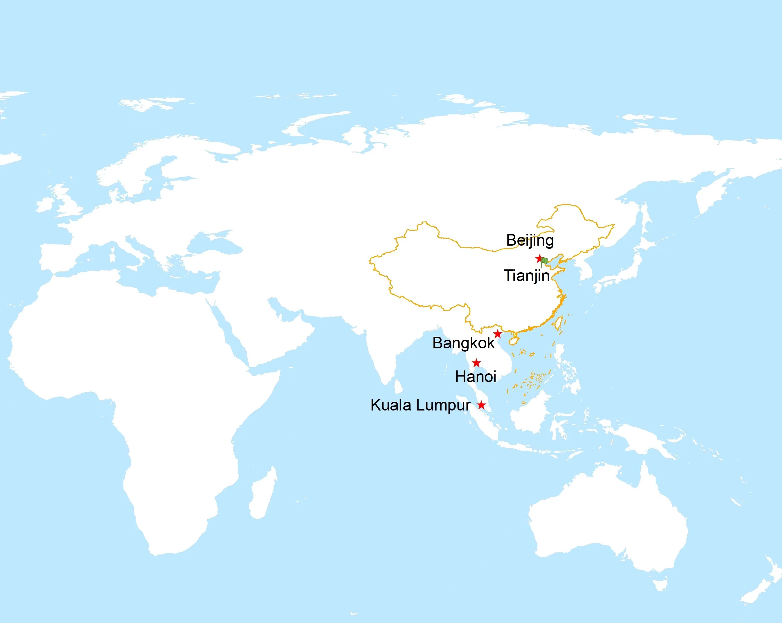
Destination: Tianjin China
● One of the municipalities in China
●Rated as one of the best cities in the world (2020)
● Population: nearly 14 million(2021)

Slide 5
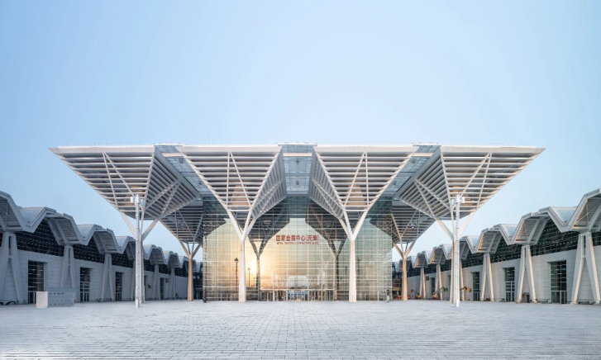
Economy of Tianjin
The GDP of Tianjin in 2020 reaches over 1.4 trillion yuan, increasing by 1.5% than last year.
China (Tianjin) Pilot Free Trade Zone
National Convention and Exhibition Center (Tianjin)

Slide 6
Business in Tianjin
Trading Port
Business Streets and Business Zones are typical in Tianjin.

Slide 7
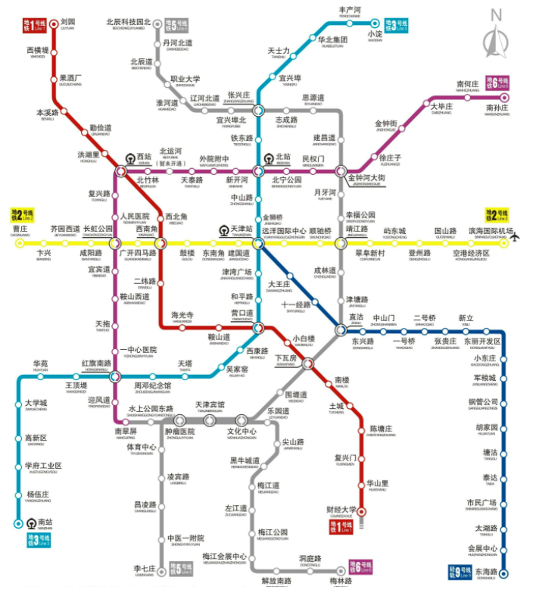
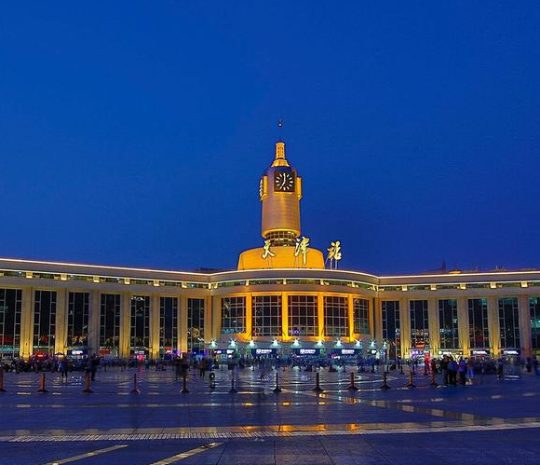
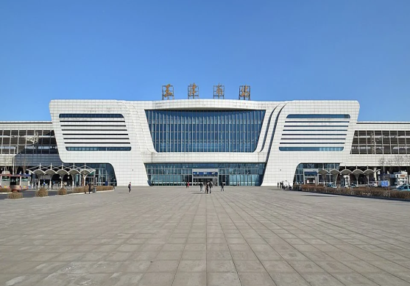
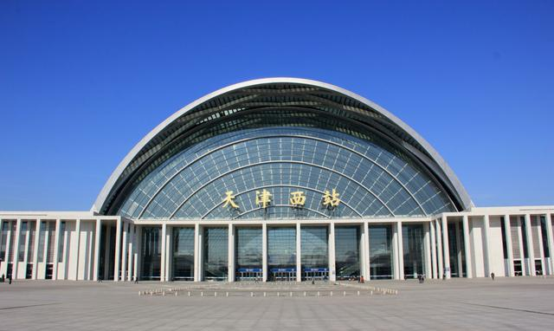
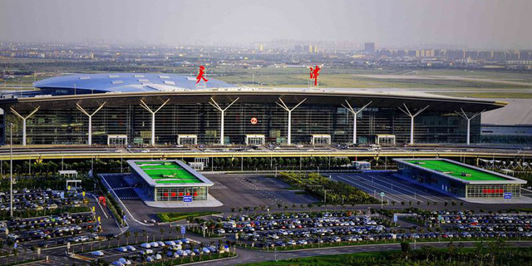
Transportation
Tianjin Rail Transit System(Metro)
Tianjin Binhai International Airport
Tianjin Railway Station
Tianjinxi Railway Station
Tianjinnan Railway Station

Slide 8
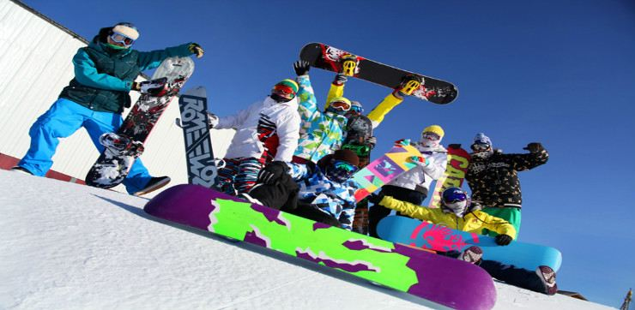
Charming Tianjin
Notes:
相册内容为天津著名建筑，景点，传统食物，天津自然景观

Slide 9


Charming Tianjin

Slide 10
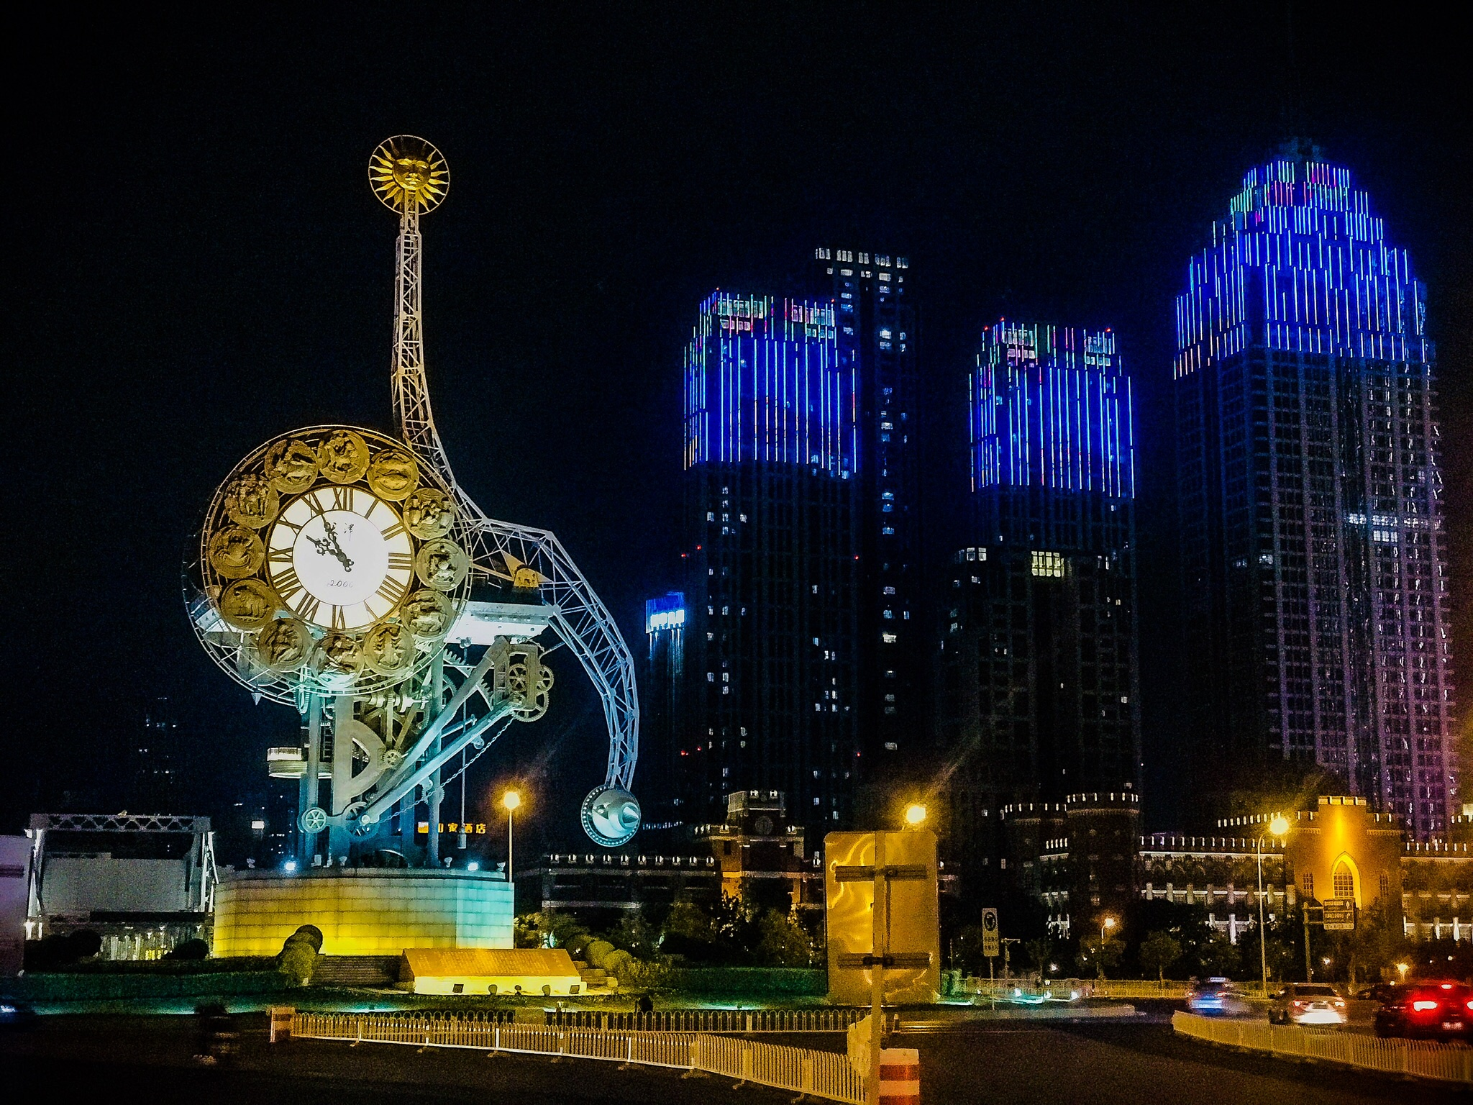
Charming Tianjin
Notes:
相册内容为天津著名建筑，景点，传统食物，天津自然景观

Slide 11

Charming Tianjin

Slide 12
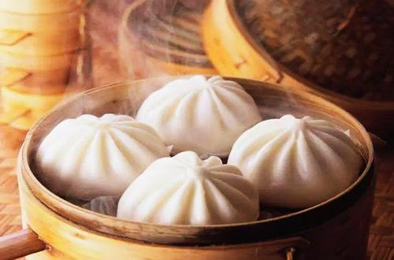
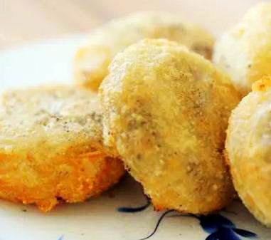
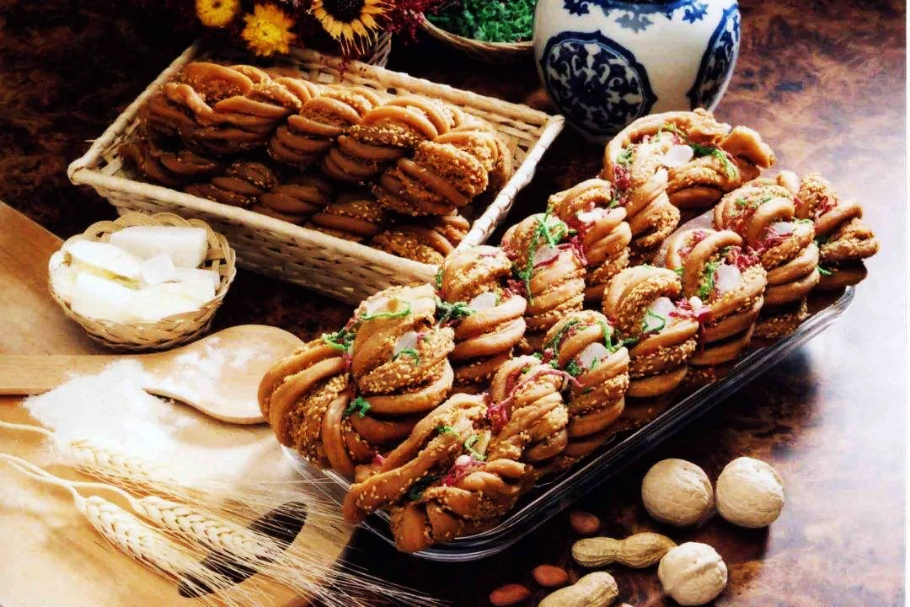
Charming Tianjin
Notes:
相册内容为天津著名建筑，景点，传统食物，天津自然景观

Slide 13
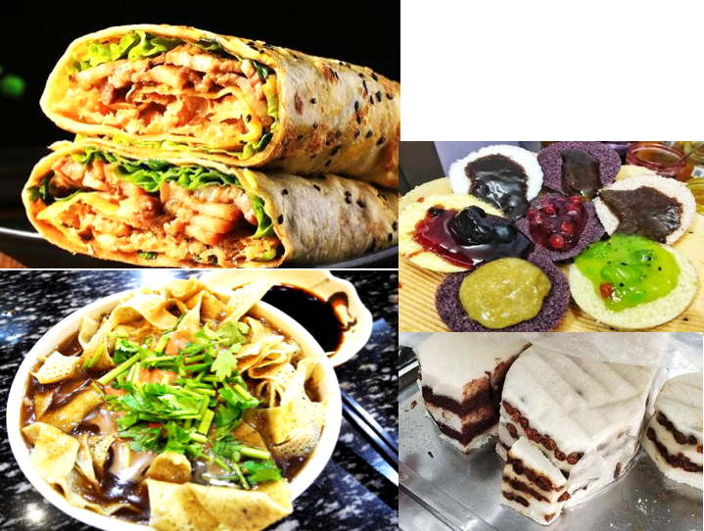
CharmingTianjin
Notes:
相册内容为天津著名建筑，景点，传统食物，天津自然景观

Slide 14
02
Choosing NKU

Slide 15

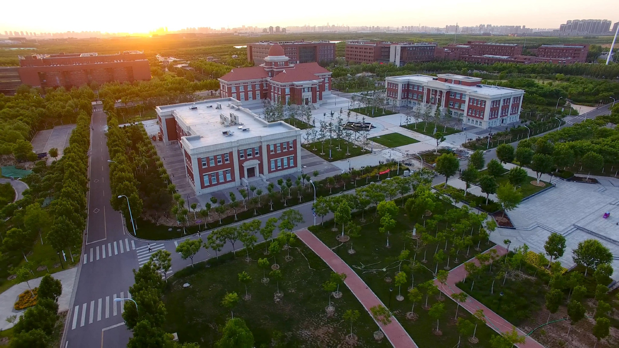
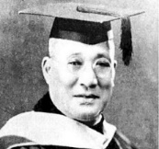

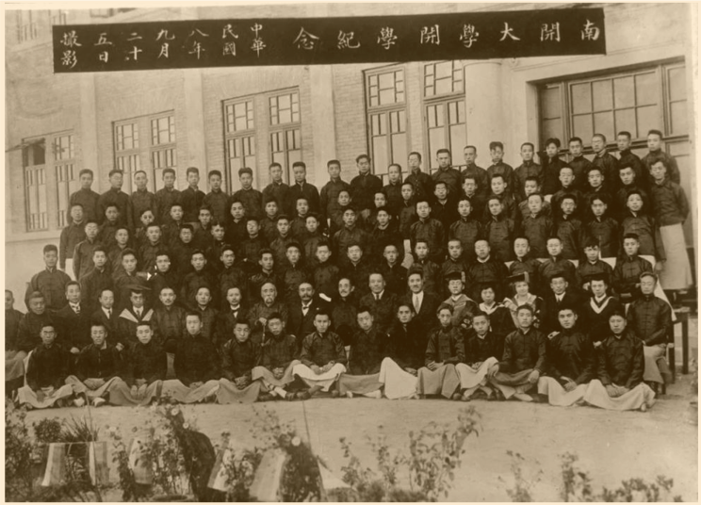
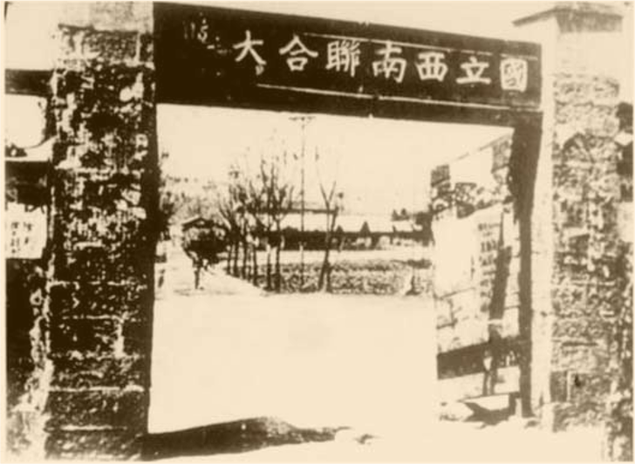
High Quality in Academic and Teaching
Peking University, Tsinghua University, Nankai University
The National SouthWest Associated University
张伯苓
周恩来为南开大学
文科第一期学生
1938
100-Year Anniversary
2019
Return to Tianjin
1904
Nankai founded
1946
2017
“Double First-Class”
1919
2000
Foundation of NKU. Mr. Zhou Enlai entered NKU as the first group of Undergraduate (Students NO. 62)
“985 Project”

Slide 16


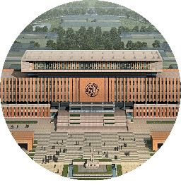
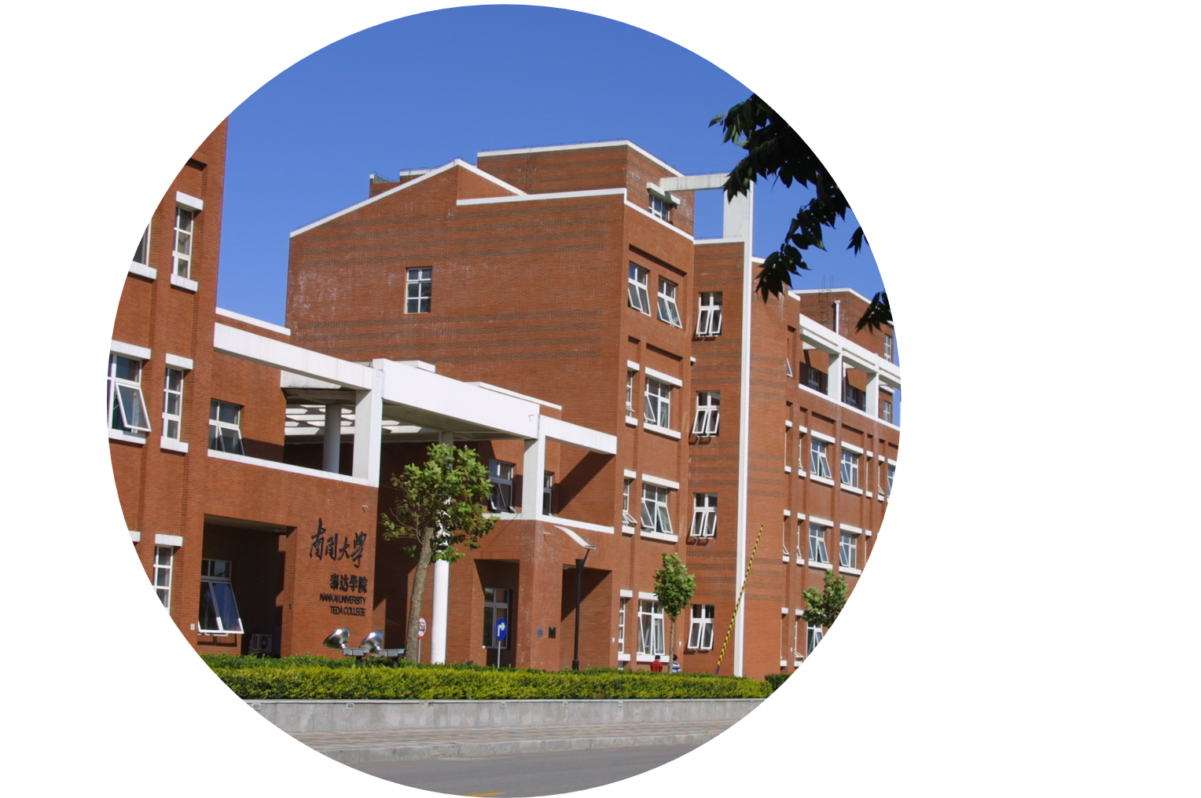
Three-campus Layout
Electronic Computer Science
Artificial Intelligence
Cyber Science
Information and Optical Engineering
Tourism and Service Management
Software
Materials Sciences and Engineering
ZhouEnlai School of Government
Chinese Language and Culture
Comprehensive NKU with balanced Sciences and Humanities
Literature
Business
Economics
Foreign Languages
Life Sciences
Statistic and Data Sciences
Balitai
Jinnan
Chemistry
Mathematical Science
Physics
Pharmacy
Medicine
Law
Philosophy
History
Finance
Tourism and Service Management
Marxism
Environmental Sciences and Engineering
Teda

Slide 17
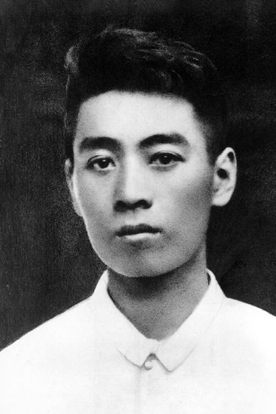
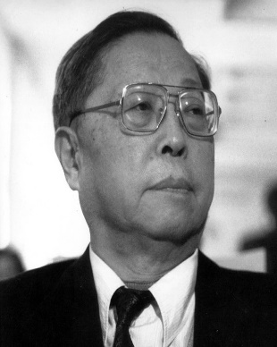
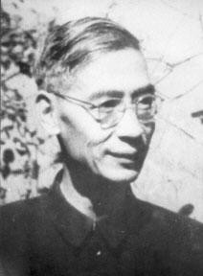
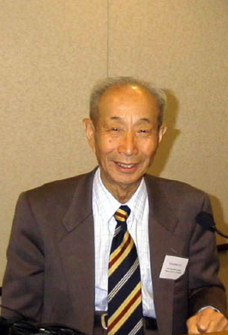
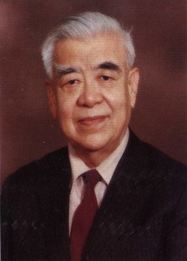
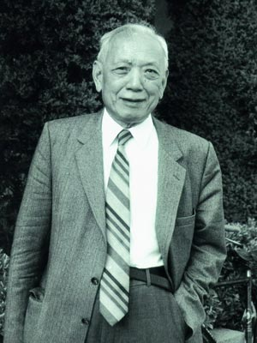
Prominent Graduates of NKU
WU Ta You
Father of Chinese Physics
Enrolled in 1925
Shiing-Shen Chern
Renowned Geometer &Mathematician
Enrolled in 1928
Liu Tungsheng
Leading in loess Research
Enroll in 1925
Zhou Enlai
Premier
Enrolled in 1919
Cao Yu
Shakespeare of the Orient
Enrolled in 1928
Guo Yonghuai
Gold Medal of Two Bombs and One Satellite
Enrolled in 1929

Slide 18
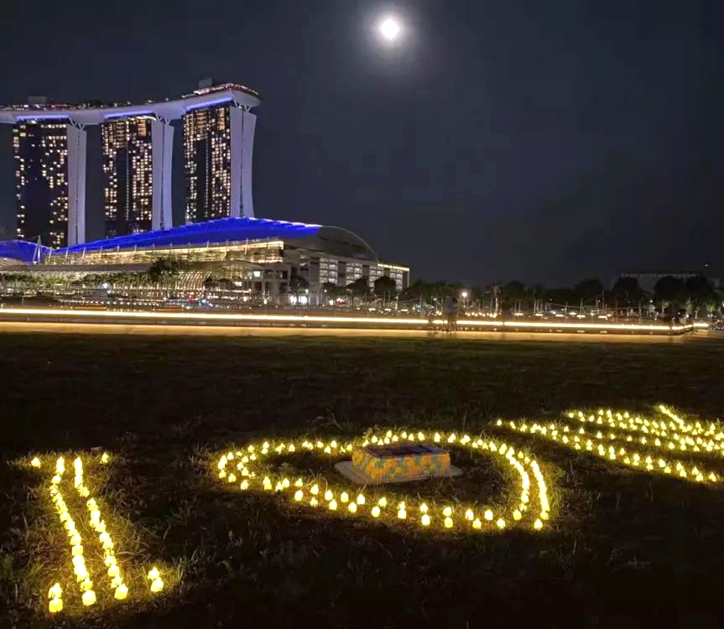
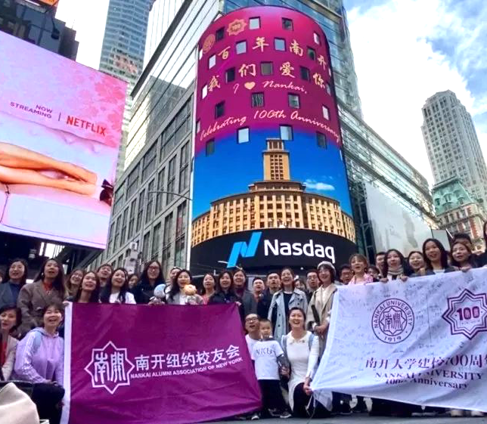
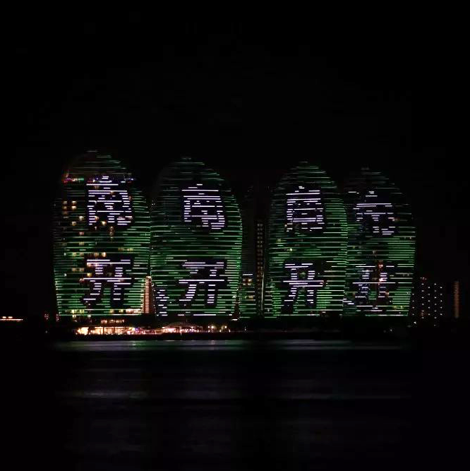


Slide 19
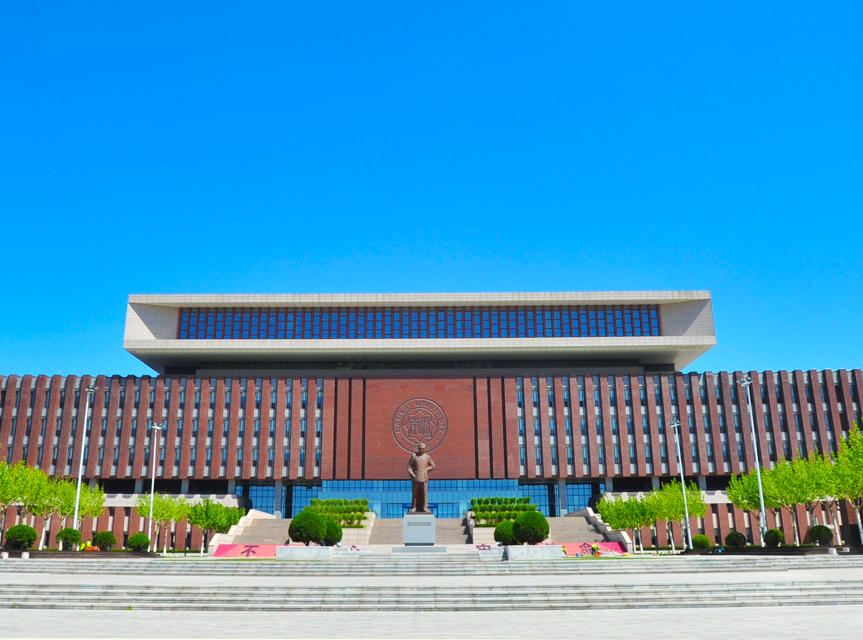
Facilities
Notes:
校园环境 图片需要更新

Slide 20
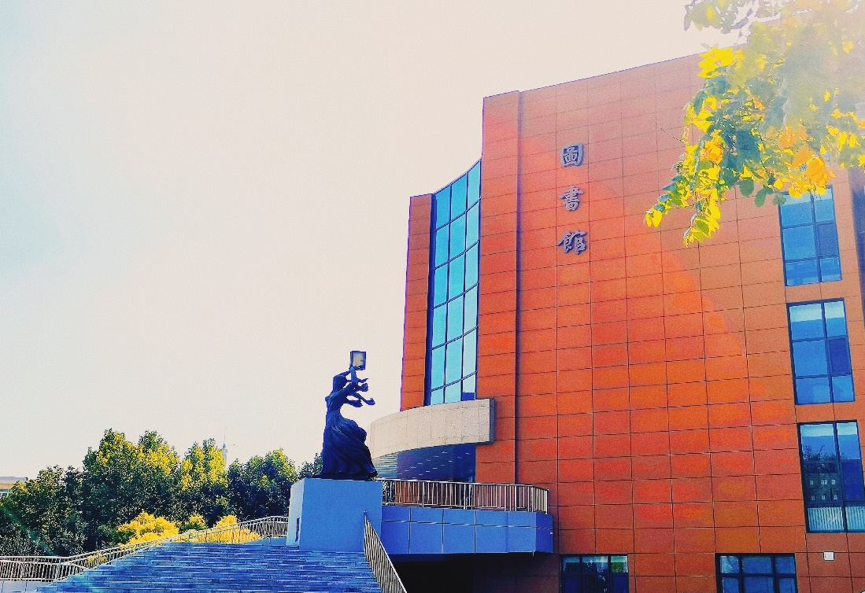


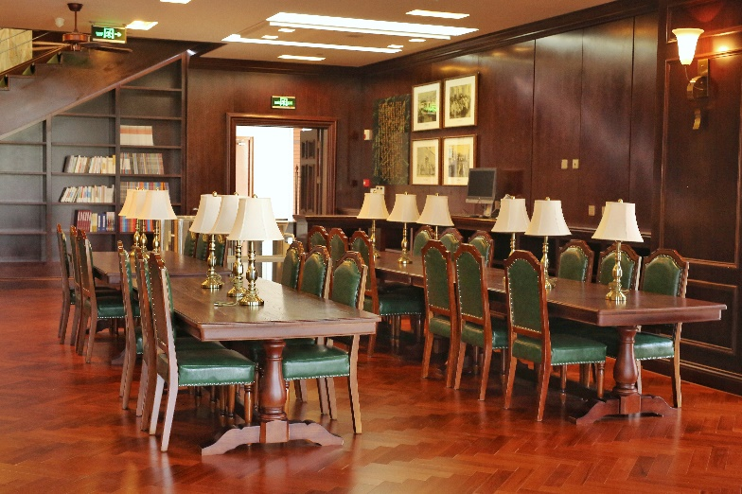

Notes:
校园环境 图片需要更新

Slide 21
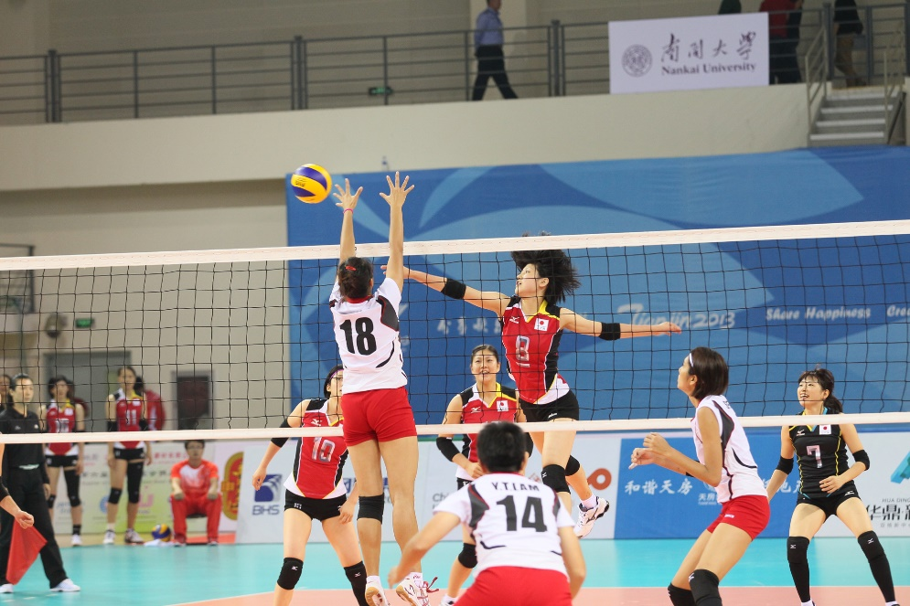
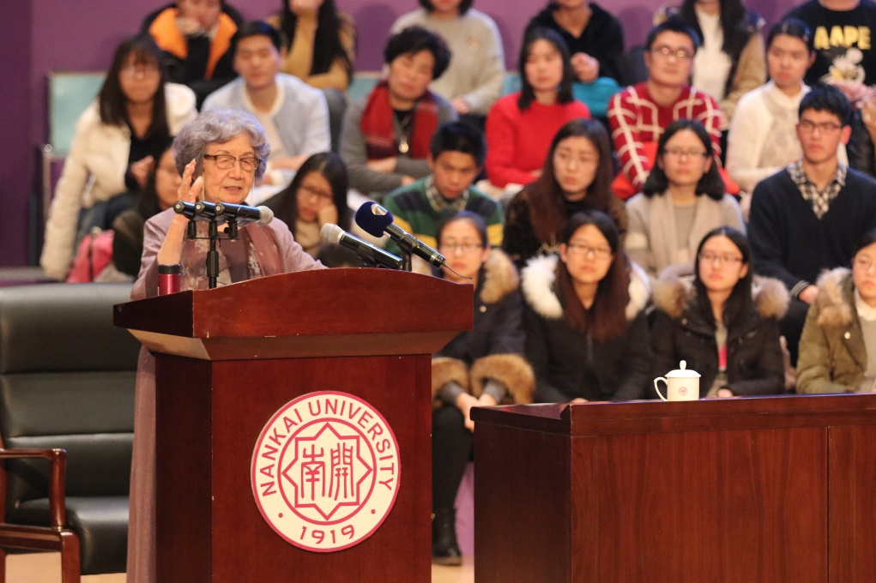
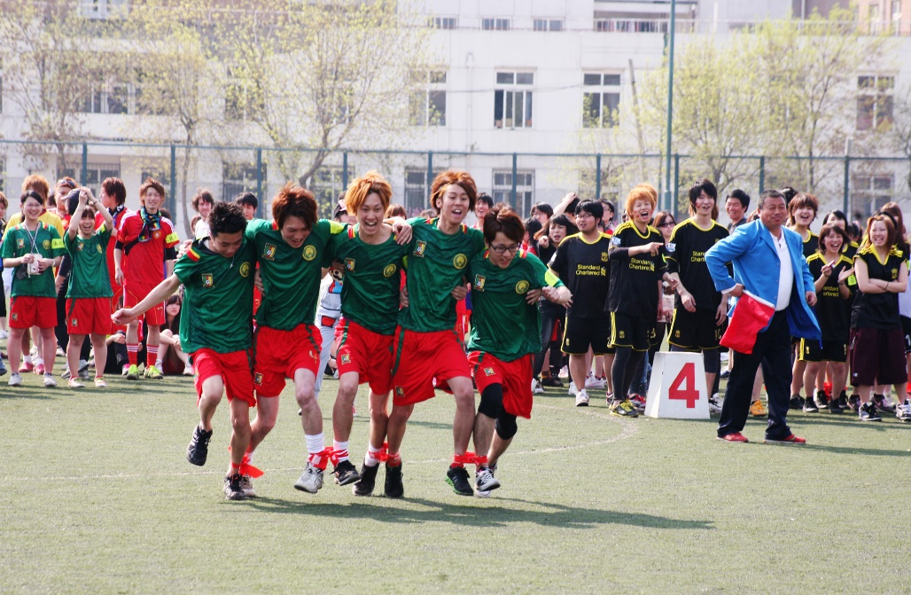
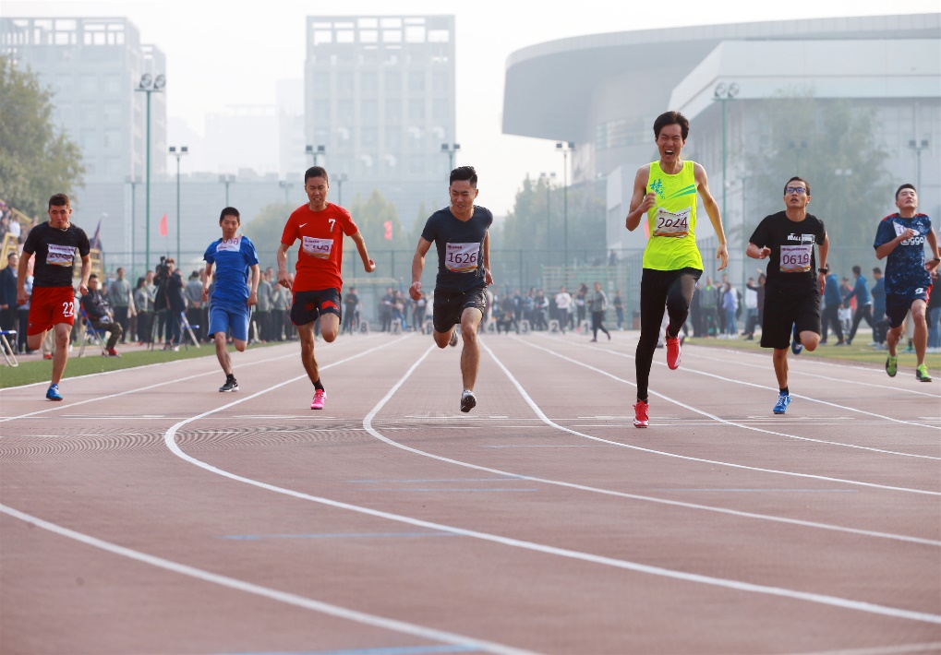

Slide 22

Campus Environment
Notes:
校园环境 图片需要更新

Slide 23
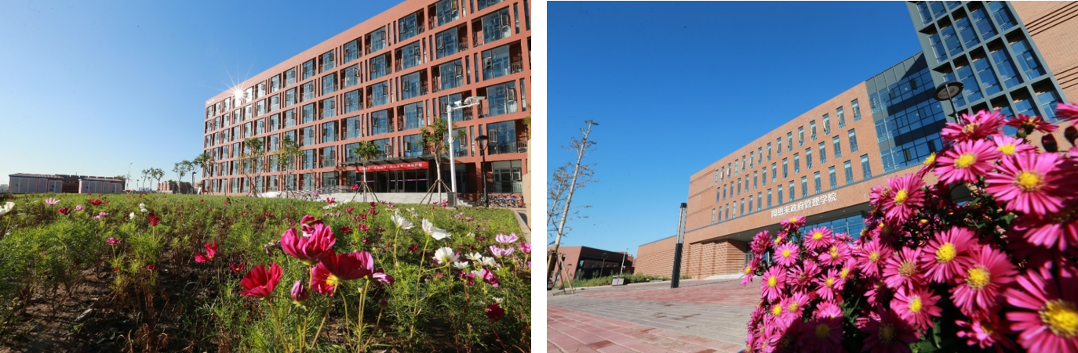
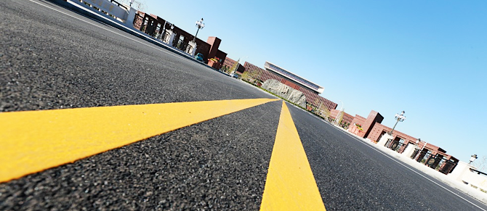
Notes:
校园环境 图片需要更新

Slide 24
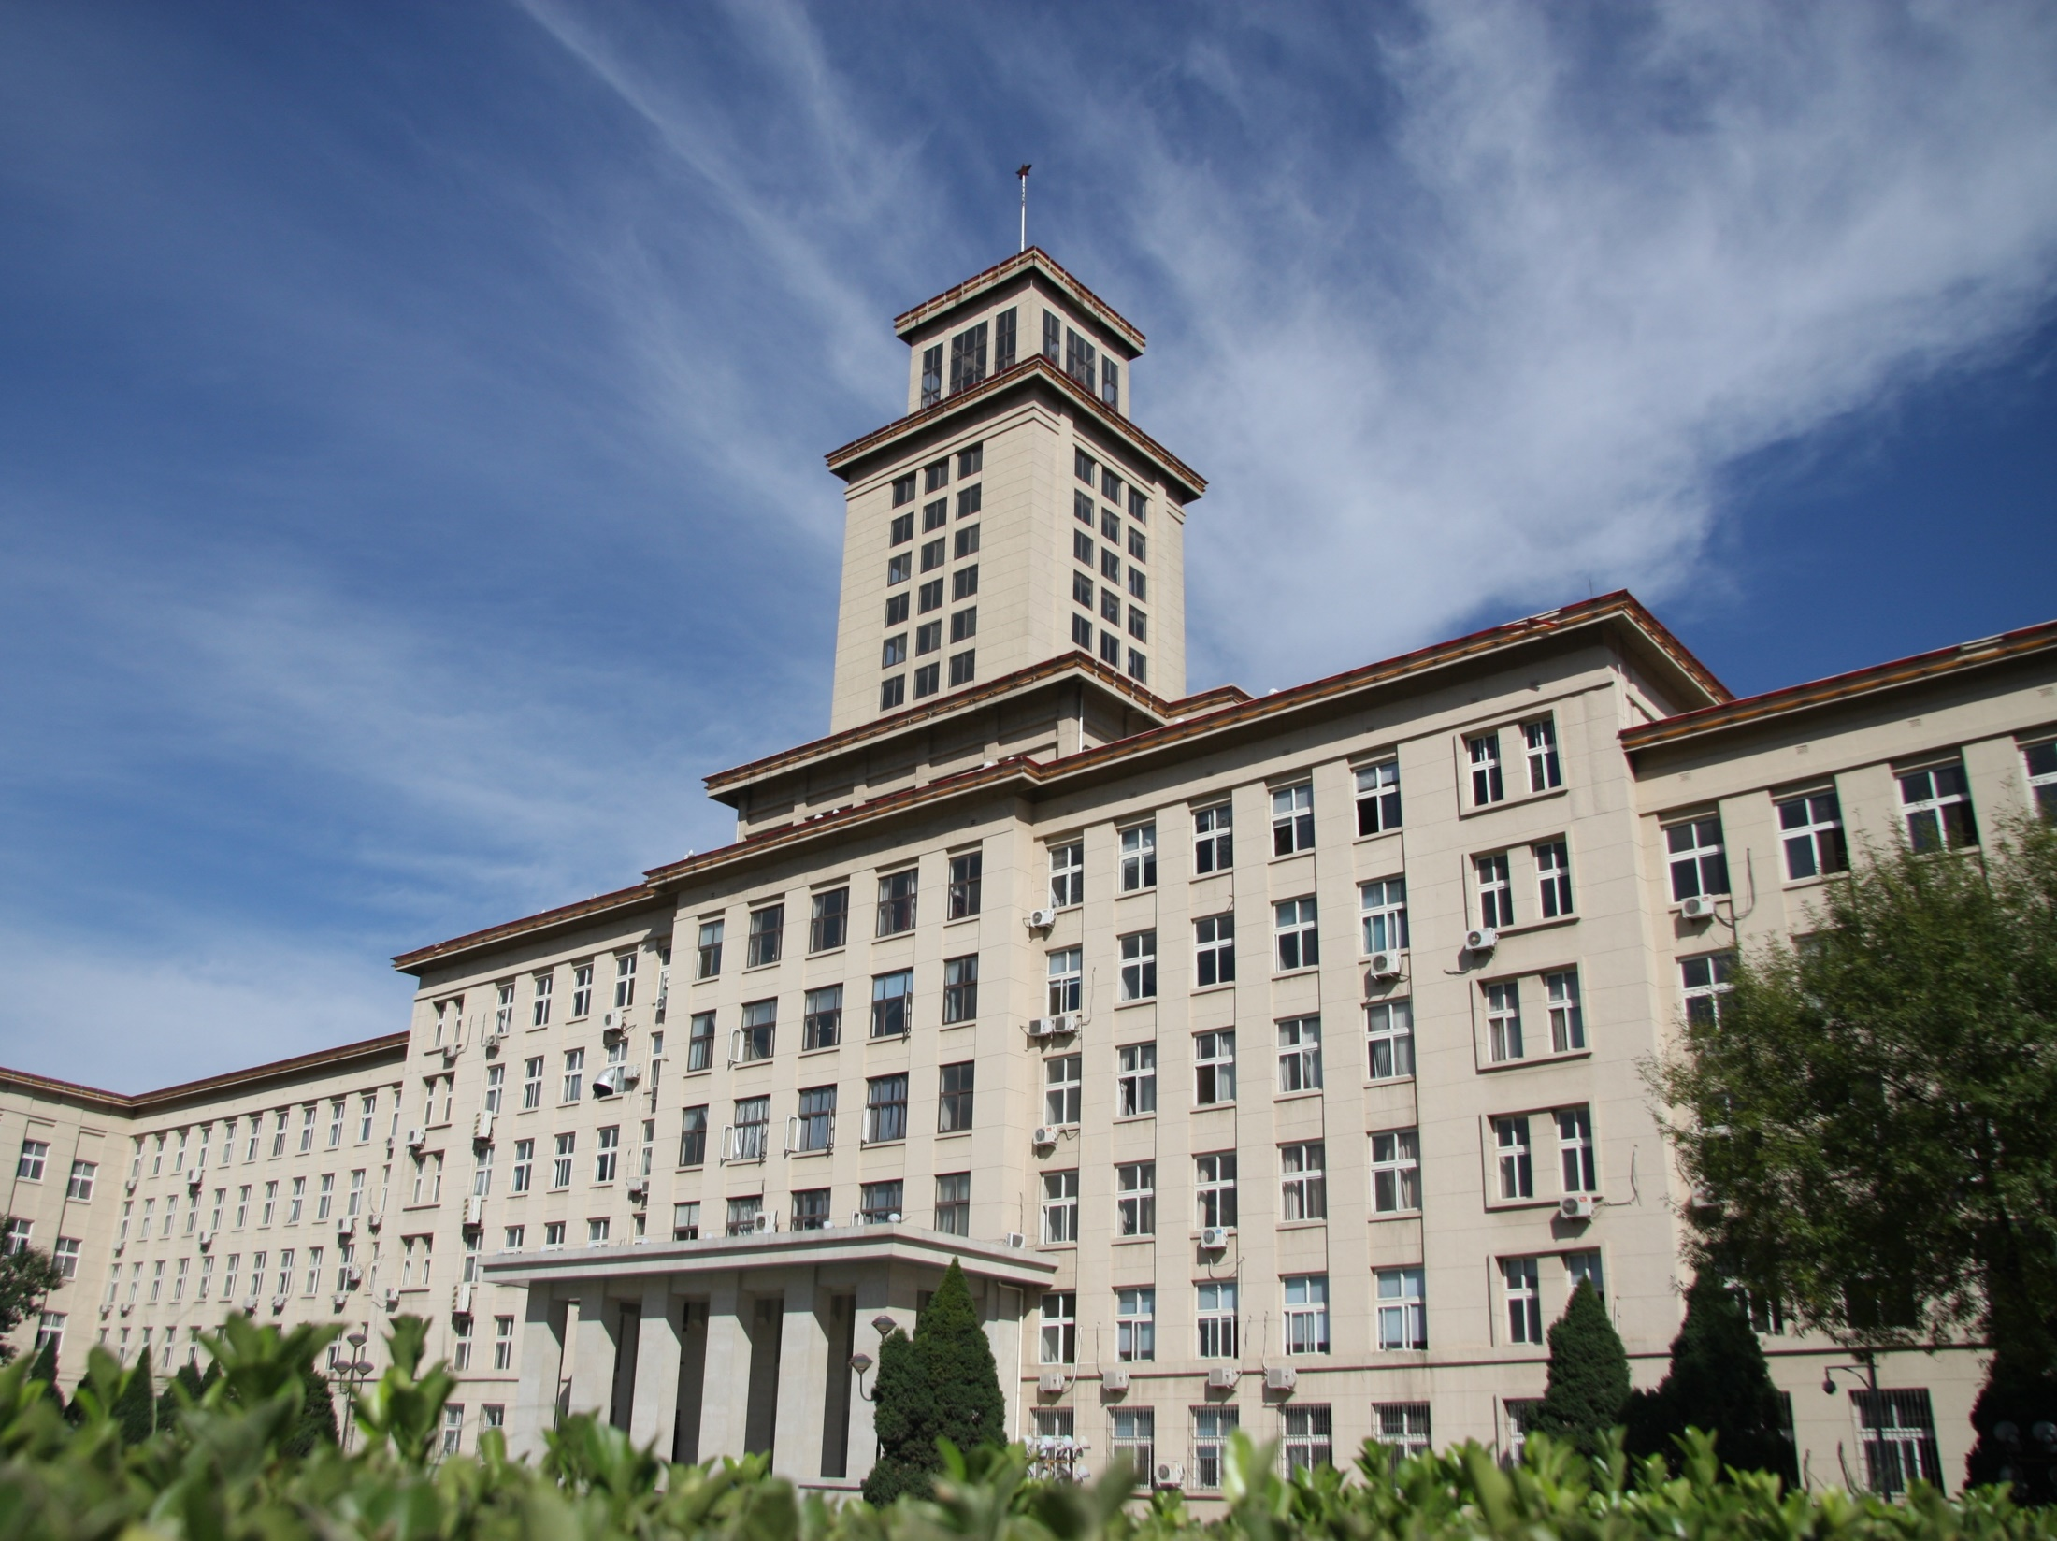
Notes:
校园环境 图片需要更新

Slide 25
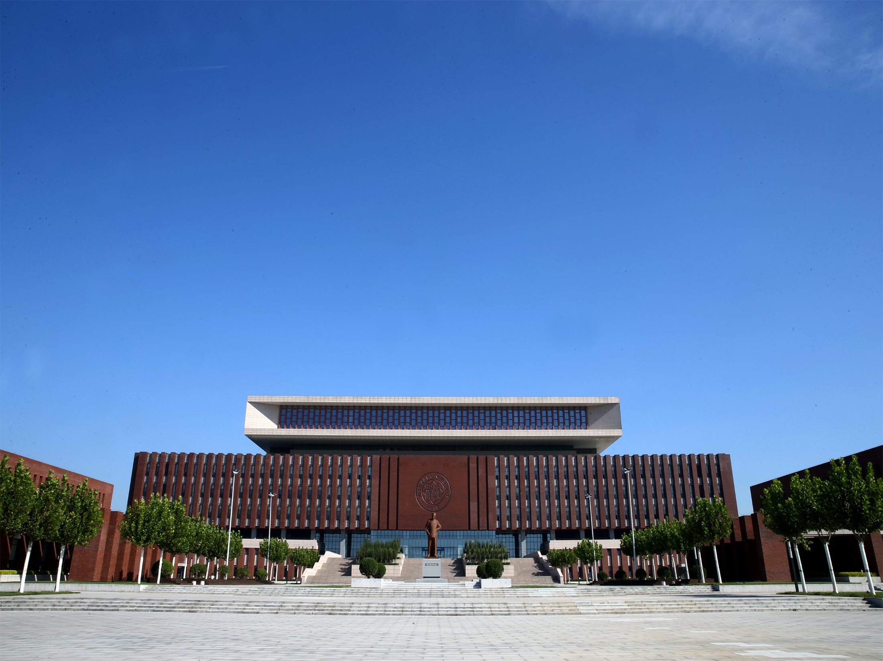
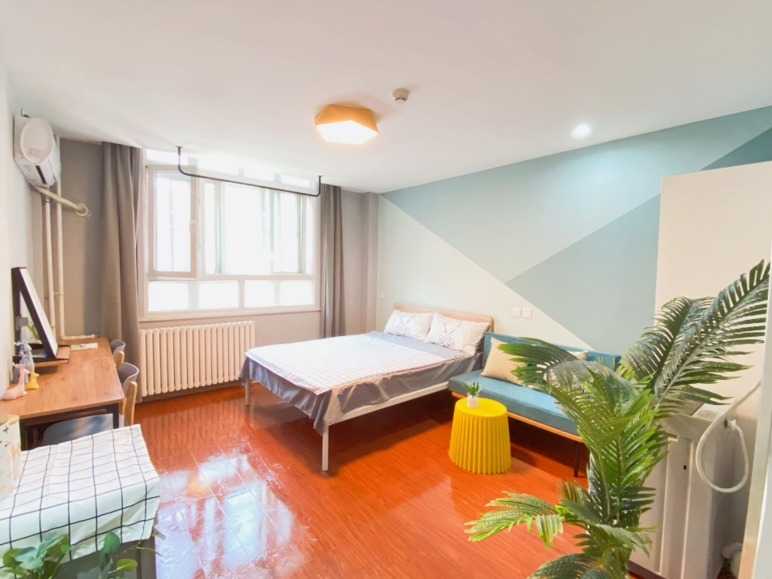
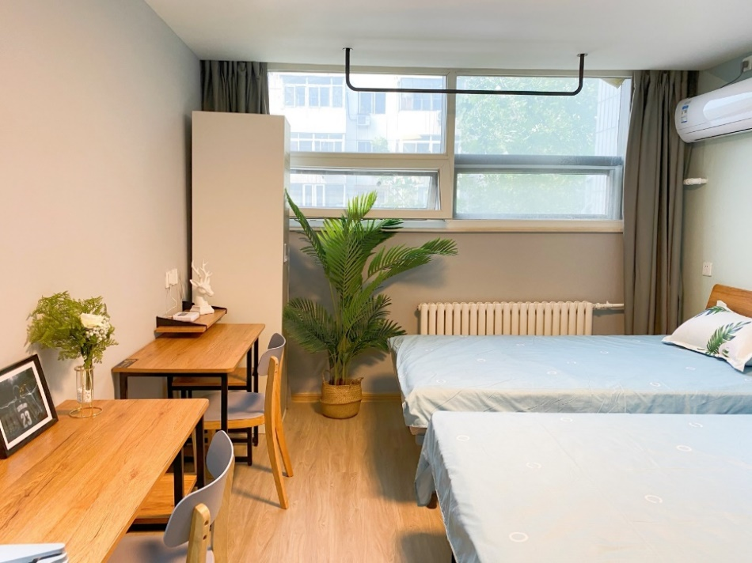
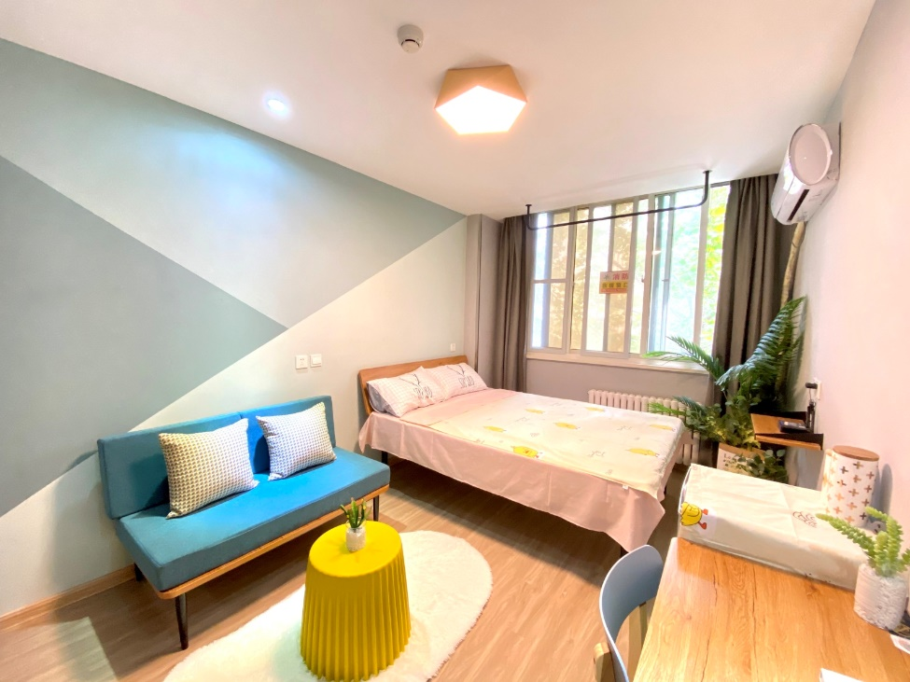
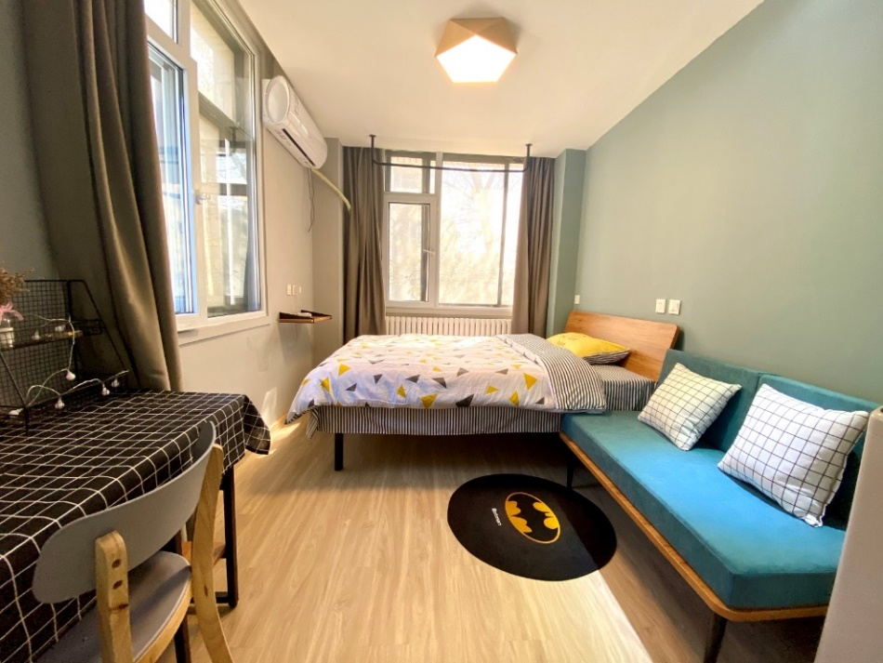
Off-campus Accommodation

Slide 26
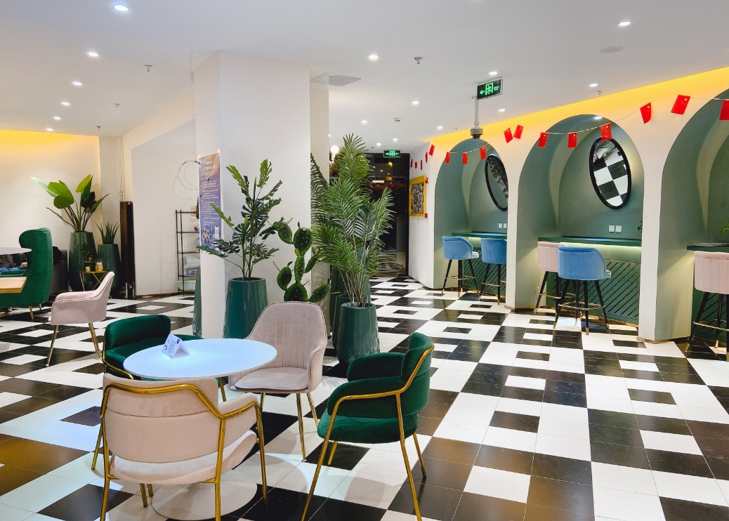

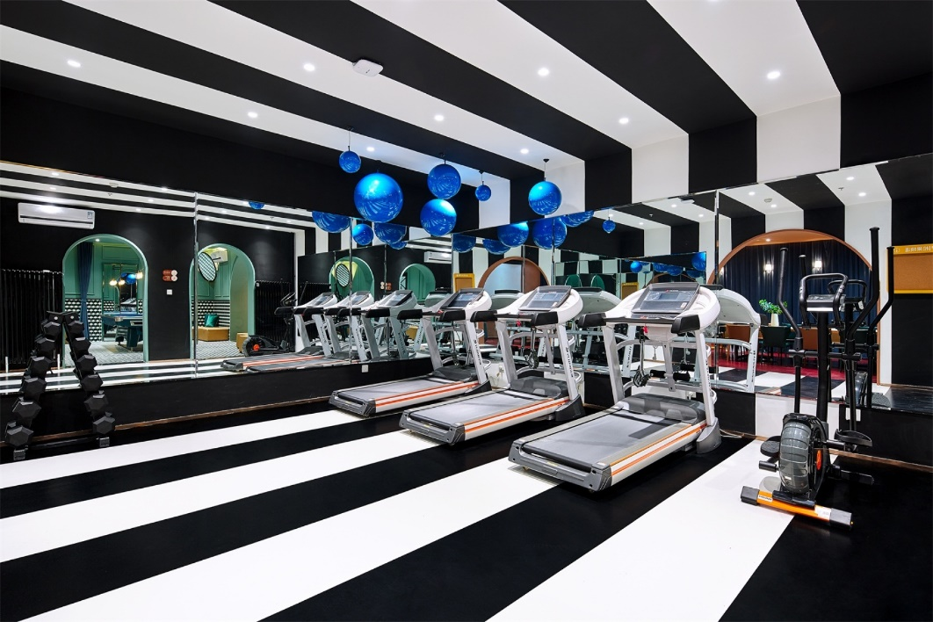


Slide 27
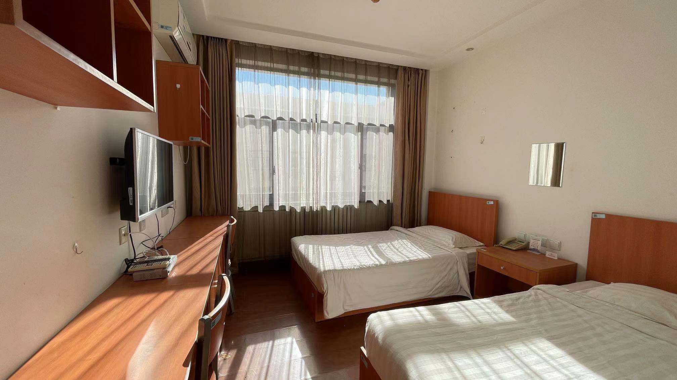
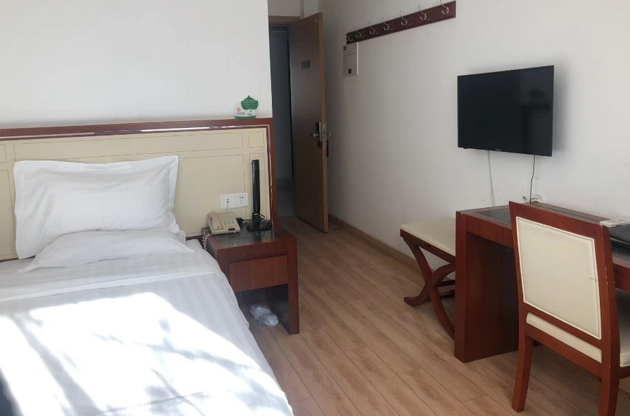
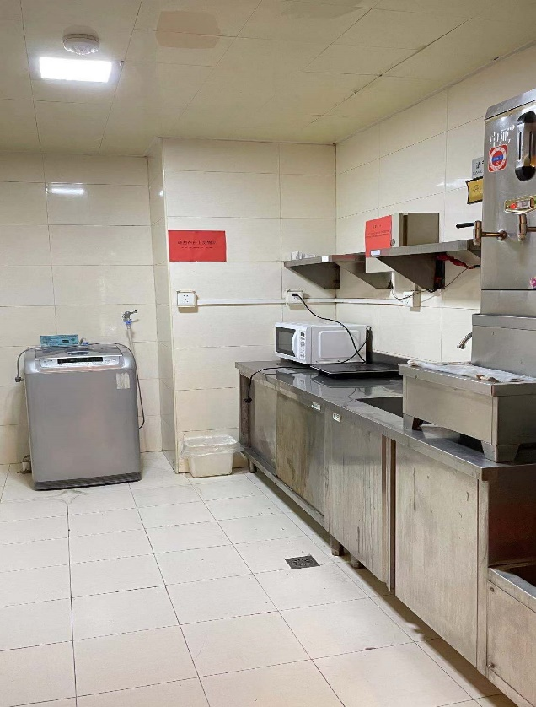
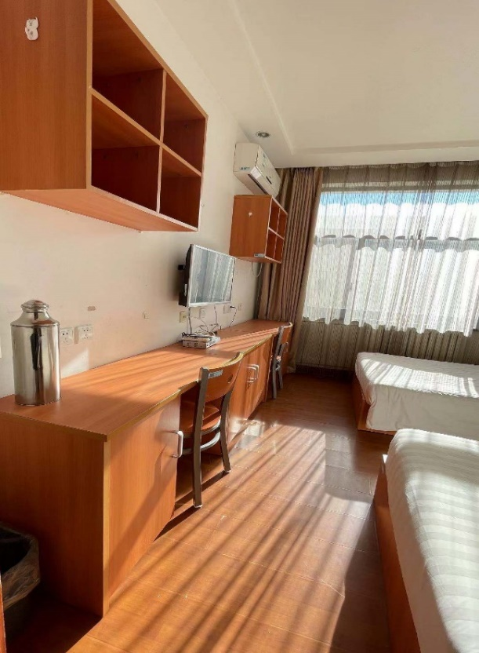

On-campus Accommodation

Slide 28

Campus Activities
Notes:
校园环境 图片需要更新

Slide 29


Slide 30


Slide 31




Slide 32


Slide 33





Slide 34

Read Ten-Thousand Books, Walk Ten-Thousand Miles

Slide 35





Slide 36
03
Programs for International Students

Slide 37

(Non-Degree) Chinese Language Advanced Study
Program Name | Length | Language | Tuition | Deadline
 |  | Proficiency | Fee
Chinese Language Training Courses | I. Feb 21-Apr.15 2022 | Starter—HSK level 3, studying Chinese for less than 1.5 years | 3,500 RMB | 31-Dec-22
 | II. Apr. 25- Jun. 17 2022 |  |  | 15-Apr-22
Advanced Chinese Language Training Courses(2022Spring 2) | I. Feb 21-Apr.15 2022 | HSK level 4—level 6, studying Chinese for more than 1.5 years | 3,500 RMB | 31-Dec-22
 |  |  |  | 15-Apr-22
 | II. Apr. 15 –Jun. 17 2022
2022 Winter Short-term Thematic Advanced Study on HSK | Jan 3, 2022 - Jan 28, 2022 | Beginners | 3,400 RMB | Jan 31, 2022
、

Slide 38
2022 Undergraduate Program for International Students
College | Majors Available | Study Length | Campus | Tuition Fee (RMB)
School of Literature | Chinese Language &Literature | 4 | Balitai | 20,000
College of Foreign Languages | English/Translation (Chinese-English) /Japanese/Russian/ French/German/Spanish/Portuguese/Italian | 4 | Balitai | 20,000
Zhou Enlai School of Government | International Politics | 4 | Jinnan | 20,000
 | Sociology | 4 | Jinnan | 20,000
 | Applied Psychology | 4 | Jinnan | 25,000
College of Chinese Language and Culture | Teaching Chinese to Speakers of Other Languages (TCSOL) | 4 | Balitai | 20,000
 | Chinese Language | 4 | Balitai | 20,000
 | Chinese Language 3+1 (International Business) | 4 | Balitai | 24,000
School of Economics | International Economics and Trade | 4 | Balitai | 20,000
Business School | Business Management | 4 | Balitai | 20,000
College of Tourism and Service Management | Tourism Management | 4 | Jinnan | 20,000
School of Finance | Finance | 4 | Jinnan | 20,000
 | Insurance | 4 | Jinnan | 20,000
 | Financial Engineering | 4 | Jinnan | 20,000
College of Environmental Science and Engineering | Resource Recycling Science and Engineering | 4 | Jinnan | 25,000

Slide 39
Selected Majors for Postgraduate Students 2022
School | Major | Master/PhD | Language
School of Literature | Chinese Language and Literature | Master | Chinese
College of Chinese Language and | Chinese Teaching and Research as a Second Language | Master | Chinese
School of Law | Law | Master、PhD | Chinese
College of History | Chinese History | Master、PhD | Chinese
Zhou Enlai School of Government | Politics，International Relation | Master、PhD | Chinese/English
School of Electronic Information and Optical Engineering | Optical Engineering, Electronical Information | Master | Chinese/English
School of Electronic Information and Optical Engineering | Material Physics/Chemistry | Master、PhD | Chinese
School of Finance | Applied Economics | Master | Chinese
School of Economics | Theoretical Economics, International Business | Master、PhD | Chinese/English
College of Life Sciences | Biology | Master、PhD | Chinese
College of Environmental Science and Engineering | Ecology | Master、PhD | Chinese/English
School of Physics | Theoretical Physics | Master、PhD | Chinese
College of Chemistry | Inorganic Chemistry | Master、PhD | Chinese
College of Tourism and Service | Tourism Management | Master、PhD | Chinese
Medical School | Physiology | Master | Chinese
School of Pharmacy | Pharmaceutical Engineering | Master、PhD | Chinese

Slide 40

Requirements for International Applicants of Nankai University
Requirement | Undergraduate Programs | Postgraduate Programs
Language | HSK 4 (180) or above | Chinese Taught Programs-HSK 5 (210) or above; English-taught programs( IELTS 6.0 or TOEFL 85) or above/ Applicants who hold an English-taught Degree can be waived the English language requirement.
Diploma | Senior high School Diploma | Bachelor Degree /Master Degree
Age | 18 or above (till Sep.2022)
Application Deadline | 31st May (Online Application: https://nankai.at0086.cn/StuApplication)

Slide 41
2022 Scholarship for International Students of Nankai
Scholarship | Coverage | Deadline | Age Limits | Registration Link
Chinese Government Scholarship | Tuition fee, accommodation fee, medical insurance, living stipends. | 3-31-2022 | 25 or below (Undergraduate Applicants); 35 or below (Master applicants);40 or below (Ph.D. applicants); | https://studyinchina.csc.edu.cn/#/login
China Studies Program (Ph.D. Applicants Only) | Tuition fee, accommodation fee, medical insurance, research/living stipends. | 2-28-2022 |  | http://csp.chinese.cn/myDoip
International Confucian Association Scholarship (Master's Applicants Only) | Tuition fee, accommodation fee, medical insurance, and living stipends. | 3-31-2022
International Chinese Language Teachers Scholarship | Tuition fee, accommodation fee, medical insurance, living stipends. | 5-15-2022 | Generally 16-35; Undergraduate Applicants 25 or below; Applicants working as Chinese Language Teachers 45 or below; | https://cis.chinese.cn/account/login
Tianjin Government Scholarship | Tuition fee assistance. | 5-15-2022 | 25 or below (Undergraduate Applicants);35 or below (Master applicants);40 or below (Ph.D. applicants);
“Study-at-NKU” President Scholarship | Tuition fee assistance, accommodation fee or living stipends. | 5-31-2022

Slide 42
Procedure
1. Online Application （1st Dec 2021 -31st May 2022)
https://nankai.at0086.cn/StuApplication
2. Application Fee Payment
Non degree/ Undergraduate: 400 RMB;
Postgraduate: 600 RMB
3. Review
Material Review-Integrative Assessment-Interview
4. Admission (Jul. 2022)
5. Enrollment (Sep. 2022 )
More information:
https://sie.nankai.edu.cn/

Slide 43




NKU official website and WeChat account
http://sie.nankai.edu.cn
TEL: 86-22-23508825/3615/8686/9646
E-mail:
nkadmission01@nankai.edu.cn(Master/Ph.D.)
nkundergraduate@126.com(Bachelor)
hyzsb@nankai.edu.cn(Non-degree)
Contact

