Slide 1

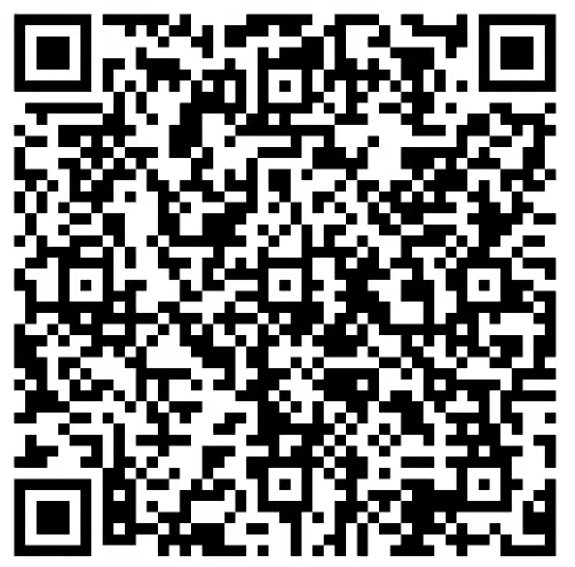
TIANJIN UNIVERSITY

Slide 2

Why
TJU
Study& Living
How
to Apply
Support
from TJU

Slide 3
WHY TJU
Why
TJU
Study& Living
TJU History
Milestones
Figures
Alumni
Academic Schools & Disciplines
How
to apply
Support
from TJU
International Accreditation
Scientific Research

Slide 4


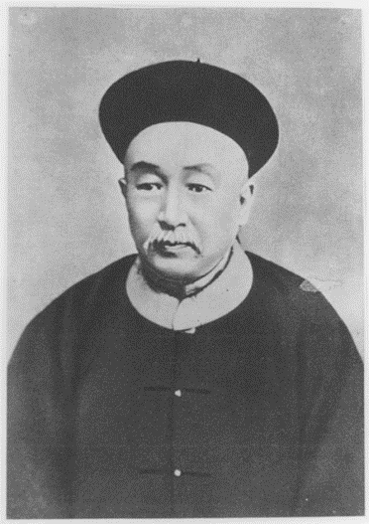
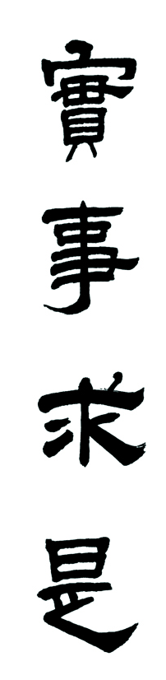
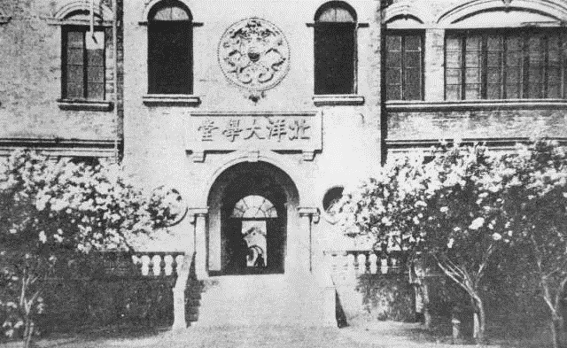
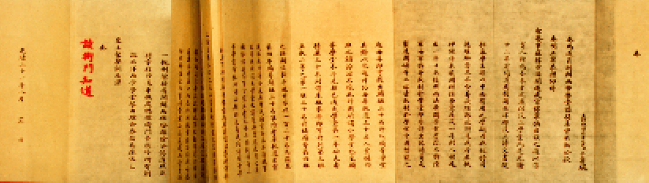
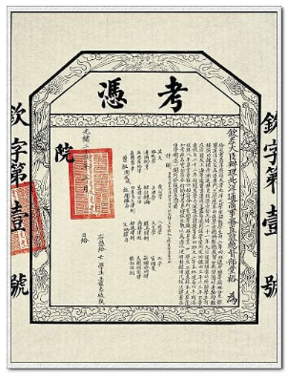
TJU History
TJU was established in 1895 as Peiyang University
Sheng Xuan Huai – The founder
TJU is the oldest institution of higher education in the modern history of China.
A national key university directly under the
administration of the Ministry of Education of China.
The ‘Double First-Class’ Initiative University
Motto: Seeking Truth from Facts

Slide 5
Milestones
First Batch of Universities Under ‘211’ Project
120th Anniversary and the Inauguration of New Campus
Renamed as Tianjin University
New Campus Plan Launched
.
1895
1951
1959
1996
2000
2010
2013
2015
2017
Peiyang University founded
First Batch of 16 National Key Universities
First Batch of Universities Under ‘985’ Project
First Batch of ‘2011’ Projects
Tianjin University has been selected for the ‘Double First-Class’

Slide 6
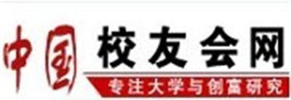



Figures
Ranking
Students
10
2021 China Alumni Association Chinese University Rankings
19,337 Undergraduate students
13,729 Master’s students
5,092 Doctoral students
4,391 International students
49
U.S.NEWS 2022 Asian University Rankings
95
2021 SCIMAGO World University Rankings

Slide 7



Figures
Human Resource
Programs
5,036 faculty & staff
744 professors
141 international faculty & staff
1 Nobel Prize professor
11 honorary Nobel Prize professors
64 Bachelor’s Programs
39 Master’s Programs
(1st-Level Discipline)
28 Doctoral Programs
(1st-Level Discipline)
23 Postdoctoral Programs
James Fraser Stoddart

Slide 8
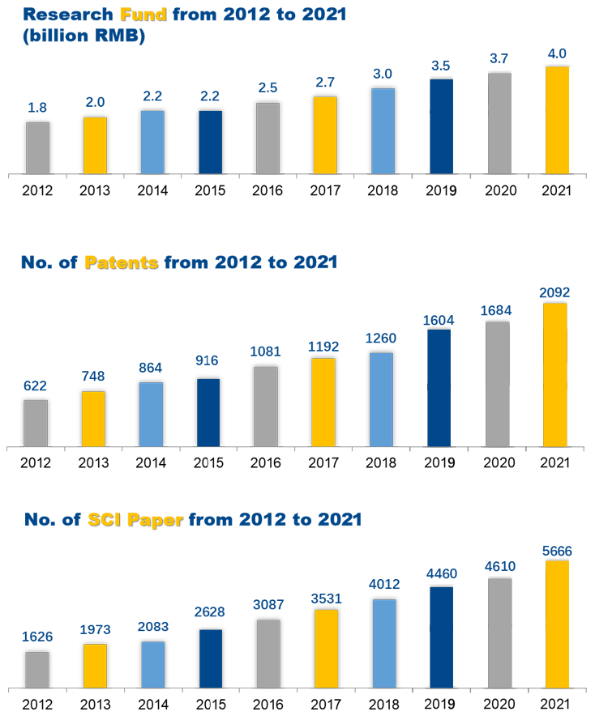

Figures
Research
4.0 bn research income
2092 patents
5666 SCI papers

Slide 9

Figures
Collaboration
CI at Bratislava
Europe
North
America
78 partners
Asia
77 partners
232 partner universities and institutions in 45 countries and 3 regions
3 overseas Confucius Institutes
47 partners
CI at Nice Sophia
Africa
CI at Queensland
2 partners
South
America
3 partners
Oceania
25 partners

Slide 10
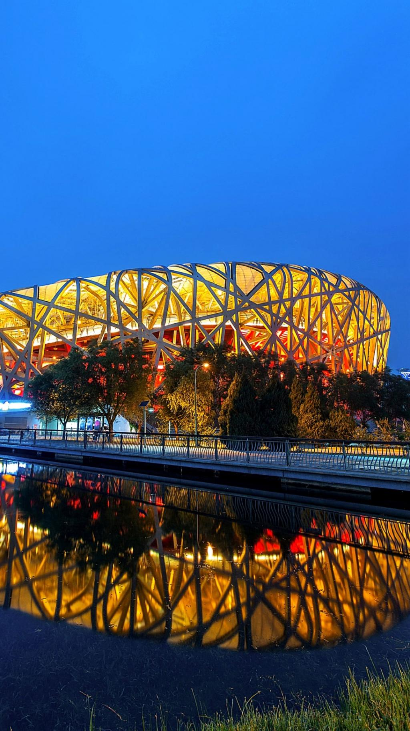

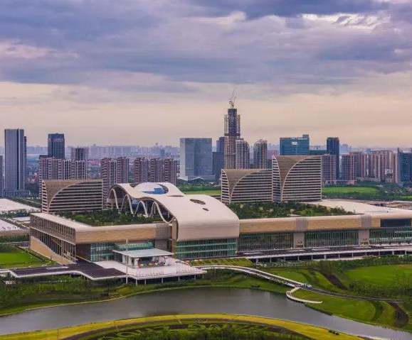




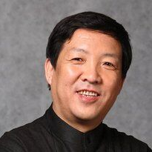
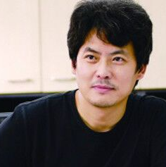
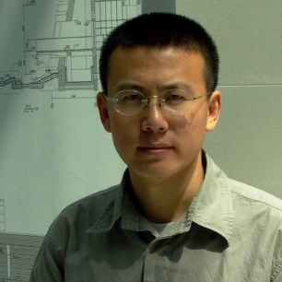
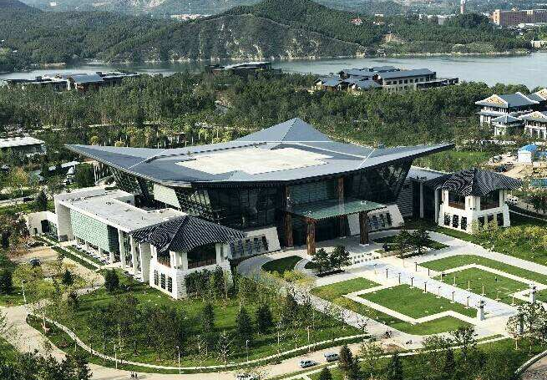
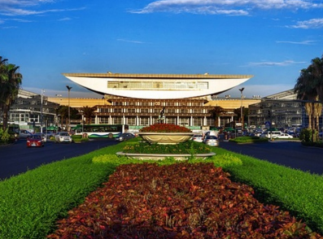
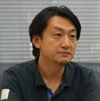
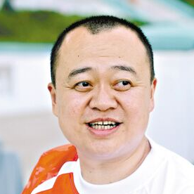
Alumni
A Lot of outstanding alumni of TJU are active on the ‘frontline’ of various industries, such as architecture and civil engineering.
Alumni from TJU were responsible for the design and construction of most of the major venues for the 2008 Olympic Games, G20 and APEC meetings.
General Director of Olympic Project
Kai Cui
Chief Architect of Beijing Olympic Park
Kai Zhou
Chinese Cooperative Chief Architect of Bird’s Nest
XingGang Li
Chief Architect of main stadium of APEC and G20
Fanglei Liu
Chinese Cooperative Chief Designer of Water Cube
Xiaojun Zhao
Notes:
alumni

Slide 11

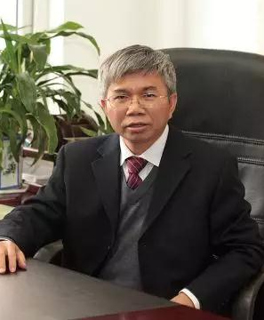

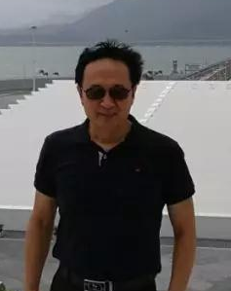
Alumni
YongChang Lu
Chief Engineer of island tunnel
RuKai Wang
Project Consultant of island tunnel
YuanZhan Wang
Professor,
School of Civil Engineering
Hong Kong-Zhuhai-Macao Bridge

Slide 12
Academic Schools
Weijin Road Campus
Institute of Surface-Earth System Science
School of Electrical and Information Engineering
Law School
College of Management and Economics
School of International Education
School of Marine Science and Technology
School of Architecture
School of Precision Instrument and Optoelectronics Engineering
School of Life Sciences
School of Microelectronics
School of Pharmaceutical Science and Technology
School of New Media and Communication
Tianjin International Engineering Institute
Institute of Molecular Plus
Divisi on of Medicine
Peiyang Park Campus
School of Materials Science and Engineering
School of Chemical Engineering and Technology
School of Environmental Science and Engineering
School of Mechanical Engineering
School of Education
School of Civil Engineering
School of Science
School of Mathematics
School of Foreign Languages and Literature
College of Intelligence and Computing
School of Medicine
School of Marxism

Slide 13
Discipline Ranking
2018 National Discipline Assessment by
Ministry of Education
Essential Science Indicators (ESI) Ranking
A+ : Chemical Engineering and Technology
Chemistry
Materials Science
Engineering
Top 1‰
A : Instrument Science and Technology
A : Mechanical Engineering
A : Management Science and Engineering
A : Optics Engineering
Geoscience
Physics
Agricultural Science
Biology and Biochemistry
Computer Science
Pharmacology & Toxicology
Environmental Science and Ecology
Social Science
Clinical Medicine
Mathematics
A- : Architecture
A- : Civil Engineering
A- : Hydraulic Engineering
A- : Environmental Science and Engineering
A- : Mechanics
A- : Power Engineering and Engineering Thermo-physics
A- : Materials Science and Engineering
A- : Software Engineering
A- : Urban and Rural Planning
Disciplines quality ranks top 3 in China.
Top 1%

Slide 14





International Accreditation
7 academic programs being accredited
Architecture by UIA (International Union of Architects)
Chemical Engineering by IChemE
MBA, EMBA and MPA by AMBA (Association of MBAs)
Project Management by PMI (Project Management Institute)
Civil Engineering by JBM (the Joint Board of Moderators)

Slide 15
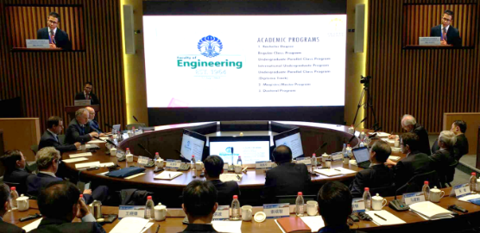
Emerging Engineering Education (3E)
To face the 4th industrial revolution, the MOE proposed the Emerging Engineering Education (3E) plan in 2016. TJU is a pioneer.
Milestones of 3E at TJU:
Key Characteristics of 3E:
Interdisciplinary Studies;
University-Industry Collaboration;
International Cooperation.
April, 2018
The Establishment of the Center of 3E
Goal of 3E:
Nurture competent and innovative future engineers
Dec, 2018
The Establishment of the International Affairs Office of Washington Accord
April, 2019
The Establishment of the International Alliance of 3E
June, 2020
Released "TJU Plan 2.0" for 3E

Slide 16
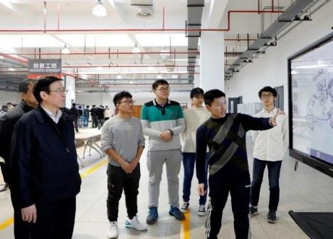
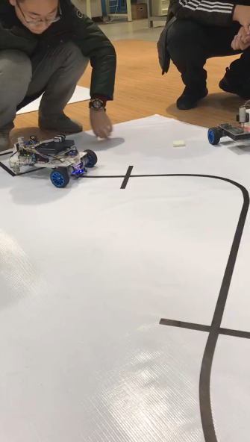
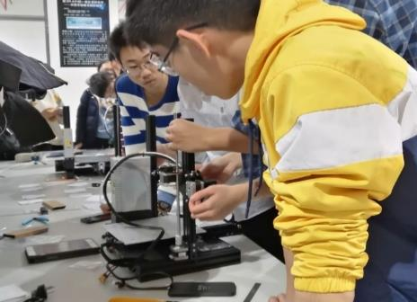
Emerging Engineering Education (3E)
Pilot Program of 3E at TJU: Talent training platform for “Future Intelligent Machines and Systems”
Project Based Learning is the feature of the platform
Goal of 3E:
Nurture competent and innovative future engineers
Designing Logistic
Tracking Car
Design and Construction Course
Smart Classroom

Slide 17

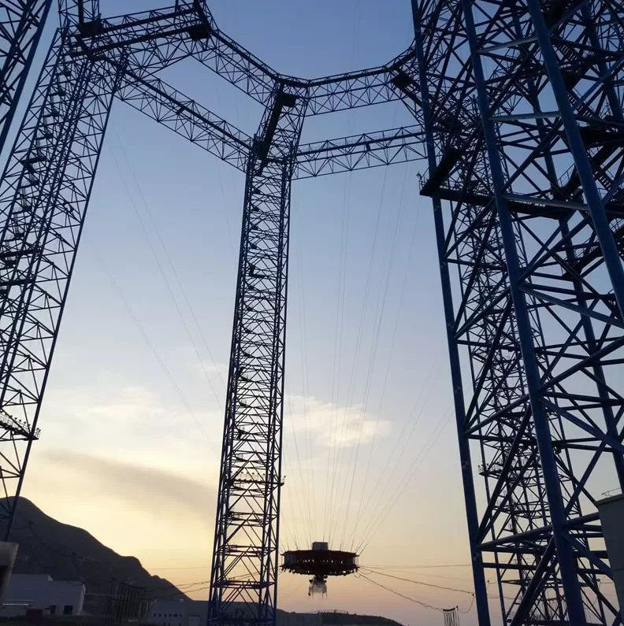

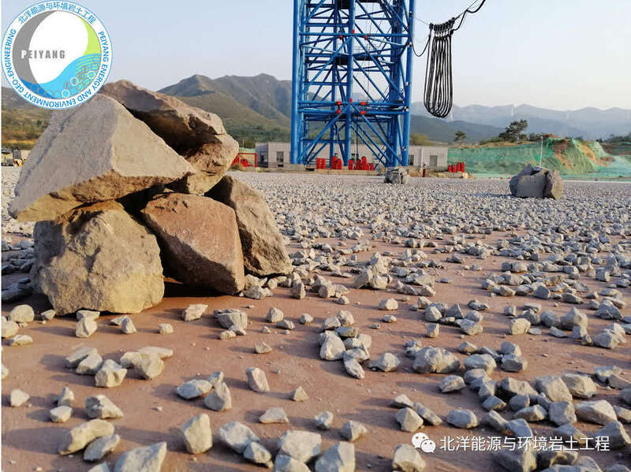
Contributions in Tianwen 1
Mars surface research
Site selection for the automatic and safe deployment of the landing gear
Study on the bearing characteristics of Martian soil for safety and stability after landing
"Tianwen 1" landing simulation animation
Simulation of the rocky surface of Mars
Comprehensive test tower for extraterrestrial celestial bodies

Slide 18
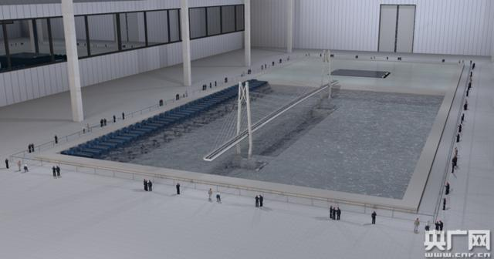
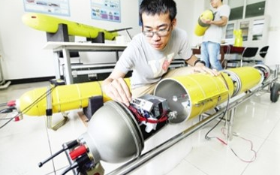

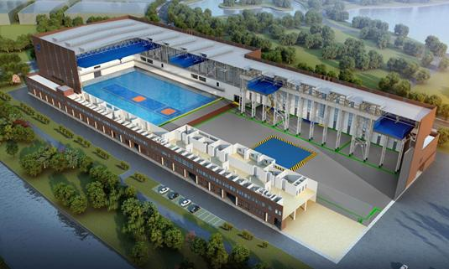
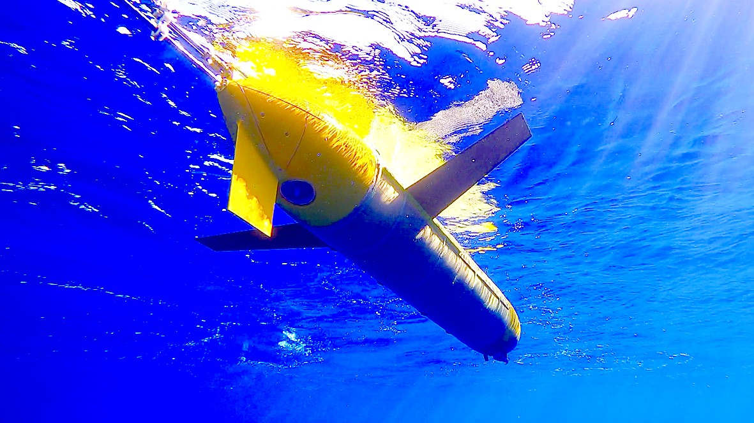

National Facility for Earthquake Engineering Simulation &
“Petrel” Underwater Glider
Occupies 77,000 square meters
The first major scientific and technological infrastructure in the field of earthquake engineering in China
The largest and most versatile in the world
Applicable for deep-sea environment observation above a depth of 10,000m
1500m
in 2014
Field effect picture of a wave-current coupling test of the underwater shaking table array for long-span bridges
WORLD RECORD
8213m
in 2018
WORLD DIVING RECORD
10619m
in 2020

Slide 19
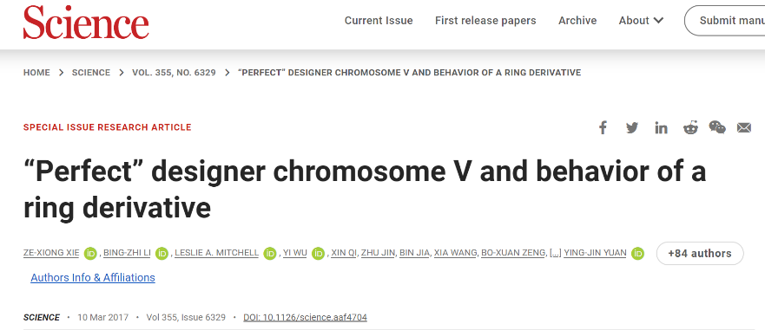
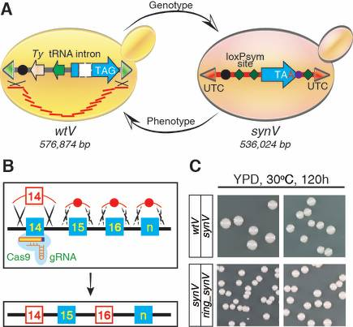
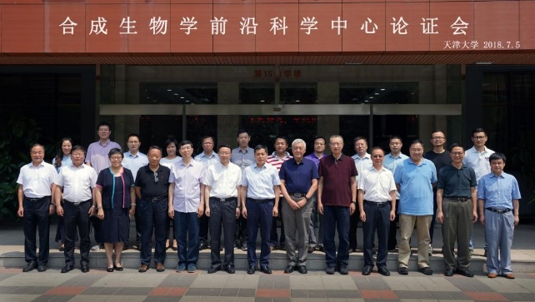
Breakthrough in Synthetic Biology
On March 10, 2017, Yuan Yingjin's team from the Key Laboratory of System Bioengineering of the Ministry of Education, School of Chemical Engineering and Technology, Tianjin University published an article in the journal Science
One of the first domestic universities to carry out synthetic biology research
The first domestic university to establish a master's degree and doctoral degree in synthetic biology
Fills the gap in the design and synthesis of eukaryotic genomes in China
The Frontier Science Center of Synthetic Biology of the Ministry of Education

Slide 20
Study & Living
Why
TJU
Study& Living
Introduction of Tianjin
Our Campus
Accommodation
Canteen
How
to apply
Support
from TJU
Campus Infrastructure
Campus Life

Slide 21

Where is TJU
Located in Tianjin
120 km or 30 minutes by inter-city express train from Beijing
One of the four municipalities directly under the central government of China
One of the First Batch of Coastal Open Cities
One of the Best Commercial Cities and Most Creative Cities
Features of continental climate with four distinct seasons
Moderate Living Cost in China
  : RMB 750-1800 / month
  Food: RMB 600-1000 / month
  Transportation: RMB 100-200 / month
  Communications: RMB 50-200 / month

Slide 22



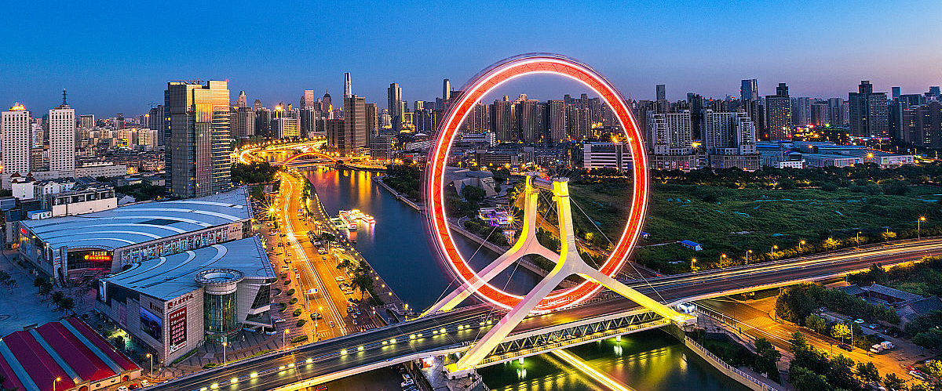
Tianjin

Slide 23
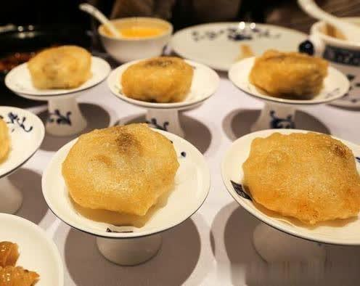
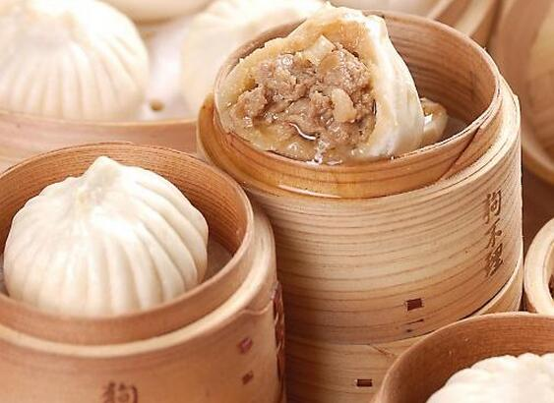

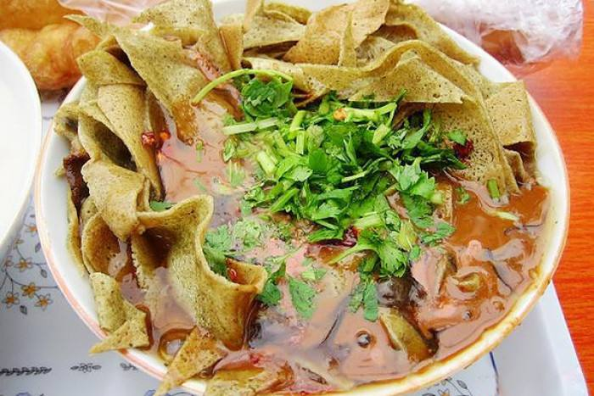
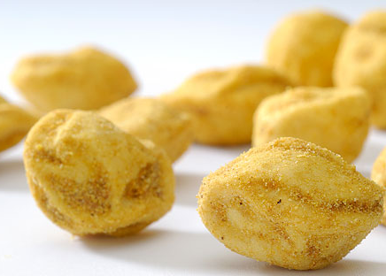

Go Believe Bun
Fried Dough Twist（Mahua）
Ear-hole fried cake
Beng Dou
Guo Ba Cai
A Bite of Tianjin

Slide 24
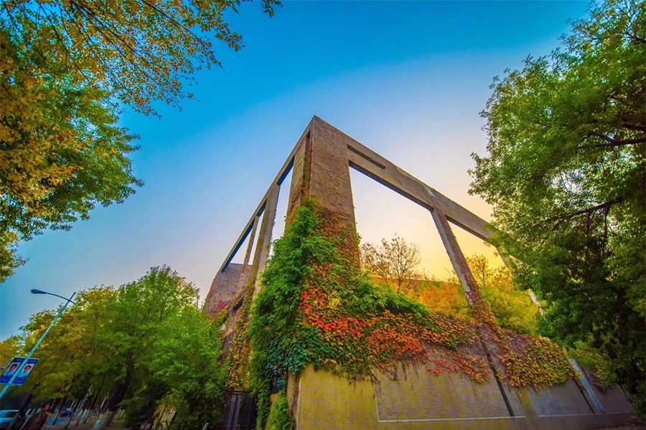

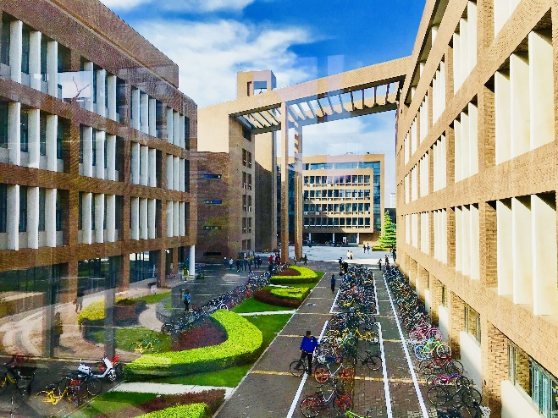
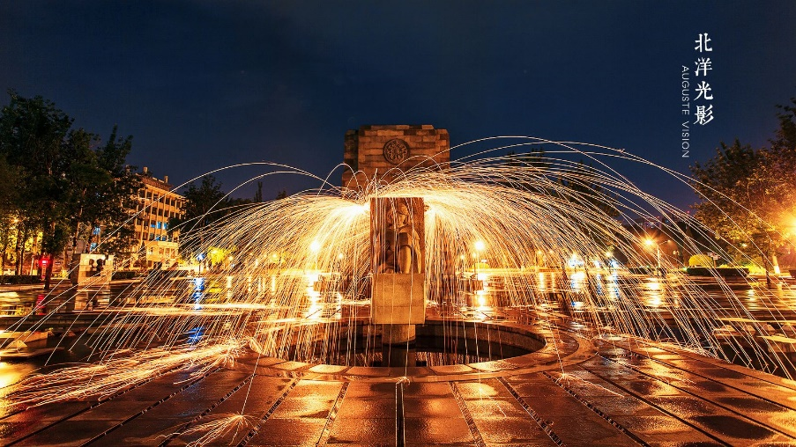
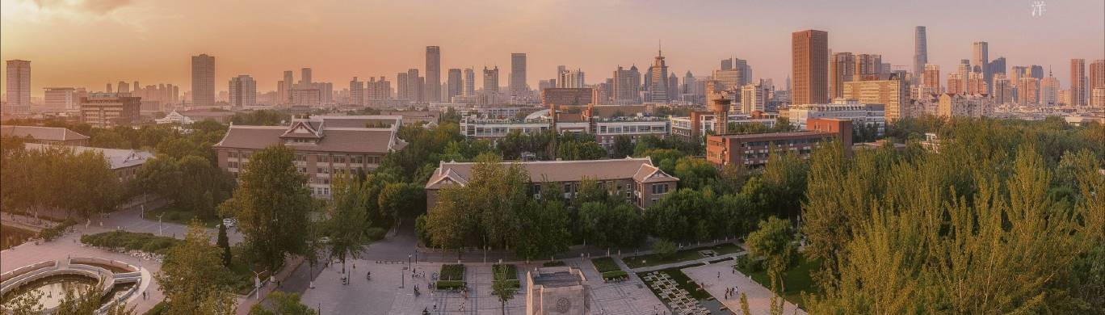
TJU Campus
Weijin Road

Slide 25
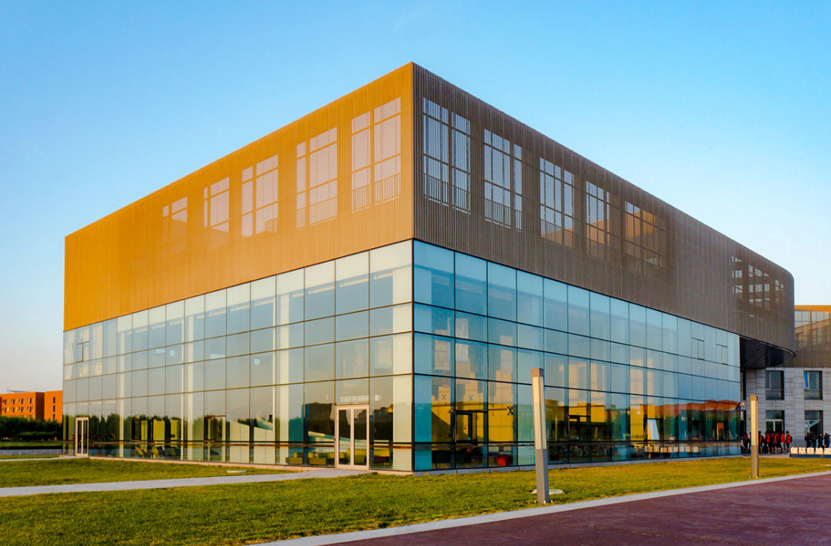
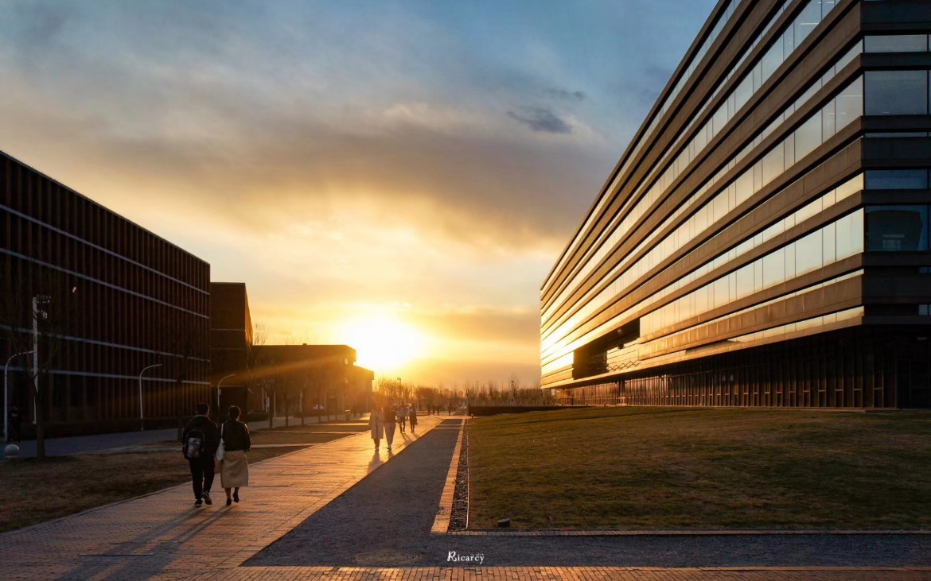
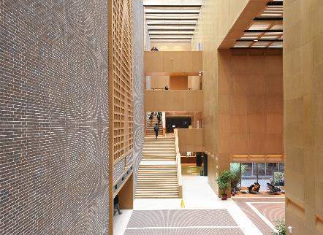
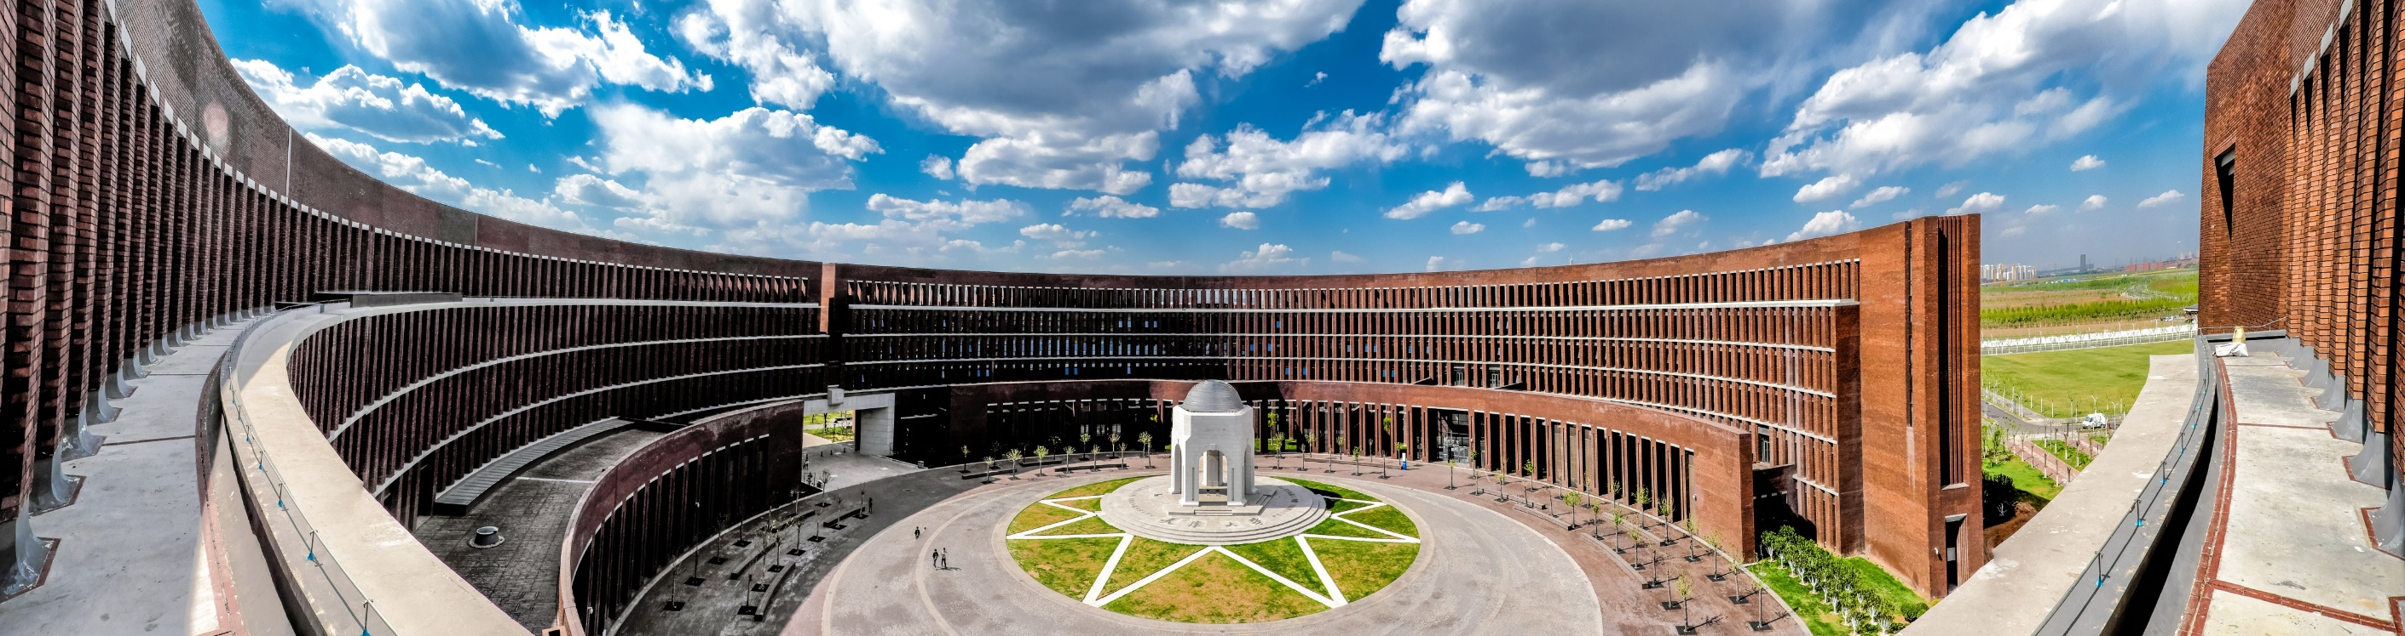
TJU Campus
Peiyang Park

Slide 26
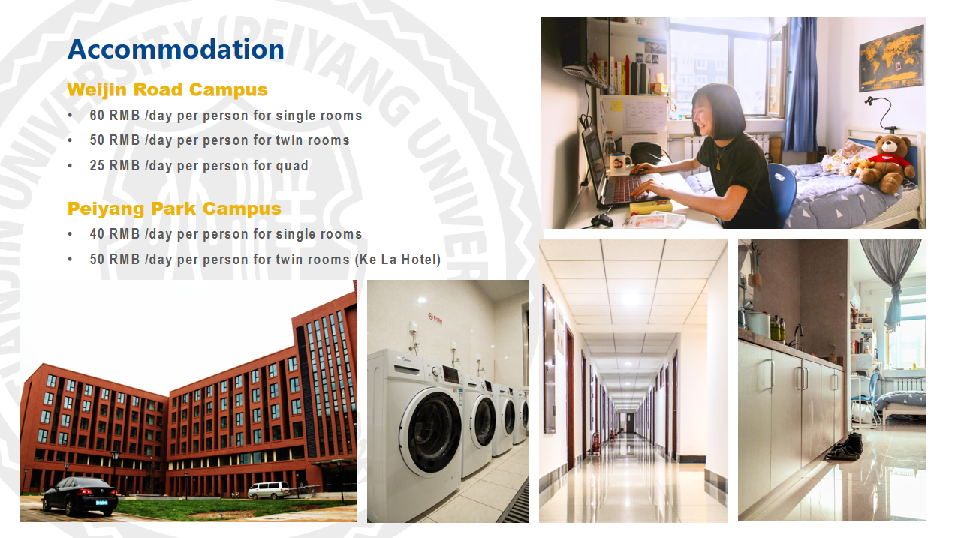

Slide 27
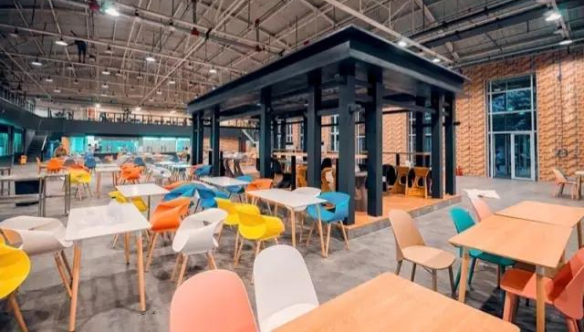


Canteen in Tianjin University

Slide 28
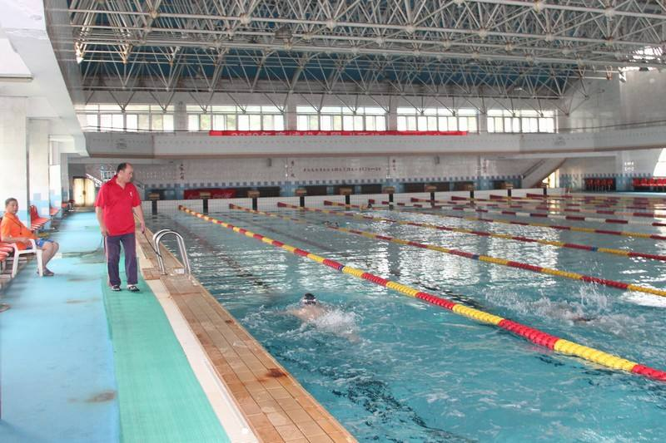



Swimming Pool
Library
Campus Infrastructure
Student-Union
Gymnasium

Slide 29
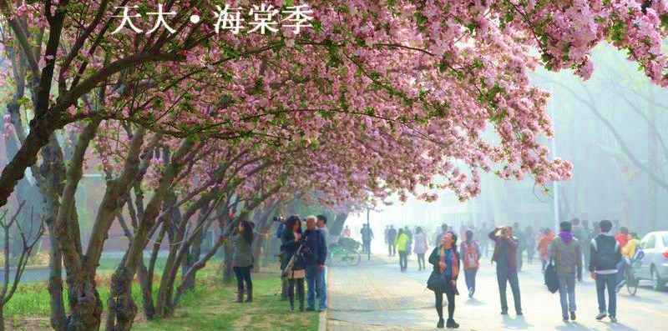
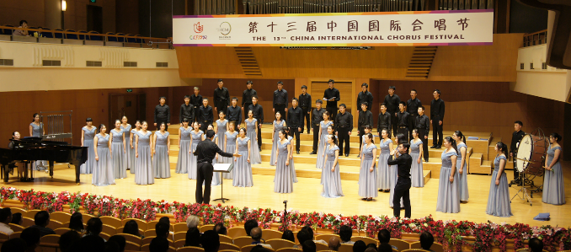



Campus Life

Slide 30
SUPPORT FROM TJU
Why
TJU
Study& Living
Before Arriving
Study Here
How
to apply
Support
from TJU
Career Development

Slide 31

Guide before arriving
Orientation
Before arriving at Tianjin University, every admitted student will receive a pre-arrival guide, including the guide of airport pick-up service, accommodation reservation, necessities list……
• Get acquainted with teachers and new friends
• Learn about majors and courses，laws & regulations
• Know about career development and involvement opportunities
• Explore the campus

Slide 32


Multicultural Research and Psychological Consultation Center
Founded in 2009, the Psychological Consultation Center is the first in China to be open to international students, and to introduce ‘Sand play therapy’ to provide psychological consultation services.
Psychological Consultation Center mainly focus on cross-cultural adaptation, academic pressure, interpersonal relationship, emotional management, love psychology and other issues of international students.

Slide 33













Career
With strong academic background and excellent student quality,
Tianjin University has established friendly cooperative relations with many enterprises to provide internship and employment opportunities for students.

Slide 34
APPLICATION GUIDANCE
Why
TJU
Study& Living
Degree Programs
Non-degree Programs
How
to apply
Support
from TJU
Scholarships

Slide 35

Programs
Foundation
Program
Chinese Language Program
Degree Programs
Bachelor, Master, PhD
Visiting
Student
Program
Short-term Program

Slide 36
Degree Programs for International Students (2022)
Program Category | Tuition （RMB） | Application Timelines
Bachelor (4-5 years) | General Programs: 16,600 RMB / year (in Chinese) 20,000 RMB / year (in English) | Oct. – next Jun. (for Fall Semester enrollment)
 | Special Major (Architecture / Urban Planning / Software Engineering / Animation) : 26,000 RMB / year
Master (2-3 years) | General Programs：24,900 RMB / year (in Chinese) 30,000 RMB / year (in English)
 | Programs in the School of Architecture: 31,000 RMB / year (in Chinese) 39,000 RMB / year (in English) MBA: 39,000 RMB / year (in English)
PhD (4-5 years) | General Programs: 33,200 RMB / year
 | Programs in the School of Architecture: 39,000 RMB/ year

Slide 37

Programs in English (2022)
Bachelor’s Programs
Chemical Engineering (IchemE Accredited)
Pharmaceutical Science
Environmental Science
Environmental Engineering
Doctoral Programs
Environmental Science
Material Science
Information and Communication System
Electrical Engineering
Chemistry
Marine Environmental Dynamics
Chemical Engineering
Pharmacy Engineering
Environmental Science
Environmental Engineering
Mechanical Engineering
Industrial Design
Civil Engineering
Hydraulic Engineering
Urban Planning
Architecture
Biomedical Engineering
Medical Physics
Mathematics
Software Engineering
Computer Software and Technology
Chemical Energy industry
Synthetic Biology
Environmental Ecology
Mechanical Engineering
Ocean and Naval Structure Engineering
Structural Engineering
Circuit and System
Applied Chemistry (Pharmaceutical Science Direction)
……
59 Doctoral Programs in English
Click here to download the catalog of undergraduate programs
Master’s Programs
Electronic Information
Business Administration
Chemistry
Architecture
Urban Planning
Landscape Architecture
Art Design
Chemical Engineering
Civil Engineering
Hydraulic Engineering
Naval and Ocean Engineering
Electrical Engineering
Control Science and Engineering
Information and Communications Engineering
Environmental Science
Environmental Engineering
Mechanical Engineering
Pharmaceutical Science
Optical Engineering
Biomedical Engineering
Chemistry
Click here to download the catalog of graduate programs

Slide 38
Non-Degree Programs for International Students (2022)
Program Category | Application Timelines | Tuition （RMB）
Foundation Program | Mar. - Jun. (for Fall Semester enrollment); Oct. - Dec. (for Spring Semester enrollment) | 12,000 RMB / fall semester 16,900 RMB / spring semester
Visiting Student Program |  | 8,300-15,000 RMB / semester
Chinese Language Program |  | 6,900 RMB / semester
Short-term Program | Mar. - Jun. | 3,000-6,200 RMB / month

Slide 39


Chinese Language Program (2021)
Program Introduction
Foundation Program is designed for beginners who plan to study science or engineering to have a systematic study of general Chinese, technical Chinese, basic mathematics, physics and chemistry.
Program Introduction
Chinese Language Program is open to international students who love Chinese Language and Chinese culture.
Course Setting
Course Setting
Chinese Language Courses
Speaking
Listening
Reading
Comprehensive Chinese
Chinese Cultural Courses
(Optional)
Tai Chi
Martial Arts
Calligraphy
Chinese Painting
Papercut
Chinese Cuisine
Chinese Song
Comprehensive Chinese
Chinese Listening
Chinese Character
Technical Chinese
Oral Chinese
Mathematics
Physics
Chemistry
Other Courses (Optional)
HSK Level 4-6
Business Chinese
Admission to Foundation Program:
http://sie.tju.edu.cn/en/ykxm/
Admission to Chinese Language Program:
http://sie.tju.edu.cn/en/jxxm/hyjxxm/
Foundation Program (2021)

Slide 40






Short-term Program
Georgia Institute of Technology
The University of Queensland
Nanyang Technological University
Slovak University of Agriculture
Université Nice Sophia Antipolis
Etc.……
Link: http://sie.tju.edu.cn/xygk/xyjj/kzxy/

Slide 41
Scholarships For PhD (2022)
Scholarship | Type | Coverage and Standard | Where to Apply
Chinese Government Scholarship (Type B) Silk & Road Program/ Chinese University Program | Full | Tuition waiver and accommodation on campus Monthly Living Allowance: 3,500 RMB/month Comprehensive Medical Insurance | TJU
Chinese Government Scholarship(Type A) Bilateral Program/MOFCOM | Full | Free tuition Living allowance: 2500 RMB /month Accommodation on campus Free comprehensive medical insurance | Chinese embassies/consulate
Peiyang Future Scholar Scholarship | Full | Tuition subsidy: 38000RMB/academic year Living allowance: 3500RMB/month Accommodation on campus | TJU
Tianjin Government Scholarship | Full /Partial | Full Tuition: 38000RMB Living allowance: 2000RMB/month (10 months in total) Comprehensive medical insurance 800RMB Partial Tuition: 38000RMB | TJU

Slide 42
Scholarships For Master (2022)
Scholarship | Type | Coverage and Standard | Where to Apply
Chinese Government Scholarship (Type B) Silk & Road Program/ Chinese University Program | Full | Tuition waiver and accommodation on campus Monthly Living Allowance: 3,000 RMB/month Comprehensive Medical Insurance | TJU
Chinese Government Scholarship (Type A) Bilateral Program/MOFCOM | Full | Free tuition Living allowance: 2500 RMB /month Accommodation on campus Free comprehensive medical insurance | Chinese embassies/consulate
Confucius Institute Scholarship | Full | Free tuition Free accommodation on campus Comprehensive medical insurance fee Living allowance: 3,000 RMB/month for MTCSOL students 2,500 RMB/month for One-Academic-Year Study and One-Semester Study students | TJU
Tianjin Government Scholarship | Full /Partial | Full: Tuition: 30000RMB Living allowance: 1700RMB/month (10 months in total) Comprehensive medical insurance 800RMB Partial Tuition: 30000RMB | TJU
Tianjin University Scholarship in School of Civil Engineering and Technology | Full /Partial | Full: Tuition：30000 RMB/year Living allowance: 2000 RMB/month Partial Living allowance: 1200 RMB/month | TJU

Slide 43
Scholarships For Bachelor (2022)
Scholarship | Type | Coverage and Standard | Where to Apply
Chinese Government Scholarship (Type A) Bilateral Program/MOFCOM | Full | Tuition waiver Living allowance: 2500 RMB /month Accommodation on campus Comprehensive medical insurance | Chinese embassies/consulate
Tianjin University International Student Scholarship | A/B/C/D | Type A Tuition subsidy: 20000 RMB Living allowance: 1400 RMB /month (10 months in total) Type B Tuition subsidy: 20000RMB Type C Tuition subsidy: 10000RMB Type D Tuition subsidy: 6000RMB | TJU
Qiushi Scholarship | Full | Tuition subsidy:20,000 RMB/ academic year Living allowance: 2,500 RMB/month Accommodation on campus | TJU
Tianjin University Scholarship in Chemical Engineering | Full/ Partial | Full Tuition subsidy: 20000 RMB Living allowance: 2400 RMB /month Partial Tuition subsidy: 20000 RMB Living allowance: 1400 RMB /month | TJU

Slide 44

How to apply
Applicants should complete the Online Application Process on the International Student Service System (ISSS Website: tju.at0086.cn/student) according to the application schedule.
Application Period: October 15, 2021 - June 15, 2022
Interviews will be arranged from April to July 2022 (The specific time will be notified). Admission results will be released in July 2022.
Time of Registration: Early September, 2022
Register an application account
Upload required documents
Initial review of materials
Participate in the interview
Fill in application information
Material reviewed by Colleges
Submit application
Notification of admission result
* For detailed information of documents required, please refer to Online Application (tju.at0086.cn/student). Applicants shall guarantee all the information and application documents submitted in this application are authentic and accurate, otherwise they will be disqualified from admission.

Slide 45














Contact Us
International Admissions Office
Phone: 86-22-27406691
Email: iso@tju.edu.cn
undergraduate@tju.edu.cn
graduate@tju.edu.cn
Website: http://sie.tju.edu.cn/
Facebook: Tianjin University
Instagram: @Tianjin_uni
Website of School Of Internation Education
Study at TJU
TJU Website: http://www.tju.edu.cn/

Slide 46
TJU Application Group

