Slide 1
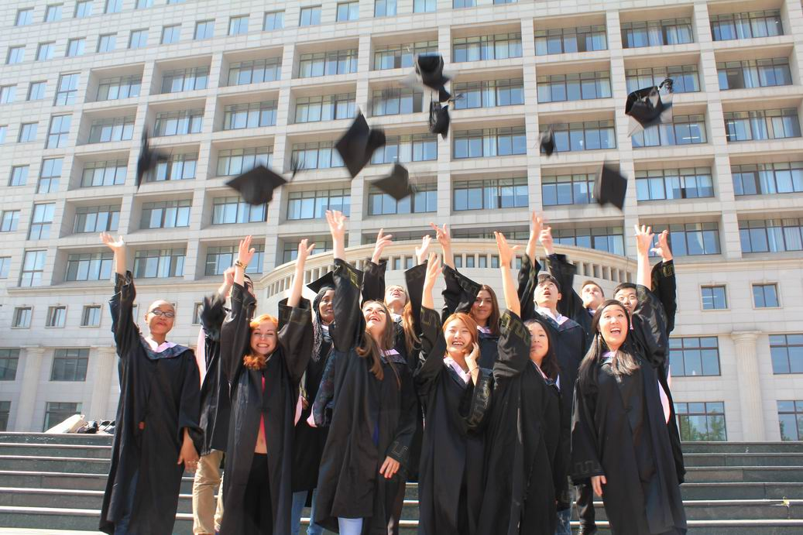
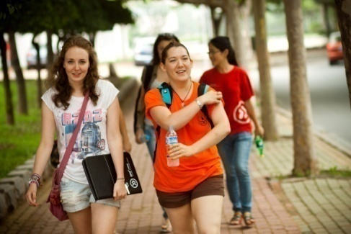
Welcome to
Dongbei University of Finance and Economics (DUFE) ！
东北财经大学欢迎你！
2022-01-13

Slide 2
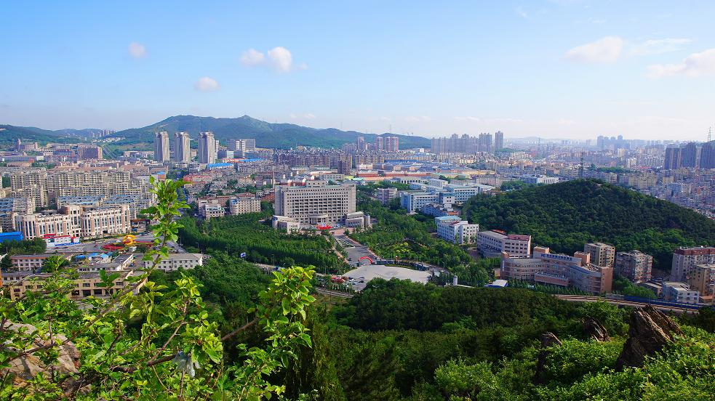
东北财经大学
Dongbei University of Finance and Economics
DUFE

Slide 3
地理位置 Location
中国China
辽宁省
Liaoning Province
大连Dalian

Slide 4
Why DUFE？
为什么选择东财 ......
Let's watch a 5 mins video .
我们一起来观看五分钟的视频。

Slide 5
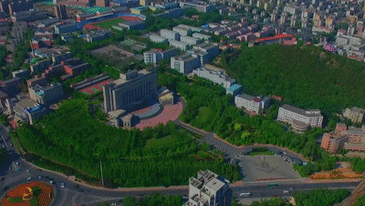
TOP1
Excellent location 优越的地理位置
+
Beautiful campus 优美的校园环境

Slide 6
Dalian City
Dalian is the most livable city and business center in the northeast China.
大连是中国东北最宜居的城市和商业中心。

Slide 7
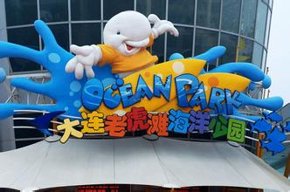
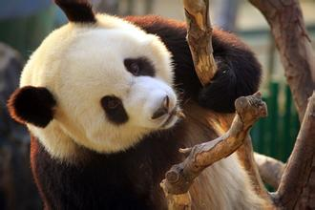
Popular Tourist Destination
A City Built in Gardens
Dalian is also home to three zoological parks, including Dalian Forest Zoo, Laohutan Ocean Park and Sunasia Ocean World .
Dalian City

Slide 8
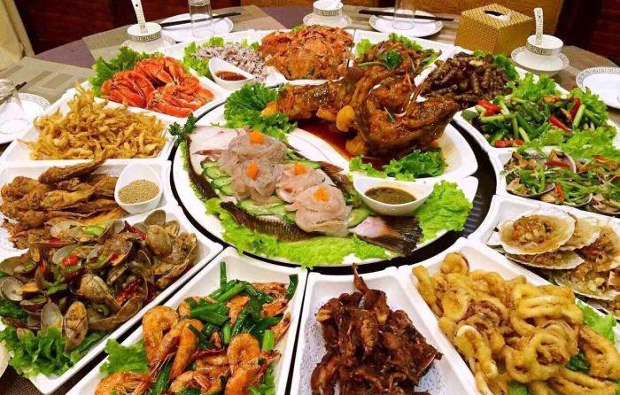
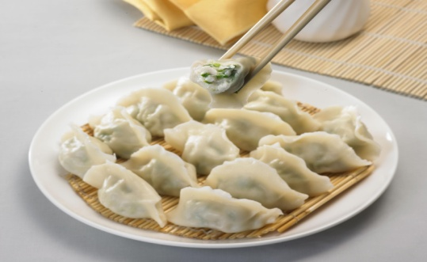
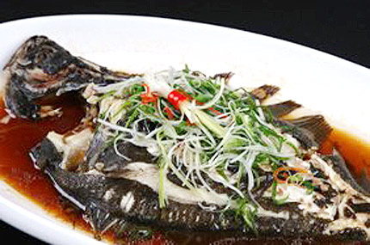
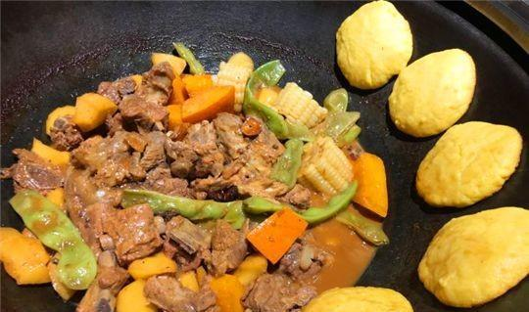
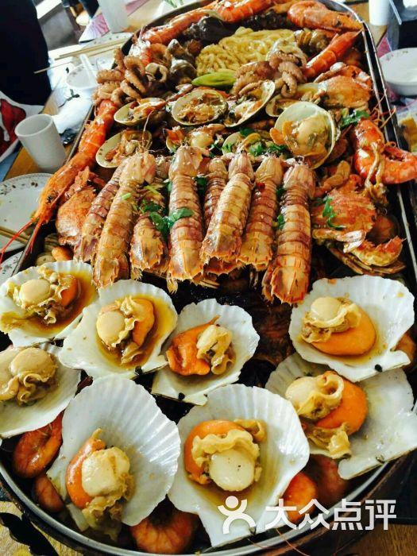
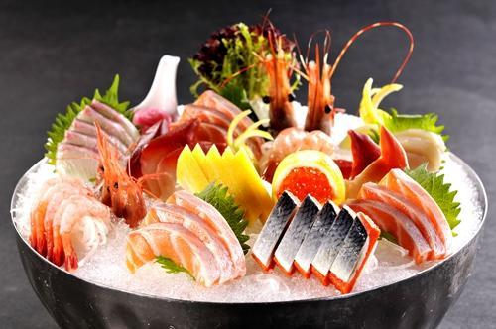
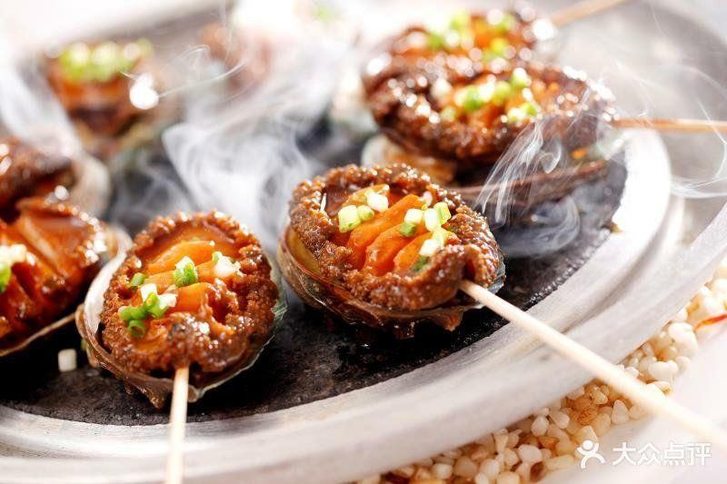

Slide 9
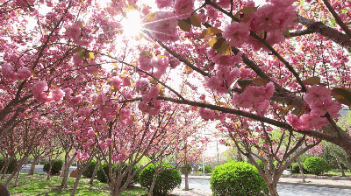
春 粉色樱花漫天飞舞
Sakura blooming in spring

Slide 10
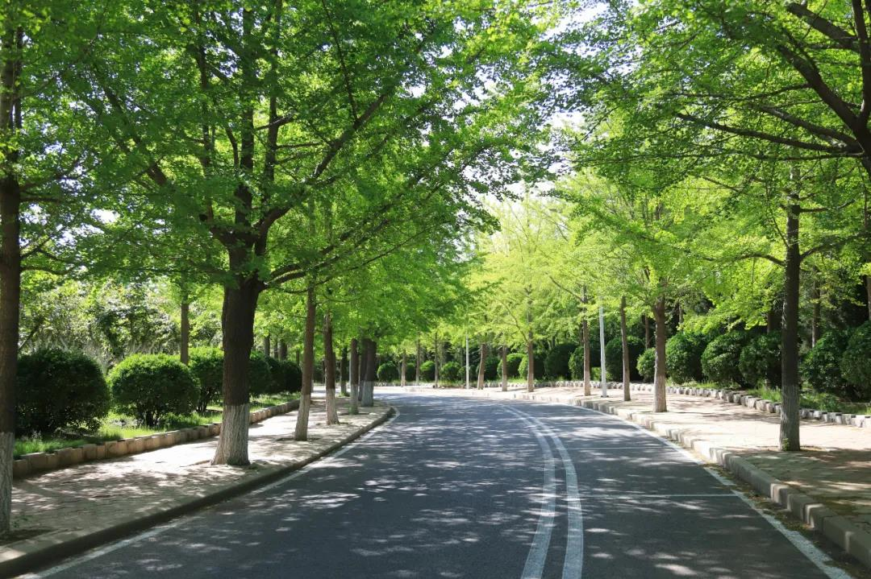
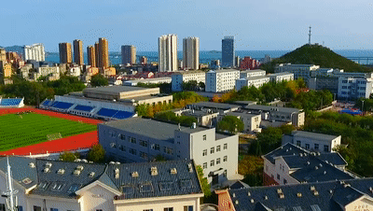
夏 绿树成荫郁郁葱葱
Green and luxuriant trees in summer

Slide 11
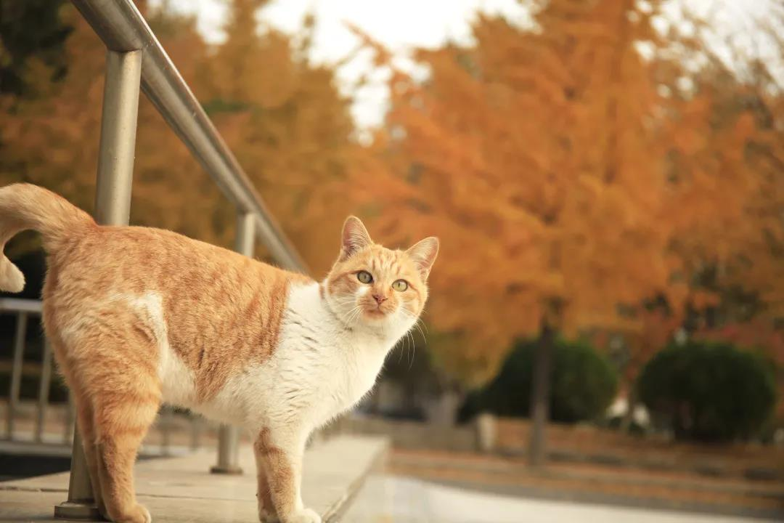
秋 浪漫银杏铺满金黄
A golden world filled with gingko leaves in autumn

Slide 12
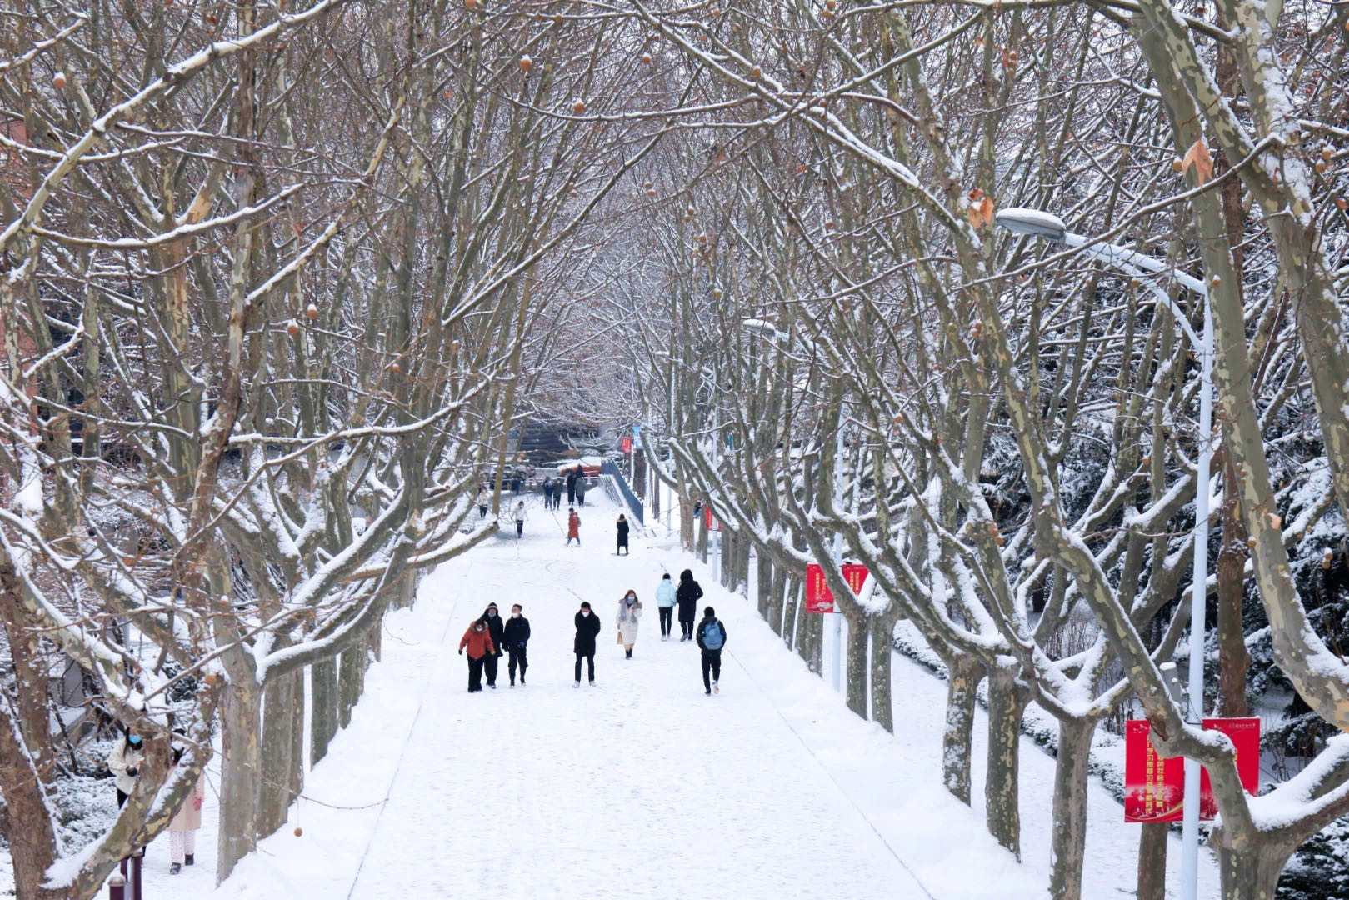
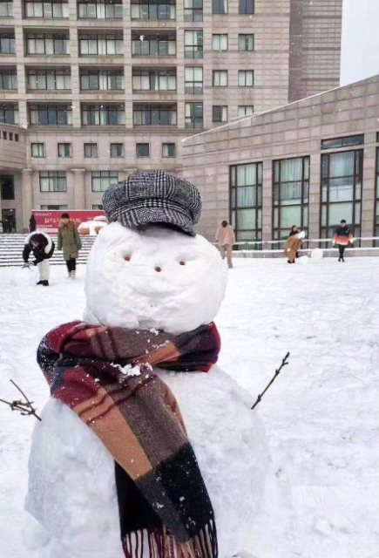
冬 皑皑白雪素裹银装
Gleaming snow in winter

Slide 13
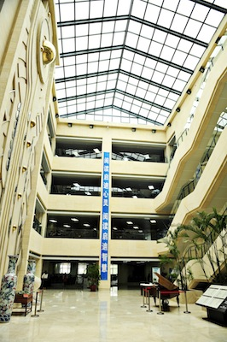
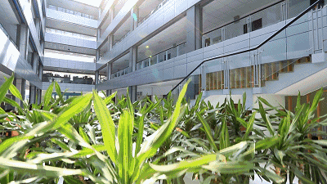
Notes:
辽宁省来华留学教育示范基地自评报告
东北财经大学

Slide 14
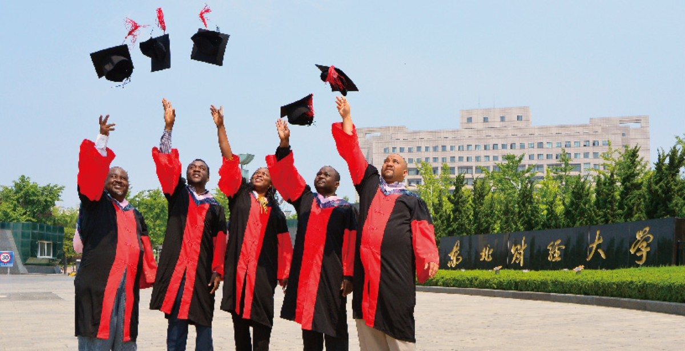
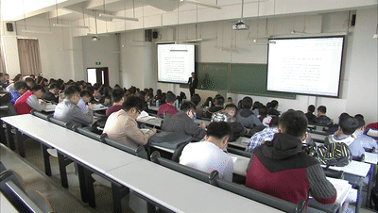
TOP2
First-class discipline and professional strength
一流的学科专业实力

Slide 15
学科 Disciplines Branche d’etude
文学
文学Literature
法学
法学
Law
DUFE
理学
理学Science
经济学
Economics
管理学
管理学
Management

Slide 16
中国教育部 全国第四轮学科评估东北财经大学A类学科数量3个
The 4th Round of Discipline Evaluation by Ministry of Education, China
应用经济学
工商管理
统计学
First-class Discipline
A类学科
Applied Economics
Business Administration
Statistics
A
A-
A-
TOP 3
财经类高校位居第三位
among universities of Finance and Economics
TOP 3
辽宁省高校位居第三位
among universities in Liaoning Province
TOP 59
全国高校第59位
among Chinese universities
Notes:
辽宁省来华留学教育示范基地自评报告
东北财经大学

Slide 17
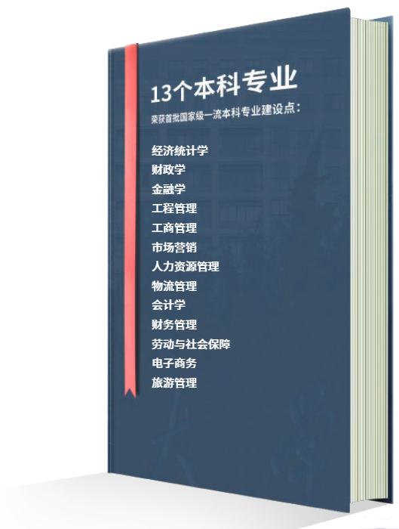
经济统计学
财政学
金融学
工程管理
工商管理
市场营销
人力资源管理
物流管理
会计学
财务管理
劳动与社会保障
电子商务
旅游管理
13个本科专业荣获首批国家级一流本科专业建设点：
13 undergraduate programs have been awarded the National First-class Undergraduate Major Sites
Economic Statistics
Public Finance
Finance
Engineering Management
Business Management
Marketing
Human Resource Management
Logistics Management
Accounting
Financial Management
Labor and Social Security
E-commerce
Tourism Management

Slide 19
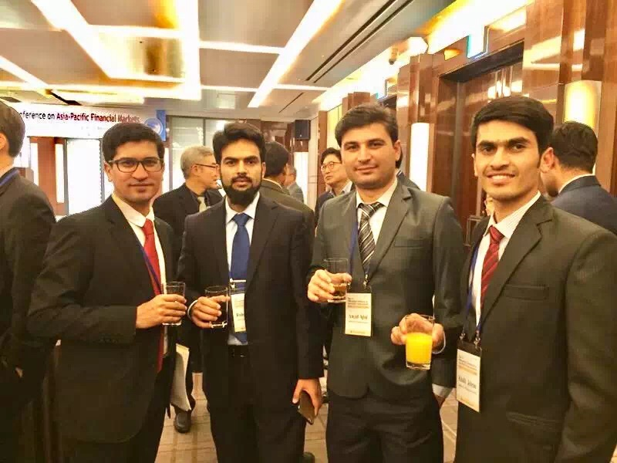
TOP3
Bright Career 就业前景广阔
——中国盛产银行高管最多的大学排名第一，被誉为“最盛产银行行长的大学”
——2016胡润百富校友榜第33位
——2017全球CEO母校排行全球61位，中国11位
-- Known as the University with the Most Bank Presidents
-- Ranked No.1, the University with the Most Bank Executives
-- Ranked No.33, Hurun Rich List Alumni Report
-- Ranked No.61, in the world and No.11 in China, Times Higher Education Alma Mater Index (Global Executives) 2017

Slide 20
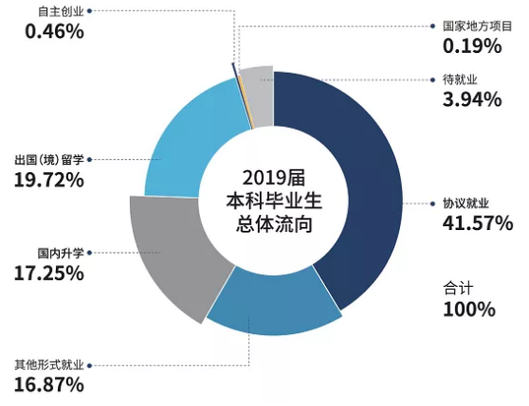
self-employment
local government projects
2019届本科毕业生年终就业率达96.06% ，超过36%的毕业生选择继续深造。
The year-end employment rate of 2019 undergraduates is 96.06%. More than 36% of graduates choose to continue their studies.
underemployed
study abroad
employment
agreement
master study in China
other
DUFE Undergraduates Employment Rate 2019

Slide 22
TOP4
Internationalization Expands Global Vision 国际化办学拓展全球视野
By 2019, DUFE signed MOU or MOA with 100+ overseas universities and institutions from 20+ countries to enhance its global interactions.
截至2019年，我校已与20多个国家的100多所高校和研究机构签署合作备忘录，增进对外交流。
25
124
9
countries
国家
colleges and universities
高等院校
International organizations
国际机构

Slide 23
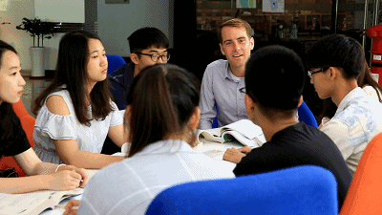
教学语言国际化、教材选用国际化、课程体系国际化、学生来源国际化、教师资源国际化、教学管理方式国际化。
Internationalization of teaching language, teaching material, curriculum system, students, faculties and academic affairs administration.

Slide 24
分別与荷兰、斯洛伐克的大学共建孔子学院
Jointly established Confucius Institutes with universities in , the Netherlands and Slovakia.
1个中外合作办学机构
6个中外合作办学项目
1 Sino-foreign joint educational institute
6 Sino-foreign joint educational programs

Slide 25
工商管理、旅游管理两个双学位专业获得全球最具影响力的国际商学院协会AACSB机构的认证
会计学专业通过全球三大会计师公会之一的澳洲 会计师公会（CPA Australia）的全面认证
The dual degree programs of business administration and tourism management are accredited by AACSB.
Accounting is fully accredited by CPA Australia.
通过了英国高等教育质量保证署（QAA）的现场评估
与美国注册金融分析师协会（CFA）建立大学合作伙伴关系
DUFE has been assessed on site by the UK Higher Education Quality Assurance Agency (QAA).
Partnership with the Chartered Financial Analyst Institute (CFA)

Slide 26
近十年来，来自印尼的留学生人数为112人，其中博士5人，硕士20人，本科生33人，非学位生54人。
The total number of students from Indonesia in the past decade is 112，including 5 PhD students, 20 Master students, 33 undergraduate students and 54 non-degree students

Slide 27
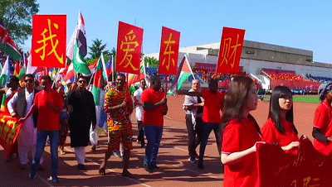
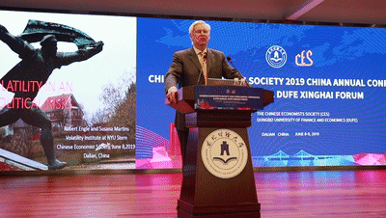
TOP 5
Colorful Campus Life 丰富多彩的校园生活
Academic, professional and cultural developments
学术、职业及文化活动
Academic Support Center
学业指导中心
Mental Health & Guidance Center
心理健康指导中心
Career Development Center
就业指导中心
International Students Affairs Office
留学生管理办公室
International Alumni Association
国际学生校友会

Slide 28
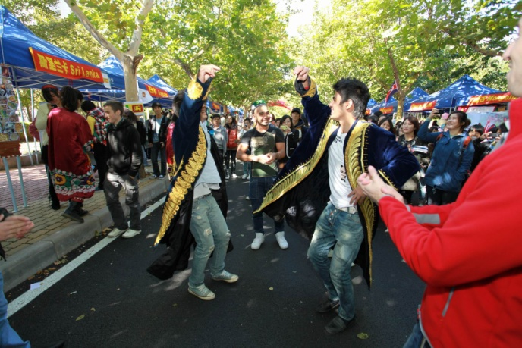
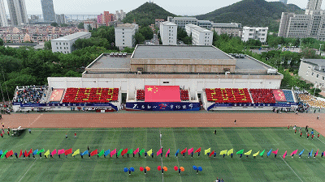
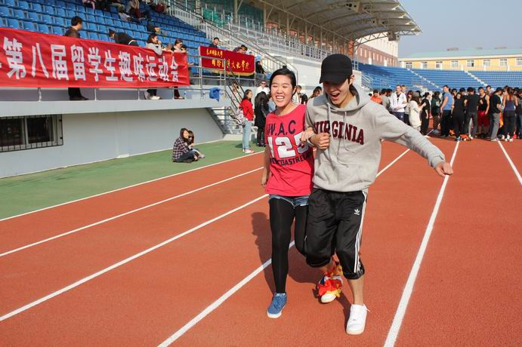
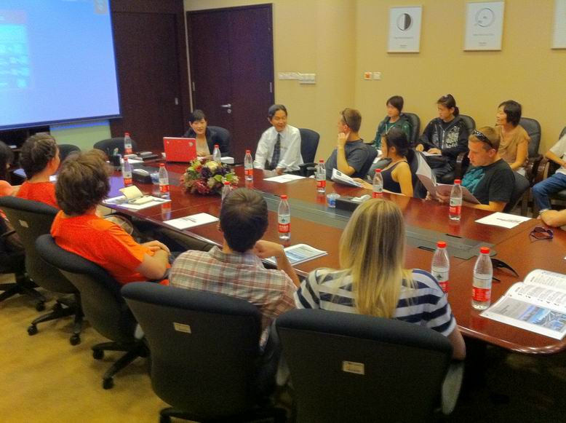
Amazing Student Life

Slide 29
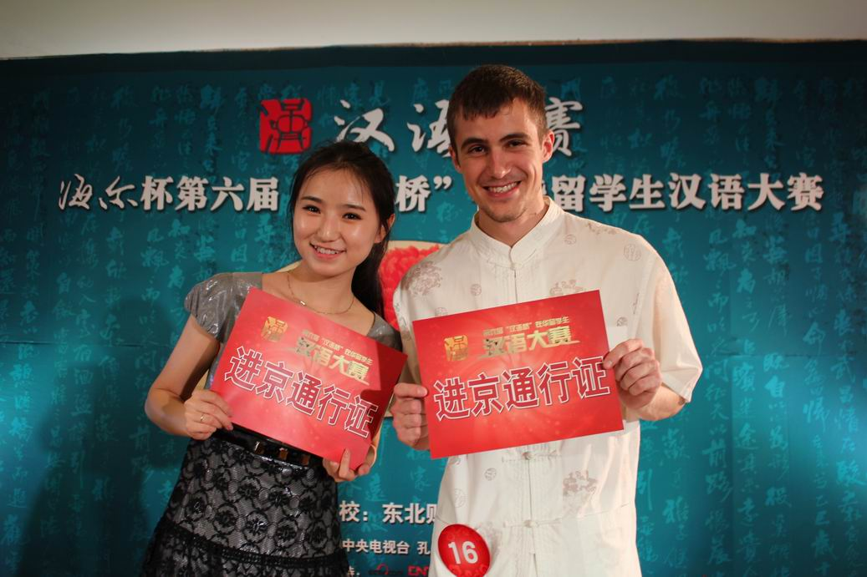
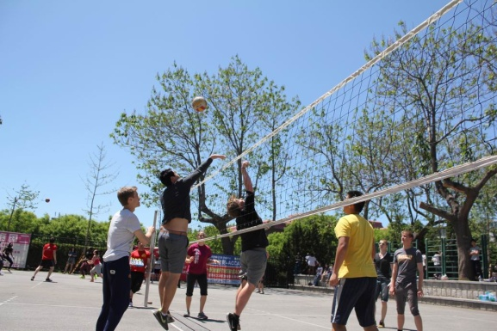
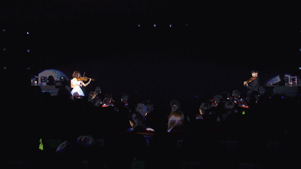
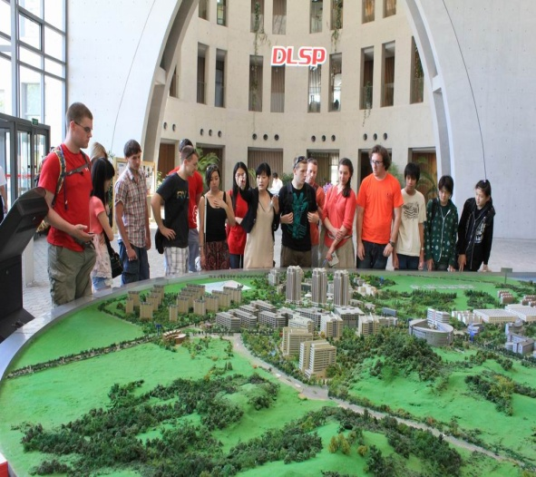
Amazing Student Life

Slide 30
学院与专业 Schools & Majors Académies & Spécialités

Slide 31
School of International Education(International Student Office)
School of Finance School of Economics
School of Accounting School of Marxism
School of Statistics School of Law
School of Business Administration
School of Public Administration
School of Public Finance and Taxation
School of Management Science and Engineering
School of Tourism and Hotel Management
School of Investment and Engineering Management
School of International Economics and Trade
School of Humanities and Communication
School of Data Science and Artificial Intelligence
School of International Business and Foreign Languages
Schools

Slide 32
Undergraduate
Accounting
Administrative Management
Advertisement
Assets Evaluation
Business Administration*
Business English
Chinese Language
Computer Science and Technology
E-Commerce
Economics
Engineering Management
Finance
Financial Engineering
Financial Management
Human Resources Management
Information Management and Information System
International Economics and Trade
Insurance
Investment
Japanese
Journalism
Labor and Social Security
Law
Logistics Management
Management Science
Marketing
Mathematics and Applied Mathematics
Public Finance
Public Service Administration
Real Estate Development and Management
Sociology
Statistics
Taxation
Tourism Management*
本科

Slide 33
Master
Marxism in China
Master of Teaching Chinese to Speakers of Other Languages
National Economics
Political Theory
Population, Resources and Environmental Economics
Public Finance
Quantitative Economics
Regional Economics
Social Security
Statistics
Taxation (2 years)
Techno-economic and Management
The Basic Principles of Marxism
Tourism Management*
Western Economics
World Economics
硕士

Slide 34
Master
Accounting
Administrative Management
Business Management*
Chinese Modern and Contemporary History
Civil and Commercial Law Studies
Constitution and Administrative Law
Communication
Criminal Law
Corporate Governance
E-commerce*
Economic Law
Education Economics and Management
Engineering Management*
Finance
Finance and Risk
Statistics
Financial Engineering
Financial Management*
Foreign Linguistics and Applied Linguistics
History of Economic Thought
Human Resources Management
Ideological and Political Education
Insurance
International Trade*
Journalism
Land Resources Management
Logistics Management
Management Science and Engineering*
Marketing
硕士

Slide 35
Phd
Accounting*
Administrative Management
Auditing*
Behavioral Economics
Business Management*
Corporate Governance
E-commerce*
Economic History
Economic Philosophy
Economics of Regulation
Education Economics and Management *
Finance*
Financial Engineering
Financial Management*
History of Economic Thought
Human Resources Management*
Industrial Economics*
Industrial Organization*
Insurance
International Trade*
Labor Economics
Management Science and Engineering*
Marketing*
National Economic Accounting
National Economics
Political Economics
Population, Resources and Environmental Economics
Public Economics and Public Policies
Public Finance*
Quantitative Economics*
Regional Economics
Social Security
Statistics*
Techno-economic and Management
Tourism Management*
Western Economics*
World Economy*
博士

Slide 37
Chinese Language & Business Chinese Program 汉语/商务汉语
Long-Term Program 长期项目
Admission Requirements入学要求：
① High school graduate 高中毕业;
② Over 16 years old and healthy 16周岁以上且身体健康.
Main courses 主要课程: Intensive Reading, Speaking, Listening, Reading, Advanced and Intermediate Writing, etc.
Electives 选修课: Chinese Pronunciation, Chinese Calligraphy, Chinese Characters Reading and Writing, Newspaper Reading, Chinese Folklore, Economic Reading, Chinese Cooking, Martial arts, Erhu (Chinese traditional music instrument), Paper Cutting, Tai Chi, etc.

Slide 38
Chinese Language & Business Chinese Program 汉语/商务汉语
Long-Term Program 长期项目
Main business language training courses 商务汉语主要课程: Basic Chinese, Chinese Listening and Speaking, Business Chinese, Business Chinese Speaking, China Economic Issues, etc.
A variety of practical activities 语言实践活动: sightseeing, company visit, language practice activity, etc.
Application Deadline申请截止日期:
Spring semester: 31st March
Fall semester: 30th September
春季学期：3月31日
秋季学期：9月30日
Class Start Date学习开始日期:
Spring semester春季学期: early March 三月初
Fall semester秋季学期: early September 九月初
* Students having Chinese basis can be placed in appropriate classes anytime

Slide 39
Chinese Language & Business Chinese Program 汉语/商务汉语
Summer Camp 暑期学校: Chinese Language & Chinese Culture Experience Program 中文和中国文化体验
Other Short-Term Chinese Language & Chinese Culture Program 其它短期项目
Class Start Date: June & July
Application Deadline: before class starts
Class schedule can be separately designed for group (more than 10 students). Please contact us for more details.
Main courses 主要课程: Elementary Chinese, Chinese Speaking, Basic Chinese, Chinese Listening and Speaking, Comprehensive Chinese
A variety of practical activities 语言实践活动:
sightseeing, field trip, language practice activity, etc.

Slide 40
Application Requirements
Undergraduate 本科
Graduate 研究生
- Language Proficiency 语言要求
English medium: IELTS 5.5 or equivalent
Chinese medium: HSK 4 180 or above
*Other please visit sie.dufe.edu.cn
High school and/or College Transcripts
- Entrance interview 入学面试
- Language Proficiency 语言要求
English medium: IELTS 5.5 or equivalent
Chinese medium: HSK 5 220 or above
*Other please visit sie.dufe.edu.cn
College Transcripts
- Recommended by two professors or
associate professors
- Entrance interview 入学面试
APPLY ONLINE在线申请 http://study.dufe.edu.cn

Slide 42
Tuition 学费
Chinese Medium
English Medium
Bachelor’s programs: ¥ 19,000-21,000/year
Master’s programs: ¥ 25,000/year
Doctoral programs: ¥ 38,000/year
Chinese language program: ¥ 16,500/year
Bachelor’s programs: ¥ 35,000/year
Master’s programs: ¥ 35,000/year
Doctoral programs: ¥ 48,000/year
Accommodation 住宿费
Insurance 保险费: ¥ 800/year
Double room: ¥ 10,800-14,400/year
Single room: ¥ 14,400-21,600/year
Application Fee 报名费
Degree program: ¥800-1,000
Non-degree program: ¥580-680

Slide 43
Certificate Program(English Medium)
Proposed Programs

Slide 44
Full Government Scholarships
Chinese Government Scholarship(CSC)
International Chinese Language Teachers Scholarship
Liaoning Provincial Government Scholarship(LN)
Partial Scholarships
Freshmen Scholarship (English Medium Program)
Foundation Program (Chinese Medium Program)
Alumni Scholarship
Outstanding Students Scholarship
奖学金
please visit http://sie.dufe.edu.cn for more information

Slide 45
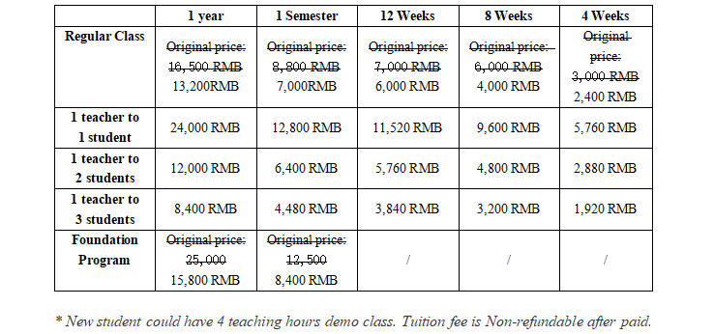
Online Chinese Program Fees 线上汉语课程费用:
(1) Application fee：Waiver
(2)Tuition fee：

Slide 46
Full Government Scholarships
Chinese Government Scholarship(CSC)
International Chinese Language Teachers Scholarship
Liaoning Provincial Government Scholarship(LN)
All majors for doctral applicants; deadline is April 30
Scholarships | Categories | Deadline | Major
University program | Master/PHD | March 31 | all
Silk Road program | Master/PHD | April 30 | Tourism Management
Sino-Russian program | Master/PHD | April 30 | all
Others | Master/PHD | April 30 | all
Study Begins | Deadline
2021.09 | 2021.05.15
2022.03 | 2021.11.25

Slide 47
Chinese Language Teachers Scholarship Online Program
Types | Enrollment Time | Requirements | Tuition fees
One-year Chinese language (Business Chinese) online study program | 2021.9 | HSK 3 score of 180 and above; HSKK Certificate holders receive first preference | waiver
One semester Chinese language (Business Chinese) online study program | 2021.9 or 2022.3 | HSK score (No specific requirements on level and score) | waiver

Slide 48
入学申请 Application

Slide 49
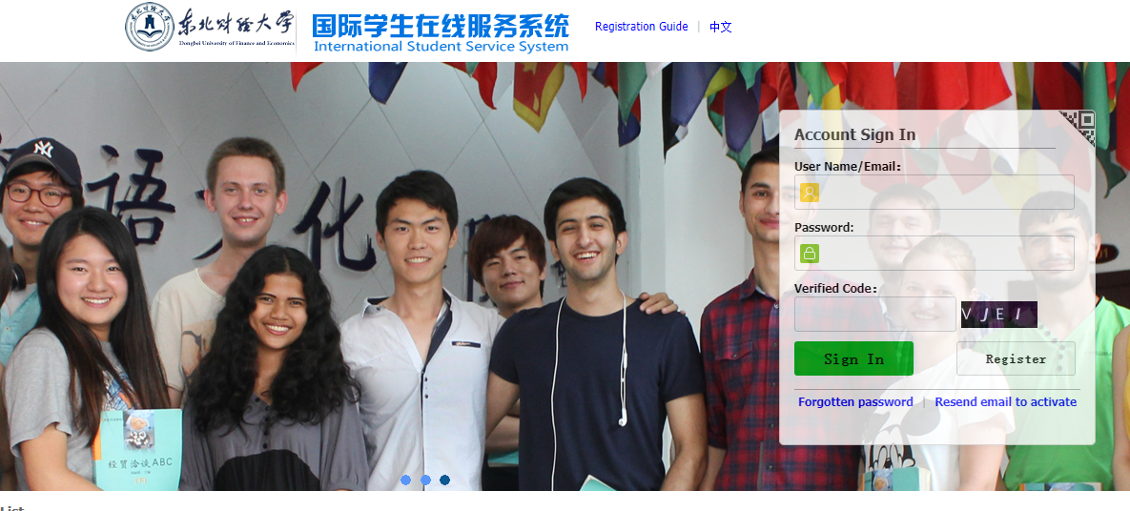
http://study.dufe.edu.cn

Slide 50
Q&A

Slide 51
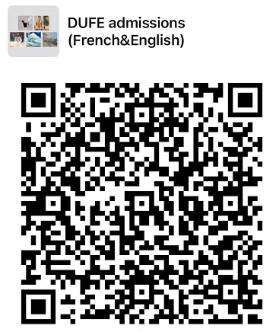
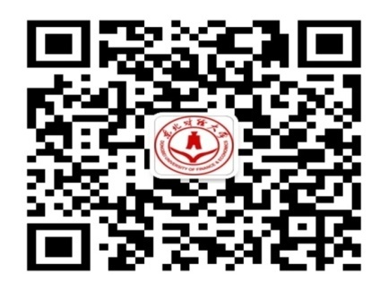
Contacts
Latest news, notice, study information, scholarship information, activities, etc.
Wechat :
Official account: StudyinDUFE
Official Wechat group
Questions? Email to: study@dufe.edu.cn scholarship@dufe.edu.cn
Tel：+86-411-84712106

Slide 52
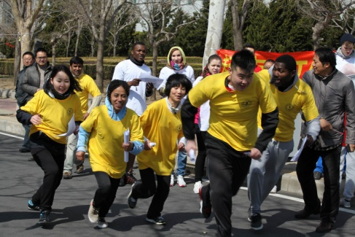
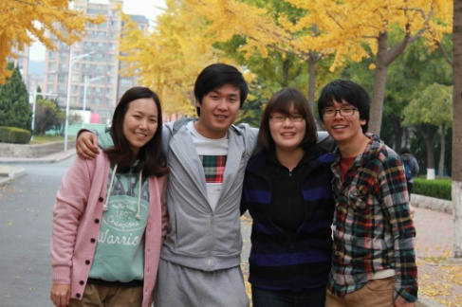
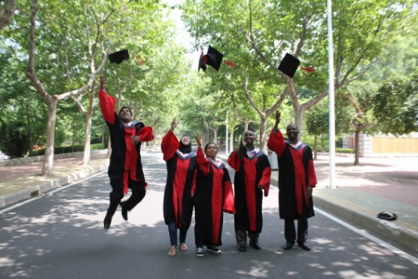
Thank you！

